Slide 1


Javascript Unit 1
By Prof. Prasad Junghare

Slide 2
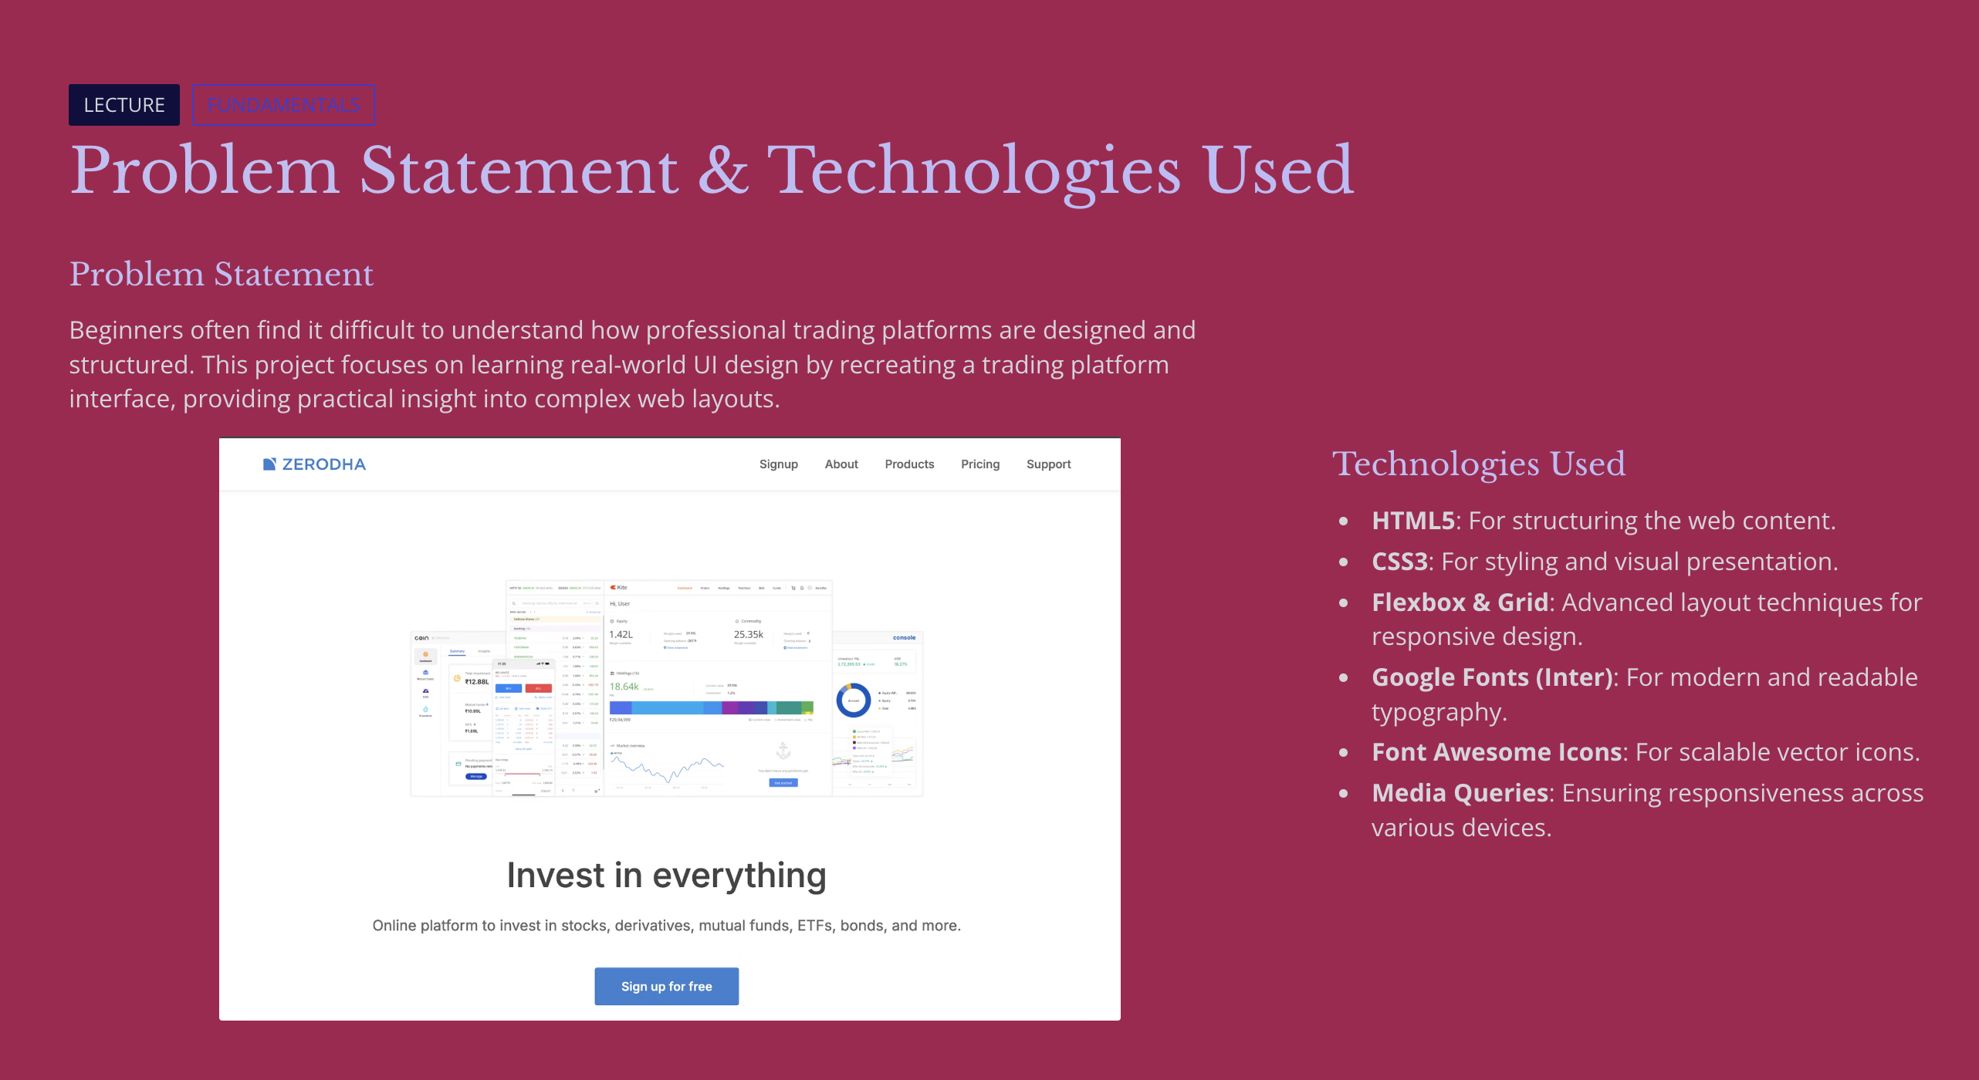

Index

Slide 3
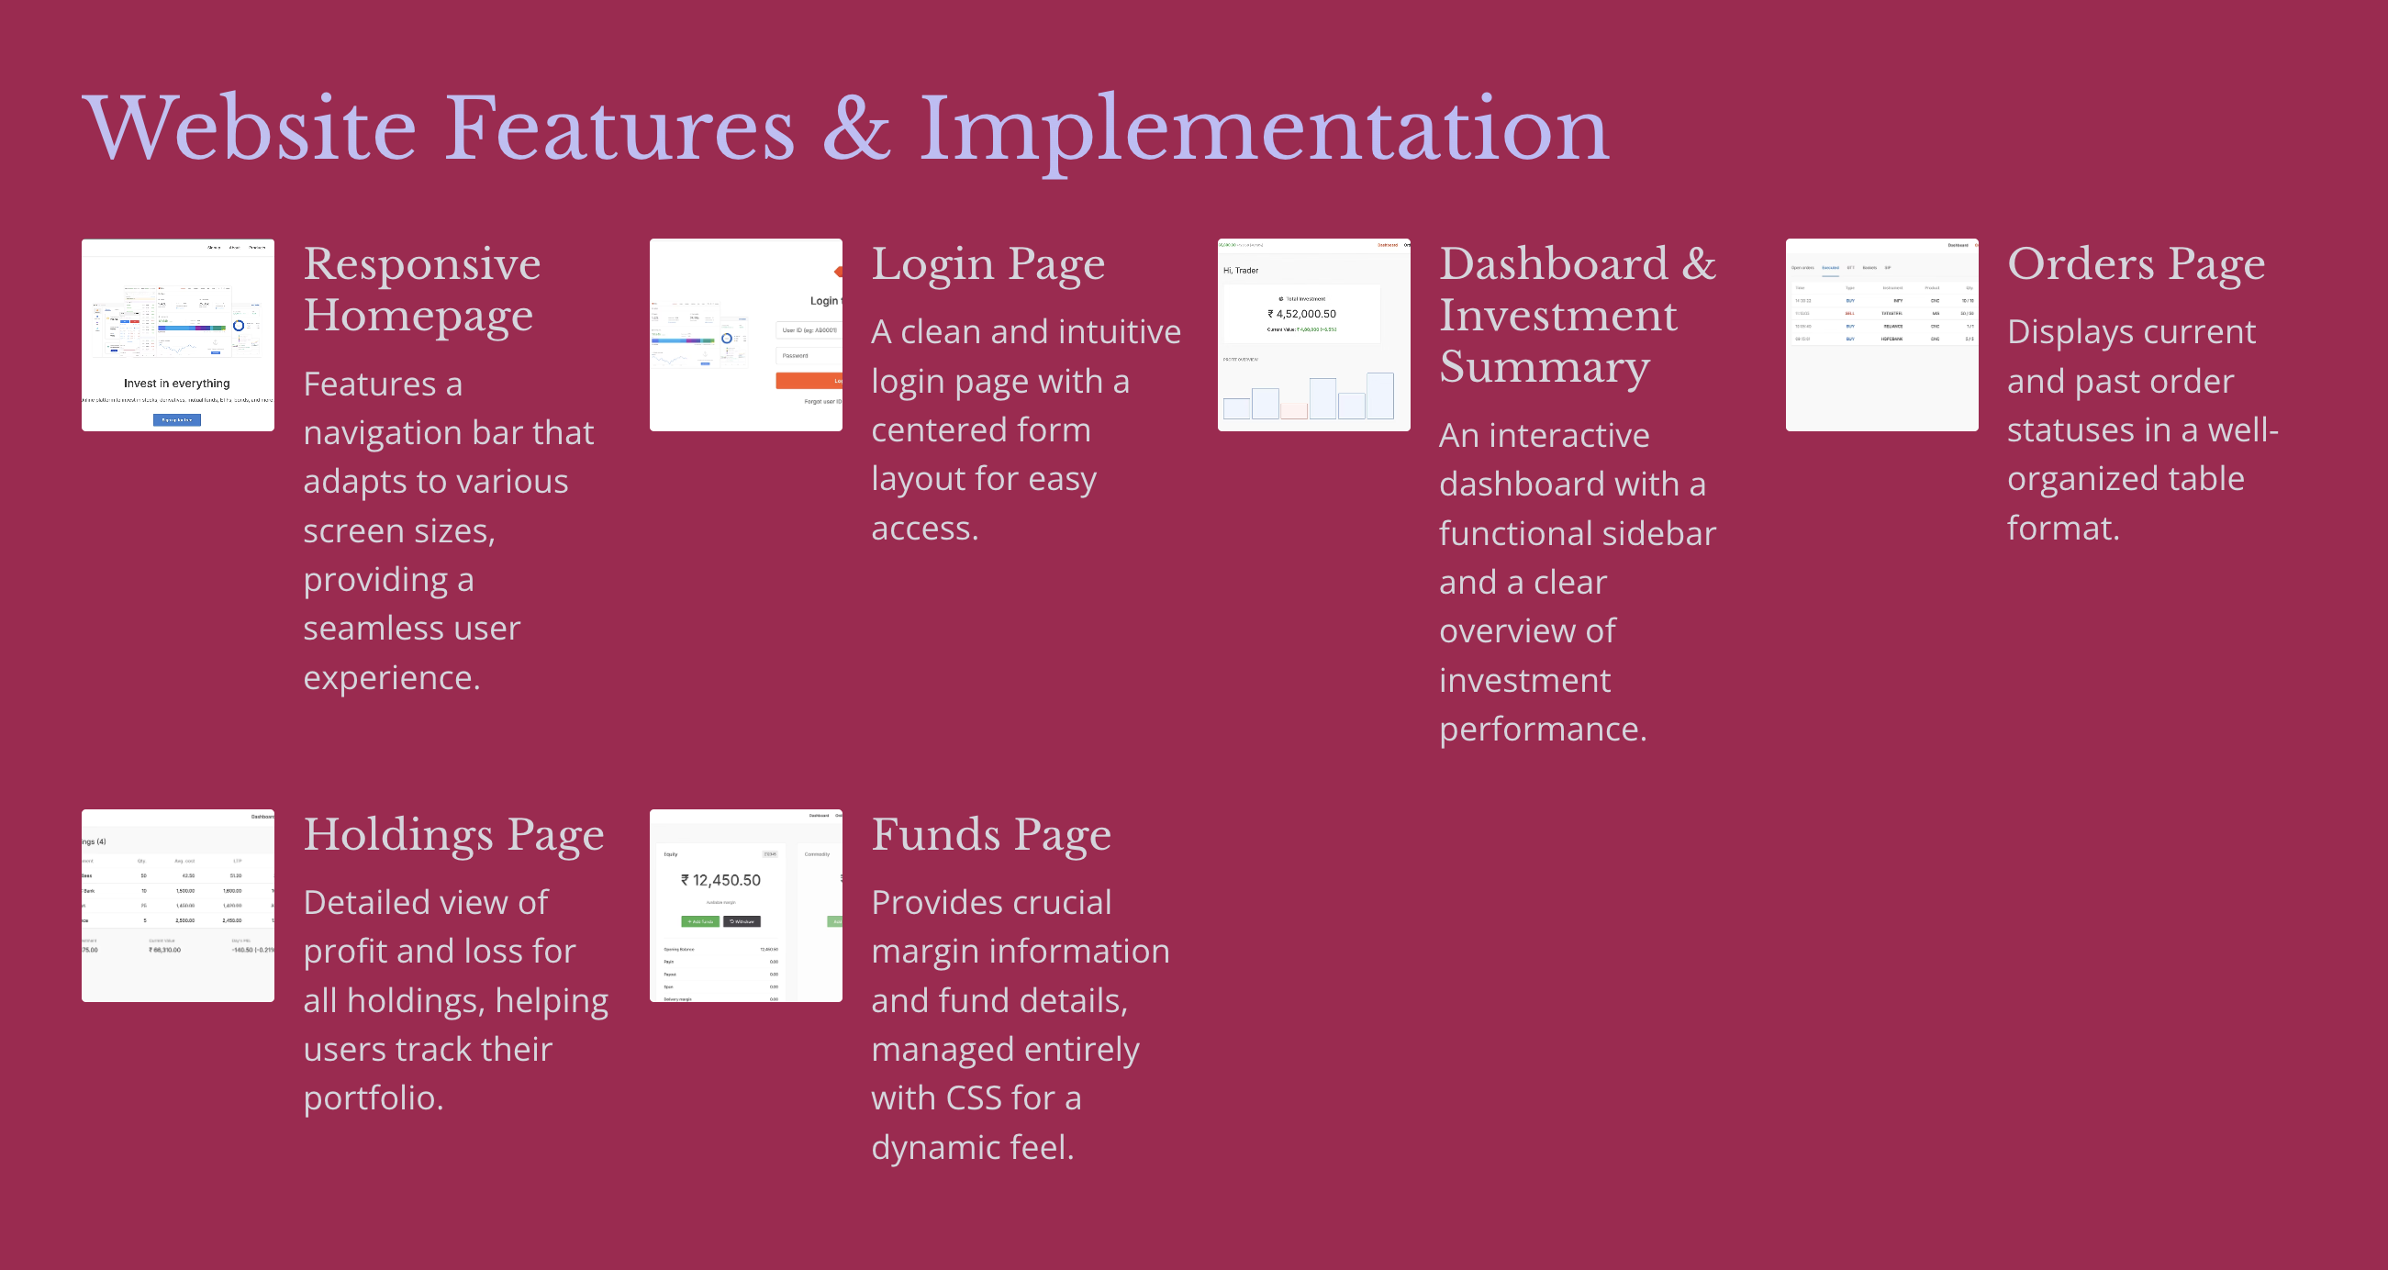
Index

Slide 4

Thank You

