Slide 1
Analyzing Effect of Cache on web page load time & Predicting the PLT
Aman Raj – 109939872 Sahil jain – 110281300 Anshul roonwal – 110554783
CSE 534: Fundamentals of Computer Networks
Spring 2016
Professor : Aruna Balasubramanian

Slide 2
Problem Statement
Analyze how Page Load Time (PLT) varies after loading the website multiple times using Wprof.
What are the factors that determines PLT?
Can we predict the PLT of a new website given the factors mentioned above?

Slide 3


Motivation
PLT is an important metric in determining user’s satisfaction.
→ Slowdown in Page load time by one second could cost it $1.6 billion in sales/year. Reduction in PLT by 100 ms increases the revenue by 1%
→ Faster Website is made to appear in top search

Slide 4





Approach
Running Alexa top 200 websites for 10 iterations one after the other.
Logs are collected using “Wprof” tool setup on a VM running Ubuntu 12.04.
Top 200

Slide 5
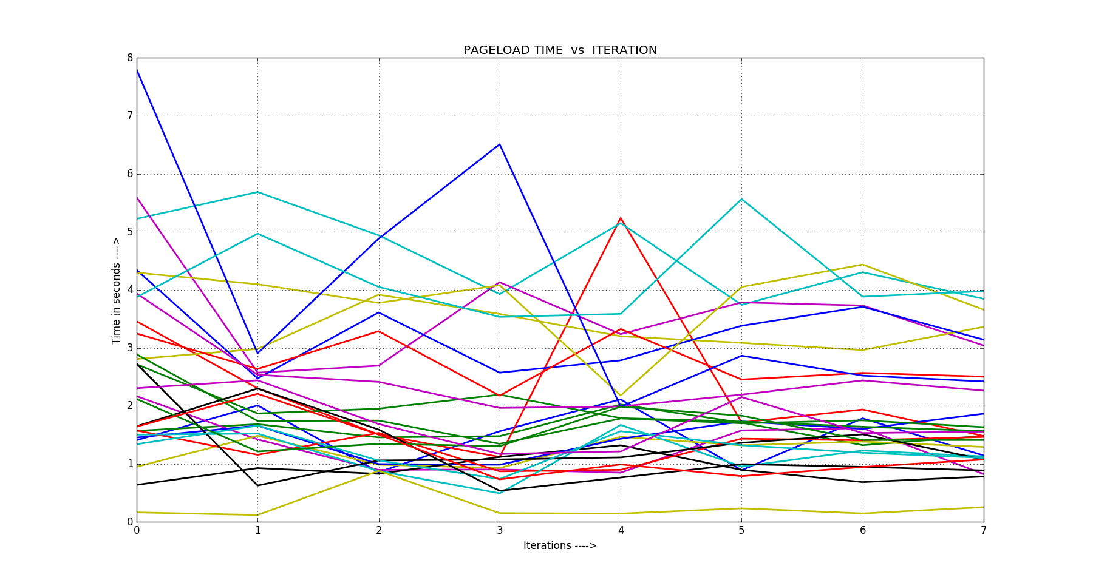
Page Load Time (Real World – Dynamic Content)

Slide 6
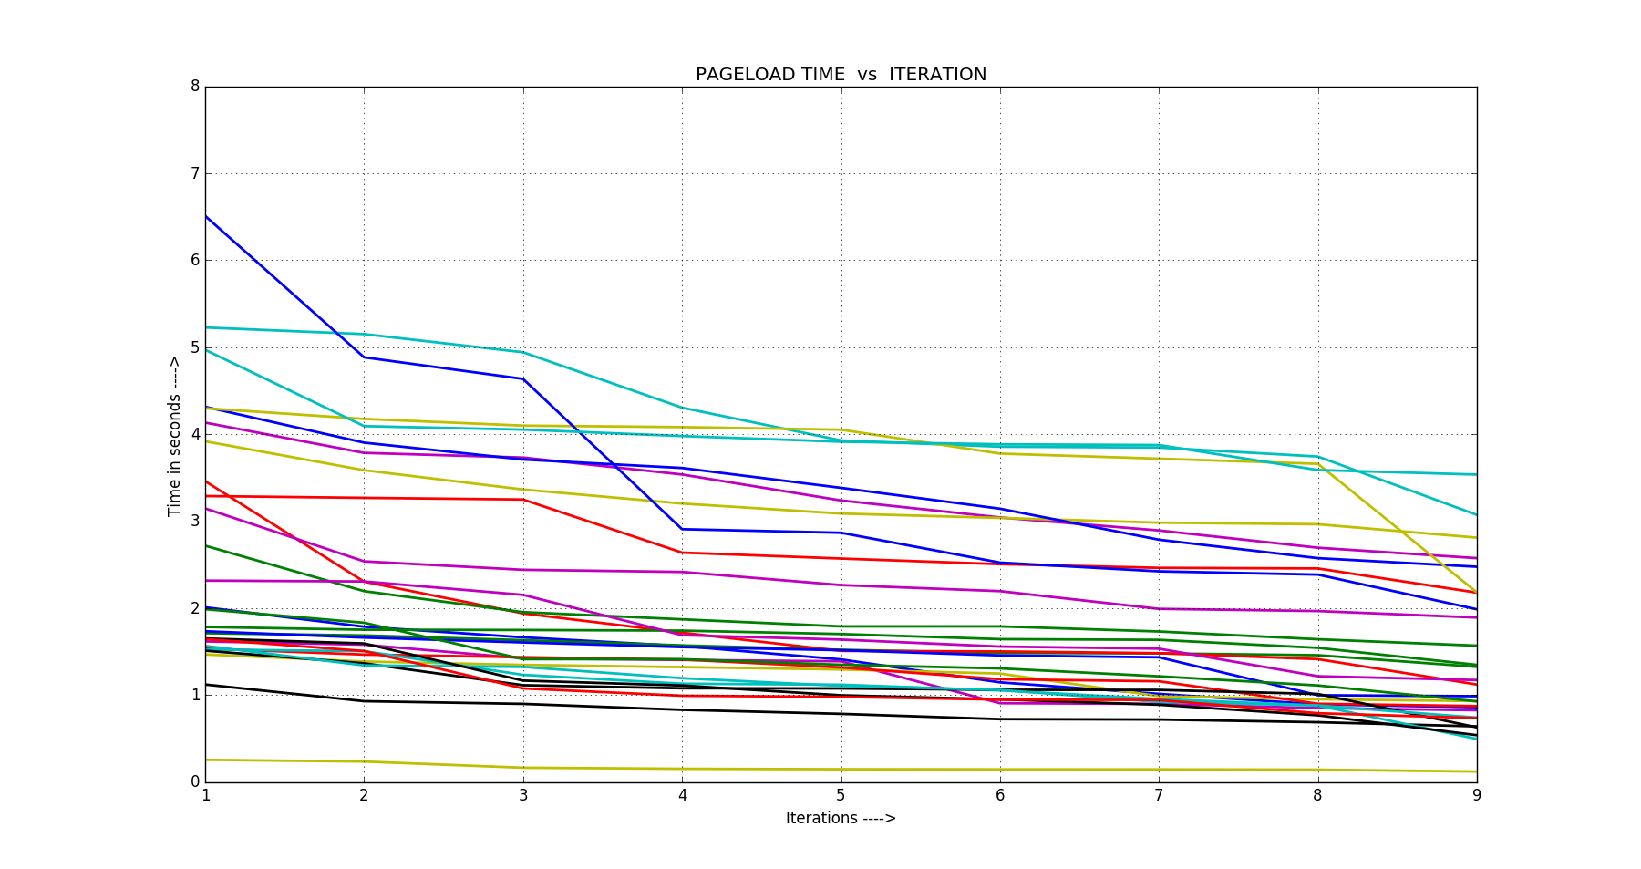
Page Load Time (Apache Server – Static Content)

Slide 7
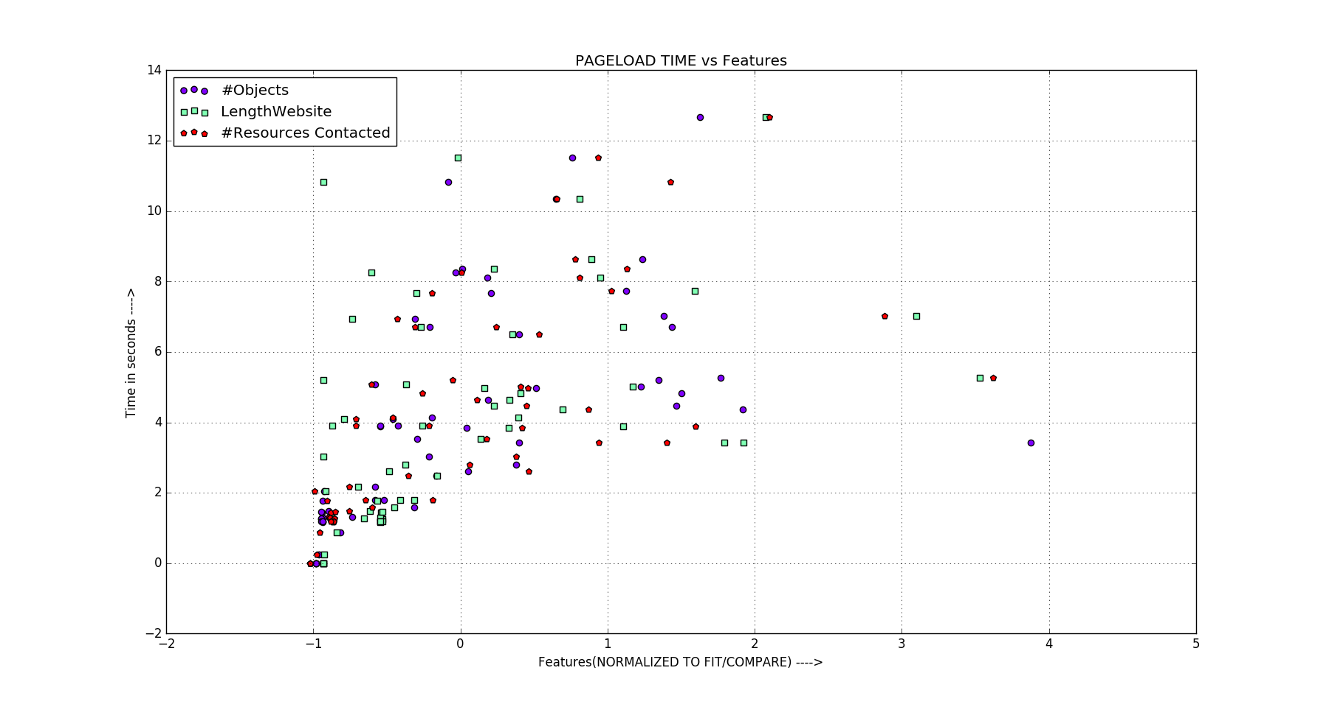
PLT Varying With Multiple features

Slide 8
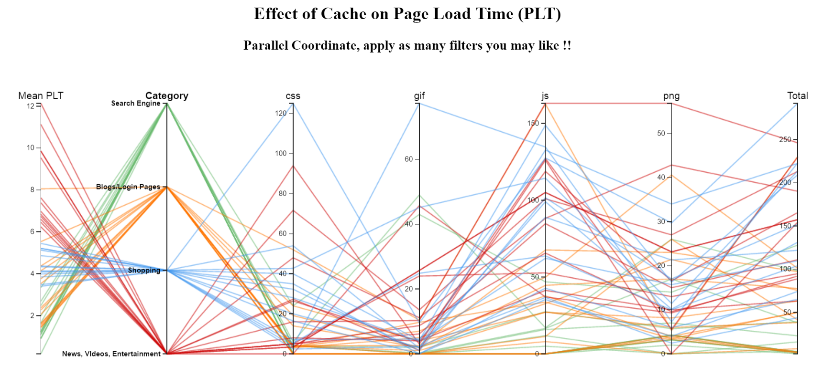
Know your PLT !! (Demo has been shared in email with Ma’am and TA Javad)

Slide 9
Predict PLT for a new website
JavaScript
Images
CSS
Train the model with captured data
Prediction Out Come
“PLT”
We used Linear Regression with a feature vector like this →
{ CSS, Images, JavaScript, Length in bytes, Server contacted }

Slide 10
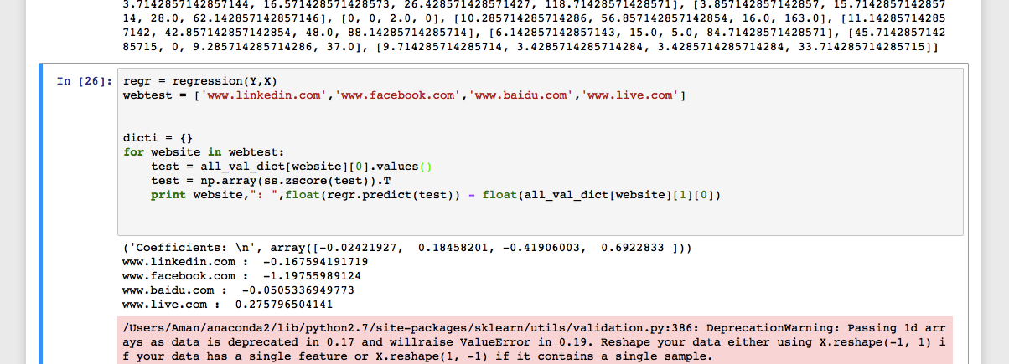
Prediction in Action!!
< As per your comments, We will come up a graph to show the root mean square error. >

Slide 11
Thank you!
Git Hub Link →
https://github.com/sahil2441/fcn_project
Machine Learning Algorithm
https://github.com/sahil2441/fcn_project/blob/master/FCNProj.ipynb

