Slide 1

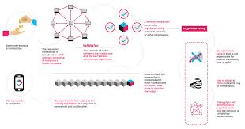
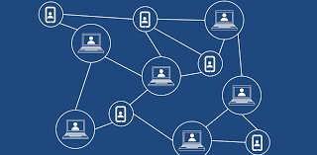
Decentralized Secured File Storage
Developed By:-
Akshit Gupta (1610991077)
Mast Ram Sharma (1610991508)
Vinayak Dev Sharma (1610991957)

Slide 2
Decentralized Secured File Storage
Project Statement :
Cloud storage offers a convenient alternative to offline storage devices, but cloud providers are not necessarily the most secure option available to consumers.
Even though data is encrypted but still the encryption depends on individual servers to protect data as it travels between the user’s computer and the cloud. Therefore, it can be broken or weakened by a server that has been compromised by a hacker, or doesn’t support the latest version of encryption, potentially allowing a bad actor to steal your data or login information.
Not only are they susceptible to identity theft, financial theft and even potential for physical harm. Cloud servers are also prone to natural/manmade disasters, accidents and attacks like DOS or DDOS.
DE - CLOUD is a distributed cloud storage system which splits the data in large numbers of chunks and then encrypting it to send into a diverse network of storage devices.
Encrypted small spitted chunks of data ensure that even if a cloud storage gets compromised, the attacker will only get a small incomplete encrypted form of a large file which is useless until you gather and combine all chunks of data

Slide 3
Decentralized Secured File Storage
Technology Used :
Front-end
Java FX
Back-end
Java Libraries
Security
Crypto
File
IO
Java Servlet
Server Connection

Slide 4
Decentralized Secured File Storage
Flow Diagram :
Encryption
Data 1.1
Encrypted 1.1
Data
Data 1.2
Encrypted 1.2
Data 1.3
Encrypted 1.3

Slide 5
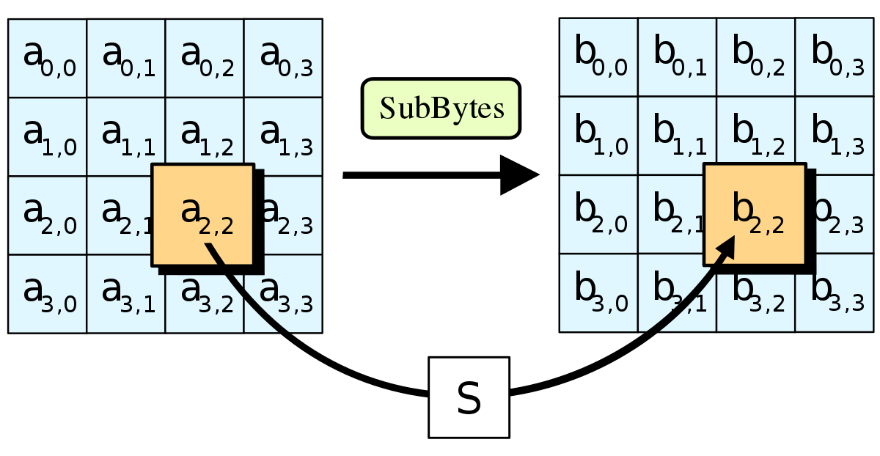
Decentralized Secured File Storage
Working :
AES Encryption
The more popular and widely adopted symmetric encryption algorithm likely to be encountered nowadays is the Advanced Encryption Standard (AES). It is found at least six time faster than triple DES.
A replacement for DES was needed as its key size was too small. With increasing computing power, it was considered vulnerable against exhaustive key search attack. Triple DES was designed to overcome this drawback but it was found slow.

Slide 6
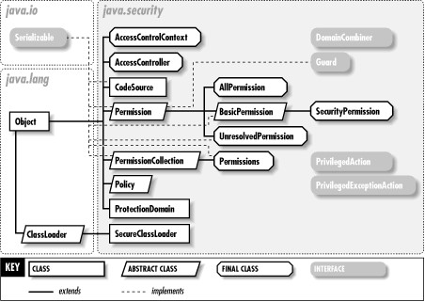
Decentralized Secured File Storage
Java Libraries:
Security
Java Security services have expanded and include a large set of application programming interfaces (APIs), tools, a number of security algorithm implementations, mechanisms, and protocols. This provides a comprehensive environment to develop secure applications and manage them accordingly. The span of the Java security API is extensive. The basis of developing a secure application lies in the Cryptographic and public key infrastructure (PKI) interfaces, multiple interoperable common algorithmic implementation, and other security services. There are interfaces for performing authentication and access control. This enables applications to guard against unauthorized access to protected resources.

Slide 7
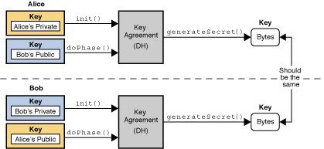
Decentralized Secured File Storage
Crypto
The Java Cryptography Architecture (JCA) is the name for the internal design of the Java cryptography API.JCA is structured around some central general purpose classes and interfaces. The real functionality behind these interfaces are provided by providers. Thus, you may use a Cipher class to encrypt and decrypt some data, but the concrete cipher implementation (encryption algorithm) depends on the concrete provider used. We can implement and plugin your own providers too, but you should be careful with that.
Implementing encryption correctly without security holes is hard! Unless you know that you are doing, you are probably better off using the built in Java provider, or use a well-established provider like Bouncy Castle.

Slide 8
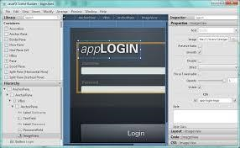
Decentralized Secured File Storage
Java FX
JavaFX is a GUI toolkit for Java (GUI is short for Graphical User Interface). JavaFX makes it easier to create desktop applications and games in Java. This JavaFX tutorial is a multi-page tutorial explaining the core features of JavaFX. See the menu in the left side of this page to see all the topics covered in this JavaFX tutorial.
Some applications are just easier to create as standalone desktop applications than as web applications. For instance, applications that need to access the local disk of the computer it runs on, or which needs to communicate with many different remote systems, and sometimes using other protocols than HTTP (e.g. IAP or streaming protocols etc.). JavaFX is a good option in these cases. We at Nanosai are actually developing a desktop app using JavaFX for these exact reasons. See JavaFX use cases for more examples.

Slide 9
Decentralized Secured File Storage
Advantages
Even if a cloud server is compromised, data still remains the safe.
In case of failure of any cloud storage server. There is very loss of only a chunk of data which can also be retrieved because multiple copies of data are made.
No need to apply expensive load balancing technique because data is already at multiple locations.
Natural calamities or disaster have minimum to no effects on efficiency of data storage and retrieval system.
Maximum bandwidth is achieved while uploading and downloading data due to multiple connections formations.
Saves money and time to build gigantic data storage warehouses.

Slide 10
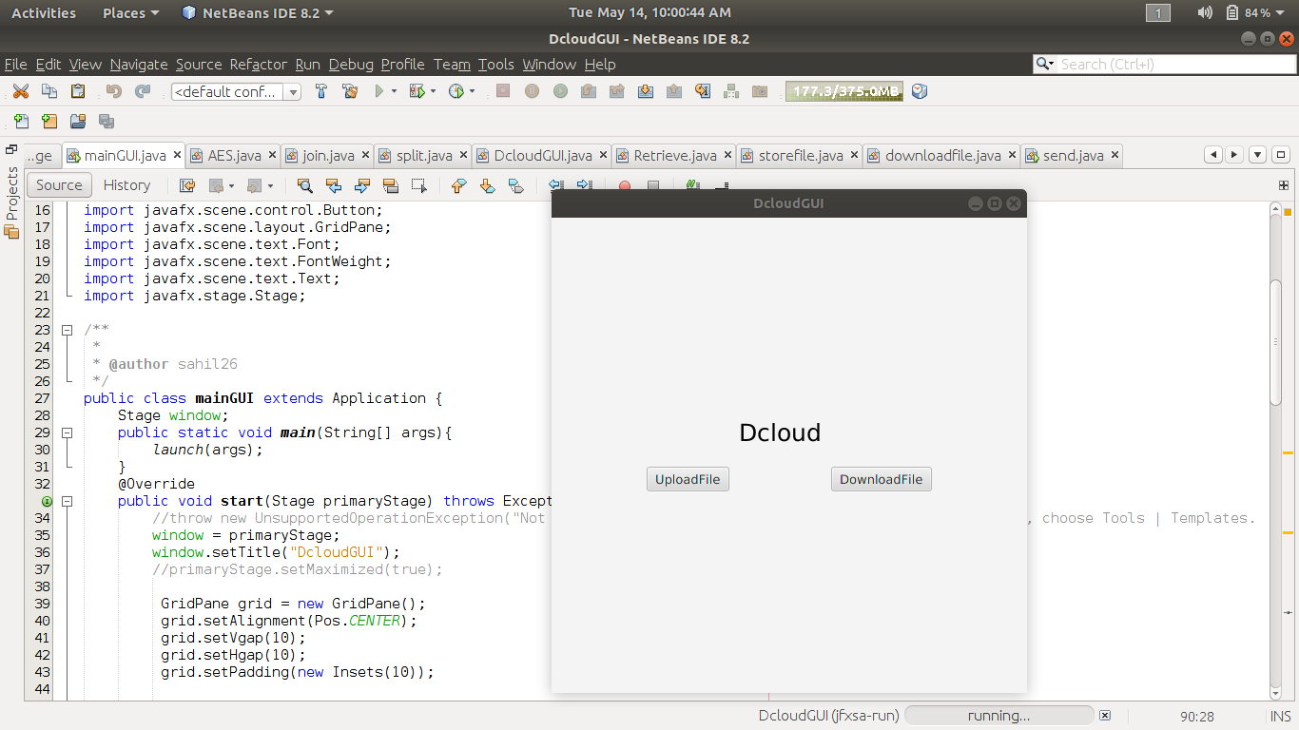
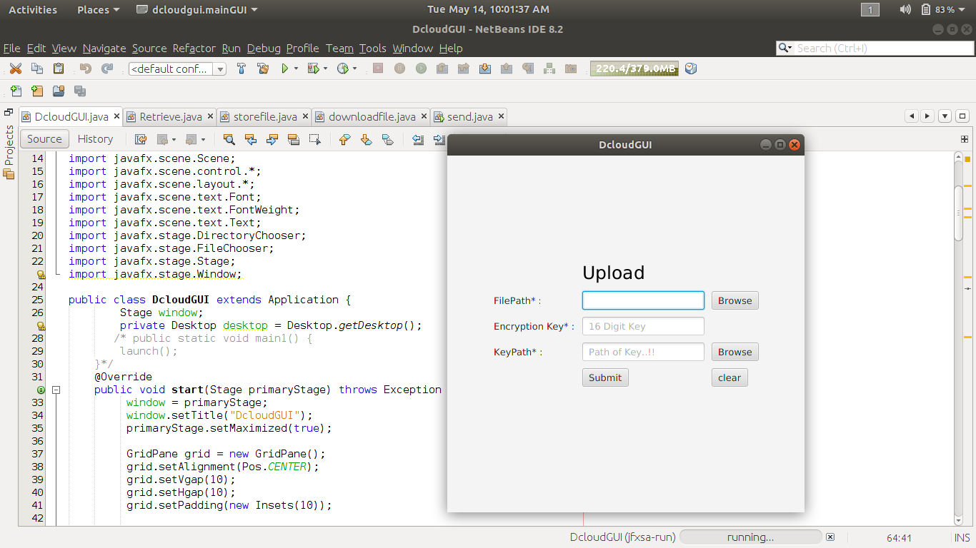
Decentralized Secured File Storage
Snapshots :

Slide 11
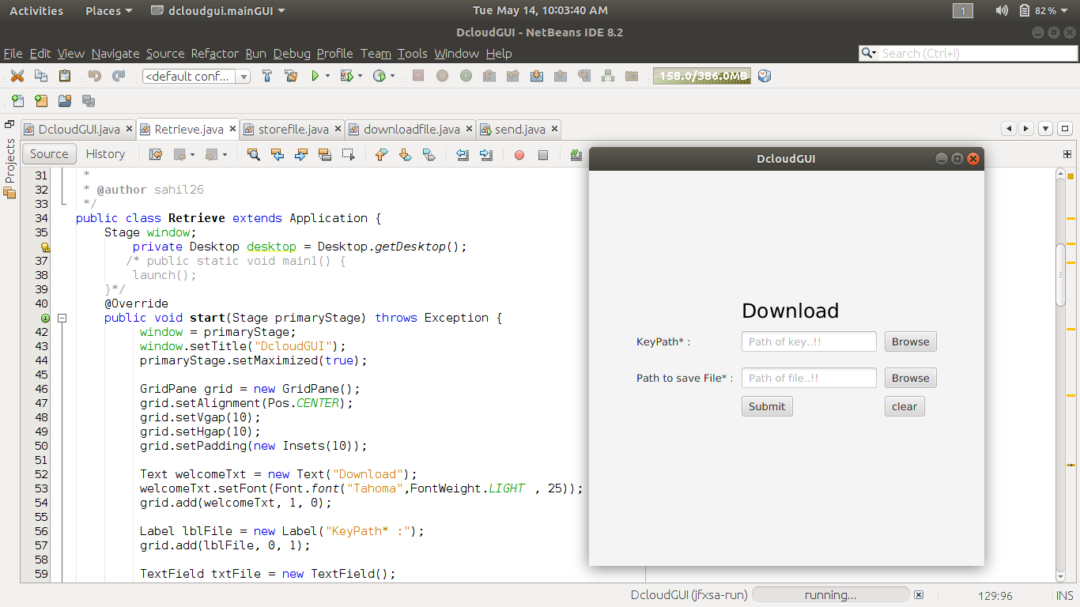
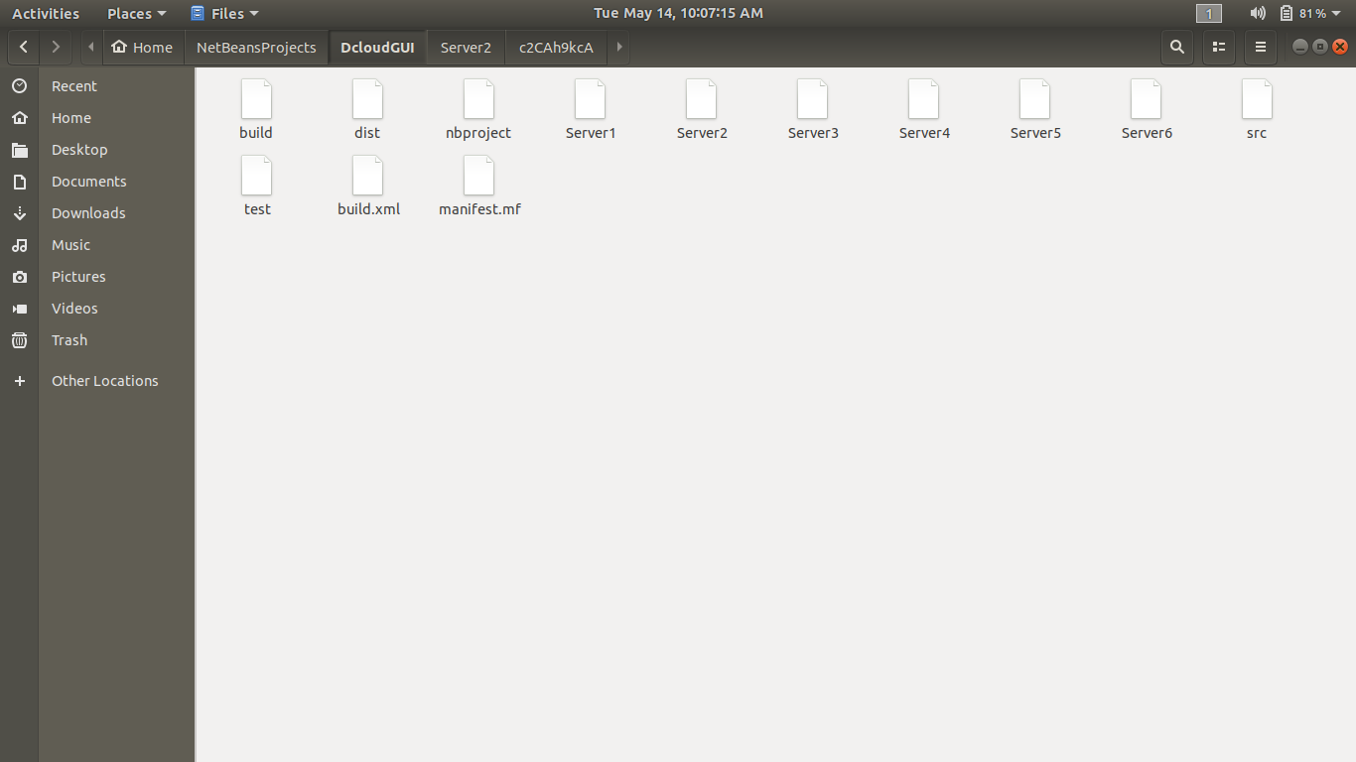
Decentralized Secured File Storage

Slide 12
Decentralized Secured File Storage
Future Scope :
Blockchain technology is not a company, nor is it an app, but rather an entirely new way of documenting data on the internet. The technology can be used to develop blockchain applications, such as social networks, messengers, games, exchanges, storage platforms, voting systems, prediction markets, online shops and much more. In this sense, it is similar to the internet, which is why some have dubbed it “The Internet 3.0”.
A servlet is a java programming language class that is used to extend the capabilities of servers that host applications accessed by means of a request-response programming model. Although servlets can respond to any type of request, they are commonly used to extend the applications hosted by web servers. It is also a web component that is deployed on the server to create a dynamic web page.

