Slide 1
Smart Meter Data Analysis
Sri Team-
Sahil Arora
Ayushi

Slide 2
Exploratory Data Analysis
It is a multivariate series comprised of seven variables (besides the date and time); they are:
global_active_power: The total active power consumed by the household (kilowatts).
global_reactive_power: The total reactive power consumed by the household (kilowatts).
voltage: Average voltage (volts).
global_intensity: Average current intensity (amps).
sub_metering_1: Active energy for kitchen (watt-hours of active energy).
sub_metering_2: Active energy for laundry (watt-hours of active energy).
sub_metering_3: Active energy for climate control systems (watt-hours of active energy).

Slide 3
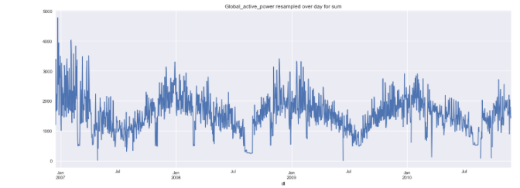
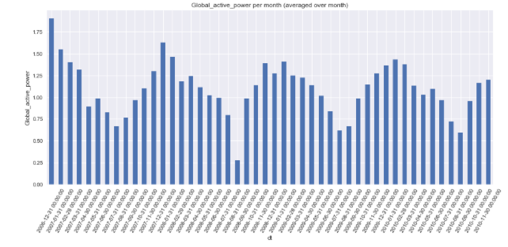
Observations Made
Active power averaged over day
Active power averaged over month

Slide 4
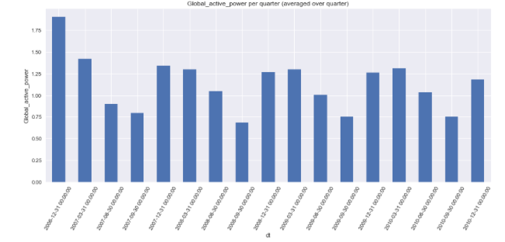
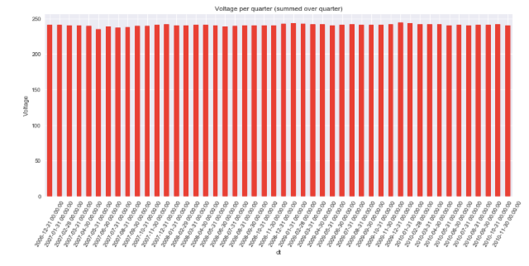
Observations Made
Active power averaged per quarter
Voltage summed over quarter

Slide 5
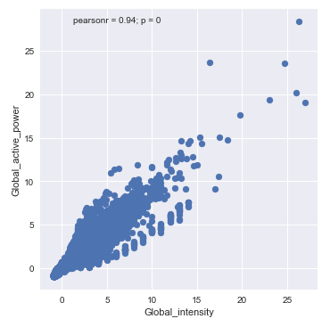
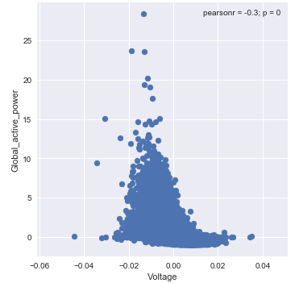
Correlation Observed
Intensity & Power
Voltage & Power

Slide 6
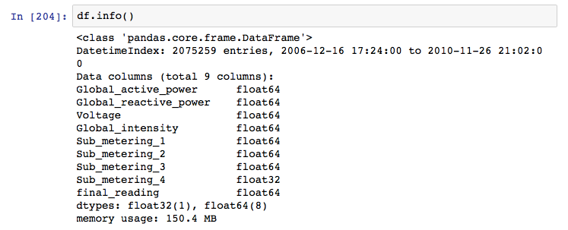
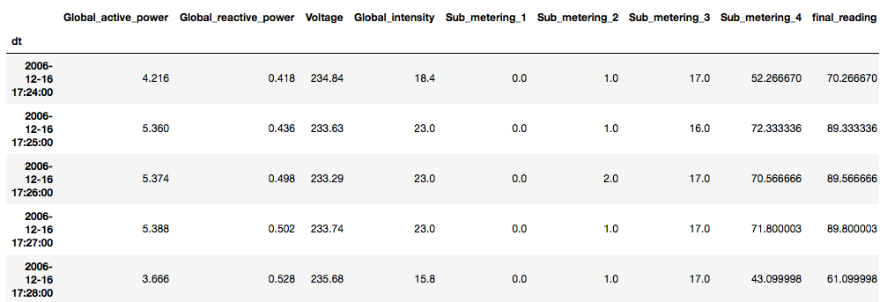
Dataset Overview

Slide 7
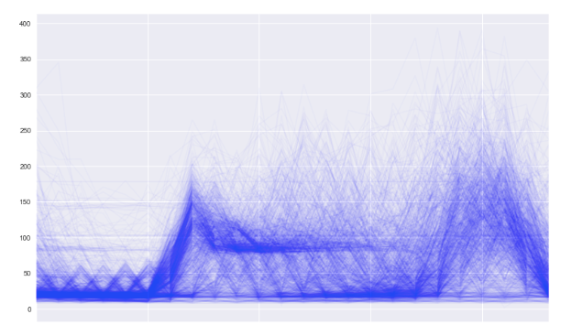
kWh vs Time Graph
kWh
Time

Slide 8
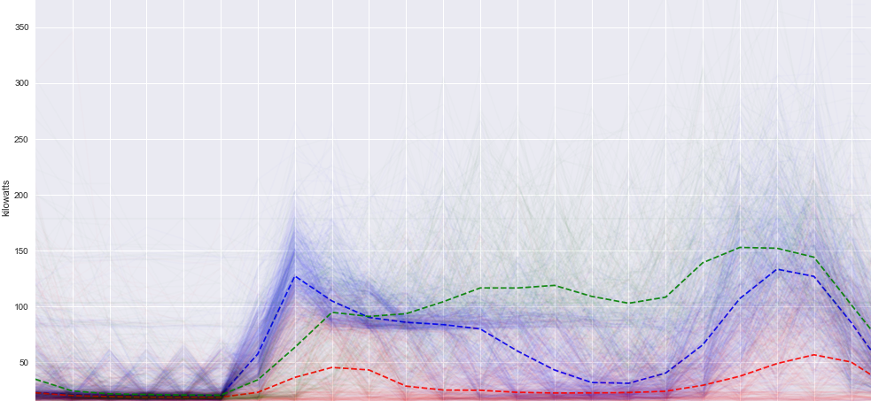
KMeans Clustering
The graph shows 3 user segments- Low usage, Moderate usage and high usage consumers

Slide 9
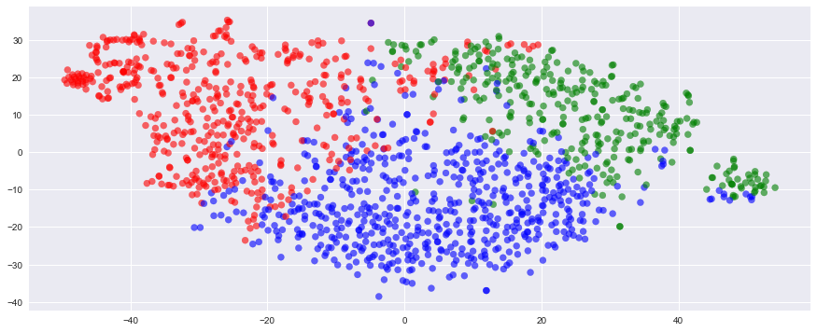
KMeans Clustering
Grouping the users into 3 clusters

Slide 10
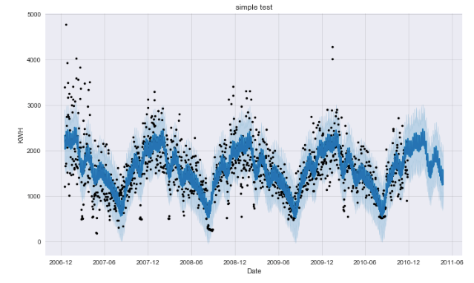
Time-Series Data Forecasting
Used Prophet library for time-series data analysis and future energy usage prediction

Slide 11
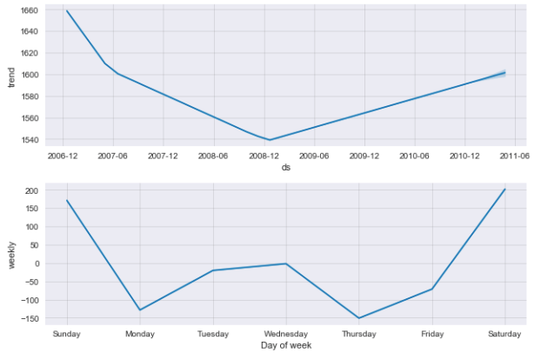
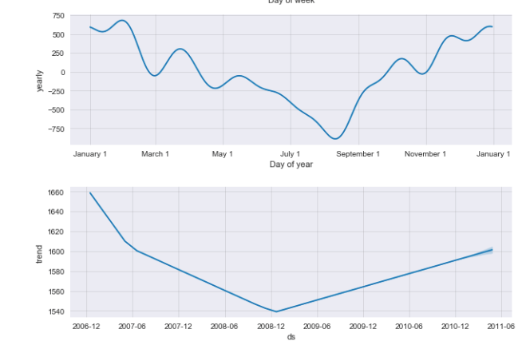
Data Trends

Slide 12
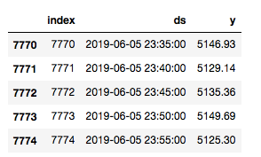
Testing Model on Data
Scrap real time data from State Load Dispatch Center, Delhi - http://www.delhisldc.org/

Slide 13
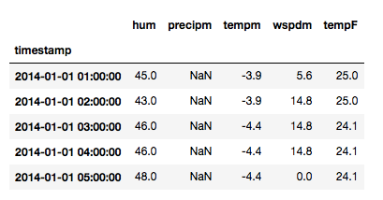
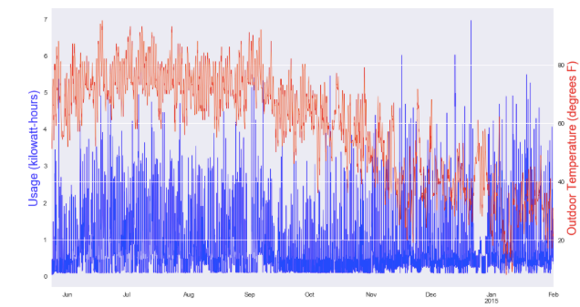
Adding Weather Data
sample_dataset
Energy usage vs temperature

Slide 14
Future Enhancements
Enabling IOT Devices synchronisation with the smart meter.
Predictive Analysis using geospatial data.
Adding Monetization features.

Slide 15
Thank you

