Slide 1
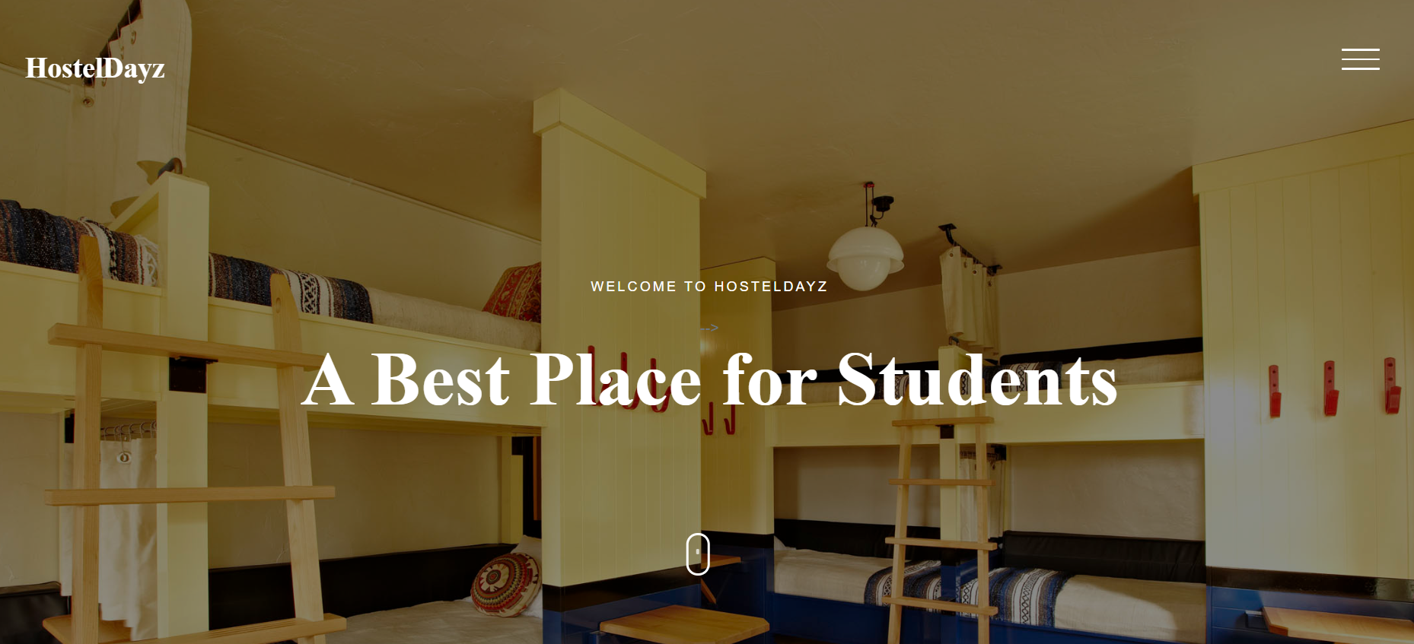

Slide 2

SVERI COE(Poly),Pandharpur
“Hostel Management System”
Presented By
1)Avadhut Sunil Chavan.(2010740343)
2)Bhushan Rajendra Mote.(2010740338)
3)Pavan Dagadu Wagh.(2010740292)
4)Sahil Suhas Sadekar.(2010740336)
Under the guidance:
Mr.G.S.Misal(IT HOD)

Slide 3
Title of Project:
“Hostel Management System Webiste”

Slide 4
Content: Introduction –
Literature Review- Objective – Scope Of Work- Methodology- Diagrams- Implementations- Advantages- Applications- Hardware/Software Requirement – Future Scope- Refrence- Conclusion- Thank U

Slide 5
INTRODUCTION
In our current era of automated systems with it being either software or hardware, it’s not advisable to be using manual system. Hostels without a management system are usually done manually. Registration forms verification to other data saving processes are done manually and most at times, they are written on paper. Thus a lot of repetitions can be avoided with an automated system. The drawbacks of existing systems lead to the design of a computerised system that will help reduce a lot of manual inputs. With this system in place, we can improve the efficiency of the system, thus overcome the drawbacks of the existing manual system.This system is designed in favour of the hostel management which helps them to save the records of the students about their rooms and other things. It helps them from the manual work from which it is very difficult to find the record of the students and the mess bills of the students, and the information of about the those ones who had left the hostel years before.

Slide 6
Literature Review
Hostel management is a crucial aspect of student housing, and efficient management can improve student satisfaction and reduce costs. With the increasing number of students opting for hostel accommodation, there is a need for automated hostel management systems to streamline processes and ensure smooth operations. Hostel management software has emerged as a solution to automate and improve hostel management processes. This literature review aims to explore existing research and publications related to the implementation and effectiveness of hostel management software for student hostels.

Slide 7
Objective:
The main objective of the Hostel Management System is to manage the details of Rent, Allotees, Hostel, Rooms, Payments. It manages all the information about Rent, Beds, Payments, Rent. The project is totally built at administrative end and thus only the administrator is guaranteed the access. The purpose of the project is to build an application program to reduce the manual work for managing the Rent, Allotees, Beds, Hostel. It tracks all the details about the Hostel, Rooms, Payments.
Provides the searching facilities based on various factors. Such as Rent, Hostel, Rooms, Payments.
College Management System also sells the employees details online for students details, employees details, courses.
College Management System also sells the employees details online for students details, employees details, courses.
Provide the functionality to make your own bookings
Update your web site without the need to get a web designer involved.
It tracks all the information of Allotees, Beds, Rooms etc
7. Manage the information of Allotees.
8. Shows the information and description of the Rent, Hostel
9. To increase efficiency of managing the Rent, Allotees.
10. It deals with monitoring the information and transactions of Rooms.
11. Manage the information of Rent.

Slide 8
Scope Of Work :
Each resident student will be provided with:
One Single bed .
One Study table.
One Study chair.
Wi-fi internet facilities in all the flats.
24 hours power backup and water facilities.
Drinking water (RO System) with Refrigerator in every floor.
Sufficient security arrangements at the hostel premises.
Laundry facilities for washing and ironing of clothes on payment basis.
24 hours maintenance facility for repair of Electrical /Plumbing other maintenance issues pertaining to the hostel.
Provision of vehicle for medical emergency.
Provision of Supervisory staff - Hostel Wardens and other staff.
Cleaning and hygiene maintenance services for Rooms and Common areas of the Hostel, daily. First aid medical facilities, list with telephone numbers of nearby Hospitals, Nursing Home and ambulance facilities .
Adequate number of fans and lights.
Hot Water during winters.

Slide 9
Methodology:
Hardware Requirements:-
Processor: 1.6GHz,Dual core ,Octa core(any processor).
RAM: 512MB(Min)
Hard Disk: 4GB Space Required 2gb acceptable
Any android based smartphone as well as ios
Software Requirements:
Any browser is acceptable like chrome,firefox,safari,etc.
Used Softwares:-
Database Server: Xampp
IDE:Visual Studio Code,Notepad++
Language:HTML,CSS,JavaScript,PHP
Browser: Chrome,Microsoft edge,Firefox,Maximum all browser support,internet explorer,safari.
Operating System:Windows-windows xp,Microsoft windows version 2000,7,8,10,11,further:

Slide 10
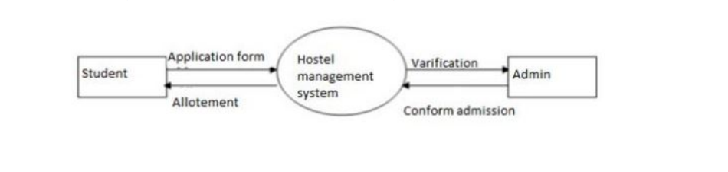
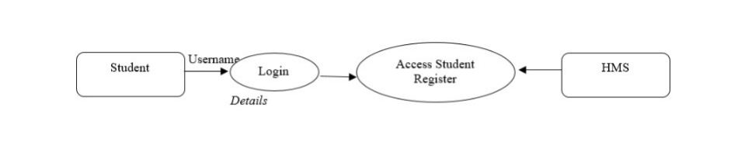
Diagrams
1. LEVEL 0

Slide 11
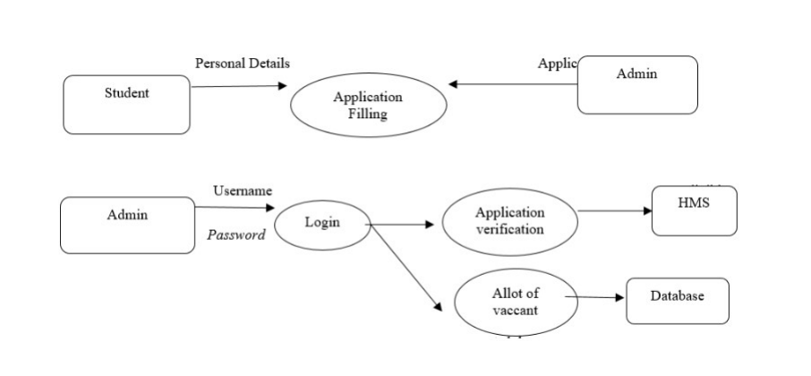
2. LEVEL 1

Slide 12
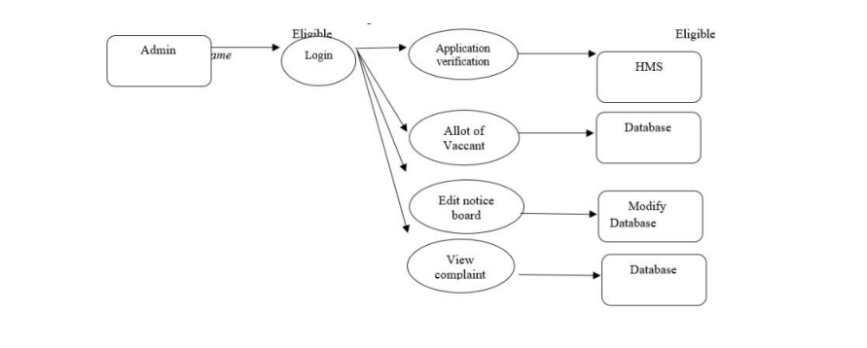
3. LEVEL 2

Slide 13
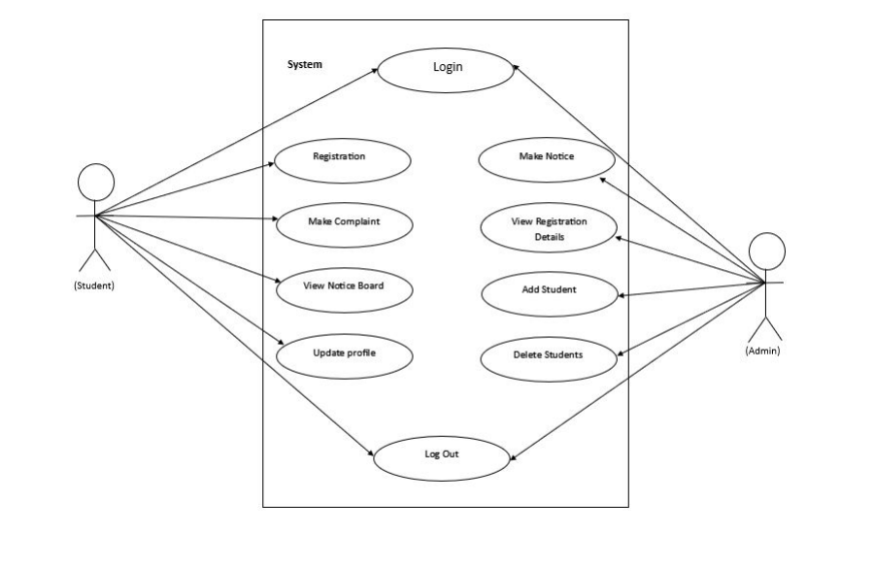
UML Diagrams:
1. Use Case Diagram of Admin:

Slide 14
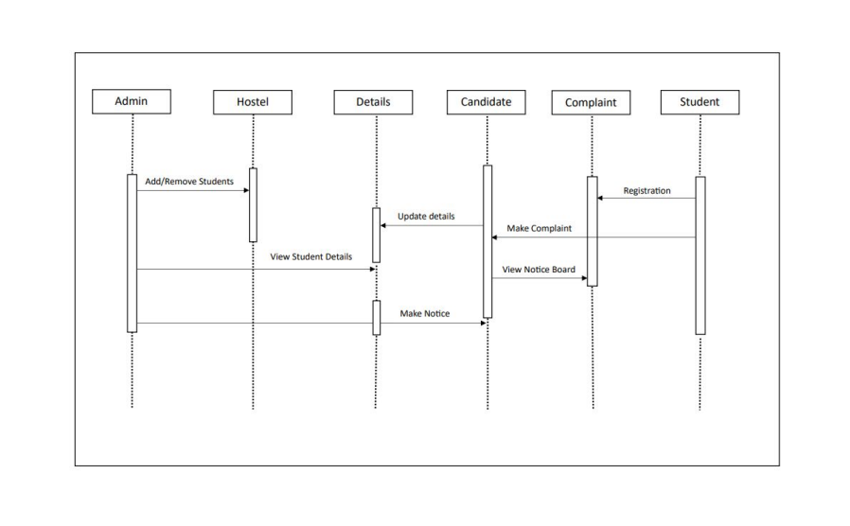
2. Sequence Diagram of Admin:

Slide 15
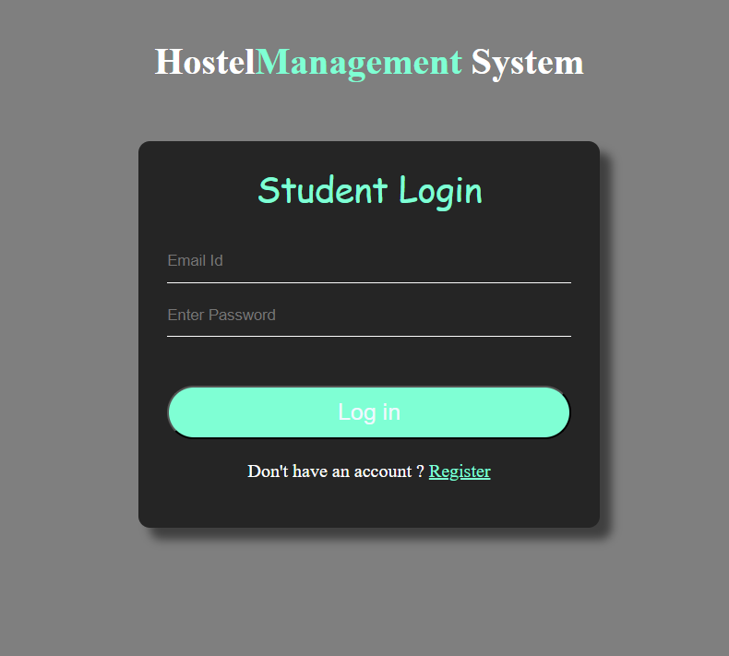
Implementation
A hostel management website admin page typically provides access to the website's backend management system. This allows administrators to manage various aspects of the website, including user accounts, room bookings, payment processing, and website content.
The ability to manage room reservations, including booking confirmation, cancellations, and modifications.

Slide 16
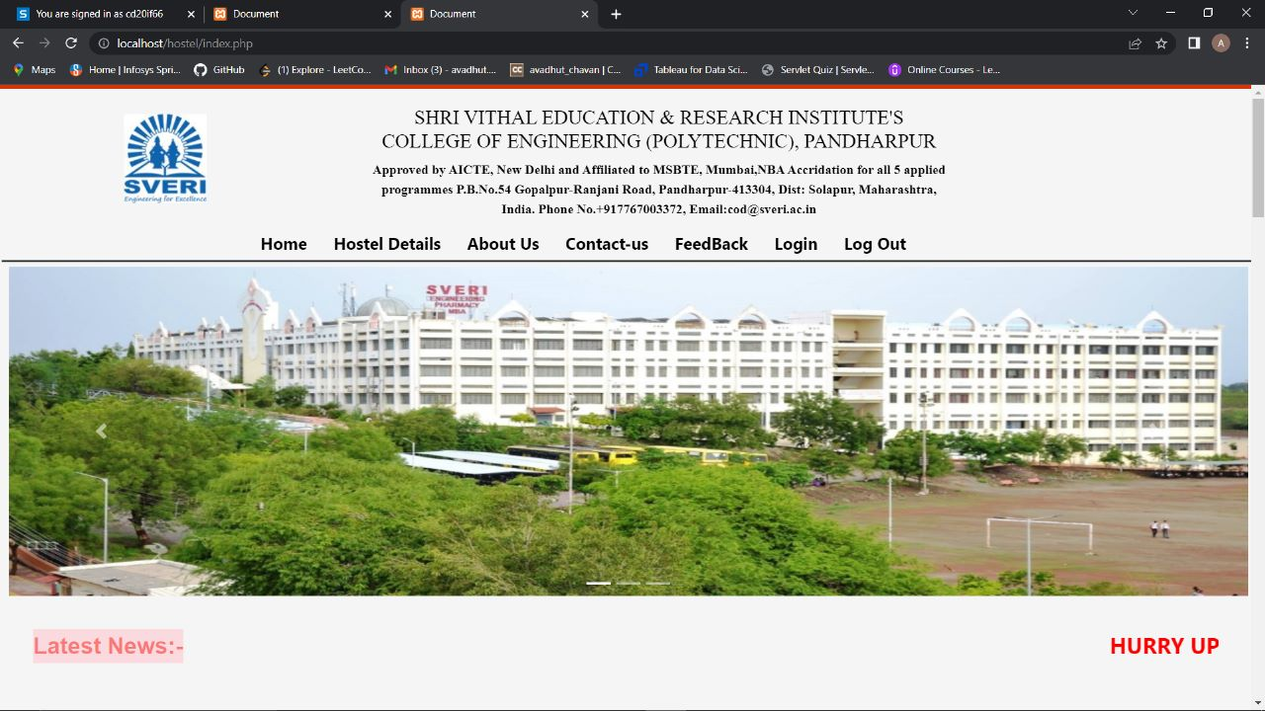
A hostel management website home page is the primary page of a website that visitors see when they land on the site. It is the first impression that potential guests will have of the hostel and is therefore critical in attracting and retaining visitors.

Slide 17
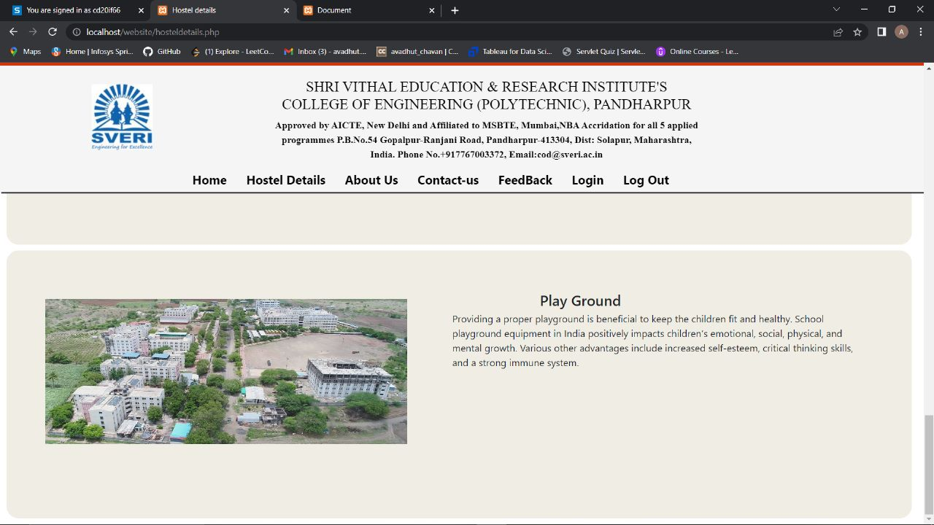
Location: A map and description of the hostel's location, including nearby attractions, transportation options, and points of interest.
Facilities: A list of the hostel's facilities, including common areas, play ground, laundry facilities, and other amenities that are available to guests.

Slide 18
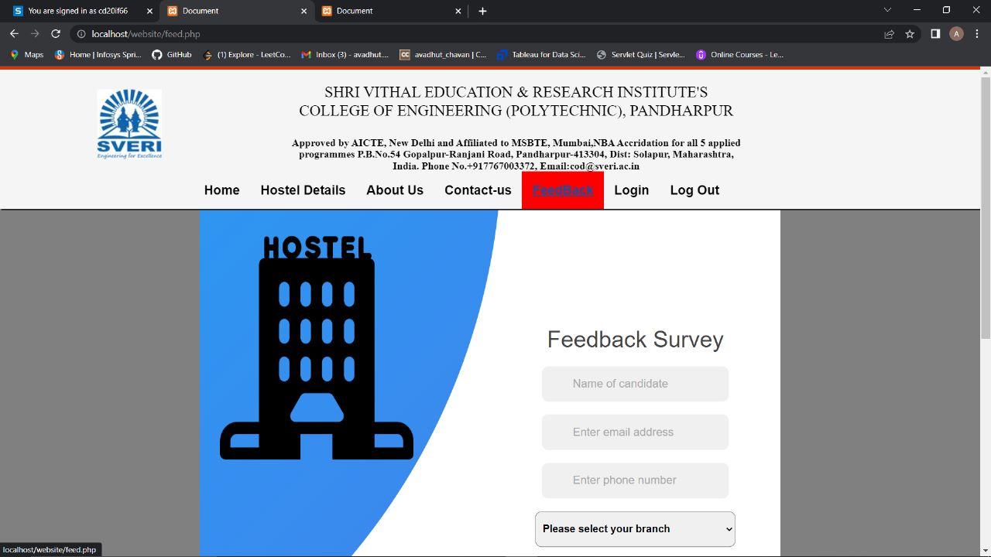
A hostel management website feedback page is designed to collect feedback and reviews from guests who have stayed at the hostel. This feedback can be used to improve the hostel's services, amenities, and overall guest experience.
Overall, a feedback page is an important component of a hostel management website, as it provides valuable insights into the guest experience and allows the hostel to make improvements and adjustments based on guest feedback. By providing a platform for guests to share their opinions, a feedback page can also help to build trust and loyalty with guests, and promote the hostel to a wider audience

Slide 19
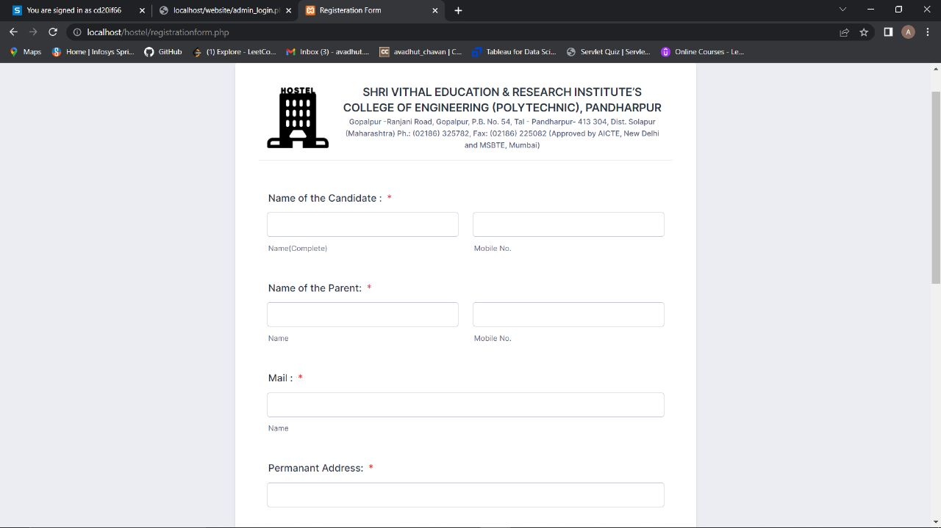
A hostel management website registration page is designed to allow users to create an account on the website.

Slide 20
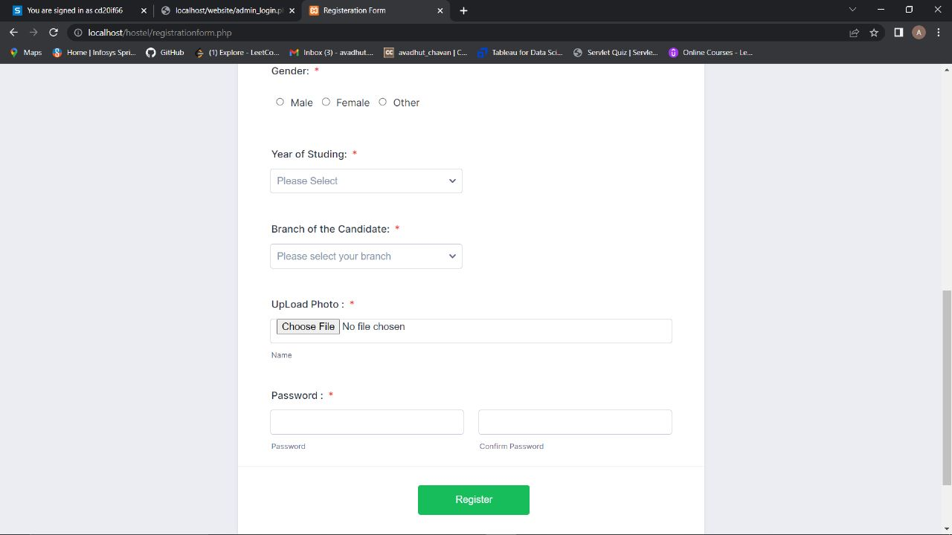
Overall, a registration page is an important component of a hostel management website, as it allows users to create an account and access features and information that may not be available to non-registered users. By collecting user information, a registration page also helps the hostel to better understand its audience and tailor its services to meet their needs.
Some websites may require users to verify their email address or phone number before allowing them to create an account. This helps to ensure that the account is created by a real person and not a bot or automated program.

Slide 21
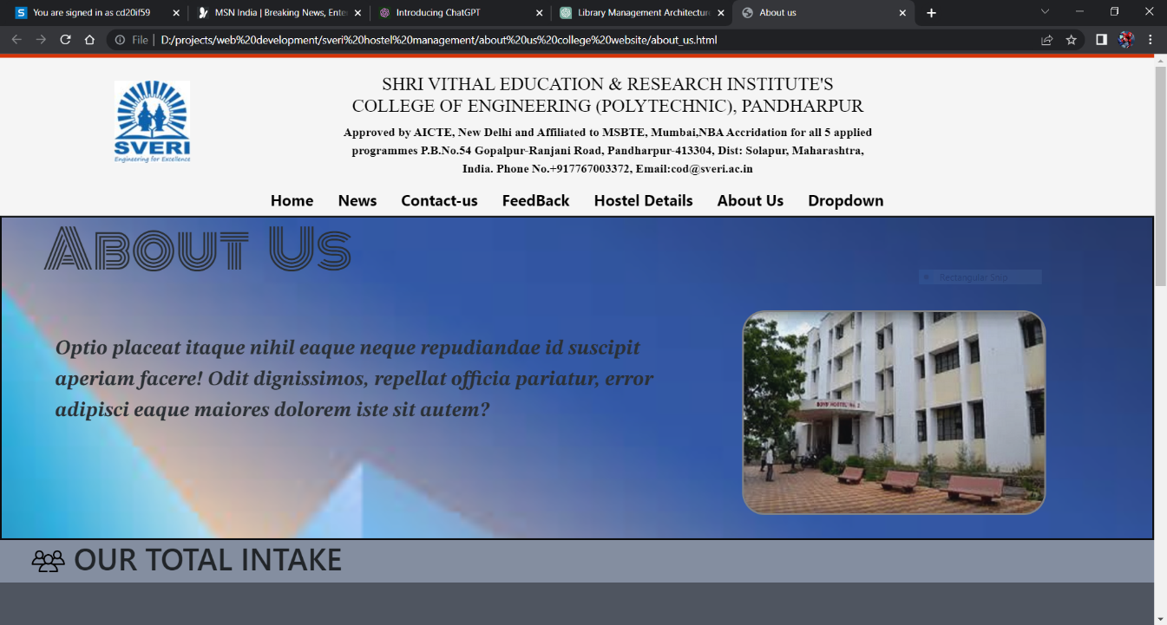
A hostel management website About Us page is a section of the website that provides information about the hostel and its management team. This page is designed to help potential guests learn more about the hostel, its values, and its mission, and to build trust and credibility with website visitors.

Slide 22
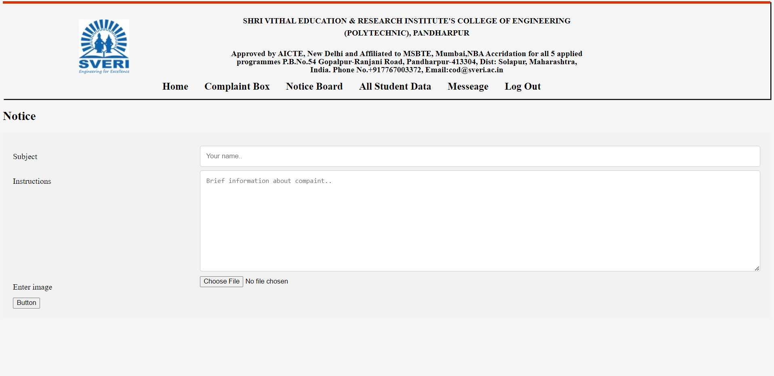
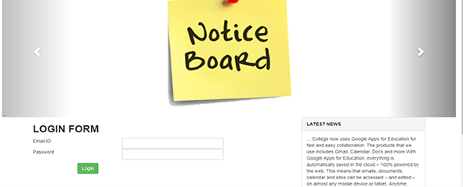
A hostel management website's noticeboard page is a section on the website that allows administrators, staff, and residents to share important information with one another. The noticeboard page can be accessed by logging in to the website, and it typically contains announcements, news, and updates that are relevant to the hostel community.

Slide 23
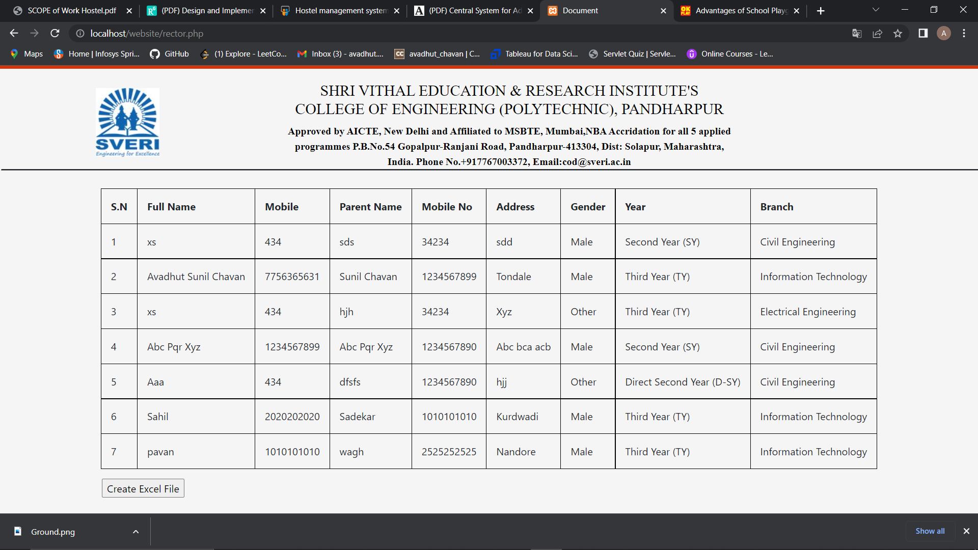
Personal Information: This could include the student's name, address, phone number, email address, date of birth, and emergency contact information.
Room Assignment: Hostel management would need to keep track of which students are assigned to which rooms, including the room number, occupancy, and move-in and move-out dates.

Slide 24
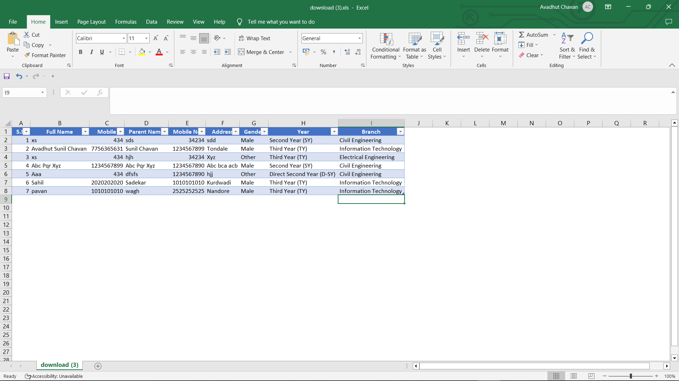
Customization: The export function should allow Admins to select which data to export and in what format. For example, admin may choose to export only certain fields or records, or they can use as an records for registered students.

Slide 25
Advantages:
Good security for user information.
Easy to handle.
Easy data updating.
Authorization schemes
It is less time and effort consuming
It makes the process of updating the data is fast
It automates mundane tasks
It secures the data of the students
It reduces the manual work of management
It enhances the reputation of the educational institute

Slide 26
Applications:
Maintenance Requests: A student hostel management website can provide a way for students to submit maintenance requests online, such as for broken appliances, plumbing issues, or other necessary repairs.
Student Feedback and Surveys: The hostel management system can collect student feedback through surveys or feedback forms, allowing hostel management to gain insights into student preferences and identify areas for improvement.
Online Room Reservations: A hostel management system can allow students to make room reservations online, selecting, occupancy, and preferred move-in date.
Check-in and Check-out: The hostel management system can handle the check-in and check-out process, including managing room keys and providing students with necessary information about their stay.

Slide 27
Future Scope:
Hostel management system (HMS). This hostel management software is designed for people who want to manage various activities in the hostel. This project is designed to fulfill the need of the future generations.
This project is small package which includes different categories as well as having all possible features. We have expected that it will be helpful to the, customers as well as Administrative member.
We will improve this project in future with online room reservation system and also improve in security by providing a magnetic coated card to permanent students for automatic check in and check out.

Slide 28
References :
https://www.slideshare.net/yogeshsharma647/hostel-management-system-80748575
https://www.researchgate.net/publication/326493698_Design_and_Implementation_of_Hostel_Management_Sy-stem_HOMASY_LASU_as_Case_Study
https://www.academia.edu/411851/Central_System_for_Admission_to_Universities_CSAU_Software_Requirements_Specification
https://www.aisect.org/assets/upload_files/AgenciesForSupportWork/SupportService/SCOPE%20of%20Work%20Hostel.pdf

Slide 29
Conclusion:
software is designed for people who want to manage various activities in the hostel. For the past few years the numbers of educational institutions are increasing rapidly Thereby the numbers of hostels are also increasing for the accommodation of the students studying in this institution. And hence there is a lot of strain on the person who are running the hostel and software’s are not usually used in this contex. This particular project deals with the problems on managing a hostel and avoids the problems which occur when carried manually. Identification of the drawbacks of the existing system leads to the designing of computerized system that will be compatible to the existing system with the system which is more user friendly and more GUI oriented.

Slide 30


