Slide 1
Lecture Zero
  CSG202
  Generative AI Fundamentals

Slide 2
Course Introduction
•Course Code : CSG202
•Course Title : Generative AI Fundamentals
•L-T-P Structure : 2 0 2
•Credits: 03
•Nature of Course : Core

Slide 3
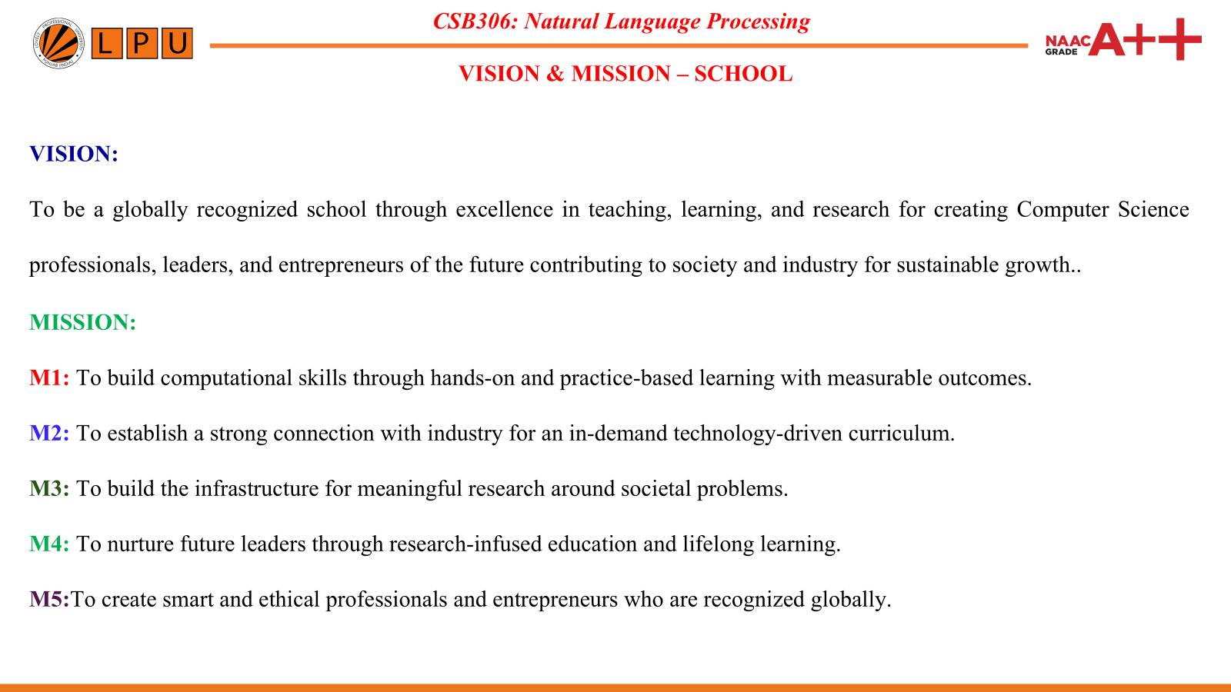

Slide 4
COURSE OUTCOMES
Course Outcome | DESCRIPTION
CO 1 | Understand the fundamental concepts of Generative AI and its distinction from traditional machine learning.
CO 2 | Explain the core components and applications of Large Language Models (LLMs).
CO 3 | Apply prompt engineering techniques to effectively interact with and optimize Generative AI models, specifically within Vertex AI.
CO 4 | Analyze the ethical considerations and principles of Responsible AI in the development and deployment of AI systems.
CO 5 | Evaluate how Google's AI principles are implemented in practice within Google Cloud environments.
CO 6 | Assess well-structured prompts to achieve desired outputs from multimodal generative models like Gemini.

Slide 5
CSB306: Natural Language Processing
PROGRAM OUTCOMES
PO1: Engineering Knowledge: Apply knowledge of mathematics, natural science, computing, engineering fundamentals and an engineering specialization as specified in WK1 to WK4 respectively to develop to the solution of complex engineering problems.
PO2: Problem Analysis: Identify, formulate, review research literature and analyze complex engineering problems reaching substantiated conclusions with consideration for sustainable development. (WK1 to WK4)
PO3: Design/Development of solutions: Design creative solutions for complex engineering problems and design/develop systems/components/processes to meet identified needs with consideration for the public health and safety, whole-life cost, net zero
PO4: Conduct investigations of complex problems: Conduct investigations of complex engineering problems using research-based knowledge including design of experiments, modelling, analysis & interpretation of data to provide valid conclusions. (WK8).
PO5: Engineering Tool Usage: Create, select and apply appropriate techniques, resources and modern engineering & IT tools, including prediction and modelling recognizing their limitations to solve complex engineering problems. (WK2 and WK6)
PO6: The Engineer and The World: Analyze and evaluate societal and environmental aspects while solving complex engineering problems for its impact on sustainability with reference to economy, health, safety, legal framework, culture and environment.

Slide 6
CSB306: Natural Language Processing
PROGRAM OUTCOMES
PO7: Ethics: Apply ethical principles and commit to professional ethics, human values, diversity and inclusion; adhere to national & international laws. (WK9)
PO8: Individual and Collaborative Team work: Function effectively as an individual, and as a member or leader in diverse/multi-disciplinary teams.
PO9: Communication: Communicate effectively and inclusively within the engineering community and society at large, such as being able to comprehend and write effective reports and design documentation, make effective presentations considering cultural, language, and learning differences
PO10: Project Management and Finance: Apply knowledge and understanding of engineering management principles and economic decision-making and apply these to one’s own work, as a member and leader in a team, and to manage projects and in multidisciplinary environments.
PO11: Life-Long Learning: Recognize the need for, and have the preparation and ability for i) independent and life-long learning ii) adaptability to new and emerging technologies and iii) critical thinking in the broadest context of technological change. (WK8)

Slide 7
CSB306: Natural Language Processing
PROGRAM SPECIFIC OUTCOMES
PSO1: Design, develop, optimize and deploy intelligent computational systems by applying advanced artificial intelligence techniques including machine learning, deep learning, computer vision, natural language processing, foundation models and reinforcement learning.
PSO2: Apply mathematical foundations, optimization strategies, research methodologies and modern computational tools to investigate complex artificial intelligence problems and develop innovative, scalable and responsible AI solutions.

Slide 8
CSB306: Natural Language Processing
Program Education Objectives
PEO1: Graduates will demonstrate professional excellence by applying advanced knowledge of artificial intelligence, machine learning, data-driven modelling, and computational techniques to design innovative solutions for complex engineering and societal problems.
PEO2: Graduates will contribute to research and innovation by identifying emerging technological challenges, developing intelligent computational models, and advancing knowledge through scientific investigation, publications, patents, or technology development.
PEO3: Graduates will engage in lifelong learning, professional development, and upskilling to adapt to advancements in artificial intelligence, computing technologies, and evolving industry requirements.
PEO4: Graduates will practice responsible development and deployment of intelligent systems by considering ethical principles, societal impact, sustainability, fairness, privacy, and professional responsibilities.

Slide 9
Course Content Overview
Unit I
Foundations of Generative AI: Define generative AI, explain how generative AI works,
describe generative AI model types, and describe generative AI applications.
Unit II
Exploring Large Language Models (LLMs): Define LLMs, describe LLM use cases,
explain prompt tuning, and describe Google's Generative AI development tools.
Unit III
Introduction to Responsible AI: Understand Google's AI Principles, identify the need for
responsible AI, recognize lifecycle impacts, and align AI with organizational values.
Unit IV
Practical Prompt Design with Vertex AI: Explain the business case for responsible AI, identify
ethical issues, apply Google's AI Principles, and operationalize responsible AI.

Slide 10
Unit V
Implementing Responsible AI in Google Cloud: Overview of Google's AI Principles, ethical AI development, governance, stakeholder trust, risk management, compliance, and competitive advantage.
Unit VI
Advanced Generative AI Applications: Overview of Vertex AI, Generative AI Studio, Gemini, Model Garden, multimodal workflows, text-to-image, image, video, audio, and cross-modal AI.

Slide 11
List of Practicals
Get Started with Generative AI Studio
Generative AI with Vertex AI: Getting Started
Generative AI with Vertex AI: Prompt Design
Vertex AI PaLM API: Qwik Start
Integrate Search in Applications Using Gen AI App Builder
Prompt Design using PaLM
Explore and Evaluate Models using Model Garden

Slide 12
Innovative pedagogies
Pedagogy | Application in the Course
Use of AI | AI tools such as Gemini, ChatGPT, Google AI Studio, Vertex AI Studio, and NotebookLM will be used to demonstrate generative AI concepts, compare prompt outputs, explain LLM architectures, generate multimodal content (text, image, code), evaluate prompts, and illustrate responsible AI practices. Students will also use AI assistants for debugging prompts, summarizing concepts, and generating prototype applications. Applied across Units 1–6, especially during prompt engineering, multimodal AI, and practical sessions.
Case-Based Learning | Real-world case studies from healthcare, education, finance, customer service, software development, and content generation will be analyzed to understand Generative AI applications, ethical issues, AI governance, and business impact. Students will evaluate successful and failed AI deployments. Primarily used in Units 1, 3, 5, and 6.
Quizzes and AI Challenge Activities | Short concept quizzes, prompt debugging challenges, AI output evaluation exercises, and scenario-based assessments will be conducted after every major topic. Students will compare outputs from different LLMs and justify the best prompt design. Used throughout the course.

Slide 13
Assessment & Evaluation Framework
Total Course Marks: 100
●Attendance: 5 Marks
●Continuous Assessment (CA): 25 Marks
●Mid-Term Examination(MTE): 20 Marks(MCQ)
●End-Term Examination( ETE): 50 Marks( MCQ + Subjective Questions)

Slide 14
Guidelines for Continuous Assessment (CA)
Component | From Units
CA1: Test1 | UNIT-I,II
CA1: Test2 | UNIT-IV, V
CA1: Test3 | UNIT-I,II,III,IV,V
Best two out of three CA scores will be considered.

Slide 15
LATEST TRENDS IN GENERATIVE AI
Automated EDA (AutoEDA): Rapid, one-click data profiling and visualization using libraries like ydata-profiling, Sweetviz, and D-Tale.
Generative AI & LLMs: Leveraging AI assistants (e.g., ChatGPT, Copilot) to query datasets, generate insights, and write analysis code using natural language.
Interactive Dashboards: Transitioning from static plots to dynamic, web-based exploratory apps using frameworks like Streamlit and Dash.
Big Data Exploration: Scaling EDA for massive datasets using high-performance, distributed computing tools like PySpark, Dask, and Polars.
Real-Time Analytics: Shifting from traditional batch processing to exploring and visualizing streaming data instantly.
Data Observability: Automated tracking of data health, missing values, and anomalies right from the initial exploration phase.

Slide 16
Learning Resources
Topic | Official Reference
Foundations of Generative AI | cloud.google.com/discover/what-is-generative-ai
Gemini API / LLMs | ai.google.dev/gemini-api/docs
Prompt Engineering | developers.google.com/machine-learning/resources/prompt-eng
Google AI Principles | ai.google/responsibility/principles
Responsible AI | cloud.google.com/responsible-ai
Vertex AI Studio | cloud.google.com/vertex-ai/docs/generative-ai/learn/overview
Model Garden | cloud.google.com/model-garden
Multimodal AI | cloud.google.com/use-cases/multimodal-ai

Slide 17
PLACEMENT & CAREER RELEVANCE
Employability Skills
Prompt engineering and LLM application development
Hands-on experience with Vertex AI, Gemini, and Model Garden
AI-assisted software development and cloud AI deployment
Industry Applications
AI chatbots and virtual assistants
Content generation and document automation
Software development and code generation
Healthcare, finance, education, retail, and customer support
Career Opportunities
Generative AI Engineer
Prompt Engineer
AI/ML Engineer
LLM Developer
AI Solutions Consultant
Cloud AI Engineer
Data Scientist

Slide 18
REVENUE GENERATION & ENTREPRENEURSHIP OPPORTUNITIES
Freelancing & Consulting
Prompt engineering services
AI chatbot and automation development
AI content creation and workflow automation
Product Development
AI chatbots and virtual assistants
Document summarization systems
Educational AI platforms
Enterprise knowledge management solutions
Start-up Opportunities
AI SaaS products
EdTech and Healthcare AI solutions
Customer support automation platforms
Industry Collaboration & Monetization
Industry-sponsored AI projects
Google Cloud-based AI solution development
Custom AI applications for enterprises

Slide 19
SKILL ATTAINMENT
Technical & Professional Skills
Understanding of Generative AI, LLMs, and prompt engineering
Hands-on proficiency with Vertex AI, Gemini, Model Garden, and Generative AI Studio
Development of AI-powered applications using Google Cloud tools
Industry-Aligned Competencies
Design and optimization of prompts for LLMs
Development of enterprise AI solutions using cloud platforms
Application of Generative AI for automation, content creation, and business workflows
Expected Proficiency upon Course Completion
Understand Generative AI concepts and LLM architectures.
Develop AI-powered applications using Vertex AI and Gemini.
Apply effective prompt engineering techniques for diverse use cases.
Evaluate AI systems based on accuracy, ethics, and business requirements.
Implement Responsible AI principles in real-world AI solutions.

Slide 20

EDU Revolution
Learning Beyond the Classroom
Division of Academic Affairs

Slide 21
Why EDU-Revolution!!!
  Supports the 'Earn Your Fee' vision through Revenue Generation activities
  Enhance Real World Skills ensuring Industry readiness
  Promote Innovation and Creativity to handle real world challenges
  Promote Lifelong Learning

Slide 22
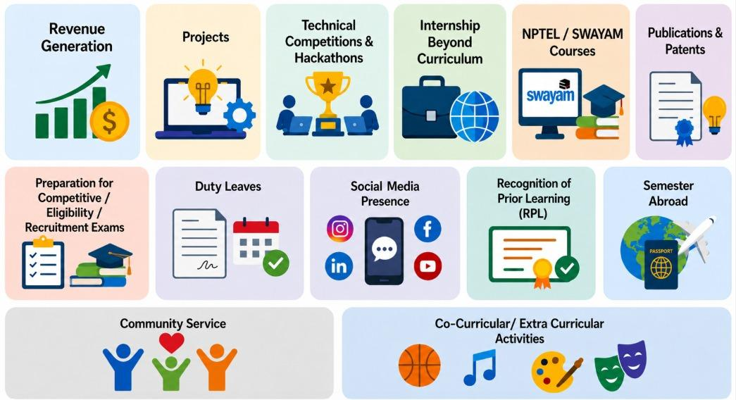
Initiatives under EDU Revolution

Slide 23
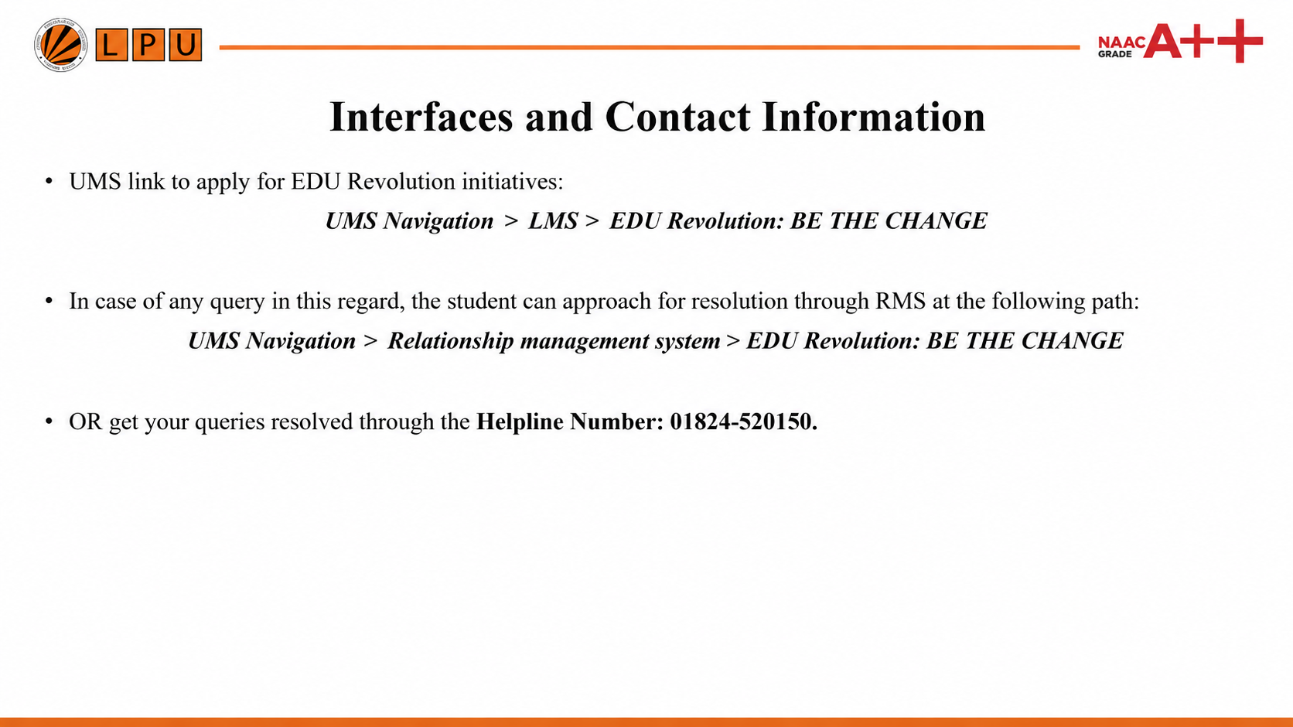

Slide 24


