Slide 1
Practical Prompt Design
with Vertex AI
04
Applying Responsible AI
Notes:
This is CSG202 Unit IV. Its official title is Practical Prompt Design with Vertex AI, while the detailed syllabus and instruction-plan lectures 15–18 specify the responsible-AI business case, ethical issue spotting, lessons from Google, and organizational operationalization. Those detailed outcomes define this module. Module 2 already explains prompting and LLM mechanics. Here, learners apply responsible decisions to an AI-assisted workflow. The campus examples are fictional teaching cases, not clinical protocols or accounts of a Google deployment. Explain that an organization still owns the decisions it makes using a model.
Sources and further reading:
Responsible AI: Applying AI Principles with Google Cloud
https://www.skills.google/course_templates/388

Slide 2
Module 4 in the course
1
2
3
4
5
Modules
1–2
Module
3
Module
4
Module
5
Module
6
AI and LLM
foundations
Responsible-AI
foundations
Apply principles
to a project
Google Cloud
governance
Multimodal
applications
Today: a business need becomes a bounded, evaluated, accountable AI service.
Notes:
Read the sequence from left to right. Modules 1–2 explain generation and interaction with language models. Module 3 introduces stakeholders, lifecycle impact, values, oversight and recourse. Module 4 now asks learners to use these concepts to design and judge a project. Module 5 deepens Google Cloud governance, trust, risk and compliance. Module 6 covers platform workflows and multimodal systems. Some vocabulary returns because students must apply it, but the exercises here require a requirement, owner, control and evidence. Ask learners to name one Module 3 concept that could change a project decision.
Sources and further reading:

Slide 3
01
The business case
Lecture 15: useful outcomes, safeguards and evidence
Notes:
Module 3 established why responsible AI matters. This section asks how to put that argument into a project proposal. The running problem is a student-support queue. Ask what the service is trying to improve for a person, then distinguish that outcome from a convenient technical metric. A faster model may still send students to the wrong service.
Sources and further reading:
Responsible AI at Google Cloud
https://cloud.google.com/responsible-ai

Slide 4

Running case: a campus support assistant
The need
Students wait for the right help. Staff spend time reading and organizing messages.
Proposed role
AI drafts a summary and suggests a route. A trained counselor checks the original request and decides.
Success includes timely, appropriate help and a usable manual route.
Notes:
The illustration shows a student request, an AI summary beside the source, and a counselor reviewing the result. Follow that order aloud. A summary is a shorter representation of the original message. Routing means directing a request to an appropriate staff member or queue. The model supports that work but does not independently diagnose a student or decide an intervention. This is a fictional service-design case. Ask: what happens if a summary removes the phrase “I need help today”? The business benefit is less reading and waiting, while the potential harm is a delayed response. Keep both in view throughout the module.
Sources and further reading:
Design a responsible approach
https://ai.google.dev/responsible/docs/design
Visual: original AI-generated instructional illustration. Read the relationships described above.

Slide 5
A business case connects value with conditions
Need
Faster first response
Reduce avoidable waiting while preserving counselor judgment.
Outcome
Appropriate help
Track whether the student reaches the right service.
Resources
People and operating cost
Budget for review, testing, corrections and model use.
Safeguards
Bounded pilot
Keep escalation and manual support available.
Evidence
A decision to continue
Expand only when the agreed measures support it.
Notes:
A convincing business case says who benefits, how the benefit will be measured, what resources are needed and when the organization should change course. Expected savings are an assumption until the team measures them. Include correction work and reviewer workload rather than counting only automated replies. Preventive controls can reduce rework and harmful errors, but they also require time and money. A controlled pilot is a limited release with clear review conditions. Ask students to turn “use AI to reduce cost” into a proposal that also protects student outcomes. A suitable answer names speed, service quality, safety evidence and manual fallback.
Sources and further reading:
Responsible AI at Google Cloud
https://cloud.google.com/responsible-ai

Slide 6
Technical performance and human outcomes
Measure | What it tells us | Campus example
Efficiency | How quickly work moves | First-response time
Quality | Whether the task succeeds | Counselor agreement with routing
Safety and fairness | Who experiences harmful errors | Critical misses by language group
User experience | Whether people can use the service | Understanding the answer and help route
A low response time cannot establish all four outcomes.
Notes:
A technical metric measures a system property such as latency, the delay before a response arrives. A human outcome measures what actually happens to a person. Routing agreement compares the suggestion with a qualified reviewer’s judgment. A critical miss is a case that needs urgent handling but does not receive the required escalation under the service’s agreed rules. Its denominator must be the relevant urgent cases, not every request. A subgroup is a meaningful segment such as the language used. User understanding can be assessed with short comprehension or usability checks. Explain each row, then ask which measure is missing if a proposal reports only speed and routing agreement.
Sources and further reading:
Evaluate model and system for safety
https://ai.google.dev/responsible/docs/evaluation

Slide 7
Worked example: review effort and correction effort
Option A
100 initial + 200 corrections
= 300 minutes total
Option B
200 review + 50 corrections
= 250 minutes total
Review takes longer at first, but fewer corrections reduce total effort in this example.
Illustrative numbers only. Count harm and service quality as well as time.
Notes:
This arithmetic is a constructed teaching example, not an empirical claim about an AI product. Option A uses 100 × 1 = 100 minutes for initial work and 20 × 10 = 200 minutes for corrections, making 300 minutes. Option B uses 100 × 2 = 200 minutes and 5 × 10 = 50 minutes, making 250. The extra review effort could pay for itself if it reduces correction work as assumed. Ask what happens if review takes four minutes: Option B then takes 450 minutes. The point is to test the assumptions, not promise a saving. Serious harms, access and trust cannot always be reduced to staff minutes.
Sources and further reading:

Slide 8
Pilot evidence: faster replies can hide harmful misses
Observed measure | Baseline | Pilot
Average first response | 12 minutes | 6 minutes
Urgent misses, language A | 2 of 100 (2%) | 2 of 100 (2%)
Urgent misses, language B | 2 of 100 (2%) | 8 of 100 (8%)
Uncertain cases using fallback | No AI workflow | 3 of 20 cases (15%)
Illustrative data. The pilot improved speed but needs investigation before expansion.
Notes:
Read the table by row rather than treating it as one overall score. The response time halved. Language B’s urgent-miss rate increased from 2% to 8%, while language A stayed at 2%. Only 3 of 20 uncertain cases used fallback. That last number is a signal to inspect the routing rules, staff capacity and whether staff can actually use fallback. It does not by itself identify the cause. The equal subgroup denominators make this example easy to compare. Real evaluations also need representative sampling and uncertainty estimates. Ask students what evidence would justify expanding the pilot. A good response requires investigating the subgroup failures and checking the fallback in practice.
Sources and further reading:

Slide 9
Discussion: should the pilot expand?
“Replies are twice as fast, so the assistant is ready for every student.”
A justified decision
Keep the pilot bounded. Investigate the language pattern, inspect missed cases, and verify that fallback works.
Record the owner, corrective action, retest cases and the conditions for expansion.
Which result would change your decision?
Notes:
This is an open discussion, not an additional MCQ. Invite students to separate the observation (speed improved) from the unsupported conclusion (all students can safely use it). The evidence from the previous slide indicates an unresolved outcome problem. Suitable actions include reviewing the original messages, testing the translation or summary behavior, checking the routing rule, and confirming staff availability. The owner should document the decision and retest criteria. Avoid presenting a universal numeric safety threshold: an organization must set criteria appropriate to the task with relevant expertise. Transition by asking how the team could have spotted this failure before launch.
Sources and further reading:
Design a responsible approach
https://ai.google.dev/responsible/docs/design

Slide 10
02
Ethical issue spotting
Lecture 16: specific failures, people and safeguards
Notes:
The business case identifies the proposed value. Issue spotting now tests the proposal from the perspectives of affected people. A vague concern such as “AI might be biased” is only a starting point. Learners will identify who is affected, how the failure occurs, what follows and who can intervene. Reuse the campus case while introducing attendance and scholarship examples to check transfer.
Sources and further reading:
Responsible AI: Applying AI Principles with Google Cloud
https://www.skills.google/course_templates/388

Slide 11
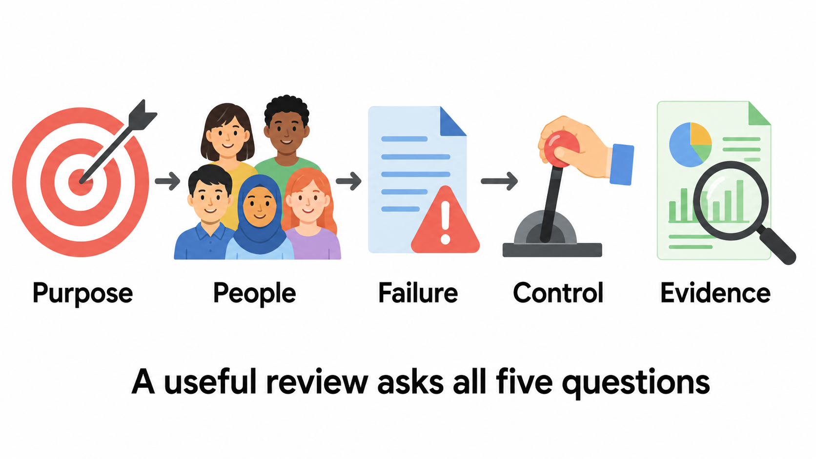
Five questions for an AI project
Use the questions before decisions and whenever the use case changes.
Notes:
The five symbols represent purpose, people, failure, control and evidence. Purpose asks what need is being solved and whether AI is appropriate. People asks who benefits, who may be harmed and who is absent from the team’s assumptions. Failure asks for a plausible event and consequence. Control asks who can review, correct, pause or stop. Evidence asks which tests and observations show that the design works. Read the diagram left to right, then explain that a later discovery can send the team back to an earlier question. This is a teaching review aid, not an official Google certification checklist.
Sources and further reading:
Design a responsible approach
https://ai.google.dev/responsible/docs/design
Visual: original AI-generated instructional illustration. Read the relationships described above.

Slide 12
The five questions applied to campus support
Question | A specific answer
Purpose | Reduce waiting while preserving qualified judgment.
People | Students, counselors and people needing language or accessibility support.
Failure | A summary omits urgency and delays appropriate help.
Control | A counselor can override routing and use manual support.
Evidence | Critical misses, subgroup results and correction records.
Notes:
Walk through a completed review rather than asking students to memorize five labels. The purpose keeps the organization focused on the service need. The people analysis includes students who are missing from the initial test data. The failure describes a causal link between an output and a delayed response. The control is an action with an authorized person. The evidence tells us whether that action works. If any row is vague, the next row becomes weaker. For example, “use good data” gives no way to check language coverage. Ask learners to write one alternative failure that would require a different control, such as disclosure of sensitive details.
Sources and further reading:

Slide 13
A useful failure statement names the consequence
“A student writes an urgent request in mixed-language text. The summary drops the urgency, and staff route it to a routine queue.”
What the statement gives us
A person, an input condition, a failure in the workflow and a possible consequence.
Now the team can create a test case and decide where a reviewer should intervene.
“The system might be biased” still needs this level of detail.
Notes:
Mixed-language text combines more than one language in a message. The concern is that the system may misunderstand an equivalent request because of its form rather than its need. Do not assume a particular language will fail: that is a hypothesis to test. Trace the event in order: input, summary, routing rule, delayed response. A failure statement helps the team select representative test messages and identify where review is useful. Distinguish the model’s text error from the organization’s decision to act on that text. Ask learners to write a similarly specific statement for automated grading or attendance. Avoid real private student messages in classroom exercises.
Sources and further reading:

Slide 14
Fairness example: equivalent need, different wording
Request A
Request B
“I cannot access the exam portal.
The deadline is today.
Please help me submit.”
The same need in another language
or with spelling and grammar differences.
The deadline is still today.
Test question: Do both requests receive the same urgency and access to human help?
Compare preserved facts and routing outcomes across supported languages.
Notes:
The test changes language or expression while preserving the relevant meaning. Fairness here means the service should not systematically disadvantage equivalent requests because of language. It does not mean every request must receive the same decision. Different urgency or facts can justify different handling. Bias refers to systematic patterns that can produce unjustified differences. Subgroup testing compares outcomes for meaningful groups and helps find those patterns. Both translation quality and later routing rules may contribute. Ask a bilingual student or domain reviewer to validate that the paired messages really have equivalent meaning before drawing conclusions. Log corrections and unresolved cases as evidence.
Sources and further reading:
Evaluate model and system for safety
https://ai.google.dev/responsible/docs/evaluation

Slide 15
Privacy example: the data needed for the task
Too much context
Task-relevant context
A full student record accompanies
a simple timetable question.
Unrelated personal details may appear
in drafts or logs.
The assistant receives the timetable
and the question it must answer.
Staff confirm permission, limit access
and minimize sensitive data.
Design decision: remove unrelated fields before they enter prompts, logs or outputs.
Existing access to data does not automatically authorize every new use.
Notes:
Data minimization means using only the information needed for a stated purpose. Permission means the organization has an appropriate basis and follows its policies for that use. The syllabus’s campus case explicitly includes consent, language coverage and sensitive-data minimization. Explain these as design considerations, not a legal conclusion about a jurisdiction. Privacy risk can arise from collection, the prompt, generated text, logs or human access. Removing a name may not eliminate identifying information if other details remain. Ask learners why a timetable assistant needs a student’s health record. A useful answer connects the data to the task and removes unrelated fields.
Sources and further reading:
Design a responsible approach
https://ai.google.dev/responsible/docs/design

Slide 16
The people analysis includes users missing from testing
Who benefits?
Instructors save time
An automated grading proposal reduces marking effort.
Who is missing?
Students needing accessibility support
The pilot includes only standard text submissions.
What changes?
Access and outcome tests
Include supported submission formats and affected students.
Who acts?
Course owner and support staff
Resolve barriers and provide an equivalent manual route.
Notes:
A stakeholder is anyone who affects or is affected by the system, including people who never directly operate it. Accessibility means being able to use the service with relevant needs or assistive technology. Here, the issue is that the team measured instructor benefit but did not test whether some students can submit or challenge outcomes. Ask affected students and support specialists about barriers. An average accuracy score across the initial sample cannot answer that question. The manual route should provide meaningful access rather than a significantly worse service. Explain that including stakeholders can change the project’s requirements, not merely the wording of its announcement.
Sources and further reading:
People + AI Guidebook
https://pair.withgoogle.com/guidebook/

Slide 17
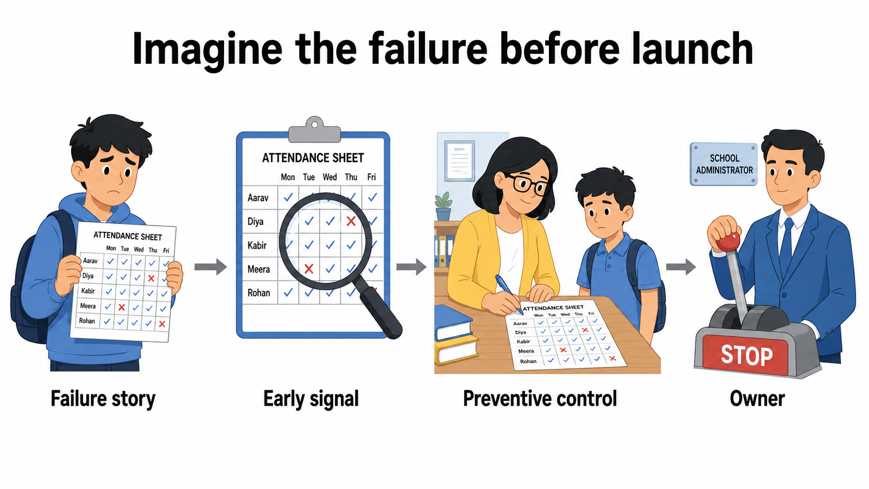
Premortem: a structured failure rehearsal
The output is an actionable failure story with a signal, control and owner.
Notes:
A premortem asks participants to imagine a future deployment has failed, then describe how that happened. It is different from a postmortem, which investigates an event after it occurs. Read the four illustrated stages. A specific failure story contains a person, event and consequence. An early signal is an observation that could reveal a problem. A preventive control is an action that reduces the likelihood or consequence of the failure. An owner is a person or role with responsibility and authority to act. The activity surfaces assumptions before launch. It complements testing and stakeholder input rather than replacing them.
Sources and further reading:
Visual: original AI-generated instructional illustration. Read the relationships described above.

Slide 18
Worked premortem: incorrect attendance records
Part | Example | Why it matters
Failure story | A group repeatedly receives false absence marks. | Attendance records affect students.
Early signal | The group’s false-absence rate rises. | A pattern needs investigation.
Preventive control | Confirm uncertain matches and offer manual attendance. | Errors can be caught before use.
Owner | An authorized staff member reviews and corrects records. | The signal leads to action.
Notes:
A false absence occurs when a present student is recorded as absent. A rising rate is an indicator; it does not correct anything by itself. Human confirmation and a manual attendance route are controls. The owner must have access to the evidence and authority to amend records or pause the system. Ask the class which row is missing if a team creates a dashboard but nobody responds. Then ask which row is missing if the team only promises to be fair. The example does not endorse facial recognition attendance or assume it is necessary. The purpose question may support using a simpler attendance method.
Sources and further reading:

Slide 19
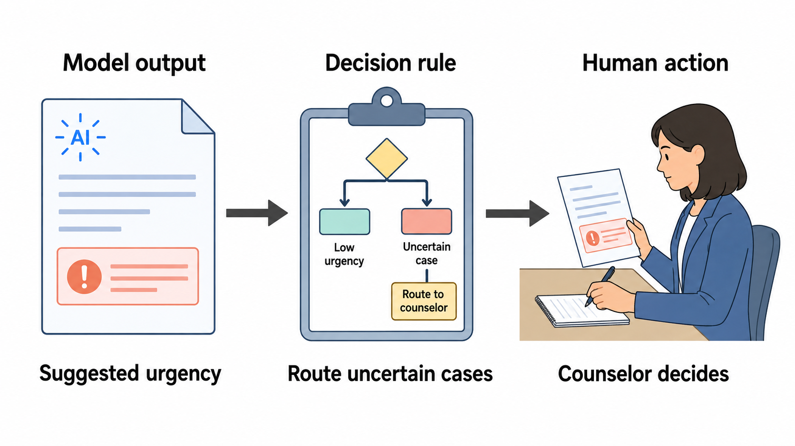
Model output, decision rule and human action
A failure can arise at any of these stages. Test the complete workflow.
Notes:
The left document is the model’s output, such as a summary or suggested urgency. The middle clipboard is the decision rule that the application or organization uses to route the case. The reviewer on the right performs the human action. These are separate objects of evaluation. A correct summary can still lead to poor routing if the rule is inappropriate. A good routing rule can still fail if the assigned counselor has no time to review the request. A model-generated confidence statement is not a validated probability. Where confidence scores exist, document their source and measured reliability; expose uncertainty and limitations when an adequate score is unavailable.
Sources and further reading:
Evaluate model and system for safety
https://ai.google.dev/responsible/docs/evaluation
Visual: original AI-generated instructional illustration. Read the relationships described above.

Slide 20
Human oversight depends on consequence and uncertainty
Arrangement | How it works | Example
Human-in-the-loop | A person approves before the action. | Counselor approval before urgent routing.
Human-on-the-loop | Automation runs under supervision with intervention authority. | A monitored queue that staff can pause.
Human-out-of- the-loop | No routine prior approval or active supervision of each output. | Low-consequence autocomplete with easy recovery.
In this course, consequential recommendations require stronger review and recourse.
Notes:
Read the three terms carefully because the question bank distinguishes them. In-the-loop places approval before each specified action. On-the-loop permits automation while a supervisor can monitor and intervene. Out-of-the-loop removes routine human involvement in individual outputs. For the course examples, consider that arrangement only when consequences are low and correction is easy. This is a teaching boundary, not a universal claim about every automated system. Event-name suggestions can receive ordinary user review. Urgent intervention recommendations require qualified judgment, fallback and recourse. Review strength should also reflect uncertainty and the practical ability to recover after an error.
Sources and further reading:
People + AI Guidebook
https://pair.withgoogle.com/guidebook/

Slide 21

Meaningful review needs more than a reviewer’s name
Information
The reviewer sees the original source, uncertainty and known limits.
Capacity and authority
Training, sufficient time and permission to overturn, pause or escalate make review usable.
A reviewer who cannot examine or change an output is a nominal safeguard.
Notes:
The illustration combines source and draft documents, a clock, a training guide and a stop control. Each object represents a condition for useful oversight. Context lets the reviewer detect omissions. Uncertainty and known limits help the reviewer decide where extra care is needed. Training supplies relevant expertise. Time prevents rushed approvals. Authority allows the reviewer to correct an outcome or halt a workflow. Nominal oversight means the role exists in name but cannot meaningfully affect the result. Automation bias is over-reliance on a system’s suggestion. Ask learners what happens when one reviewer must approve hundreds of drafts per hour. Log disagreements and corrections to improve the process.
Sources and further reading:
People + AI Guidebook
https://pair.withgoogle.com/guidebook/
Visual: original AI-generated instructional illustration. Read the relationships described above.

Slide 22
Transparency should answer the audience’s questions
Audience | Useful information | A practical example
Student | AI involvement, meaning of the outcome and help route. | How to challenge an urgency category.
Reviewer | Original evidence, uncertainty and limitations. | Which source facts the draft may have omitted.
Owner | Tests, incidents and change history. | Whether a revised routing rule reduced misses.
More technical detail does not automatically make an explanation useful.
Notes:
Transparency means making relevant information understandable and available to the person who needs it. A student usually needs a clear explanation of what happened and what they can do next. A counselor needs source evidence and uncertainty to judge the recommendation. A service owner needs records that explain how the system behaves and changes over time. Showing source code alone is unlikely to satisfy these different needs. Explainable AI tools may provide additional evidence, but this slide concerns communication and usable information rather than a particular technical explanation method. Ask the class to rewrite a technical statement for a first-year student.
Sources and further reading:
People + AI Guidebook
https://pair.withgoogle.com/guidebook/

Slide 23
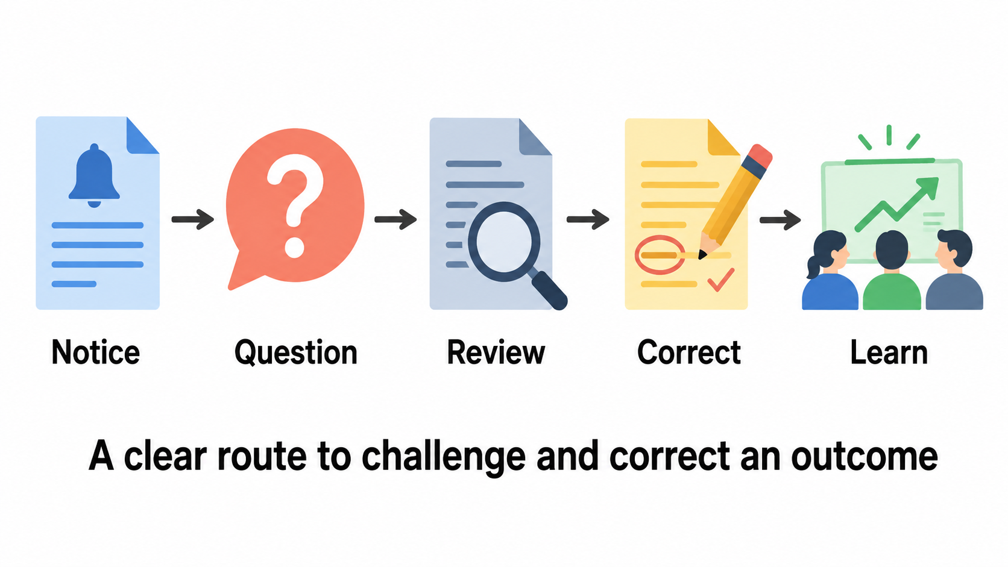
Recourse includes review and correction
A notice or complaint form is only one part of the process.
Notes:
Recourse is the practical route through which an affected person can seek review or correction. Contestability means a consequential outcome can be challenged. Follow the five illustrated steps: notice tells the student what occurred; a question or challenge begins the process; a qualified person reviews the evidence; correction addresses the outcome and relevant data; learning uses repeated problems to improve the service. A system that repeats the same AI output in response to a complaint has not supplied meaningful review. The student should not have to explain the model’s internal mathematics. Evidence includes appeal outcomes, correction records and unresolved cases.
Sources and further reading:
Visual: original AI-generated instructional illustration. Read the relationships described above.

Slide 24
Scholarship scenario: narrowing the AI role
Proposed automation
Responsible redesign
Rank applicants from historical awards.
Use one generated summary as the decision.
Provide no way to correct missing context.
Summarize supplied evidence only.
Trained reviewers check original sources.
Test omissions and subgroup errors.
Applicants can correct factual mistakes.
Boundary: the AI organizes evidence. A qualified reviewer makes and can correct the decision.
The redesign narrows the model’s role and adds review and recourse.
Notes:
Historical awards may reflect earlier exclusion, so treating them as neutral labels can reproduce an unfair pattern. Summaries can also omit circumstances that matter to a reviewer. A narrower task limits the system to organizing evidence and removes automated ranking or award decisions. This does not make summarization harmless: reviewers must check the source and evaluation must test omissions across relevant groups. Applicants need a correction route. This is a fictional task-design exercise rather than a recommended admissions policy. Ask which safeguard remains missing if the team has reviewers but applicants cannot correct errors. The answer is recourse.
Sources and further reading:

Slide 25
Expert assistance in an HR information workflow
1
2
3
4
5
Employee
question
Relevant
policy
AI
draft
Expert
verification
Answer and
help route
What is the
leave process?
Supply approved
source context
Organize and
explain
Check facts and
policy meaning
Offer a route for
exceptions
The expert needs source access, time and authority to correct the draft.
Notes:
An HR information assistant can draft an explanation using an approved leave policy. HR means human resources, the organizational function supporting employment processes. The expert checks the draft against the policy before the employee receives it. A policy exception, such as approval outside normal rules, requires an authorized decision rather than a model’s guess. The five stages adapt the expert-assist pattern to a different setting. Explain that the same model can be useful in both low- and high-consequence workflows, but the controls depend on the use. Ask what fails if the expert sees only the draft or cannot revise it.
Sources and further reading:

Slide 26
03
Google’s lessons in practice
Lecture 17: principles, decisions and learning
Notes:
The syllabus explicitly asks how Google developed and applied its AI Principles and what an organization can learn. This section gives a concise historical sequence, one documented design change, and an applied value-to-evidence example. Detailed Google Cloud governance, compliance and business reputation belong to Module 5. The historical material here explains the development of a practice and should not be presented as a complete description of current organizational structures.
Sources and further reading:
Taking care of business with Responsible AI (2020)
https://cloud.google.com/blog/products/ai-machine-learning/taking-care-of-business-with-responsible-ai
AI at Google: our principles (2018, updated 2025)
https://blog.google/innovation-and-ai/products/ai-principles/

Slide 27
Google’s principles evolved with its AI practice
2017
2018
2020
2025
2026
Development
began
Principles
published
Practice and
lessons shared
Principles
updated
Progress
report
Work began
in mid-2017
Initial public
framework
Reviews and
product changes
Updated public
commitments
Lifecycle work
and safeguards
The original seven-principle list is historical. Read the current public principles.
Notes:
Google’s September 2020 account says development began in mid-2017 and the principles were published in June 2018. Its original 2018 article carries a February 2025 update notice. The 2026 progress report describes ongoing work. The current public headings are Bold innovation, Responsible development and deployment, and Collaborative progress, together. Use the live reference for exact current wording. The historical sequence shows that a public principle requires a continuing practice. Avoid treating the 2018 list as the current list or assuming that every internal process described in 2020 has the same structure today.
Sources and further reading:
Taking care of business with Responsible AI (2020)
https://cloud.google.com/blog/products/ai-machine-learning/taking-care-of-business-with-responsible-ai
AI at Google: our principles (2018, updated 2025)
https://blog.google/innovation-and-ai/products/ai-principles/
Google AI Principles
https://ai.google/principles/
Responsible AI Progress Report 2026
https://ai.google/static/documents/ai-responsibility-update-2026.pdf

Slide 28
Lessons from Google’s published practice
Review early
Find issues while design can change
Review the product and its intended use before commitment.
Include different views
Improve the questions being asked
Seek technical, domain and affected-community input.
Change the design
Act on the review
Narrow a use, add safeguards or stop when needed.
Keep learning
Revisit earlier decisions
Use new evidence to improve the approach.
Notes:
Google’s 2020 account describes product and custom-work reviews, varied expertise and decisions that can narrow or change a proposed product. These are historical published lessons rather than a claim about today’s exact approval chain. The practical lesson is that a review must be able to change a decision. Ask learners to imagine a review after a vendor contract and workflow design have already been fixed. The team then has less room to respond. Translate the lessons to the campus case by involving students and counselors early and allowing the owner to revise the task. Module 5 examines governance mechanisms in more detail.
Sources and further reading:
Taking care of business with Responsible AI (2020)
https://cloud.google.com/blog/products/ai-machine-learning/taking-care-of-business-with-responsible-ai

Slide 29
Historical example: changing an output category
The question Google revisited
The documented change
Should an image-labeling system
assign gender-related labels
based on a person’s appearance?
Google reported removing gender
labels from Cloud Vision API.
The permitted output categories changed.
Design lesson: change the permitted output, then verify that the new boundary holds.
Historical example from Google’s published 2020 account.
Notes:
Google’s 2020 Responsible AI blog reports removing gender labels from Cloud Vision API. Present this as a documented historical example. The teaching point is that responsible design can change the output specification itself. Do not generalize from the historical case to an unverified statement about every current vision product. Ask students to connect it to the scholarship redesign: the organization can remove ranking from the system’s role and retain evidence summarization. That is a change in permitted outputs, not merely a warning attached to the same automated decision. Evaluation then needs to verify the new boundary.
Sources and further reading:
Taking care of business with Responsible AI (2020)
https://cloud.google.com/blog/products/ai-machine-learning/taking-care-of-business-with-responsible-ai

Slide 30
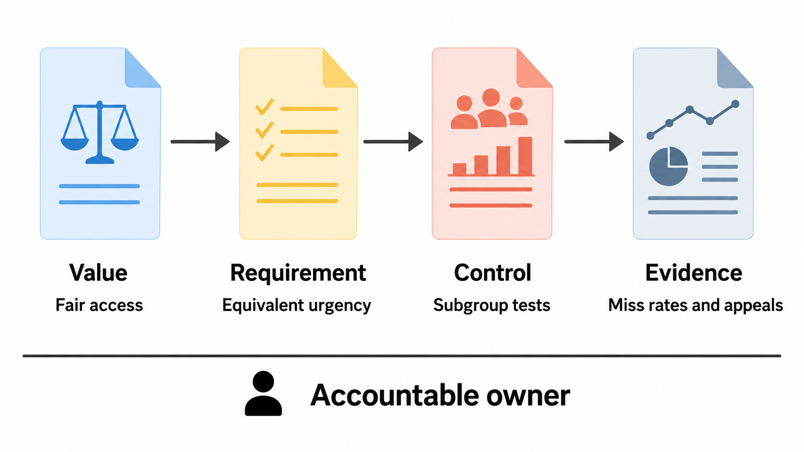
A principle becomes a requirement and evidence
The owner links the value to daily decisions and checks whether the control works.
Notes:
Read the four documents from left to right. A value states what the organization cares about. A requirement translates that value into a property the system should satisfy. A control is a concrete action or mechanism intended to meet the requirement. Evidence is information about whether that mechanism succeeds. The owner beneath the chain is accountable for decisions and follow-up. The illustration uses fair access, equivalent urgency, subgroup tests and miss rates or appeals. Testing generates evidence but can also be part of an evaluation control. Distinguish the planned test from its recorded result. This is a course teaching pattern, not a proprietary Google framework.
Sources and further reading:
Visual: original AI-generated instructional illustration. Read the relationships described above.

Slide 31
Worked chain: fair access to campus support
Value
Fair access
Students with equivalent needs can obtain appropriate help.
Requirement
Language should not change urgency
Preserve equivalent facts across supported languages.
Control
Subgroup tests and manual fallback
Review uncertain or failed cases with a counselor.
Evidence
Miss rates, appeals and corrections
Compare outcomes and confirm that fallback operates.
Owner
Student-support service lead
Authorize changes when the requirement is not met.
Notes:
This is the fully specified version of the preceding diagram. A general claim such as “the service is fair” is an aspiration. The requirement makes the claim testable in a particular context. The controls should operate in the real service, not only on a presentation. For example, a manual route cannot help if it is hidden or unstaffed. Evidence must connect to the requirement: model parameter count cannot show language-neutral urgency handling. Miss rates and review records can help. Explain that a difference in rates triggers investigation and does not by itself prove a single cause. The service lead owns the response and documents the decision.
Sources and further reading:

Slide 32
Worked chain: contestability needs records
Requirement and control
Evidence to retain
Students can challenge an urgency outcome.
A qualified person rechecks the evidence.
That person can correct the outcome
and relevant source data.
The request for review and its date.
The reviewer’s decision and reason.
Any correction and its completion.
Patterns that need a system change.
Operational test: Can a student use the route, receive review and see a correction completed?
A value, requirement and control still need evidence of operation.
Notes:
Contestability is the ability to question a consequential outcome. The control is a qualified review route with correction authority. Evidence should show whether people can use it and whether the organization acts. An appeal outcome may confirm the initial decision or change it; both results can be useful if the process is fair and understandable. Correction records connect a decision to completed action. Access to records should follow the organization’s data policies and minimize unnecessary private information. Ask learners what remains unknown if the organization advertises an appeal button but records neither decisions nor corrections. It cannot establish that recourse is effective.
Sources and further reading:

Slide 33
04
Operationalizing Responsible AI
Lecture 18: ownership, lifecycle decisions and review
Notes:
Operationalizing means turning a concept into routine work that someone can perform and verify. Learners now assemble the project rather than learning another abstract list. The deliverables are a bounded use case, named owners, a small test set, evidence, launch conditions and a response plan. Use the preceding examples as evidence for why each deliverable matters. A checklist is a reminder and discussion aid; it cannot settle every ethical question automatically.
Sources and further reading:
Responsible AI: Applying AI Principles with Google Cloud
https://www.skills.google/course_templates/388

Slide 34
An organization needs people, process and resources
Direction
A defined purpose and values
Leadership sets boundaries and supports responsible decisions.
People
Named roles with authority
Owners, reviewers and affected people contribute.
Process
Review at meaningful decision points
Findings can change the task, controls or launch.
Resources
Tools, training and evidence
Allocate time for testing, records, feedback and response.
Notes:
These are components of the course’s practical framework. Direction explains what the organization is trying to achieve and what it considers unacceptable. People provide ownership, expertise and affected perspectives. Process specifies when decisions occur and who can escalate them. Resources make those duties feasible. A review board with no time, data or ability to stop a launch is unlikely to work. Conversely, a testing tool cannot decide all of the organization’s values. Ask students which component is missing when a team has a policy and dashboard but nobody responds to an alert. Keep enterprise compliance mechanisms for Module 5.
Sources and further reading:
Responsible AI: Applying AI Principles with Google Cloud
https://www.skills.google/course_templates/388

Slide 35
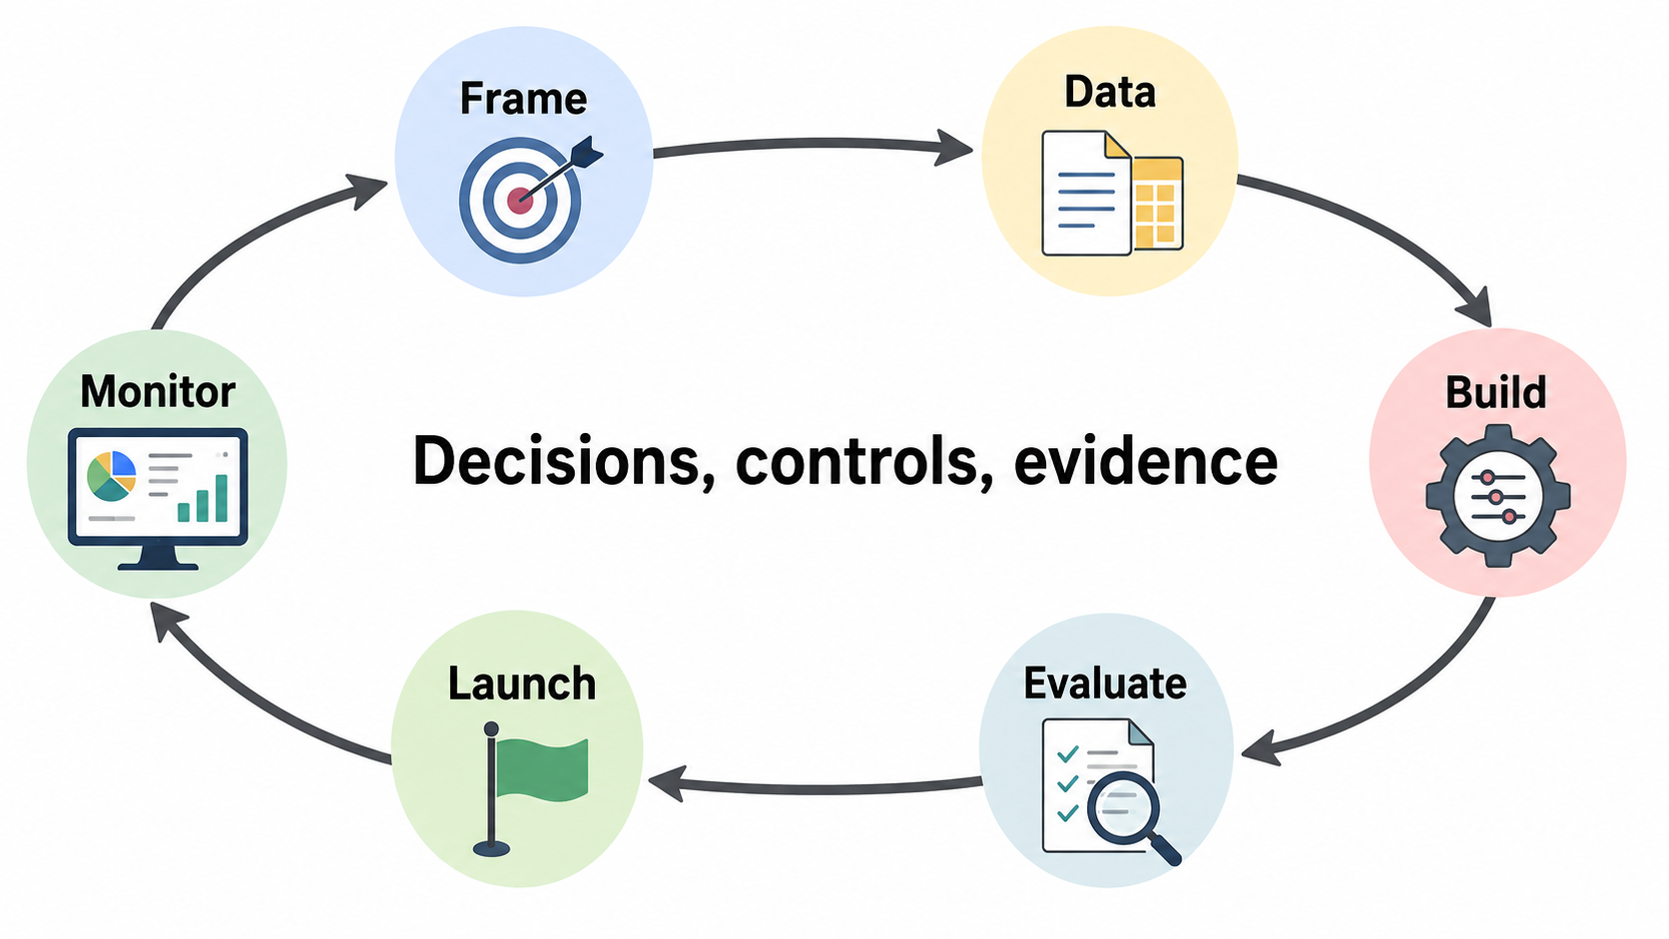
Decisions and evidence across the lifecycle
Revisit earlier stages when monitoring reveals a new need or failure.
Notes:
Read the oval clockwise starting at Frame. Framing defines the need and boundaries. Data work checks permission, relevance and representation. Building chooses the model role and the surrounding decision rules. Evaluation tests both outputs and the complete service. Launch uses appropriate limits, notice, fallback and review. Monitoring examines changed inputs, outcomes and incidents. The return arrow indicates that evidence can change earlier decisions. This diagram is a simplified teaching lifecycle rather than the exact organization of a particular Google team. A model or prompt update may require new evaluation even if the service name is unchanged.
Sources and further reading:
Responsible AI Progress Report 2026
https://ai.google/static/documents/ai-responsibility-update-2026.pdf
Visual: original AI-generated instructional illustration. Read the relationships described above.

Slide 36
Frame and data: the first project records
Frame record
Data record
Need: faster access to the right help.
Boundary: AI assists counselor judgment.
Affected people: supported user groups.
Success: useful service and acceptable risk.
Permission and intended use.
Relevant fields and sensitive-data limits.
Language and accessibility coverage.
Source quality and known gaps.
These records define the claims that later evaluation can support.
Decisions made here determine what later testing must cover.
Notes:
A project record captures decisions so another person can review them. Framing must not assume that counselor replacement is the goal. It should explain the service need and whether an AI method fits. The data record should describe the information used for the task and the evaluation sample. Coverage means the sample includes relevant user conditions, such as supported languages and message formats. Confirm consent or applicable permissions through organizational procedures. Minimize sensitive information. If a supported group is absent, document that gap and gather appropriate evidence before making claims about that group. The records remain useful after launch when the context changes.
Sources and further reading:
Design a responsible approach
https://ai.google.dev/responsible/docs/design

Slide 37
Build: a bounded role with reviewable evidence
Decision | Control | Evidence
Summarize and suggest a route | Show original source beside the draft. | Source-linked corrections.
Handle uncertain requests | Expose limits and route for qualified review. | Uncertainty and routing records.
Preserve counselor judgment | Allow overrides and manual fallback. | Override outcomes and fallback use.
If confidence scores exist, document and validate what they mean.
Notes:
A bounded role is an explicit limit on what the AI can do. The course bank uses “expose confidence” in the Build-stage example. Explain that as showing meaningful uncertainty evidence when available, with context about the score’s source and limitations. A language model saying “95% confident” has not automatically produced a calibrated probability of correctness. Calibration concerns how predicted confidence relates to measured outcomes. A system without a valid score can still show missing facts or other limitations and require review. Records of source facts, routing and counselor corrections let the team assess the control. Do not log unnecessary personal details.
Sources and further reading:
Evaluate model and system for safety
https://ai.google.dev/responsible/docs/evaluation

Slide 38
Evaluation uses cases that can reveal the failure
Test case | What to inspect | Evidence
Equivalent requests in supported languages | Facts and urgency survive the summary. | Subgroup misses and corrections.
Urgent request with indirect wording | The workflow reaches qualified review. | Critical-miss and escalation results.
Sensitive information in a request | Only needed details reach authorized users. | Disclosure findings and fixes.
Uncertain or unsupported input | Manual fallback actually works. | Observed routing and completion.
Notes:
Representative evaluation uses inputs that resemble real use, including less common but consequential cases. A critical test should reflect an agreed failure, not merely test a random prompt. Evaluate the complete workflow: source handling, generated text, routing, reviewer action and fallback. Hold back some cases for evaluation so repeated prompt adjustment does not merely memorize a small example set. Record the version of the prompt, model, rules and data used for a test. Google’s Responsible GenAI toolkit describes several complementary forms of safety evaluation; this beginner exercise applies the underlying idea of testing against defined risks. A successful demonstration alone is weak evidence.
Sources and further reading:
Evaluate model and system for safety
https://ai.google.dev/responsible/docs/evaluation

Slide 39
Launch: a pilot with an operating fallback
Scope
A limited starting group
Use a clearly defined task and supported inputs.
Notice
Understandable user information
Explain AI involvement and the route to help.
Review
An available qualified reviewer
Provide time, source access and intervention authority.
Fallback
A tested manual route
Verify that people can receive help when AI is uncertain.
Decision
Conditions for continuing
Name who can pause, correct or authorize expansion.
Notes:
A pilot is a limited deployment used to learn under controlled conditions. Limit both who can use the service and what the service may do as appropriate to the project. Notice should be understandable rather than a technical document alone. Escalation means moving a case or issue to an appropriate person with more expertise or authority. Fallback means an alternate way to complete the task when the AI workflow cannot be used. Test it with actual staff, not just a visible button. Expansion should depend on evidence and unresolved risks. Initial tests cannot guarantee permanent safety because inputs and operational conditions can change.
Sources and further reading:
Design a responsible approach
https://ai.google.dev/responsible/docs/design

Slide 40
Monitoring connects a signal to an action
Signal | Possible concern | Owner’s next action
Subgroup misses rise | A pattern affects access or safety. | Inspect cases and pause expansion.
Fallback use drops unexpectedly | A route may be unavailable or bypassed. | Test access and reviewer capacity.
Appeals reveal recurring omissions | The summary drops needed context. | Revise design and add test cases.
Inputs change after launch | Earlier evidence may no longer apply. | Re-evaluate under the new conditions.
Notes:
A monitoring signal is an observation that can trigger investigation. It does not automatically establish the cause. Drift means a relevant change in inputs or system behavior over time. An incident is an event that has caused or may cause harm or service failure. Appeals are useful because they can reveal errors the team’s original test set missed. Low complaint counts do not prove that users understand the route or that harms are absent. The owner connects the signal to action and records the result. Use thresholds chosen for the actual context, with expert input, rather than inventing one universal acceptable miss rate.
Sources and further reading:
Responsible AI Progress Report 2026
https://ai.google/static/documents/ai-responsibility-update-2026.pdf

Slide 41
A monitoring finding becomes a verified correction
1
2
3
4
5
Observe
Investigate
Respond
Learn
Verify
A subgroup’s
misses increase
Review source,
rule and action
Pause, correct
or escalate
Revise control
and test set
Check the fix
in realistic use
The response owner records what changed and why the service can resume.
Notes:
The sequence extends the monitoring loop introduced in Module 3. Observe records a concrete signal. Investigate traces the failure through data, model output, decision rule and human action. Respond contains the immediate problem and corrects affected outcomes when appropriate. Learn changes the design or control and adds relevant test cases. Verify tests whether the change worked without introducing other problems. If verification fails, the owner must continue the response rather than merely close the record. Ask students why hiding complaints or changing a dashboard display would not repair the underlying failure. The diagram shows the work sequence; real response may revisit earlier stages.
Sources and further reading:
Responsible AI Progress Report 2026
https://ai.google/static/documents/ai-responsibility-update-2026.pdf

Slide 42
A successful pilot has a boundary
What the pilot tested
What changed
The original language set.
A limited number of supported tasks.
A particular prompt and routing rule.
The available reviewer workload.
A new language or input format.
A new consequential use.
An updated model or workflow.
A much larger queue for the same staff.
Decision: identify which earlier assumption changed and select the relevant retest.
Earlier evidence does not automatically support the changed use.
Notes:
Pilot evidence supports a claim within the conditions actually tested. It does not settle all future uses. A new model may behave differently with the same prompt. An unchanged model may produce different service outcomes when the queue grows and reviewers become overloaded. A new language can expose a coverage gap. Document which change occurred, which earlier assumptions it affects and what needs retesting. Avoid assuming that every change requires identical testing; select tests for the affected risks and dependencies. An accountable owner decides whether the evidence still supports use. This explains why responsible operation continues after a successful launch.
Sources and further reading:

Slide 43
Worked project record: campus support
Stage | Decision or control | Evidence to keep
Frame | Assist counselor judgment. | Purpose and scope record.
Data | Permission, coverage, minimization. | Approved data and gap record.
Build | Source view and uncertain-case review. | Routing and correction records.
Evaluate | Test urgent and subgroup cases. | Miss rates and reviewer findings.
Launch | Bounded pilot and manual fallback. | Launch decision and fallback test.
Monitor | Investigate changes and incidents. | Actions, retests and follow-up.
Notes:
This table collects the case into one reviewable project record. Read each row as a link between a stage, an actual decision and the record that could support it. A stage name alone does not demonstrate responsible practice. For example, writing “evaluation completed” without relevant results gives a reviewer little information. The owner should also record unresolved issues and the rationale for the decision. The classroom version is intentionally short; a real consequential service would require more context and relevant expertise. Ask each group to point to the evidence it would inspect before supporting an expansion to another language.
Sources and further reading:

Slide 44
Trainer demonstration: can a summary preserve the need?
Fictional source message
“The portal rejected my submission. My exam form is due today. I need staff help before the deadline.”
Compare two prepared drafts
Draft A: “The student has a portal question.”
Draft B: “The portal rejected an exam-form submission due today. Staff help is requested.”
Observe omissions, inspect the source and decide what still needs human review.
Notes:
Run demonstration M04-D1 from the separate trainer guide. First show the source and the two prepared outputs. These are constructed examples, not recorded model responses. Ask learners to underline the facts each draft preserves or omits. If an authorized trainer environment is available, generate a summary live using fictional data and compare it with the source. Do not guarantee that the model will produce a particular failure. A source-preserving prompt can improve an output, but it does not replace the counselor’s judgment or end-to-end evaluation. Keep prompt-writing mechanics brief because Module 2 teaches those. The point here is to observe evidence for the responsible requirement.
Sources and further reading:

Slide 45
Group activity: prepare a review decision
A short review-board exercise
Choose attendance, grading or customer support.
Complete the five issue-spotting questions.
Write one requirement, control, owner and evidence source.
Decide: revise the design, continue a bounded pilot, or stop.
Use a specific failure scenario to explain your decision.
Notes:
Allow about two minutes for individual thinking, five minutes for group discussion and three minutes to share. Assign roles such as user representative, developer, domain reviewer and service owner. The role names encourage different perspectives rather than a formal governance simulation of Google. Ask each group to identify one missing stakeholder and one condition that would change its decision. A useful answer names a concrete action and evidence. “Be fair” or “use a better model” is too vague without an operational requirement. This activity is open-ended and separate from the three knowledge-check MCQs.
Sources and further reading:

Slide 46
Google Skills learning activity
Responsible AI: Applying AI Principles
with Google Cloud
Complete the course’s available lessons and assessment.
Relate one lesson to the campus support project.
Identify one control and the evidence needed to judge it.
This is a conceptual course activity, not a timed Google Cloud lab.
Notes:
The public Google Skills page for course template 388 was available when checked on 5 September 2026. It describes an introductory course about operationalizing responsible AI and learning from Google Cloud’s approach. Students use their institution-provided Skills access. The activity does not require creating a personal GCP project. The public page does not establish the student’s individual entitlement, so follow the institution’s access arrangement. Do not invent a lab ID, temporary credentials or a mandatory cloud exercise for a conceptual course. Keep any live trainer generation within an already authorized environment. Ask learners to bring back one applicable lesson rather than only a completion badge.
Sources and further reading:
Responsible AI: Applying AI Principles with Google Cloud
https://www.skills.google/course_templates/388

Slide 47
Module review
Business case
Useful outcomes with safeguards
Value includes service quality and correction effort.
Issue spotting
Specific people and failures
Purpose, people, failure, control and evidence.
Principles in practice
Values become decisions
Requirements, controls, records and accountable owners.
Operation
Evidence throughout the lifecycle
Review changes and verify that corrective action works.
Notes:
Return to the four official learning objectives. Learners should now be able to build a simple business case, identify a specific ethical issue, apply a value-to-evidence chain and describe how the organization continues responsible operation. Ask them to give an example without reading the slide. The best summary connects the parts: a worthwhile need defines the service, issue spotting reveals a failure, a requirement and control address it, and evidence determines the next decision. Module 5 develops Google Cloud governance, assurance, stakeholder trust and business implications in greater detail.
Sources and further reading:

Slide 48
Q&A
Knowledge check
Three questions, followed by explanations
Notes:
Ask every learner to choose an answer before revealing the next slide. The questions test interpretation of evidence, meaningful human oversight and operationalizing values. They sample the key decisions in Unit IV; the wider question bank contains more scenarios. Invite a short explanation for why the other options fail.
Sources and further reading:

Slide 49
Question 1: A pilot is faster, but one language has more urgent misses. What is the best next step?
A. Expand because average speed improved.
B. Investigate subgroup failures and verify fallback before expansion.
C. Remove language-level metrics from the report.
D. Use a larger model and skip the retest.
Notes:
Correct answer: B. The benefit is real within the example, but it does not resolve the harmful-miss pattern. A treats one metric as sufficient. C hides useful evidence. D assumes that model size solves a workflow problem and omits verification. Connect the answer to the pilot table and ask which cases should enter the retest. The correct response examines the source, model behavior, routing rules and review process.
Sources and further reading:

Slide 50
Answer 1
B. Investigate subgroup failures and verify fallback
Speed is one outcome. The team needs evidence that urgent requests receive appropriate handling across the supported population.
Notes:
The relevant distinction is technical or process improvement versus safe and fair service outcomes. An investigation might reveal a summary issue, a routing rule or an inaccessible fallback. The organization must test the proposed correction. There is no basis in the question to conclude that a larger model alone would fix the problem. A responsible decision can acknowledge an improvement and still keep the pilot bounded.
Sources and further reading:

Slide 51
Question 2: A reviewer can see the draft but cannot read the source or change the result. What is missing?
A. A more prominent reviewer name.
B. A higher number of model parameters.
C. More draft text on the screen.
D. Information and authority for meaningful oversight.
Notes:
Correct answer: D. A named reviewer is not enough. Source evidence lets the reviewer identify omissions and errors, and authority makes correction possible. Time and training are also required in practice. A changes the label, B changes an unrelated property and C adds material without ensuring useful context. Ask students to redesign the role in one sentence.
Sources and further reading:

Slide 52
Answer 2
D. Information and authority for meaningful oversight
The reviewer needs source context, uncertainty, time, training and the ability to overturn or escalate the result.
Notes:
Meaningful oversight is a functional role. The person must be able to affect the decision, not merely acknowledge it after it is final. Apply this distinction to the HR expert, counselor and scholarship reviewer. In each case, the reviewer’s access and practical workload matter. Correction records provide evidence that the role operates as intended.
Sources and further reading:

Slide 53
Question 3: A team promises fair access and adds manual fallback, but records no outcomes. What is the main gap?
A. Evidence showing whether the requirement and control work.
B. A longer public statement about its values.
C. More colors in the interface.
D. Automatic approval of every future use.
Notes:
Correct answer: A. The project has a value and an intended control but lacks evidence. Relevant evidence includes subgroup miss rates, actual fallback use, appeals and corrections. B repeats the aspiration. C is unrelated to the requirement. D removes the continuing review that the lifecycle requires. Ask learners to name the owner of the missing evidence and who acts if it shows the control failing.
Sources and further reading:

Slide 54
Answer 3
A. Evidence that the requirement and control work
Values guide requirements. Controls put them into practice. Evidence and accountable owners support the next decision.
Notes:
This answer reconnects the full operational chain. Evidence must relate to the actual requirement rather than a convenient model statistic. A process can look complete on paper and still fail in use, for example if the manual route is unstaffed. The owner must examine the result, investigate failures and verify changes. This completes the three-question knowledge check.
Sources and further reading:

Slide 55
References: principles and their development
Google AI Principles
https://ai.google/principles/
AI at Google: our principles (2018, updated 2025)
https://blog.google/innovation-and-ai/products/ai-principles/
Taking care of business with Responsible AI (2020)
https://cloud.google.com/blog/products/ai-machine-learning/taking-care-of-business-with-responsible-ai
Responsible AI Progress Report 2026
https://ai.google/static/documents/ai-responsibility-update-2026.pdf
Documentation checked: 5 September 2026
Notes:
The current public principles and 2026 progress report support contemporary terminology. The 2018 article and 2020 practice account provide historical context. Their dates matter: historical lessons should not be presented as a complete account of today’s organization. These links are clickable in the slide and remain available in the notes. Documentation checked on 5 September 2026.
Sources and further reading:
Google AI Principles
https://ai.google/principles/
AI at Google: our principles (2018, updated 2025)
https://blog.google/innovation-and-ai/products/ai-principles/
Taking care of business with Responsible AI (2020)
https://cloud.google.com/blog/products/ai-machine-learning/taking-care-of-business-with-responsible-ai
Responsible AI Progress Report 2026
https://ai.google/static/documents/ai-responsibility-update-2026.pdf

Slide 56
References: design, evaluation and safeguards
Design a responsible approach
https://ai.google.dev/responsible/docs/design
Evaluate model and system for safety
https://ai.google.dev/responsible/docs/evaluation
Safeguard your models
https://ai.google.dev/responsible/docs/safeguards
Documentation checked: 5 September 2026
Notes:
These Google Responsible GenAI Toolkit pages support further study of context-aware design, evaluation and safeguards. Students should connect the guidance to their application’s requirements and people. Tools and prompts provide parts of a responsible system, while a service still needs an accountable workflow. Documentation checked on 5 September 2026.
Sources and further reading:
Design a responsible approach
https://ai.google.dev/responsible/docs/design
Evaluate model and system for safety
https://ai.google.dev/responsible/docs/evaluation
Safeguard your models
https://ai.google.dev/responsible/docs/safeguards

Slide 57
References: human interaction and learning
People + AI Guidebook
https://pair.withgoogle.com/guidebook/
Responsible AI: Applying AI Principles with Google Cloud
https://www.skills.google/course_templates/388
Responsible AI at Google Cloud
https://cloud.google.com/responsible-ai
Documentation checked: 5 September 2026
Notes:
The People + AI Guidebook supports further study of human interaction. The Google Skills course applies principles in organizations. Google Cloud’s Responsible AI page provides an overview of its approach and resources. Unit IV’s detailed scope comes from the CSG202 syllabus and instruction-plan lectures 15–18. The campus, attendance, scholarship and HR cases in this deck are fictional teaching examples. Illustrations are original AI-generated course assets and do not represent official Google artwork. Documentation checked on 5 September 2026.
Sources and further reading:
People + AI Guidebook
https://pair.withgoogle.com/guidebook/
Responsible AI: Applying AI Principles with Google Cloud
https://www.skills.google/course_templates/388
Responsible AI at Google Cloud
https://cloud.google.com/responsible-ai

