Slide 1



CSG221
ARCHITECTING WITH GOOGLE COMPUTE ENGINE
Lecture_Zero
1
www.lpu.in Lovely Professional University

Slide 2

L T P
Lecture - 2
Tutorial - 0
Practical - 2
Credits - 3
2
www.lpu.in Lovely Professional University

Slide 3
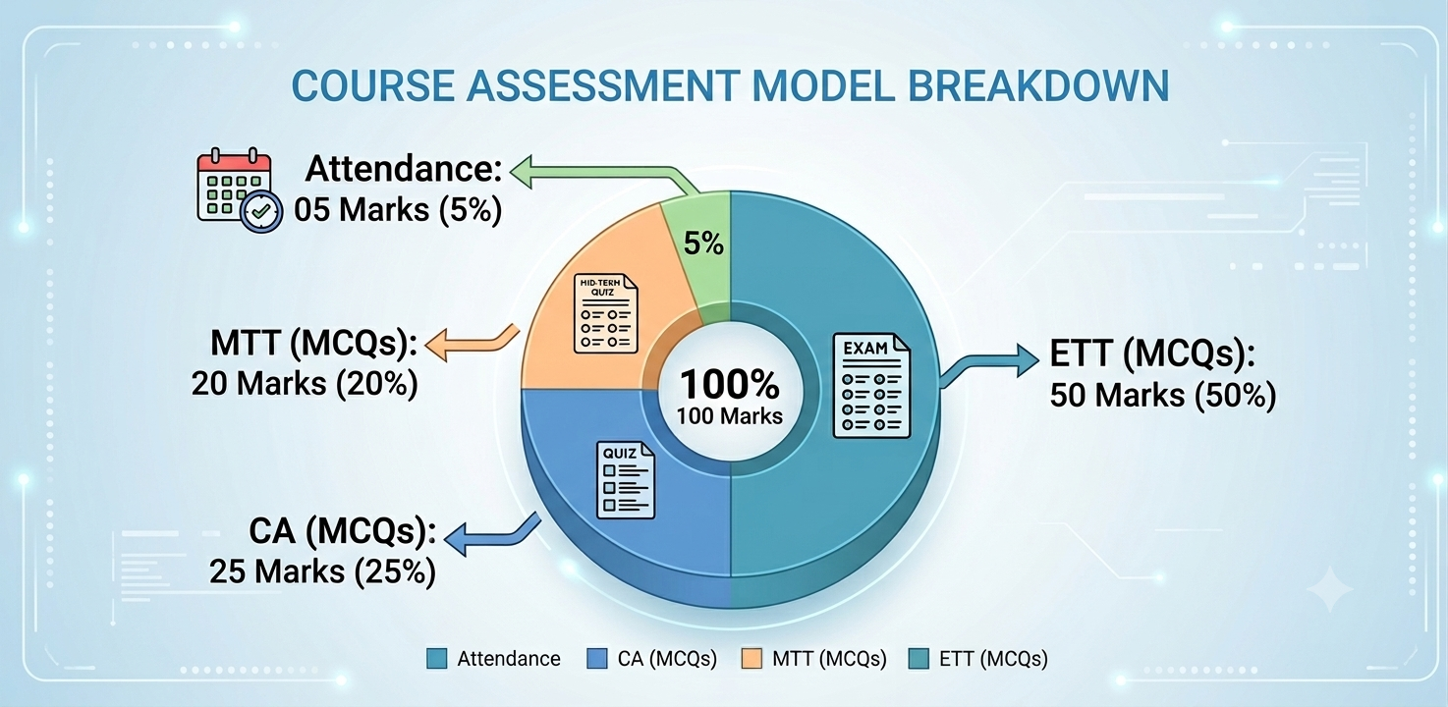
COURSE WEIGHTAGE & TEXTBOOKS
L-T-P: 2-0-2
[Two Lectures and two practical per week]
Credits: 03
[No Lab hours per week]
  Course Assessment Model:
  Attendance : 05 M
  CA (MCQs) : 25 M
  MTT (MCQs) : 20 M
  ETT (MCQs) : 50 M
  Total : 100 M
  Reference Text Books (T):
Google Compute Engine Documentation – https://cloud.google.com/compute/docs
Google Cloud Skills Boost Learning Path – https://www.cloudskillsboost.google
Google Cloud Training – Infrastructure & Networking – https://cloud.google.com/learn
3
www.lpu.in Lovely Professional University

Slide 4
COURSE OUTCOMES
Course Outcome | Description
CO 1 | recognize a deeper understanding of Google Compute Engine, including virtual machines, and how to configure and manage instances.
CO 2 | learn how to design and implement secure network architectures, manage firewalls, and set up private connectivity options.
CO 3 | discuss various storage options on Google Cloud, such as persistent disks, cloud storage, and how to integrate them into your architecture.
CO 4 | discover best practices for monitoring infrastructure performance, managing resources efficiently, and implementing logging and alerting systems using Google Cloud tools.
CO 5 | understand the principles of auto-scaling and load balancing to ensure high availability and reliability of applications.
CO 6 | demonstrate the use of tools like Terraform and Deployment Manager to automate infrastructure deployment and management.
4
www.lpu.in Lovely Professional University

Slide 5
CONTENTS
Unit I Introduction to Google Cloud : Google Cloud Infrastructure: Introduction to Google Cloud, Interact with Google Cloud: Google Cloud Console, Cloud Shell, Cloud SDK (gcloud CLI), gcloud Command Structure, Cloud APIs and REST Interface.
Unit II Virtual Machines : Compute Engine, Virtual Machine, Hypervisor and Virtualization: concept of hypervisor, role in abstracting hardware, Types of Hypervisors: Type 1 (bare-metal) vs Type 2 (hosted) hypervisors, examples (KVM, VMware ESXi, Hyper-V), VM Lifecycle Management: creating, starting, stopping, suspending, and deleting VM instances.
Virtual Networks : Virtual Private Cloud (VPC), Google's managed networking functionality, projects, networks, subnetworks, IP
addresses, routes, and firewall rules, along with network pricing.
Identity and Access Management (IAM) : IAM, components within IAM, which are organizations, roles, members, and service
accounts.
Unit III Data Storage Services : Storage and database services, Types of Storage: object storage (Cloud Storage), block storage (Persistent Disks), file storage (Filestore), and in-memory storage, Cloud Storage Classes: Standard, Nearline, Coldline, and Archive, use cases, and cost implications.
5
www.lpu.in Lovely Professional University

Slide 6
CONTENTS
Unit IV Resource Management : Resource Manager, Quotas, Labels and Names, Billing, Resource Hierarchy: organization, folders, projects, and resources, Quota Management: understanding per-project and per-region quotas, requesting quota increases, Labels and Tags: using labels for cost allocation, filtering, and resource organization.
Resource Monitoring : Cloud Monitoring, Cloud Logging, Error Reporting, Cloud Trace, and Cloud Profiler services.
Unit V Interconnecting Networks : Cloud VPN, Cloud Interconnect, and Peering, VPC Networks, Cloud VPN: HA VPN vs Classic VPN, IKEv2 tunnels, dynamic routing with Cloud Router, Cloud Interconnect: Dedicated vs Partner Interconnect — use cases, SLAs, and bandwidth options, VPC Peering: connecting VPC networks across projects and organizations, Shared VPC: centralized network management across multiple projects within an organization.
Load Balancing and Auto Scaling : Global and Regional load balancer, Types of Load Balancers: HTTP(S), SSL Proxy, TCP Proxy,
Network (TCP/UDP), and Internal load balancers, Global vs Regional Load Balancing: anycast-based global LB vs regional backend
services.
6
www.lpu.in Lovely Professional University

Slide 7
CONTENTS
  Unit VI Infrastructure Automation : Terraform, Infrastructure as Code (IaC) Concepts: declarative vs imperative approaches, idempotency, and state management, Terraform Basics: providers, resources, variables, outputs, and modules for GCP, Terraform State Management: local vs remote state (GCS backend), state locking, and workspaces.
Managed Services : BigQuery, Dataflow, Dataprep by Trifacta, and Dataproc, BigQuery Architecture: columnar storage, serverless
query execution, slots, and partitioned/clustered tables, BigQuery ML: building and deploying ML models directly within BigQuery
using SQL.
7
www.lpu.in Lovely Professional University

Slide 8

VISION & MISSION – SCHOOL
VISION:
To be a globally recognized school through excellence in teaching, learning, and research for creating Computer Science professionals, leaders, and entrepreneurs of the future contributing to society and industry for sustainable growth.
MISSION:
M1: To build computational skills through hands-on and practice-based learning with measurable outcomes.
M2: To establish a strong connect with industry for in-demand technology driven curriculum.
M3: To build the infrastructure for meaningful research around societal problems.
M4: To nurture future leaders through research-infused education and lifelong learning.
M5:To create smart and ethical professionals and entrepreneurs who are recognized globally.
8
www.lpu.in Lovely Professional University

Slide 9
PROGRAM OUTCOMES
PO1: Engineering Knowledge: Apply the knowledge of mathematics, science, engineering fundamentals, and an engineering specialization to the solution of complex engineering problems.
PO2: Problem Analysis: Identify, formulate, and analyse complex engineering problems, reaching substantiated conclusions with consideration for the holistic nature of the problem.
PO3: Design/Development of solutions Design creative solutions for complex engineering problems and design systems, components, or processes to meet identified needs — with consideration for public health and safety, and cultural, societal, and environmental factors. Sustainability is now intrinsic to design.
PO4: Conduct investigations of complex problems: Conduct investigations of complex engineering problems using research-based knowledge and research methods, including design of experiments, analysis and interpretation of data, and synthesis of information to provide valid conclusions.
PO5: Engineering tool usage : Create, select, and apply appropriate techniques, resources, and modern engineering and IT tools, including prediction and modelling — recognizing their limitations — to solve complex engineering problems.
9
www.lpu.in Lovely Professional University

Slide 10
PROGRAM OUTCOMES
PO6: The Engineer and the World: Analyse and evaluate societal and environmental aspects while solving complex engineering problems, considering their impact on sustainability with reference to economy, health, safety, legal frameworks, culture, and the environment.
PO7: Ethics: Apply ethical principles and commit to professional ethics, human values, diversity, and inclusion; and adhere to relevant national and international laws. (Diversity and inclusion are now explicit additions.)
PO8: Individual and Collaborative Team Work: Function effectively as an individual, and as a member or leader in diverse and multi-disciplinary teams.
PO9: Communication: Communicate effectively and inclusively within the engineering community and with society at large — comprehending and writing effective reports and design documentation, and making effective presentations — considering cultural, language, and learning differences.
PO10: Project management and finance: Apply knowledge and understanding of engineering management principles and economic decision-making, and apply these to one's own work, as a member and leader in a team, to manage projects in multi-disciplinary environments.
PO11: Life-Long Learning: Recognise the need for, and have the preparation and ability for, independent and life-long learning, adaptability to new and emerging technologies, and critical thinking in the broadest context of technological change.
10
www.lpu.in Lovely Professional University

Slide 11
PROGRAM SPECIFIC OUTCOMES
PSO 1: Cloud Infrastructure and Platform Engineering
Apply principles of cloud computing, virtualization, networking, storage systems, distributed computing, and DevOps practices to design, deploy, secure, monitor, and optimize scalable cloud infrastructure and services across modern cloud platforms.
PSO 2: Cloud-Native Application Development and Data-Driven Solutions
Develop and manage cloud-native applications by integrating software engineering principles, databases, web technologies, data analytics, machine learning, automation, and site reliability practices to deliver efficient, secure, and business-oriented solutions.
11
www.lpu.in Lovely Professional University

Slide 12
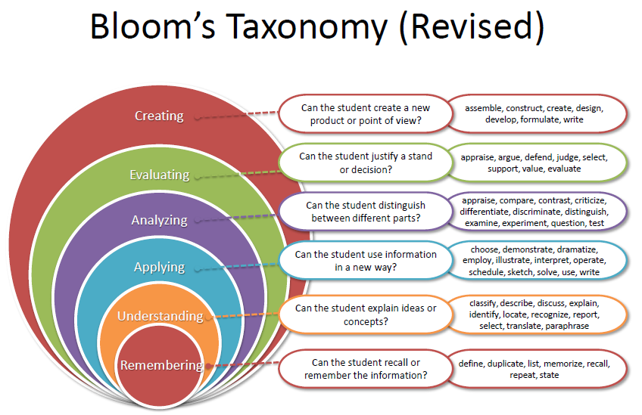
BLOOM’s TAXONOMY
12
www.lpu.in Lovely Professional University

Slide 13

Assessment Model
Compulsory
MCQ test,
30 marks
Online
MCQ test,
30 marks
Online
CA 1
CA 2
13
www.lpu.in Lovely Professional University

Slide 14
Open Education Resources
Unit mapped | Broad topic/Sub Topic | OER Type | Title of OER | *%age unit mapped with OER (approx) | Source URL
Unit 1 |  |  |  | 100% | https://cloud.google.com/docs/overview
 | Introduction to Google Cloud: Google Cloud Infrastructure, Google Cloud Console, Cloud Shell, Cloud SDK (gcloud CLI), gcloud Command Structure, Cloud APIs and REST Interface | Google Cloud Documentation | ARCHITECTING WITH GOOGLE COMPUTE ENGINE
Unit 2 | Virtual Machines & Hypervisors, VM Lifecycle Management; Virtual Networks (VPC, subnetworks, IP addresses, routes & firewall rules); Identity and Access Management (IAM) - organizations, roles, members, service accounts | Google Cloud Documentation | ARCHITECTING WITH GOOGLE COMPUTE ENGINE | 100% | https://cloud.google.com/compute/docs

Slide 15
Open Education Resources
Unit 3 | Data Storage Services: object storage (Cloud Storage), block storage (Persistent Disks), file storage (Filestore), in-memory storage; Cloud Storage Classes (Standard, Nearline, Coldline, Archive), use cases & cost implications | Google Cloud Documentation | ARCHITECTING WITH GOOGLE COMPUTE ENGINE | 100% | https://cloud.google.com/storage/docs
Unit 4 | Resource Management (Resource Manager, quotas, labels & names, billing, resource hierarchy); Resource Monitoring (Cloud Monitoring, Cloud Logging, Error Reporting, Cloud Trace, Cloud Profiler) | Google Cloud Documentation | ARCHITECTING WITH GOOGLE COMPUTE ENGINE | 100% | https://cloud.google.com/monitoring/docs

Slide 16
Open Education Resources
Unit 5 | Interconnecting Networks (Cloud VPN - HA vs Classic, Cloud Interconnect, VPC Peering, Shared VPC); Load Balancing & Auto Scaling (HTTP(S), SSL/TCP Proxy, Network & Internal LB, Global vs Regional) | Google Cloud Documentation | ARCHITECTING WITH GOOGLE COMPUTE ENGINE | 100% | https://cloud.google.com/load-balancing/docs
Unit 6 | Infrastructure Automation: Terraform, Infrastructure as Code (IaC), providers, resources, variables, outputs, modules, and Terraform state management | Google Cloud Documentation | ARCHITECTING WITH GOOGLE COMPUTE ENGINE | 100% | https://cloud.google.com/docs/terraform
Unit 6 | Managed Services: BigQuery, Dataflow, Dataprep by Trifacta, Dataproc, and BigQuery ML (building & deploying ML models directly with SQL) | Google Cloud Skills Boost | ARCHITECTING WITH GOOGLE COMPUTE ENGINE | 100% | https://www.cloudskillsboost.google/catalog?keywords=compute+engine

Slide 17
Additional Tools / Activities
Since this is an industry-collaborative course aligned with official Google Cloud Documentation, all study material and hands-on lab resources are readily available to every student.
Practical learning and Case-based learning is delivered through Google Cloud Skills Boost and hands-on labs covering Compute Engine, virtual networks, storage, resource monitoring, load balancing, and Terraform automation.
The course aligns with Google Cloud Skill Badges, which students can earn while completing their lab sessions.
www.lpu.in Lovely Professional University

Slide 18
Industry Certifications &Skill Development
Preparation for Google Cloud Digital Leader Certification by building a strong foundation in Google Cloud services, cloud concepts, and infrastructure management.
Readiness for Google Associate Cloud Engineer Certification through practical experience in deploying, managing, and monitoring Google Cloud resources.
Infrastructure as Code (IaC) Skills using Terraform, enabling students to automate cloud infrastructure provisioning and configuration.
Career Readiness for Cloud Computing Roles such as Cloud Engineer, Cloud Administrator, DevOps Engineer, Site Reliability Engineer (SRE), Infrastructure Engineer, and Cloud Support Associate by integrating theoretical concepts with practical laboratory exercises.
www.lpu.in Lovely Professional University

Slide 19

EDU Revolution
Learning Beyond the Classroom
Division of Academic Affairs

Slide 20
Why EDU-Revolution!!!
  Supports the 'Earn Your Fee' vision through real-world achievements
  Career Readiness
  Enhance Real World Skills
  Promote Innovation and Creativity
  Promote Lifelong Learning

Slide 21
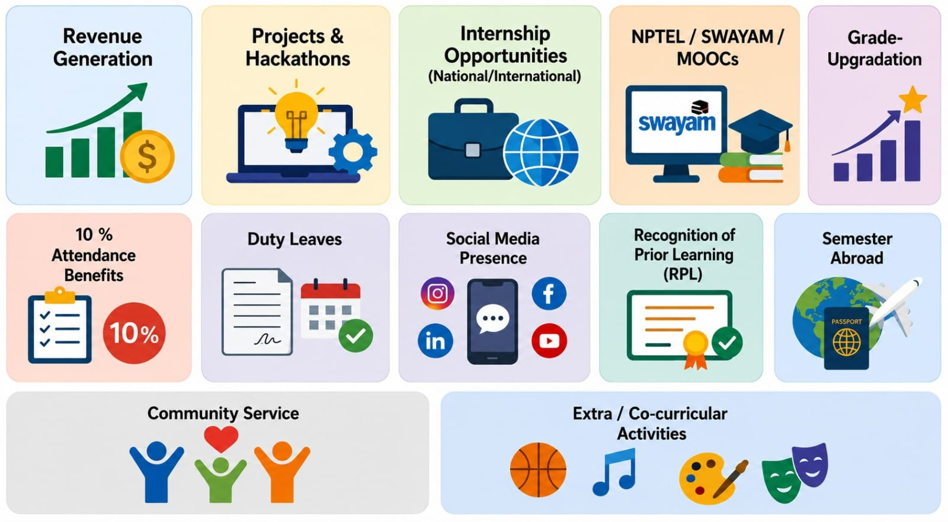
Academic initiatives under EDU Revolution

Slide 22
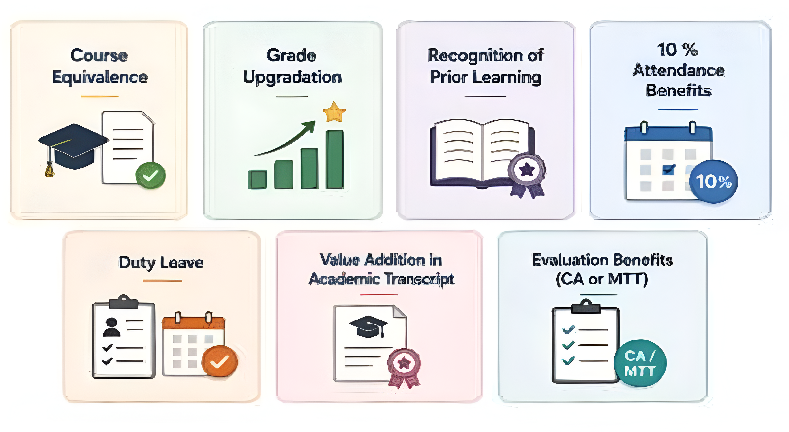
Academic Benefits

Slide 23
Review & Approval Process
Criteria Sheet- it is a structured framework for evaluating EDU Revolution submissions to ensure transparency, consistency, and standardization in assessment. It defines:
Eligibility criteria
Required evidence
Evaluation parameters
Academic benefits

Slide 24
Standing Committee
Standing Committee- it reviews EDU Revolution nominations and recommends eligible academic benefits.
Composition-
5–7 members constituted by the HoS.
Additional members may be nominated by the HoS.
All relevant committee coordinators are members.

Slide 25
Processing of Student Nominations
Students apply through UMS/LMS
Standing Committee verifies eligibility and supporting documents
Head of School approves course mapping and academic benefits
Transparent, standardized and timely decision-making

Slide 26
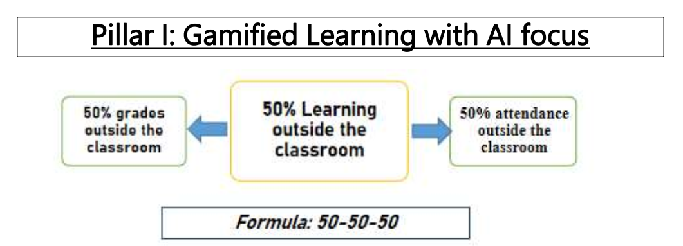

Slide 27
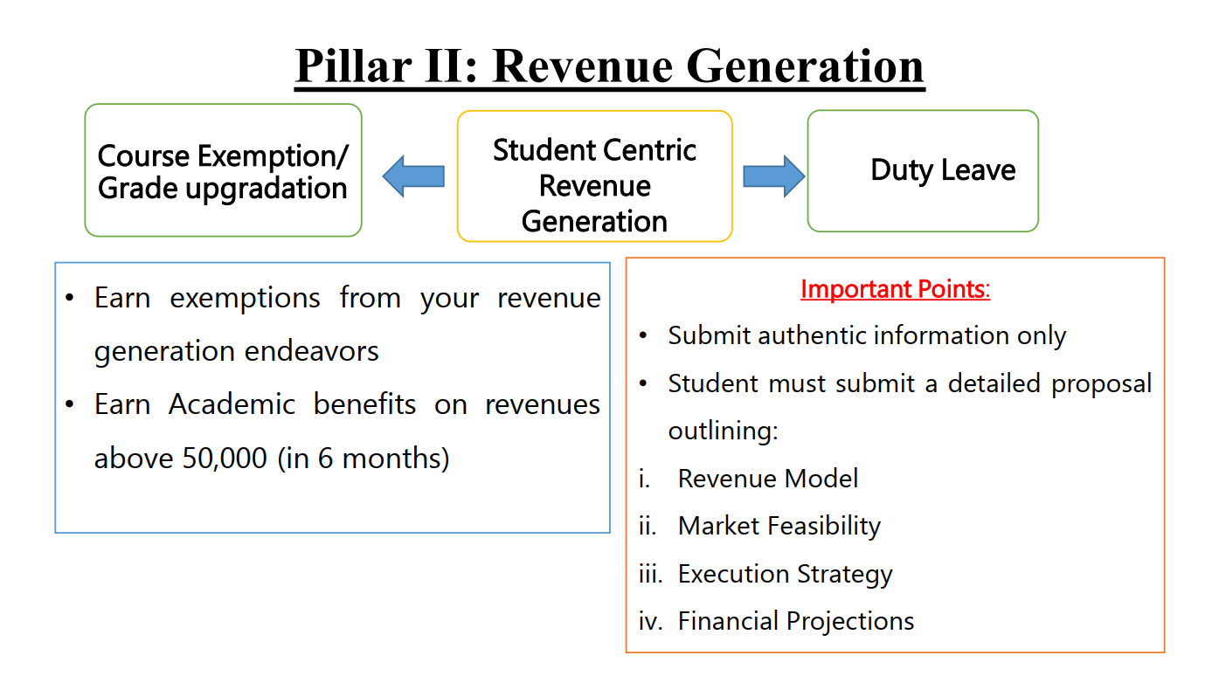

Slide 28
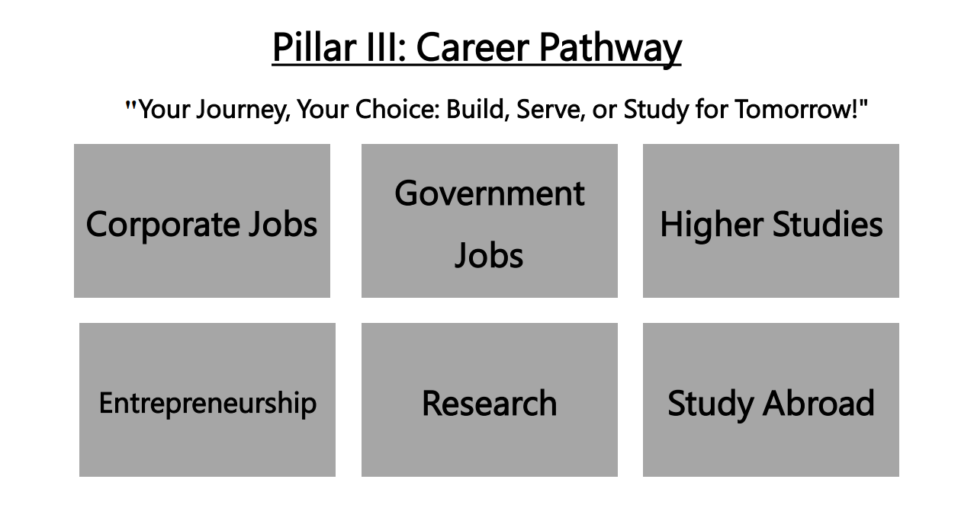

Slide 29
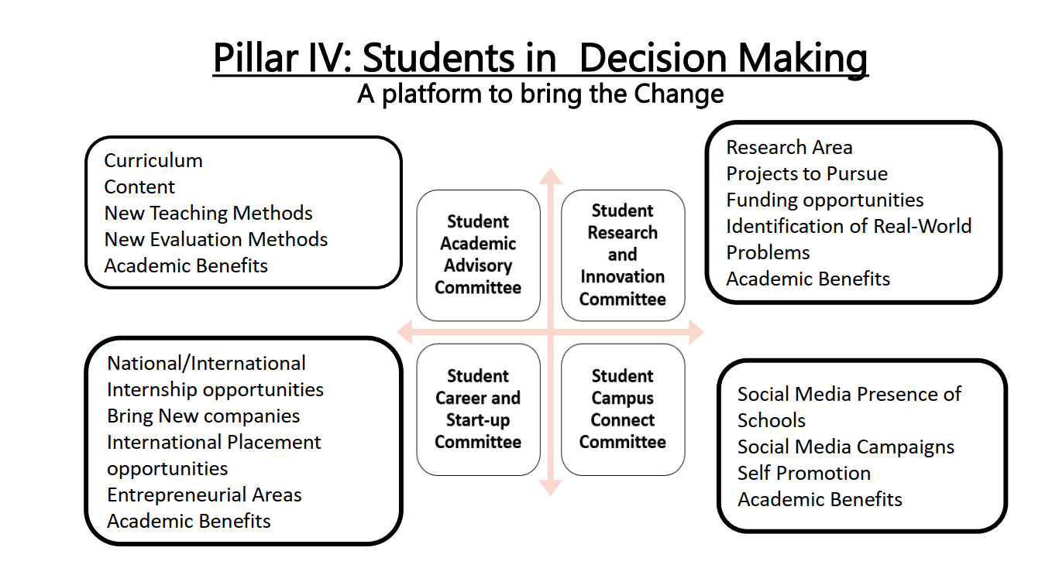

Slide 30
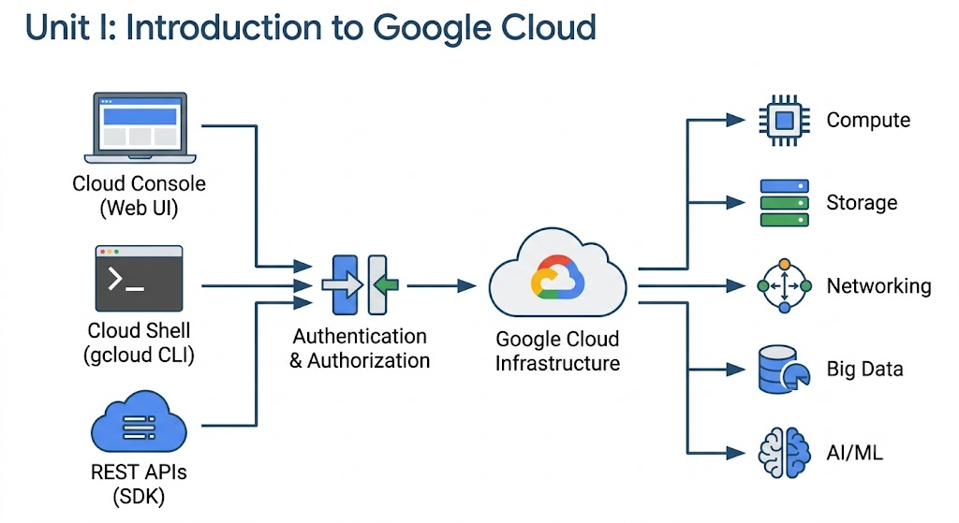

Slide 31
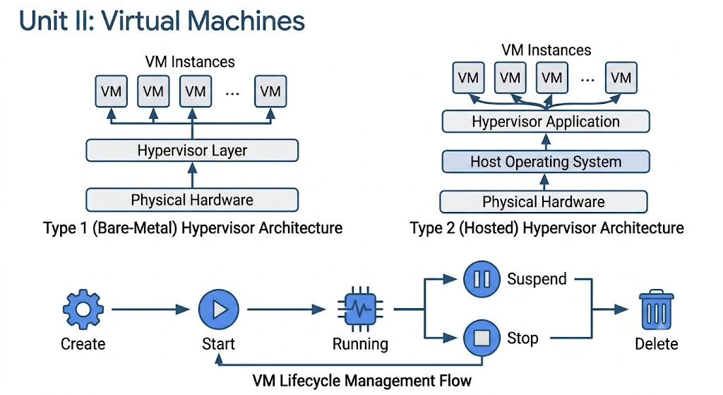

Slide 32
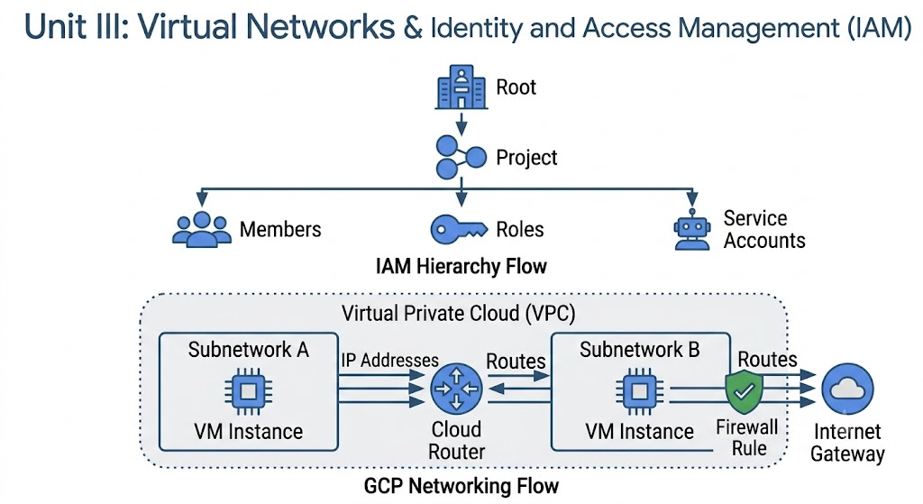

Slide 33
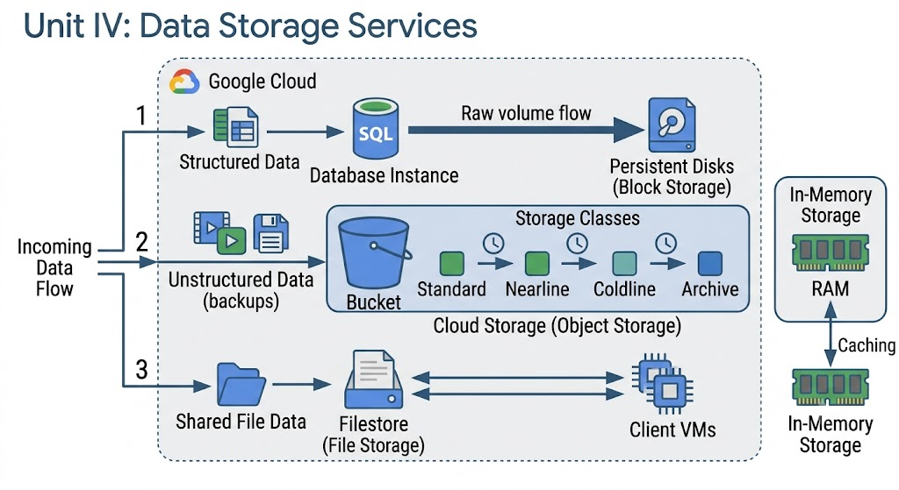

Slide 34
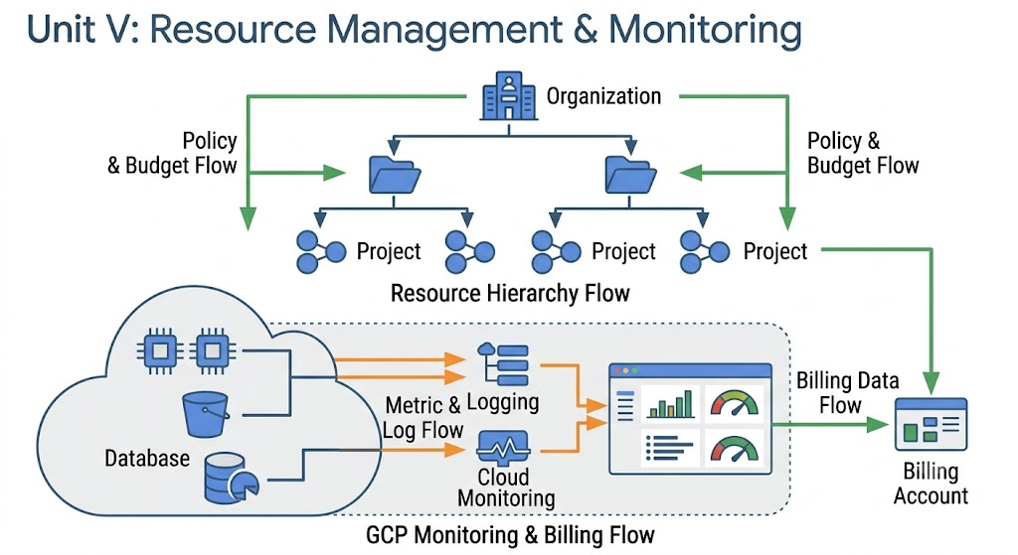

Slide 35
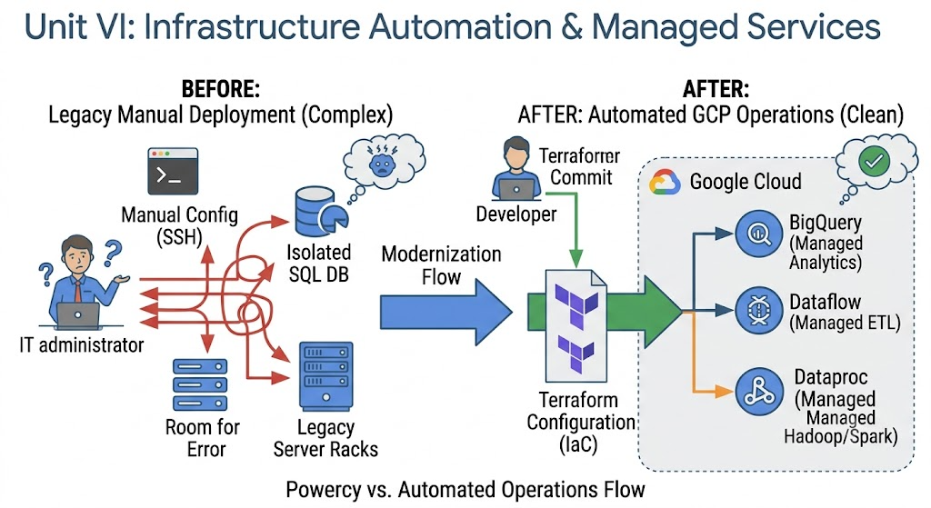

Slide 36
THANKS
Any Queries!

