Slide 1
CSG303
Lecture Zero
MULTI CLOUD FOCUS COURSE

Slide 2
L T P
Lecture - 2
Tutorial - 0
Practical - 2
Credits - 3

Slide 3
Course outcomes
CO1 :: recognize scalable, resilient, and secure Google Kubernetes Engine (GKE) cluster architectures tailored for various application workloads and organizational requirements.
CO2 :: associate complex, containerized applications onto GKE clusters, utilizing advanced deployment strategies, service mesh technologies, and workload orchestration techniques.
CO3 ::indicate robust network policies, authentication (IAM), authorization, and security best practices within GKE environments to protect cluster resources and deployed applications.
CO4 ::apply the core concepts of logging, monitoring, and tracing, and their strategic importance for achieving comprehensive application observability on Google Cloud.

Slide 4
Course outcomes
CO5 ::articulate comprehensive monitoring dashboards, alerting policies, and custom metrics using Cloud Monitoring to effectively track the health and performance of Google Cloud resources and applications.
CO6 ::evaluate logs and traces across distributed systems using Cloud Logging, Log Analytics, and Cloud Trace to diagnose issues, understand system behavior, and proactively improve application reliability and performance.

Slide 5
Unit Wise Breakdown
Unit 1:
Kubernetes Operations : Introduction to Containers, Introduction to Kubernetes and GKE, Kubernetes Architecture, Inspect the cluster and Pods, View a Pod’s console output, Sign in to a Pod interactively, Introspection
Deployments, Jobs, and Scaling : Deployments, Jobs and CronJobs, Cluster Scaling, Controlling Pod Placement, Getting Software into Your Cluster
Unit 2:
Google Kubernetes Engine (GKE) Networking : Pod Networking, Services, Service Types and Load Balancers, Ingress Resource, Container-Native Load Balancing, Network Security
Persistent Data and Storage : Volumes, StatefulSets, ConfigMaps, Secrets

Slide 6
Unit Wise Breakdown
Unit 3:
Access Control and Security in Kubernetes and Google: Kubernetes Engine (GKE), Authentication and Authorization, Cloud IAM, Kubernetes RBAC, Kubernetes Control Plane Security, Pod Security
Unit 4:
Google Kubernetes Engine (GKE) Logging and Monitoring: Stack driver, Logging, Monitoring, Probes, Monitoring and Logging
Using GCP Managed Storage Services : Kubernetes Engine (GKE), Using GCP Services, Using Cloud Storage, Using GCP Databases

Slide 7
Unit Wise Breakdown
Unit 5:
Introduction to Google Cloud Monitoring Tools : Overview of Google Cloud Monitoring Tools, Operations-Based Tools, Application Performance Management Tools
Unit 6:
Avoiding Customer Pain : Critical Measures, Four Golden Signals, SLIs, SLOs, SLAs, Specifying SLIs, Developing SLOs and SLIs
Alerting Policies : Developing an Alerting Strategy, Creating Alerts, Creating Alerting Policies with the CLI, Service Monitoring

Slide 8
Program Outcomes
PO1: Engineering knowledge -Apply the knowledge of mathematics, science, engineering fundamentals, and an engineering specialization to the solution of complex engineering problems.
PO2: Problem analysis -Identify, formulate, research literature, and analyze complex engineering problems reaching substantiated conclusions using first principles of mathematics, natural sciences, and engineering sciences.
PO3: Design/development of solutions-Design solutions for complex engineering problems and design system components or processes that meet the specified needs with appropriate consideration for the public health and safety, and the cultural, societal, and environmental considerations.
PO4: The Engineer and Society -Apply reasoning informed by the contextual knowledge to assess societal, health, safety, legal and cultural issues and the consequent responsibilities relevant to the professional engineering practice.
PO5: Environment and sustainability -Understand the impact of the professional engineering solutions in societal and environmental contexts, and demonstrate the knowledge of, and need for sustainable development.

Slide 9
Program Outcomes Contd..
PO6: Communication -Communicate effectively on complex engineering activities with the engineering community and with society at large, such as, being able to comprehend and write effective reports and design documentation, make effective presentations, and give and receive clear instructions.
PO7: Project Management and Finance -Demonstrate knowledge and understanding of the engineering, management principles and apply the same to one’s own work, as a member or a leader in a team, manage projects efficiently in respective disciplines and multidisciplinary environments after consideration of economic and financial factors.
PO8: Life-long Learning -Recognize the need for, and have the preparation and ability to engage in independent and life-long learning in the broadest context of technological change.
PO9: Competitive Skills -Ability to compete in national and international technical events and building the competitive spirit.
PO10: Communication -Communicate effectively on complex engineering activities with the engineering community and with society at large, such as, being able to comprehend and write effective reports and design documentation, make effective presentations, and give and receive clear instructions.

Slide 10
Program Outcomes Contd..
PO11: Project management and finance -Demonstrate knowledge and understanding of the engineering, management principles and apply the same to one’s own work, as a member or a leader in a team, manage projects efficiently in respective disciplines and multidisciplinary environments after consideration of economic and financial factors.

Slide 11
Program Specific Outcomes
PSO 1: Cloud Infrastructure and Platform Engineering
Apply principles of cloud computing, virtualization, networking, storage systems, distributed computing, and DevOps practices to design, deploy, secure, monitor, and optimize scalable cloud infrastructure and services across modern cloud platforms.
PSO 2: Cloud-Native Application Development and Data-Driven Solutions
Develop and manage cloud-native applications by integrating software engineering principles, databases, web technologies, data analytics, machine learning, automation, and site reliability practices to deliver efficient, secure, and business-oriented solutions.

Slide 12

Assessment Model
Compulsory
MCQ test,
30 marks
Online
MCQ test,
30 marks
Online
CA 1
CA 2

Slide 13

Weightage division
Attendance - 5 marks
CA - 25 marks
MTE - 20 marks (MCQs)
ETE - 50 marks (MCQs)

Slide 14
Open Education Resources
Unit mapped | Broad topic/Sub Topic | OER Type | Title of OER | *%age unit mapped with OER (approx) | Source URL
Unit 1 | Kubernetes Operations | OER (Documentation) | Google Kubernetes Engine (GKE) Documentation – Concepts and Workloads | 100% | https://cloud.google.com/kubernetes-engine/docs
Unit 2 | Google Kubernetes Engine Networking and Persistent Storage | OER (Documentation) | GKE Networking and Storage Documentation | 100% | https://cloud.google.com/kubernetes-engine/docs/concepts
Unit 3 | Access Control and Security in Kubernetes and GKE | OER (Documentation) | Secure Google Kubernetes Engine | 100% | https://cloud.google.com/kubernetes-engine/docs/how-to/hardening-your-cluster

Slide 15
Open Education Resources
Unit 4 | Logging, Monitoring and Managed Storage Services | OER (Documentation) | Google Cloud Operations Suite Documentation | 95% | https://cloud.google.com/monitoring/docs
Unit 5 | Google Cloud Monitoring Tools | OER (Documentation) | Google Cloud Monitoring Documentation | 100% | https://cloud.google.com/monitoring/docs
Unit 6 | Service Reliability and Alerting | OER (Documentation) | Site Reliability Engineering (SRE) and Cloud Monitoring Documentation | 100% | https://cloud.google.com/stackdriver/docs

Slide 16
Additional Tools / Activities
Since this is an industry collaborative course, it aligns with Google Cloud Documentation and Hence all study material will be readily available to each student through industry experts
Edu-revolution benefits cannot be extended to this subject due to its industry collaboration and mapping of syllabus with Certification
The course aligns with Google Badges which students can collect while working on lab sessions.

Slide 17
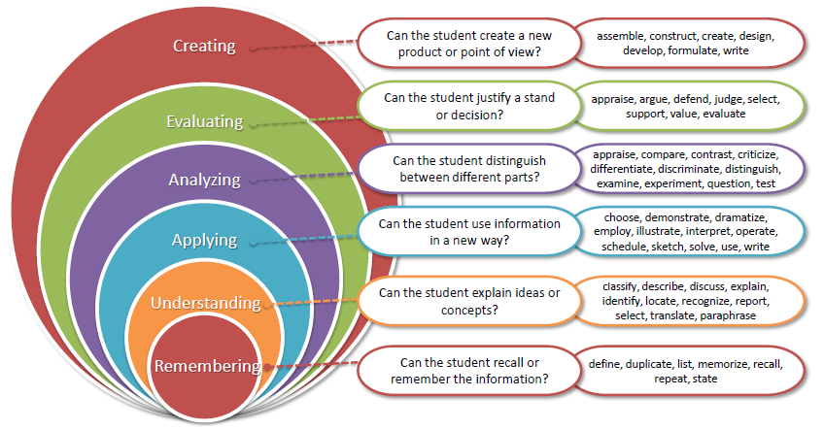
Bloom’s taxonomy

Slide 18

EDU Revolution
Learning Beyond the Classroom
Division of Academic Affairs

Slide 19
Why EDU-Revolution!!!
  Supports the 'Earn Your Fee' vision through real-world achievements
  Career Readiness
  Enhance Real World Skills
  Promote Innovation and Creativity
  Promote Lifelong Learning

Slide 20
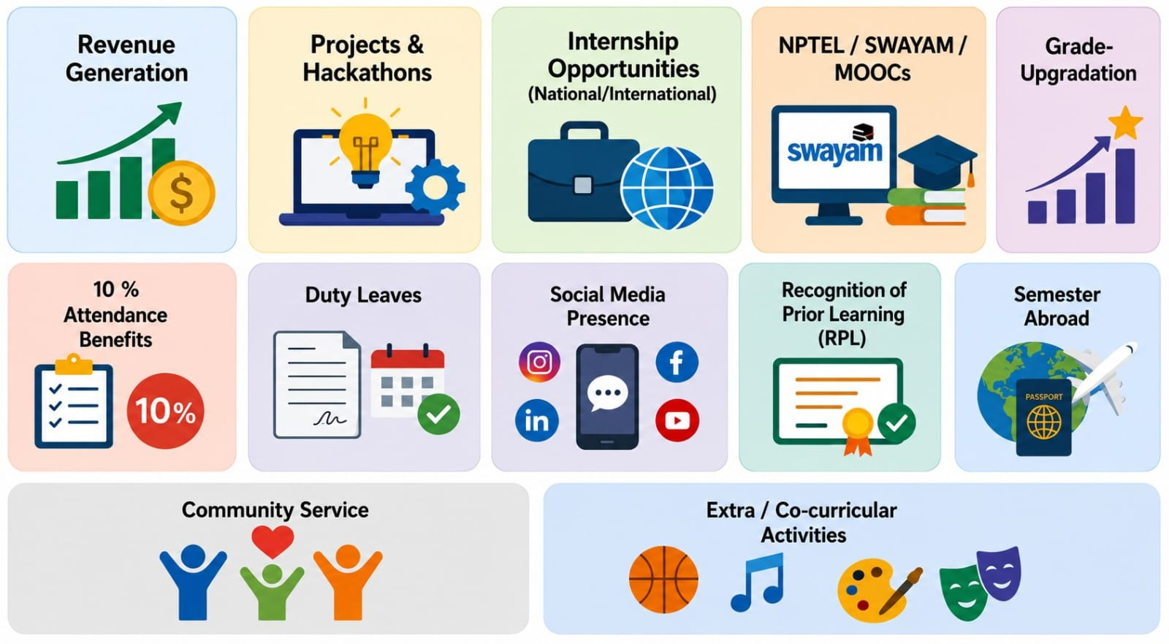
Academic initiatives under EDU Revolution

Slide 21
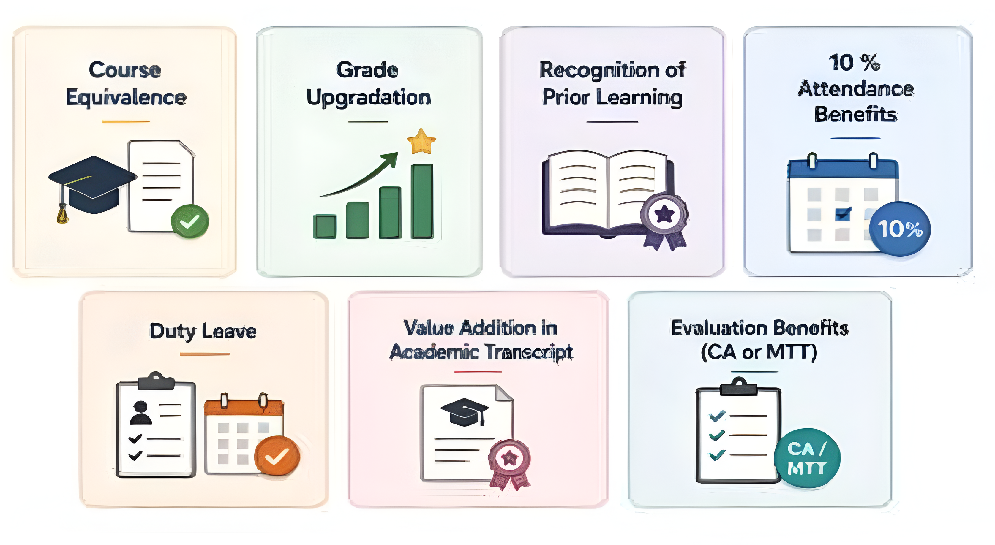
Academic Benefits

Slide 22
Review & Approval Process
Criteria Sheet- it is a structured framework for evaluating EDU Revolution submissions to ensure transparency, consistency, and standardization in assessment. It defines:
Eligibility criteria
Required evidence
Evaluation parameters
Academic benefits

Slide 23
Standing Committee
Standing Committee- it reviews EDU Revolution nominations and recommends eligible academic benefits.
Composition-
5–7 members constituted by the HoS.
Additional members may be nominated by the HoS.
All relevant committee coordinators are members.

Slide 24
Processing of Student Nominations
Students apply through UMS/LMS
Standing Committee verifies eligibility and supporting documents
Head of School approves course mapping and academic benefits
Transparent, standardized and timely decision-making

Slide 25
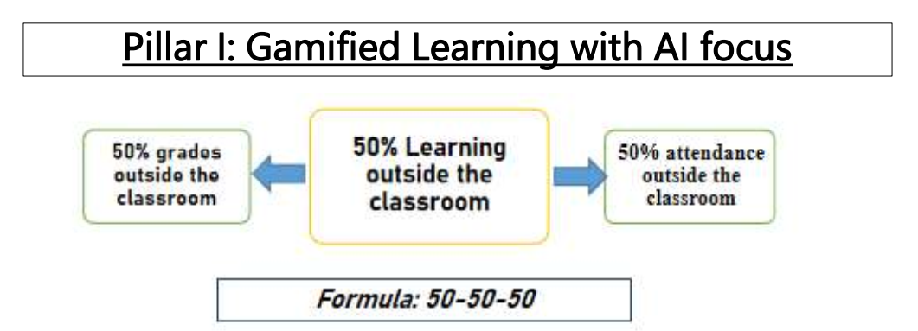

Slide 26
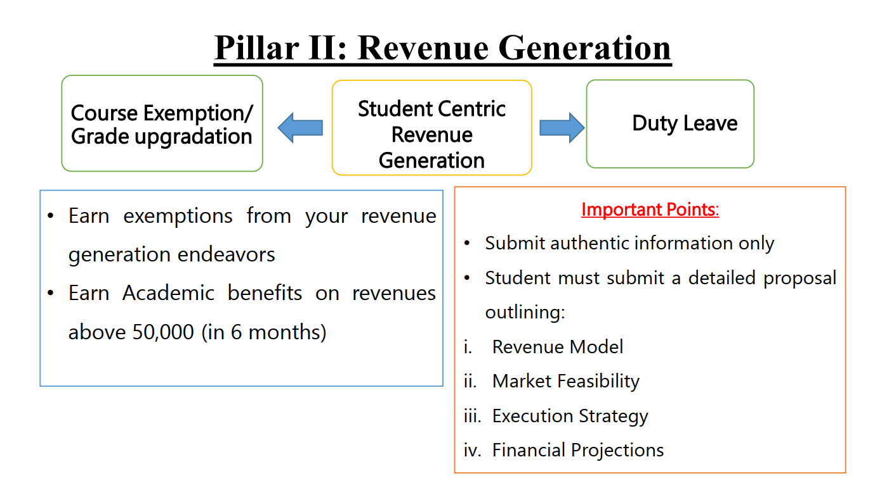

Slide 27
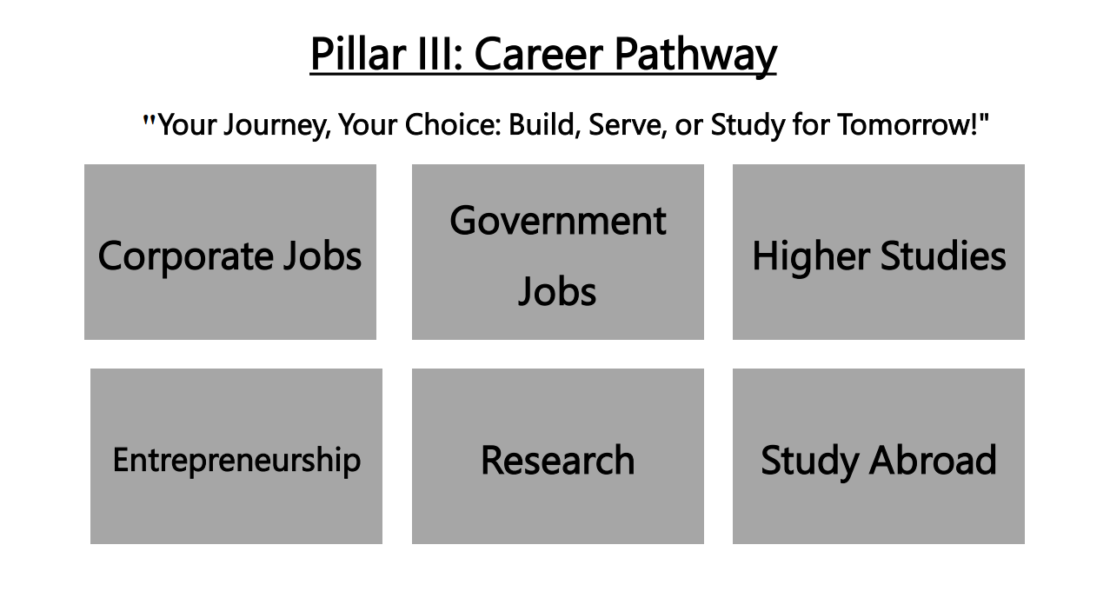

Slide 28
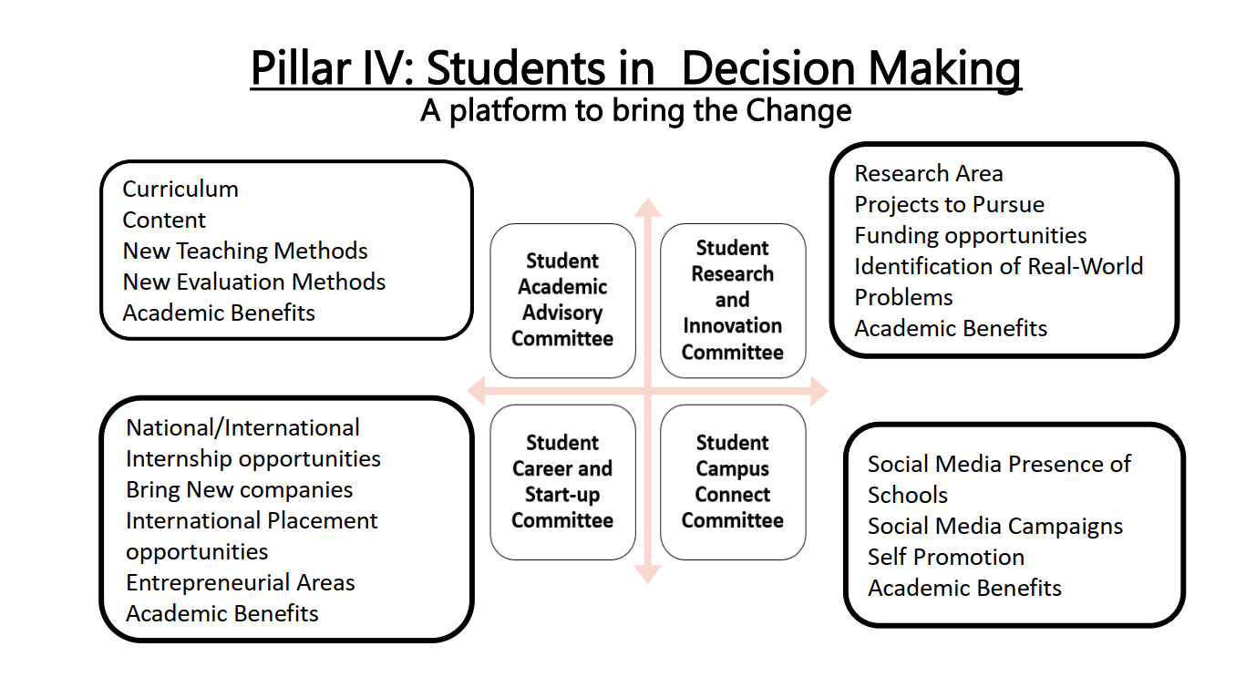

Slide 29
EDU-Revolution
Applying for EDU-Revolution Initiatives
How can students apply:
Login UMS → LMS → EDU-Revolution: Be the Change → Apply for EDU- Revolution
Need Help:
Students can visit the EDU-Revolution Query & Assistance Zone at Block 38-205

Slide 30
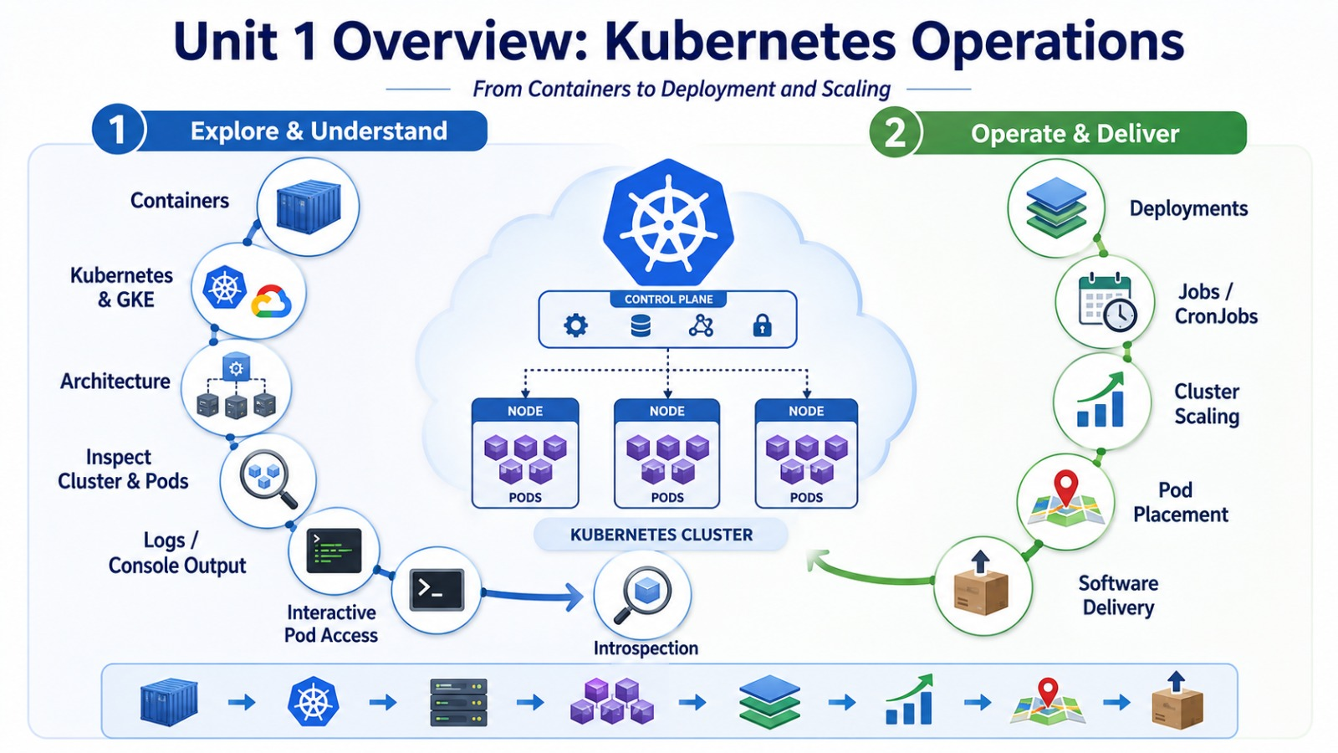

Slide 31
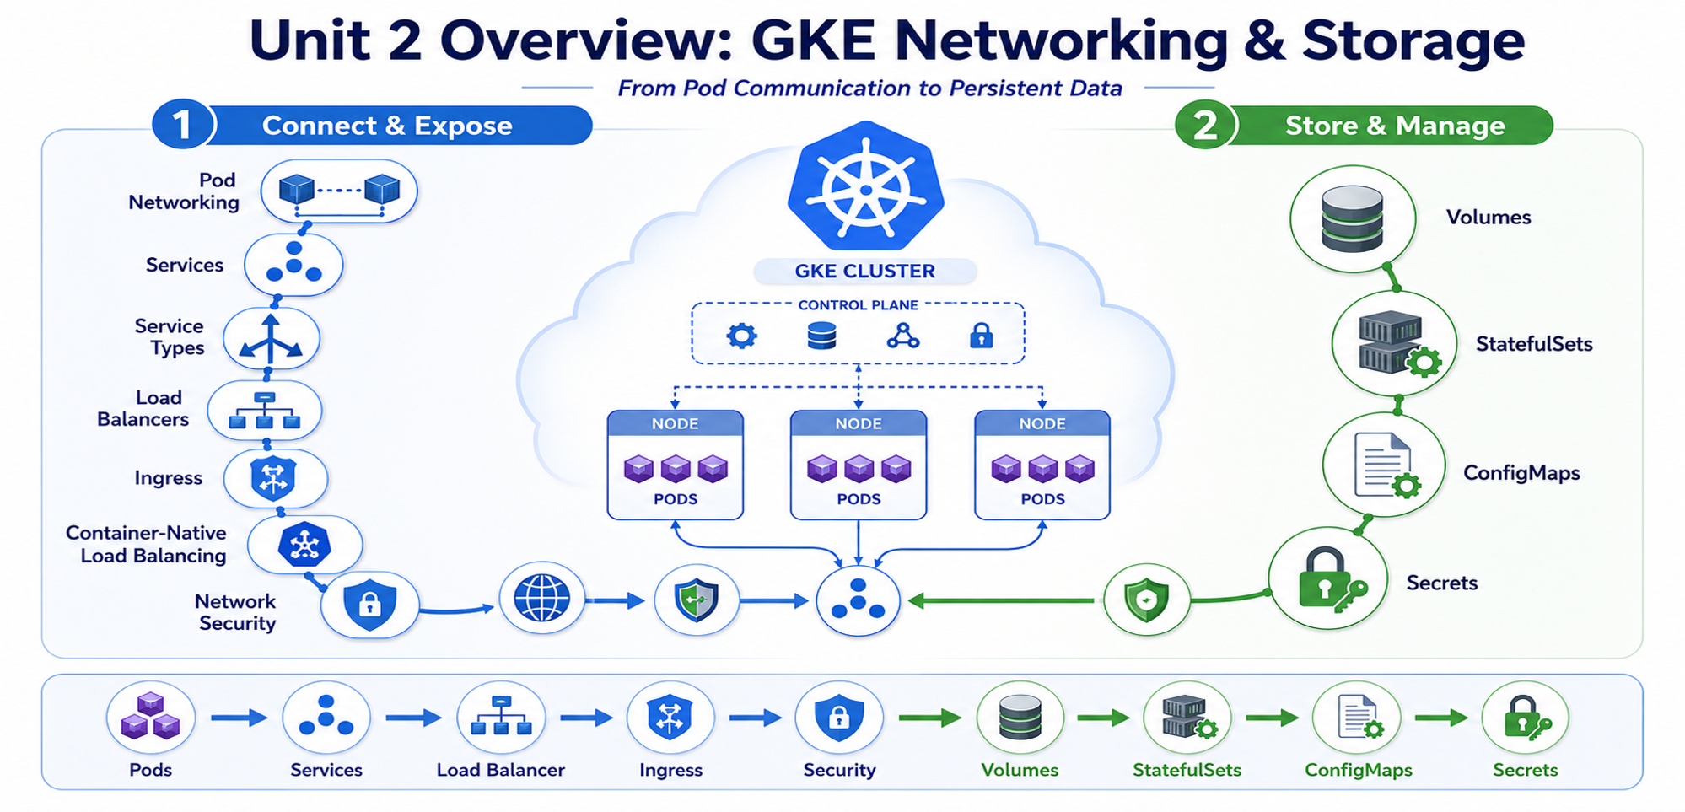

Slide 32
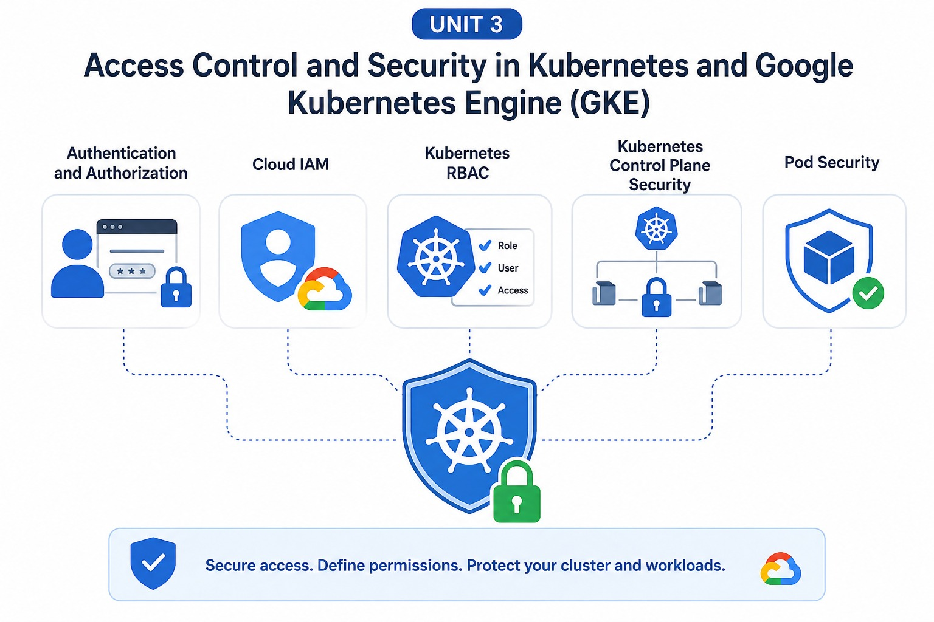

Slide 33
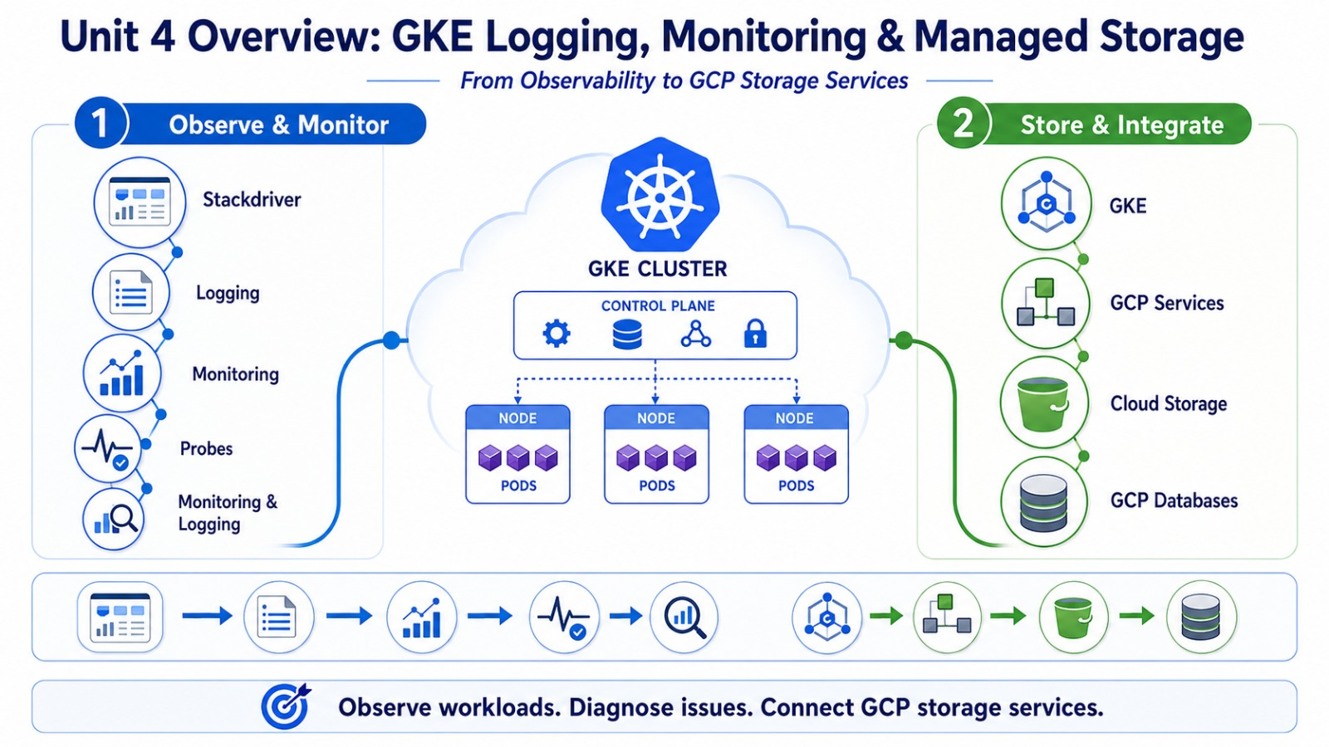

Slide 34
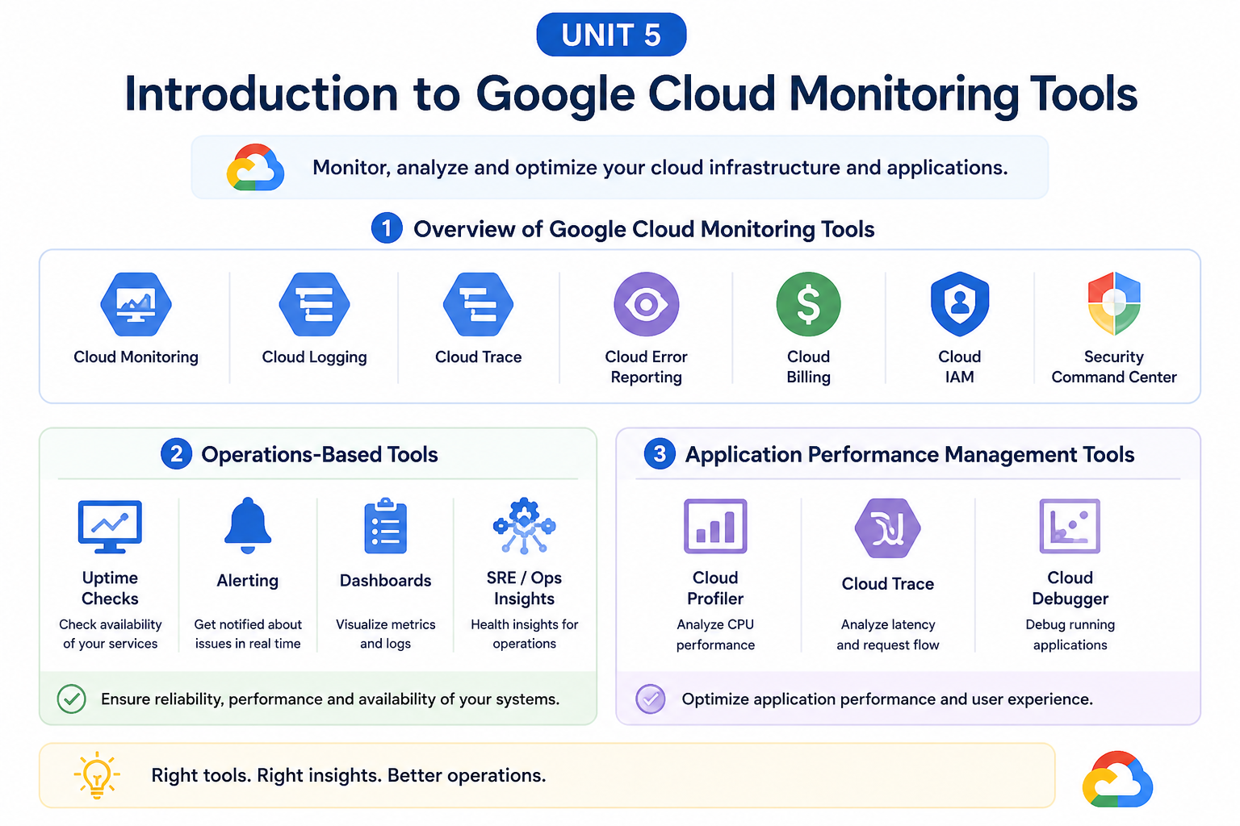

Slide 35
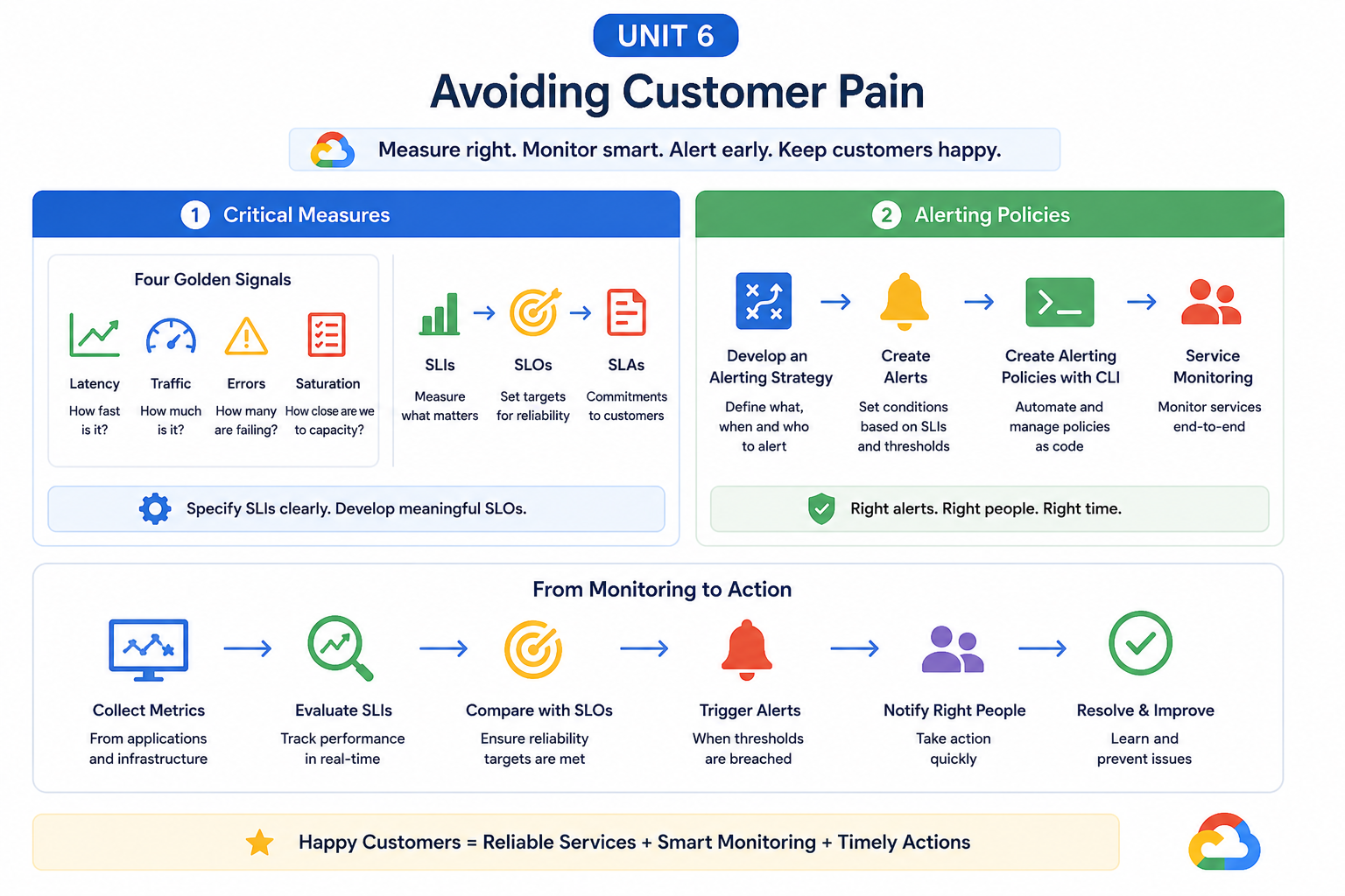

Slide 36
THANKS
Any Queries!

