Slide 1
CSE 401
ACE TRAINING
L T P: 0 0 4

Slide 2
CSG401: ACE TRAINING
L-T-P: 0-0-4
[4 Practical Sessions per week] – Credits: 03
  Course Assessment Model:
  Attendance : 05 M
  CA : 45 M
  ETT : 50 M
  Total : 100 M
  Reference Books (R):
  Google Cloud Documentation by GOOGLE

Slide 3
CSG401: ACE TRAINING
VISION & MISSION – SCHOOL
VISION:
To be a globally recognized school through excellence in teaching, learning, and research for creating Computer Science professionals, leaders, and entrepreneurs of the future contributing to society and industry for sustainable growth.
MISSION:
M1: To build computational skills through hands-on and practice-based learning with measurable outcomes.
M2: To establish a strong connection with industry for an in-demand technology-driven curriculum.
M3: To build the infrastructure for meaningful research around societal problems.
M4: To nurture future leaders through research-infused education and lifelong learning.
M5:To create smart and ethical professionals and entrepreneurs who are recognized globally.

Slide 4
CSG401: ACE TRAINING
COURSE OUTCOMES
Course Outcome | DESCRIPTION
CO 1 | recall the fundamental principles of Infrastructure as Code (IaC) and Terraform's core concepts for automating Google Cloud resource provisioning.
CO 2 | describe Terraform HashiCorp Configuration Language (HCL) to declare and manage various Google Cloud resources, including compute, storage, and networking components.
CO 3 | transform Terraform state effectively, utilize modules for reusability, and troubleshoot common deployment issues within a Google Cloud context.
CO 4 | determine complex scenario-based practice questions to identify critical requirements, constraints, and relevant Google Cloud services across all ACE exam domains.
CO 5 | illustrate multiple-choice options for Google Cloud Associate Cloud Engineer questions, justifying the most optimal and secure solutions based on best practices.
CO 6 | estimate core Google Cloud concepts across all ACE exam domains to accurately solve practical problems presented in discussion-based practice questions.

Slide 5
CSG401: ACE TRAINING
PROGRAM OUTCOMES
PO1: Engineering Knowledge: Apply the knowledge of mathematics, science, engineering fundamentals, and an engineering specialization to the solution of complex engineering problems
PO2: Problem Analysis: Identity, formulate, review research literature, and analyze complex engineering problems reaching substantiated conclusions using the first principles of mathematics, natural sciences, and engineering sciences
PO3: Design/Development of solutions: Design solutions for complex engineering problems and design system components or processes that meet the specified needs with appropriate consideration for the public health and safety, and the cultural, societal, and environmental considerations
PO4: Conduct investigations of complex problems: Use research-based knowledge and research methods including design of experiments, analysis, and interpretation of data, and synthesis of the information to provide valid conclusions
PO5: Engineering tool usage: Create, select, and apply appropriate techniques, resources, and modern engineering and IT tools including prediction and modeling to complex engineering activities with an understanding of the limitations.
PO6: The Engineer and the World Apply reasoning informed by the contextual knowledge to assess societal, health, safety, legal, and cultural issues and the consequent responsibilities relevant to the professional engineering practice.

Slide 6
CSG401: ACE TRAINING
PROGRAM OUTCOMES
PO7: Ethics: Apply reasoning informed by the contextual knowledge to assess societal, health, safety, legal, and cultural issues and the consequent responsibilities relevant to the professional engineering practice.
PO8: Individual and Collaborative Team Work: Function effectively as an individual, and as a member or leader in diverse teams, and in multidisciplinary settings
PO9: Communication: Communicate effectively on complex engineering activities with the engineering community and with society at large, such as, being able to comprehend and write effective reports and design documentation, make effective presentations, and give and receive clear instructions
PO10: Project management and finance: Demonstrate knowledge and understanding of the engineering and management principles and apply these to one’s work, as a member and leader in a team, to manage projects and in multidisciplinary environments.
PO11: Life-long learning: Recognize the need for, and have the preparation and ability to engage in independent and life-long learning in the broadest context of technological change.

Slide 7
CSG401: ACE TRAINING
PROGRAM SPECIFIC OUTCOMES
PSO 1: Cloud Infrastructure and Platform Engineering
Apply principles of cloud computing, virtualization, networking, storage systems, distributed computing, and DevOps practices to design, deploy, secure, monitor, and optimize scalable cloud infrastructure and services across modern cloud platforms.
PSO 2: Cloud-Native Application Development and Data-Driven Solutions
Develop and manage cloud-native applications by integrating software engineering principles, databases, web technologies, data analytics, machine learning, automation, and site reliability practices to deliver efficient, secure, and business-oriented solutions.

Slide 8
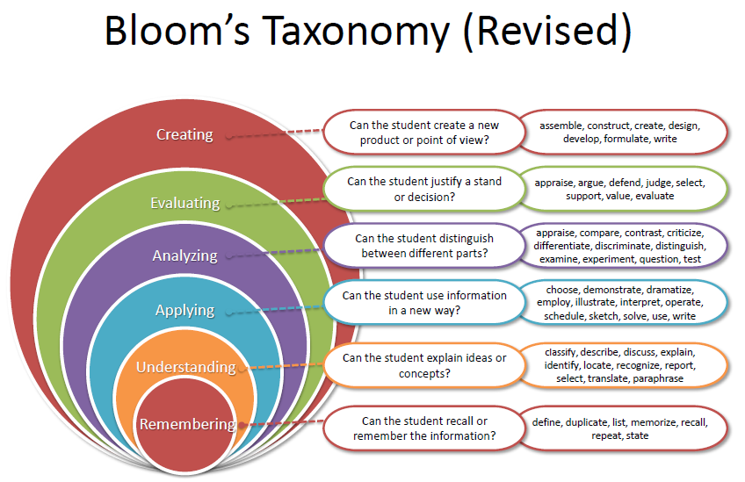
CSG401: ACE TRAINING
BLOOM’s TAXONOMY

Slide 9
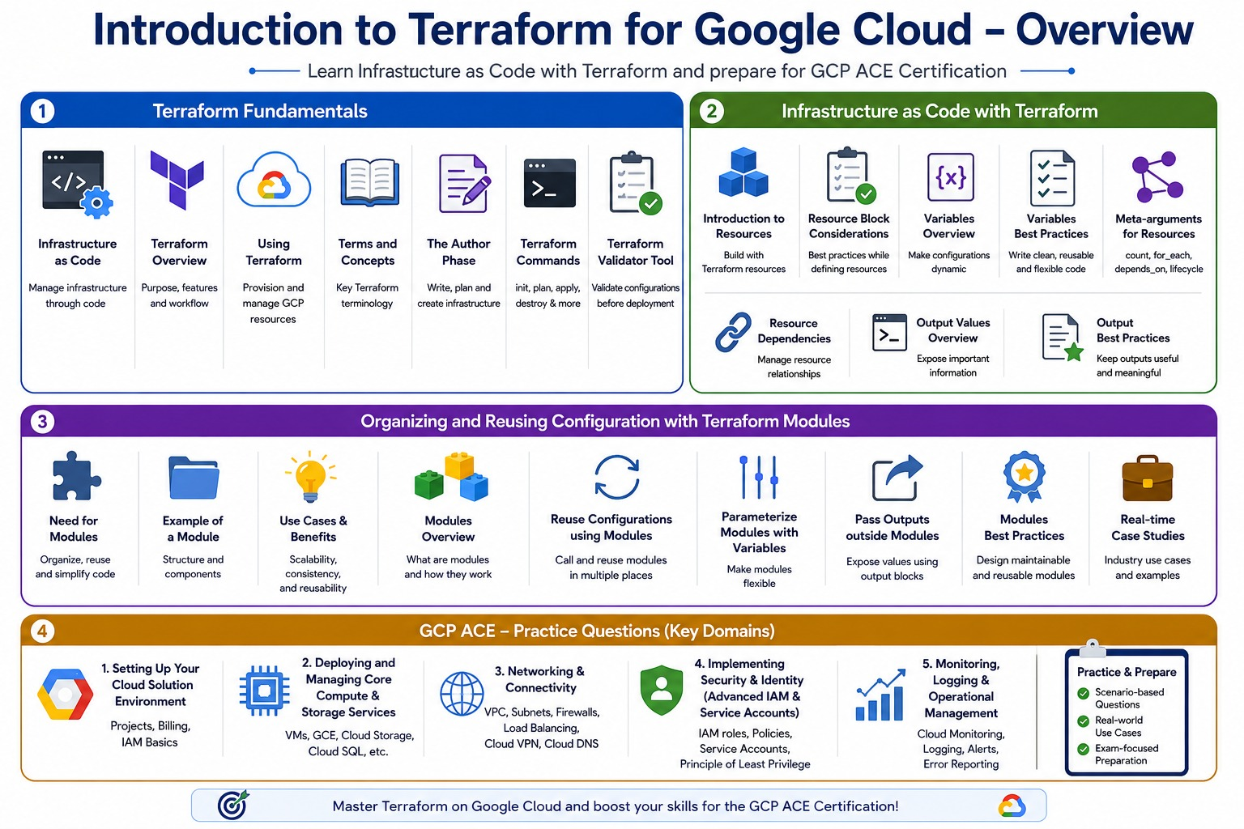
CSG401: ACE TRAINING

Slide 10
CSG401: ACE TRAINING
List of Practical/Experiments
Introduction to Terraform for Google Cloud
Infrastructure as code, Terraform overview, Using Terraform,
Terms and Concepts
The Author Phase, Terraform commands, Terraform Validator Tool
Infrastructure as Code with Terraform
Introduction to resources, Considerations for defining a resource block, Variables overview, Variables best practices, Meta-arguments for resources, Resource dependencies, Output values overview, Output best practices
Organizing and Reusing Configuration with Terraform Modules
Need for modules, Example of a module, use cases and benefits, Modules overview, Reuse configurations by using modules, Use variables to parameterize a module, Pass resource attribute outside the module by using output values, Modules best practices, real-time case studies
GCP ACE - Practice Questions
Setting Up Your Cloud Solution Environment (Projects, Billing, IAM Basics), Deploying and Managing Core Compute & Storage Services, Networking & Connectivity, Implementing Security & Identity (Advanced IAM & Service Accounts), Monitoring, Logging & Operational Management

Slide 11
CSG401: ACE TRAINING
EVALUATION CRITERIA
CA1: Practical Test: The first Continuous Assessment (CA1) will be a practical examination carrying a total of 30 marks. This assessment will cover the first half of Unit-I.
CA2: Practical Test: CA2 will be a practical examination carrying a total of 30 marks. This assessment will cover the second half of Unit-I.
Rubrics for Practical Class Assessment:
Implementation & Execution → 15 Marks: Correctness and completeness of the practical task performed.
Understanding & Viva → 10 Marks: Conceptual understanding demonstrated during viva/questioning.
Documentation & Submission → 05 Marks: Quality and timely submission of the lab record/report.
Academic Task | Allotment/Submission Week | Maximum Marks
AT1 | 3/5 | 30
AT2 | 10/11 | 30

Slide 12
CSG401: ACE TRAINING
TEACHING METHODOLOGY
Practice papers will be solved for certification exams
Case-wise study for each aspect and blueprint syllabus for certification preparation
Students will get to understand the process at hand for appearing in certification exams.
Since this is an industry collaborative course, it aligns with Google Cloud Documentation, and hence, all study material will be readily available to each student through industry experts
Edu-revolution: Grade Upgradation is the only benefit that is provided in this subject due to its industry collaboration and the mapping of syllabus with Certification
The course aligns with Google Badges, which students can collect while working on the lab session

Slide 13
CSG401: ACE TRAINING
LATEST TRENDS IN CLOUD COMPUTING
Cloud Service Providers in Industry:
Amazon Web Services (AWS), Google Cloud Services (GCS/GCP), Microsoft Azure, etc.
Advanced Topics in Cloud Computing
Containers,
Edge Computing
Fog Computing
Energy Efficiency in Cloud
Federated Cloud Computing
Green Cloud Computing
Mobile Cloud Computing
IoT
Big Data Analytics

Slide 14
CSG401: ACE TRAINING
OPEN EDUCATIONAL RESOURCE
Unit mapped | Broad topic | Sub Topic | Source Type | Source Title | *%age mapping (approx.) | Source URL
Unit I | Introduction to Terraform for Google Cloud: | Infrastructure as Code Terraform Overview Using Terraform The Author Phase Terraform Commands Terraform Validator Tool | Reading Material | CSG 401 | 100% | Google Cloud Terraform Docs Terraform Introduction – HashiCorp Get Started with Terraform on GCP Google Cloud Skills Boost – Terraform Path
Unit I | Infrastructure as Code with Terraform: | Introduction to Resources Considerations for Defining a Resource Block Variables Overview & Best Practices Meta-arguments for Resources Resource Dependencies Output Values Overview & Best Practices | Reading Material | CSG 401 | 100% | Terraform Resources – HashiCorp Docs Terraform Input Variables Resource Dependencies – depends_on Terraform Output Values Best Practices for Terraform on GCP
Unit I | Organizing and Reusing Configuration with Terraform Modules: | Need for Modules Example, Use Cases and Benefits Modules Overview Reuse Configurations Using Modules Use Variables to Parameterize a Module Pass Resource Attributes via Output Values Modules Best Practices | Reading Material | CSG 401 | 100% | Terraform Modules – HashiCorp Docs Google Cloud Terraform Modules Registry Reuse Configuration with Modules – Tutorial Use Modules from the Terraform Registry GCP Terraform Module Best Practices

Slide 15
CSG401: ACE TRAINING
OPEN EDUCATIONAL RESOURCE
Unit mapped | Broad topic | Sub Topic | Source Type | Source Title | *%age mapping (approx.) | Source URL
Unit I | GCP ACE Practice Questions: | Setting Up Cloud Solution Environment (Projects, Billing, IAM Basics) Deploying and Managing Core Compute Storage Services | Reading Material | CSG 401 | 100% | Creating VM Instances – GCP Docs Google Cloud Storage Introduction Cloud IAM Overview GCP Fundamentals: Core Infrastructure Cloud Billing Concepts
Unit I | GCP ACE Practice Questions: | Networking & Connectivity Implementing Security & Identity (Advanced IAM & Service Accounts) | Reading Material | CSG 401 | 100% | VPC Network Overview – GCP Docs Cloud Load Balancing Overview Creating Service Accounts – GCP Docs Understanding IAM Roles VPC Firewall Rules Overview
Unit I | GCP ACE Practice Questions: | Monitoring, Logging & Operational Management | Reading Material | CSG 401 | 85% | sCloud Logging Overview – GCP Docs Cloud Trace Overview Error Reporting – GCP Docs Monitor and Log with Google Cloud Operations Suite

Slide 16

CSG401: ACE TRAINING

Slide 17
CSG401: ACE TRAINING
EDUCATION REVOLUTION
Learning by doing,
Application-based concept elaboration,
Learning beyond classrooms,
Activity-based assessments and project driven learning
Less Ppts and more interactive Classroom teaching
Experiential learning and Many More Initiatives
Welcome to the New LPU

Slide 18
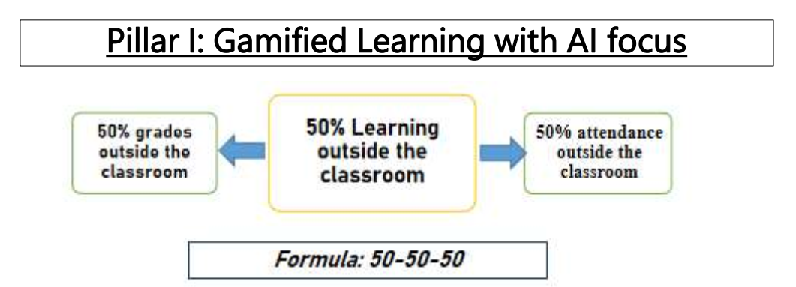
CSG401: ACE TRAINING
EDUCATION REVOLUTION

Slide 19
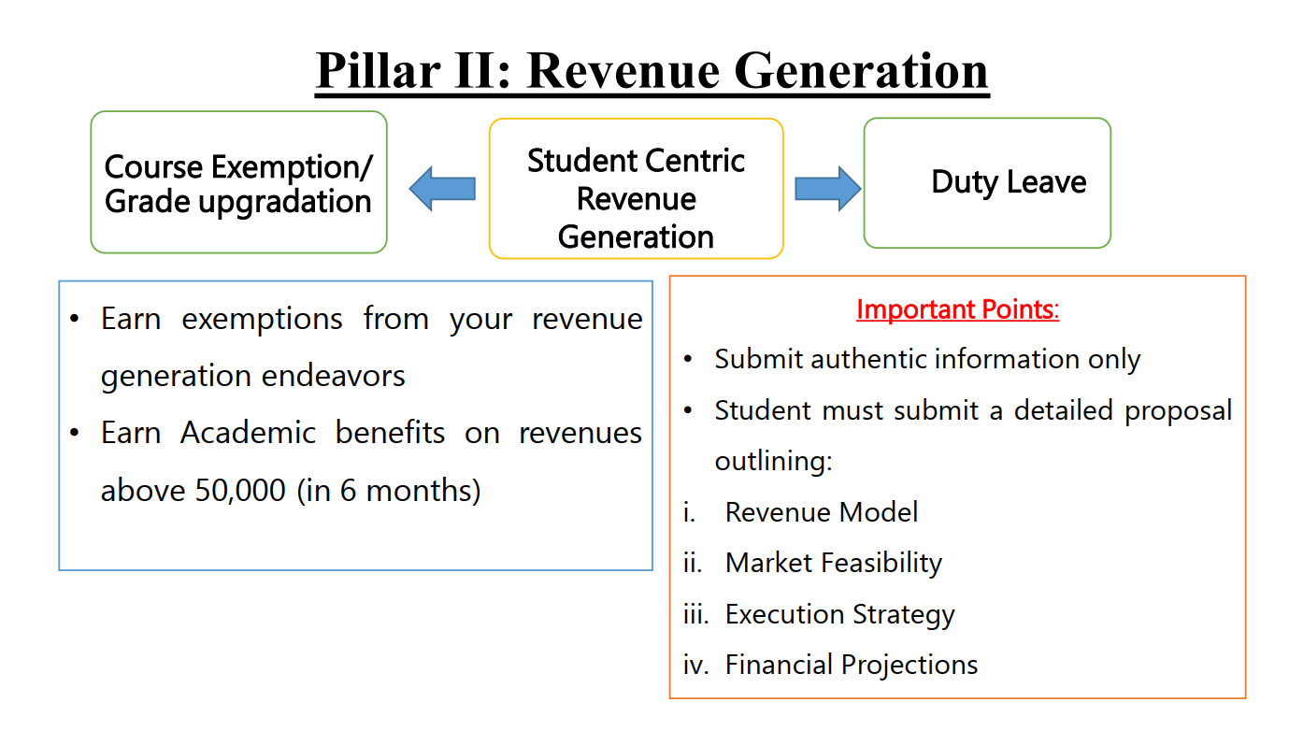
CSG401: ACE TRAINING
EDUCATION REVOLUTION

Slide 20

CSG401: ACE TRAINING

Slide 21
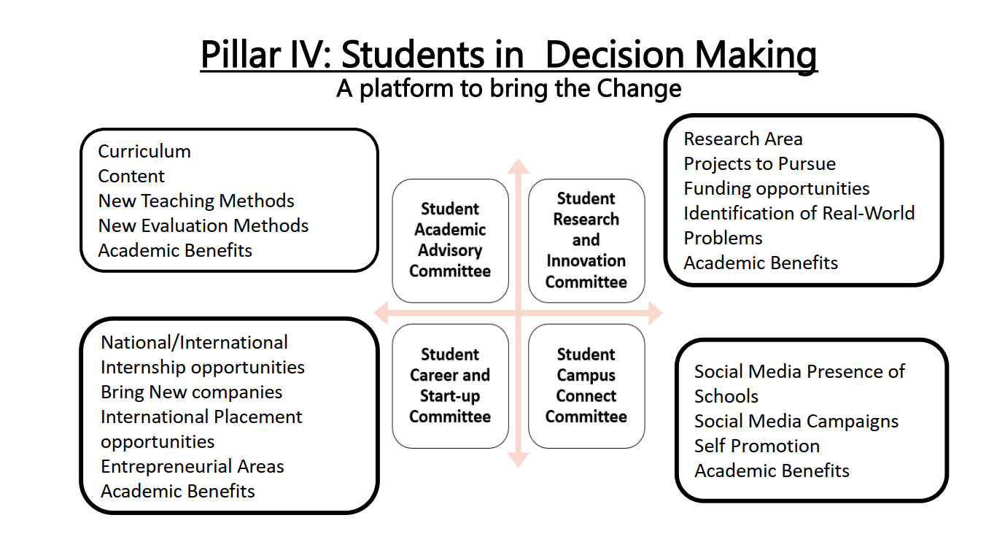
CSG401: ACE TRAINING
EDUCATION REVOLUTION

Slide 22
CSG401: ACE TRAINING
Why EDU-Revolution!!!
  Supports the 'Earn Your Fee' vision through real-world achievements
  Career Readiness
  Enhance Real World Skills
  Promote Innovation and Creativity
  Promote Lifelong Learning

Slide 23
CSG401: ACE TRAINING
EDUCATION REVOLUTION
What's New
Goodbye to old-fashioned teaching and evaluation, and let’s embrace the new paradigm, Edu-Revolution: - Be the Change
Register to avail Privileges and benefits for the following Initiatives
A. Course Equivalence and Attendance Relaxation
B. Grade Revision and Overall Welfare (GROW)
C. 10 % Attendance waiver for students in the Pre-final/Final year of the programme
D. Continuous Assessment Reduction Through Experience (CARE)
E. Students in active decision-making through Student Committees

Slide 24

CSG401: ACE TRAINING
Academic initiatives under EDU Revolution

Slide 25
CSG401: ACE TRAINING
EDUCATION REVOLUTION
Review & Approval Process
Criteria Sheet: It is a structured framework for evaluating EDU Revolution submissions to ensure transparency, consistency, and standardization in assessment. It defines:
Eligibility criteria
Required evidence
Evaluation parameters
Academic benefits

Slide 26
CSG401: ACE TRAINING
EDUCATION REVOLUTION
Standing Committee
Standing Committee: It reviews EDU Revolution nominations and recommends eligible academic benefits.
Composition:
5–7 members constituted by the HoS.
The HoS may nominate additional members.
All relevant committee coordinators are members.

Slide 27

CSG401: ACE TRAINING
Academic Benefits

Slide 28
CSG401: ACE TRAINING
PROCESSING OF STUDENT NOMINATION
Students apply through UMS/LMS
Standing Committee verifies eligibility and supporting documents
Head of School approves course mapping and academic benefits
Transparent, standardized and timely decision-making

Slide 29
CSG401: ACE TRAINING
Interfaces and Contact Information
UMS link to apply for EDU Revolution initiatives:
UMS Navigation --- LMS → EDU Revolution: BE THE CHANGE
In case of any query in this regard, the student can approach for resolution through RMS at the following path:
UMS Navigation--- Relationship management system → EDU Revolution: BE THE CHANGE
OR get your queries resolved through the Helpline Number: 01824-520150.
EDU Revolution Office: 38-205

Slide 30
CSG401: ACE TRAINING
RULES TO BE FOLLOWED IN CLASS
Students need to sit according to Roll Number wise from the very left to the faculty member
Should not use mobiles in class.
The mobile Phones should be in Silent mode and kept inside the bag.
Attendance will be taken within the initial 10 minutes of the class.
Students should not inform other students that they are “on the way” etc., while taking attendance to the instructor.
While a class is going on, no one should disturb the class

Slide 31

CSG401: ACE TRAINING

