Slide 1


Managing Nomad Environments

Slide 2

ManagingNomad Environments
Like any application or platform, Nomad requires operational monitoring, maintenance, upgrades, key rotations, and troubleshooting
The same goes for the workloads running on Nomad –they need to be updated, monitored, and patched
Now that we know how to deploy Nomad and run jobs:
How do we manage Operations of our Nomad cluster? What are the ways we can monitor our environment and the
applications running on Nomad?

Slide 3

ManagingNomad Environments
Monitoring the Nomad Environment
Monitoring Application Logs
Upgrading Nomad to Newer Version

Slide 4
Monitoring the Nomad Environment

Slide 5
Nomad Monitoring
Nomad offers multiple, integrated options to monitor the cluster for system events, audit logging, and events
Nomad serverand client agents collect runtime metrics that are useful for monitoring the health and performance of Nomad clusters
The cluster leader also collects specific metrics as well
Nomad clients have separate metrics for the host they are running on as well as each allocation being run
Telemetry data can be sent to upstream systems at a 1 second interval (default), allowing you to leverage the capabilities of a monitoring provider to set up alerts and dashboards

Slide 6


Viewing System Logs
You can view journal logs on Linux operating systems to view important information about the Nomad service. This is great for troubleshooting issues if Nomad won't start or if you think you have misconfigurations in your Nomad agent configuration
$ journactl–b –u nomad
(-u = filter by unit)
(-b = filter by current boot)
TERMINAL
$ journalctl
Jan 29 19:16:19 nomad_svr_a Jan 29 19:16:19 nomad_svr_a Jan 29 19:16:19 nomad_svr_a Jan 29 19:16:20 nomad_svr_a Jan 29 19:16:20 nomad_svr_a Jan 29 19:16:20 nomad_svr_a Jan 29 19:16:20 nomad_svr_a Jan 29 19:16:20 nomad_svr_a Jan 29 19:16:20 nomad_svr_a Jan 29 19:16:20 nomad_svr_a Jan 29 19:16:20 nomad_svr_a Jan 29 19:16:20 nomad_svr_a Jan 29 19:16:20 nomad_svr_a Jan 29 19:16:20 nomad_svr_a Jan 29 19:16:20 nomad_svr_a Jan 29 19:16:20 nomad_svr_a
–u nomad
nomad[3060]: WARNING: keyring exists but -encrypt given, using keyring
nomad[3060]: ==> Loaded configuration from /etc/nomad.d/nomad.hcl
nomad[3060]: ==> Starting Nomad agent...
nomad[3060]: ==> Nomad agent configuration:
nomad[3060]: Advertise Addrs: HTTP: 10.0.102.53:4646; RPC: 10.0.102.53:4647; Serf: 10.0.102.53:4648 nomad[3060]: Bind Addrs: HTTP: [0.0.0.0:4646]; RPC: 0.0.0.0:4647; Serf: 0.0.0.0:4648
nomad[3060]: Client: false
nomad[3060]: Log Level: INFO
nomad[3060]: Region: global (DC: dc1)
nomad[3060]: Server: true
nomad[3060]: Version: 1.4.3
nomad[3060]: ==> Nomad agent started! Log data will stream in below:
nomad[3060]: 2023-01-29T19:16:19.736Z [WARN] nomad[3060]: 2023-01-29T19:16:19.760Z [INFO] nomad[3060]: 2023-01-29T19:16:19.760Z [INFO] nomad[3060]: 2023-01-29T19:16:19.760Z [INFO]
agent.plugin_loader: skipping external plugins since plugin_dir agent: detected plugin: name=java type=driver plugin_version=0. agent: detected plugin: name=docker type=driver plugin_version= type=driver plugin_versio
agent: detected plugin: name=raw_exec

Slide 7
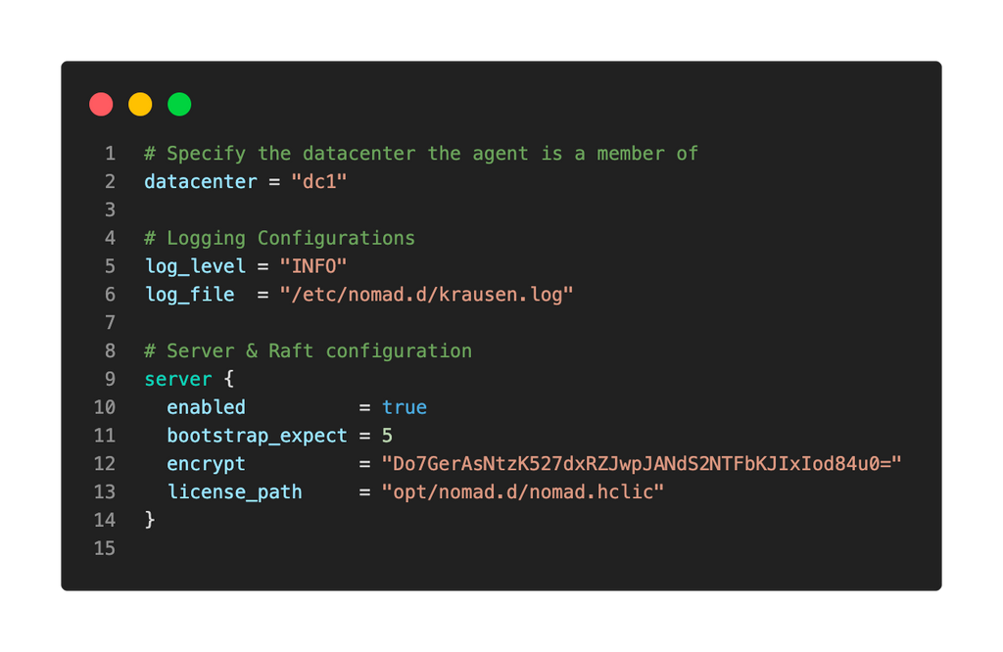
Viewing System Logs
Use the log_level and log_file parameters in the Nomad agent configuration file to output logs for Nomad.
Add the parameters to your
agent configuration file

Slide 8

Getting Metrics from the API
Nomad offers an API endpoint to return metrics for the current Nomad process
https://nomad.example.com:4646/v1/metrics
TERMINAL
$ curl https://nomad:4646/v1/metrics | jq
{
"Labels": {
"datacenter": "dc1", "node_class": "none",
"node_status": "ready",
"node_scheduling_eligibility": "eligible",
"host": "nomad_host_a", "node_id": "7ff357a0-0510-5a04-3d5b-0346fafa1517"
}, "Name": "nomad.client.allocated.disk", "Value": 0
}, {
"Labels": {
"node_id": "7ff357a0-0510-5a04-3d5b-0346fafa1517",
"datacenter": "dc1",

Slide 9
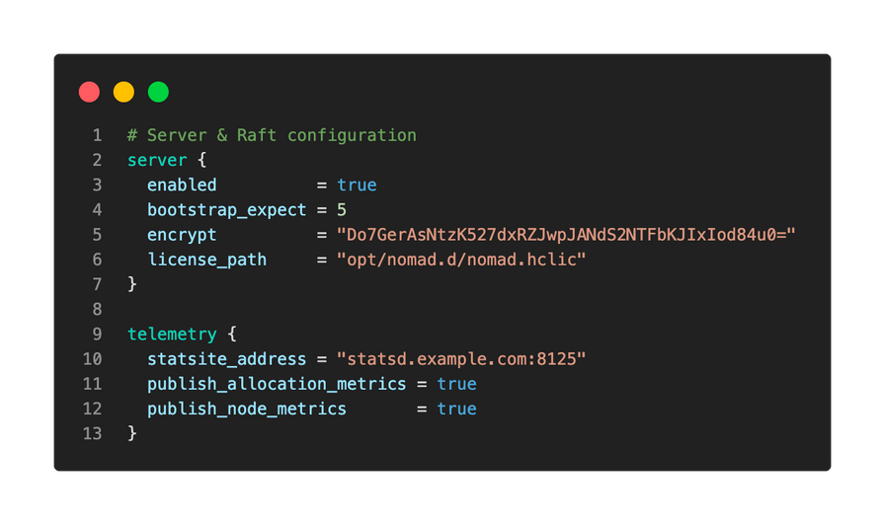
Configuring Telemetry
Telemetry logs provide metrics about the health of our cluster along with key performance metrics we can use to validate or forecast the resources of our cluster
To enable and use telemetry metrics, add the stanza to Nomad client and server configuration files to send metrics to Prometheus/Graphana, Splunk, DataDog, etc.
Examples of key performance indicators (KPIs) include:
x
Raft
Scheduling
Capacity
Job and Task Status
Runtime Metrics

Slide 10
DEMO
Nomad Monitoring

Slide 11
Monitoring Applications

Slide 12
Monitoring Applications
Beyond Nomad cluster logs, you might need to gather or monitor application logs for security, performance, or troubleshooting purposes
Nomad offers multiple options for collecting logs directly from an application:
All tasks will write logs to the Nomad client under the alloc/logs directory
Use the nomad alloclogs CLI command to view logs of an allocation
Stream logs via the API using the /v1/client/fs/logs/<alloc> endpoint

Slide 13
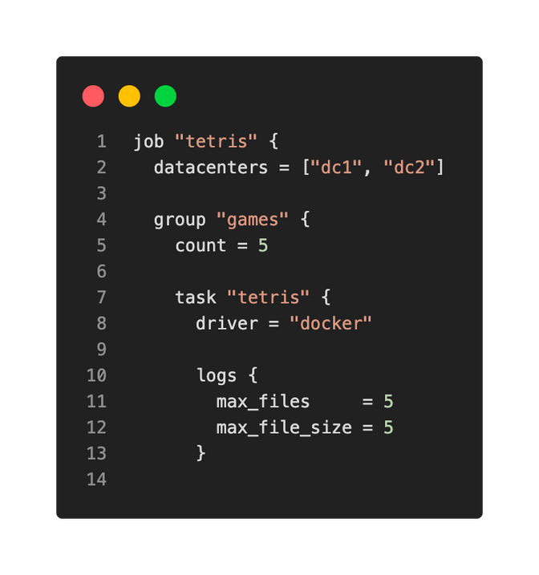
Allocation Logs
All tasks in Nomad will automatically write logs when running on Nomad clients
Currently, there is no way to disable logging for tasks Tasks will write logs to a file in the directory:
/data/alloc/<task>/alloc/logs/ <stdout/stderr>.index
You can change the maximum number of files Nomad will retain and the maximum size of those files

Slide 14

Allocation Logs
Path on a Nomad client for the tetris job:
/etc/nomad.d/data/alloc/003b26e5-8f6c-af88-e5e7-a07a1792cbd9/alloc/logs
TERMINAL
$ ls
tetris.stderr.0 tetris.stdout.0
$ cat tetris.stdout.0
/docker-entrypoint.sh: /docker-entrypoint.d/ is not empty, will attempt to perform configuration /docker-entrypoint.sh: Looking for shell scripts in /docker-entrypoint.d/
/docker-entrypoint.sh: Launching /docker-entrypoint.d/10-listen-on-ipv6-by-default.sh
10-listen-on-ipv6-by-default.sh: info: Getting the checksum of /etc/nginx/conf.d/default.conf
10-listen-on-ipv6-by-default.sh: info: Enabled listen on IPv6 in /etc/nginx/conf.d/default.conf
/docker-entrypoint.sh: Launching /docker-entrypoint.d/20-envsubst-on-templates.sh
/docker-entrypoint.sh: Launching /docker-entrypoint.d/30-tune-worker-processes.sh
/docker-entrypoint.sh: Configuration complete; ready for start up
/docker-entrypoint.sh: /docker-entrypoint.d/ is not empty, will attempt to perform configuration /docker-entrypoint.sh: Looking for shell scripts in /docker-entrypoint.d/
/docker-entrypoint.sh: Launching /docker-entrypoint.d/10-listen-on-ipv6-by-default.sh

Slide 15

Using the Nomad CLI to View Logs
Use the nomad alloclogs <alloc_id> to view logs directly from the CLI
Requires a valid ACL token (if ACL is implemented)
TERMINAL
$ nomad alloclogs 003b26e5
/docker-entrypoint.sh: /docker-entrypoint.d/ is not empty, will attempt to perform configuration /docker-entrypoint.sh: Looking for shell scripts in /docker-entrypoint.d/
/docker-entrypoint.sh: Launching /docker-entrypoint.d/10-listen-on-ipv6-by-default.sh
10-listen-on-ipv6-by-default.sh: info: Getting the checksum of /etc/nginx/conf.d/default.conf
10-listen-on-ipv6-by-default.sh: info: Enabled listen on IPv6 in /etc/nginx/conf.d/default.conf
/docker-entrypoint.sh: Launching /docker-entrypoint.d/20-envsubst-on-templates.sh
/docker-entrypoint.sh: Launching /docker-entrypoint.d/30-tune-worker-processes.sh
/docker-entrypoint.sh: Configuration complete; ready for start up
/docker-entrypoint.sh: /docker-entrypoint.d/ is not empty, will attempt to perform configuration /docker-entrypoint.sh: Looking for shell scripts in /docker-entrypoint.d/
/docker-entrypoint.sh: Launching /docker-entrypoint.d/10-listen-on-ipv6-by-default.sh
10-listen-on-ipv6-by-default.sh: info: Getting the checksum of /etc/nginx/conf.d/default

Slide 16

Stream Logs via API
•
Using the API, you can stream the contents of a file in an allocation directory, such as the stdout or stderr logs
Uses the full allocation ID (not the short one) as part of the API endpoint path
•
TERMINAL
$ curl \
http://localhost:4646/v1/client/fs/stream/003b26e5-8f6c-af88-e5e7-a07a1792cbd9
?path=/alloc/logs/tetris.stdout.0
{"Data":"L2RvY2tlci1lbnRyeXBvaW50LnNoOiAvZG9ja2VyLWVudHJ5cG9pbnQuZC8gaXMgbm90IGVtcHR5 LCB3aWxsIGF0dGVtcHQgdG8gcGVyZm9ybSBjb25maWd1cmF0aW9uCi9kb2NrZXItZW50cnlwb2ludC5zaDogT G9va2luZyBmb3Igc2hlbGwgc2NyaXB0cyBpbiAvZG9ja2VyLWVudHJ5cG9pbnQuZC8KL2RvY2tlci1lbnRyeX
BvaW50LnNoOiBMYXVuY2hpbmcgL2RvY2tlci1lbnRyeXBvaW50LmQvMTAtbGlzdGVuLW9uLWlwdjYtYnktZGV
mYXVsdC5zaAoxMC1saXN0ZW4tb24taXB2Ni1ieS1kZWZhdWx0LnNoOiBpbmZvOiBHZXR0aW5nIHRoZSBjaGVj
a3N1bSBvZiAvZXRjL25naW54L2NvbmYuZC9kZWZhdWx0LmNvbmYKMTAtbGlzdGVuLW9uLWlwdjYtYnktZGVmY
XVsdC5zaDogaW5mbzogRW5hYmxlZCBsaXN0ZW4gb24gSVB2NiBpbiAvZXRjL25naW54L2NvbmYuZC9kZWZhdW

Slide 17
DEMO
Monitoring Applications

Slide 18
Upgrading Nomad to a Newer Version

Slide 19
Upgrading Nomad to a Newer Version
Nothing says "Day 2 Operations" more than upgrading the cluster
Nomad supports both in-place upgrades by replacing the binary or rolling updates by adding new hosts to the cluster and removing the old ones
Nomad is backward compatible for at least one point release but doesn't test or support upgrades beyond that
Nomad does NOT support downgrading either

Slide 20


Critical Items for Upgrading
Servers:
•When upgrading server nodes, you MUSTmaintain a quorum to ensure the Nomad service is available. Quorum size is based on the number of server agents in the cluster. Upgrade incrementally and verify cluster health at each step.
Clients:
•
Clients run jobs. Jobs are applications, and applications are important to the business and its customers. Client node upgrades should likely involve disabling allocation eligibility and draining any existing allocations

Slide 21

Order of Operations(Rolling)
•
HashiCorp recommends to upgrade servers first since many new client features will not work until servers are upgraded
Any new features (server and client) are unlikely to work correctly until all
nodes in the cluster have been upgraded
•
1
2
3
4
5
Add New
Validate
Remove
Validate
Migrate
Servers to the Cluster
Cluster Health
Older Servers from Cluster
*gracefully
Cluster Health
Workloads
and Upgrade
Clients

Slide 22

Order of Operations(In-Place)
1
2
3
4
5
Stop Nomad Service
Stop Nomad Service
Stop Nomad Service
Stop Nomad Service
Stop Nomad Service
Replace
Binary
Server E
(Follower)
Replace
Binary
Server D
(Follower)
Replace
Binary
Server C
(Follower)
Replace
Binary
Server B
(Follower)
Replace
Binary
Server A
(Leader)
Nomad doesn't currently have an option to tell the cluster leader to gracefully give up leadership, so just stop the service on the Leader node and another node will be elected Leader

Slide 23
OtherNotes forUpgrades
Check the Upgrade Guides:
•
HashiCorp publishes version-specific upgrade guides that will call out any "gotchas" or issues that you might run into during the upgrade process.
Read the Release Notes
•
Make sure to checkout the release notes for each version before upgrading to ensure there aren't any deprecated features or commands that you might be using in your environment

Slide 24
DEMO
Upgrading Nomad to a Newer Version

