Slide 1


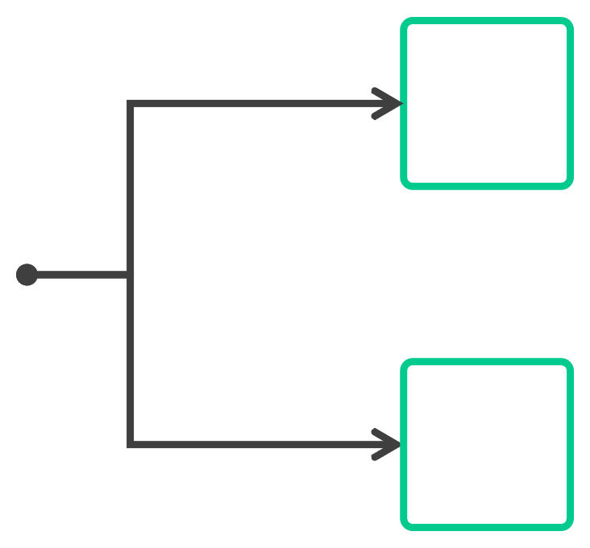









Secure Nomad with ACLs
Token-based authentication
Tokens are associated with a policy that permits/denies access to capabilities in Nomad
Policies are centrally managed
Policies and tokens are automatically replicated across regions for easy, centralized administration at scale
ACL TOKENS
ACL POLICIES
CAPABILITIES
PERMIT JOB
ASSOCIATED POLICY
ALLOW QUERY

Slide 2
SecureNomad withACLs
There are three components to the ACL system:
Tokens
• •
Management tokens Client tokens (default)
Policy
• •
Policies provide role-based access control Associated with tokens
Capabilities
•
Defines the actions that can be performed on the designated path

Slide 3



SecureNomad withACLs
Nomad ACLs are NOT enabled by default and therefore the ACL must be bootstrapped before you can use them to secure Nomad
All servers must include the acl stanza and parameters in the agent config, otherwise you'll get an error message stating that ACL support is disabled
Steps Required to Use Nomad ACLs
Configure Server Agent to include
Bootstrap
Create ACL
Create ACL
ACL System
Policies
Tokens
ACL stanza

Slide 4
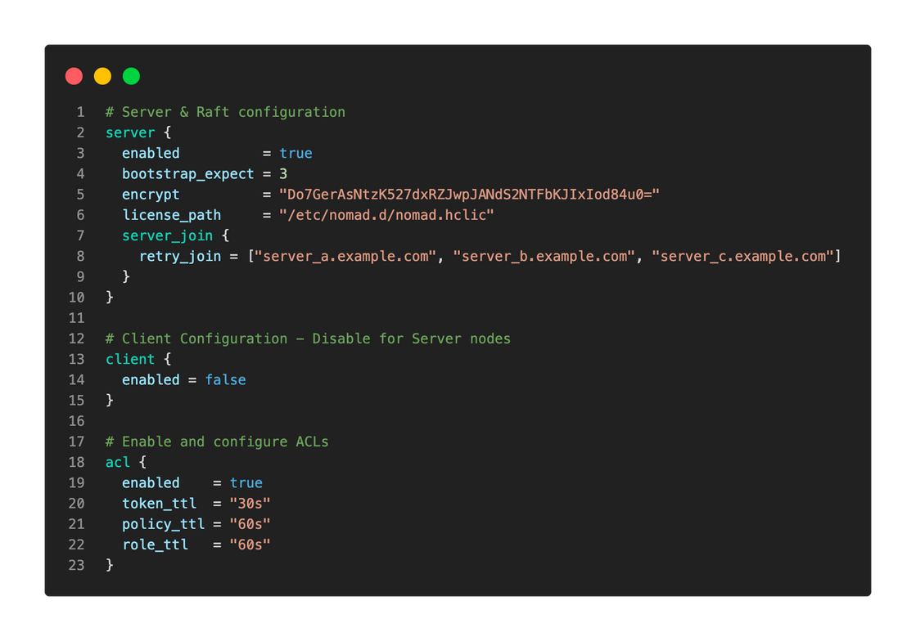
SecureNomad with ACLs

Slide 5
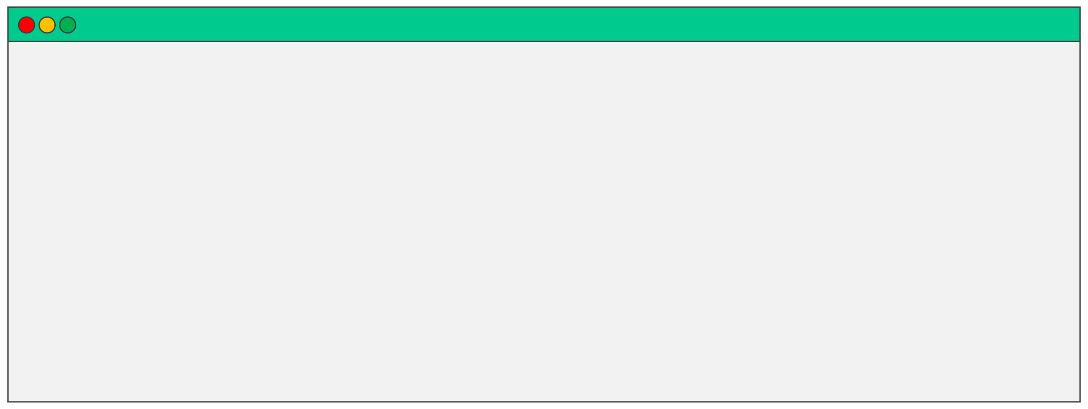
Bootstrap ACLs
To bootstrap the ACL system, use the nomad aclbootstrap command:
TERMINAL
$ nomad acl
Accessor ID Secret ID Name
Type
Global Create Time Expiry Time
bootstrap
= 400a8f88-8f73-ef48-0750-fd122e2abe8d
= 4a8be0a9-459c-6598-ac8b-d80f26a6e8f0
= Bootstrap Token
= management
= true
= 2023-01-03 14:19:04.509226313 +0000 UTC = <none>
Create Index = 9877 Modify Index = 9877
Policies Roles
= n/a = n/a

Slide 6



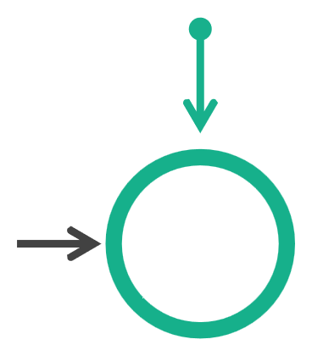
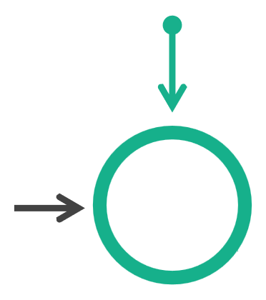




ACL Tokens
• • •
When the ACL system is bootstrapped, you get the bootstrap token The bootstrap token is a management token that provides access to everything It is NOT recommended that you use this token for day-to-day operations
QA Team
Dev Team
Ops Team
QA Policy
ACL Token
Dev Policy
ACL Token
Ops Policy
ACL Token

Slide 7
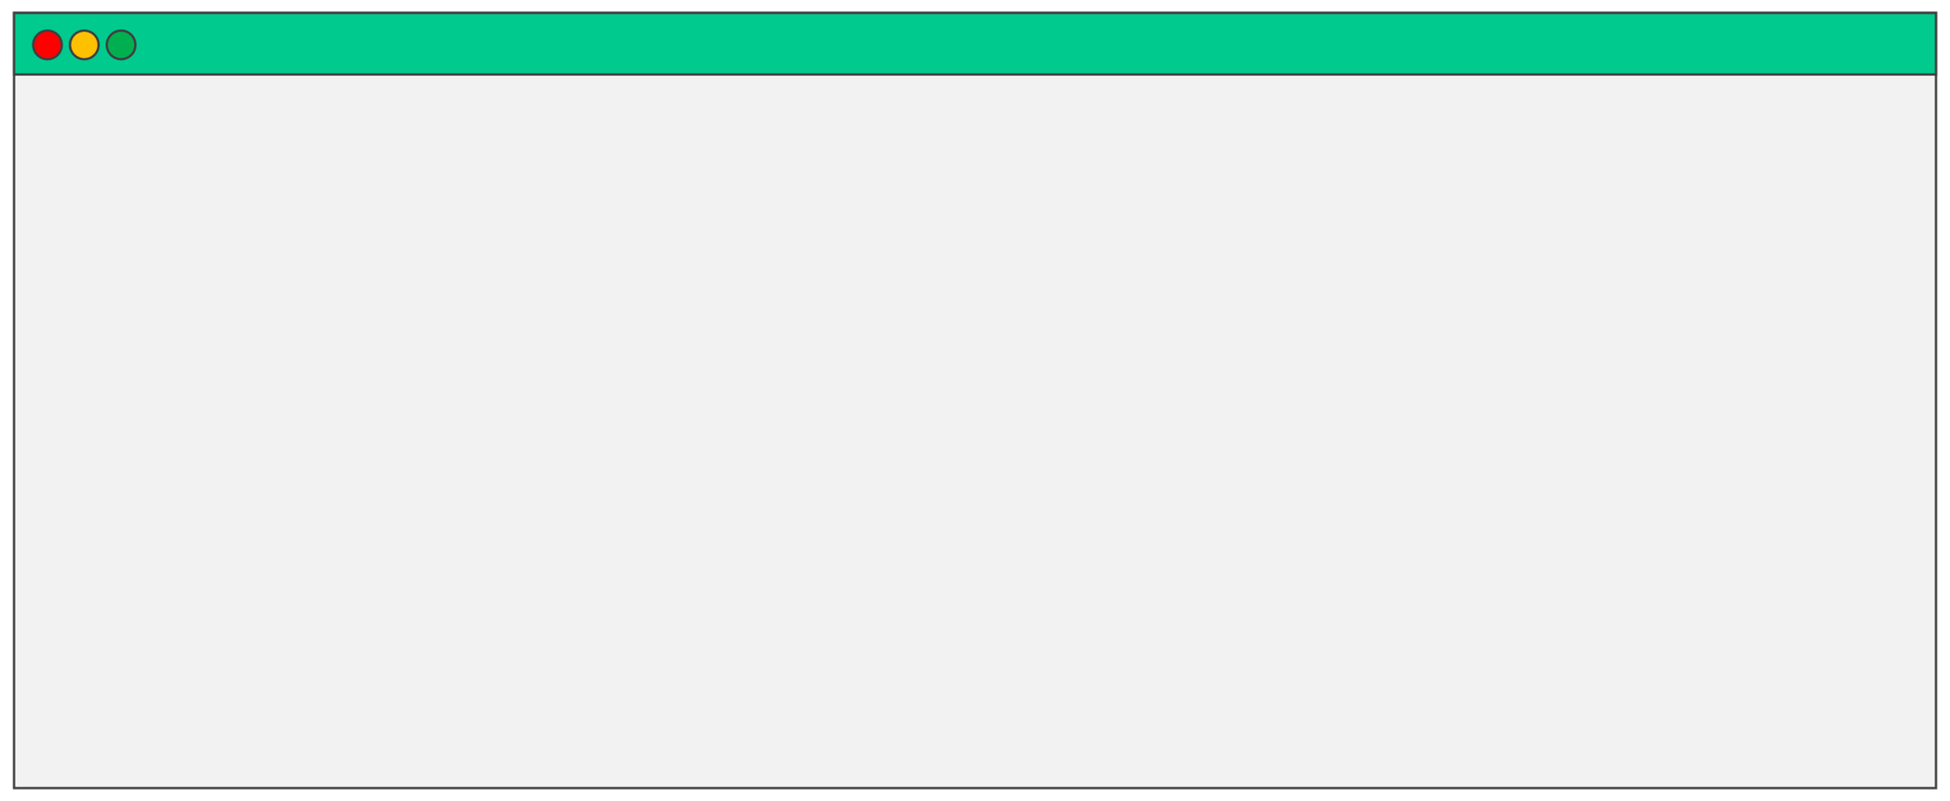
ACL Tokens
TERMINAL
$ nomad acltoken create -name="nomad_is_awesome" -policy=“raman"
Accessor ID = ebea4525-51a4-3b6d-6511-da8fecf63eb1
Secret ID = 0f8b37f4-6f22-ef1d-c9aa-e1f04a86dd76
Name = nomad_is_awesome
Type = client
Global = false
Create Time = 2023-01-03 18:41:06.447109751 +0000 UTC
Expiry Time = <none>
Create Index = 10166
Modify Index = 10166
Policies Roles
= raman
= n/a

Slide 8
ACL Policies
• • •
Control access to Nomad data and APIs (RBAC) Written in HCL (or JSON) and contains one or more rules Policies generally have the following dispositions:
• • • •
read write
–allows read and list of Nomad resources
–allows read and write of Nomad resources
deny list
–denies read or write –takes precedence over any other permission –list resources but not provide details
•
Other rules also allow more fine-grained controls and capabilities

Slide 9
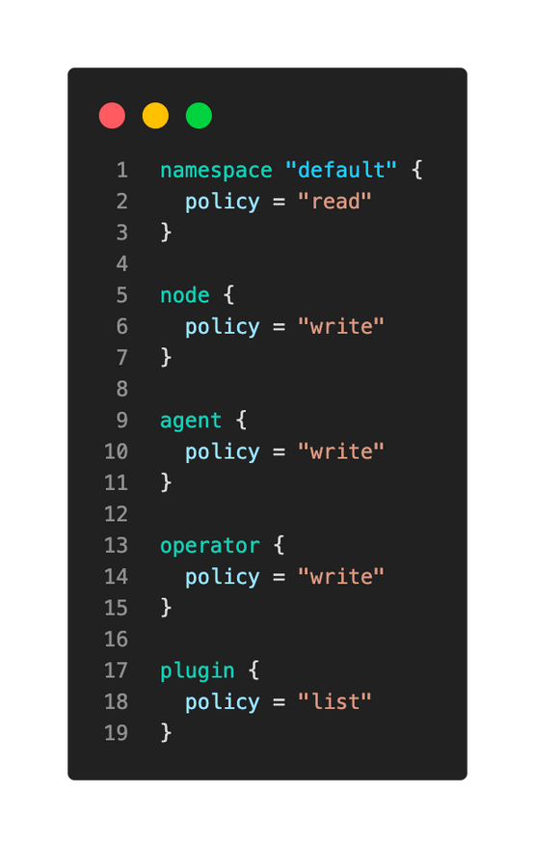
ACL Policies
Example
• • •
Policy written in HCL Provides write to most resources in Nomad More aligned to a Nomad operator

Slide 10
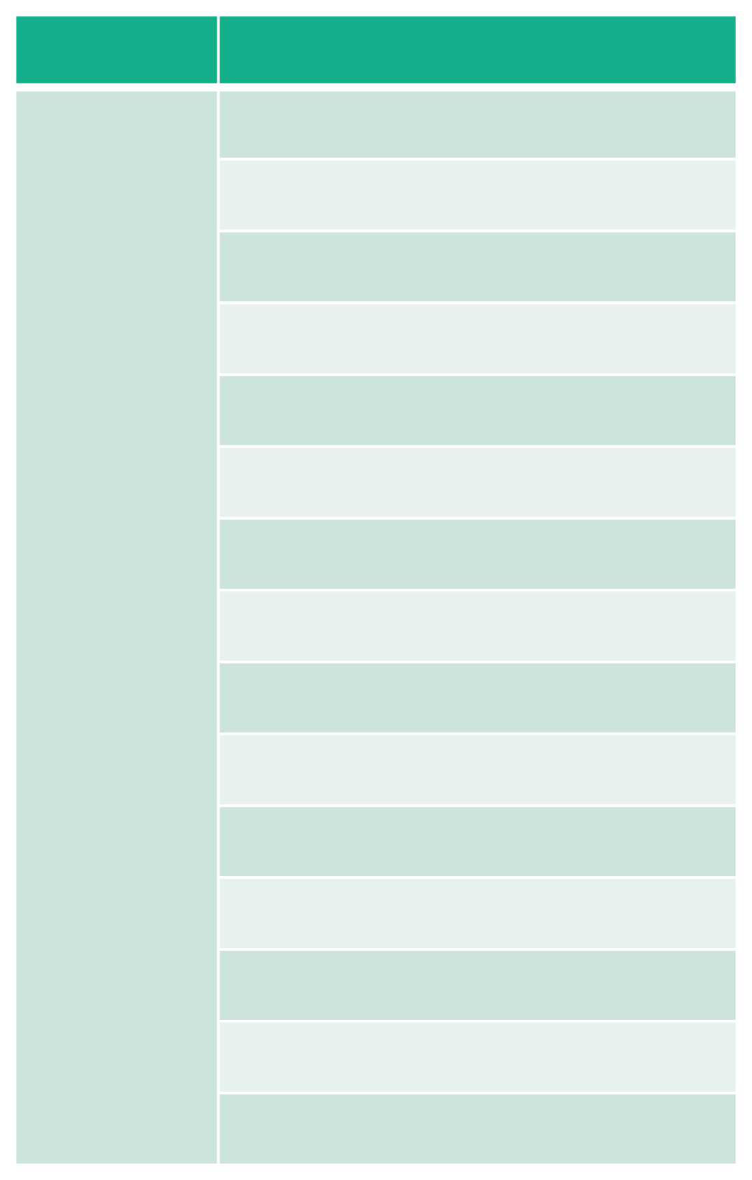
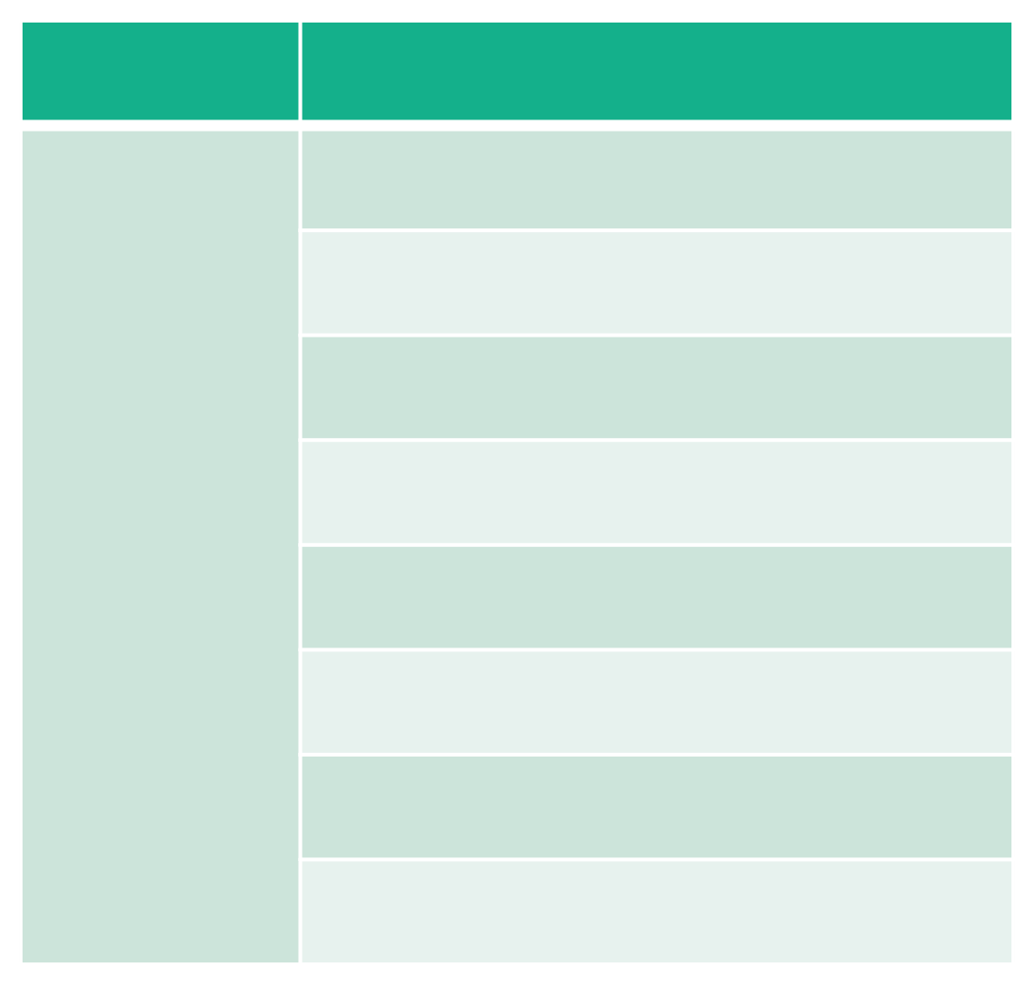
Namespace Capabilities
Policy write
Capabilities
list-jobs
parse-job
read-job
submit-job
dispatch-job
read-logs
read-fs
alloc-exec
alloc-lifecycle
csi-write-volume
csi-mount-volume list-scaling-policies read-scaling-policies read-job-scaling scale-job
Policy read
Capabilities
list-jobs
parse-job
read-job
csi-list-volume
csi-read-volume
list-scaling-policies read-scaling-policies read-job-scaling

Slide 11
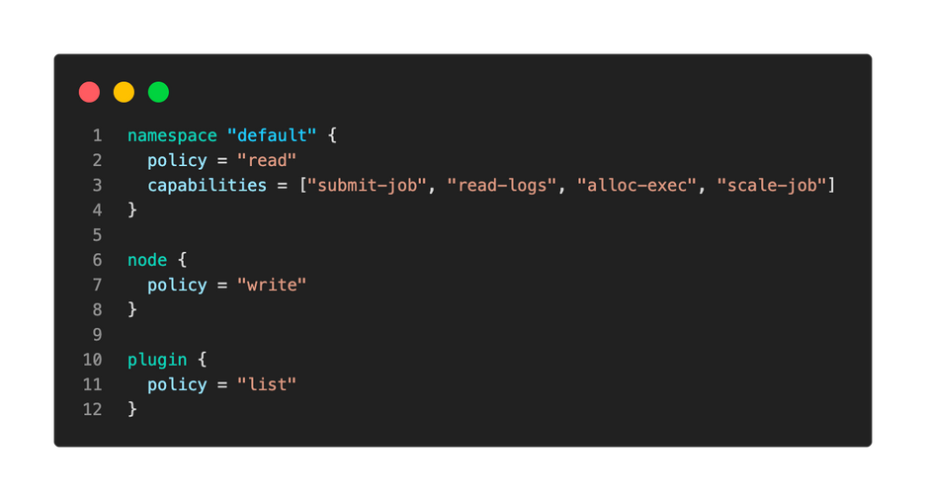
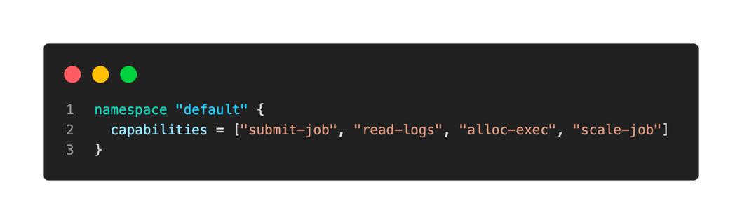
Namespace Capabilities
Provides read and four additional rights
Only provides rights explicitly listed here

Slide 12
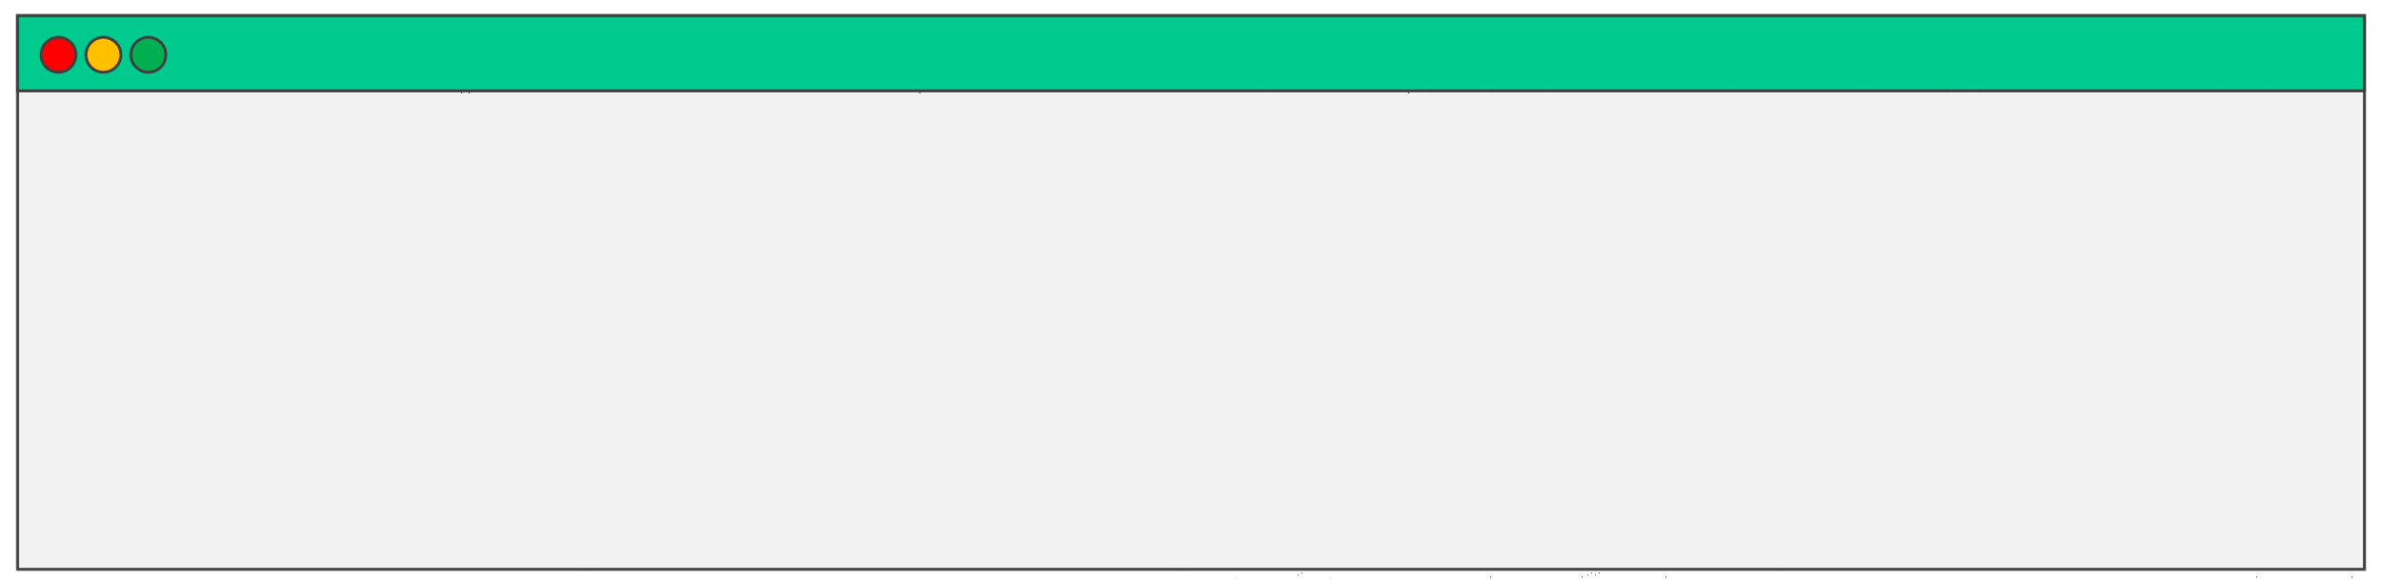
Nomad ACLs
Interaction via CLI requires an ACL token to perform almost all operations
There are a few ways you can provide the token:
-token flag on the CLI with the desired command to be executed
Setting the NOMAD_TOKEN environment variable
TERMINAL
# Use the –token flag for authentication $ nomad job run webapp.nomad–token=4a8be0a9-459c-6598-ac8b-d80f26a6e8f0
# Set the NOMAD_TOKEN environment variable to authenticate
$ export NOMAD_TOKEN=4a8be0a9-459c-6598-ac8b-d80f26a6e8f0 $ nomad job run webapp.nomad

Slide 13
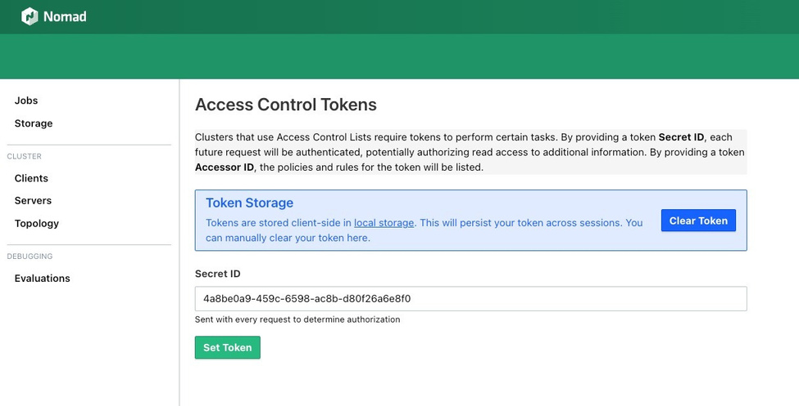
Nomad ACLs
Authenticate to the Nomad UI without exposing the token to the browser's history

Slide 14
DEMO
Securing Nomad with ACLs

