Slide 1
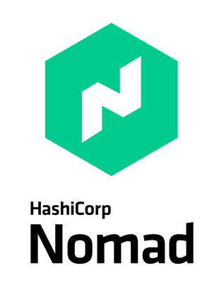

Introduction to
Nomad

Slide 2

Nomad is a Container Orchestrator
(Ok, it can do more than just containers…..)
Much simpler alternative to Kubernetes Nomad can deploy, manage, and scale containers for your environment You can use Nomad to deploy containers on-prem, at the edge, and on any cloud platform.
Multi-region and multi-datacenter support.
Nomad can scale to thousands of nodes in a single cluster Supports non-containerized workloads as well, such as VMs, binaries, and more…
Tight integration into the HashiCorp ecosystem

Slide 3





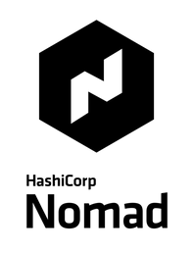

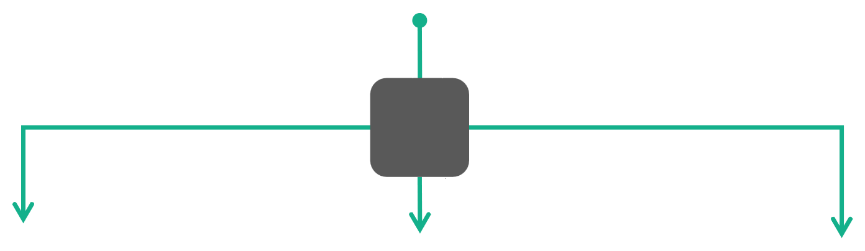


Simple Container Orchestration
The Foundation for Cloud Application Automation
Developer
Jobs
Operator
Policies
AWS WEST
AZURE WEST
ON-PREM

Slide 4
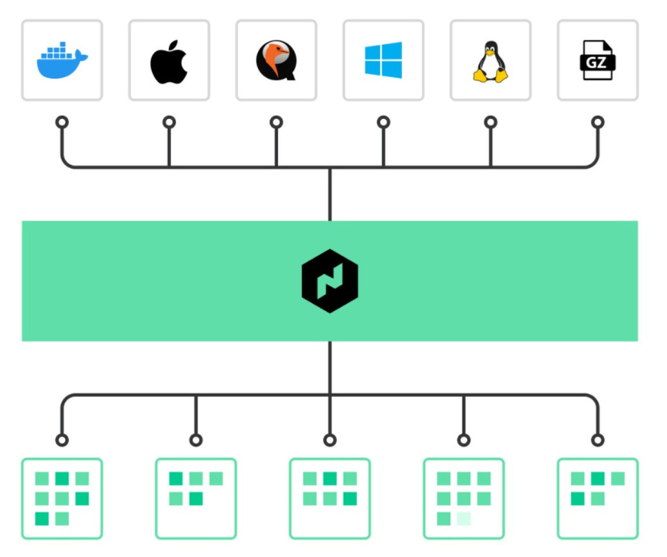
OrchestrateAny
Application
Containerized
Non-containerized
Batch Applications
Java Apps

Slide 5
"Nomad is an emerging
disruptor in the container orchestrator world"
-NetApp

Slide 6
Nomad Components

Slide 7
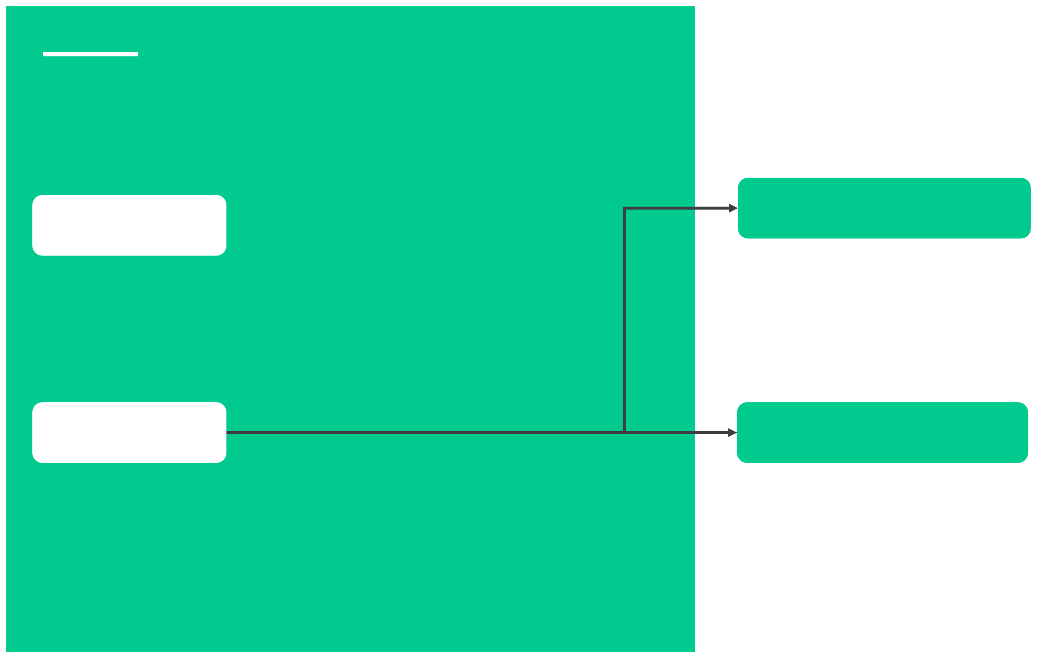
Nomad Components
Server Mode
Node
A physical or virtual machine in the cluster. A node is a machine running the Nomad agent.
An agent running on a server that holds the global state of the cluster and participates in scheduling decisions.
Agent
Client Mode
Long-running daemon running on every member of the Nomad cluster. Agent can run in either client or server mode. This is essentially the binary that is downloaded from HashiCorp.
An agent that fingerprints the host to determine the capabilities, resources, and available drivers. Responsible for running workloads, such as containers.

Slide 8
Nomad Components
Jobs
Definition of how a workload should be scheduled.The job specification (spec) is composed of one or more task groups, and each task defines a series of resource configurations and constraints.
A job is submitted to Nomad and represents a desired state. For example, run 3 instances of my application using this Docker image and spread them across three nodes to ensure high-availability.

Slide 9
Nomad Components
An HCL configuration file on disk which describes how a workload should be scheduled.
It contains multiple stanzas that define configurations such as jobs, groups, tasks, services, and resources for the application
Job Specification (jobspec)

Slide 10

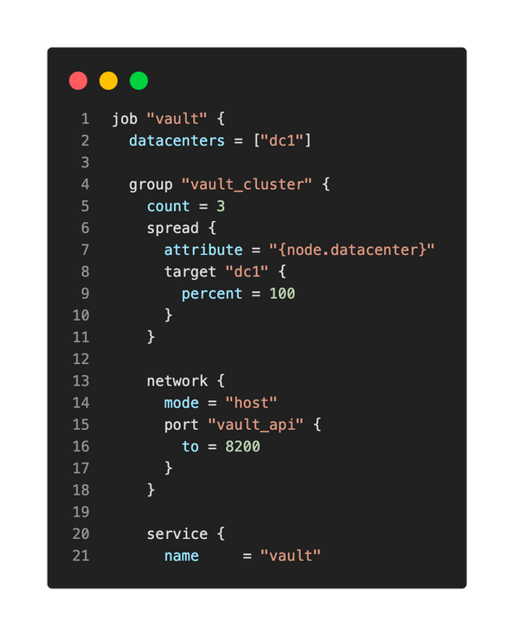

Job Specification File
vault-cluster.nomad

Slide 11
Nomad Components
Pluggable components that execute a task and provide resource isolation.
Example drivers include: docker, java, podman, and raw-exec
Drive must be installed/available before tasks can be executed. For example, if you submit a job to schedule Docker containers, Docker must be available on the Nomad clients to use…
Driver

Slide 12
Nomad Components
A command, service, application, or "set of work" to be executed by Nomad.
Tasks are executed by their driver. Examples include:
Run these containers
Execute these commands
Run this Java application from a .jar file
Task

Slide 13
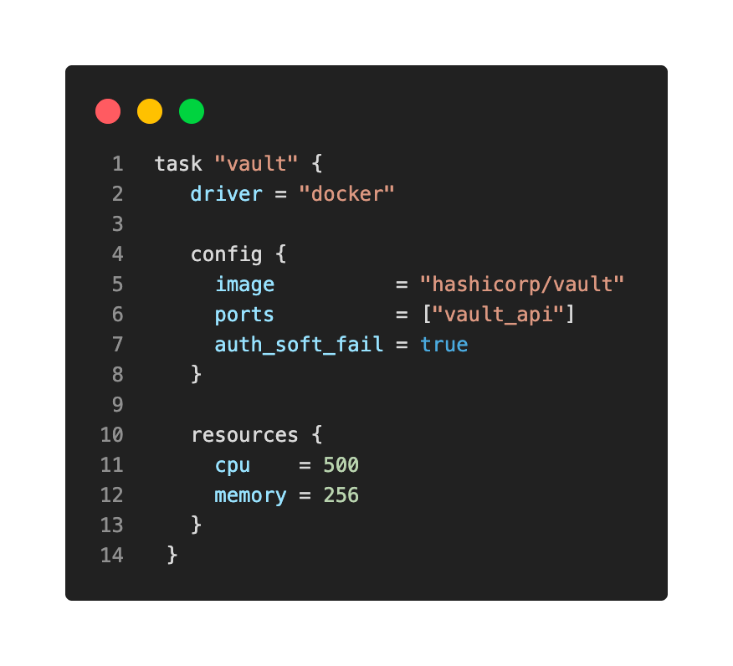

Task Example
vault-cluster.nomad

Slide 14
Nomad Components
Task Group
A collection of individual task that should be co-located on the same node
Any task within the defined group will be placed on the same Nomad client
This is especially useful for applications that require low latency or have high throughput to another application in the task group.

Slide 15
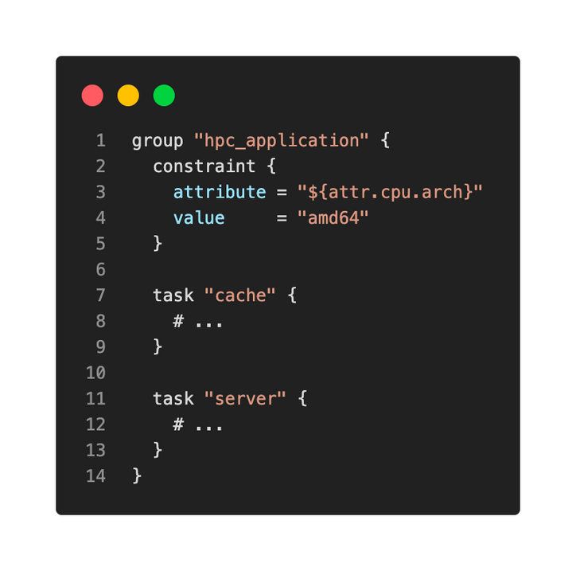

TaskGroup -Example
Resources defined in
both cacheand server
will be scheduled on the same Nomad client

Slide 16
Nomad Components
A calculation performed by the Nomad servers to determine what action(s) need to take place to execute a job.
Nomad performs evaluations whenever jobs are submitted or client state changes to determine if what changes need to be made to ensure the desired state.
Evaluation

Slide 17
Nomad Components
The mapping of tasks in a job to clients is done using allocations.
An allocation is used to declare that a set of tasks in a job should be run on a particular node.
Allocations can fail if there are not enough resources to execute the task, a node is down, etc.
Allocation

Slide 18

Schedulingin Nomad
Job
Evaluation
Allocation
Client
Submitted by users
Represents desired state
Triggers an evaluation when submitted
Compared current state to desired state
Evaluates the state and reconciles it
Map the tasks in the job to a client
Determines set of tasks that should run on a client
Runs the set of tasks defined in the job spec.
This is where the containers are scheduled

Slide 19
Nomad Architecture

Slide 20



Nomad Architecture
Datacenter
Consensus
Environment that has private,
Agreement of an elected
low latency and high- bandwidth between nodes.
leader in the cluster
Region
Collection of multiple datacenters, often grouped
geographically.

Slide 21




Nomad Datacenter
Single-Region Architecture
FORWARDING
REPLICATION
SERVER
FOLLOWER
SERVER
LEADER
SERVER
FOLLOWER
REPLICATION
FORWARDING
RPC
RPC
RPC
CLIENT
CLIENT
CLIENT

Slide 22

Datacenter A
Multi-Region Architecture
FORWARDING
REPLICATION
SERVER
FOLLOWER
SERVER
LEADER
SERVER
FOLLOWER
REPLICATION
FORWARDING
Region Forwarding
WAN Gossip (Federation)
Datacenter B
FORWARDING
REPLICATION
SERVER
FOLLOWER
SERVER
LEADER
SERVER
FOLLOWER
REPLICATION
FORWARDING

Slide 23

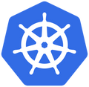

Comparing Nomad
to Kubernetes

Slide 24
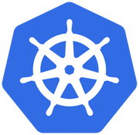
How Does NomadCompare to Kubernetes?
Nomad is not based on Kubernetes, and Kubernetes is not based on Nomad, they are separate products.
Both solutions are open-source, although HashiCorp does currently offer an Enterprise version of Nomad.
Nomad supports more types of workloads than Kubernetes, such as VMs, Java JAR, Qemu, Raw Executables, Firecracker microVMs, and Wasm.
Nomad is a single binary for everything Nomad-related.
Kubernetes is much more architecturally complex than a Nomad environment.
Nomad can scale to millions of containers. (check out the 1 million and 2 million container challenge HashiCorp did)
Kubernetes is considered the industry standard, but it doesn't mean it's always the right tool.

Slide 25
How Does NomadCompare to Kubernetes?
Nomad doesn't have the concept of Ingress Controllers for managing network connectivity.
Nomad is primarily a task-scheduling platform and can't orchestrate load balancing, config management, or routing.
Most cloud platforms provide a managed service for Kubernetes, simplifying the deployment and management of the platform. There is currently no managed service for Nomad on any cloud platform, including HCP.
Kubernetes has an extensive community for support, but it comes with the increased complexity of deployment.
Nomad is an emerging disruptor in the container orchestrator world.

Slide 26
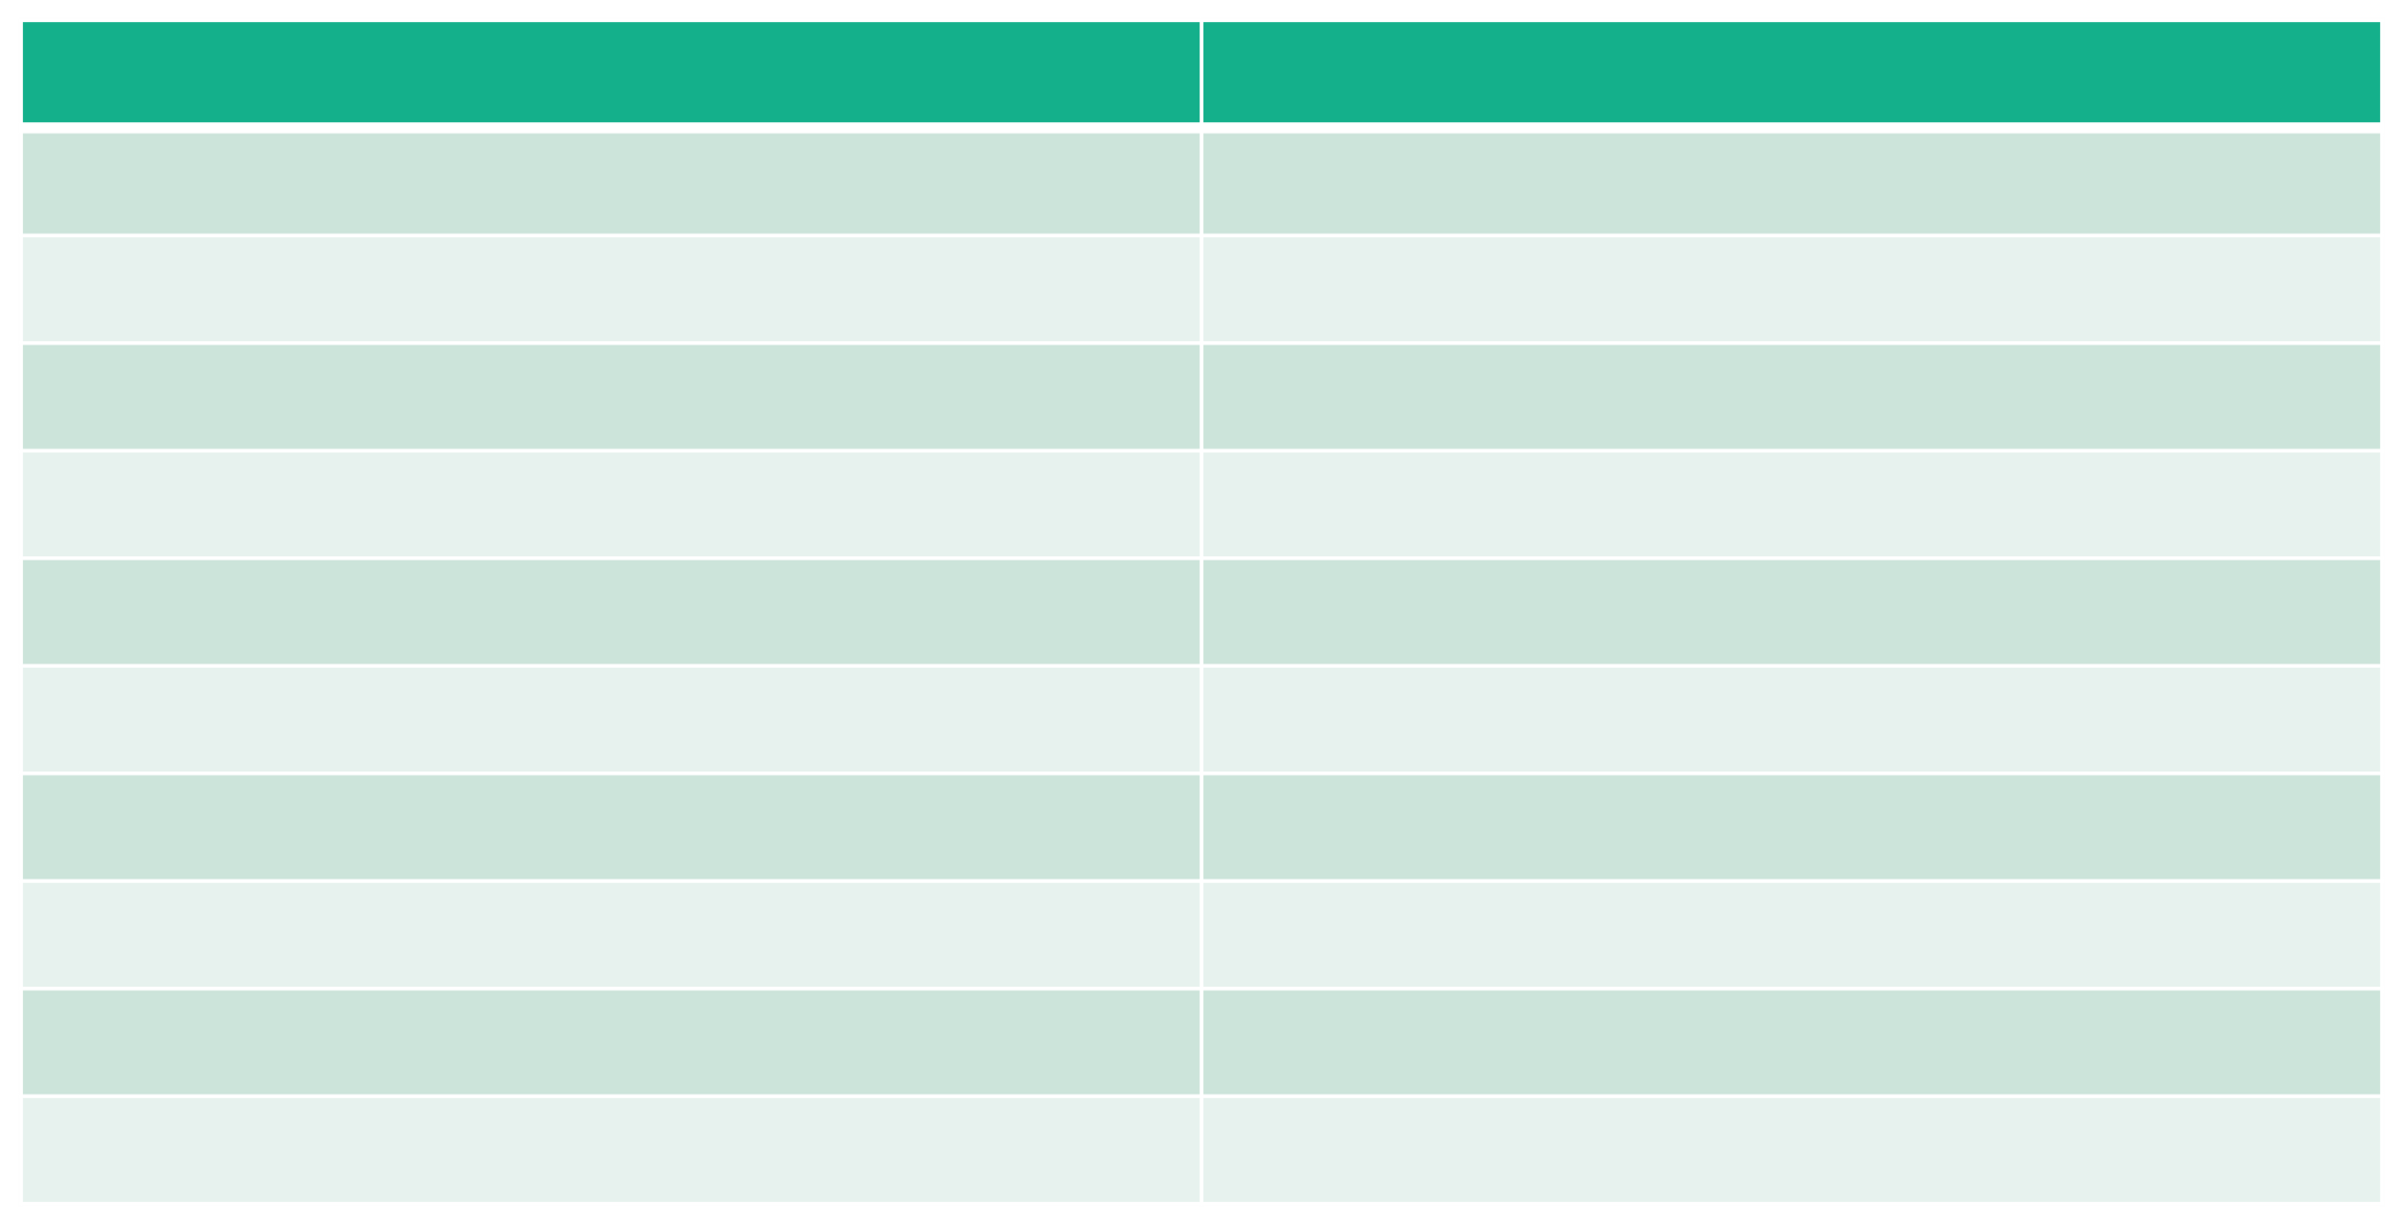
Comparing Terminology
HashiCorp Nomad
Job
Tasks/Group
Client Agent
Server Node
Client Node
Task Driver
Service Discovery/Reverse Proxy Integrated API
Raft
HCL
Kubernetes
Job
Pods
Kubelet Controllers/Control Plane Worker Node
Container Runtime
Load Balancer/Ingress API Server
etcd
YAML

Slide 27
End of Section

