Slide 1
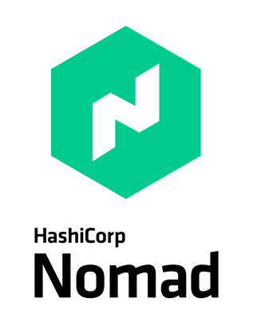

Introduction to
Nomad

Slide 2

Nomad is a Container Orchestrator
(Ok, it can do more than just containers…..)
• • •
Much simpler alternative to Kubernetes Nomad can deploy, manage, and scale containers for your environment You can use Nomad to deploy containers on-prem, at the edge, and on
any cloud platform. Multi-region and multi-datacenter support.
• •
Nomad can scale to thousands of nodes in a single cluster Supports non-containerized workloads as well, such as VMs, binaries, and
more…
Tight integration into the HashiCorp ecosystem
•

Slide 3





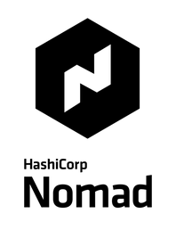

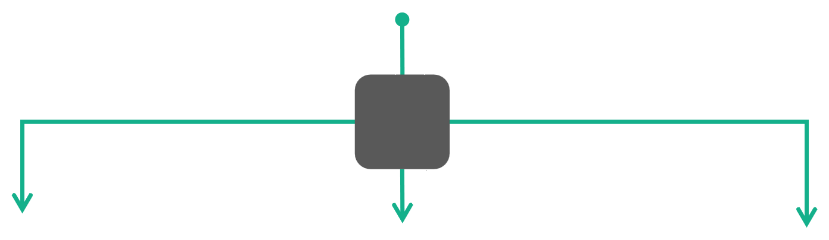


Simple Container Orchestration
The Foundation for Cloud Application Automation
Developer
Jobs
Operator
Policies
AWS WEST
AZURE WEST
ON-PREM

Slide 4
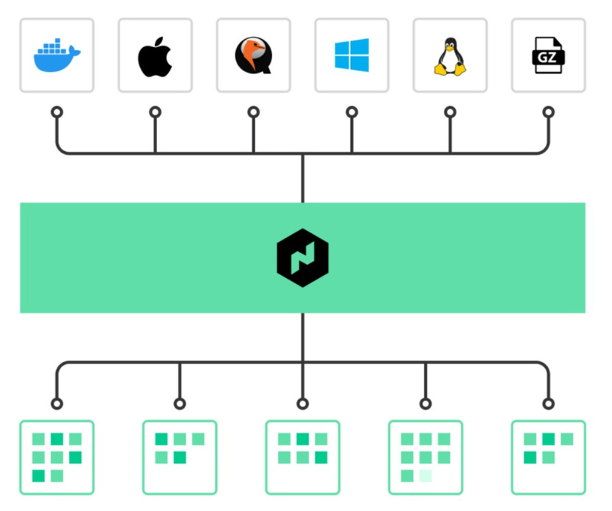
OrchestrateAny
Application
• • • •
Containerized Non-Containerized Batch Applications Java Apps

Slide 5
"Nomad isanemerging
disruptorin thecontainer orchestratorworld"
-NetApp

Slide 6
Nomad Components

Slide 7
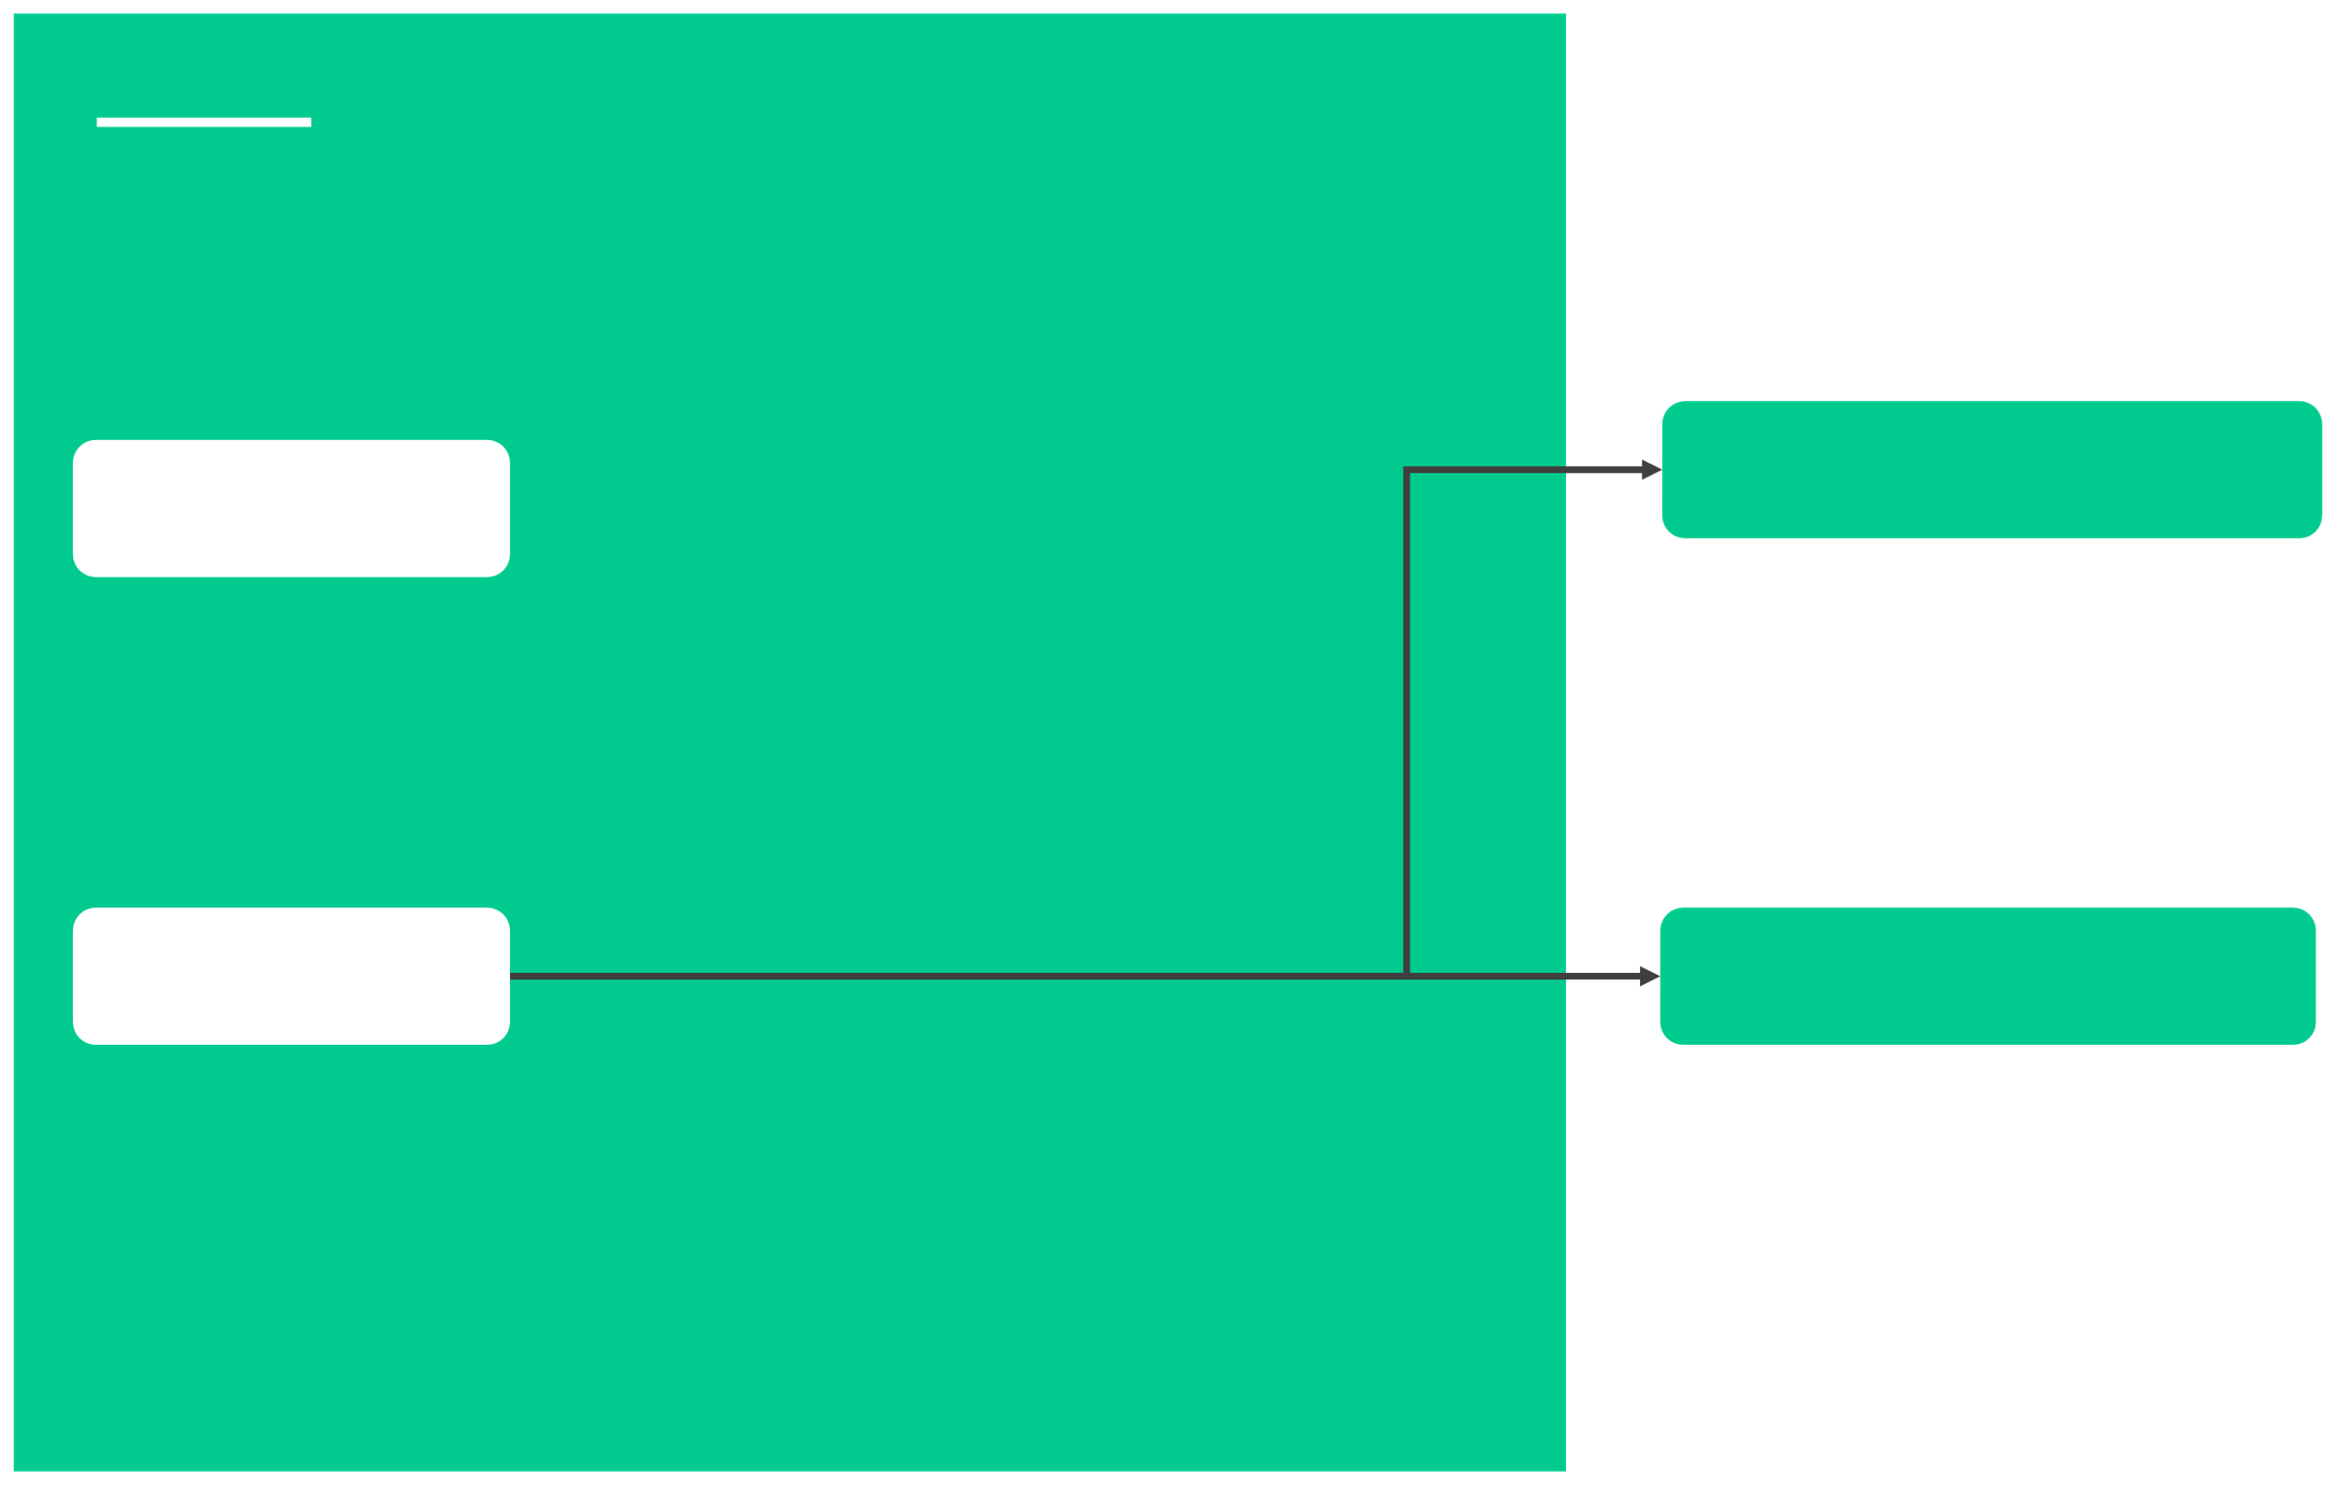
Nomad Components
Server Mode
Node
A physical or virtual machine in the cluster. A node is a machine running the Nomad agent.
An agent running on a server that holds the global state of the cluster and participates in scheduling decisions.
Agent
Client Mode
Long-running daemon running on every member of the Nomad cluster. Agent can run in either client or server mode. This is essentially the binary that is downloaded from HashiCorp.
An agent that fingerprints the host to determine the capabilities, resources, and available drivers. Responsible for running workloads, such as containers.

Slide 8
Nomad Components
Jobs
•
Definition of how a workload should be scheduled.
The job specification (spec) is composed of one or
more task groups, and each task defines a series of resource configurations and constraints.
•A job is submitted to Nomad and represents a
desired state. For example, run 3 instances of my
application using this Docker image and spread
them across three nodes to ensure high-availability.

Slide 9
Nomad Components
•
An HCL configuration file on disk which describes how a workload
Job Specification (jobspec)
should be scheduled.
•
It contains multiple stanzas that define configurations such as jobs, groups, tasks, services, and resources for the application

Slide 10

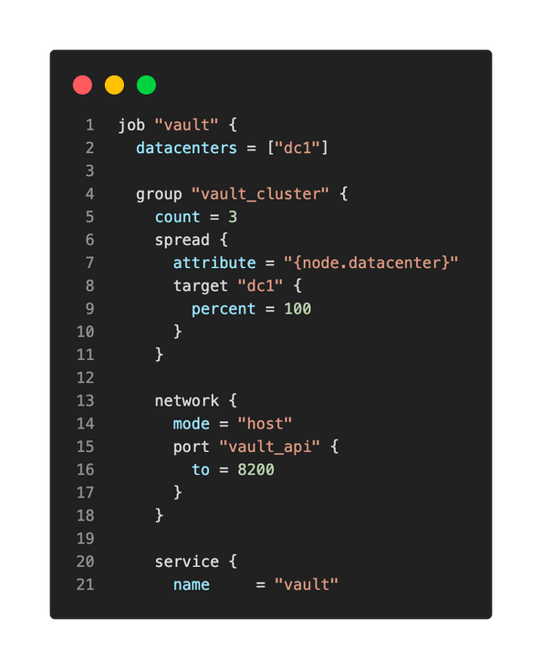

Job Specification File
vault-cluster.nomad

Slide 11
Nomad Components
•
Pluggable components that execute a task and provide resource isolation.
Driver
Example drivers include: docker, java, podman, and
raw-exec
Drive must be installed/available before tasks can be
executed. For example, if you submit a job to
schedule Docker containers, Docker must be
available on the Nomad clients to use…
•
•

Slide 12

Nomad Components
•
A command, service, application, or "set of work" to
Task
be executed by Nomad.
Tasks are executed by their driver. Examples include:
• •
•
Run these containers
•Execute these commands
•Run this Java application from a
.jar file

Slide 13
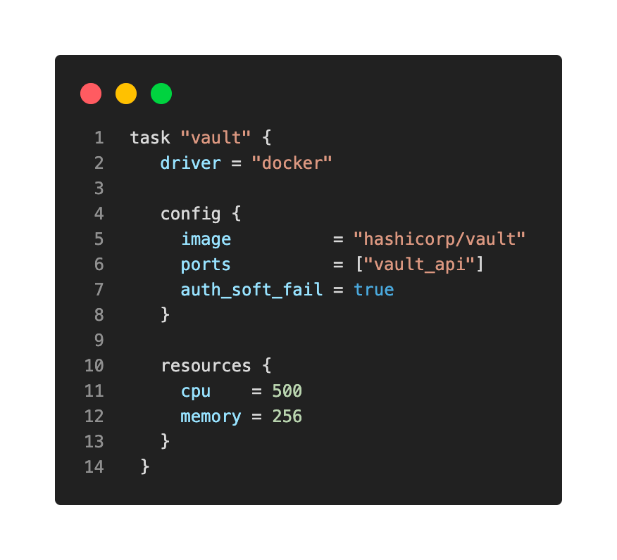

Task Example
vault-cluster.nomad

Slide 14
Nomad Components
Task Group
•
A collection of individual task that should be co-
located on the same node
Any task within the defined group will be placed on
the same Nomad client
This is especially useful for applications that require
low latency or have high throughput to another
application in the task group.
•
•

Slide 15
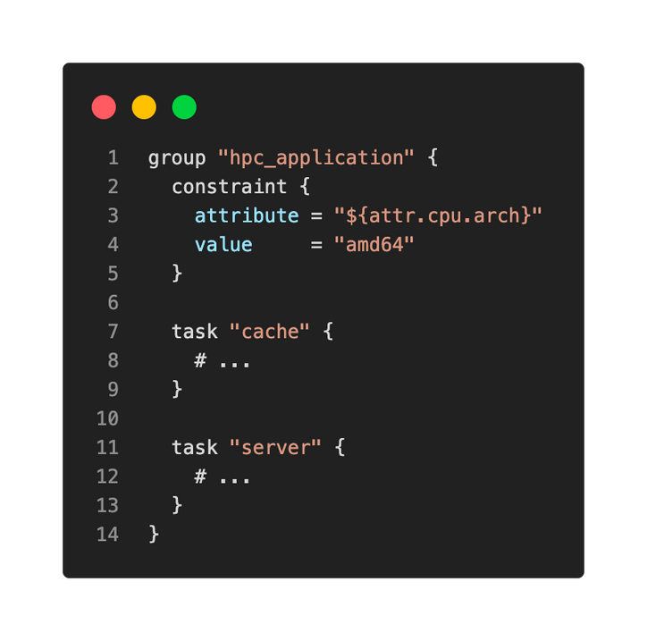

TaskGroup -Example
Resources defined in
both cacheand server
will be scheduled on the same Nomad client

Slide 16
Nomad Components
•
A calculation performed by the Nomad servers to determine what action(s) need
Evaluation
to take place to execute a job. Nomad performs evaluations whenever jobs are submitted or client state changes to determine if what changes need to be made to ensure the desired state
•

Slide 17
Nomad Components
•
The mapping of tasks in a job to clients is done using allocations.
Allocation
An allocation is used to declare that a set of
tasks in a job should be run on a particular
node.
Allocations can fail if there are not enough
resources to execute the task, a node is
down, etc.
•
•

Slide 18

Schedulingin Nomad
Job
Evaluation
Allocation
Client
• •
Submitted by users Represents desired
state
Triggers an
evaluation when
submitted
•
Compared current state to desired state
Evaluates the state
and reconciles it
•
Map the tasks in the job to a client
Determines set of
tasks that should
run on a client
•
Runs the set of tasks defined in the job spec.
This is where the
containers are
scheduled
•
•
•
•

Slide 19
Nomad Architecture

Slide 20



Nomad Architecture
Datacenter
Consensus
Environment that has private,
Agreement of an elected
low latency and high- bandwidth between nodes.
leader in the cluster
Region
Collection of multiple datacenters, often grouped
geographically.

Slide 21




Nomad Datacenter
Single-Region Architecture
FORWARDING
REPLICATION
SERVER
FOLLOWER
SERVER
LEADER
SERVER
FOLLOWER
REPLICATION
FORWARDING
RPC
RPC
RPC
CLIENT
CLIENT
CLIENT

Slide 22

Datacenter A
Multi-Region Architecture
FORWARDING
REPLICATION
SERVER
FOLLOWER
SERVER
LEADER
SERVER
FOLLOWER
REPLICATION
FORWARDING
Region Forwarding
WAN Gossip (Federation)
Datacenter B
FORWARDING
REPLICATION
SERVER
FOLLOWER
SERVER
LEADER
SERVER
FOLLOWER
REPLICATION
FORWARDING

Slide 23

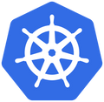

Comparing Nomad
to Kubernetes

Slide 24
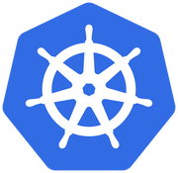
How Does NomadCompare to Kubernetes?
•
Nomad is not based on Kubernetes, and Kubernetes is not based on Nomad, they are separate products
Both solutions are open-source, although HashiCorp does currently offer an
Enterprise version of Nomad
Nomad supports more types of workloads than Kubernetes, such as VMs, Java
JAR, Qemu, Raw Executables, Firecracker microVMs, and Wasm
Nomad is a single binary for everything Nomad-related
Kubernetes is much more architecturally complex than a Nomad environment
Nomad can scale to millions of containers (check out the 1 million and 2 million
container challenge HashiCorp did)
Kubernetes is considered the industry standard, but it doesn't mean it's always
the right tool
•
•
• • •
•

Slide 25
How Does NomadCompare to Kubernetes?
•
Nomad doesn't have the concept of Ingress Controllers for managing network connectivity
Nomad is primarily a task-scheduling platform and can't orchestrate load balancing,
•
config management, or routing
Most cloud platforms provide a managed service for Kubernetes, simplifying the
deployment and management of the platform. There is currently no managed service
for Nomad on any cloud platform, including HCP
Kubernetes has an extensive community for support, but it comes with the increased
complexity of deployment
Nomad is an emerging disruptor in the container orchestrator world
•
•
•

Slide 26
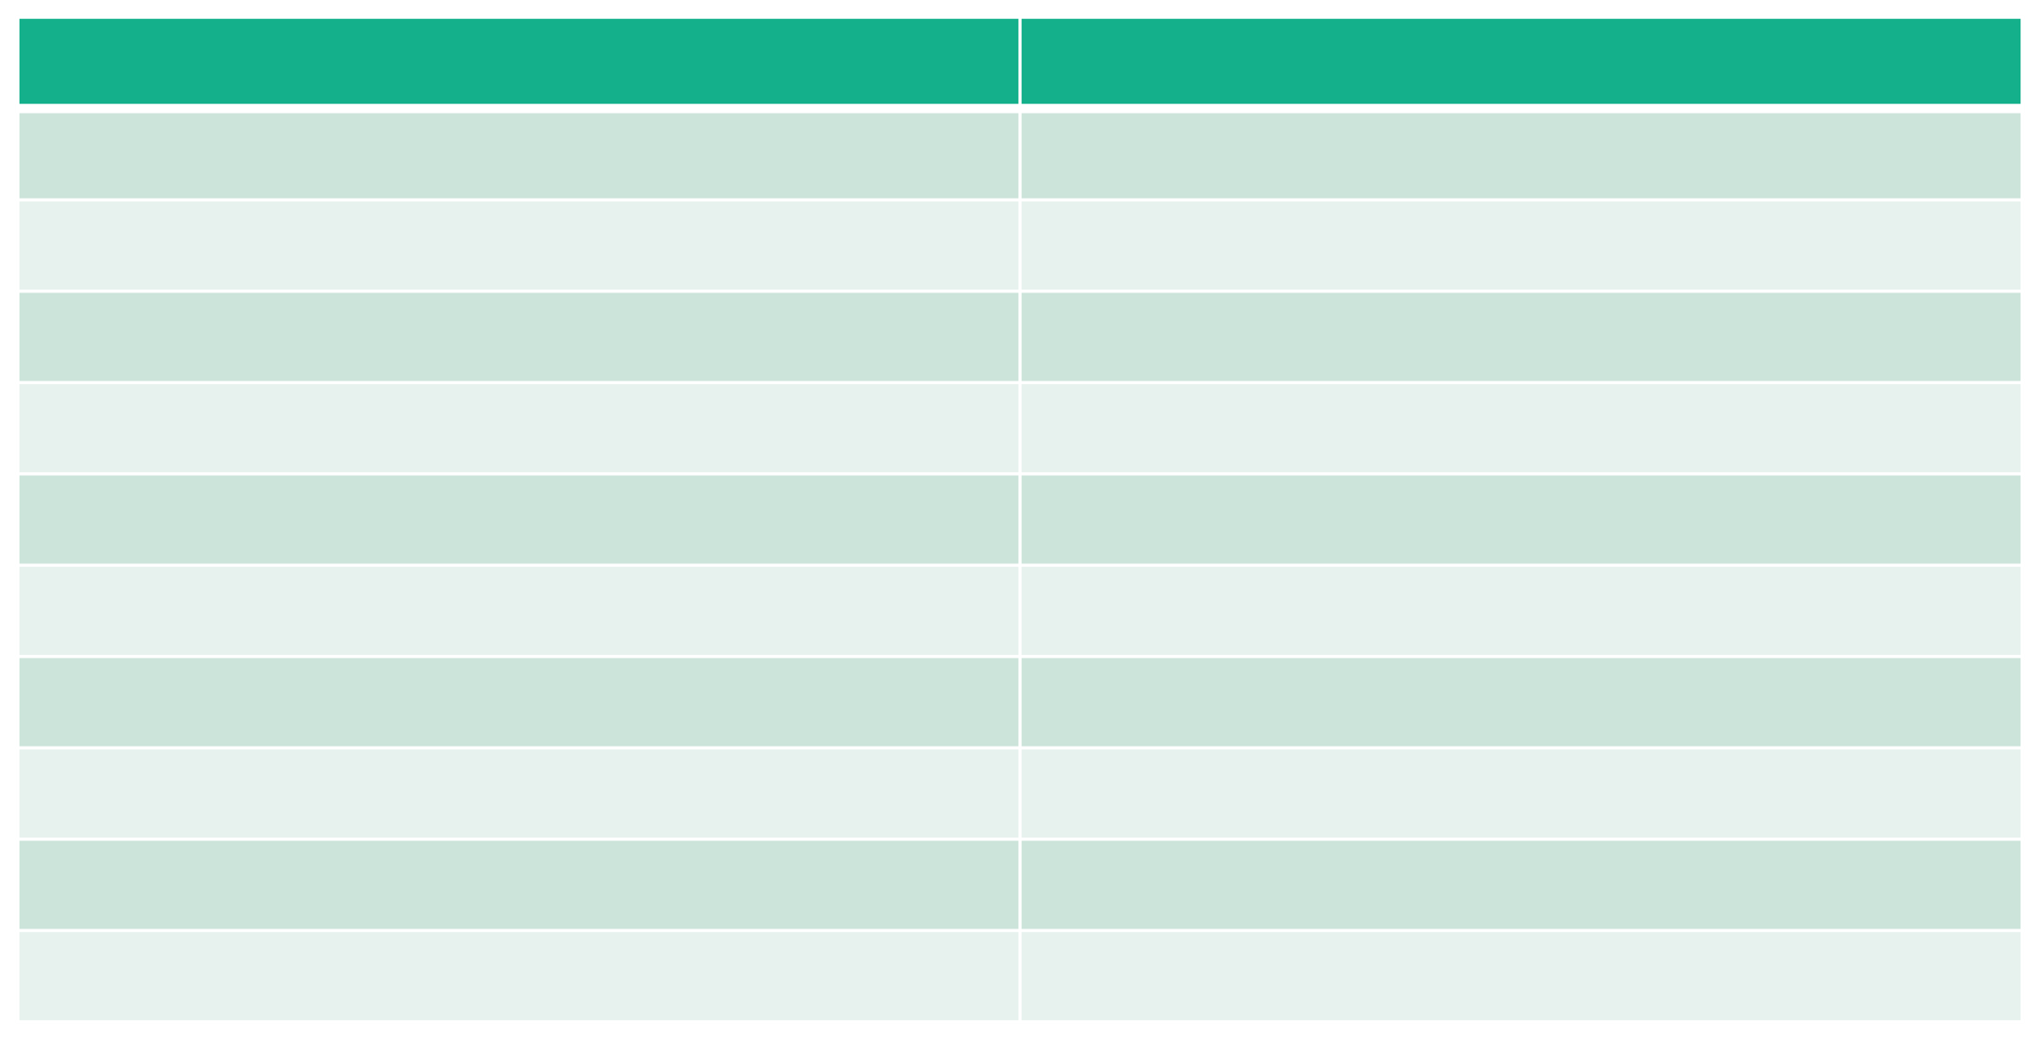
Comparing Terminology
HashiCorp Nomad Job Tasks/Group Client Agent Server Node Client Node Task Driver Service Discovery/Reverse Proxy Integrated API Raft HCL
Kubernetes Job Pods Kubelet Controllers/Control Plane Worker Node Container Runtime Load Balancer/Ingress API Server etcd YAML

Slide 27
End of Section

