Slide 1


Interacting with
Nomad

Slide 2
How Do I Managed Nomad?
Nomad includes three different interfaces….
• • •
Nomad CLI API User Interface (UI)
All these interfaces are available to the user as long as Nomad is running

Slide 3
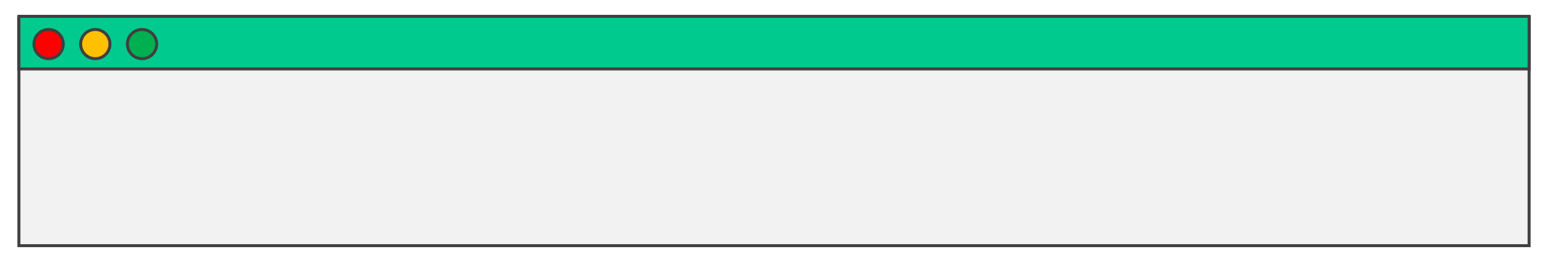
Nomad CLI
The CLI requires that you have the Nomad binary installed on your machine
•
https://releases.hashicorp.com/nomad/
•
You don't need to log into a Nomad server to interact with Nomad. You can easily interact with Nomad clusters deployed in your datacenter by using the Nomad CLI on your own laptop/desktop.
•
Nomad also has an autocomplete that you can install for tab completion
TERMINAL
$ nomad –autocomplete-install

Slide 4



Remotely Connect to Nomad
Use your local machine to interact with Nomad
•
Your machine doesn't need to have Nomad running to interact with a Nomad cluster….you just need the Nomad CLI (binary) installed
To interact with a remote Nomad host, set the environment variable
•
NOMAD_ADDR
$ export NOMAD_ADDR=https://nomad.example.com:4646
PS> $env:NOMAD_ADDR= "https://nomad.example.com:4646"
•
Alternatively, you can use the
–address
flag when running commands
$ nomad server members –address=https://nomad.example.com:4646
*Using a flag on the CLI takes precedence over environment variables

Slide 5
Environment Variables
Most popular environment variables
NOMAD_ADDR
The address of the Nomad server you want to interact with…
NOMAD_REGION
The region of the Nomad server to forward commands to…
NOMAD_NAMESPACE
The target namespace for queries and actions that you want to use…
NOMAD_TOKEN
The ACL token you want to use to authenticate to Nomad…

Slide 6
Nomad SubCommands
• •
All commands in the Nomad CLI start with
Nomad has an extensive CLI with lots of subcommands
nomad
• • • • • •
•
•
•
acl agent agent-info alloc config deployment
eval
fmt
job
• • • • • •
•
•
•
license monitor namespace node operator plugin
quota
recommendation
scaling
• • • • • •
•
•
•
sentinel server service status system ui
var
version
volume

Slide 7
Nomad CLI
• •
Nomad CLI supports help commands
Use
–h or --help
•
or just press enter to see a list of available commands
•
The CLI is <mostly> used for managing jobs and therefore defaults to working with jobs unless you specify a different command name
Examples:
•
•
is equal to
nomad run myapp.nomad myapp.nomad
nomad status is equal to nomad job status
nomad job run
•

Slide 8
DEMO
Using the Nomad CLI

Slide 9
Nomad UI

Slide 10
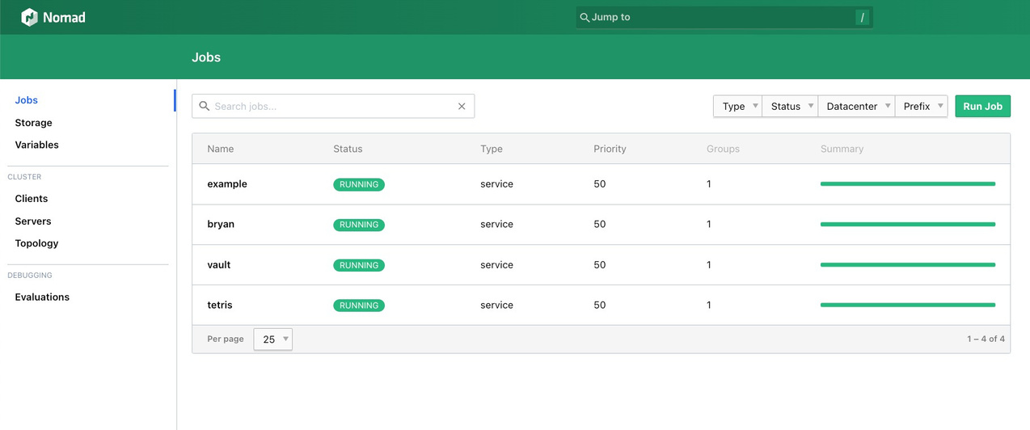
Nomad UI
• •
Provides a simple interface to interact with Nomad View Nomad infrastructure, jobs, evaluations, allocations, variables, and more.

Slide 11
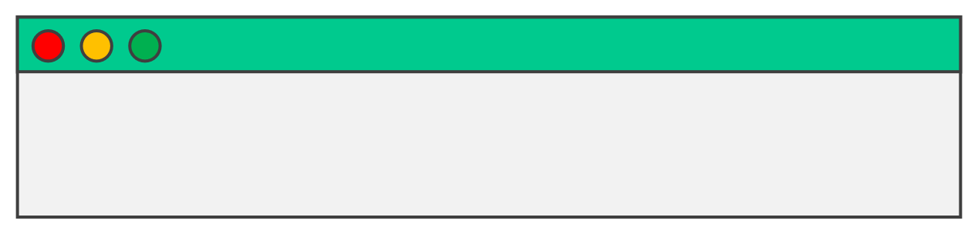
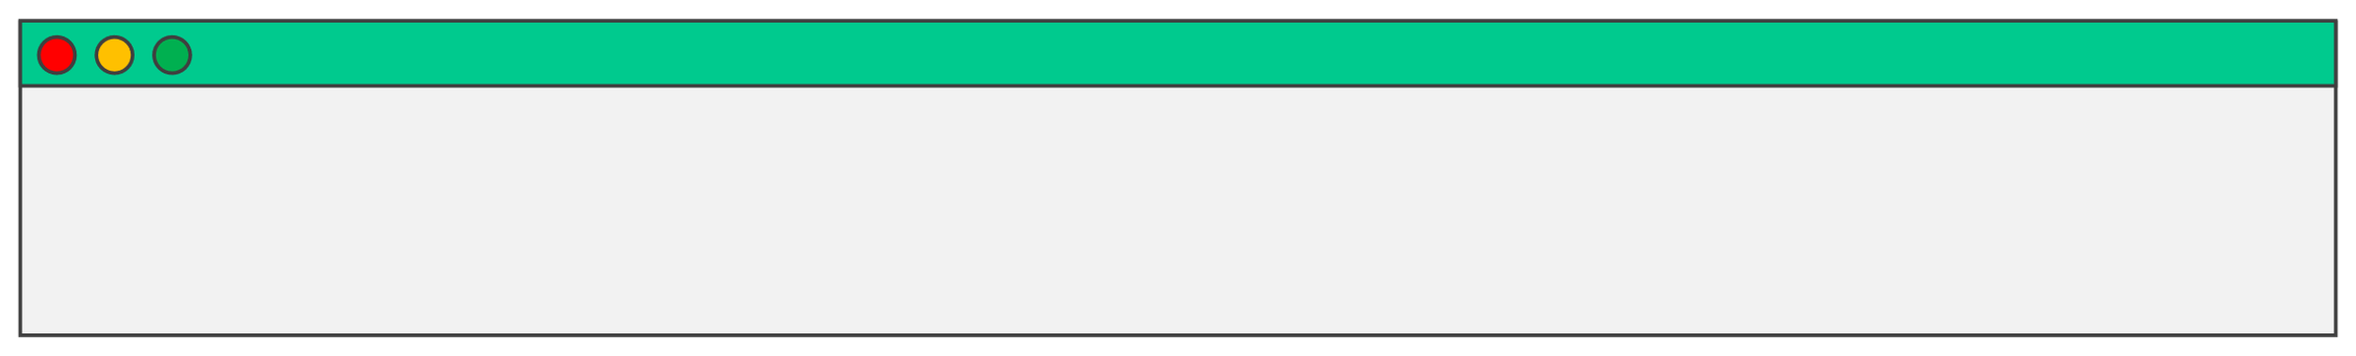
Nomad UI
Access the UI by hitting the URL (assuming default port):
• https://nomad.example.com:4646
You can also get to the URL by using the
nomad ui
command:
TERMINAL
$ nomad ui
Print the Nomad UI URL without opening the browser
TERMINAL
$ nomad ui
–show-url
URL for web UI: https://nomad.example.com:4646

Slide 12
DEMO
Using the Nomad UI

Slide 13
Nomad API
Nomad offers a fully-featured API to configure and work with your Nomad infrastructure
•
In fact, the CLI and UI invokes the proper API when using them
The API address is determined by the http address and port in the agent configuration file
•
By default, the API uses port
4646
https://developer.hashicorp.com/nomad/api-docs#http-api

Slide 14
Nomad API
• •
All API routes are prefixed with
Additional information may be passed as a query parameter
v1/
API Prefix
Targeted Namespace
https://nomad.example.com:4646/v1/jobs?namespace=prod
URL of Your Nomad Cluster
Endpoint You
Need to Use

Slide 15
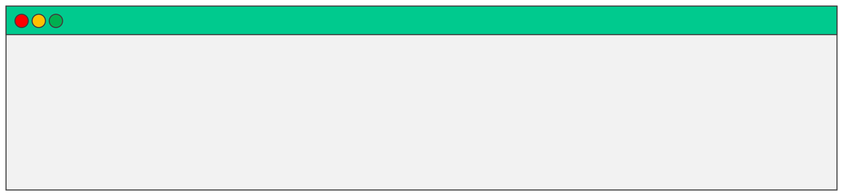
Nomad API
• •
If ACLs are enabled, a Nomad token must be provided when invoking an API
Authentication is done using the
header
X-Nomad-Tokenor
Authorization: Bearer
TERMINAL
$ curl \
--header "X-Nomad-Token: 4a8be0a9-459c-6598-ac8b-d80f26a6e8f0" \ --request POST --data @myapp.json https://nomad.example.com:4646/v1/jobs
https://developer.hashicorp.com/nomad/api-docs#http-api

