Slide 1


Working with Nomad Jobs

Slide 2

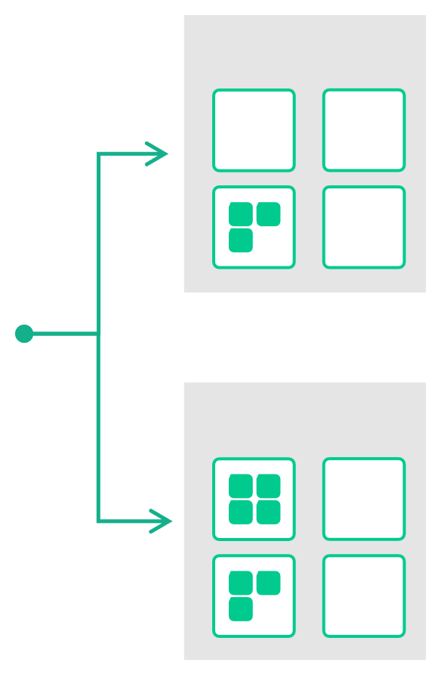


Core Concepts
(Reminder)
Task
The smallest unit of scheduling work. It could be a Docker container, a Java application, or batch processing.
JOB
CLIENT
Group
A series of tasks that should be co- located on the same Nomad client. Tightly-coupled tasks in the same group can share the same network/storage
Group "Frontend"
CLIENT
Job
The declarative that defines the deployment rules for applications
Group "Backend"
Application
The instance of a task group that are running on client

Slide 3
I’m Ready….How Do We Run a Job?
First, we need to write our Job spec
• •
Each job is submitted to Nomad using a job specification (job spec) The job file is written in HCL (or JSON) and is often saved with a
.nomad extension
Job files only contain one job, but they can have multiple tasks &
groups if needed
Tasks define the actual work that will be executed while the driver
controls how the task is executed
•
•

Slide 4

Job Specification Hierarchy
job
# …
group
GOAL:
# …
Start with a small job spec
task
and build up from there
# …
resources
# …
constraint
# …
task

Slide 5
Creating a Nomad Job Specification

Slide 6
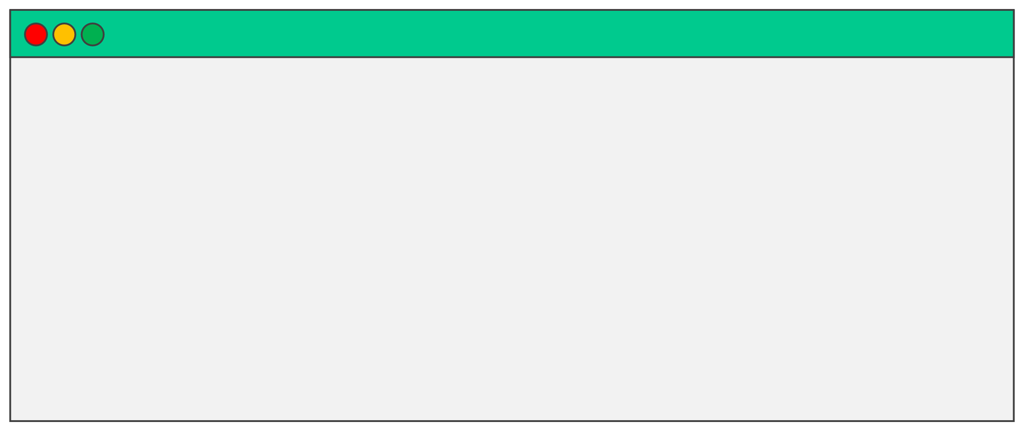
Nomad Job Specification
job
TERMINAL
job "tetris" {
# ...
}

Slide 7
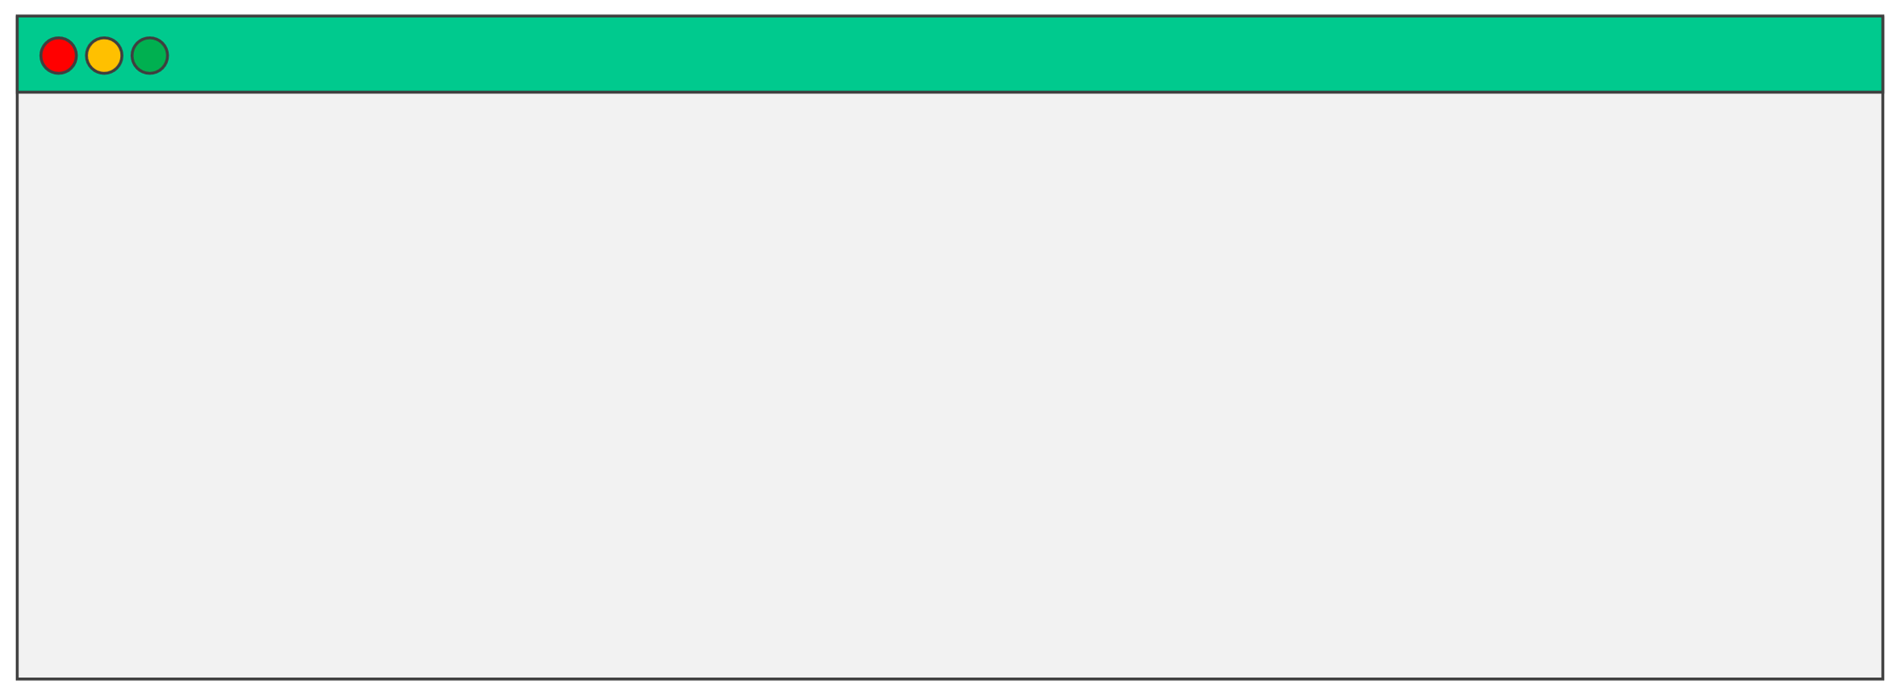
Nomad Job Specification
job
TERMINAL
job "tetris" {
# ...
# Specify the datacenters this job can run in datacenters = ["dc1"] # ...
}

Slide 8
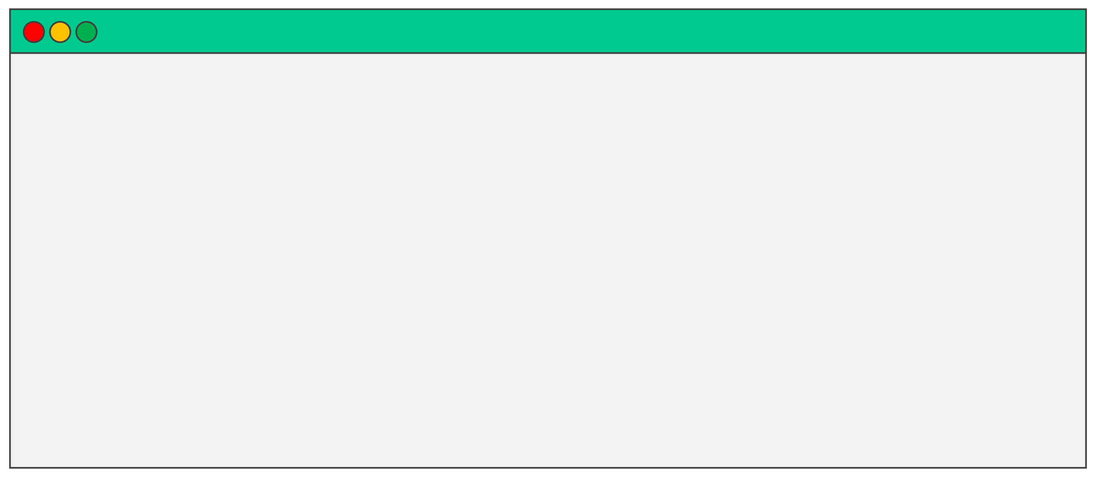
Nomad Job Specification
job
TERMINAL
job "tetris" {
# ...
# Specify the datacenters this job can run in datacenters = ["dc1"] type = "service" # ...
}

Slide 9
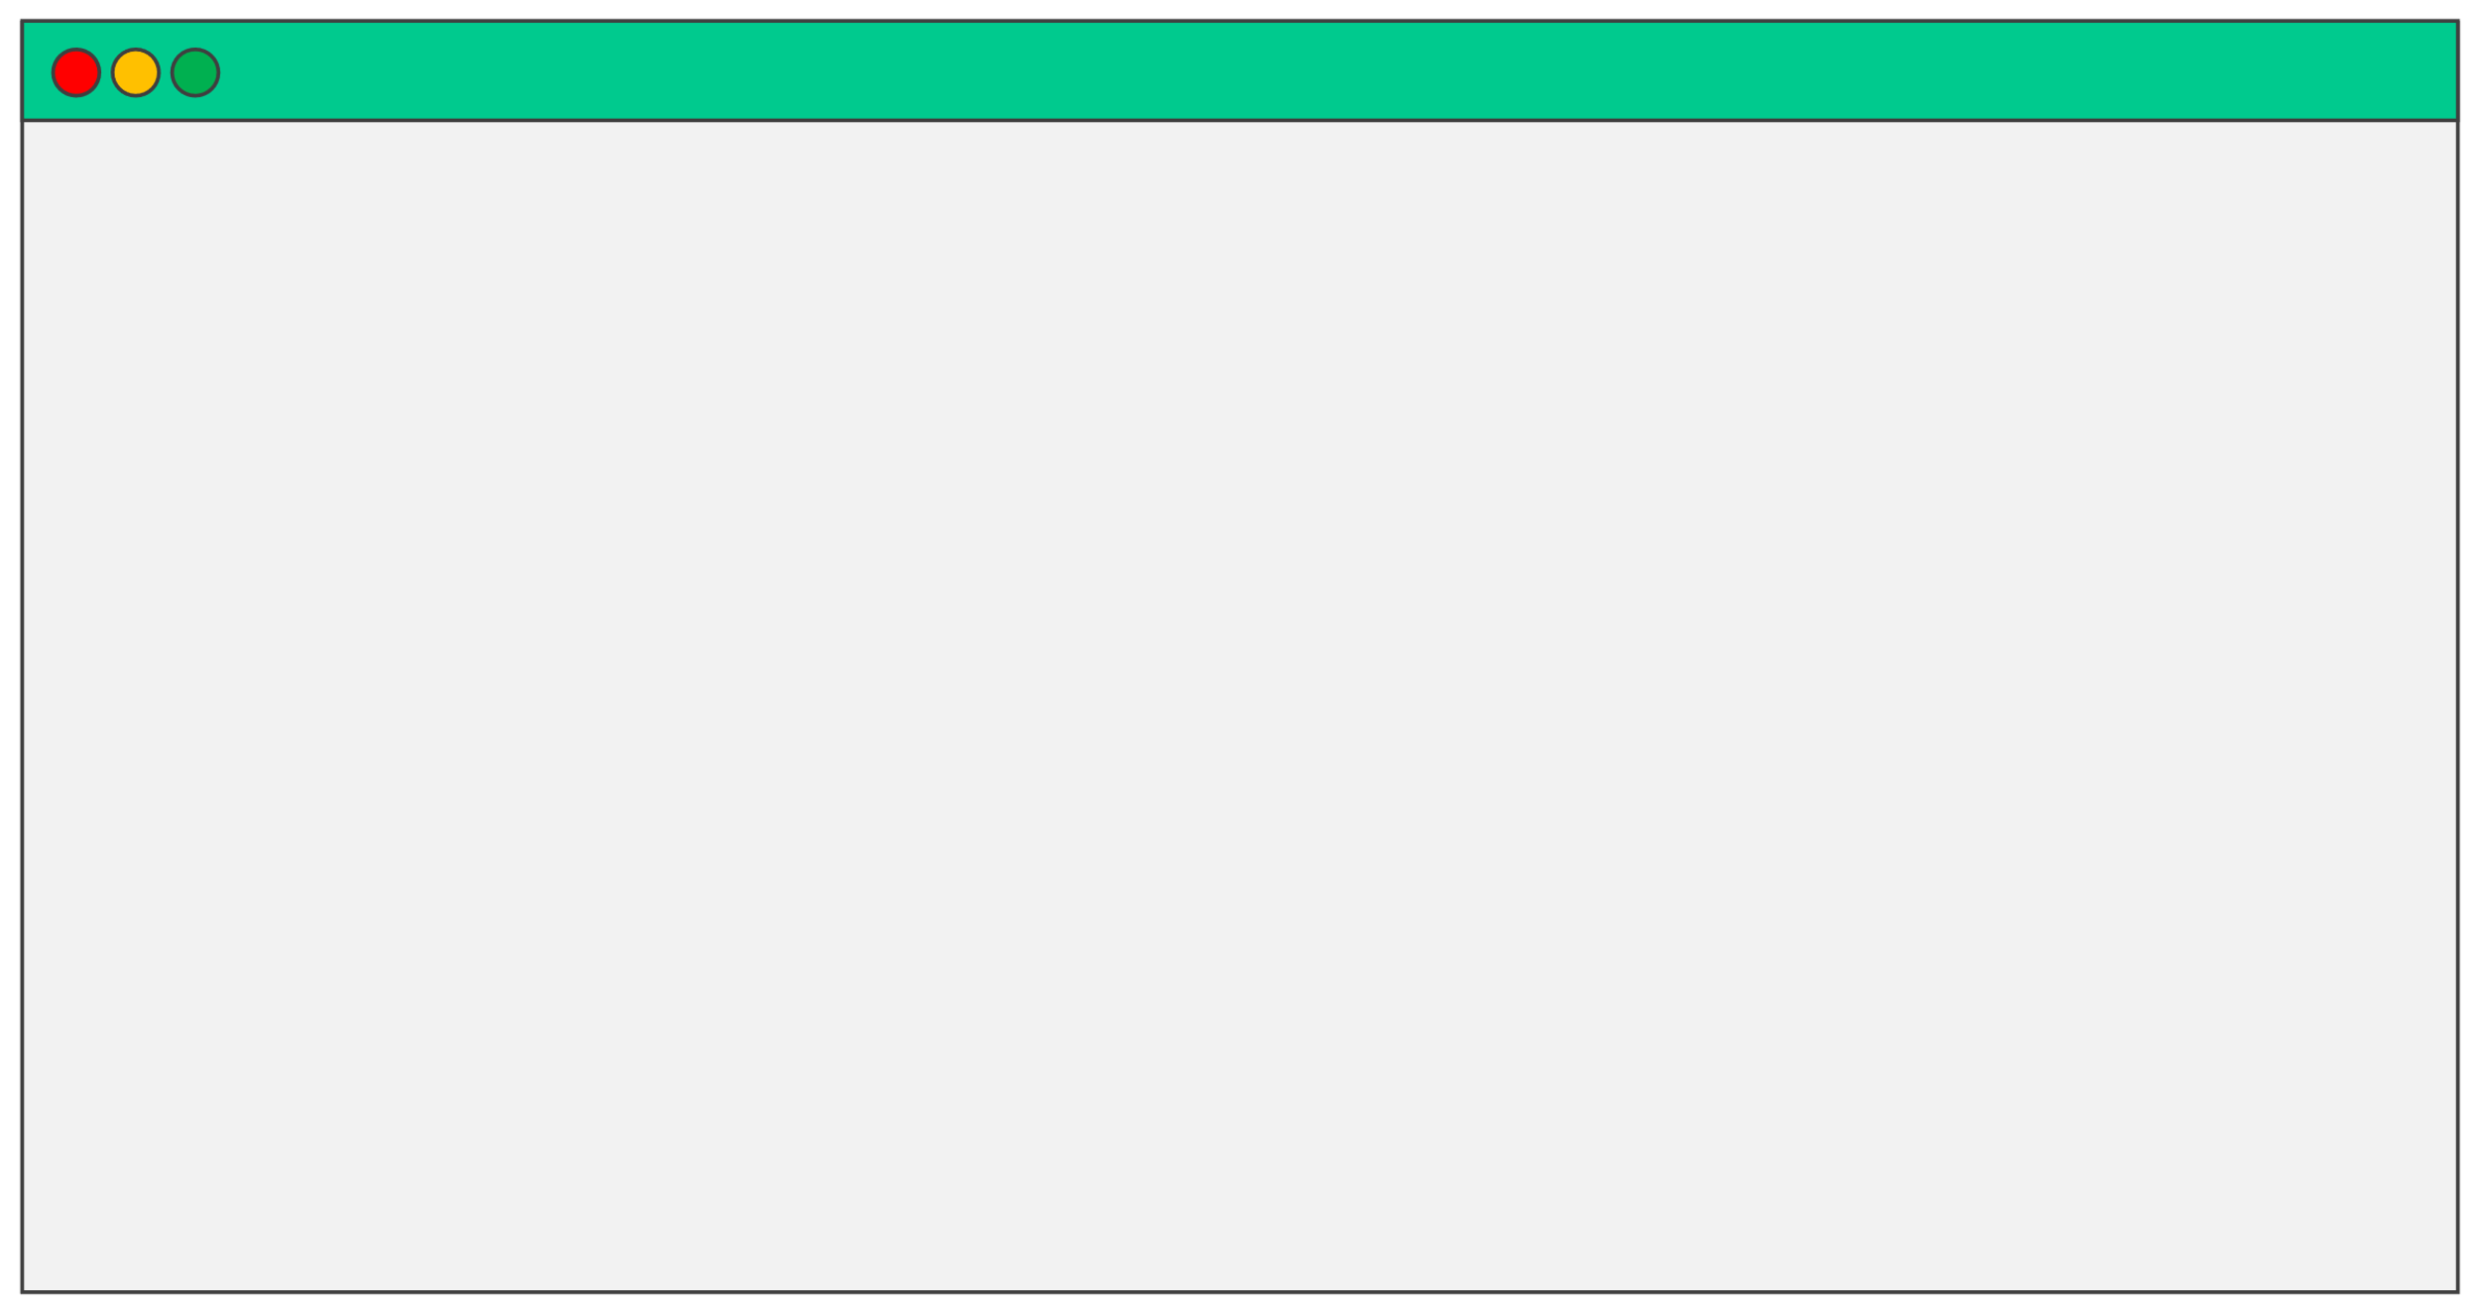
Nomad Job Specification
job
TERMINAL
job "tetris" {
# ...
datacenters = ["dc1"] type = "service" constraint {
attribute = "${attr.kernel.name}"
value
= "linux"
}
# ...
}

Slide 10
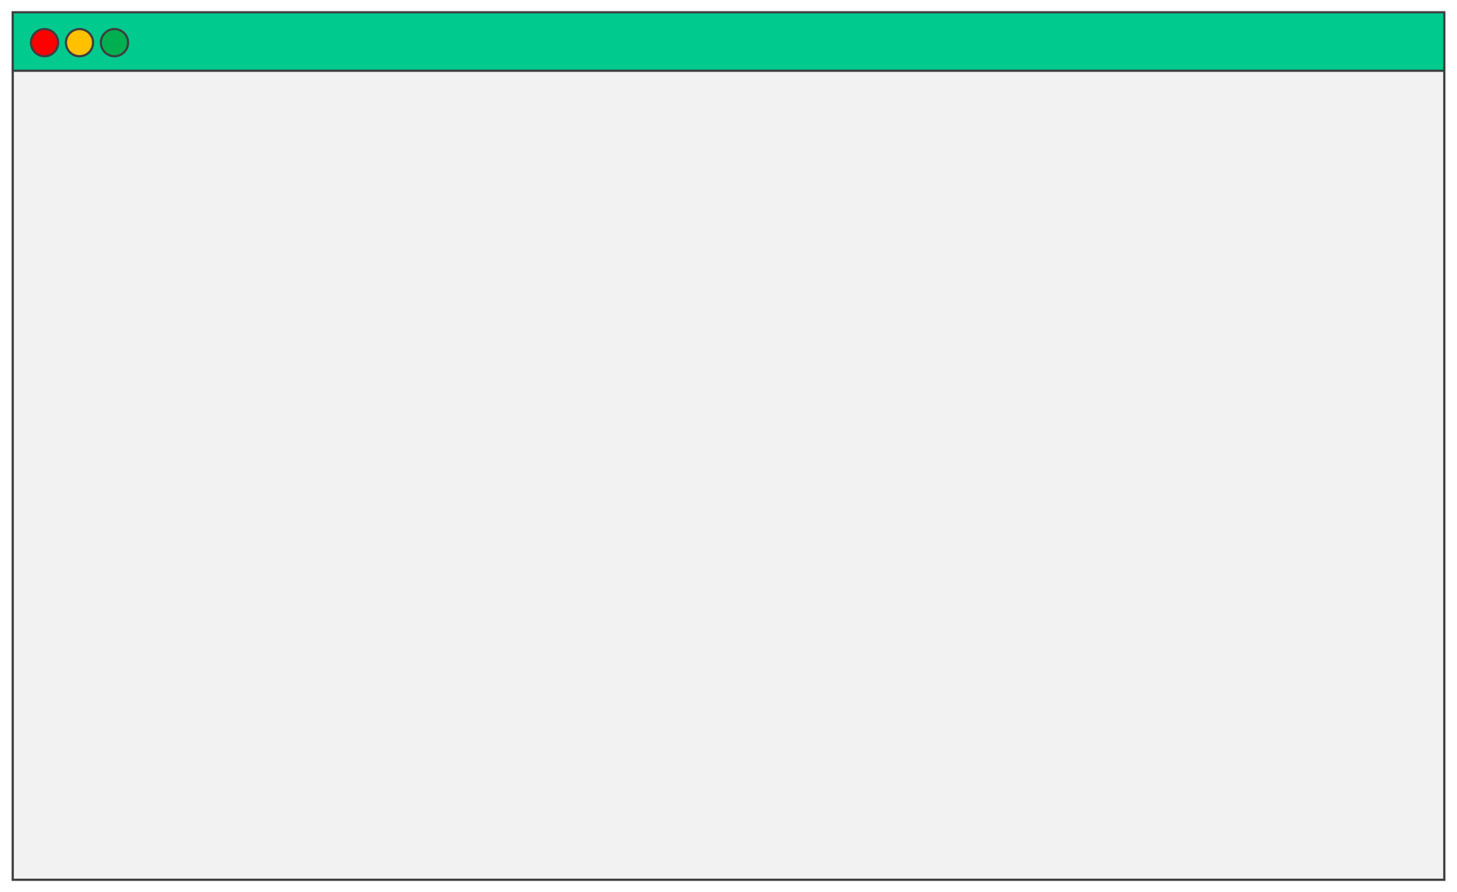
Nomad Job Specification
TERMINAL
job
job "tetris" {
# ...
datacenters = ["dc1"] type = "service" constraint {
attribute = "$[attr.kernel.name}"
value
= "linux"
} update {
max_parallel
= 1
}
# ...
}

Slide 11
Nomad Job Specification
TERMINAL
job "tetris" {
group
# ...
datacenters = ["dc1"]
group "games" {
count = 1 # ...
}
# ...
}

Slide 12

Nomad Job Specification
TERMINAL
job "tetris" {
group
# ...
datacenters = ["dc1"]
group "games" {
count = 1
task "tetris" {
driver = "docker"
config {
image
ports
auth_soft_fail
= "bsord/tetris"
= ["web"]
= true
}
}
}
}

Slide 13
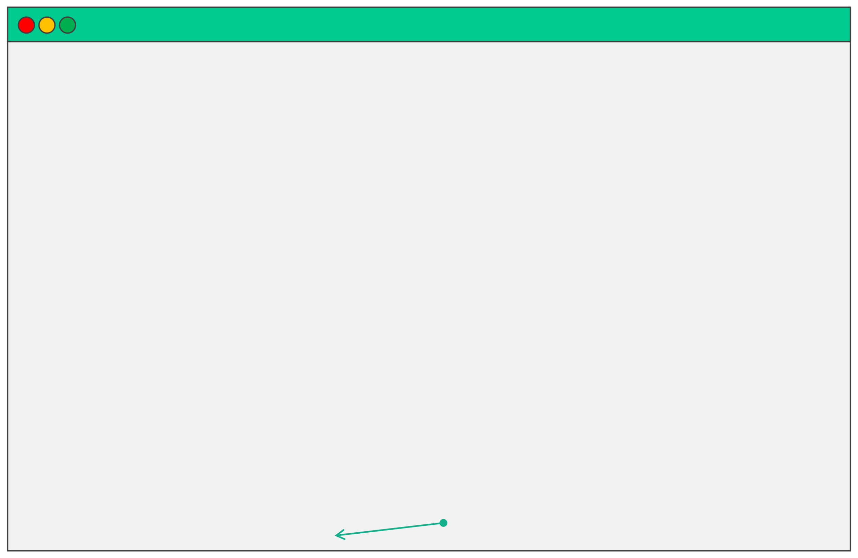
Nomad Job Specification
TERMINAL
job "tetris" {
group
# ...
group "games" {
count = 1
task "tetris" {
driver = "docker"
config {
image = "bsord/tetris"
ports = ["web"]
auth_soft_fail= true
}
resources {
cpu
= 500 # 500MHz
memory = 256 # 256MB network {
mbits= 10
}
}
Please assume I closed all my brackets here
J
}

Slide 14
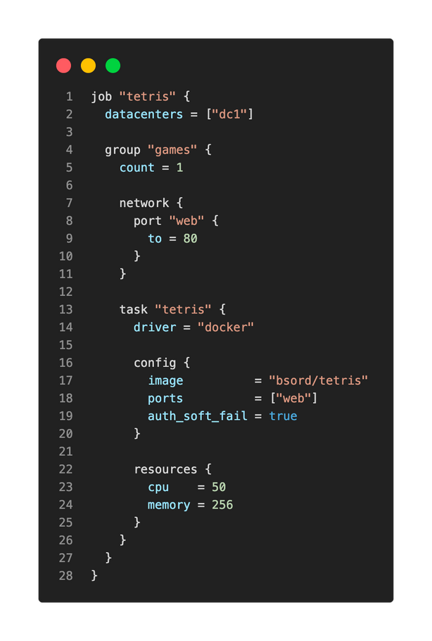
Complete File
With a Few Additions
•
All these configurations are in
a single
.nomad file
The file can be stored in a
code repo and iterated on as
needed
The file will be submitted to
Nomad to create our
resources when we're ready to
launch our application
•
job
group
•
task

Slide 15
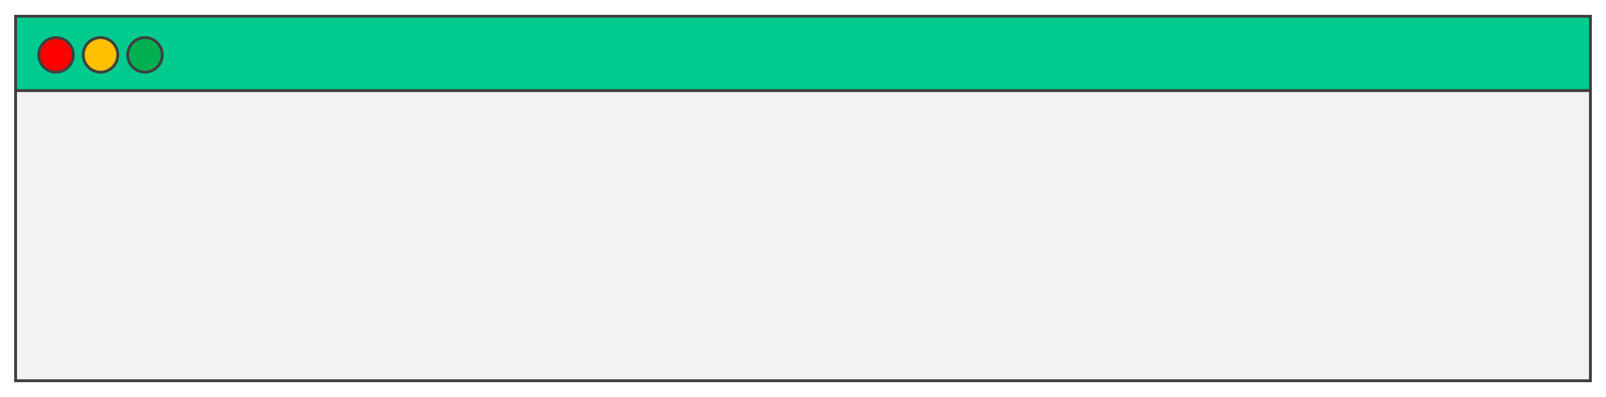
Validate Job Spec
•
Nomad CLI supports multiple ways to validate and format your job specification file
Use
•
nomad fmtto format the job spec file to a canonical format
•
This will automatically format all .
directory where the command is run
nomador .hclfiles in the
•
Use
nomad validate <file>
to check a job spec for any
syntax errors or validation problems
TERMINAL
$ nomad validate tetris.nomad
Job validation successful

Slide 16
DEMO
Create a Job Specification

Slide 17
Running Our First Nomad Job

Slide 18
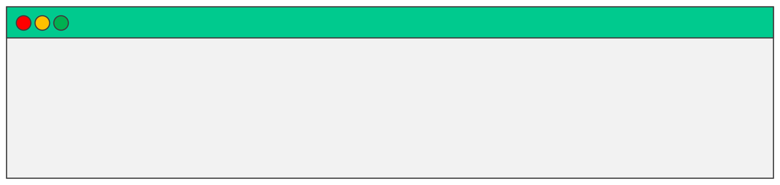
Nomad Job
•
Once your job specification has been written, we can now create jobs and submit to Nomad to launch our application
You can use the CLI or API to submit new jobs
• •
Use the command
to Nomad
nomad job run <file>to submit the job
TERMINAL
$ nomad job run [options] <file>

Slide 19
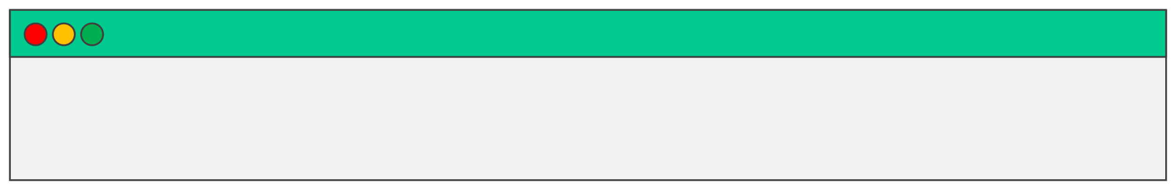
Nomad JobPlan
•
Before you submit a "real" job, you can use the
nomad job run
plan <file>to perform a dry-run to determine what would happen if the job is submitted
This is helpful to determine how the scheduler will react to the
submission of this new job
Can determine whether the job will run successfully, or it might
show you that you have insufficient resources to run it
•
•
TERMINAL
$ nomad job run plan [options] <file>

Slide 20


Nomad JobPlan
TERMINAL
$ nomad job plan tetris.nomad
+/-Job: "tetris" +/-Stop: "true" => "false"
Task Group: "games" (1 create)
PASSED
Task: "tetris"
Scheduler dry-run:
-All tasks successfully allocated.
Job Modify Index: 10764
To submit the job with version verification run:
nomad job run -check-index 10764 tetris.nomad
When running the job with the check-index flag, the job will only be run if the
job modify index given matches the server-side version. If the index has
changed, another user has modified the job and the plan's results are
potentially invalid.

Slide 21

Nomad JobPlan
TERMINAL
$ nomad job plan tetris.nomad
+/-Job: "tetris" +/-Stop: "true" => "false" +/-Task Group: "games" (100 create)
+/-Count: "1" => "100" (forces create)
FAILED
Task: "tetris"
Scheduler dry-run:
-
WARNING: Failed to place all allocations.
Task Group "games" (failed to place 94 allocations):
* Resources exhausted on 3 nodes
* Dimension "memory" exhausted on 3 nodes
Job Modify Index: 10764
To submit the job with version verification run:
nomad job run -check-index 10764 tetris.nomad
When running the job with the check-index flag, the job will only be run if the
job modify index given matches the server-side version. If the index has
changed, another user has modified the job and the plan's results are
potentially invalid.

Slide 22
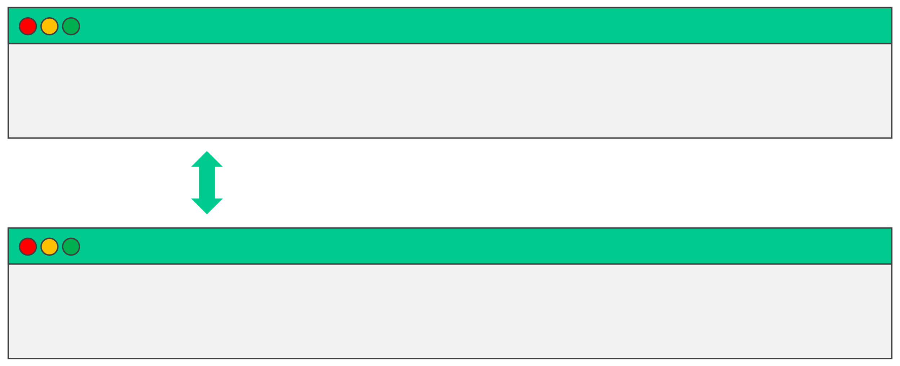
Nomad Job
•
Ok, let's submit our tetrisjob with just a count of "1" which we know will work fine
TERMINAL
$ nomad job run tetris.nomad
SAME COMMAND
TERMINAL
$ nomad run tetris.nomad

Slide 23

Nomad Job
TERMINAL
$ nomad job run tetris.nomad
==> 2023-01-04T15:10:12Z: Monitoring evaluation "ec4eb3c0"
2023-01-04T15:10:12Z: Evaluation triggered by job "tetris" 2023-01-04T15:10:13Z: Evaluation within deployment: "f5cbd676" 2023-01-04T15:10:13Z: Allocation "83ff6abb" created: node "f55a64a7", group "games" 2023-01-04T15:10:13Z: Evaluation status changed: "pending" -> "complete"
==> 2023-01-04T15:10:13Z: Evaluation "ec4eb3c0" finished with status "complete" ==> 2023-01-04T15:10:13Z: Monitoring deployment "f5cbd676"
✓Deployment "f5cbd676" successful
2023-01-04T15:10:31Z
ID
Job ID
= f5cbd676
= tetris
Job Version = 0
Status
= successful
Description = Deployment completed successfully
Deployed
Task Group
games
Desired
1
Placed
1
Healthy
1
Unhealthy
0
Progress Deadline
2023-01-04T15:20:29Z

Slide 24
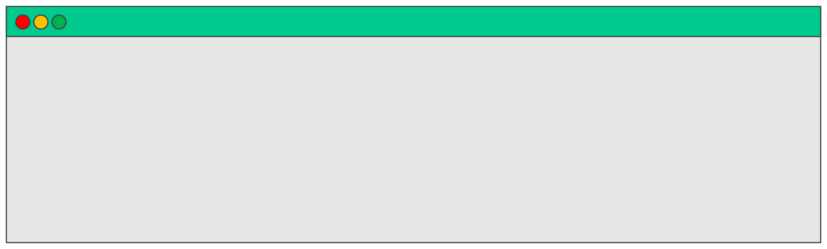
Nomad Job
Use the command the cluster
to show the status of alljobs on
nomad job status
TERMINAL
$ nomad job status
ID tetris vault
Type service 50 service 50
Priority Status
Submit Date running 2023-01-04T15:10:12Z running 2022-12-27T15:09:14Z
I had another job already running on this cluster

Slide 25
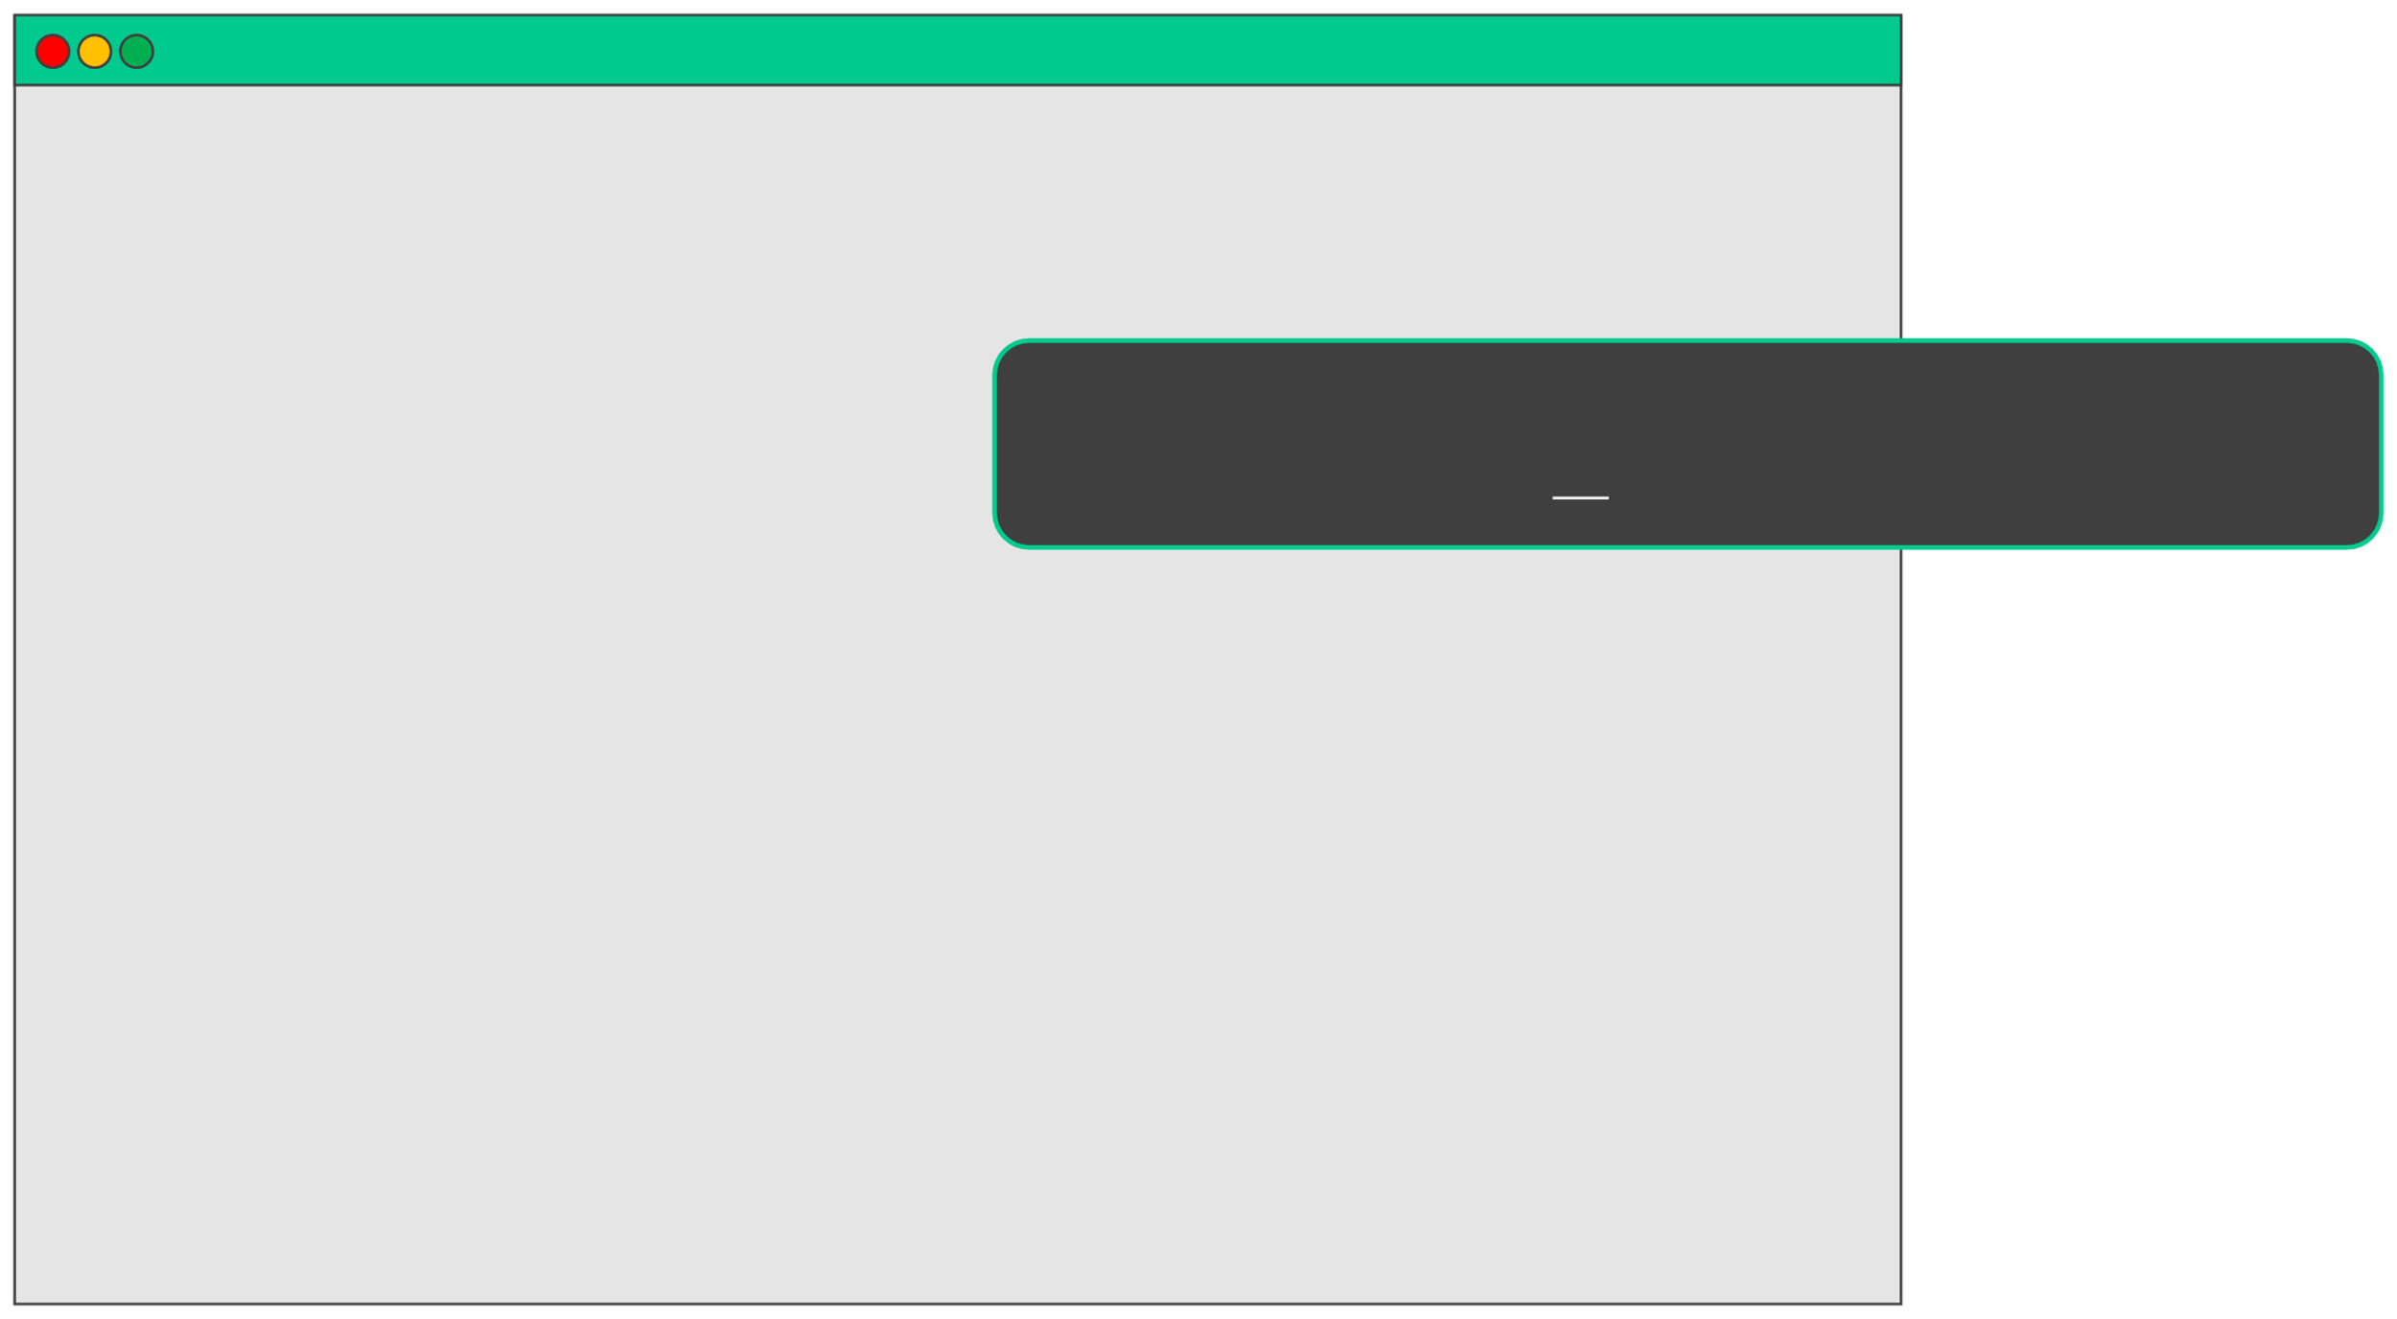
TERMINAL
Nomad Job
$ nomad job status tetris
ID Name Submit Date
Type
Priority
Datacenters
Namespace
Status
Periodic
= tetris = tetris = 2023-01-04T15:10:12Z
= service
= 50
= dc1
= default
= running
= false
Parameterized = false
Use the command
nomad job status <job name>
to show the status of alljobs on the cluster
Summary Task Group Queued Starting Running Failed Complete Lost Unknown
games
0
0
1
0
0
0
0
Latest Deployment
ID
Status
= f5cbd676
= successful
Description = Deployment completed successfully
Deployed
Task Group Desired Placed Healthy Unhealthy Progress Deadline
games
1
1
1
0
2023-01-04T15:20:29Z
Allocations
ID
83ff6abb f55a64a7 games
Node ID
Task Group Version Desired Status
Created
Modified
0
run
running 1h13m ago 1h13m ago

Slide 26
DEMO
Run Our First Nomad Job

