Slide 1

VAULT

Slide 2
INTRODUCTION INTO VAULT
HashiCorp Vault is an identity-based secrets and encryption management system.
A secret is anything that you want to tightly control access to, such as API encryption keys, passwords, and certificates.
Vault provides encryption services that are gated by authentication and authorization methods.
Using Vault’s UI, CLI, or HTTP API, access to secrets and other sensitive data can be securely stored and managed, tightly controlled (restricted), and auditable.

Slide 3
Why we need Vault?
HashiCorp Vault is a tool that helps protect sensitive data and manage secrets. It can be used in a variety of ways, including:
Encryption: Vault can help protect data at rest and in transit by managing and automating encryption keys. It can also act as a KMIP server to provide cryptographic keys to clients.
Audit logs: Vault tracks user actions, such as which user accessed what vault, when, and how they authenticated.
Dynamic secrets: Vault can provide short-lived credentials to applications, which are valid for a specific period of time.
Kubernetes secrets: Vault can help securely introduce secrets into applications and infrastructure. It allows each service to authenticate and request its own credentials.
Access control: Vault allows administrators to control who has access to specific files and folders.

Slide 4
History of vault
HashiCorp Vault was introduced in 2015 as a solution to the complex challenges of securing secrets in dynamic, cloud-native environments. Since its release, Vault has evolved to handle a wide range of security tasks, from secret management to data encryption and identity management.
2015 - Initial Release of Vault 0.1 as an open source to manage secrets
2016 - Vault 0.5: Dynamic Secrets were added
2017 - Vault 0.9: Expanding Beyond Secrets Management by including encryption
2018 - Vault 1.0: Production-Ready and released as a stable product with enterprise edition available

Slide 5
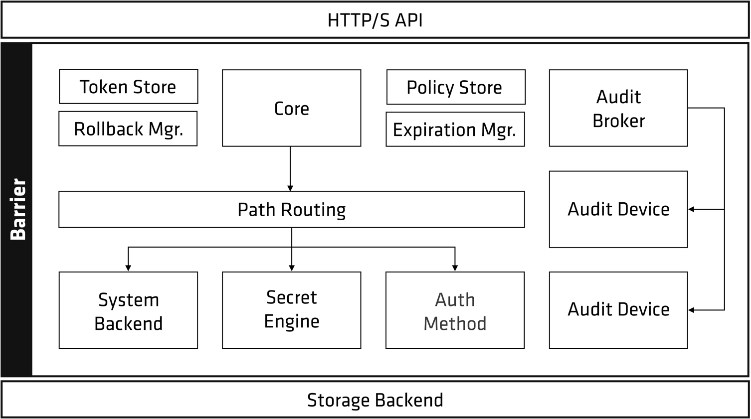
Vault architecture

Slide 6
Reference
For more details read from official documents at : https://developer.hashicorp.com/vault/docs/internals/architecture

