Slide 1
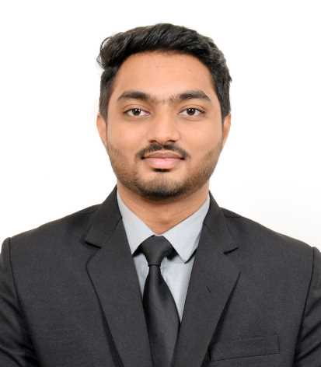

SAHIL AHAMED SHAIK
UNSW Robotics Master’s Student · AI & Autonomous Systems
5+
2
3
1
Major Projects
Internships
Conferences
AIP Publication
Master’s in Robotics — UNSW Sydney | B.Tech Mechatronics — Hindustan Institute of Technology & Sciences (HITS)
ROS 1 & 2
SolidWorks
Python
C++
TensorFlow
ANSYS
SLAM
Unity AR/VR
MATLAB
sahil86469@gmail.com · linkedin.com/in/sahil-shaik-8bb309219 · github.com/sahil86469

Slide 2







CAREER
Professional Experience
Robotics Intern
ROS Intern
Abhyaz
Edgeforce Solutions
Built hands-on expertise in ROS architecture, topics & launch files
Mastered SolidWorks & Fusion 360 for parametric 3D modeling
Self-directed learning approach to tackle advanced robotics challenges
UGV path-planning: Move Base (DWA) & custom A* with SLAM
3D point cloud obstacle detection via LiDAR + camera integration
CBM system design, exoskeleton work & airport tug CAD (PLANSYS2)
Key Deliverables from Edgeforce
Gazebo & RViz
Simulations
UGV Physical
Deployment
Airport Tug
CAD Design
PLANSYS2
ROS 2 Task Planner
2 / 12

Slide 3
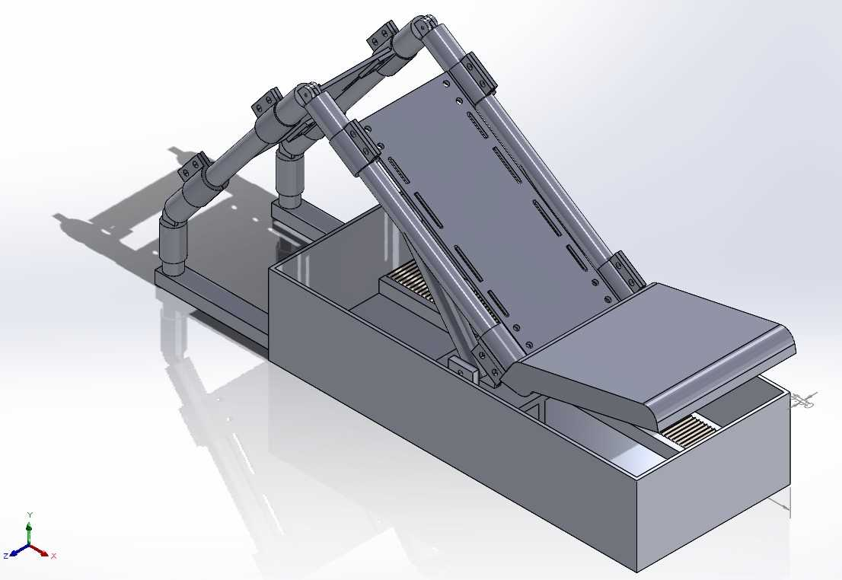
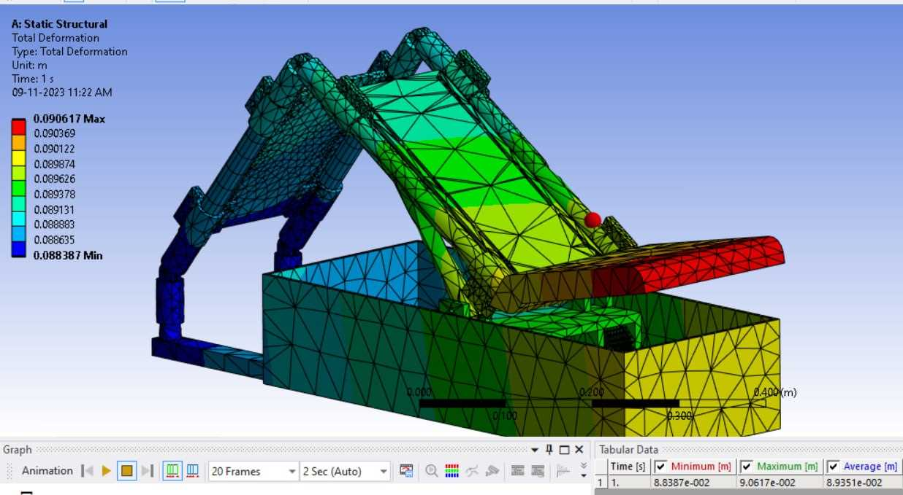
PROJECT OVERVIEW
Autonomous physiotherapy robot delivering targeted knee rehabilitation, replacing
clinician presence with precise 2-DOF arc motion and AI-powered diagnosis.
5+
3
FEATURED PROJECT · 01
Knee Rehabilitation
Robot
SolidWorks Designs
Physical Prototypes Built
56%
1★
AI-Augmented Physiotherapy System
CNN Model Accuracy
AIP Publication 2023
SolidWorks
ANSYS FEA
TECHNICAL HIGHLIGHTS
ANSYS static structural FEA: max deformation 0.09 m within safe patient limits
CNN (ReLU, 100 epochs) trained across 5 knee osteosis severity classes
Presented at RIACT 2022, RANE 2023 & AIIMS-3.0 — patent filing in progress
TensorFlow / CNN
Patent Pending
3 / 12

Slide 4
PROJECT · 02
UGV Autonomous Path Planning
Method A: ROS Move Base (DWA)
Method B: Custom A* + SLAM
Used the ROS navigation stack with Dynamic Window Approach local planner and trajectory planning for obstacle-reactive path following. Integrated global & local cost maps.
Built a bespoke A* pathfinding algorithm with SLAM-based occupancy mapping, offering full control over global and local path generation with waypoint-based static routing.
3D Point Cloud (LiDAR) for obstacle detection
Camera for region-of-interest targeting
Validated in Gazebo simulation first
Deployed on physical UGV platform
RViz for 2D/3D map visualization
Occupancy grid with static waypoints
SLAM for real-time environment mapping
Airport tug extension via PLANSYS2
Tools: ROS · Gazebo · RViz · Python · C++ · SLAM · Point Cloud · SolidWorks (Tug Design)
4 / 12

Slide 5
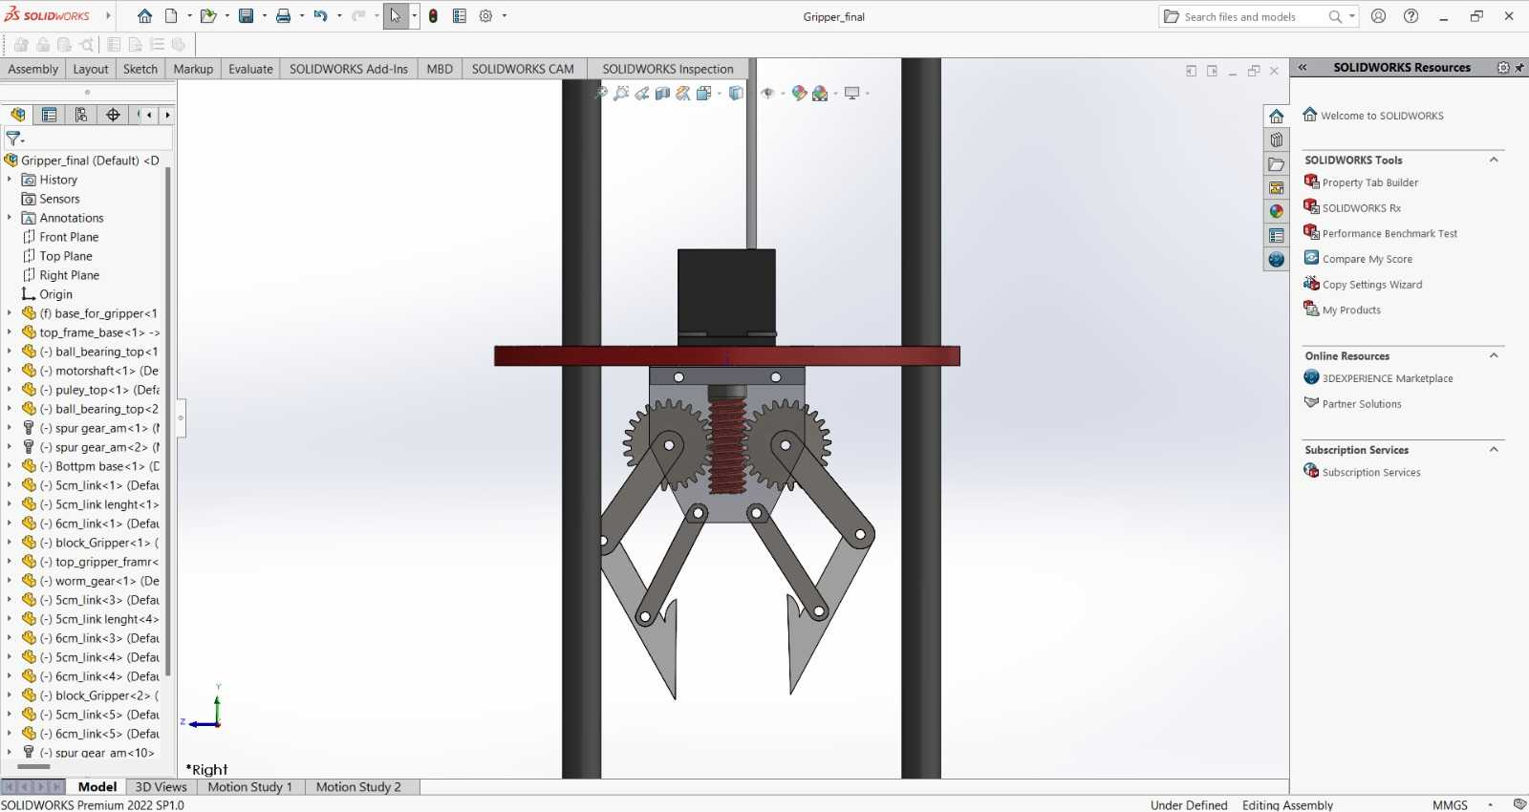
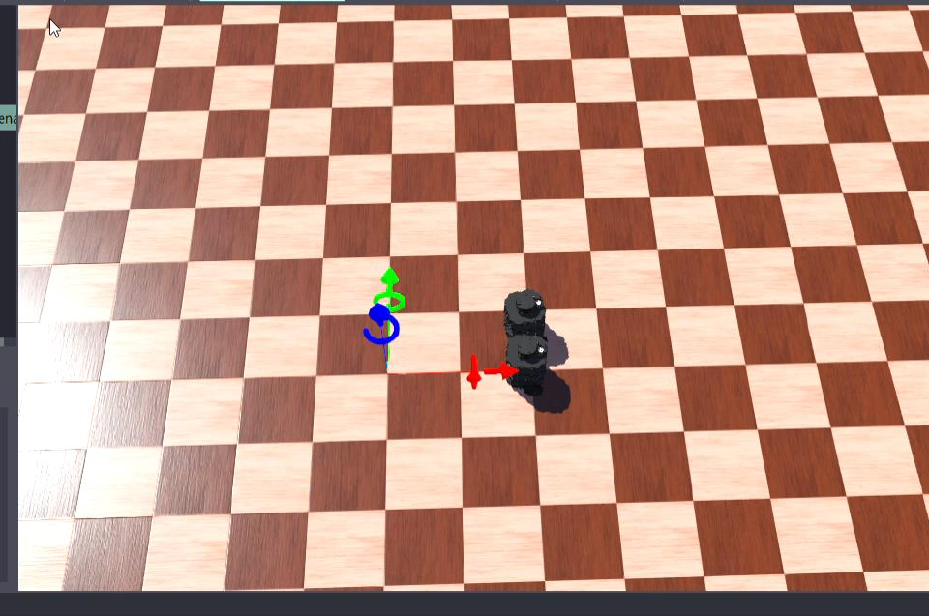
PROJECTS · 03 & 04
Rescue Robotics & Swarm Intelligence
Borewell Rescue Robot
Swarm Robot
Child rescue from borewell incidents via soft-gripper robotic system.
Multi-agent coordination in a virtual environment using Webots simulator.
• Soft grippers to safely extract child without injury
• 2 CAD designs created; 1 physical prototype developed
• Focused on simplicity, affordability & rapid deployment
• Market-available components used for reproducibility
• Full SolidWorks modelling with dimensional accuracy
• Studied swarm algorithms & inter-robot communication
• Webots simulator: Python-based controller programming
• Central world node used as communication medium
• Cumulative X-Y plane movement for coordinated motion
• Identified need for interrupt-based obstacle avoidance
5 / 12

Slide 6
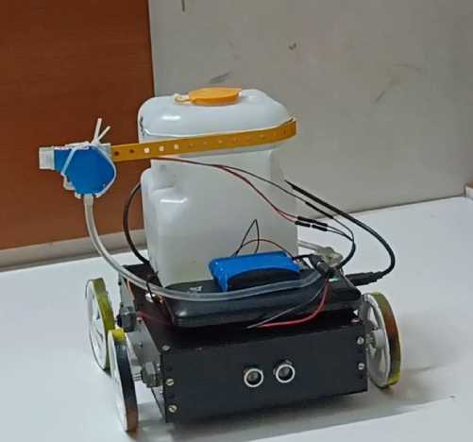
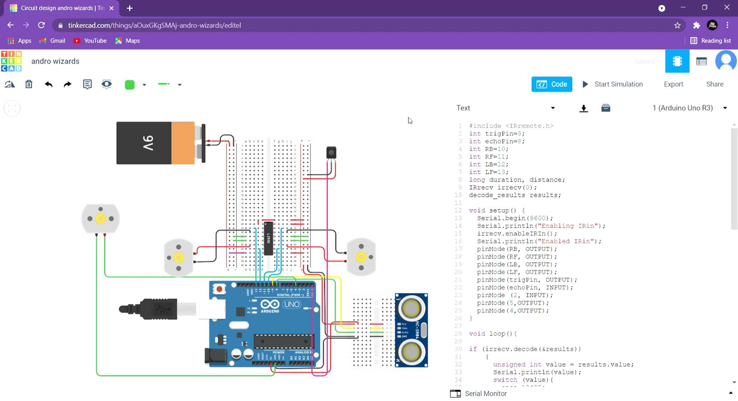
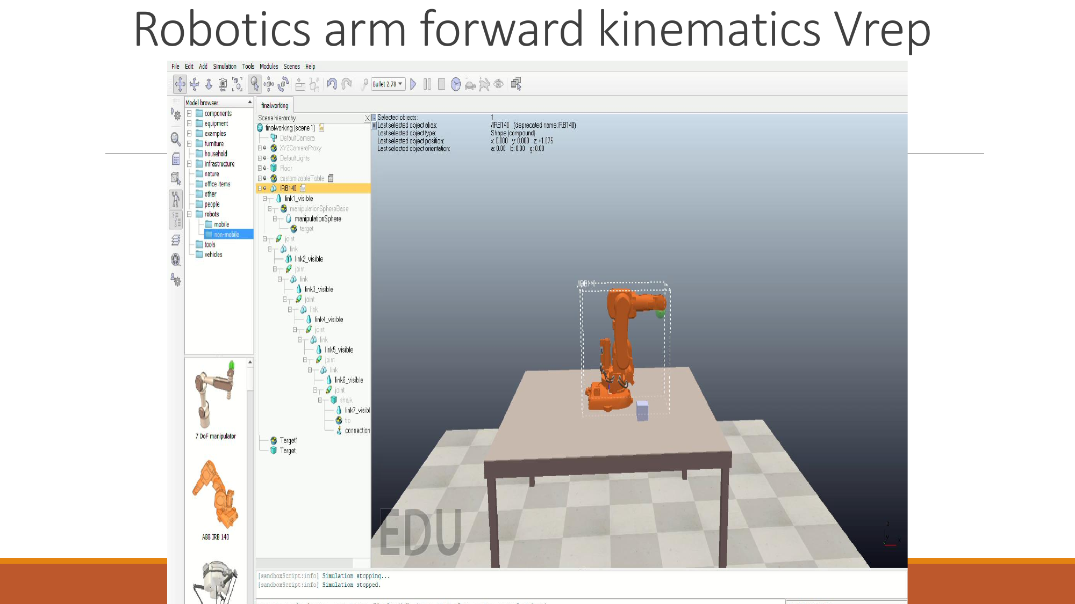
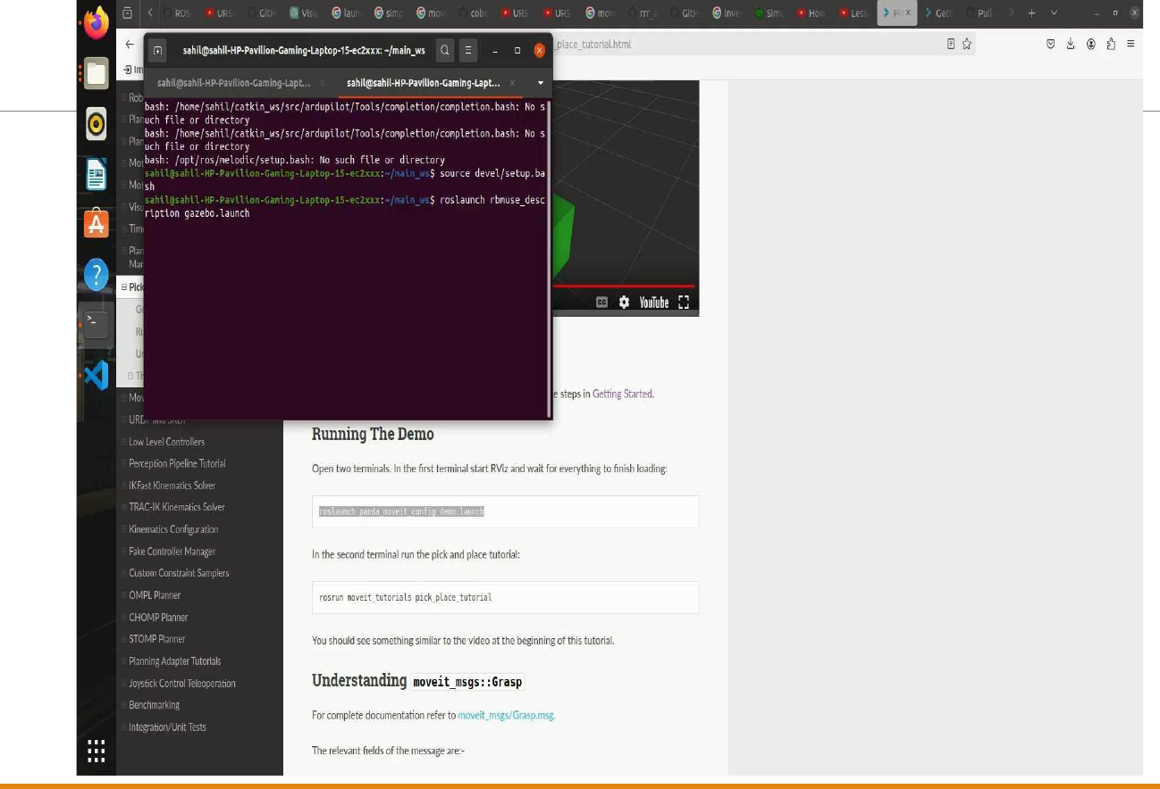
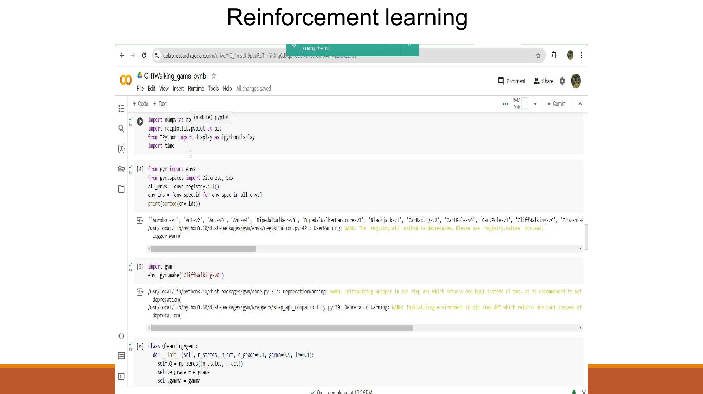
PROJECTS · 05 & ADDITIONAL
Sanitization Robot & Other Work
Additional Prototyping & Simulation Work
Selected screenshots from simulation, planning and perception work.
Circuit Simulation
V-REP Kinematics
Tinkercad wiring and code validation.
Forward kinematics of a 7-DOF robotic arm.
Autonomous Sanitizing Robot
Prototype for automated shop sanitization during the COVID-19 period.
Ultrasonic sensors for obstacle avoidance.
IR-triggered spray mechanism near shelves.
Tinkercad-based circuit and code validation.
MoveIt Planning
RL & OCR Experiments
Load-tested chassis for onboard water tank.
ROS MoveIt simulation for manipulator motion.
Reinforcement learning, OCR and vision prototypes.
6 / 12

Slide 7



RESEARCH & RECOGNITION
Publications & Presentations
Journal Publication
Design and Evaluation of Various Knee Assistive Mechanisms for Rehabilitation
AIP Publishing · November 10, 2023
RIACT 2022
RANE 2023
AIIMS-3.0
Robotics, Instrumentation, Automation & Control Technology
Recent Advancements in New Era Engineering
AI in Medical Systems — Knee Rehab Robot showcase
Patent application and additional journal submission currently in progress for the knee rehabilitation robot design.
7 / 12

Slide 8



TECHNICAL PROFILE
Skills & Tools
Core software, CAD, programming and specialization areas.
Robotics Software
CAD & Simulation
ROS 1 (Noetic)
RViz Visualizer
SolidWorks (Advanced)
MATLAB & Simulink
ROS 2 (Humble)
MoveIt Motion Planning
Fusion 360
V-REP / CoppeliaSim
Gazebo Simulator
PLANSYS2 Task Planner
ANSYS (FEA / Structural)
Unity (AR / VR)
Programming
Specializations
Python (Primary)
OpenCV
SLAM & Path Planning
Exoskeleton Design
C++
NumPy & Matplotlib
Computer Vision / OCR
Swarm Robotics
TensorFlow 2 / Keras
Embedded C (Arduino)
Reinforcement Learning
Pneumatics (SMC)
8 / 12

Slide 9

LEARNING & DEVELOPMENT
Certifications & Training
Courses and training supporting robotics, AI and simulation.
Completed
Completed
Completed
ROS for Beginners
TensorFlow 2.0
Intro to AI & Python
Basics, Motion & OpenCV
Deep Learning & AI
Machine Learning Basics
Udemy
Udemy
Udemy
Completed
Completed
Completed
MATLAB & Simulink
SMC Pneumatics
Reinforcement Learning
Onramp Training
3-Day Intensive Training
Advanced Algorithms
MathWorks
SMC Corporation
Udemy
9 / 12

Slide 10
KNEE REHAB ROBOT · DEEP DIVE
AI Algorithm: Knee Osteosis Detection
MODEL PERFORMANCE SUMMARY
Activation | Epochs | Test Loss | Accuracy
ReLU | 100 | 3.48 | 56% ★
ReLU | 50 | 2.82 | 53%
Linear | 100 | 3.71 | 50%
Linear | 50 | 3.11 | 50%
LeakyReLU | 100 | 4.58 | 52%
LeakyReLU | 50 | 3.08 | 52%
Best model: ReLU with 100 epochs achieved 56% accuracy across 5 severity classes (Normal, Doubtful, Mid, Moderate, Severe). Further gains possible with more training data.
10 / 12

Slide 11
ACADEMIC BACKGROUND
Education & Overview
Current Master’s Study
Undergraduate Degree
Master’s in Robotics
B.Tech — Mechatronics Engineering
UNSW Sydney · Australia
Hindustan Institute of Technology & Sciences (HITS) · Chennai, India
Focus: robotics, autonomous systems, ROS, navigation and manipulation.
Foundation in mechanical, electronics, control systems and programming.
5+
2
3
Robotics Projects
Internships
Conferences Presented
1
5
1
Publications
Certifications
Patent Pending
11 / 12

Slide 12



LET'S CONNECT
Sahil Ahamed Shaik
UNSW Robotics Master’s Student · Open to robotics internships & research roles
sahil86469@gmail.com
github.com/sahil86469
linkedin.com/in/sahil-shaik-8bb309219
Thank you for your time.

