Slide 1

SAHIL AHAMED SHAIK
Robotics enthusiast
EDUCATION:
  B.tech-mechatronics from Hindustan Institute of Technology and Sciences (HITS).
EXPERIENSES:
  Abhyaz internship (Robotics intern)
    Learning about ROS, SolidWorks, and CAD software
    Self-learning approach.
  Edgeforce solutions (ROS intern)
  Worked on UGV path-planning (MOVE_BASE PACKAGE + creating self program)
    Worked on CBM designing and developing along with UGV parts
    Worked on EXO skeleton.
PUBLICATIONS AND PRESENTATIONS:
  Design and evaluation of various knee assistive mechanisms for rehabilitation design and evaluation of various knee assistive mechanisms for rehabilitation, AIP Publishing · Nov 10, 2023
  Presented at RIACT 2022, RANE 2023 and AIIMS- 3.0.
  Patent and journal is in process.

Slide 2
UGV Path-Planning
Edgeforce solutions(experience)

Slide 3
UGV Path-Planning
This is the static programming of the robot where the robot movement is defined by giving waypoints at the start.
The major obstacle detention is done by 3D point cloud sensor and the camera is there for region of interest.
The two methods described are
  Move Base package using DWA and trajectory planning
  The base programming using A* along with local and global map
The simulations are done in the gazebo and RVIZ for initial testing. The sensor data collection along with final testing was done in the UGV with some major changes.
Along with that airport tug designing and PLANSYS2 in ROS 2.

Slide 4
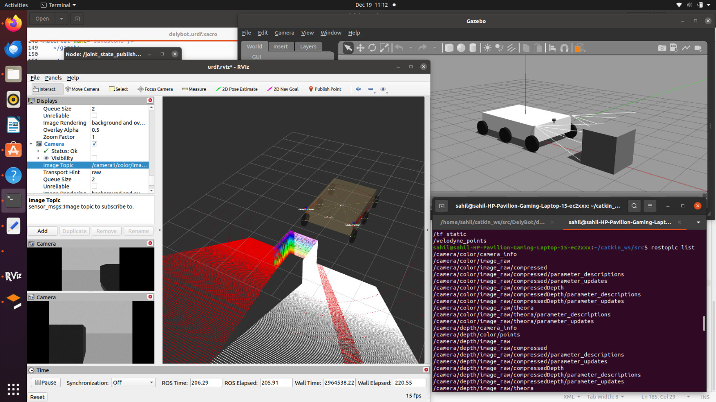
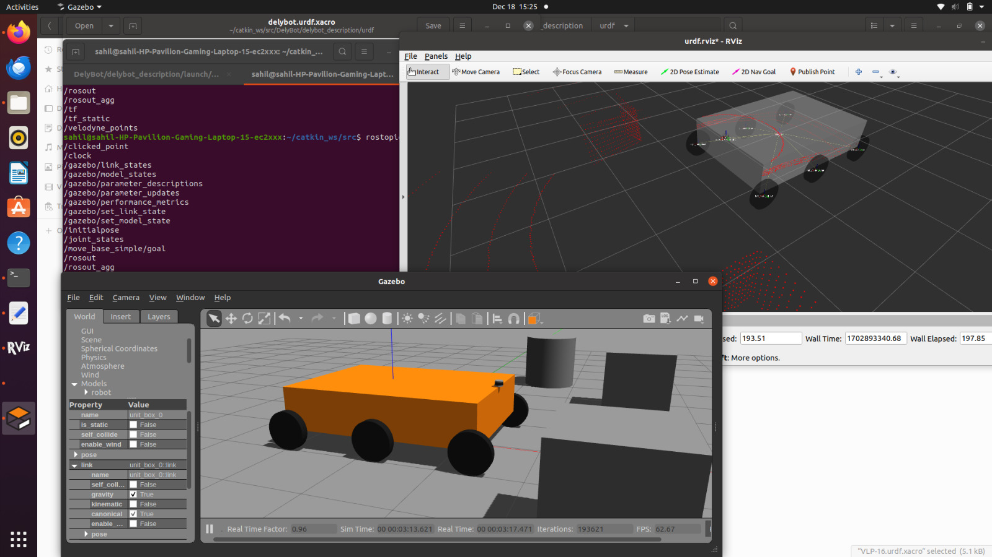
ROS INSTALLATION AND CAMERA INTEGRATION TO TUG IN RVIZ+GAZEBO

Slide 5
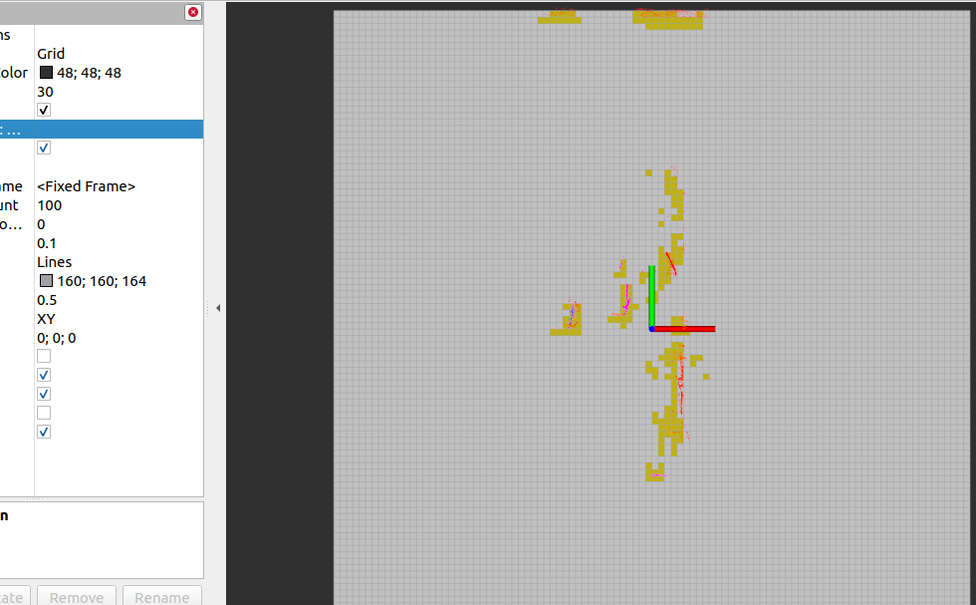
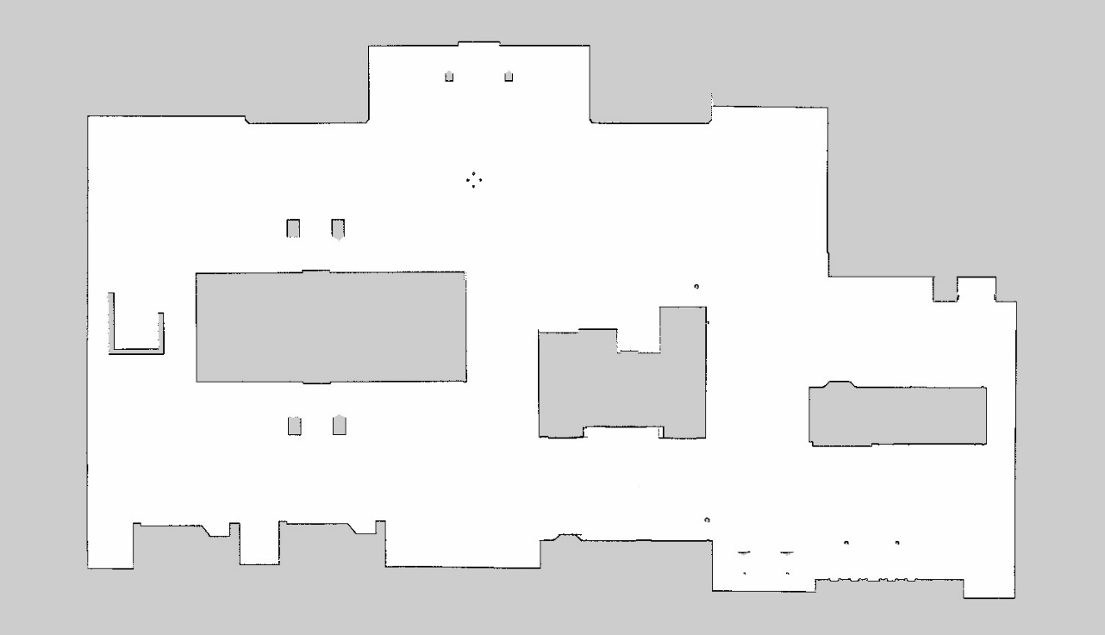
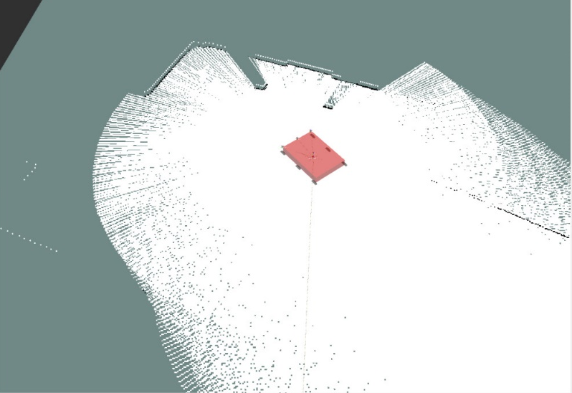
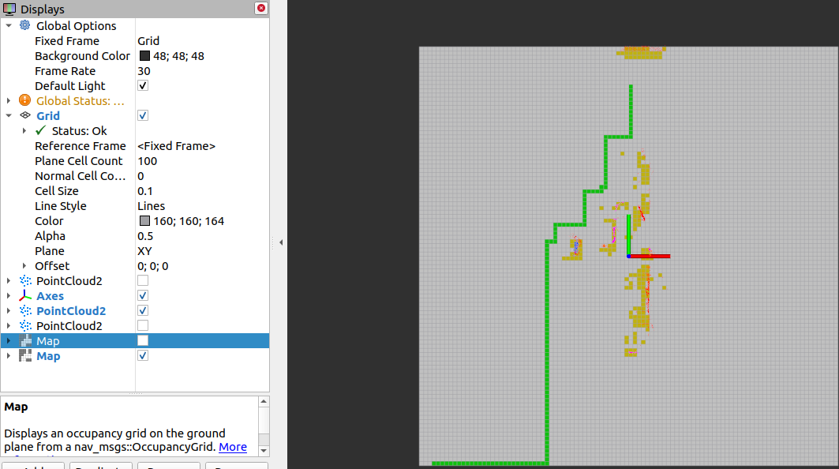
Path planning using A* and SLAM

Slide 6
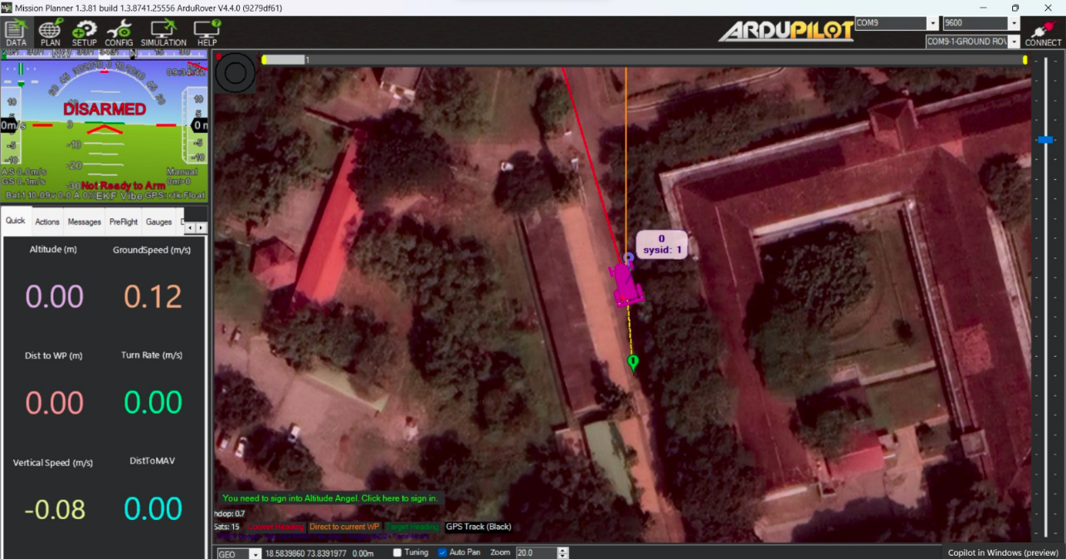
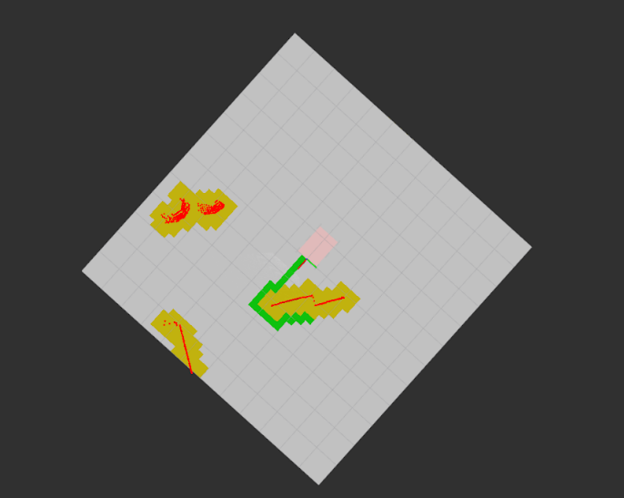
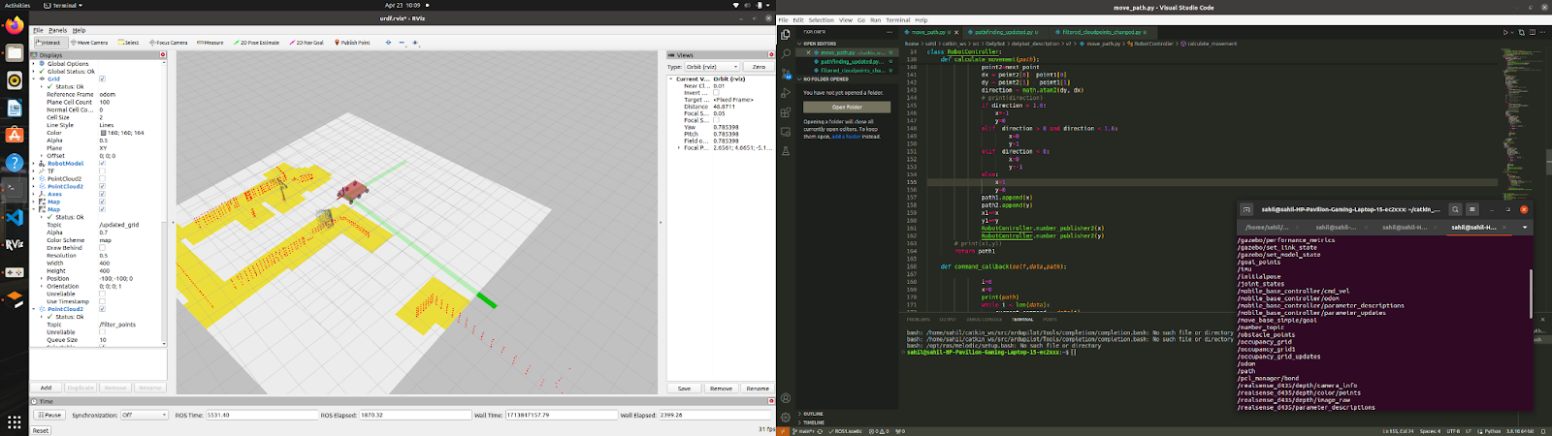
A* waypoint follower algorithm

Slide 7
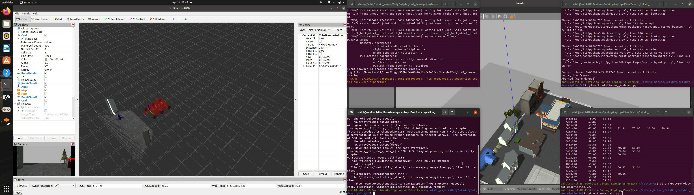
Path-planning algorithm

Slide 8
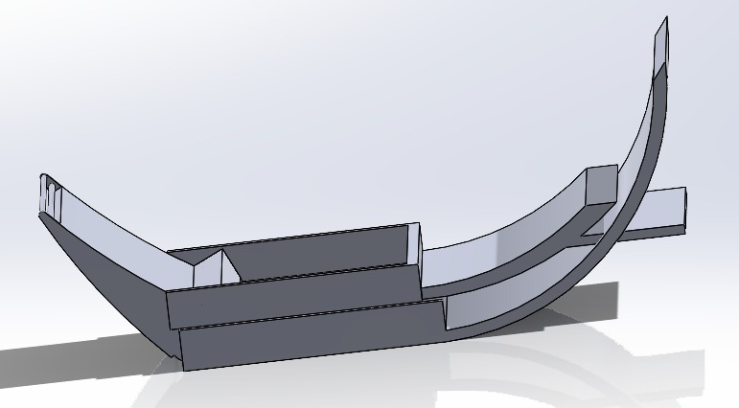
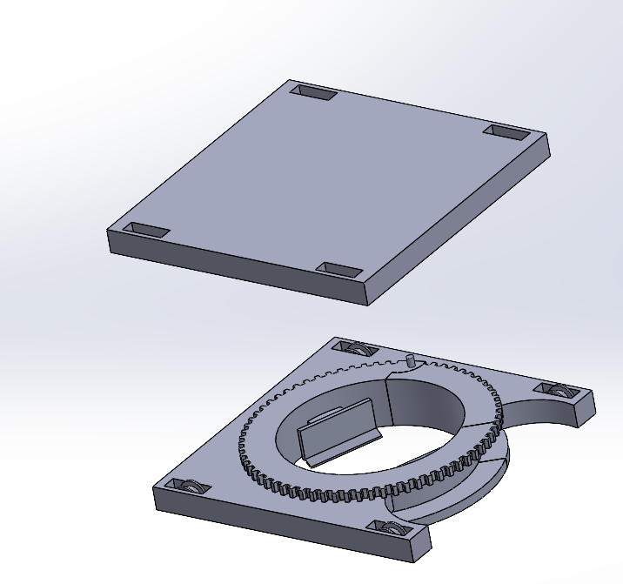
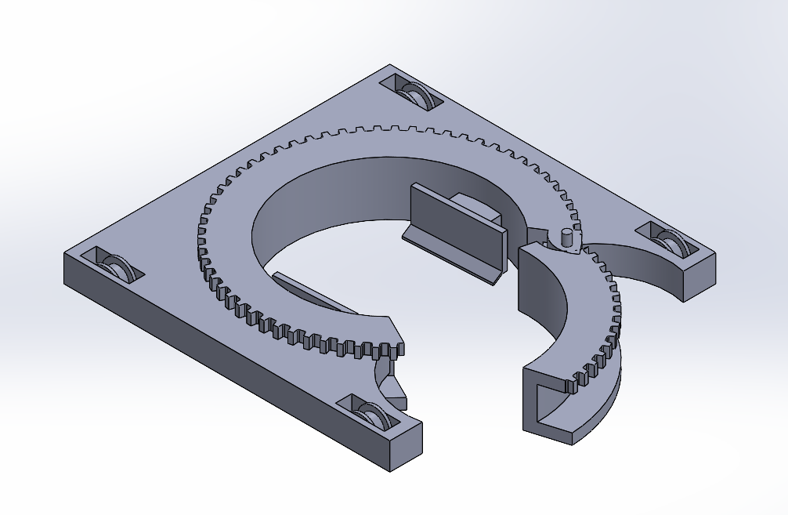
AIRPORT TUG DESIGNS

Slide 9
Other projects

Slide 10
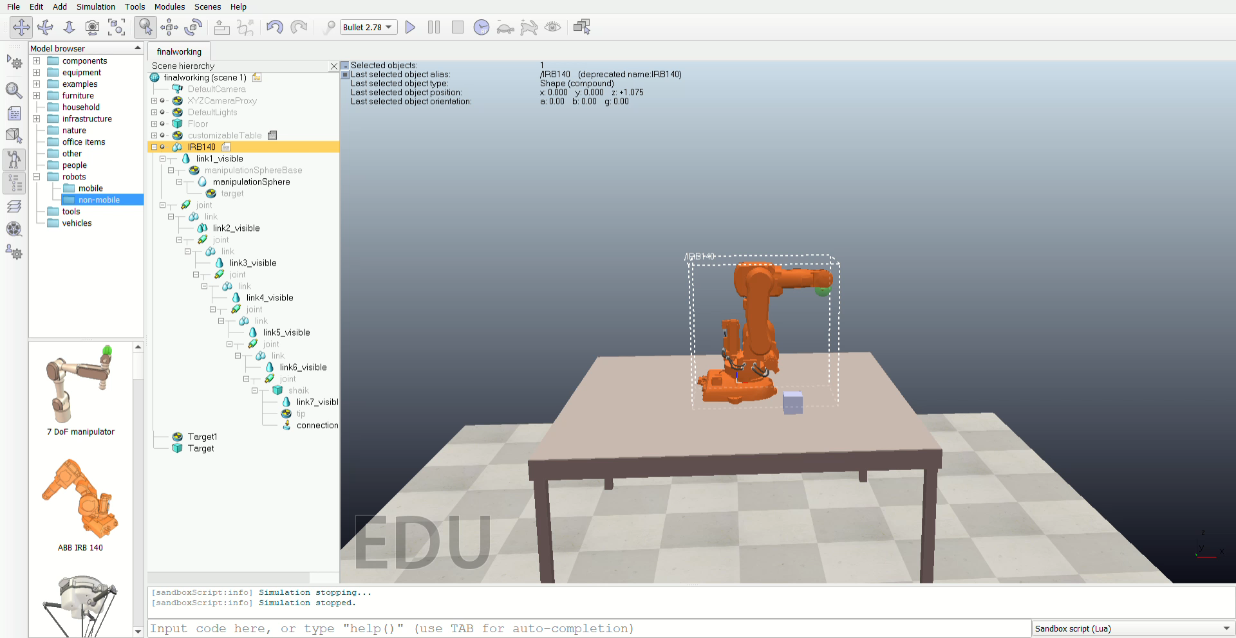
Robotics arm forward kinematics Vrep

Slide 11
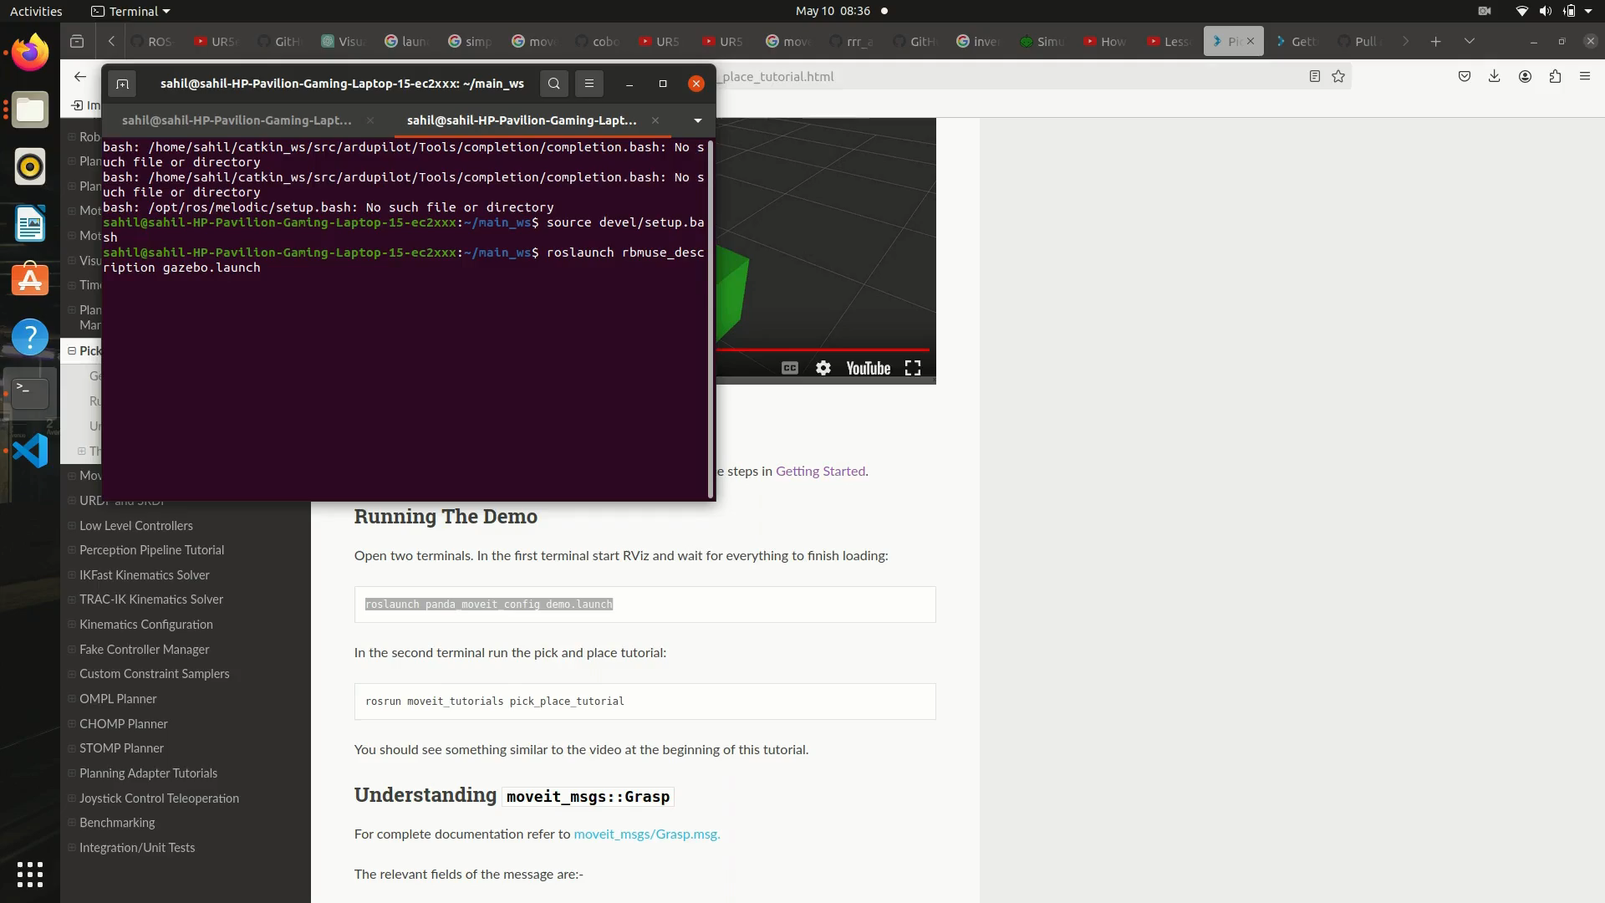
Robotics arm Moveit simulation

Slide 12
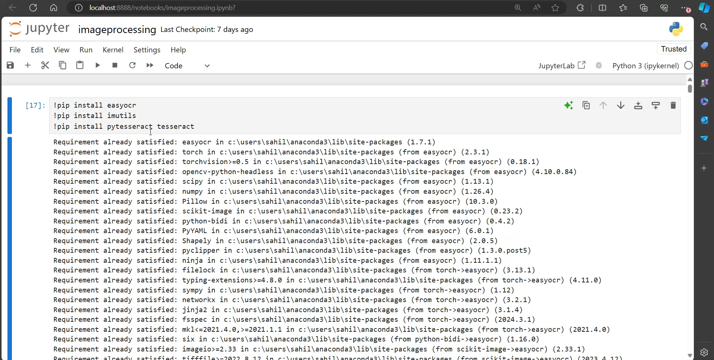
License plate recognition- pytesseract

Slide 13
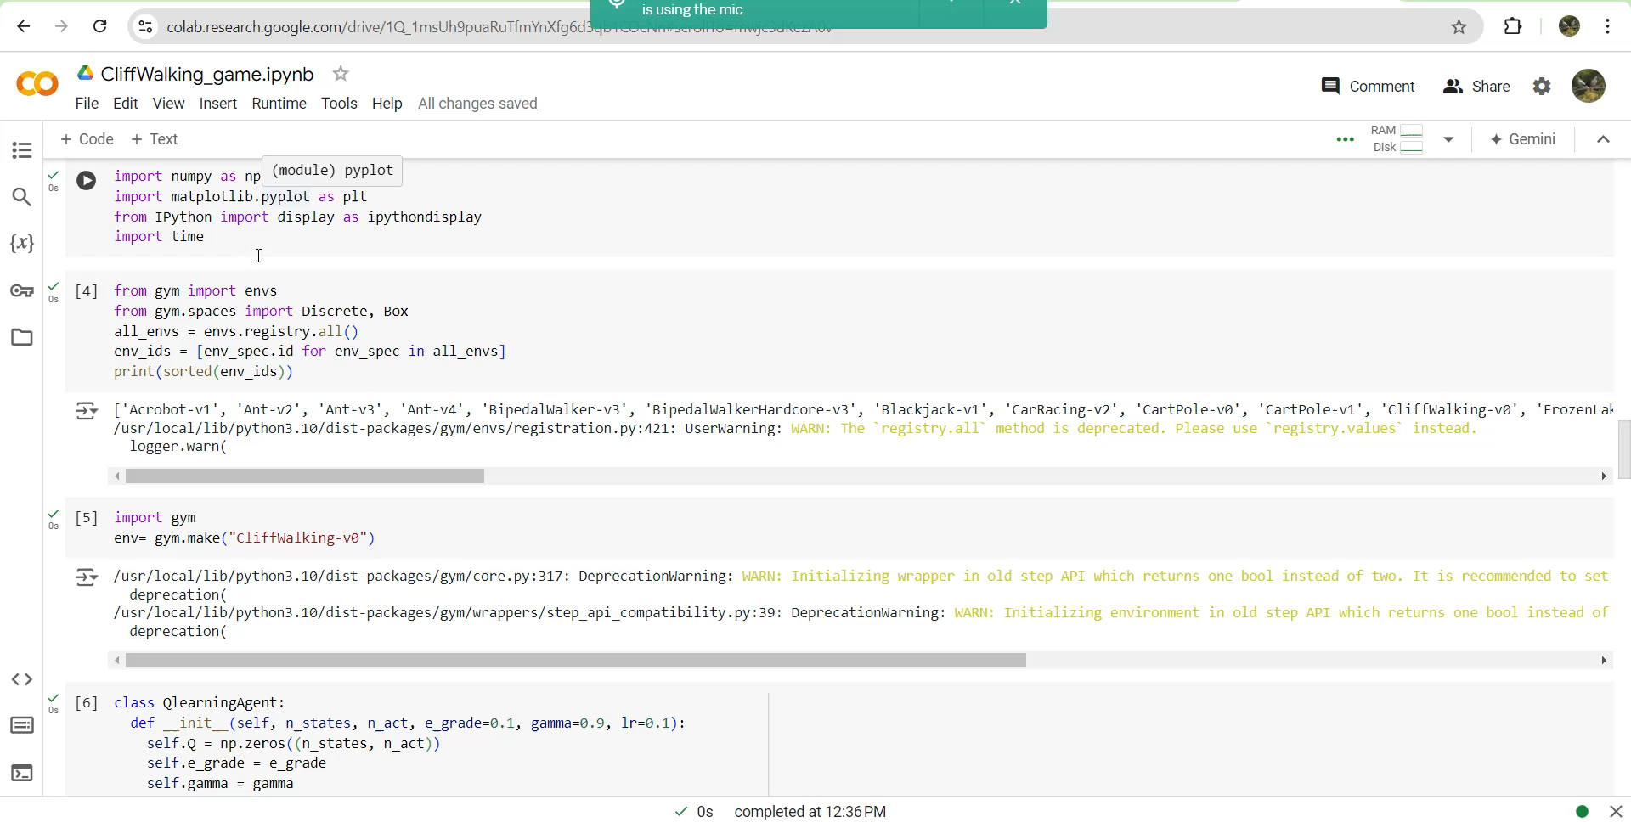
Reinforcement learning

Slide 14
Design and development of knee rehabilitation robot

Slide 15
Design and development of knee rehabilitation robot
The robot is designed to give physiotherapy in the absence of the doctors. The robot’s mechanical design is to hold 2 degrees of motion and give an arc movement instead of an X-Y movement.
The robot had to undergo extensive research for available designs and their advantages & disadvantages. To find the best optimal design to mimic human action.
AI algorithm was applied to check the patients had knee osteosis, using the convolution algorithm.
One design is going through a patent and the other is going to be published and hopefully be patent in the coming future

Slide 16
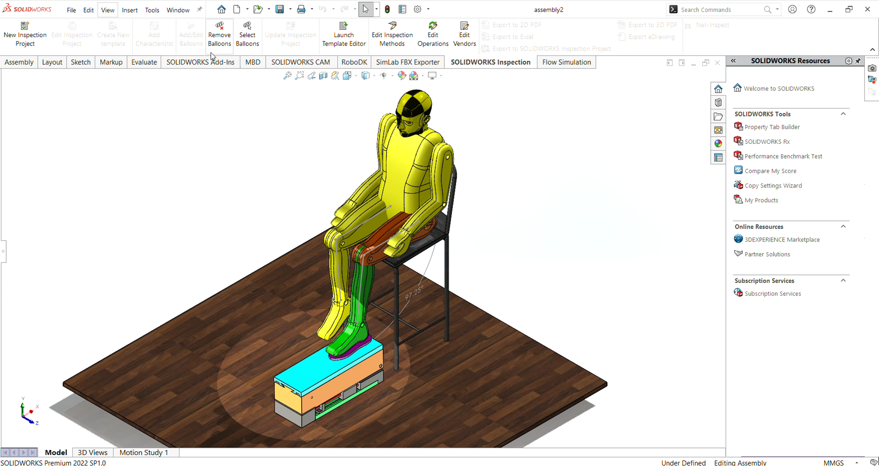
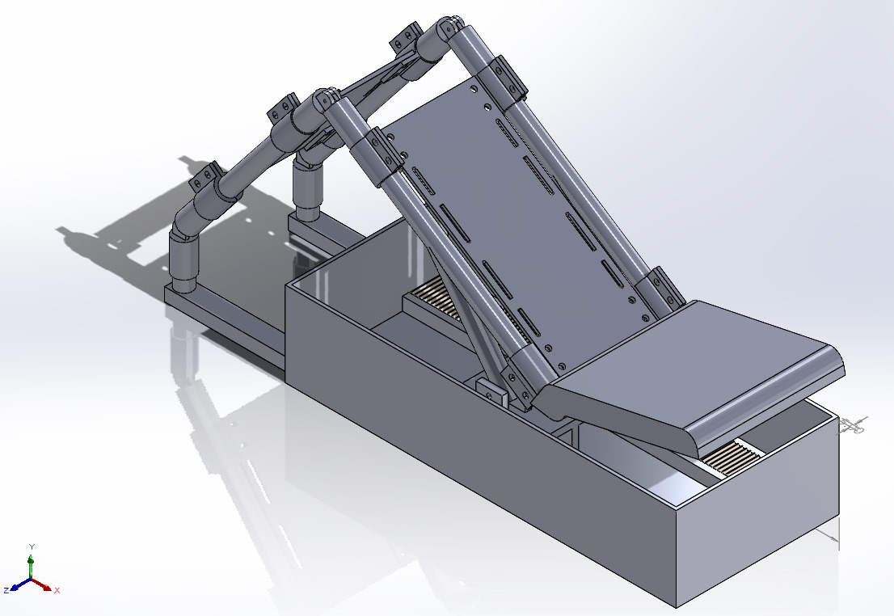
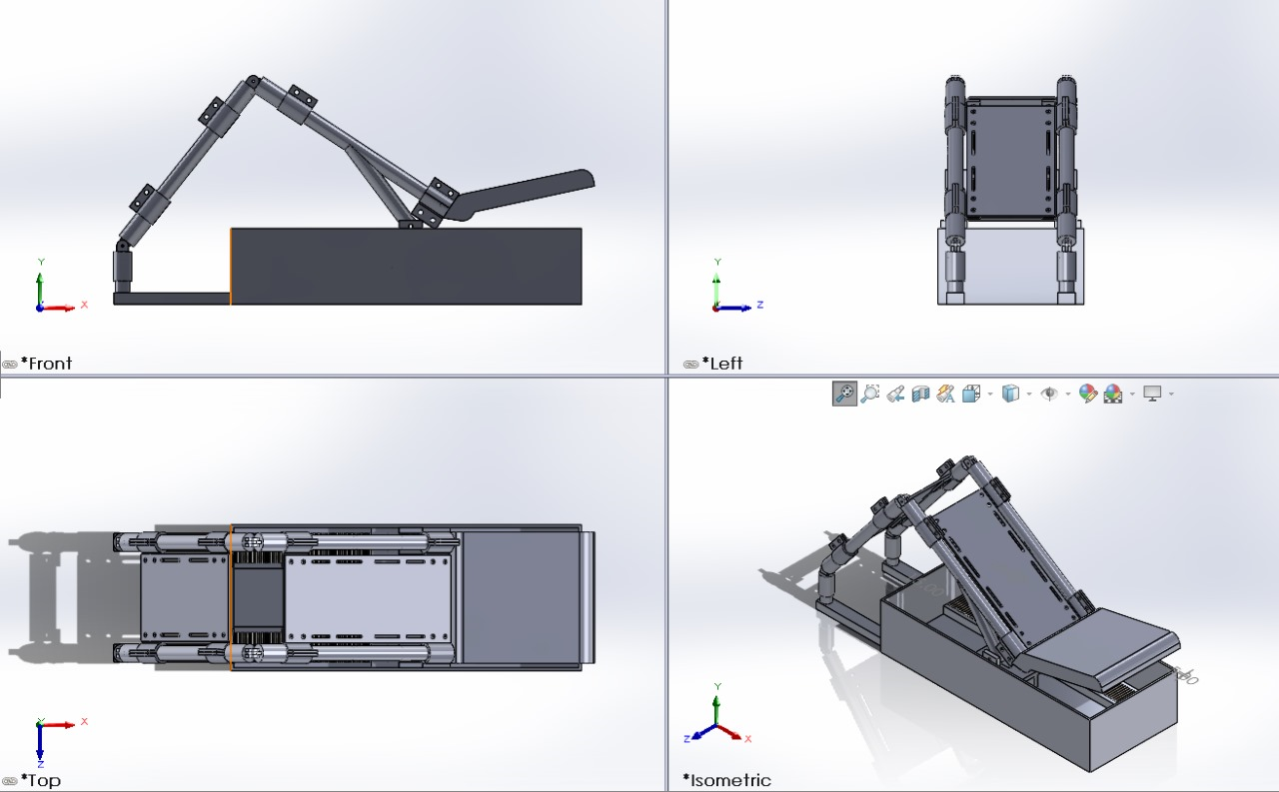
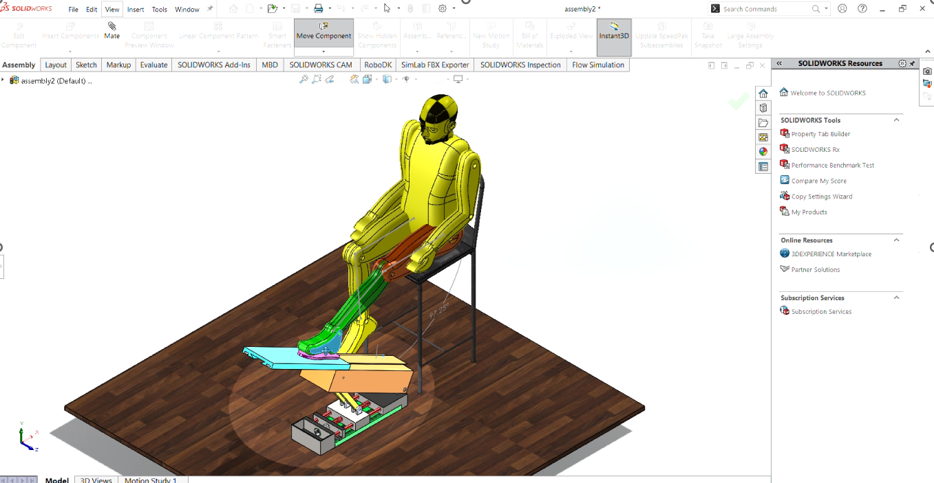
3D CAD MODEL

Slide 17
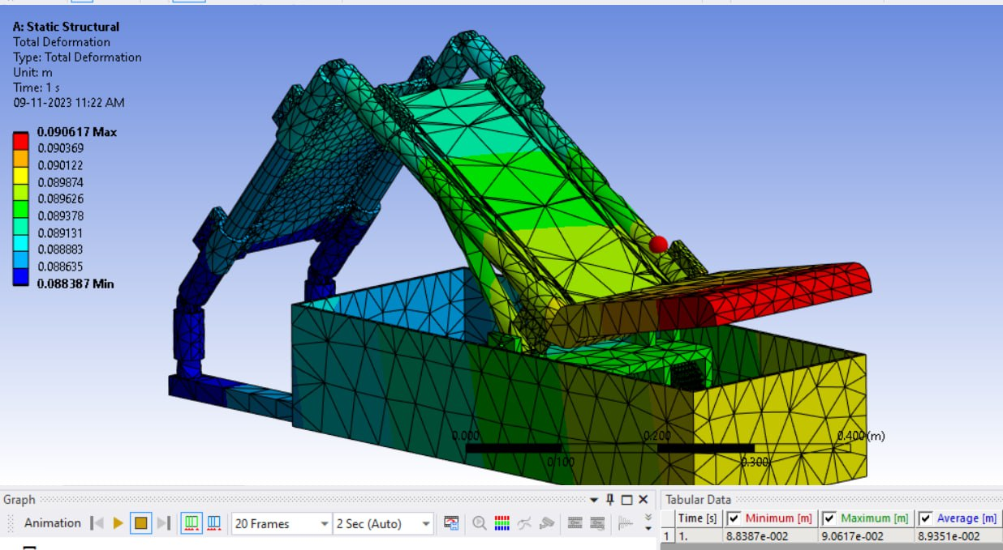
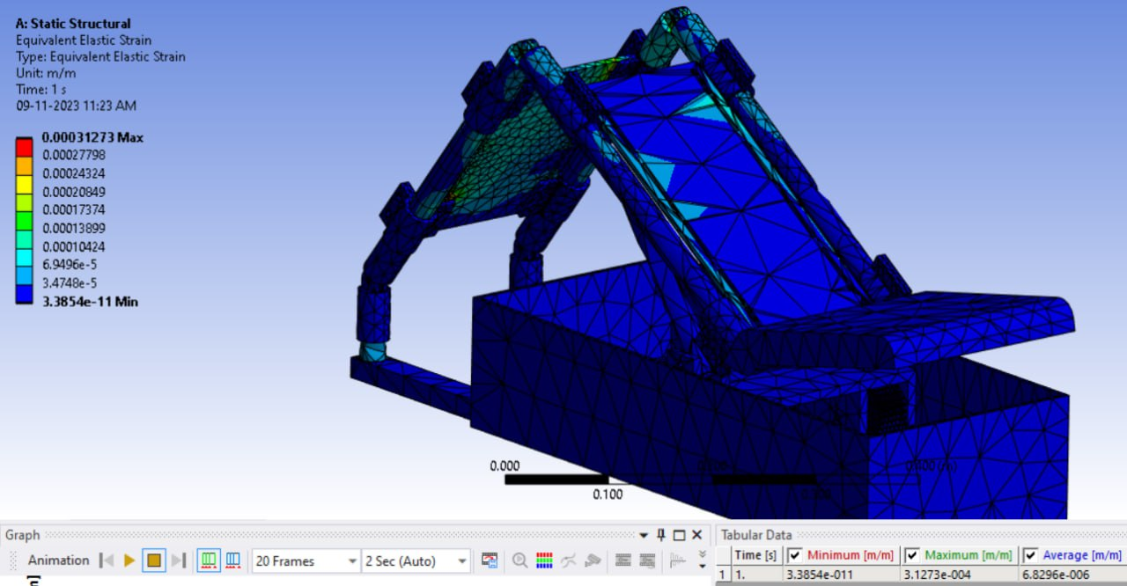

Slide 18
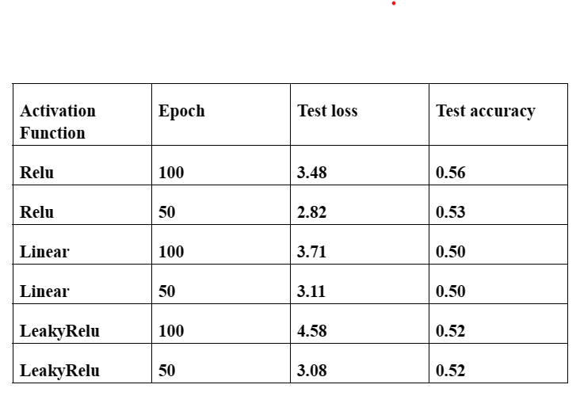
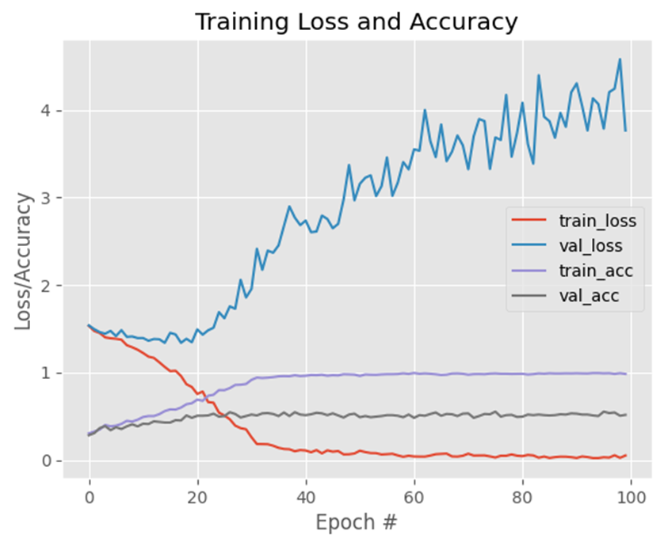
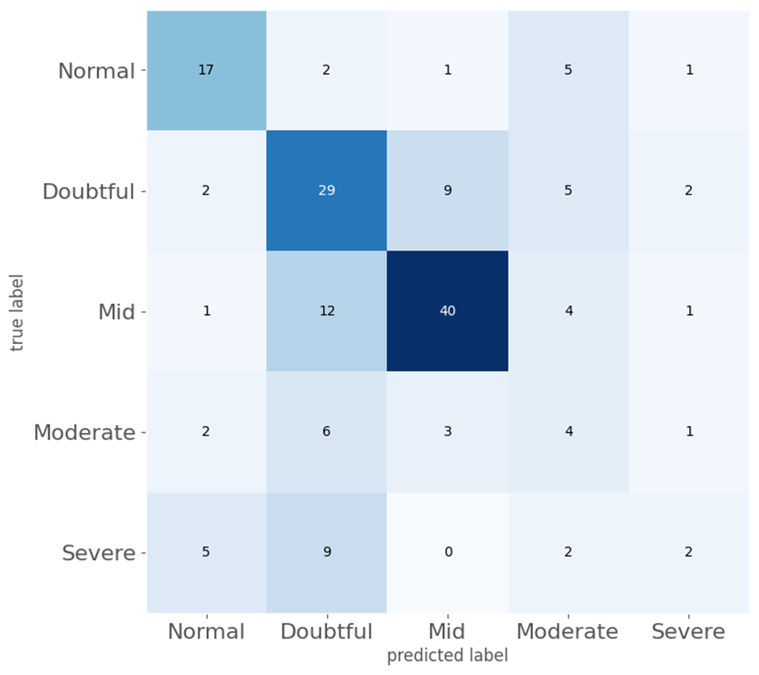
AI ALGORITHM OUTPUT(Relu activation)
Training Loss vs Accuracy
test loss: 3.478864908218384 %
Grading criteria based on confusion matrix
test accuracy: 0.5575757622718811 %
Source Code Link - https://colab.research.google.com/drive/1uN9005P1ps0T7iTNDYV62JI_ArKktOZW#scrollTo=XoKGbeNYJXFr

Slide 19
Design and Development of Borewell Rescue System

Slide 20
Design and Development of Borewell Rescue System
The borewell system was designed to save children who fall into the borewell. The robot has soft grippers to rescue them without harming them
The design was done keeping the dimensions accuracy and the joint functionality.
The designing major motto was to keep the design simple and affordable.
The major designs were taken to be as market-available and programable content was also made to design and upload within minutes so as of not to waste time.
The final and initial designs as in the below slide along with simulation.

Slide 21
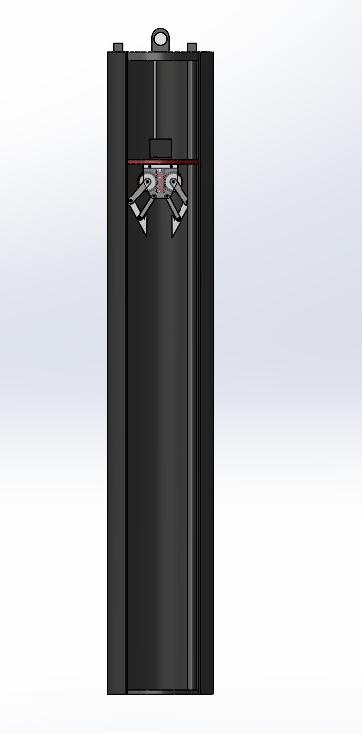
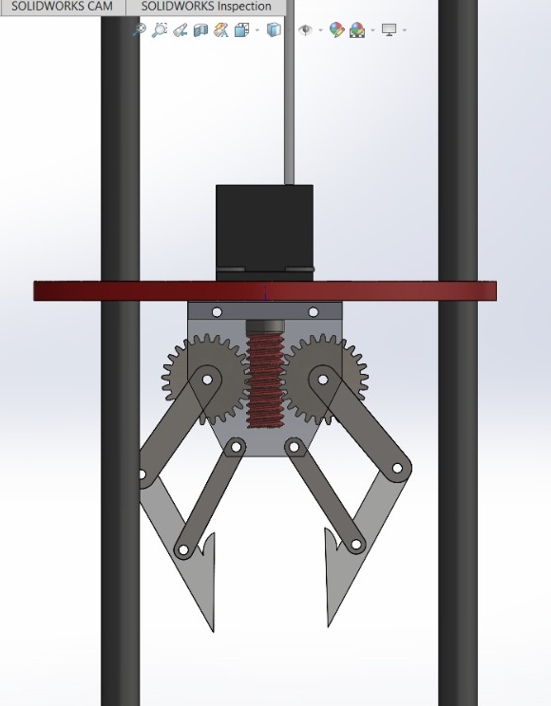
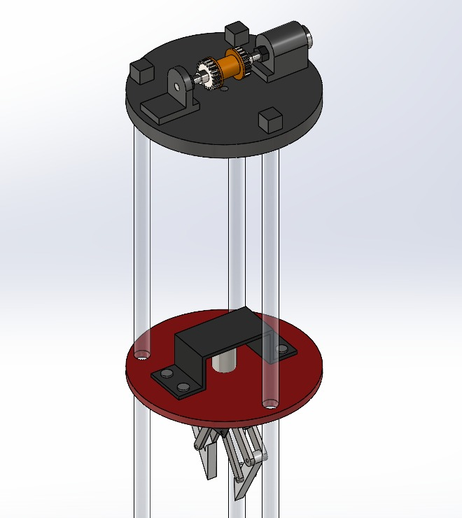
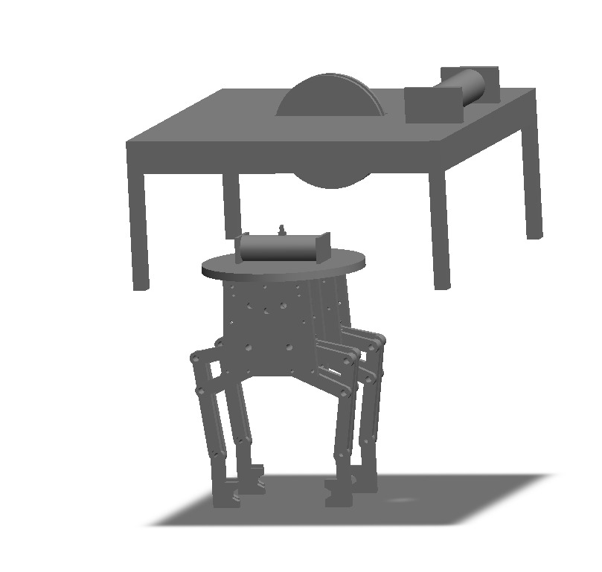
BOREWELL RESCUE ROBOT
Initial design

Slide 22
Design and development of a homogeneous swarm of cooperative robots in a virtual environment

Slide 23
Design and development of a homogeneous swarm of cooperative robots in a virtual environment
The homogeneous robot communications were explored and studied in detail the algorithms and formulas related to the swarm robotics.
The Webot software provides a similar experience as of ROS along with prebuilt packages to learn to code in whichever language is comfortable.
The robots are communicating with each other using the world node as the medium the speed is getting communicating with each other hence movement is possible
The robot adding the cumulative movement in the X-Y plane is done and the output was not satisfactory as it needed interrupt control to avoid obstacles first.

Slide 24
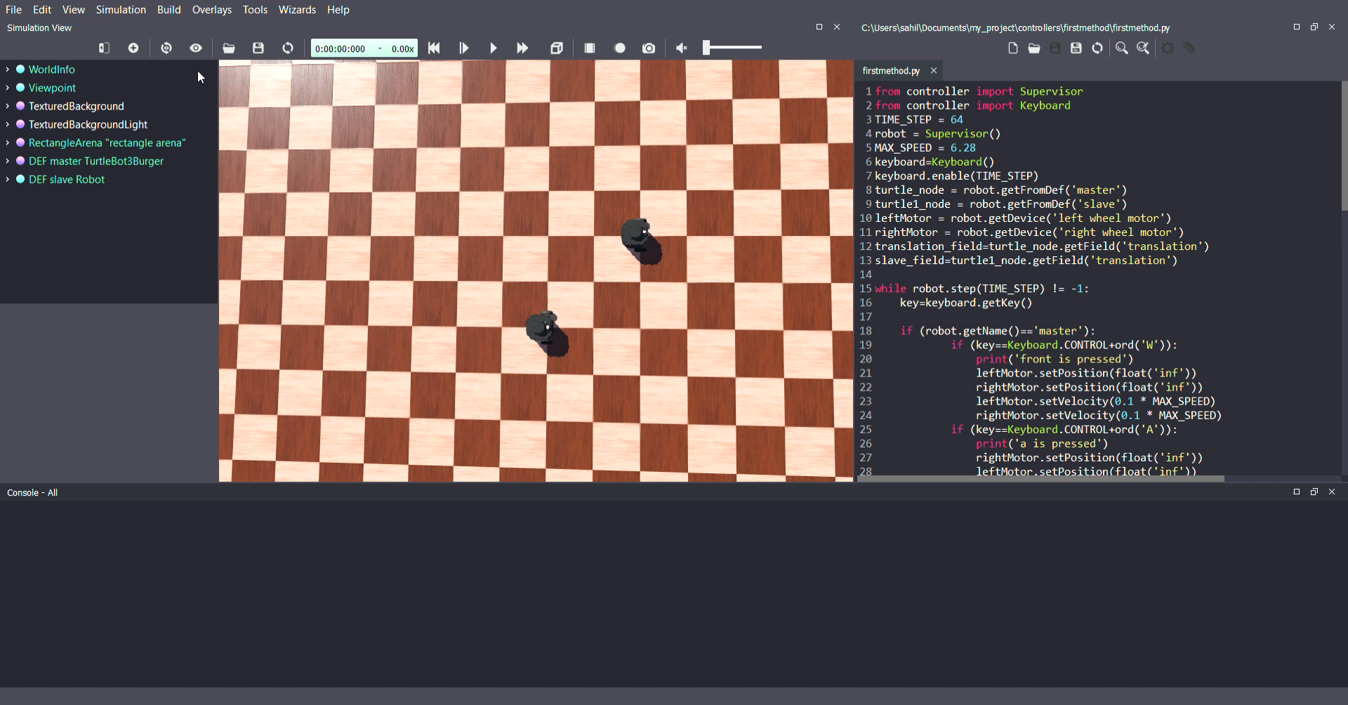
Final test run

Slide 25
Designing and developing of autonomous sanitizing robot

Slide 26
Designing and developing of autonomous sanitizing robot
The robot was visioned during the lockdown time to give to the shopkeepers to sanitize their shops at regular intervals to ensure sanitized shops.
The robot uses a basic avoidance program by using ultrasonic sensor data.
The robot has an IR sensor which is limited by distance to detect objects for the spray to initialize and spray on the cupboard of the shops.
The robot chassis was tested to hold the water tank and the program simulation was made in Tinkercad fro simulation and code testing.

Slide 27
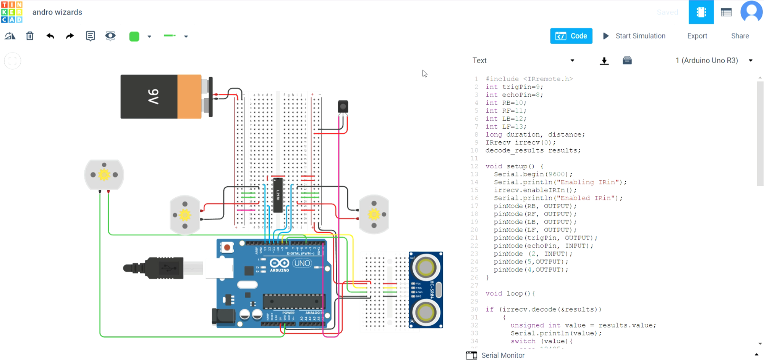
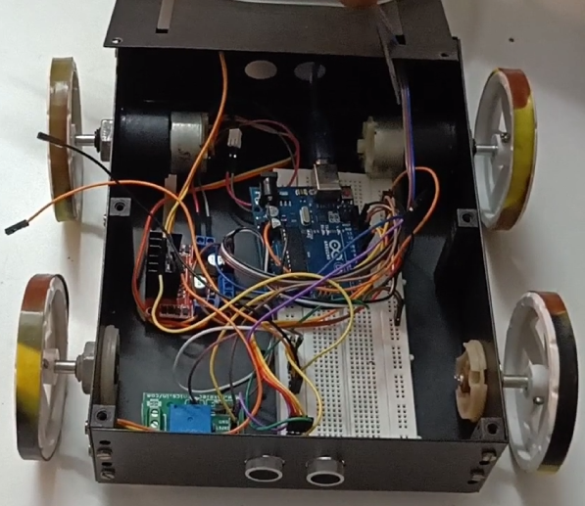
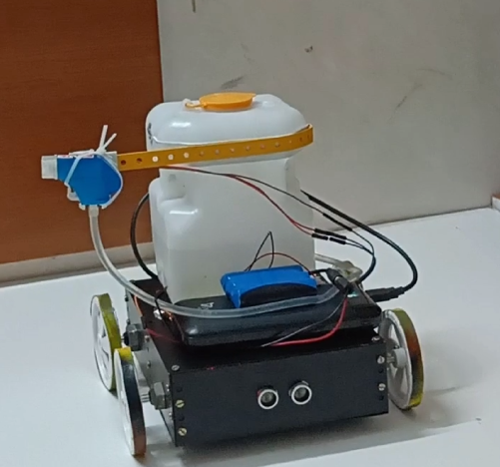
Sanitization robot

Slide 28


THANK YOU
CONTACT INFO:
Email:sahil86469@gmail.com
Phone: +91 7337013571
www.linkedin.com/in/sahil-shaik-8bb309219
https://github.com/sahil86469

