Slide 2
REAL TIME PREDICTIVE MAINTENANCE
Summer Internship Presentation
Presented by:
Sahil Kumar Singh(102)
Rishi Pandey(97)
Parth(85)
Rajesh Yadav(155)
Under the guidance of:
Mr. Gourav Bathla
Assistant Professor, Department of Cybernetics, School of Computer science, UNIVERSITY OF PETROLEUM & ENERGY STUDIES

Slide 3
CONTENT
Introduction…………………………………………………………………...4
Problem Statement…………………………………………………………5
Objective(s)…………………………………………………………………....6
Methodology…………………………………………………………………..7
Flowchart………………………………………………………………………..8
Results…………………………………………………………………………....9
References………………………………………………………………………10

Slide 4
Introduction
What is Predictive Maintenance?
Predictive maintenance is a technique that uses data analysis tools and techniques to detect anomalies in your operation and possible defects in equipment and processes so you can fix them before they result in failure.
Benefits of predictive maintenance
The time the equipment is being maintained
Minimizing the production hours lost to maintenance
Minimizing the cost of spare parts and supplies

Slide 5

PROBLEM STATEMENT
The modern industries are growing rapidly. Each and every company wants to cut their losses on repairment of parts and replacing heavy machineries. Because of which companies are investing huge sums of money on developing their AI and machine learning systems for managing their heavy machineries.
How can we create a predictive maintenance system which can predict which machine is going to fail or not.

Slide 6
OBJECTIVES
Stream the dataset from Azure Event Hub to Azure Databricks.
Train the system using a logistic regression algorithm.
3. Predicting which machine is going to fail.

Slide 7
METHODOLOGY
The project runs as follows:
A csv file is streamed from Azure Event hub to Azure Databricks.
A dataframe is created using streamed dataset.
Train the system using logistic regression algorithm.
Checking the accuracies of the ML model.
Predictions are made using SQL queries.
The visualization of result is done through PowerBI.

Slide 8
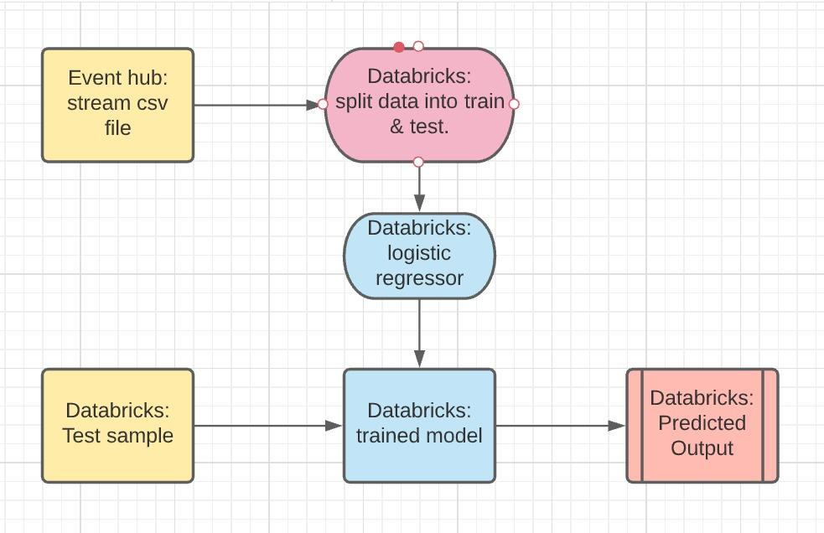
FLOWCHART

Slide 9
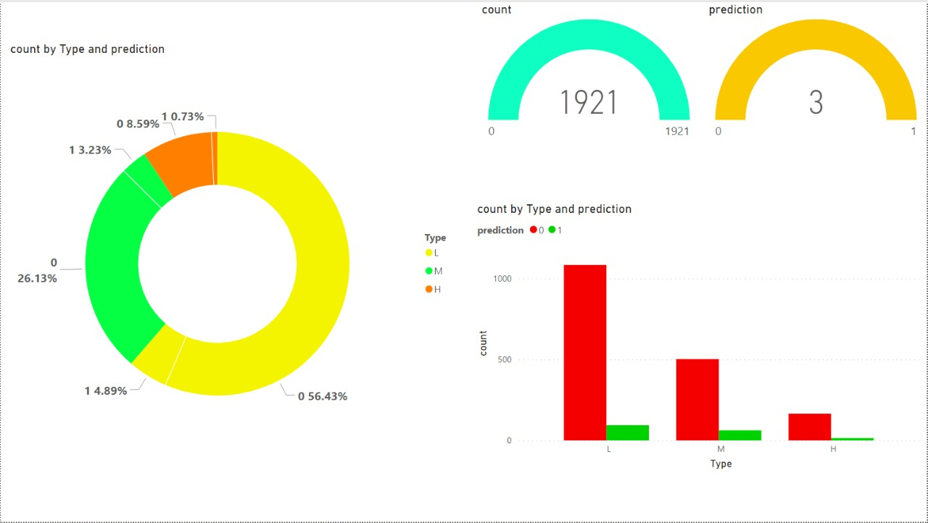
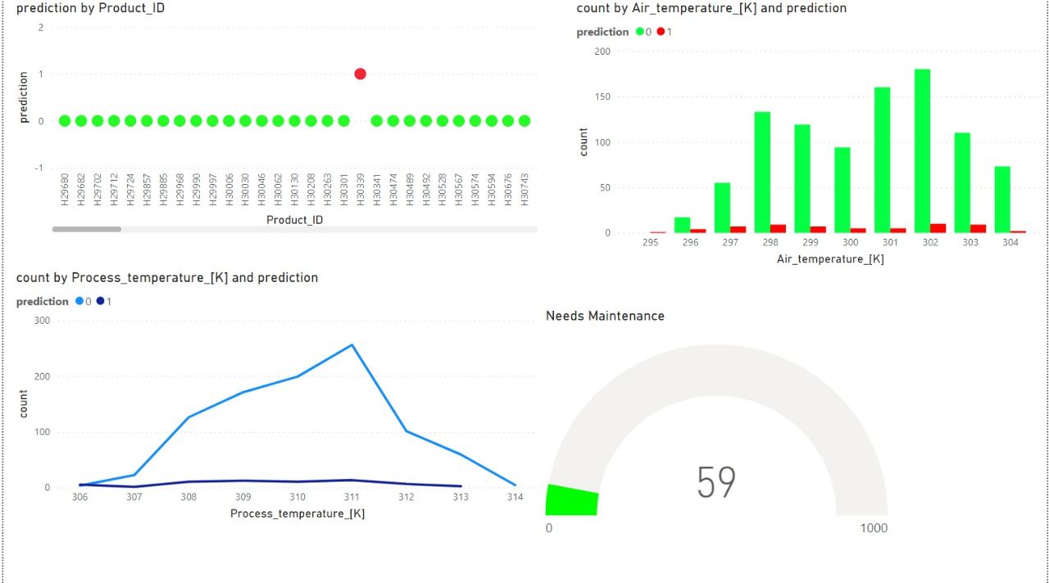
RESULTS

Slide 10
References
https://archive.ics.uci.edu/ml/datasets/AI4I+2020+Predictive+Maintenance+Dataset
https://medium.com/swlh/logistic-regression-with-pyspark-60295d41221
https://docs.microsoft.com/en-in/azure/event-hubs/event-hubs-about

