Slide 1

SMART INDIA HACKATHON 2026
MARINE SENTINEL
Problem Statement ID: [Enter SIH ID]
Problem Statement: AI-Powered Automated Underwater Marine Debris and Anomaly Detection System using Side-Scan Sonar Imagery
Theme: [Enter SIH theme]
PS Category: Software
Team ID: [Enter team ID]
TEAM [NAME]
Notes:
Marine Sentinel SIH prototype.

Slide 2
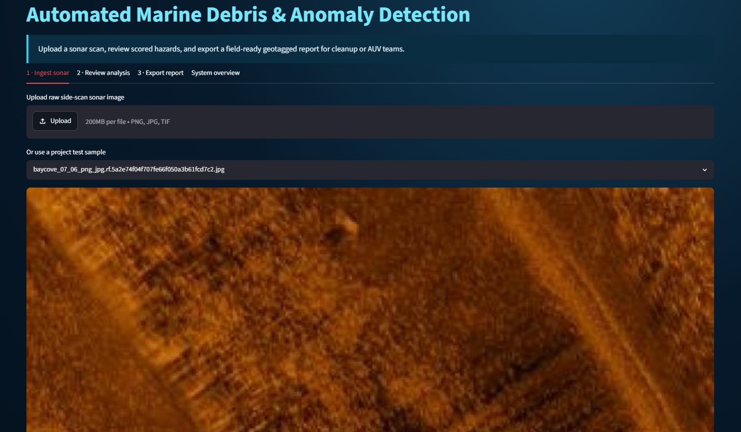
MARINE SENTINEL
TEAM [NAME]
Local dashboard for side-scan sonar review
Upload sonar imagery and survey metadata
Condition scans for speckle noise and uneven contrast
Detect crab pots and debris with trained YOLO inference
Show confidence, dimensions and approximate coordinates
Export a field report for cleanup and AUV teams
Notes:
Marine Sentinel SIH prototype.

Slide 3
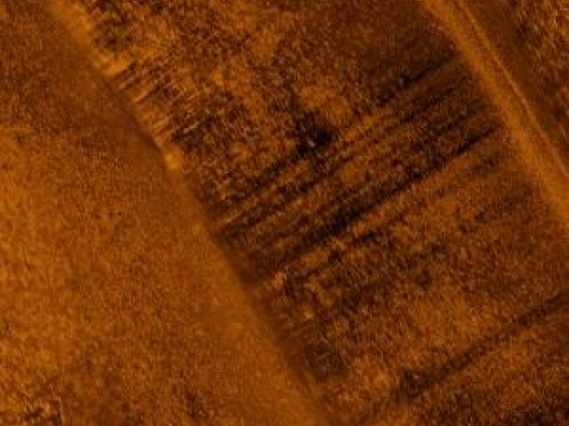
TECHNICAL APPROACH
TEAM [NAME]
Input
Side-scan sonar image with location and scale metadata
Image conditioning
Non-local means denoising and CLAHE local contrast normalization
Object detection
Trained YOLO11n model for Crab-Pot and Maybe-Crab-Pot labels
Decision support
Confidence threshold and IoU suppression reduce duplicate boxes
Output
Annotated scan plus JSON and CSV anomaly report
Notes:
Marine Sentinel SIH prototype.

Slide 4
FEASIBILITY AND VIABILITY
TEAM [NAME]
Dataset readiness
The project includes YOLO-formatted training, validation and held-out test splits for two debris classes.
Build readiness
The prototype uses Python, Streamlit, OpenCV and Ultralytics YOLO. A trained best.pt model now resides in the project models folder.
Deployment path
Train or resume on Google Colab GPU, evaluate on held-out test data and run local inference in the dashboard.
Risk control
Operators review low-confidence targets before field action.
Notes:
Marine Sentinel SIH prototype.

Slide 5
IMPACT AND BENEFITS
TEAM [NAME]
Conservation teams can prioritise sonar regions for human review instead of examining full sonar logs manually.
Cleanup and vessel teams receive a structured report containing target class, confidence, dimensions, priority and estimated coordinates.
Local inference supports offshore missions with intermittent connectivity.
Human review remains part of the workflow for ambiguous targets and safety-critical decisions.
Notes:
Marine Sentinel SIH prototype.

Slide 6
RESEARCH AND REFERENCES
TEAM [NAME]
NOAA Marine Debris Program
https://marinedebris.noaa.gov/what-marine-debris/derelict-fishing-gear
FAO Responsible Fishing Practices
https://www.fao.org/responsible-fishing/en
Ultralytics YOLO custom-data documentation
https://docs.ultralytics.com/yolov5/tutorials/train-custom-data
Project evidence
YOLO-format Crab-Pot and Maybe-Crab-Pot sonar dataset included in this project
Notes:
Sources: NOAA Marine Debris Program, FAO Responsible Fishing Practices, Ultralytics documentation.

