Slide 1
Enhancing Fraud Detection Using Synthetic Transactions Generated by GenAI
Submitted By: Sahil Adlakha

Slide 2
Objectives of Project
To improve fraud detection
To solve class imbalance by augmenting minority class using GenAI
Preserve data privacy
Improve ML model by generating more samples.
Improve recall without sacrificing precision or introducing bias.

Slide 3
Dataset Details
Dataset: creditcard.csv
Source: Kaggle - Credit Card Fraud Dataset
Size: 284,807 rows x 31 cols
Target Variable: Class
Class Distribution:
Non-Fraud: 284,315
Fraud: 492

Slide 4
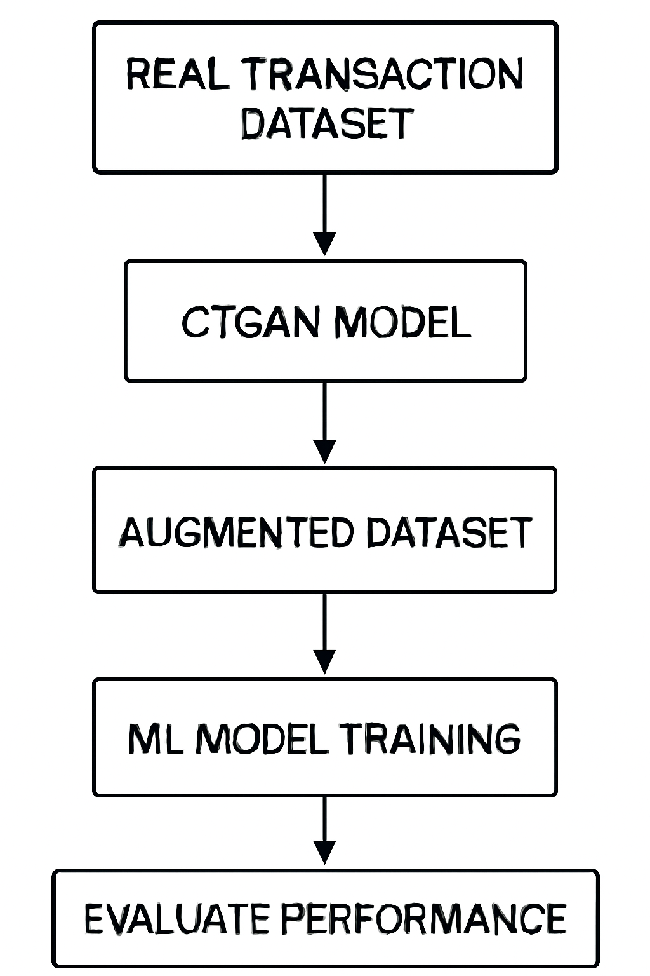
Technical Architecture

Slide 5
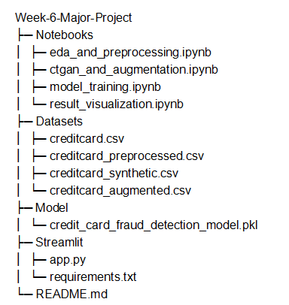
File Structure

Slide 6
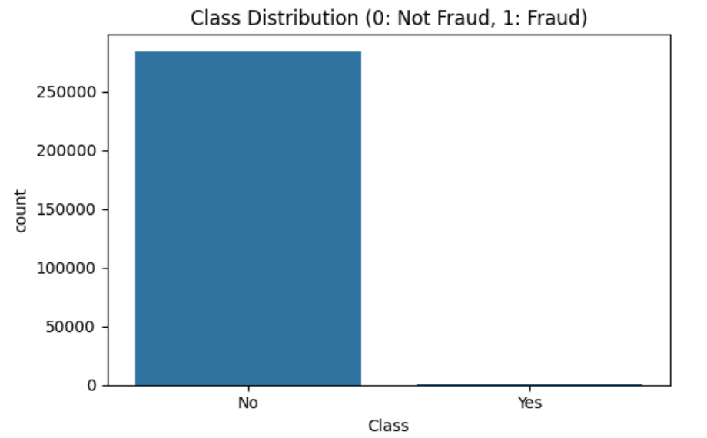
EDA Insights
From the given distribution it is clearly visible that the given dataset is highly imbalanced as the no. of fraud cases are way less than non-fraud ones.

Slide 7
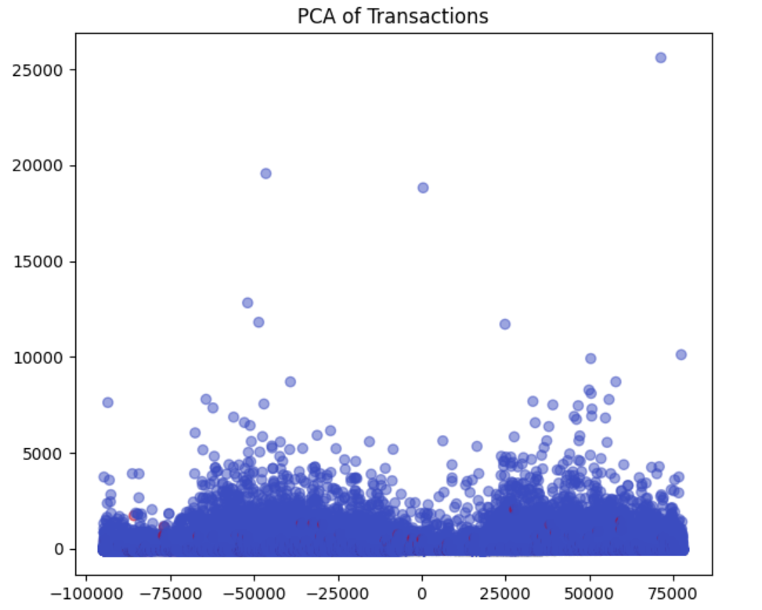
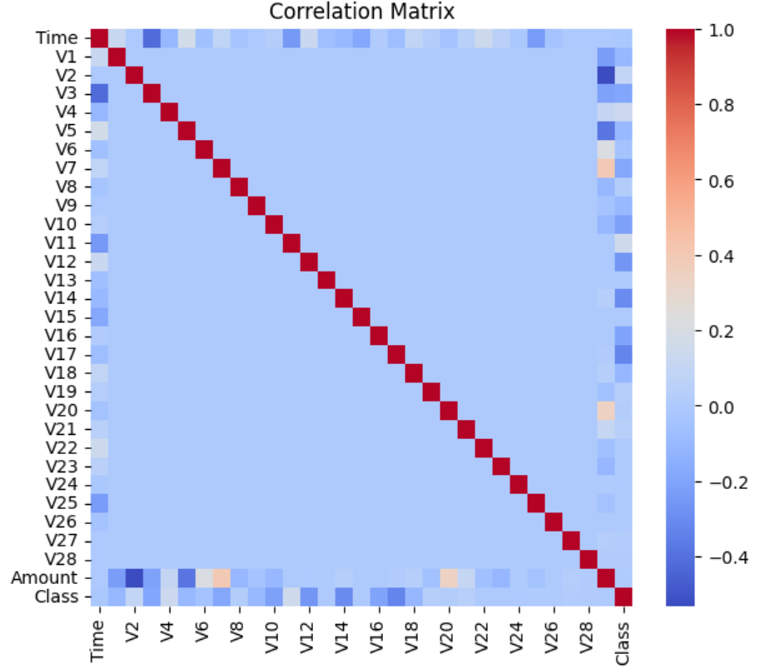
EDA Insights

Slide 8
Data Preprocessing
Normalized the Time and Amount features of the dataset.
Standardized the values of Time and Amount using Standard Scaler which sets mean to 0 and standard deviation to 1.
And saved the preprocessed dataset as new CSV file for further use.

Slide 9
Sample Generation By CTGAN Model
To counter the problem of class imbalance, Conditional Tabular GAN model is used to generate synthetic samples of fraud class to augment them to preprocessed dataset.
Feature | Description
Model | CTGAN
Training Epochs | 50
Target Variable | Class = 1(Fraud)
Output | 5,000 synthetic fraud samples

Slide 10
Model Training
Algorithms Used:
Logistic Regression
Random Forest
XGBoost
Dataset: Augmented (Original + Synthetic)
Type of Problem: Fraud Classification
Train-Test Ratio: 70:30

Slide 11
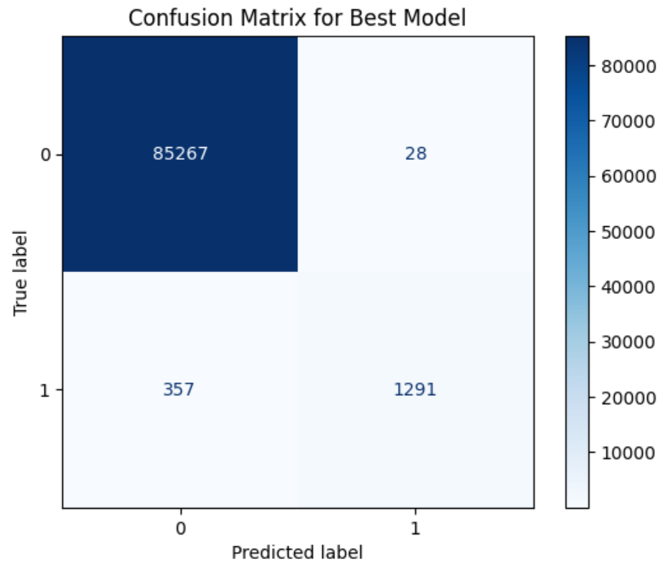
Model Training Results
Best Model: XGBoost Classifier
Recall: 0.783
Precision: 0.978
F1-Score: 0.87
ROC-AUC: 0.992

Slide 12
Performance Analysis
This is the detailed comparison of performance of XGBoost Classifier for real dataset and augmenetd dataset after preprocessing.
Model Dataset | F1-Score | Recall | Precision | ROC-AUC
Real | 0.838 | 0.756 | 0.94 | 0.928
Real + Synthetic | 0.87 | 0.783 | 0.978 | 0.992

Slide 13
Model Deployment
Deployment Platform: Streamlit
URL: https://credit-card-fraud-detection-myapp.streamlit.app/#credit-card-fraud-detection
Github Repo: https://github.com/sahiladlakha33/GNCIPL-Internship-Projects
Github Project Folder Link: https://github.com/sahiladlakha33/GNCIPL-Internship-Projects/tree/main/Week%206%20Major%20Project

Slide 14
Business Impact
Higher catch rate of rare fraud events.
Improved performance of model.
Reduced fraud leakage through better model generalization.
Synthetic generation avoids using real customer data.
Training data can be increased artificially as needed.

Slide 15
Conclusion
This project demonstrated Generative AI-powered data augmentation for credit card fraud detection. It is a viable approach to handle extreme data imbalance.
The methodology resulted in increase of 3% more increase in Recall and 7% increase in ROC-AUC score on normalized data.
It ensured data compliance.
It gave overall better classification performance.

Slide 16
THANK YOU

