Slide 1
Conditional Probability. Expected Value
 | Miles Jones | MTThF 8:30-9:50am | CSE 4140
August 29, 2016

Slide 2
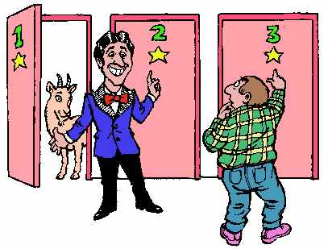
The Monty Hall Puzzle
Car hidden behind one of three doors.
Goats hidden behind the other two.
Player gets to choose a door.
Host opens another door, reveals a goat.
Player can choose whether to swap choice with other closed door or
stay with original choice.
What's the player's best strategy?
Always swap. B. Always stay. C. Doesn't matter, it's 50/50.

Slide 3


Some history…
Puzzle introduced by Steve Selvin in 1975.
Marilyn vos Savant was a prodigy with record scores on IQ tests who wrote an advice column. In 1990, a reader asked for the solution to the Monty Hall puzzle.
After she published the (correct) answer, thousands of readers (including PhDs and even a professor of statistics) demanded that she correct her "mistake".
She built a simulator to demonstrate the solution so they could see for themselves how it worked.

Slide 4
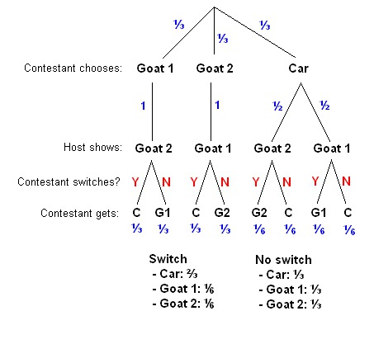
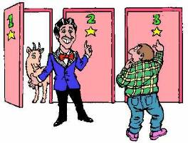
The Monty Hall Puzzle … the solution
Pick a door at random to start

Slide 5
The Monty Hall Puzzle … the solution

Slide 6
The Monty Hall Puzzle … the solution
What's the probability of winning
(C) if always switch ("Y") ?
1/3
1/2
2/3
1
None of the above.

Slide 7
The Monty Hall Puzzle … the solution
What's the probability of winning
(C) if always stay ("N") ?
1/3
1/2
2/3
1
None of the above.

Slide 8
The Monty Hall Puzzle … the solution
What's wrong with the following argument?
"It doesn't matter whether you stay or swap because the host opened one door to show a goat so there are only two doors remaining, and both of them are equally likely to have the car because the prizes were placed behind the doors randomly at the start of the game"

Slide 9

Conditional probabilities
Probability of an event may change if have additional information about outcomes.
Suppose E and F are events, and P(F)>0. Then,
i.e.
Rosen p. 456

Slide 10
Conditional probabilities
Are these probabilities equal?
The probability that two siblings are girls if know the oldest is a girl.
The probability that two siblings are boys if know that one of them is a boy.
They're equal.
They're not equal.
???
Assume that each child being a boy or a girl is equally likely.

Slide 11
Conditional probabilities
Are these probabilities equal?
The probability that two siblings are girls if know the oldest is a girl.
The probability that two siblings are boys if know that one of them is a boy.
Sample space
2. Initial distribution on the sample space
3. What events are we conditioning on?
Assume that each child being a boy or a girl is equally likely.

Slide 12
Conditional probabilities
Are these probabilities equal?
The probability that two siblings are girls if know the oldest is a girl.
The probability that two siblings are boys if know that one of them is a boy.
Sample space
Possible outcomes: {bb, bg, gb, gg} Order matters!
2. Initial distribution on the sample space
3. What events are we conditioning on?
Assume that each child being a boy or a girl is equally likely.

Slide 13
Conditional probabilities
Are these probabilities equal?
The probability that two siblings are girls if know the oldest is a girl.
The probability that two siblings are boys if know that one of them is a boy.
Sample space
Possible outcomes: {bb, bg, gb, gg} Order matters!
2. Initial distribution on the sample space
Uniform distribution, each outcome has probability ¼.
3. What events are we conditioning on?
Assume that each child being a boy or a girl is equally likely.

Slide 14
Conditional probabilities
Are these probabilities equal?
The probability that two siblings are girls if know the oldest is a girl.
The probability that two siblings are boys if know that one of them is a boy.
3. What events are we conditioning on?
Assume that each child being a boy or a girl is equally likely.

Slide 15
Conditional probabilities
Are these probabilities equal?
The probability that two siblings are girls if know the oldest is a girl.
The probability that two siblings are boys if know that one of them is a boy.
What events are we conditioning on?
A = { outcomes where oldest is a girl } B = { outcomes where two are girls}
Assume that each child being a boy or a girl is equally likely.

Slide 16
Conditional probabilities
Are these probabilities equal?
The probability that two siblings are girls if know the oldest is a girl.
The probability that two siblings are boys if know that one of them is a boy.
What events are we conditioning on?
A = { outcomes where oldest is a girl } B = { outcomes where two are girls }
= { gg, gb} = { gg }
Assume that each child being a boy or a girl is equally likely.

Slide 17
Conditional probabilities
Are these probabilities equal?
The probability that two siblings are girls if know the oldest is a girl.
The probability that two siblings are boys if know that one of them is a boy.
What events are we conditioning on?
A = { outcomes where oldest is a girl } B = { outcomes where two are girls }
= { gg, gb} = { gg }
P(A) = ½ P(B) = ¼ = P(A B)
Assume that each child being a boy or a girl is equally likely.
U

Slide 18
Conditional probabilities
Are these probabilities equal?
The probability that two siblings are girls if know the oldest is a girl.
The probability that two siblings are boys if know that one of them is a boy.
What events are we conditioning on?
A = { outcomes where oldest is a girl } B = { outcomes where two are girls }
= { gg, gb} = { gg }
P(A) = ½ P(B) = ¼ = P(A B)
By conditional probability law: P(B | A) = P(A B) / P(A) = (1/4) / (1/2) = ½.
Assume that each child being a boy or a girl is equally likely.
U
U

Slide 19
Conditional probabilities
Are these probabilities equal?
The probability that two siblings are girls if know the oldest is a girl. 1/2
The probability that two siblings are boys if know that one of them is a boy.
Sample space
Possible outcomes: {bb, bg, gb, gg} Order matters!
2. Initial distribution on the sample space
Uniform distribution, each outcome has probability ¼.
3. What events are we conditioning on?
Assume that each child being a boy or a girl is equally likely.

Slide 20
Conditional probabilities
Are these probabilities equal?
The probability that two siblings are girls if know the oldest is a girl. 1/2
The probability that two siblings are boys if know that one of them is a boy.
What events are we conditioning on?
C = { outcomes where one is a boy} D = { outcomes where two are boys }
= { bb, bg, gb } = { bb }
P(C) = ¾ P(D) = ¼ = P(C D)
Assume that each child being a boy or a girl is equally likely.
U

Slide 21
Conditional probabilities
Are these probabilities equal?
The probability that two siblings are girls if know the oldest is a girl. 1/2
The probability that two siblings are boys if know that one of them is a boy.
What events are we conditioning on?
C = { outcomes where one is a boy} D = { outcomes where two are boys }
= { bb, bg, gb } = { bb }
P(C) = ¾ P(D) = ¼ = P(C D)
By conditional probability law: P(D | C) = P(C D) / P(C) = (1/4) / (3/4) = 1/3.
Assume that each child being a boy or a girl is equally likely.
U
U

Slide 22
Conditional probabilities
Are these probabilities equal?
The probability that two siblings are girls if know the oldest is a girl. 1/2
The probability that two siblings are boys if know that one of them is a boy. 1/3
Assume that each child being a boy or a girl is equally likely.

Slide 23
Conditional probabilities: Simpson's Paradox
 | Treatment A | Treatment B
Small stones | 81 successes / 87 | 234 successes / 270
Large stones | 192 successes / 263 | 55 successes / 80
Combined | 273 successes / 350 (78%) | 289 successes / 350 (83%)
Which is the better overall treatment?

Slide 24
Conditional probabilities: Simpson's Paradox
 | Treatment A | Treatment B
Small stones | 81 successes / 87 (93%) | 234 successes / 270 (87%)
Large stones | 192 successes / 263 (73%) | 55 successes / 80 (69%)
Combined | 273 successes / 350 (78%) | 289 successes / 350 (83%)
Which treatment is better?
Treatment A for all cases. C. A for small and B for large.
Treatment B for all cases. D. A for large and B for small.
C. R. Charig, D. R. Webb, S. R. Payne, J. E. Wickham (29 March 1986). "Comparison of treatment of renal calculi by open surgery, percutaneous nephrolithotomy, and extracorporeal shockwave lithotripsy". Br Med J (Clin Res Ed) 292 (6524): 879–882. doi:10.1136/bmj.292.6524.879. PMC 1339981. PMID 3083922. cf. Wikipedia "Simpson's Paradox"

Slide 25
Conditional probabilities: Simpson's Paradox
 | Treatment A | Treatment B
Small stones | 81 successes / 87 (93%) | 234 successes / 270 (87%)
Large stones | 192 successes / 263 (73%) | 55 successes / 80 (69%)
Combined | 273 successes / 350 (78%) | 289 successes / 350 (83%)
Simpson's Paradox
"When the less effective treatment is applied more frequently to easier cases, it can appear to be a more effective treatment."
C. R. Charig, D. R. Webb, S. R. Payne, J. E. Wickham (29 March 1986). "Comparison of treatment of renal calculi by open surgery, percutaneous nephrolithotomy, and extracorporeal shockwave lithotripsy". Br Med J (Clin Res Ed) 292 (6524): 879–882. doi:10.1136/bmj.292.6524.879. PMC 1339981. PMID 3083922. cf. Wikipedia "Simpson's Paradox"

Slide 26
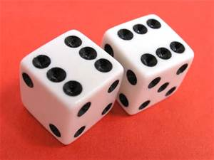
Random Variables Motivation
Sometimes, we are interested in a quantity determined by a random process.
For Example:
The total sum of 2 dice.
The number of heads after flipping n fair coins
The maximum of 2 dice rolls.
The time that a randomized algorithm takes.

Slide 27
Random Variables
Rosen p. 460,478
A random variable is a function from the sample space to the real numbers.
The distribution of a random variable X is a function from the possible values to [0,1] given by:
r → P(X = r)

Slide 28
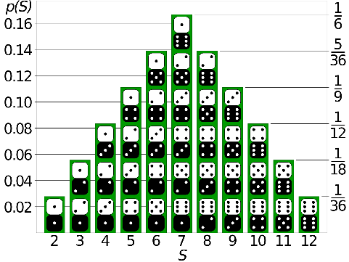
Random Variables Examples:
Rosen p. 460,478
Let X be the sum of the pips of two fair dice
X(5,2)=7
X(3,3) = 6
The distribution is shown as the height of the graph , e.g.
The probability that X=7 is 6/36=1/6
The probability that X=9 is 4/36=1/9
X=

Slide 29
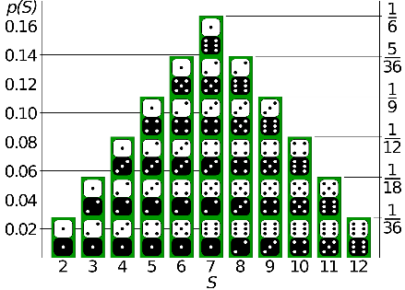
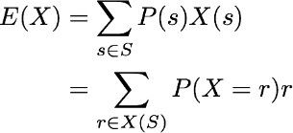
Expected Value
The expectation (average, expected value) of random variable X on sample space S is
For the example of two dice with X being the sum of the pips, we have that the expectation is given by
X=
$E\left(X\right)=$
$$2\left(\frac{1}{36}\right)+3\left(\frac{1}{18}\right)+4\left(\frac{1}{12}\right)+5\left(\frac{1}{9}\right)+6\left(\frac{5}{36}\right)+7\left(\frac{1}{6}\right)+8\left(\frac{5}{36}\right)+9\left(\frac{1}{9}\right)+10\left(\frac{1}{12}\right)+11\left(\frac{1}{18}\right)+12\left(\frac{1}{36}\right)=7$$

Slide 30
Expected Value Examples
Rosen p. 460,478
The expectation (average, expected value) of random variable X on sample space S is
Calculate the expected number of boys in a family with two children.
0
1
1.5
2

Slide 31
Expected Value Examples
Rosen p. 460,478
The expectation (average, expected value) of random variable X on sample space S is
Calculate the expected number of boys in a family with three children.
0
1
1.5
2

Slide 32
Expected Value Examples
Rosen p. 460,478
The expectation (average, expected value) of random variable X on sample space S is
Calculate the expected number of boys in a family with three children.
The expected value might not be a possible value of the random variable…
like 1.5 boys!
0
1
1.5
2

Slide 33
Properties of Expectation
Rosen p. 460,478
E(X) may not be an actually possible value of X.
But m <= E(X) <= M, where
m is minimum value of X and
M is maximum value of X.

Slide 34
Useful trick 1: Case analysis
Rosen p. 460,478
The expectation can be computed by conditioning on an event and its complement
Theorem: For any random variable X and event A,
E(X) = P(A) E(X | A) + P( A^{c} ) E ( X | A^{c} )
where A^{c} is the complement of A.
Conditional
Expectation

Slide 35
Useful trick 1: Case analysis
Example: If X is the number of pairs of consecutive Hs when we flip a fair coin three times, what is the expectation of X?
e.g. X(HHT) = 1
X(HHH) = 2.

Slide 36
Useful trick 1: Case analysis
Example: If X is the number of pairs of consecutive Hs when we flip a fair coin three times, what is the expectation of X?
Solution:
Directly from definition
For each of eight possible outcomes, find probability and value of X:
HHH (P(HHH)=1/8, X(HHH) = 2) , HHT, HTH, HTT, THH, THT, TTH, TTT etc.

Slide 37
Useful trick 1: Case analysis
Example: If X is the number of pairs of consecutive Hs when we flip a fair coin three times, what is the expectation of X?
Solution:
Using conditional expectation
Let A be the event "The middle flip is H".
Which subset of S is A?
{ HHH }
{ THT }
{ HHT, THH}
{ HHH, HHT, THH, THT}
None of the above.

Slide 38
Useful trick 1: Case analysis
Example: If X is the number of pairs of consecutive Hs when we flip a fair coin three times, what is the expectation of X?
Solution:
Using conditional expectation
Let A be the event "The middle flip is H".
E(X) = P(A) E(X | A) + P( A^{c} ) E ( X | A^{c} )

Slide 39
Useful trick 1: Case analysis
Example: If X is the number of pairs of consecutive Hs when we flip a fair coin three times, what is the expectation of X?
Solution:
Using conditional expectation
Let A be the event "The middle flip is H". P(A) = 1/2 , P(A^{c}) = 1/2
E(X) = P(A) E(X | A) + P( A^{c} ) E ( X | A^{c} )

Slide 40
Useful trick 1: Case analysis
Example: If X is the number of pairs of consecutive Hs when we flip a fair coin three times, what is the expectation of X?
Solution:
Using conditional expectation
Let A be the event "The middle flip is H". P(A) = 1/2 , P(A^{c}) = 1/2
E(X) = P(A) E(X | A) + P( A^{c} ) E ( X | A^{c} )
E( X | A^{c} ) : If middle flip isn't H, there can't be any pairs of consecutive Hs

Slide 41
Useful trick 1: Case analysis
Example: If X is the number of pairs of consecutive Hs when we flip a fair coin three times, what is the expectation of X?
Solution:
Using conditional expectation
Let A be the event "The middle flip is H". P(A) = 1/2 , P(A^{c}) = 1/2
E(X) = P(A) E(X | A) + P( A^{c} ) E ( X | A^{c} )
E( X | A^{c} ) : If middle flip isn't H, there can't be any pairs of consecutive Hs
E( X | A ) : If middle flip is H, # pairs of consecutive Hs = # Hs in first & last flips

Slide 42
Useful trick 1: Case analysis
Example: If X is the number of pairs of consecutive Hs when we flip a fair coin three times, what is the expectation of X?
Solution:
Using conditional expectation
Let A be the event "The middle flip is H". P(A) = 1/2 , P(A^{c}) = 1/2
E(X) = P(A) E(X | A) + P( A^{c} ) E ( X | A^{c} )
E( X | A^{c} ) = 0
E( X | A ) = ¼ * 0 + ½ * 1 + ¼ * 2 = 1

Slide 43
Useful trick 1: Case analysis
Example: If X is the number of pairs of consecutive Hs when we flip a fair coin three times, what is the expectation of X?
Solution:
Using conditional expectation
Let A be the event "The middle flip is H". P(A) = 1/2 , P(A^{c}) = 1/2
E(X) = P(A) E(X | A) + P( A^{c} ) E ( X | A^{c} ) = ½ ( 1 ) + ½ ( 0 ) = 1/2
E( X | A^{c} ) = 0
E( X | A ) = ¼ * 0 + ½ * 1 + ¼ * 2 = 1

Slide 44
Useful trick 1: Case analysis
Examples: Ending condition
Each time I play solitaire I have a probability p of winning. I play until I win a game.
Each time a child is born, it has probability p of being left-handed. I keep having kids until I have a left-handed one.
Let X be the number of games OR number of kids until ending condition is met.
What's E(X)?
1.
Some big number that depends on p.
1/p.
None of the above.

Slide 45
Useful trick 1: Case analysis
Ending condition
Let X be the number of games OR number of kids until ending condition is met.
Solution:
Directly from definition
Need to compute the sum of all possible P(X = i) i .

Slide 46
Useful trick 1: Case analysis
Ending condition
Let X be the number of games OR number of kids until ending condition is met.
Solution:
Directly from definition
Need to compute the sum of all possible P(X = i) i .
P(X = i) = Probability that don't stop the first i-1 times and do stop at the i^{th} time
= (1-p)^{i-1} p

Slide 47

Useful trick 1: Case analysis
Ending condition
Let X be the number of games OR number of kids until ending condition is met.
Solution:
Directly from definition
Need to compute the sum of all possible P(X = i) i .
P(X = i) = Probability that don't stop the first i-1 times and do stop at the i^{th} time
= (1-p)^{i-1} p
hmmm… Math 20B?
Math 20B?

Slide 48
Useful trick 1: Case analysis
Ending condition
Let X be the number of games OR number of kids until ending condition is met.
Solution:
Using conditional expectation
E(X) = P(A) E(X | A) + P( A^{c} ) E ( X | A^{c} )

Slide 49
Useful trick 1: Case analysis
Ending condition
Let X be the number of games OR number of kids until ending condition is met.
Solution:
Using conditional expectation Let A be the event "success at first try".
E(X) = P(A) E(X | A) + P( A^{c} ) E ( X | A^{c} )

Slide 50
Useful trick 1: Case analysis
Ending condition
Let X be the number of games OR number of kids until ending condition is met.
Solution:
Using conditional expectation Let A be the event "success at first try".
E(X) = P(A) E(X | A) + P( A^{c} ) E ( X | A^{c} )
P(A) = p P(A^{c}) = 1-p

Slide 51
Useful trick 1: Case analysis
Ending condition
Let X be the number of games OR number of kids until ending condition is met.
Solution:
Using conditional expectation Let A be the event "success at first try".
E(X) = P(A) E(X | A) + P( A^{c} ) E ( X | A^{c} )
P(A) = p P(A^{c}) = 1-p
E(X|A) = 1 because stop after first try

Slide 52
Useful trick 1: Case analysis
Ending condition
Let X be the number of games OR number of kids until ending condition is met.
Solution:
Using conditional expectation Let A be the event "success at first try".
E(X) = P(A) E(X | A) + P( A^{c} ) E ( X | A^{c} )
P(A) = p P(A^{c}) = 1-p
E(X|A) = 1
E(X|A^{c}) = 1 + E(X) because tried once and then at same situation from start

Slide 53
Useful trick 1: Case analysis
Ending condition
Let X be the number of games OR number of kids until ending condition is met.
Solution:
Using conditional expectation Let A be the event "success at first try".
E(X) = P(A) E(X | A) + P( A^{c} ) E ( X | A^{c} )
P(A) = p P(A^{c}) = 1-p
E(X|A) = 1
E(X|A^{c}) = 1 + E(X)
E(X) = p(1) + ( 1-p ) (1 + E(X) )

Slide 54

Useful trick 1: Case analysis
Ending condition
Let X be the number of games OR number of kids until ending condition is met.
Solution:
Using conditional expectation Let A be the event "success at first try".
E(X) = p(1) + ( 1-p ) (1 + E(X) )
Solving for E(X) gives:

Slide 55
Useful trick 2: Linearity of expectation
Rosen p. 477-484
Theorem: If X_{i} are random variables on S and if a and b are real numbers then
E(X₁+…+X_{n}) = E(X₁) + … + E(X_{n})
and E(aX+b) = aE(x) + b.

Slide 56
Useful trick 2: Linearity of expectation
Example: Expected number of pairs of consecutive heads when we flip a fair coin n times?
1.
(n-1)/4.
n.
n/2.
None of the above

Slide 57

Useful trick 2: Linearity of expectation
Example: Expected number of pairs consecutive heads when we flip a fair coin n times?
Solution: Define X_{i} = 1 if both the i^{th} and i+1st flips are H; X_{i}=0 otherwise.
Looking for E(X) where .
For each i, what is E(X_{i})?
0.
¼.
½.
1.
It depends on the value of i.

Slide 58

Useful trick 2: Linearity of expectation
Example: Expected number of consecutive heads when we flip a fair coin n times?
Solution: Define X_{i} = 1 if both the i^{th} and i+1st flips are H; X_{i}=0 otherwise.
Looking for E(X) where .

Slide 59
Useful trick 2: Linearity of expectation
Example: Expected number of consecutive heads when we flip a fair coin n times?
Solution: Define X_{i} = 1 if both the i^{th} and i+1st flips are H; X_{i}=0 otherwise.
Looking for E(X) where .
Indicator variables:
1 if pattern occurs, 0 otherwise

Slide 60
Useful trick 2: Linearity of expectation
Example: Consider the following program:
Findmax(a[1…n])
max:=a[1]
for i=2 to n
if a[i]>max then
max:=a[i]
return max
If the array is in a random order, how many times do we expect max to change?

Slide 61
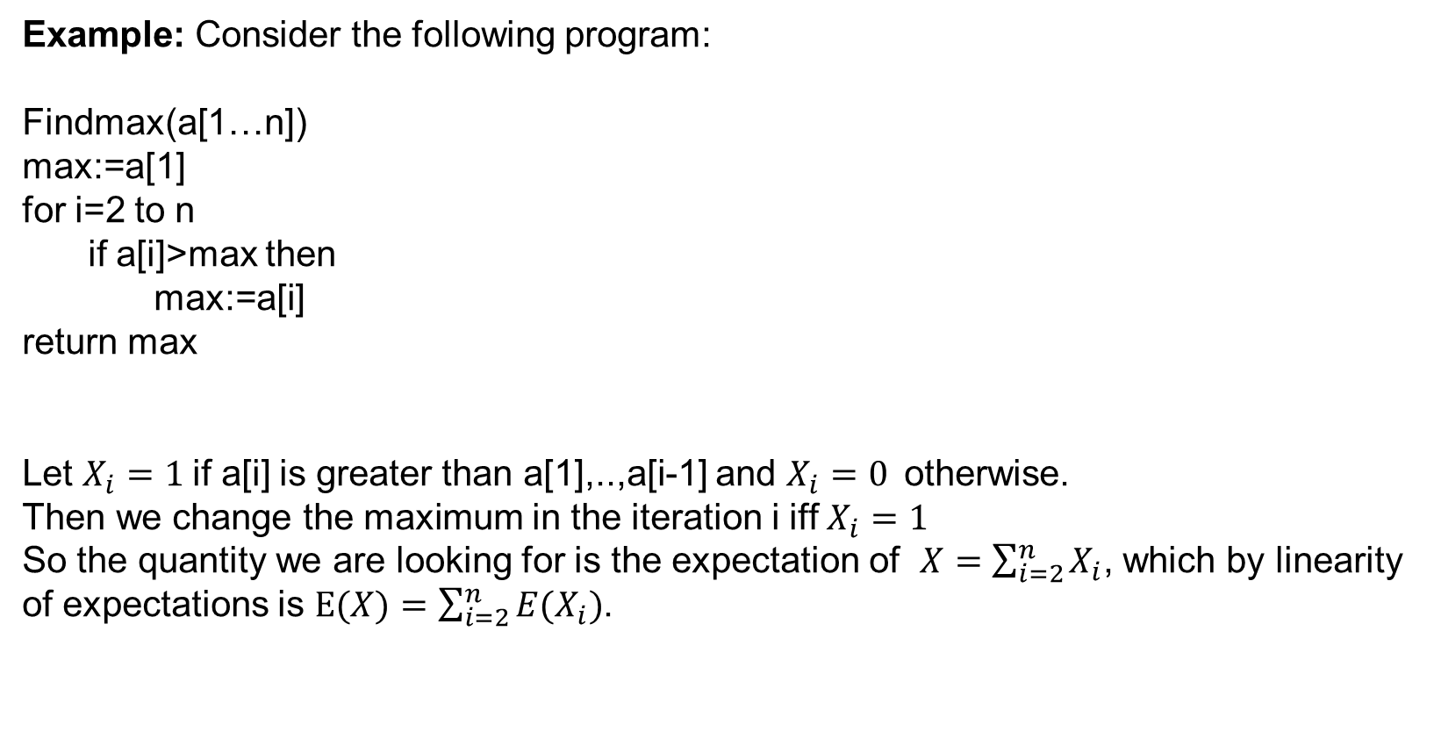
Useful trick 2: Linearity of expectation
Example: Consider the following program:
Findmax(a[1…n])
max:=a[1]
for i=2 to n
if a[i]>max then
max:=a[i]
return max
Let $X_{i}=1$if a[i] is greater than a[1],..,a[i-1] and $X_{i}=0$otherwise.
Then we change the maximum in the iteration i iff $X_{i}=1$
So the quantity we are looking for is the expectation of $X=\sum_{i=2}^{n}{X_{i}}$, which by linearity of expectations is $E(X)=\sum_{i=2}^{n}{E(X_{i})}$.

Slide 62
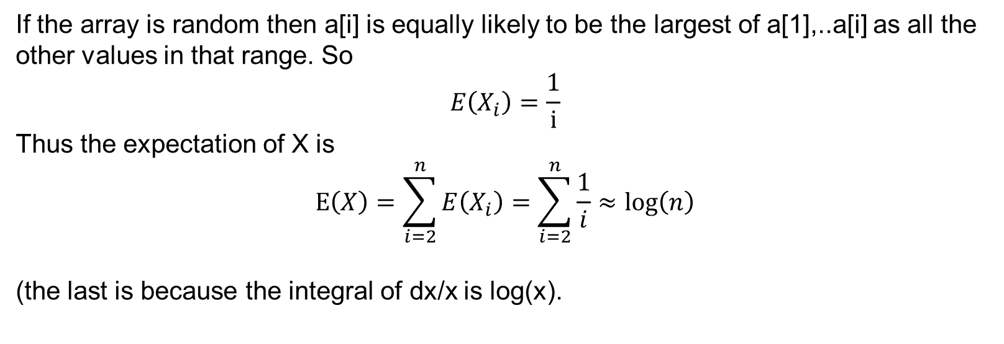
Useful trick 2: Linearity of expectation
If the array is random then a[i] is equally likely to be the largest of a[1],..a[i] as all the other values in that range. So
$$E\left(X_{i}\right)=\frac{1}{i}$$
Thus the expectation of X is
$$E\left(X\right)=\sum_{i=2}^{n}{E\left(X_{i}\right)}=\sum_{i=2}^{n}{\frac{1}{i}}≈\log\left(n\right)$$
(the last is because the integral of dx/x is log(x).

Slide 63
Other functions?
Rosen p. 460,478
Expectation does not in general commute with other functions.
E ( f(X) ) ≠ f ( E (X) )
For example, let X be random variable with P(X = 0) = ½ , P(X =1) = ½
What's E(X)?
What's E(X²)?
What's ( E(X) )²?

Slide 64
Other functions?
Rosen p. 460,478
Expectation does not in general commute with other functions.
E ( f(X) ) ≠ f ( E (X) )
For example, let X be random variable with P(X = 0) = ½ , P(X =1) = ½
What's E(X)? (½)0 + (½)1 = ½
What's E(X²)? (½)0² + (½)1² = ½
What's ( E(X) )²? (½)² = ¼

