Slide 1
Eulerian tours
 | Miles Jones | MTThF 8:30-9:50am | CSE 4140
August 15, 2016

Slide 2
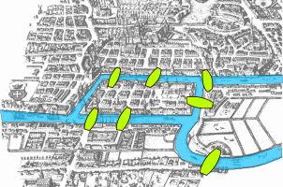
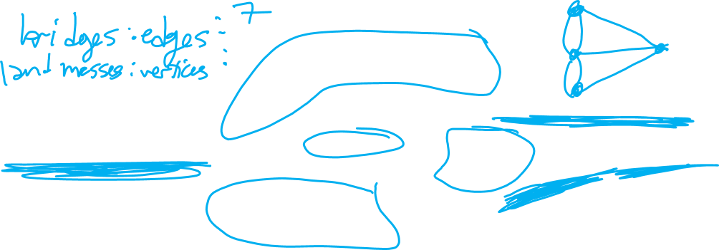
Seven Bridges of Konigsberg
Is there a path that crosses each bridge (exactly) once?
Rosen p. 693

Slide 3
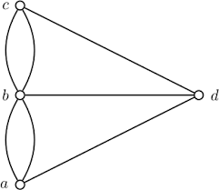
Seven Bridges of Konigsberg
Observe: exact location on the north side doesn't matter because must come & go via a bridge. Can represent each bridge as an edge.

Slide 4
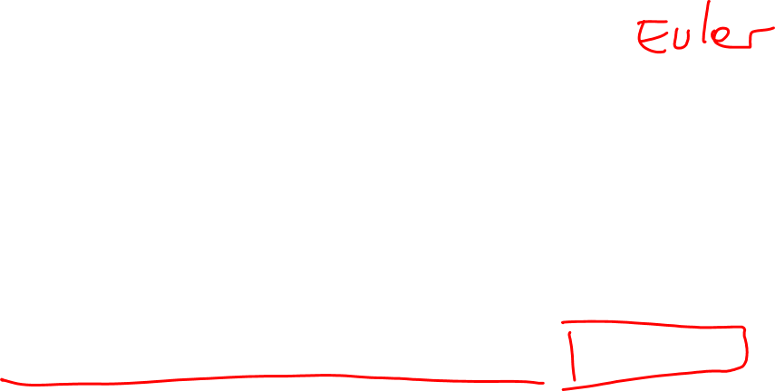
Seven Bridges of Konigsberg
Is there a path where each edge occurs exactly once? Eulerian tour
Rosen p. 693

Slide 5
Eulerian tour and Eulerian cycle (or circuit)
Eulerian tour (or path): a path in a graph that passes through every edge exactly once.
Eulerian cycle (or circuit): a path in a graph that pass through every edge exactly once and starts and ends on the same vertex.

Slide 6
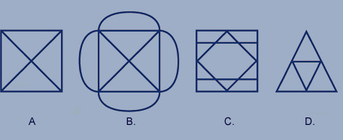
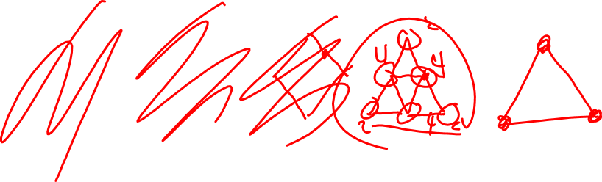
Seven Bridges of Konigsberg redux
Which of these puzzles can you draw without lifting your pencil off the paper?

Slide 7
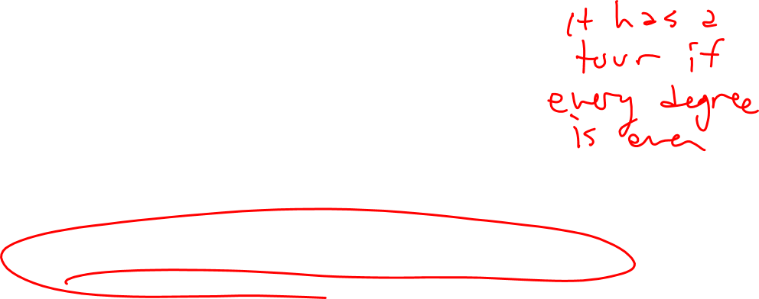
Algorithmic questions related to Euler tours
Existence:
Does the given graph G contain an Euler tour?
Path:
Find an Euler tour for the given graph G, if possible.
Turns out there are great algorithms for each of these … next!

Slide 8
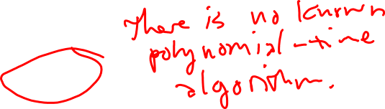
Algorithmic questions related to Euler tours
Hamiltonian tour
A Hamiltonian tour is a path where each vertex occurs exactly once.
Existence:
Does the given graph G contain a Hamiltonian tour?
Path:
Find a Hamiltonian tour for the given graph G, if possible.
These questions turn out to be intractable!!!

Slide 9
Algorithmic questions related to Euler tours
Hamiltonian tour
Actually, it is not known how to determine in any reasonable amount of time whether a graph G has a Hamilton Tour, or how to find one.
An Opportunity:
You can earn $1,000,000 if you can give an algorithm that finds a Hamilton Tour (if one exists) in an arbitrary graph on n vertices that takes time O(n^{k}) for constant k.

Slide 10

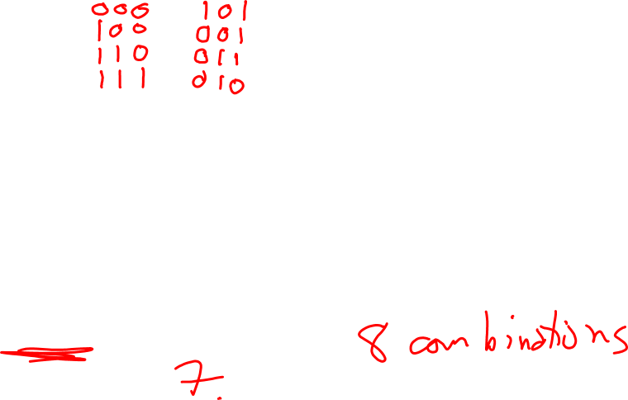
Light Switches
A light bulb is connected to 3 switches in such a way that it lights up only when all the switches are in the proper position. But you don't know what the proper position of each switch is!
What's the minimum number of single flips of a switch to guarantee that the light bulb turns on?
4
8
16
64
None of the above

Slide 11
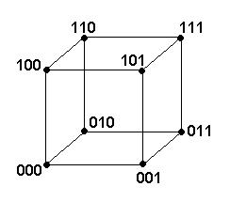
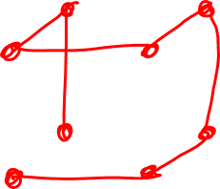
Light Switches
Configuration 1 if switch is UP, 0 if DOWN
Connect configuration if off by one switch.
Rephrasing the problem:
Looking for Hamiltonian tour through graph.

Slide 12
Our Strategy
Puzzle / Problem
Model as a graph
Choose vertex set & edge set … sometimes many possible options
Use graph algorithms to solve puzzle / problem

Slide 13

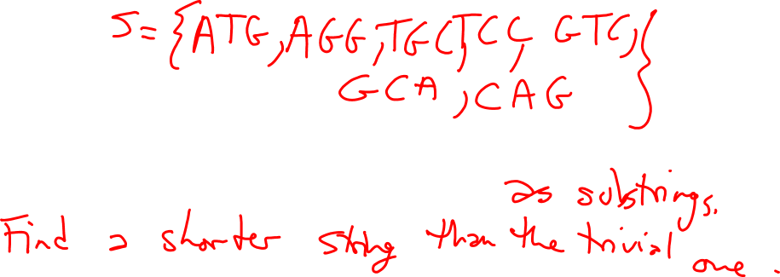
DNA Reconstruction
Problem
Given collection of short DNA strings.
Find longer DNA string that includes them all.
Many possible formulations as a graph problem.
Successful solution was a big step in Human Genome Project.

Slide 14
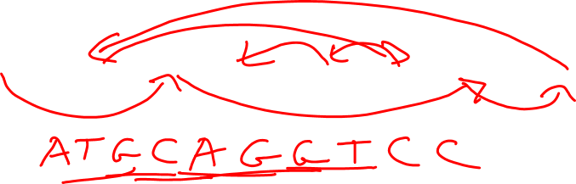
DNA Reconstruction: as a Hamiltonian tour
Given collection of short DNA strings.
S = { ATG, AGG, TGC, TCC, GTC, GGT, GCA, CAG }
Find longer DNA string that includes them all.
Vertex set: S, i.e. a vertex for each short DNA string
Edge set: edge from v to w if the first two letters of w equal the
last two letters of v
ATG AGG TGC TCC GTC GGT GCA CAG

Slide 15
DNA Reconstruction: as a Hamiltonian tour
Given collection of short DNA strings.
S = { ATG, AGG, TGC, TCC, GTC, GGT, GCA, CAG }
Find longer DNA string that includes them all.
Vertex set: S, i.e. a vertex for each short DNA string
Edge set: edge from v to w if the first two letters of w equal the
last two letters of v
ATG AGG TGC TCC GTC GGT GCA CAG
What's a Hamiltonian tour?

Slide 16
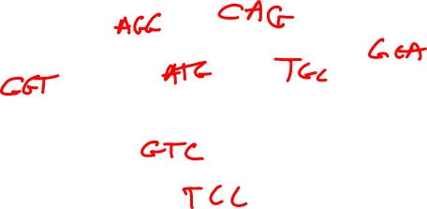
DNA Reconstruction: as an Eulerian tour
Given collection of short DNA strings.
S = { ATG, AGG, TGC, TCC, GTC, GGT, GCA, CAG }
Find longer DNA string that includes them all.
Vertex set: All length-two strings that appear in a word in S
Edge set: edge from ab to bc if abc is in S.
AG GG CA
AT TG GC
TC GT CC
What's an Eulerian tour?

Slide 17
Finding Eulerian tours
Consider only undirected graphs.
1st goal: Determine whether a given undirected graph G has an Eulerian tour.
2nd goal: Actually find an Eulerian tour in an undirected graph G, when possible.

Slide 18
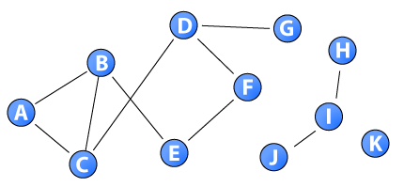

Finding Eulerian tours
How many paths are there between vertex A and vertex I?
None.
Exactly one.
Exactly two.
More than two.
None of the above.

Slide 19
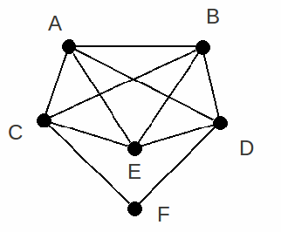
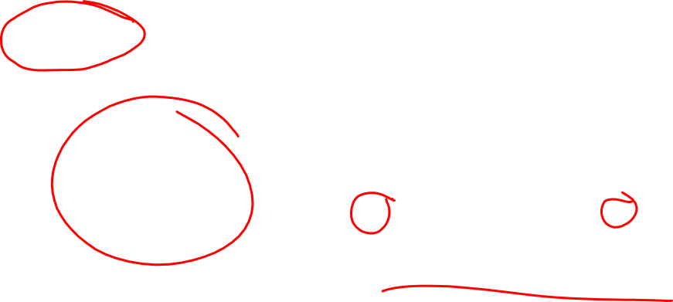
Connectedness
An undirected graph G is connected if for any ordered pair of vertices (v,w) there is a path from v to w.
Connected
Not connected

Slide 20
Connectedness
An undirected graph G is connected if for any ordered pair of vertices (v,w) there is a path from v to w.
An undirected graph G is disconnected if
for any ordered pair of vertices (v,w) there is no path from v to w.
there is an ordered pair of vertices (v,w) with a path from v to w.
there is an ordered pair of vertices (v,w) with no path from v to w.
for every ordered pair of vertices (v,w) there is a path from v to w.
None of the above.

Slide 21
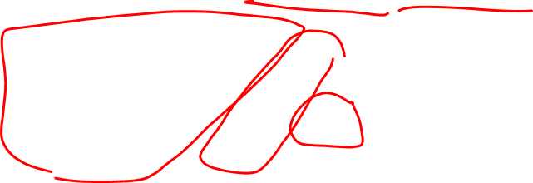
Connected Components
Disconnected graphs can be broken up into pieces where each is connected.
Each connected piece of the graph is a connected component.

Slide 22
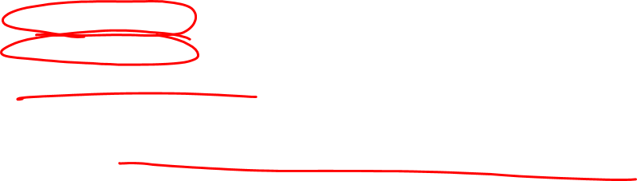
Finding Eulerian tours
Let G = (V,E) be an
undirected
connected
graph with n vertices.
1st goal: Determine whether G has an Eulerian tour.
2nd goal: If yes, find the tour itself.

Slide 23
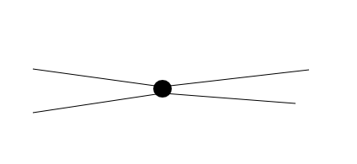
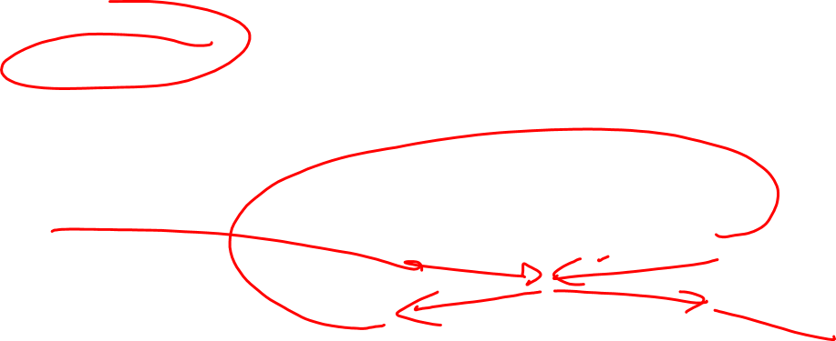
Finding Eulerian tours
Observation:
If v is an intermediate* vertex on a path p, then p must enter v the same number of times it leaves v.
* not the start vertex, not the end vertex.
v

Slide 24
Finding Eulerian tours
Observation:
If v is an intermediate* vertex on a path p, then p must enter v the same number of times it leaves v.
If p is an Eulerian tour, it contains all edges.
So, each edge incident with v is in p.
* not the start vertex, not the end vertex.
v

Slide 25
Recall: Degree
The degree of a vertex in an undirected graph is the total number of edges incident with it, except that a loop contributes twice.
Rosen p. 652

Slide 26

Finding Eulerian tours
Observation:
If v is an intermediate* vertex on a path p, then p must enter v the same number of times it leaves v.
If p is Eulerian tour, it has all edges: each edge incident with v is in p.
* not the start vertex, not the end vertex.
There are degree(v) many of these
v

Slide 27

Finding Eulerian tours
Observation:
If v is an intermediate* vertex on a path p, then p must enter v the same number of times it leaves v.
If p is Eulerian tour, it has all edges: each edge incident with v is in p.
Half these edges are entering v, half are leaving v …
degree(v) is even!
There are degree(v) many of these

Slide 28
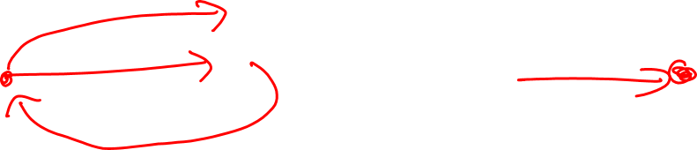
Finding Eulerian tours
(Summary of) Observation:
In an Eulerian tour, any intermediate vertex has even degree.
If tour is a circuit, all vertices are intermediate so all have even degree.
If tour is not a circuit, starting and ending vertices will have odd degree.

Slide 29
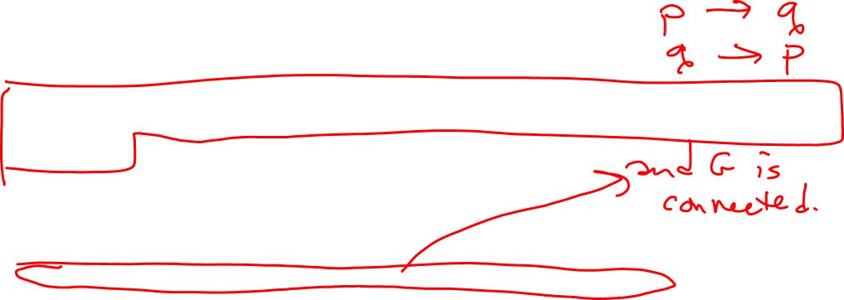
Finding Eulerian tours
Theorem: If G has an Eulerian tour, G has at most two odd degree vertices.
Which of the following statements is the converse to the theorem?
If G does not have an Eulerian tour, then G does not have at most two odd degree vertices.
If G has at most two odd degree vertices, then G has an Eulerian tour.
If G does not have at most two odd degree vertices, then G does not have an Eulerian tour.
More than one of the above.
None of the above.

Slide 30
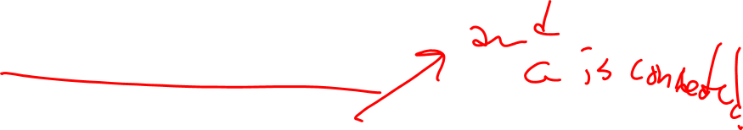
Finding Eulerian tours
Theorem: If G has an Eulerian tour, G has at most two odd degree vertices.
Question: is the converse also true? i.e
If G has at most two odd degree vertices, then must G have an Eulerian tour?

Slide 31
Finding Eulerian tours
Theorem: If G has an Eulerian tour, G has at most two odd degree vertices.
Question: is the converse also true? i.e
If G has at most two odd degree vertices, then must G have an Eulerian tour?
Answer: give algorithm to build the Eulerian tour!
We'll develop some more graph theory notions along the way.

Slide 32
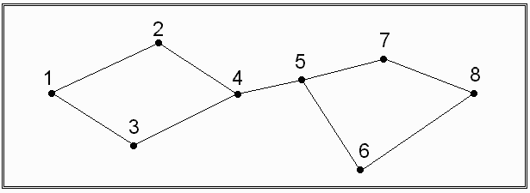
Finding Eulerian tours
Eulerian tour?

Slide 33
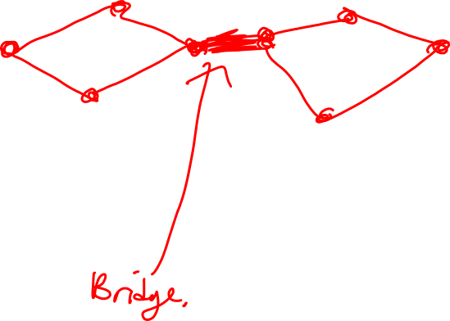
Finding Eulerian tours
Eulerian tour?
Start at 4. Where should we go next?
Along edge to 2.
Along edge to 3.
Along edge to 5.
Any of the above.

Slide 34
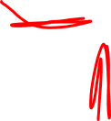
Bridges
A bridge is an edge, which, if removed, would cause G to be disconnected.
A
D
B
E
C
Which of the edges in this graph are bridges?
All of them.
D, E
A, B, C
C, D
None of the above.

Slide 35
Bridges
A bridge is an edge, which, if removed, would cause G to be disconnected.
Connection with Eulerian tours:
In an Eulerian tour, we have to visit every edge on one side of the bridge before we cross it (because there's no coming back).
** Do you see divide & conquer in here?

Slide 36
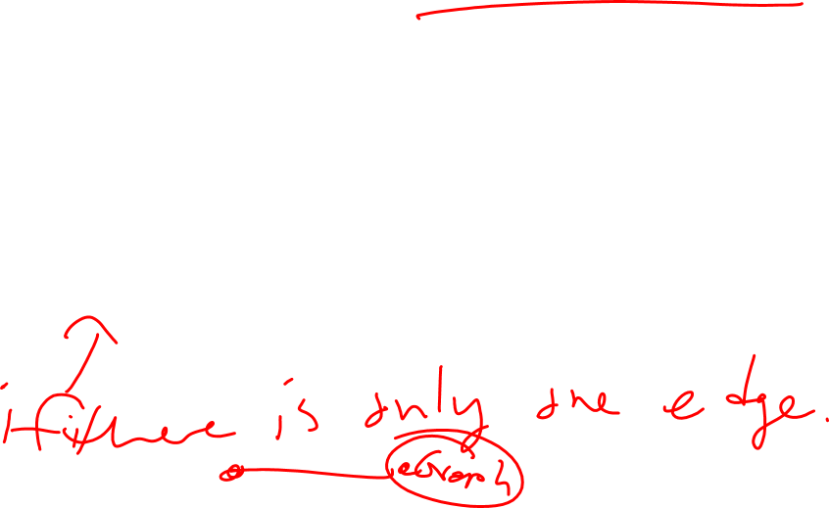
Eulerian Tours HOW Fleury's Algorithm
Check that G has at most 2 odd degree vertices.
Start at vertex v, an odd degree vertex if possible.
While there are still edges in G,
If there is more than one edge incident on v
Cross any edge incident on v that is not a bridge and delete it
Else,
Cross the only edge available from v and delete v.

Slide 37

Eulerian Tours WHY Fleury's Algorithm
Check that G has at most 2 odd degree vertices.
Start at vertex v, an odd degree vertex if possible.
While there are still edges in G,
If there is more than one edge incident on v
Cross any edge incident on v that is not a bridge and delete it
Else,
Cross the only edge available from v and delete v.
Will there always be such an edge?
Will go through each edge at most once, so if while loop iterates |E| times,
get an Eulerian tour.

Slide 38
Fleury’s algorithm correctness. invariants
If v has odd degree then there is exactly one other vertex w of odd degree. If v has even degree, all other vertices have even degree.
2. G stays connected (deleting edges as we use them.)

Slide 39
Fleury’s algorithm correctness. invariants
If v has odd degree then there is exactly one other vertex w of odd degree. If v has even degree, all other vertices have even degree.
Proof:
Base Case: since G has at most 2 odd degree vertices and we pick one as v, there must only be one other.
Induction Hypothesis: Suppose after k iterations, the current vertex has odd degree and one other vertex has odd degree or all vertices have even degree.
Call the current vertex v. Then we must cross an edge to get to a neighbor of v call it y. If y is not w then y has even degree and when you delete the edge (v,y), v now has even degree and y has odd degree and y is the new current vertex.
if y is w then when you delete the edge (v,y) v has even degree and w has even degree so all vertices have even degree.

Slide 40
Fleury’s algorithm correctness. invariants
2. G stays connected (deleting edges as we use them.)
Proof:
Base Case:
G starts as being connected.
Inductive hypothesis: Assume after k iterations, G is still connected.
If we remove the current vertex v and all the edges from v, the graph could split into connected components C_1,…C_m

Slide 41
Fleury’s algorithm correctness. invariants
2. G stays connected (deleting edges as we use them.)
If we remove the current vertex v and all the edges from v, the graph could split into connected components C_1,…C_m

Slide 42
Fleury’s algorithm correctness. invariants
2. G stays connected (deleting edges as we use them.)
If we remove the current vertex v and all the edges from v, the graph could split into connected components C_1,…C_m
Case 1: There is a single component, m=1 and there is only one edge from v. Then G stays connected because it becomes C_1 and we delete v after the one edge is removed.

Slide 43
Fleury’s algorithm correctness. invariants
2. G stays connected (deleting edges as we use them.)
Case 2: There is a component C_i with at least 2 edges from v. Then neither is a bridge and Fleury’s algorithm can take any of these edges and the graph will stay connected.

Slide 44



Fleury’s algorithm correctness. invariants
2. G stays connected (deleting edges as we use them.)
Case 3: There are at least 2 components and all have single edges from v.
THIS CASE CANNOT HAPPEN!!!!!!!!

Slide 45
Fleury’s algorithm correctness. invariants
2. G stays connected (deleting edges as we use them.)
Case 3: There are at least 2 components and all have single edges from v.
THIS CASE CANNOT HAPPEN!!!!!!!!
w would be in at most one of the at least two components. So pick a component C_i so that there is one edge from v to C_i which has no odd degree vertices. Consider the subgraph consisting just of v and C_i. This graph has only one odd degree vertex. But this contradicts the handshake lemma!!!!!

Slide 46
Fleury’s algorithm correctness. invariants
Conclusion: Throughout the algorithm, the graph stays connected. In particular, we end when there are no edges leaving our current vertex v, which means there cannot be any other vertices or the graph would be disconnected. So we have deleted all edges, and hence gone over each edge exactly once.
Bridge!
v

Slide 47
Eulerian Tours WHY Fleury's Algorithm
Check that G has at most 2 odd degree vertices.
Start at vertex v, an odd degree vertex if possible.
While there are still edges in G,
If there is more than one edge incident with v
Cross any edge incident with v that is not a bridge
Else, cross the only edge available from v.
Delete the edge just crossed from G, update v.
Will there always be such an edge?
Bridge!
v

Slide 48
Eulerian Tours WHY Fleury's Algorithm
Check that G has at most 2 odd degree vertices.
Start at vertex v, an odd degree vertex if possible.
While there are still edges in G,
If there is more than one edge incident with v
Cross any edge incident with v that is not a bridge
Else, cross the only edge available from v.
Delete the edge just crossed from G, update v.
Will there always be such an edge?
Bridge!
v

Slide 49
Eulerian Tours WHY Fleury's Algorithm
Check that G has at most 2 odd degree vertices.
Start at vertex v, an odd degree vertex if possible.
While there are still edges in G,
If there is more than one edge incident with v
Cross any edge incident with v that is not a bridge
Else, cross the only edge available from v.
Delete the edge just crossed from G, update v.
Will there always be such an edge?
v
Bridge!

Slide 50
Eulerian Tours WHY Fleury's Algorithm
Check that G has at most 2 odd degree vertices.
Start at vertex v, an odd degree vertex if possible.
While there are still edges in G,
If there is more than one edge incident with v
Cross any edge incident with v that is not a bridge
Else, cross the only edge available from v.
Delete the edge just crossed from G, update v.
Will there always be such an edge?
v

Slide 51
Eulerian Tours WHY Fleury's Algorithm
Check that G has at most 2 odd degree vertices.
Start at vertex v, an odd degree vertex if possible.
While there are still edges in G,
If there is more than one edge incident with v
Cross any edge incident with v that is not a bridge
Else, cross the only edge available from v.
Delete the edge just crossed from G, update v.
Will there always be such an edge?
etc.
v

Slide 52
Seven Bridges of Konigsberg
3
3
5
3
Is there a path where each edge occurs exactly once? Eulerian tour
No!
Rosen p. 693

Slide 53
Seven Bridges of Konigsberg redux
3
3
5
5
2
4
3
3
4
4
4
3
3
3
3
5
5
2
4
2
Which of these puzzles can you draw without lifting your pencil off the paper?
A. No
B. No
C. No
D. Yes

Slide 54
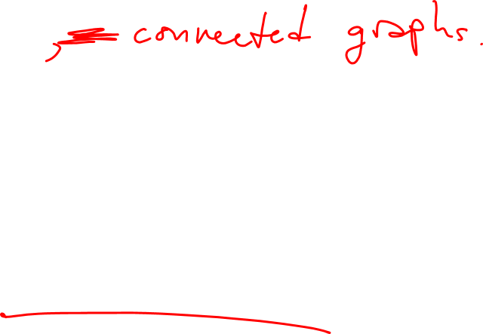
Eulerian Tours: recap
Consider only undirected graphs.
1st goal: Determine whether a given undirected graph G has an Eulerian tour.
G has an Eulerian tour if and only if G has at most 2 odd-degree vertices.
2nd goal: Actually find an Eulerian tour in an undirected graph G, when possible.
Fleury's Algorithm: don't burn your bridges.

Slide 55

Eulerian Tours: recap
Number of odd degree vertices | 0 | 1 | 2 | >2, odd | >2, even
Is such a graph possible? | yes | no | yes | no | yes
Is an Eulerian tour possible? | yes, an Eulerian circuit |  | yes |  | no

