Slide 1
Hash Functions/Review
 | Miles Jones | MTThF 8:30-9:50am | CSE 4140
September 1, 2016

Slide 2
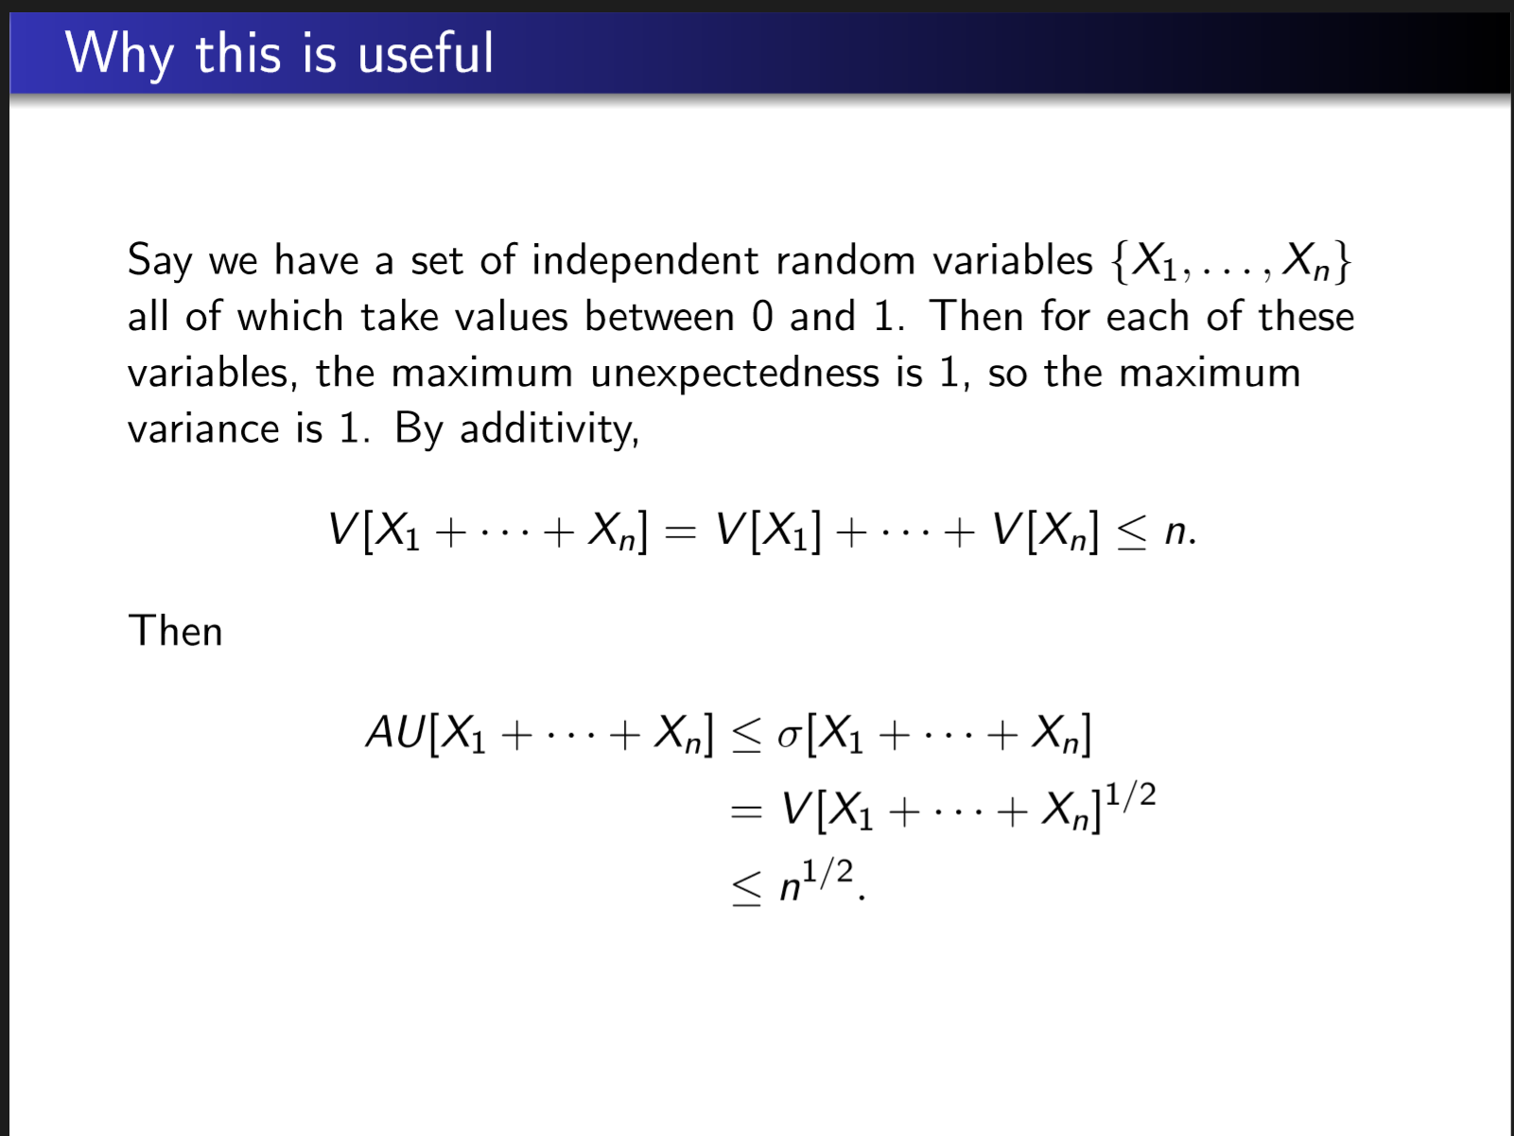

Slide 3
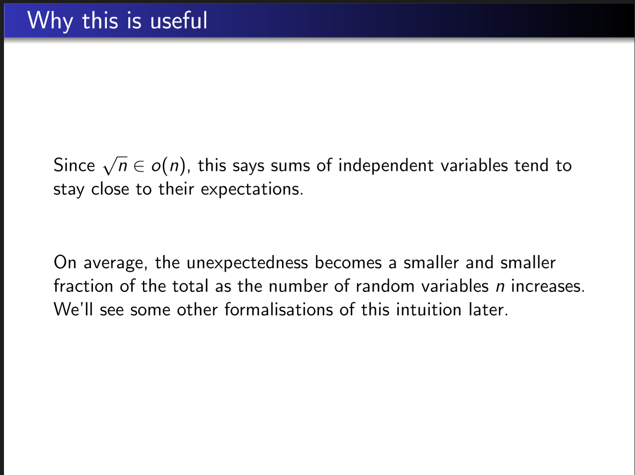

Slide 4
Element Distinctness: WHAT
Given list of positive integers a₁, a₂, …, a_{n} decide whether all the numbers are
distinct or whether there is a repetition, i.e. two positions i, j with 1 <= i < j <= n such that a_{i} = a_{j}.
What algorithm would you choose in general?

Slide 5
Element Distinctness: HOW
Given list of positive integers a₁, a₂, …, a_{n} decide whether all the numbers are
distinct or whether there is a repetition, i.e. two positions i, j with 1 <= i < j <= n such that a_{i} = a_{j}.
What algorithm would you choose in general? Can sorting help?
Algorithm: first sort list and then step through to find duplicates. What's its runtime?
None of the above

Slide 6
Element Distinctness: HOW
Given list of positive integers a₁, a₂, …, a_{n} decide whether all the numbers are
distinct or whether there is a repetition, i.e. two positions i, j with 1 <= i < j <= n such that a_{i} = a_{j}.
What algorithm would you choose in general? Can sorting help?
Algorithm: first sort list and then step through to find duplicates. How much memory does it require?
None of the above

Slide 7
Element Distinctness: HOW
Given list of positive integers a₁, a₂, …, a_{n} decide whether all the numbers are
distinct or whether there is a repetition, i.e. two positions i, j with 1 <= i < j <= n such that a_{i} = a_{j}.
What algorithm would you choose in general? What if we had unlimited memory?

Slide 8
Element Distinctness: HOW
Given list of positive integers A = a₁, a₂, …, a_{n} ,
UnlimitedMemoryDistinctness(A)
For i = 1 to n,
If M[a_{i}] = 1 then return "Found repeat"
Else M[a_{i}] := 1
Return "Distinct elements"
M is an array of memory locations
This is memory location indexed by a_{i}
What's the runtime of this algorithm?
None of the above

Slide 9
Element Distinctness: HOW
Given list of positive integers A = a₁, a₂, …, a_{n} ,
UnlimitedMemoryDistinctness(A)
For i = 1 to n,
If M[a_{i}] = 1 then return "Found repeat"
Else M[a_{i}] := 1
Return "Distinct elements"
M is an array of memory locations
This is memory location indexed by a_{i}
What's the runtime of this algorithm?
None of the above
What's the memory use of this algorithm?
None of the above

Slide 10
Element Distinctness: HOW
To simulate having more memory locations: use Virtual Memory.
Define hash function
h: { desired memory locations } → { actual memory locations }
Typically we want more memory than we have, so h is not one-to-one.
How to implement h?
CSE 12, CSE 100.
Here, let's use hash functions in an algorithm for Element Distinctness.

Slide 11
Virtual Memory Applications
Not just in this algorithm but in many computational settings we want to simulate a huge space of possible memory locations but where we are only going to access a small fraction.
For example, suppose you have a company of 5,000 employees and each is identified by their SSN. You want to be able to access employee records by their SSN.
You don’t want to keep a table of all possible SSN’s so we’ll use a virtual memory data structure to emulate having that huge table.
Can you think of any other examples?

Slide 13
Ideal Hash Function
Ideally, we could use a very unpredictable function called a hash function to assign random physical locations to each virtual location.
Later we will discuss how to actually implement such hash functions. But for now assume that we have a function h so that for every virtual location v, h(v) is uniformly and randomly chosen among the physical locations.
We call such an h an ideal hash function if its computable in constant time.

Slide 14
Element Distinctness: HOW
Given list of positive integers A = a₁, a₂, …, a_{n} , and m memory locations available
HashDistinctness(A, m)
Initialize array M[1,..,m] to all 0s.
Pick a hash function h from all positive integers to 1,..,m.
For i = 1 to n,
If M[ h(a_{i}) ] = 1 then return "Found repeat"
Else M[ h(a_{i}) ] := 1
Return "Distinct elements"

Slide 15
Element Distinctness: HOW
Given list of positive integers A = a₁, a₂, …, a_{n} , and m memory locations available
HashDistinctness(A, m)
Initialize array M[1,..,m] to all 0s.
Pick a hash function h from all positive integers to 1,..,m.
For i = 1 to n,
If M[ h(a_{i}) ] = 1 then return "Found repeat"
Else M[ h(a_{i}) ] := 1
Return "Distinct elements"
What's the runtime of this algorithm?
None of the above

Slide 16
Element Distinctness: HOW
Given list of positive integers A = a₁, a₂, …, a_{n} , and m memory locations available
HashDistinctness(A, m)
Initialize array M[1,..,m] to all 0s.
Pick a hash function h from all positive integers to 1,..,m.
For i = 1 to n,
If M[ h(a_{i}) ] = 1 then return "Found repeat"
Else M[ h(a_{i}) ] := 1
Return "Distinct elements"
What's the memory use of this algorithm?
None of the above

Slide 17
Element Distinctness: WHY
Given list of positive integers A = a₁, a₂, …, a_{n} , and m memory locations available
HashDistinctness(A, m)
Initialize array M[1,..,m] to all 0s.
Pick a hash function h from all positive integers to 1,..,m.
For i = 1 to n,
If M[ h(a_{i}) ] = 1 then return "Found repeat"
Else M[ h(a_{i}) ] := 1
Return "Distinct elements"
But this algorithm might make a mistake!!!
When?

Slide 18
Element Distinctness: WHY
Given list of positive integers A = a₁, a₂, …, a_{n} , and m memory locations available
HashDistinctness(A, m)
Initialize array M[1,..,m] to all 0s.
Pick a hash function h from all positive integers to 1,..,m.
For i = 1 to n,
If M[ h(a_{i}) ] = 1 then return "Found repeat"
Else M[ h(a_{i}) ] := 1
Return "Distinct elements"
Correctness: Goal is
If there is a repetition, algorithm finds it
If there is no repetition, algorithm reports "Distinct elements"

Slide 19

Element Distinctness: WHY
Given list of positive integers A = a₁, a₂, …, a_{n} , and m memory locations available
HashDistinctness(A, m)
Initialize array M[1,..,m] to all 0s.
Pick a hash function h from all positive integers to 1,..,m.
For i = 1 to n,
If M[ h(a_{i}) ] = 1 then return "Found repeat"
Else M[ h(a_{i}) ] := 1
Return "Distinct elements"
Correctness: Goal is
If there is a repetition, algorithm finds it
If there is no repetition, algorithm reports "Distinct elements" Hash Collisions

Slide 20
Element Distinctness: WHY
Given list of positive integers A = a₁, a₂, …, a_{n} , and m memory locations available
HashDistinctness(A, m)
Initialize array M[1,..,m] to all 0s.
Pick a hash function h from all positive integers to 1,..,m.
For i = 1 to n,
If M[ h(a_{i}) ] = 1 then return "Found repeat"
Else M[ h(a_{i}) ] := 1
Return "Distinct elements"
When is our algorithm correct with high probability in the ideal hash model?

Slide 21
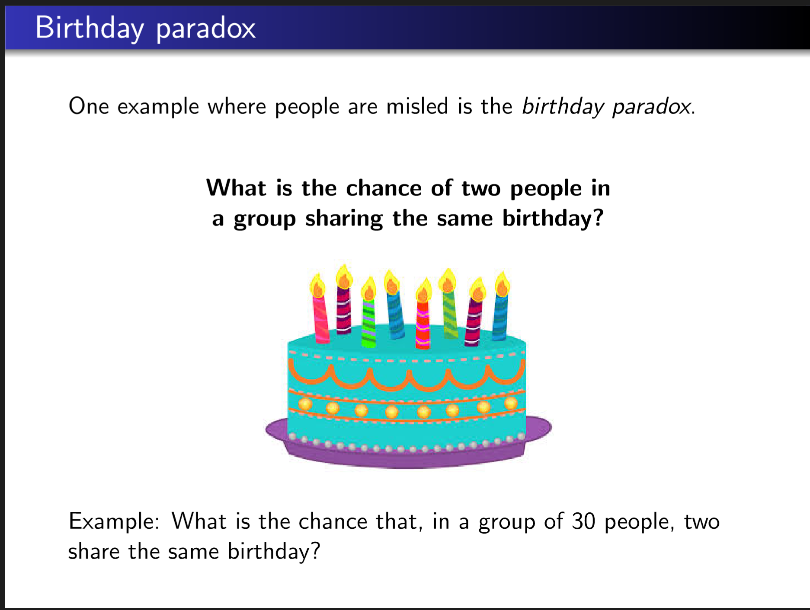

Slide 22
Where is the connection?
Think of elements in the array = people
Days of the year = memory locations
h(person)=birthday
collisions mean that two people share the same birthday.

Slide 23
General Birthday Paradox-type Phenomena
We have n objects and m places. We are putting each object at random into one of the places. What is the probability that 2 objects occupy the same place?

Slide 24

Calculating the general rule

Slide 25
Calculating the general rule
Probability the first object causes no collisions is 1

Slide 26
Calculating the general rule
Probability the second object causes no collisions is 1-1/m

Slide 27
Calculating the general rule
Probability the third object causes no collisions is (m-2)/m=1-2/m

Slide 28
Calculating the general rule
Probability the ith object causes no collisions is 1-(i-1)/m

Slide 29
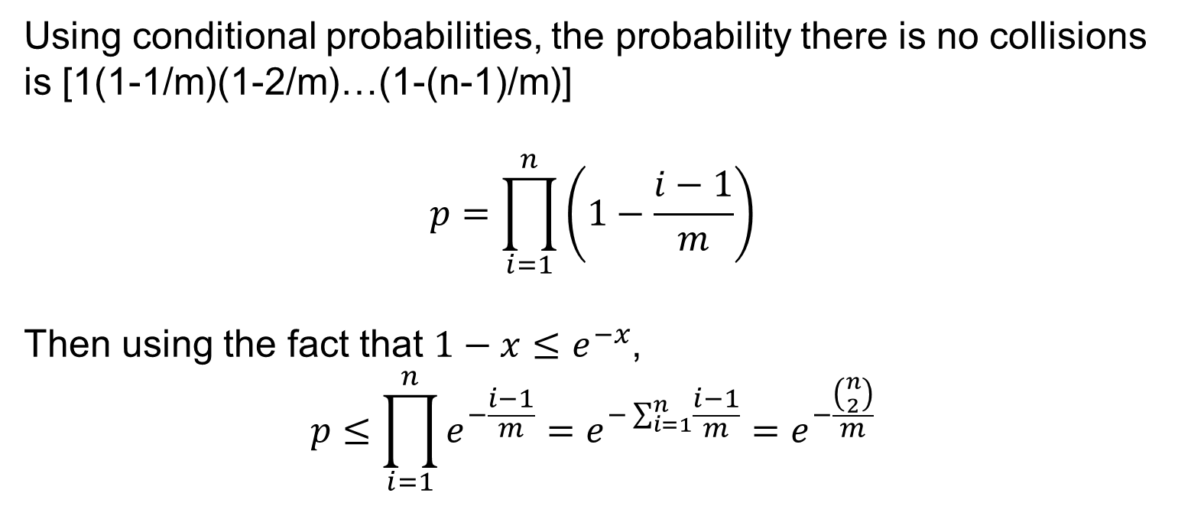
Conditional probability
Using conditional probabilities, the probability there is no collisions is [1(1-1/m)(1-2/m)…(1-(n-1)/m)]
$$p=\prod_{i=1}^{n}{\left(1−\frac{i−1}{m}\right)}$$
Then using the fact that $1−x≤e^{−x}$,
$$p≤\prod_{i=1}^{n}{e^{−\frac{i−1}{m}}=e^{−\sum_{i=1}^{n}{\frac{i−1}{m}}}}=e^{−\frac{\left({n \atop 2}\right)}{m}}$$

Slide 30
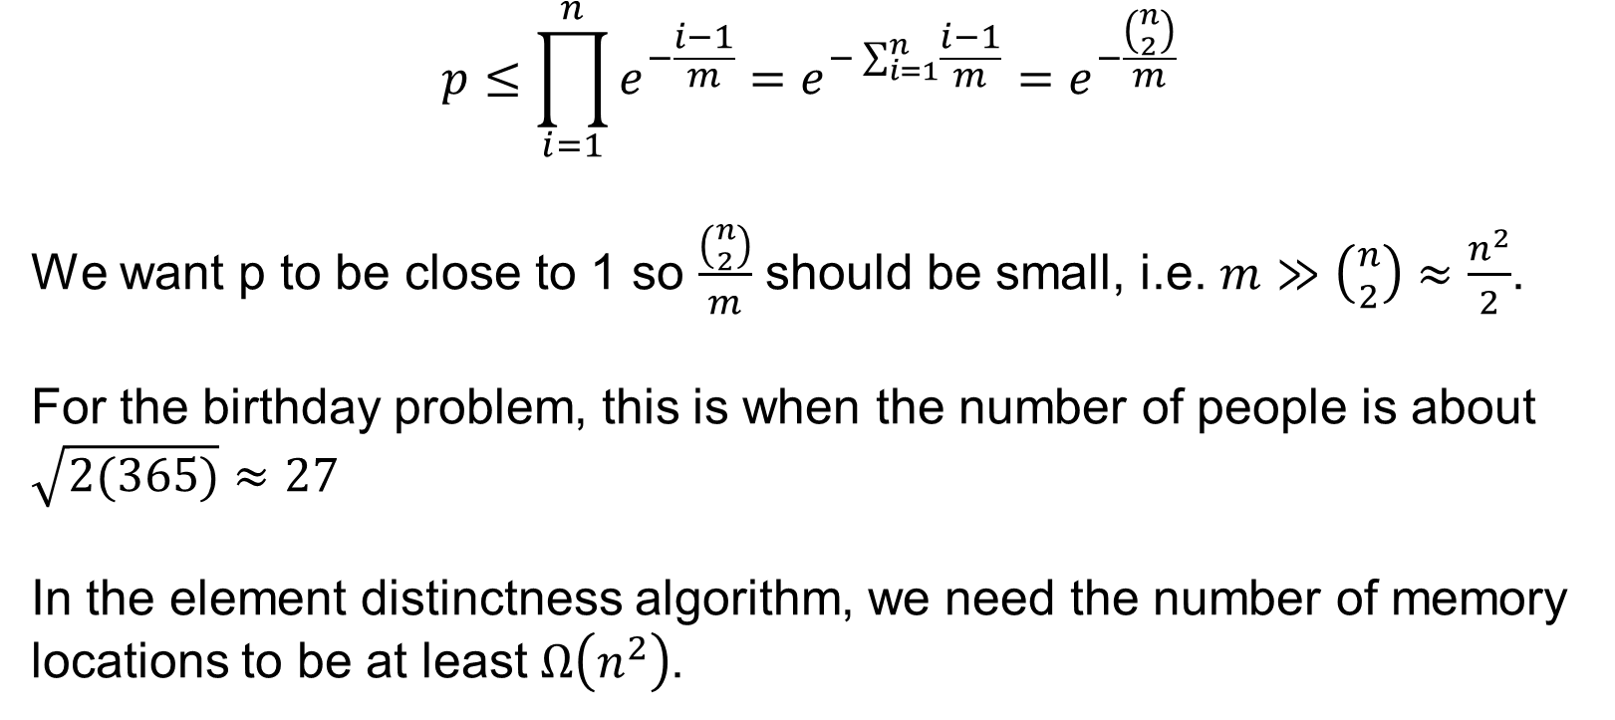
Conditional Probabilities
$$p≤\prod_{i=1}^{n}{e^{−\frac{i−1}{m}}=e^{−\sum_{i=1}^{n}{\frac{i−1}{m}}}}=e^{−\frac{\left({n \atop 2}\right)}{m}}$$
We want p to be close to 1 so $\frac{\left({n \atop 2}\right)}{m}$ should be small, i.e. $m≫\left({n \atop 2}\right)≈\frac{n^{2}}{2}$.
For the birthday problem, this is when the number of people is about $\sqrt{2(365)}≈27$
In the element distinctness algorithm, we need the number of memory locations to be at least $Ω\left(n^{2}\right)$.

Slide 31
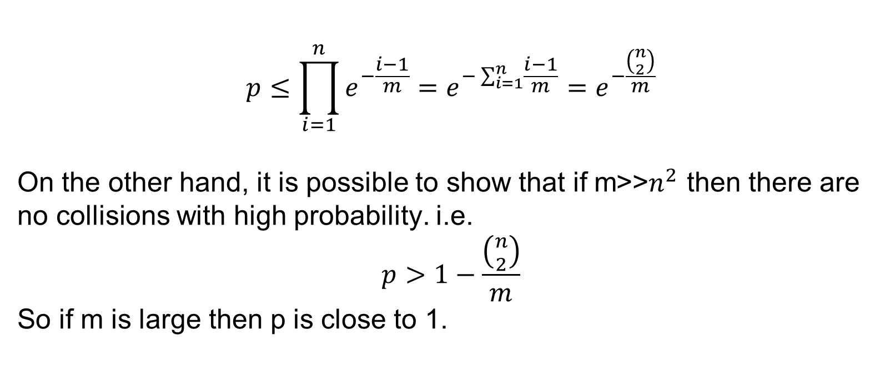
Conditional Probabilities
$$p≤\prod_{i=1}^{n}{e^{−\frac{i−1}{m}}=e^{−\sum_{i=1}^{n}{\frac{i−1}{m}}}}=e^{−\frac{\left({n \atop 2}\right)}{m}}$$
On the other hand, it is possible to show that if m>>$n^{2}$ then there are no collisions with high probability. i.e.
$$p>1−\frac{\left({n \atop 2}\right)}{m}$$
So if m is large then p is close to 1.

Slide 32
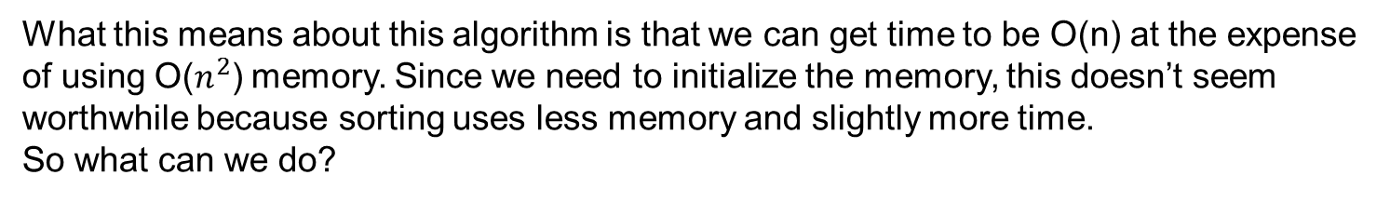
Element Distinctness: WHY
Given list of positive integers A = a₁, a₂, …, a_{n} , and m memory locations available
HashDistinctness(A, m)
Initialize array M[1,..,m] to all 0s.
Pick a hash function h from all positive integers to 1,..,m.
For i = 1 to n,
If M[ h(a_{i}) ] = 1 then return "Found repeat"
Else M[ h(a_{i}) ] := 1
Return "Distinct elements"
What this means about this algorithm is that we can get time to be O(n) at the expense of using O($n^{2}$) memory. Since we need to initialize the memory, this doesn’t seem worthwhile because sorting uses less memory and slightly more time.
So what can we do?

Slide 33
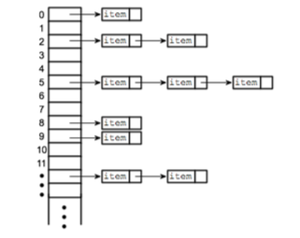
Resolving collisions with chaining
Hash Table
Each memory location holds a pointer to a linked list, initially empty.
Each linked list records the items that map to that memory location.
Collision means
there is more
than one item
in this linked list

Slide 34
Element Distinctness: HOW
Given list of positive integers A = a₁, a₂, …, a_{n} , and m memory locations available
ChainHashDistinctness(A, m)
Initialize array M[1,..,m] to null lists.
Pick a hash function h from all positive integers to 1,..,m.
For i = 1 to n,
For each element j in M[ h(a_{i}) ],
If a_{j} = a_{i} then return "Found repeat"
Append i to the tail of the list M [ h(a_{i}) ]
Return "Distinct elements"

Slide 35
Element Distinctness: WHY
Given list of positive integers A = a₁, a₂, …, a_{n} , and m memory locations available
ChainHashDistinctness(A, m)
Initialize array M[1,..,m] to null lists.
Pick a hash function h from all positive integers to 1,..,m.
For i = 1 to n,
For each element j in M[ h(a_{i}) ],
If a_{j} = a_{i} then return "Found repeat"
Append i to the tail of the list M [ h(a_{i}) ]
Return "Distinct elements"
Correctness: Goal is
If there is a repetition, algorithm finds it
If there is no repetition, algorithm reports "Distinct elements"

Slide 36
Element Distinctness: MEMORY
Given list of positive integers A = a₁, a₂, …, a_{n} , and m memory locations available
ChainHashDistinctness(A, m)
Initialize array M[1,..,m] to null lists.
Pick a hash function h from all positive integers to 1,..,m.
For i = 1 to n,
For each element j in M[ h(a_{i}) ],
If a_{j} = a_{i} then return "Found repeat"
Append i to the tail of the list M [ h(a_{i}) ]
Return "Distinct elements"
What's the memory use of this algorithm?

Slide 37
Element Distinctness: MEMORY
Given list of distinct integers A = a₁, a₂, …, a_{n} , and m memory locations available
ChainHashDistinctness(A, m)
Initialize array M[1,..,m] to null lists.
Pick a hash function h from all positive integers to 1,..,m.
For i = 1 to n,
For each element j in M[ h(a_{i}) ],
If a_{j} = a_{i} then return "Found repeat"
Append i to the tail of the list M [ h(a_{i}) ]
Return "Distinct elements"
What's the memory use of this algorithm?
Size of M: O(m). Total size of all the linked lists: O(n). Total memory: O(m+n).

Slide 38
Element Distinctness: WHEN
ChainHashDistinctness(A, m)
Initialize array M[1,..,m] to null lists.
Pick a hash function h from all positive integers to 1,..,m.
For i = 1 to n,
For each element j in M[ h(a_{i}) ],
If a_{j} = a_{i} then return "Found repeat"
Append i to the tail of the list M [ h(a_{i}) ]
Return "Distinct elements"

Slide 39
Element Distinctness: WHEN
ChainHashDistinctness(A, m)
Initialize array M[1,..,m] to null lists.
Pick a hash function h from all positive integers to 1,..,m.
For i = 1 to n,
For each element j in M[ h(a_{i}) ],
If a_{j} = a_{i} then return "Found repeat"
Append i to the tail of the list M [ h(a_{i}) ]
Return "Distinct elements"
Worst case is when we don't find a_{i}:
O( 1 + size of list M[ h(a_{i}) ] )

Slide 40
Element Distinctness: WHEN
ChainHashDistinctness(A, m)
Initialize array M[1,..,m] to null lists.
Pick a hash function h from all positive integers to 1,..,m.
For i = 1 to n,
For each element j in M[ h(a_{i}) ],
If a_{j} = a_{i} then return "Found repeat"
Append i to the tail of the list M [ h(a_{i}) ]
Return "Distinct elements"
Worst case is when we don't find a_{i}:
O( 1 + size of list M[ h(a_{i}) ] )
= O( 1 + # j<i with h(a_{j})=h(a_{i}) )

Slide 41

Element Distinctness: WHEN
ChainHashDistinctness(A, m)
Initialize array M[1,..,m] to null lists.
Pick a hash function h from all positive integers to 1,..,m.
For i = 1 to n,
For each element j in M[ h(a_{i}) ],
If a_{j} = a_{i} then return "Found repeat"
Append i to the tail of the list M [ h(a_{i}) ]
Return "Distinct elements"
Total time: O(n + # collisions between pairs a_{i} and a_{j}, where j<i )
= O(n + total # collisions)
Worst case is when we don't find a_{i}:
O( 1 + size of list M[ h(a_{i}) ] )
= O( 1 + # j<i with h(a_{j})=h(a_{i}) )

Slide 42
Element Distinctness: WHEN
Total time: O(n + # collisions between pairs a_{i} and a_{j}, where j<i )
= O(n + total # collisions)
What's the expected total number of collisions?

Slide 43

Element Distinctness: WHEN
Total time: O(n + # collisions between pairs a_{i} and a_{j}, where j<i )
= O(n + total # collisions)
What's the expected total number of collisions?
For each pair (i,j) with j<i, define: X_{i,j} = 1 if h(a_{i})=h(a_{j}) and X_{i,j}=0 otherwise.
Total # of collisions =

Slide 44

Element Distinctness: WHEN
Total time: O(n + # collisions between pairs a_{i} and a_{j}, where j<i )
= O(n + total # collisions)
What's the expected total number of collisions?
For each pair (i,j) with j<i, define: X_{i,j} = 1 if h(a_{i})=h(a_{j}) and X_{i,j}=0 otherwise.
Total # of collisions =
So by linearity of expectation: E( total # of collisions ) =

Slide 45
Element Distinctness: WHEN
Total time: O(n + # collisions between pairs a_{i} and a_{j}, where j<i )
= O(n + total # collisions)
What's the expected total number of collisions?
For each pair (i,j) with j<i, define: X_{i,j} = 1 if h(a_{i})=h(a_{j}) and X_{i,j}=0 otherwise.
Total # of collisions =
What's E(X_{i,j})?
1/n
1/m
1/n²
1/m²
None of the above.

Slide 46
Element Distinctness: WHEN
Total time: O(n + # collisions between pairs a_{i} and a_{j}, where j<i )
= O(n + total # collisions)
What's the expected total number of collisions?
For each pair (i,j) with j<i, define: X_{i,j} = 1 if h(a_{i})=h(a_{j}) and X_{i,j}=0 otherwise.
Total # of collisions =
How many terms are in the sum? That is, how many pairs (i,j) with j<i are there?
n
n²
C(n,2)
n(n-1)

Slide 47

Element Distinctness: WHEN
Total time: O(n + # collisions between pairs a_{i} and a_{j}, where j<i )
= O(n + total # collisions)
What's the expected total number of collisions?
For each pair (i,j) with j<i, define: X_{i,j} = 1 if h(a_{i})=h(a_{j}) and X_{i,j}=0 otherwise.
So by linearity of expectation:
E( total # of collisions ) = =

Slide 48
Element Distinctness: WHEN
Total time: O(n + # collisions between pairs a_{i} and a_{j}, where j<i )
= O(n + total # collisions)
Total expected time: O(n + n²/m)
In ideal hash model, as long as m>n the total expected time is O(n).

Slide 49
Review Topics:
Sorting Algorithms
Big-O
Iterative Algorithms
Recursive Algorithms
Eulerian/Hamiltonian tours
DAGs
Trees
Counting
Encoding/Decoding
Probability
Expected Value
Variance

