Slide 1
Encoding and Decoding
 | Miles Jones | MTThF 8:30-9:50am | CSE 4140
August 22, 2016

Slide 2

Review: Terminology
Rosen p. 407-413
A permutation of r elements from a set of n distinct objects is an ordered arrangement of them. There are
P(n,r) = n(n-1) (n-2) …(n-r+1)
many of these.
A combination of r elements from a set of n distinct objects is an unordered slection of them. There are
C(n,r) = n!/ ( r! (n-r) ! )
many of these.
Binomial coefficient
"n choose r"

Slide 3

Fixed-density Binary Strings
Rosen p. 413
How many length n binary strings contain k ones?
Objects: all strings made up of 0₁, 0₂, 1₁, 1₂, 1₃, 1₄ n!
Categories: strings that agree except subscripts
Size of each category: k!(n-k)!
# categories = (# objects) / (size of each category)
= n!/ ( k! (n-k) ! ) = C(n,k) =
Density is number of ones

Slide 4
Encoding Fixed-density Binary Strings
Rosen p. 413
What's the smallest number of bits that we need to specify a binary string if we know it has k ones and n-k zeros?
n
k
log₂( C(n,k) )
??

Slide 5

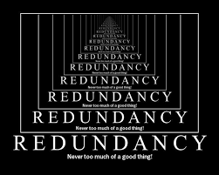
Data Compression
Store / transmit information in as little space as possible

Slide 6
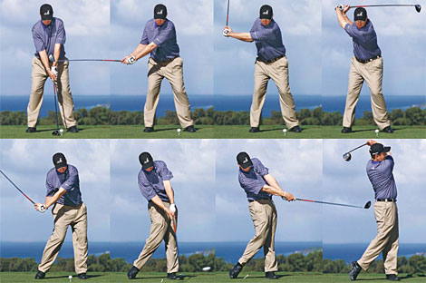
Data Compression: Video
Video: stored as sequence of still frames.
Idea: instead of storing each frame fully, record change from previous frame.

Slide 7
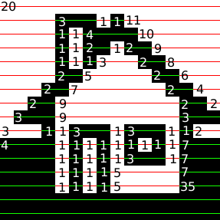
Data Compression: Run-Length Encoding
Image: described as grid of pixels, each with RED, GREEN, BLUE values.
Idea: instead of storing RGB value of each pixel, store run-length of run of same color.
When is this a good coding mechanism?
Will there be any loss in this compression?

Slide 8
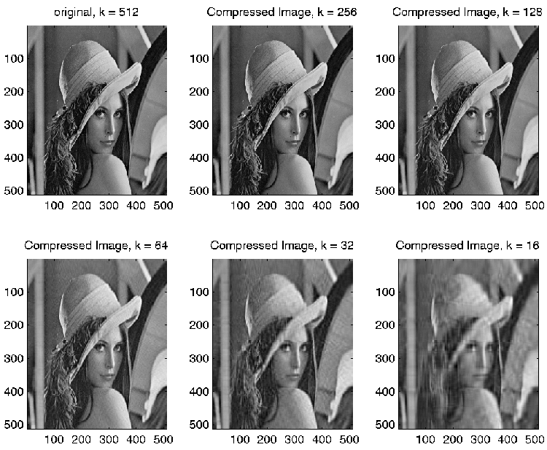
Lossy Compression: Singular Value Decomposition
Image: described as grid of pixels, each with RED, GREEN, BLUE values.
Idea: use Linear Algebra to compress data to a fraction of its size, with minimal loss.

Slide 9

Data Compression: Trade-off
Complicated compression scheme
… save storage space
… may take a long time to encode / decode
Data
Encoding Algorithm
Decoding Algorithm
Data
Stored in Computer

Slide 10
Encoding: Binary Palindromes
Palindrome: string that reads the same forward and backward.
Which of these are binary palindromes?
The empty string.
0101.
0110.
101.
All but one of the above.

Slide 11
Encoding: Binary Palindromes
Palindrome: string that reads the same forward and backward.
How many length n binary palindromes are there?
2^{n}
n
n/2
log₂n
None of the above

Slide 12

Encoding: Binary Palindromes
Palindrome: string that reads the same forward and backward.
How many bits are (optimally) required to encode length n binary palindromes?
n
n-1
n/2
log₂n
None of the above.
Is there an algorithm that achieves this?

Slide 13
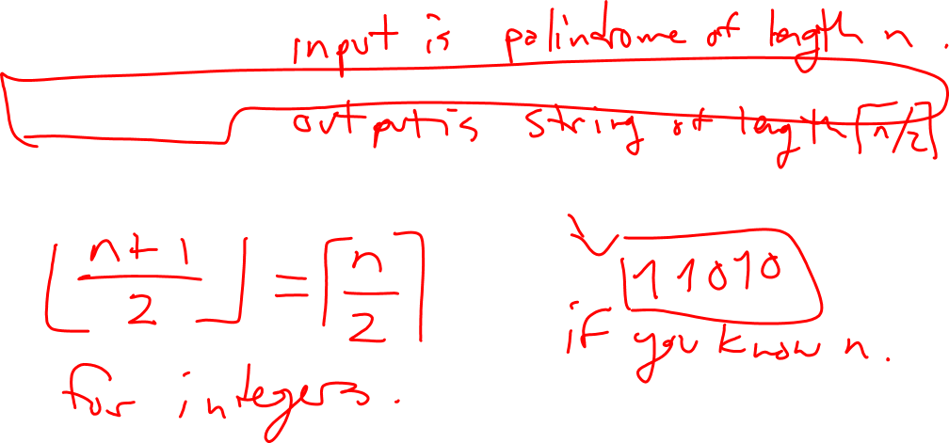
Encoding: Binary Palindromes
Palindrome: Devise an algorithm to do convert a length n palindrome to a binary string of length n/2
What would your algorithm do to the palindrome 1101001011?
Is there an algorithm that achieves this?

Slide 14
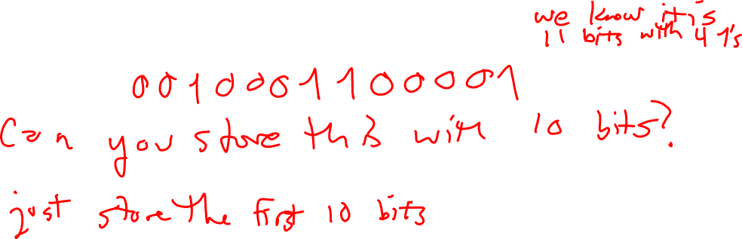
Encoding: Fixed Density Strings
Goal: encode a length n binary string that we know has k ones (and n-k zeros).
How would you represent such a string with n-1 bits?

Slide 15
Encoding: Fixed Density Strings
Goal: encode a length n binary string that we know has k ones (and n-k zeros).
How would you represent such a string with n-1 bits?
Can we do better?

Slide 16
Encoding: Fixed Density Strings
Goal: encode a length n binary string that we know has k ones (and n-k zeros).
How would you represent such a string with n-1 bits?
Can we do better?
Idea: give positions of 1s in the string within some smaller window.
- Fix window size.
- If there is a 1 in the current "window" in the string,
record its position and move the window over.
- Otherwise, record a 0 and move the window over.

Slide 17
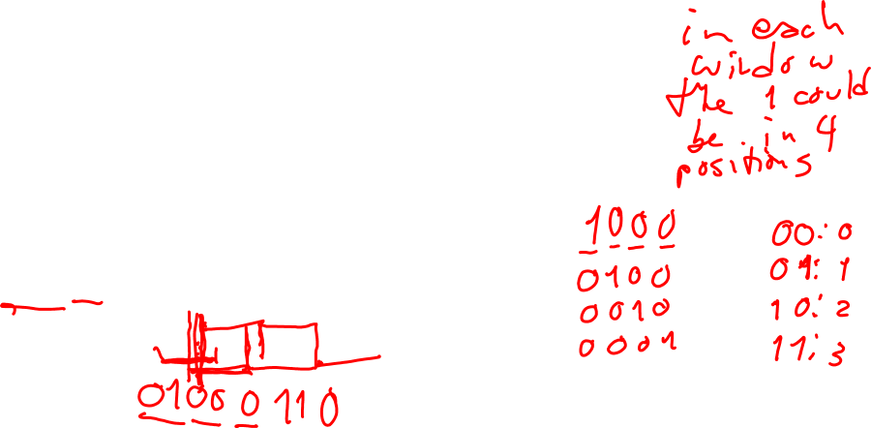
Encoding: Fixed Density Strings
Idea: give positions of 1s in the string within some smaller window.
- Fix window size.
- If there is a 1 in the current "window" in the string,
record its position and move the window over.
- Otherwise, record a 0 and move the window over.
Example n=12, k=3, window size n/k = 4.
How do we encode s = 011000000010 ?

Slide 18
Encoding: Fixed Density Strings
Idea: give positions of 1s in the string within some smaller window.
- Fix window size.
- If there is a 1 in the current "window" in the string,
record its position and move the window over.
- Otherwise, record a 0 and move the window over.
Example n=12, k=3, window size n/k = 4.
How do we encode s = 011000000010 ? Output:
There's a 1! What's its position?

Slide 19
Encoding: Fixed Density Strings
Idea: give positions of 1s in the string within some smaller window.
- Fix window size.
- If there is a 1 in the current "window" in the string,
record its position and move the window over.
- Otherwise, record a 0 and move the window over.
Example n=12, k=3, window size n/k = 4.
How do we encode s = 011000000010 ? Output: 01
There's a 1! What's its position?

Slide 20
Encoding: Fixed Density Strings
Idea: give positions of 1s in the string within some smaller window.
- Fix window size.
- If there is a 1 in the current "window" in the string,
record its position and move the window over.
- Otherwise, record a 0 and move the window over.
Example n=12, k=3, window size n/k = 4.
How do we encode s = 011000000010 ? Output: 01
There's a 1! What's its position?

Slide 21
Encoding: Fixed Density Strings
Idea: give positions of 1s in the string within some smaller window.
- Fix window size.
- If there is a 1 in the current "window" in the string,
record its position and move the window over.
- Otherwise, record a 0 and move the window over.
Example n=12, k=3, window size n/k = 4.
How do we encode s = 011000000010 ? Output: 0100
There's a 1! What's its position?

Slide 22
Encoding: Fixed Density Strings
Idea: give positions of 1s in the string within some smaller window.
- Fix window size.
- If there is a 1 in the current "window" in the string,
record its position and move the window over.
- Otherwise, record a 0 and move the window over.
Example n=12, k=3, window size n/k = 4.
How do we encode s = 011000000010 ? Output: 0100
No 1s in this window.

Slide 23
Encoding: Fixed Density Strings
Idea: give positions of 1s in the string within some smaller window.
- Fix window size.
- If there is a 1 in the current "window" in the string,
record its position and move the window over.
- Otherwise, record a 0 and move the window over.
Example n=12, k=3, window size n/k = 4.
How do we encode s = 011000000010 ? Output: 01000
No 1s in this window.

Slide 24
Encoding: Fixed Density Strings
Idea: give positions of 1s in the string within some smaller window.
- Fix window size.
- If there is a 1 in the current "window" in the string,
record its position and move the window over.
- Otherwise, record a 0 and move the window over.
Example n=12, k=3, window size n/k = 4.
How do we encode s = 011000000010 ? Output: 01000
There's a 1! What's its position?

Slide 25
Encoding: Fixed Density Strings
Idea: give positions of 1s in the string within some smaller window.
- Fix window size.
- If there is a 1 in the current "window" in the string,
record its position and move the window over.
- Otherwise, record a 0 and move the window over.
Example n=12, k=3, window size n/k = 4.
How do we encode s = 011000000010 ? Output: 0100011
There's a 1! What's its position?

Slide 26
Encoding: Fixed Density Strings
Idea: give positions of 1s in the string within some smaller window.
- Fix window size.
- If there is a 1 in the current "window" in the string,
record its position and move the window over.
- Otherwise, record a 0 and move the window over.
Example n=12, k=3, window size n/k = 4.
How do we encode s = 011000000010 ? Output: 0100011
No 1s in this window.

Slide 27
Encoding: Fixed Density Strings
Idea: give positions of 1s in the string within some smaller window.
- Fix window size.
- If there is a 1 in the current "window" in the string,
record its position and move the window over.
- Otherwise, record a 0 and move the window over.
Example n=12, k=3, window size n/k = 4.
How do we encode s = 011000000010 ? Output: 01000110.
No 1s in this window.

Slide 28
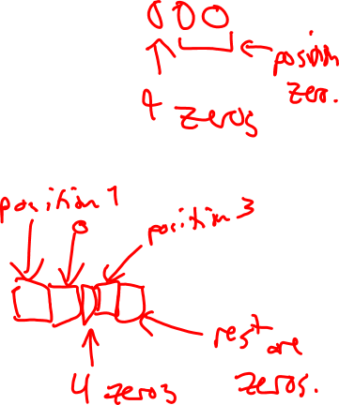
Encoding: Fixed Density Strings
Idea: give positions of 1s in the string within some smaller window.
- Fix window size.
- If there is a 1 in the current "window" in the string,
record its position and move the window over.
- Otherwise, record a 0 and move the window over.
Example n=12, k=3, window size n/k = 4.
How do we encode s = 011000000010 ? Output: 01000110.
Compressed to 8 bits!
But can we recover the original string? Decoding …

Slide 29

Encoding: Fixed Density Strings
With n=12, k=3, window size n/k = 4. Output: 01000110
Can be parsed as the (intended) input: s = 011000000010 ?
But also:
01: one in position 1
0: no ones
00: one in position 0
11: one in position 3
0: no ones
s' = 010000100010
Problem: two different inputs with same output. Can't uniquely decode.

Slide 30
Compression Algorithm
A valid compression algorithm must:
- Have outputs of shorter (or same) length as input.
- Be uniquely decodable.

Slide 31

Encoding: Fixed Density Strings
Can we modify this algorithm to get unique decodability?
Idea: use marker bit to indicate when to interpret output as a position.
- Fix window size.
- If there is a 1 in the current "window" in the string,
record a 1 to interpret next bits as position,
then record its position and move the window over.
- Otherwise, record a 0 and move the window over.

Slide 32

Encoding: Fixed Density Strings
Idea: use marker bit to indicate when to interpret output as a position.
- Fix window size.
- If there is a 1 in the current "window" in the string,
record a 1 to interpret next bits as position,
then record its position and move the window over.
- Otherwise, record a 0 and move the window over.
Example n=12, k=3, window size n/k = 4.
How do we encode s = 011000000010 ? Output:

Slide 33
Encoding: Fixed Density Strings
Idea: use marker bit to indicate when to interpret output as a position.
- Fix window size.
- If there is a 1 in the current "window" in the string,
record a 1 to interpret next bits as position,
then record its position and move the window over.
- Otherwise, record a 0 and move the window over.
Example n=12, k=3, window size n/k = 4.
How do we encode s = 011000000010 ? Output:

Slide 34
Encoding: Fixed Density Strings
Idea: use marker bit to indicate when to interpret output as a position.
- Fix window size.
- If there is a 1 in the current "window" in the string,
record a 1 to interpret next bits as position,
then record its position and move the window over.
- Otherwise, record a 0 and move the window over.
Example n=12, k=3, window size n/k = 4.
How do we encode s = 011000000010 ? Output:
What output corresponds to these first few bits?
0 C. 01 E. None of the above.
1 D. 101

Slide 35
Encoding: Fixed Density Strings
Idea: use marker bit to indicate when to interpret output as a position.
- Fix window size.
- If there is a 1 in the current "window" in the string,
record a 1 to interpret next bits as position,
then record its position and move the window over.
- Otherwise, record a 0 and move the window over.
Example n=12, k=3, window size n/k = 4.
How do we encode s = 011000000010 ? Output: 101
Interpret next bits as position of 1; this position is 01

Slide 36
Encoding: Fixed Density Strings
Idea: use marker bit to indicate when to interpret output as a position.
- Fix window size.
- If there is a 1 in the current "window" in the string,
record a 1 to interpret next bits as position,
then record its position and move the window over.
- Otherwise, record a 0 and move the window over.
Example n=12, k=3, window size n/k = 4.
How do we encode s = 011000000010 ? Output: 101

Slide 37
Encoding: Fixed Density Strings
Idea: use marker bit to indicate when to interpret output as a position.
- Fix window size.
- If there is a 1 in the current "window" in the string,
record a 1 to interpret next bits as position,
then record its position and move the window over.
- Otherwise, record a 0 and move the window over.
Example n=12, k=3, window size n/k = 4.
How do we encode s = 011000000010 ? Output: 101100
Interpret next bits as position of 1; this position is 00

Slide 38
Encoding: Fixed Density Strings
Idea: use marker bit to indicate when to interpret output as a position.
- Fix window size.
- If there is a 1 in the current "window" in the string,
record a 1 to interpret next bits as position,
then record its position and move the window over.
- Otherwise, record a 0 and move the window over.
Example n=12, k=3, window size n/k = 4.
How do we encode s = 011000000010 ? Output: 101100

Slide 39
Encoding: Fixed Density Strings
Idea: use marker bit to indicate when to interpret output as a position.
- Fix window size.
- If there is a 1 in the current "window" in the string,
record a 1 to interpret next bits as position,
then record its position and move the window over.
- Otherwise, record a 0 and move the window over.
Example n=12, k=3, window size n/k = 4.
How do we encode s = 011000000010 ? Output: 1011000
No 1s in this window.

Slide 40
Encoding: Fixed Density Strings
Idea: use marker bit to indicate when to interpret output as a position.
- Fix window size.
- If there is a 1 in the current "window" in the string,
record a 1 to interpret next bits as position,
then record its position and move the window over.
- Otherwise, record a 0 and move the window over.
Example n=12, k=3, window size n/k = 4.
How do we encode s = 011000000010 ? Output: 1011000

Slide 41
Encoding: Fixed Density Strings
Idea: use marker bit to indicate when to interpret output as a position.
- Fix window size.
- If there is a 1 in the current "window" in the string,
record a 1 to interpret next bits as position,
then record its position and move the window over.
- Otherwise, record a 0 and move the window over.
Example n=12, k=3, window size n/k = 4.
How do we encode s = 011000000010 ? Output: 1011000111
Interpret next bits as position of 1; this position is 11

Slide 42
Encoding: Fixed Density Strings
Idea: use marker bit to indicate when to interpret output as a position.
- Fix window size.
- If there is a 1 in the current "window" in the string,
record a 1 to interpret next bits as position,
then record its position and move the window over.
- Otherwise, record a 0 and move the window over.
Example n=12, k=3, window size n/k = 4.
How do we encode s = 011000000010 ? Output: 1011000111

Slide 43
Encoding: Fixed Density Strings
Idea: use marker bit to indicate when to interpret output as a position.
- Fix window size.
- If there is a 1 in the current "window" in the string,
record a 1 to interpret next bits as position,
then record its position and move the window over.
- Otherwise, record a 0 and move the window over.
Example n=12, k=3, window size n/k = 4.
How do we encode s = 011000000010 ? Output: 10110001110
No 1s in this window.

Slide 44

Encoding: Fixed Density Strings
Idea: use marker bit to indicate when to interpret output as a position.
- Fix window size.
- If there is a 1 in the current "window" in the string,
record a 1 to interpret next bits as position,
then record its position and move the window over.
- Otherwise, record a 0 and move the window over.
Example n=12, k=3, window size n/k = 4.
How do we encode s = 011000000010 ? Output: 10110001110
Compare to previous output: 01000110
Output uses more bits than last time. Any redundancies?

Slide 45
Encoding: Fixed Density Strings
Idea: use marker bit to indicate when to interpret output as a position.
- Fix window size.
- If there is a 1 in the current "window" in the string,
record a 1 to interpret next bits as position,
then record its position and move the window over.
- Otherwise, record a 0 and move the window over.
Example n=12, k=3, window size n/k = 4.
How do we encode s = 011000000010 ? Output: 10110001110
Compare to previous output: 01000110
* After see the last 1, don't need to add 0s to indicate empty windows. *

Slide 46
Encoding: Fixed Density Strings
procedure WindowEncode (input: b₁b₂…b_{n}, with exactly k ones and n-k zeros)
1. w := floor (n/k)
2. count := 0
3. location := 1
4. While count < k:
5. If there is a 1 in the window starting at current location
6. Output 1 as a marker, then output position of first 1 in window.
7. Increment count.
8. Update location to immediately after first 1 in this window.
9. Else
10. Output 0.
11. Update location to next index after current window.
Uniquely decodable?

Slide 47
Decoding: Fixed Density Strings
procedure WindowDecode (input: x₁x₂…x_{m}, target is exactly k ones and n-k zeros)
1. w := floor ( n/k )
2. b := floor ( log₂(w))
3. s := empty string
4. i := 0
5. While i < m
6. If x_{i} = 0
7. s += 0…0 (j times)
8. i += 1
9. Else
10. p := decimal value of the bits x_{i+1}…x_{i+b}
11. s += 0…0 (p times)
12. s += 1
13. i := i+b+1
14. If length(s) < n
15. s += 0…0 ( n-length(s) times )
16. Output s.

Slide 48

Encoding/Decoding: Fixed Density Strings
Correctness?
E(s) = result of encoding string s of length n with k 1s, using WindowEncode.
D(t) = result of decoding string t to create a string of length n with k 1s, using WindowDecode.
Well-defined functions?
Inverses?
Goal: For each s, D(E(s)) = s.
Strong Induction!

Slide 49
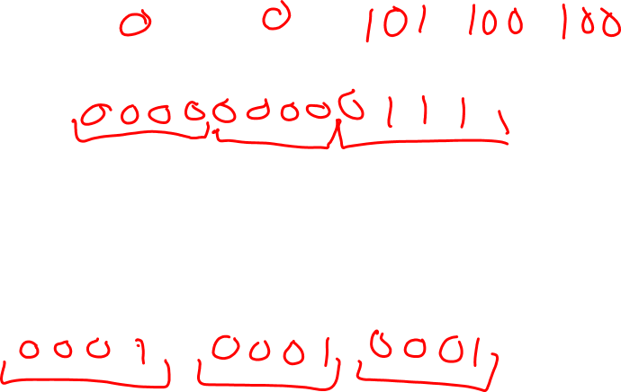
Encoding/Decoding: Fixed Density Strings
Output size?
Assume n/k is a power of two. Consider s a binary string of length n with k 1s.
How long is E(s)?
n-1
log₂(n/k)
Depends on where 1s are located in s

Slide 50
Encoding/Decoding: Fixed Density Strings
Output size?
Assume n/k is a power of two. Consider s a binary string of length n with k 1s.
For which strings is E(s) shortest?
More 1s toward the beginning.
More 1s toward the end.
C. 1s spread evenly throughout.

Slide 51
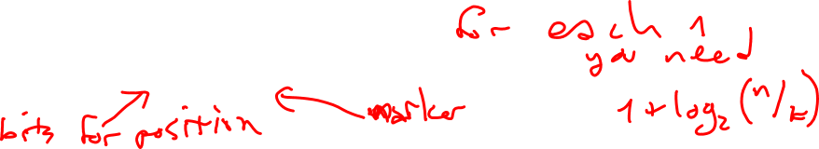
Encoding/Decoding: Fixed Density Strings
Output size?
Assume n/k is a power of two. Consider s a binary string of length n with k 1s.
Best case : 1s toward the beginning of the string. E(s) has
- One bit for each 1 in s to indicate that next bits denote positions in window.
- log₂(n/k) bits for each 1 in s to specify position of that 1 in a window.
- k such ones.
- No bits representing 0s because all 0s are "caught" in windows with 1s or
after the last 1.
Total |E(s)| = k log₂(n/k) + k

Slide 52
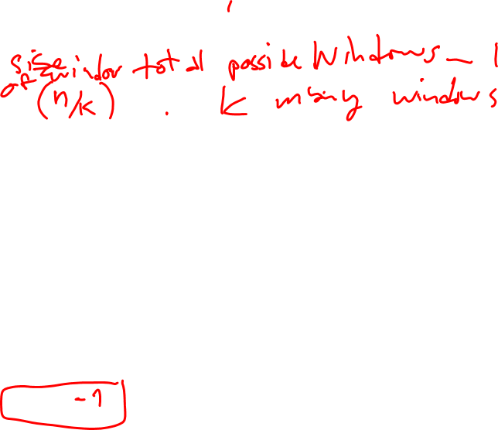
Encoding/Decoding: Fixed Density Strings
Output size?
Assume n/k is a power of two. Consider s a binary string of length n with k 1s.
Worst case : 1s toward the end of the string. E(s) has
- Some bits representing 0s since there are no 1s in first several windows.
- One bit for each 1 in s to indicate that next bits denote positions in window.
- log₂(n/k) bits for each 1 in s to specify position of that 1 in a window.
- k such ones.
What's an upper bound on the number of these bits?
n D. 1
n-k E. None of the above.
k

Slide 53
Encoding/Decoding: Fixed Density Strings
Output size?
Assume n/k is a power of two. Consider s a binary string of length n with k 1s.
Worst case : 1s toward the end of the string. E(s) has
- At most k bits representing 0s since there are no 1s in first several windows.
- One bit for each 1 in s to indicate that next bits denote positions in window.
- log₂(n/k) bits for each 1 in s to specify position of that 1 in a window.
- k such ones.
Total |E(s)| <= k log₂(n/k) + 2k

Slide 54
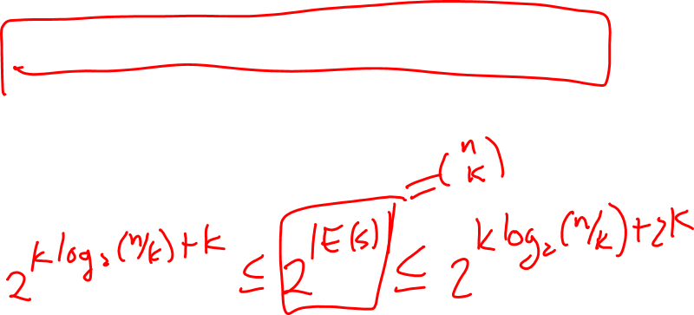
Encoding/Decoding: Fixed Density Strings
Output size?
Assume n/k is a power of two. Consider s a binary string of length n with k 1s.
k log₂(n/k) + k <= | E(s) | <= k log₂(n/k) + 2k
Using this inequality, there are at most ____ length n strings with k 1s.
2^{n} D. (n/k)^{k}
n E. None of the above.
(n/k)²

Slide 55
Encoding/Decoding: Fixed Density Strings
Output size?
Assume n/k is a power of two. Consider s a binary string of length n with k 1s.
Given | E(s) | <= k log₂(n/k) + 2k, we need at most k log₂(n/k) + 2k bits to represent
all length n binary strings with k 1s. Hence, there are at most 2… many such strings.

Slide 56
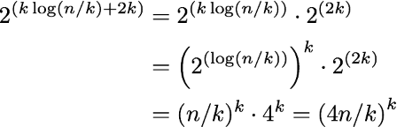
Encoding/Decoding: Fixed Density Strings
Output size?
Assume n/k is a power of two. Consider s a binary string of length n with k 1s.
Given | E(s) | <= k log₂(n/k) + 2k, we need at most k log₂(n/k) + 2k bits to represent
all length n binary strings with k 1s. Hence, there are at most 2… many such strings.

Slide 57
Encoding/Decoding: Fixed Density Strings
Output size?
Assume n/k is a power of two. Consider s a binary string of length n with k 1s.
Given | E(s) | <= k log₂(n/k) + 2k, we need at most k log₂(n/k) + 2k bits to represent
all length n binary strings with k 1s. Hence, there are at most 2… many such strings.
C(n,k) = # Length n binary strings with k 1s <= (4n/k)^{k}

Slide 58

Bounds for Binomial Coefficients
Using windowEncode():
Lower bound?
Idea: find a way to count a subset of the fixed density binary strings.
Some fixed density binary strings have one 1 in each of k chunks of size n/k.
….
How many such strings are there?
n^{n} B. k! C. (n/k)^{k} D. C(n,k)^{k} E. None of the above.

Slide 59

Bounds for Binomial Coefficients
Using windowEncode():
Using evenly spread strings:
Counting helps us analyze our compression algorithm.
Compression algorithms help us count.

Slide 60

Theoretically Optimal Encoding
A theoretically optimal encoding for length n binary strings with k 1s would use
the ceiling of bits.
How?
List all length n binary strings with k 1s in some order.
To encode: Store the position of a string in the list, rather than the string itself.
To decode: Given a position in list, need to determine string in that position.

Slide 61
Theoretically Optimal Encoding
A theoretically optimal encoding for length n binary strings with k 1s would use
the ceiling of bits.
How?
List all length n binary strings with k 1s in some order.
To encode: Store the position of a string in the list, rather than the string itself.
To decode: Given a position in list, need to determine string in that position.
Use lexicographic (dictionary) ordering …

Slide 62
Lex Order
String a comes before string b if the first time they differ, a is smaller.
I.e.
a₁a₂…a_{n} <_{lex} b₁b₂…b_{n}
means there exists j such that
a_{i}=b_{i} for all i<j AND a_{j}<b_{j}
Which of these comes last in lex order?
1001 C. 1101 E. 0000
0011 D. 1010

Slide 63
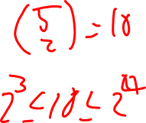
Lex Order
E.g. Length n=5 binary strings with k=3 ones, listed in lex order:
Original string, s | Encoded string (i.e. position in this list)
00111 | 0 = 0000
01011 | 1 = 0001
01101 | 2 = 0010
01110 | 3 = 0011
10011 | 4 = 0100
10101 | 5 = 0101
10110 | 6 = 0110
11001 | 7 = 0111
11010 | 8 = 1000
11100 | 9 = 1001

Slide 64
Lex Order: Algorithm?
Need two algorithms, given specific n and k:
s → E(s,n,k)
and
p → D(p,n,k)
Idea: Use recursion (reduce & conquer).

Slide 65

Lex Order: Algorithm?
Length n-1 binary strings with k 1s
For E(s,n,k): 0….
0….
…
1…..
1….
1….
Any string that starts with 0 must have position before
Any string that starts with 1 must have position at or after
Length n-1 binary strings with k-1 1s

Slide 66
Lex Order: Algorithm?
For E(s,n,k):
Any string that starts with 0 must have position before
Any string that starts with 1 must have position at or after
procedure lexEncode (b₁b₂…b_{n}, n, k)
1. If n = 1,
2. return 0.
3. If b₁ = 0,
4. return lexEncode (b₂…b_{n}, n-1, k)
5. Else
6. return C(n-1,k) + lexEncode(b₂…b_{n}, n-1, k-1)

Slide 67
Lex Order: Algorithm?
For D(s,n,k):
Any position before must correspond to string that starts with 0.
Any position at or after must correspond to string that starts with 1.
procedure lexDecode (p, n, k)
1. If n = k,
2. return 1111..1 //length n string of all 1s
3. If p < C(n-1,k),
4. return "0" + lexDecode(p, n-1, k)
5. Else
6. return "1" + lexDecode(p-C(n-1,k), n-1, k-1)

Slide 68
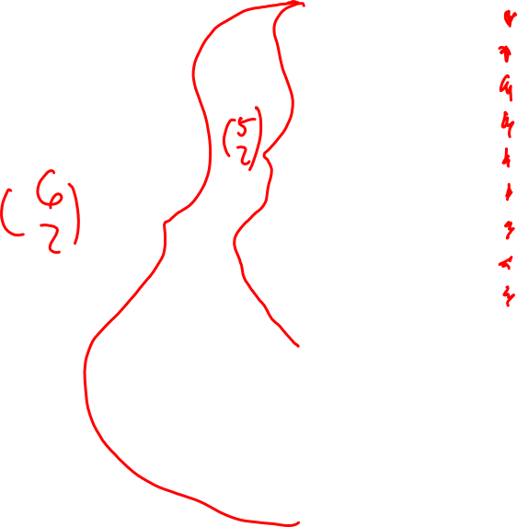
0 | 000011
1 | 000101
2 | 000110
3 | 001001
4 | 001010
5 | 001100
6 | 010001
7 | 010010
8 | 010100
9 | 011000
10 | 100001
11 | 100010
12 | 100100
13 | 101000
14 | 110000
Lex Order: Algorithm?
Remember all of the length 6 binary strings with exactly 2 ones.

Slide 69
0 | 000011
1 | 000101
2 | 000110
3 | 001001
4 | 001010
5 | 001100
6 | 010001
7 | 010010
8 | 010100
9 | 011000
10 | 100001
11 | 100010
12 | 100100
13 | 101000
14 | 110000
Lex Order: Algorithm?
Remember all of the length 6 binary strings with exactly 2 ones.

Slide 70

Victory!
Using lexEncode, lexDecode,
we can represent any fixed density length n binary string with k 1s
as a number in the range 0 through C(n,k)-1.
So, it takes log₂( C(n,k) ) bits to store fixed-density binary strings using lex order.
Theoretical lower bound: log₂( C(n,k) ).
Same! So this encoding algorithm is optimal.

Slide 71
Another application of counting … lower bounds
Sorting algorithm: performance was measured in terms of number of
comparisons between list elements
What's the fastest possible worst case for any sorting algorithm?

Slide 72
Another application of counting … lower bounds
Sorting algorithm: performance was measured in terms of number of
comparisons between list elements
What's the fastest possible worst case for any sorting algorithm?
Tree diagram represents possible comparisons we might have to do, based on relative sizes of elements.

Slide 73
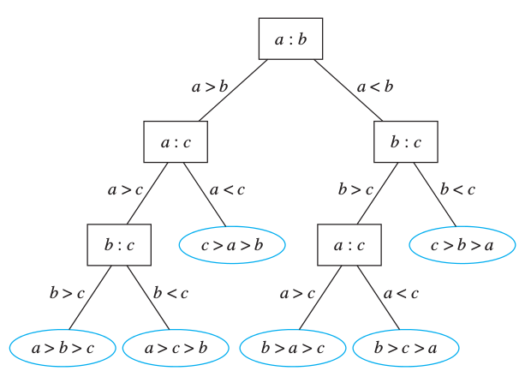
Another application of counting … lower bounds
Tree diagram represents possible comparisons we might have to do, based on relative sizes of elements.
a, b, c distinct integers
Rosen p. 761

Slide 74
Another application of counting … lower bounds
Sorting algorithm: performance was measured in terms of number of
comparisons between list elements
What's the fastest possible worst case for any sorting algorithm?
Maximum number of comparisons for algorithm is height of its tree diagram.

Slide 75
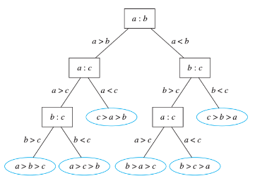
Another application of counting … lower bounds
How many leaves will there be in a decision tree that sorts n elements?
2^{n} D. C(n,2)
log n E. None of the above.
n!

Slide 76
Another application of counting … lower bounds
Sorting algorithm: performance was measured in terms of number of
comparisons between list elements
What's the fastest possible worst case for any sorting algorithm?
Maximum number of comparisons for algorithm is height of its tree diagram.
For any algorithm, what would be smallest possible height?
What do we know about the tree?
* Internal nodes correspond to comparisons.
* Leaves correspond to possible input arrangements.

Slide 77
Another application of counting … lower bounds
Sorting algorithm: performance was measured in terms of number of
comparisons between list elements
What's the fastest possible worst case for any sorting algorithm?
Maximum number of comparisons for algorithm is height of its tree diagram.
For any algorithm, what would be smallest possible height?
What do we know about the tree?
* Internal nodes correspond to comparisons. Depends on algorithm.
* Leaves correspond to possible input arrangements. n!

Slide 78
Another application of counting … lower bounds
How does height relate to number of leaves?
Theorem: There are at most 2^{h} leaves in a binary tree with height h.
Which of the following is true?
It's possible to have a binary tree with height 3 and 1 leaf.
It's possible to have a binary tree with height 1 and 3 leaves.
Every binary tree with height 3 has 1 leaf.
Every binary tree with height 1 has 3 leaves.
None of the above.

Slide 79
Another application of counting … lower bounds
How does height relate to number of leaves?
Theorem: There are at most 2^{h} leaves in a binary tree with height h.
Proof: By induction on the height h >= 0.
Base case WTS that there are at most 2⁰ leaves in a binary tree with height h=0.
What trees have height 0?

Slide 80
Another application of counting … lower bounds
How does height relate to number of leaves?
Theorem: There are at most 2^{h} leaves in a binary tree with height h.
Proof: By induction on the height h >= 0.
Base case WTS that there are at most 2⁰ leaves in a binary tree with height h=0.
If a binary tree has height 0, its only node is the root. In this case the root is also a (and the only) leaf node. So, the number of leaves is 1 = 2⁰ in the only possible tree with h=0. ☺

Slide 81
Another application of counting … lower bounds
How does height relate to number of leaves?
Theorem: There are at most 2^{h} leaves in a binary tree with height h.
Proof: By induction on the height h >= 0.
Induction Step Let h be some integer >=0 and assume (as the IH) that
There are at most 2^{h} leaves in a binary tree with height h.
WTS that there are at most 2^{h+1} leaves in a binary tree with height h+1.

Slide 82
Another application of counting … lower bounds
Induction Step Let h be some integer >=0 and assume (as the IH) that
There are at most 2^{h} leaves in a binary tree with height h.
WTS that there are at most 2^{h+1} leaves in a binary tree with height h+1.
Consider a tree U with height h+1. How can we relate it to trees of height h
so that we can use IH?

Slide 83
Another application of counting … lower bounds
Induction Step Let h be some integer >=0 and assume (as the IH) that
There are at most 2^{h} leaves in a binary tree with height h.
WTS that there are at most 2^{h+1} leaves in a binary tree with height h+1.
Consider a tree U with height h+1. How can we relate it to trees of height h
so that we can use IH?
Remove all the leaves of U. This gives a new tree, T, of height h.
By the IH the tree T has at most 2^{h} leaves.
To get from T to U, we need to add back the leaves of U. How many are there?

Slide 84
Another application of counting … lower bounds
Induction Step Let h be some integer >=0 and assume (as the IH) that
There are at most 2^{h} leaves in a binary tree with height h.
WTS that there are at most 2^{h+1} leaves in a binary tree with height h+1.
Consider a tree U with height h+1. How can we relate it to trees of height h
so that we can use IH?
Remove all the leaves of U. This gives a new tree, T, of height h.
By the IH the tree T has at most 2^{h} leaves.
To get from T to U, we need to add back the leaves of U. How many are there?
For each leaf of T, there are at most 2 leaves in U.

Slide 85
Another application of counting … lower bounds
Induction Step Let h be some integer >=0 and assume (as the IH) that
There are at most 2^{h} leaves in a binary tree with height h.
WTS that there are at most 2^{h+1} leaves in a binary tree with height h+1.
Consider a tree U with height h+1. How can we relate it to trees of height h
so that we can use IH?
Remove all the leaves of U. This gives a new tree, T, of height h.
By the IH the tree T has at most 2^{h} leaves.
To get from T to U, we need to add back the leaves of U. How many are there?
For each leaf of T, there are at most 2 leaves in U.
# leaves in U <= 2(# leaves in T) <= 2(2^{h}) = 2^{h+1} ☺

Slide 86
Another application of counting … lower bounds
What's the fastest possible worst case for any sorting algorithm?
Maximum number of comparisons for algorithm is height of its tree diagram.
For any algorithm, what would be smallest possible height?
What do we know about the tree?
* Internal nodes correspond to comparisons. Depends on algorithm.
* Leaves correspond to possible input arrangements. n!
Each tree diagram must have at least n! leaves, so its height must be at least
log₂(n!).

Slide 87
Another application of counting … lower bounds
What's the fastest possible worst case for any sorting algorithm?
Maximum number of comparisons for algorithm is height of its tree diagram.
For any algorithm, what would be smallest possible height?
What do we know about the tree?
* Internal nodes correspond to comparisons. Depends on algorithm.
* Leaves correspond to possible input arrangements. n!
Each tree diagram must have at least n! leaves, so its height must be at least
log₂(n!).
i.e. fastest possible worst case performance of sorting is log₂(n!)

Slide 88
Another application of counting … lower bounds
i.e. fastest possible worst case performance of sorting is log₂(n!)

Slide 89
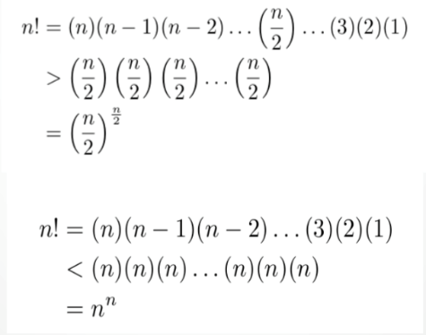

Another application of counting … lower bounds
What's the fastest possible worst case for any sorting algorithm? log₂(n!)
How big is that?
Lemma: For n>1, Proof:

Slide 90


Another application of counting … lower bounds
What's the fastest possible worst case for any sorting algorithm? log₂(n!)
How big is that?
Lemma: for n>1,
Theorem: log₂(n!) is in
Proof: For n>1, taking logarithm of both sides in lemma gives
i.e.

Slide 91
Another application of counting … lower bounds
What's the fastest possible worst case for any sorting algorithm? log₂(n!)
How big is that?
Lemma: for n>1,
Theorem: log₂(n!) is in
Therefore,
the best sorting algorithms will need comparisons in the worst case.
i.e. it's impossible to have a comparison-based algorithm that does better than Merge Sort (in the worst case).

Slide 92
Representing undirected graphs
Strategy:
Count the number of simple undirected graphs.
Compute lower bound on the number of bits required to represent these graphs.
Devise algorithm to represent graphs using this number of bits.
What's true about simple undirected graphs?
Self-loops are allowed.
Parallel edges are allowed.
There must be at least one vertex.
There must be at least one edge.
None of the above.
Rosen p. 641-644

Slide 93

Representing undirected graphs: Counting
In a simple undirected graph on n (labeled) vertices, how many edges are possible?
n²
n(n-1)
C(n,2)
2^{C(n,2)}
None of the above.
** Recall notation: C(n,k) = **

Slide 94
Representing undirected graphs: Counting
In a simple undirected graph on n (labeled) vertices, how many edges are possible?
n²
n(n-1)
C(n,2) Possibly one edge for each set of two distinct vertices.
2^{C(n,2)}
None of the above.
** Recall notation: C(n,k) = **

Slide 95
Representing undirected graphs: Counting
How many different simple undirected graphs on n (labeled) vertices are there?
n²
n(n-1)
C(n,2)
2^{C(n,2)}
None of the above.

Slide 96
Representing undirected graphs: Lower bound
How many different simple undirected graphs on n (labeled) vertices are there?
n²
n(n-1)
C(n,2)
2^{C(n,2)} For each possible edge, decide if in graph or not.
None of the above.
Conclude:
minimum number of bits to represent simple undirected graphs with n vertices is
log₂(2^{C(n,2)}) = C(n,2) = n(n-1)/2

Slide 97
Representing undirected graphs: Algorithm
Goal: represent a simple undirected graph with n vertices using n(n-1)/2 bits.
Idea: store adjacency matrix, but since
- diagonal entries all zero no self loops
- matrix is symmetric undirected graph
only store the entries above the diagonal.
How many entries of the adjacency matrix are above the diagonal?
n² D. 2n
n(n-1) E. None of the above.
C(n,2)

Slide 98
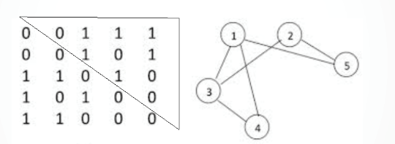
Representing undirected graphs: Algorithm
Goal: represent a simple undirected graph with n vertices using n(n-1)/2 bits
Idea: store adjacency matrix, but since
- diagonal entries all zero no self loops
- matrix is symmetric undirected graph
only store the entries above the diagonal.
Can be stored as
0111101100
which uses C(5,2) = 10 bits.

Slide 99
Representing directed graphs: Counting
In a simple directed graph on n (labeled) vertices, how many edges are possible?
n²
n(n-1)
C(n,2)
2^{C(n,2)}
None of the above.
Simple graph: no self loops, no parallel edges.

Slide 100
Representing directed graphs: Counting
In a simple directed graph on n (labeled) vertices, how many edges are possible?
n²
n(n-1) Choose starting vertex, choose ending vertex.
C(n,2)
2^{C(n,2)}
None of the above.
Simple graph: no self loops, no parallel edges.

Slide 101
Representing directed graphs: Counting
How many different simple directed graphs on n (labeled) vertices are there?
n²
n(n-1)
C(n,2)
2^{C(n,2)}
None of the above.

Slide 102
Representing directed graphs: Counting
Another way of counting that there are 2^{n(n-1)} simple directed graphs with n vertices:
Represent a graph by
For each of the C(n,2) pairs of distinct vertices {v,w},
specify whether there is
* no edge between them
* an edge from v to w but no edge from w to v
* an edge from w to v but no edge from v to w
* edges both from v to w and from v to w.

Slide 103
Representing directed graphs: Counting
Another way of counting that there are 2^{n(n-1)} directed graphs with n vertices:
Represent a graph by
For each of the C(n,2) pairs of distinct vertices {v,w}, C(n,2) pairs
specify whether there is
* no edge between them each has 4 options
* an edge from v to w but no edge from w to v
* an edge from w to v but no edge from v to w
* edges both from v to w and from v to w.
Product rule!
(4)(4)….(4) = 4^{C(n,2)}=4^{(n(n-1)/2)}=2^{n(n-1)}

Slide 104
Representing directed graphs: Lower bound
Conclude:
minimum number of bits to represent simple directed graphs with n vertices is
log₂(2^{n(n-1)}) = n(n-1)

Slide 105
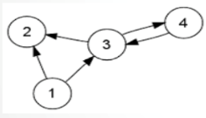
Representing directed graphs: Algorithm
Encoding:
For each of the n vertices, indicate which of the other vertices it has an edge to.
How would you encode this graph
using bits (0s and 1s)?
A. 123232443
B. 0110 0000 0101 0010
C. 110 000 011 001
D. None of the above.

Slide 106
Representing directed graphs: Algorithm
Decoding:
Given a string of 0s and 1s of length n(n-1),
Define vertex set { 1, …, n }.
First n-1 bits indicate edges from vertex 1 to other vertices.
Next n-1 bits indicate edges from vertex 2 to other vertices.
etc.
What graph does this binary string encode? 0110 1001 0001 1011 0100

