Slide 1
Probability Distributions. Conditional Probability
 | Miles Jones | MTThF 8:30-9:50am | CSE 4140
August 25, 2016

Slide 2
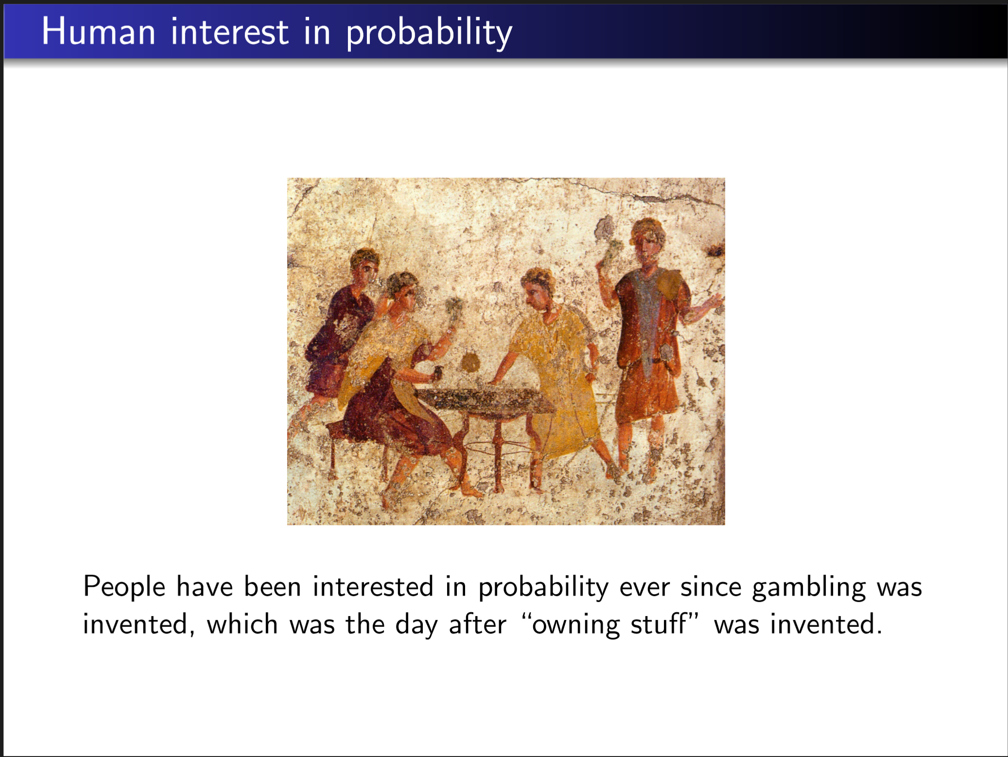

Slide 3
Probability Spaces intuition
In probability, we want to reason about the likelihood of complex events.
To do this, we must model the chance of the underlying objects that contribute.
We use the idea of a probability space to consider every possibility.

Slide 4

Probability Spaces Formal Definition
Rosen p. 446. 453
Sample space, S: (finite or countable) set of possible outcomes.
Probability distribution, p: assignment of probabilities to outcomes in S so that
- 0<= p(s) <=1 for each s in S.
- Sum of probabilities is 1, .

Slide 5

Probability
Rosen p. 446. 453
Sample space, S: (finite or countable) set of possible outcomes.
Probability distribution, p: assignment of probabilities to outcomes in S so that
- 0<= p(s) <=1 for each s in S.
- Sum of probabilities is 1, .
Compare flipping a fair coin and a biased coin:
Have different sample spaces.
Have the same sample spaces but different probability distributions.
Have the same sample space and same probability distributions.

Slide 6

Probability
Rosen p. 446. 453-4
Sample space, S: (finite or countable) set of possible outcomes.
Probability distribution, p: assignment of probabilities to outcomes in S so that
- 0<= p(s) <=1 for each s in S.
- Sum of probabilities is 1, .
Event, E: subset of possible outcomes.

Slide 7
Uniform distribution
Rosen p. 454
For sample space S with n elements, uniform distribution assigns the probability 1/n to each element of S.
When flipping a fair coin successively three times:
The sample space is {H, T}
The empty set is not an event.
The event {HHH, HHT, HTH, HTT, THH, THT, TTH, TTT} has probability less than 1.
The uniform distribution assigns probability 1/8 to each outcome.
None of the above.

Slide 8
Uniform distribution
Rosen p. 454
For sample space S with n elements, uniform distribution assigns the probability 1/n to each element of S.
When flipping a fair coin successively three times:
The sample space is {H, T}
The empty set is not an event.
The event {HHH, HHT, HTH, HTT, THH, THT, TTH, TTT} has probability less than 1.
The uniform distribution assigns probability 1/8 to each outcome.
None of the above.
Uniform distribution!

Slide 9
Uniform distribution
Rosen p. 454
For sample space S with n elements, uniform distribution assigns the probability 1/n to each element of S.
When flipping a fair coin successively three times,
what is the distribution of the number of Hs that appear?
Uniform distribution.
P( 0 H ) = P ( 3 H ) = 3/8 and P( 1 H ) =P( 2 H ) = 1/8.
P( 0 H ) = P (1 H ) = 1/8 and P( 2 H ) = P( 3 H ) = 1/8.
P( 0 H ) = P (3 H ) = 1/8 and P( 1 H ) = P( 2 H ) = 1/8.
None of the above.

Slide 10
Uniform distribution
Rosen p. 454
For sample space S with n elements, uniform distribution assigns the probability 1/n to each element of S.
When flipping a fair coin successively three times,
what is the distribution of the number of Hs that appear?
Uniform distribution.
P( 0 H ) = P ( 3 H ) = 3/8 and P( 1 H ) =P( 2 H ) = 1/8.
P( 0 H ) = P (1 H ) = 1/8 and P( 2 H ) = P( 3 H ) = 1/8.
P( 0 H ) = P (3 H ) = 1/8 and P( 1 H ) = P( 2 H ) = 1/8.
None of the above.
Not a uniform distribution!

Slide 11


Probability and couting
If start with the uniform distribution on a set S, then the probability of an event E is
When flipping n fair coins what is the probability of getting exactly k Hs?
1/n
k/n
1/2^{n}
C(n,k) / 2^{n}
None of the above.

Slide 12


Binomial distribution
When flipping n fair coins what is the probability of getting exactly k Hs?
Possible coin toss sequences: { HH..HH, HH..HT, …, TT..TH, TT..TT }

Slide 13
Binomial distribution
When flipping n fair coins what is the probability of getting exactly k Hs?
Possible coin toss sequences: { HH..HH, HH..HT, …, TT..TH, TT..TT }
What if the coin isn't fair?

Slide 14

Binomial distribution
Bernoulli trial: a performance of an experiment with two possible outcomes.
e.g. flipping a coin
Binomial distribution: probability of exactly k successes in n independent Bernoulli trials, when probability of success is p.
e.g. # Hs in n coin flips when probability of H is p
Rosen p. 480
What is it?
C(n,k) / 2^{n}
p^{k}/2^{n}
C(n,k) p^{k}
C(n,k) p^{k} (1-p)^{n-k}
None of the above.

Slide 15
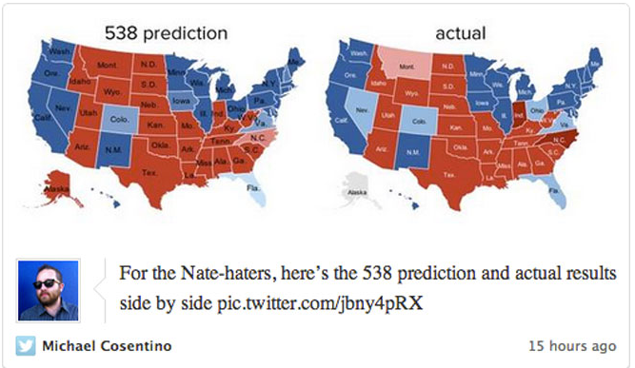
Randomness in the world
Nate Sliver: statistician famous for analyzing election predictions & baseball

Slide 16
Randomness in Computer Science
When the input is random …
- data mining
elections
weather
stock prices
genetic markers
- analyzing experimental data
When is analysis valid? When are we overfitting to available data?

Slide 17
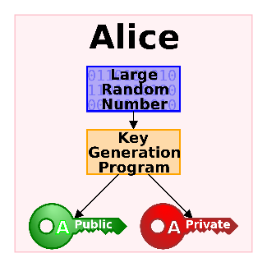
Randomness in Computer Science
When the desired output is random …
- picking a cryptographic key
- performing a scientific simulation
- programming a computer adversary in a game

Slide 18
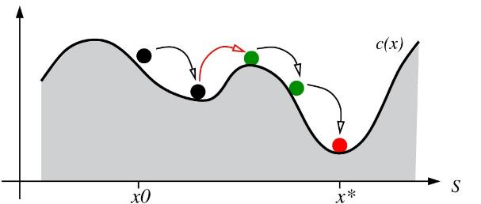
Randomness in Computer Science
When the algorithm uses randomness …
- Monte Carlo methods Rosen p. 463
- search heuristics avoid local mins
- randomized hashing
- quicksort

Slide 19

Dangers of probabilistic reasoning
"Intuitive probabilistic reasoning“ often goes wrong.

Slide 20
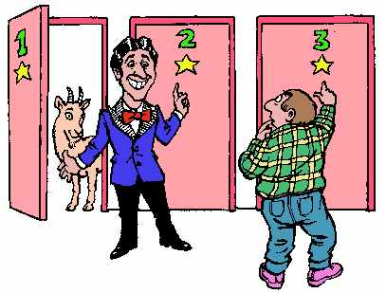
The Monty Hall Puzzle
Car hidden behind one of three doors.
Goats hidden behind the other two.
Player gets to choose a door.
Host opens another door, reveals a goat.
Player can choose whether to swap choice with other closed door or
stay with original choice.
What's the player's best strategy?
Always swap. B. Always stay. C. Doesn't matter, it's 50/50.

Slide 21


Some history…
Puzzle introduced by Steve Selvin in 1975.
Marilyn vos Savant was a prodigy with record scores on IQ tests who wrote an advice column. In 1990, a reader asked for the solution to the Monty Hall puzzle.
After she published the (correct) answer, thousands of readers (including PhDs and even a professor of statistics) demanded that she correct her "mistake".
She built a simulator to demonstrate the solution so they could see for themselves how it worked.

Slide 22
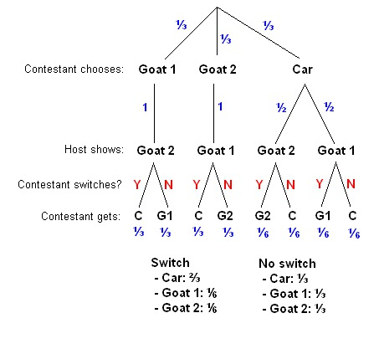
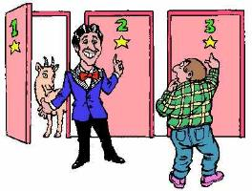
The Monty Hall Puzzle … the solution
Pick a door at random to start

Slide 23
The Monty Hall Puzzle … the solution

Slide 24
The Monty Hall Puzzle … the solution
What's the probability of winning
(C) if always switch ("Y") ?
1/3
1/2
2/3
1
None of the above.

Slide 25
The Monty Hall Puzzle … the solution
What's the probability of winning
(C) if always stay ("N") ?
1/3
1/2
2/3
1
None of the above.

Slide 26
The Monty Hall Puzzle … the solution
What's wrong with the following argument?
"It doesn't matter whether you stay or swap because the host opened one door to show a goat so there are only two doors remaining, and both of them are equally likely to have the car because the prizes were placed behind the doors randomly at the start of the game"

Slide 27

Conditional probabilities
Probability of an event may change if have additional information about outcomes.
Suppose E and F are events, and P(F)>0. Then,
i.e.
Rosen p. 456

Slide 28
Conditional probabilities
Are these probabilities equal?
The probability that two siblings are girls if know the oldest is a girl.
The probability that two siblings are boys if know that one of them is a boy.
They're equal.
They're not equal.
???
Assume that each child being a boy or a girl is equally likely.

Slide 29
Conditional probabilities
Are these probabilities equal?
The probability that two siblings are girls if know the oldest is a girl.
The probability that two siblings are boys if know that one of them is a boy.
Sample space
2. Initial distribution on the sample space
3. What events are we conditioning on?
Assume that each child being a boy or a girl is equally likely.

Slide 30
Conditional probabilities
Are these probabilities equal?
The probability that two siblings are girls if know the oldest is a girl.
The probability that two siblings are boys if know that one of them is a boy.
Sample space
Possible outcomes: {bb, bg, gb, gg} Order matters!
2. Initial distribution on the sample space
3. What events are we conditioning on?
Assume that each child being a boy or a girl is equally likely.

Slide 31
Conditional probabilities
Are these probabilities equal?
The probability that two siblings are girls if know the oldest is a girl.
The probability that two siblings are boys if know that one of them is a boy.
Sample space
Possible outcomes: {bb, bg, gb, gg} Order matters!
2. Initial distribution on the sample space
Uniform distribution, each outcome has probability ¼.
3. What events are we conditioning on?
Assume that each child being a boy or a girl is equally likely.

Slide 32
Conditional probabilities
Are these probabilities equal?
The probability that two siblings are girls if know the oldest is a girl.
The probability that two siblings are boys if know that one of them is a boy.
3. What events are we conditioning on?
Assume that each child being a boy or a girl is equally likely.

Slide 33
Conditional probabilities
Are these probabilities equal?
The probability that two siblings are girls if know the oldest is a girl.
The probability that two siblings are boys if know that one of them is a boy.
What events are we conditioning on?
A = { outcomes where oldest is a girl } B = { outcomes where two are girls}
Assume that each child being a boy or a girl is equally likely.

Slide 34
Conditional probabilities
Are these probabilities equal?
The probability that two siblings are girls if know the oldest is a girl.
The probability that two siblings are boys if know that one of them is a boy.
What events are we conditioning on?
A = { outcomes where oldest is a girl } B = { outcomes where two are girls }
= { gg, gb} = { gg }
Assume that each child being a boy or a girl is equally likely.

Slide 35
Conditional probabilities
Are these probabilities equal?
The probability that two siblings are girls if know the oldest is a girl.
The probability that two siblings are boys if know that one of them is a boy.
What events are we conditioning on?
A = { outcomes where oldest is a girl } B = { outcomes where two are girls }
= { gg, gb} = { gg }
P(A) = ½ P(B) = ¼ = P(A B)
Assume that each child being a boy or a girl is equally likely.
U

Slide 36
Conditional probabilities
Are these probabilities equal?
The probability that two siblings are girls if know the oldest is a girl.
The probability that two siblings are boys if know that one of them is a boy.
What events are we conditioning on?
A = { outcomes where oldest is a girl } B = { outcomes where two are girls }
= { gg, gb} = { gg }
P(A) = ½ P(B) = ¼ = P(A B)
By conditional probability law: P(B | A) = P(A B) / P(A) = (1/4) / (1/2) = ½.
Assume that each child being a boy or a girl is equally likely.
U
U

Slide 37
Conditional probabilities
Are these probabilities equal?
The probability that two siblings are girls if know the oldest is a girl. 1/2
The probability that two siblings are boys if know that one of them is a boy.
Sample space
Possible outcomes: {bb, bg, gb, gg} Order matters!
2. Initial distribution on the sample space
Uniform distribution, each outcome has probability ¼.
3. What events are we conditioning on?
Assume that each child being a boy or a girl is equally likely.

Slide 38
Conditional probabilities
Are these probabilities equal?
The probability that two siblings are girls if know the oldest is a girl. 1/2
The probability that two siblings are boys if know that one of them is a boy.
What events are we conditioning on?
C = { outcomes where one is a boy} D = { outcomes where two are boys }
= { bb, bg, gb } = { bb }
P(C) = ¾ P(D) = ¼ = P(C D)
Assume that each child being a boy or a girl is equally likely.
U

Slide 39
Conditional probabilities
Are these probabilities equal?
The probability that two siblings are girls if know the oldest is a girl. 1/2
The probability that two siblings are boys if know that one of them is a boy.
What events are we conditioning on?
C = { outcomes where one is a boy} D = { outcomes where two are boys }
= { bb, bg, gb } = { bb }
P(C) = ¾ P(D) = ¼ = P(C D)
By conditional probability law: P(D | C) = P(C D) / P(C) = (1/4) / (3/4) = 1/3.
Assume that each child being a boy or a girl is equally likely.
U
U

Slide 40
Conditional probabilities
Are these probabilities equal?
The probability that two siblings are girls if know the oldest is a girl. 1/2
The probability that two siblings are boys if know that one of them is a boy. 1/3
Assume that each child being a boy or a girl is equally likely.

Slide 41
Conditional probabilities: Simpson's Paradox
 | Treatment A | Treatment B
Small stones | 81 successes / 87 | 234 successes / 270
Large stones | 192 successes / 263 | 55 successes / 80
Combined | 273 successes / 350 (78%) | 289 successes / 350 (83%)
Which is the better overall treatment?

Slide 42
Conditional probabilities: Simpson's Paradox
 | Treatment A | Treatment B
Small stones | 81 successes / 87 (93%) | 234 successes / 270 (87%)
Large stones | 192 successes / 263 (73%) | 55 successes / 80 (69%)
Combined | 273 successes / 350 (78%) | 289 successes / 350 (83%)
Which treatment is better?
Treatment A for all cases. C. A for small and B for large.
Treatment B for all cases. D. A for large and B for small.
C. R. Charig, D. R. Webb, S. R. Payne, J. E. Wickham (29 March 1986). "Comparison of treatment of renal calculi by open surgery, percutaneous nephrolithotomy, and extracorporeal shockwave lithotripsy". Br Med J (Clin Res Ed) 292 (6524): 879–882. doi:10.1136/bmj.292.6524.879. PMC 1339981. PMID 3083922. cf. Wikipedia "Simpson's Paradox"

Slide 43
Conditional probabilities: Simpson's Paradox
 | Treatment A | Treatment B
Small stones | 81 successes / 87 (93%) | 234 successes / 270 (87%)
Large stones | 192 successes / 263 (73%) | 55 successes / 80 (69%)
Combined | 273 successes / 350 (78%) | 289 successes / 350 (83%)
Simpson's Paradox
"When the less effective treatment is applied more frequently to easier cases, it can appear to be a more effective treatment."
C. R. Charig, D. R. Webb, S. R. Payne, J. E. Wickham (29 March 1986). "Comparison of treatment of renal calculi by open surgery, percutaneous nephrolithotomy, and extracorporeal shockwave lithotripsy". Br Med J (Clin Res Ed) 292 (6524): 879–882. doi:10.1136/bmj.292.6524.879. PMC 1339981. PMID 3083922. cf. Wikipedia "Simpson's Paradox"

Slide 44
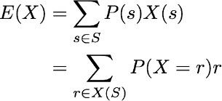
Random Variables
Rosen p. 460,478
A random variable assigns a real number to each possible
outcome of an experiment.
The distribution of a random variable X is the function
r → P(X = r)
The expectation (average, expected value) of random variable X on sample space S is

Slide 45
Expected Value Examples
Rosen p. 460,478
The expectation (average, expected value) of random variable X on sample space S is
Calculate the expected number of boys in a family with two children.
0
1
1.5
2

Slide 46
Expected Value Examples
Rosen p. 460,478
The expectation (average, expected value) of random variable X on sample space S is
Calculate the expected number of boys in a family with three children.
0
1
1.5
2

Slide 47
Expected Value Examples
Rosen p. 460,478
The expectation (average, expected value) of random variable X on sample space S is
Calculate the expected number of boys in a family with three children.
The expected value might not be a possible value of the random variable…
like 1.5 boys!
0
1
1.5
2

Slide 48
Expected Value Examples
Rosen p. 460,478
The expectation (average, expected value) of random variable X on sample space S is
Calculate the expected sum of two 6-sided dice.
6
7
8
9
None of the above.

