Slide 1
Welcome to CSE21!
 | Miles Jones | MTThF 8:30-9:50pm | CSE 4258
August 1, 2016

Slide 2
About this course
Formulate & solve problems
Describe data
Analyze algorithms
Using math
Notes:
CSE21 is a course to introduce you to some of the basic mathematical concepts upon which computer science is based.
We will learn the tools used by computer scientists on a regular basis to formulate and solve problems, describe data, and develop and analyze algorithms

Slide 3
About this course
Why is math part of the CS curriculum?
Proofs: key to convincing arguments, but also key part of
software engineering
Vocabulary: basic language of Computer Science
Quantitative Analysis: are our solutions / programs / algorithms good enough? How much computational resources (time, memory, power) does our solution use?
Notes:
We will rigorously justify (i.e. prove) our conclusions, so that others may follow our reasoning and be convinced of our results.
We will treat the skills needed for this course as examples of problem-solving techniques that can be used in a much broader context.
The mathematical concepts we will learn in this course are foundational for computer science.
They are taken for granted by those who work in the field (not to mention in your future classes) and are used in many different ways.

Slide 4
About you
To change your remote frequency
Press and hold power button until flashing
Enter two-letter code
Checkmark / green light indicates success
Have you used iClickers before?
Yes
No

Slide 5
About you
To change your remote frequency
Press and hold power button until flashing
Enter two-letter code
Checkmark / green light indicates success
Where are you from?
San Diego
California
United States
Other country

Slide 6
About you
To change your remote frequency
Press and hold power button until flashing
Enter two-letter code
Checkmark / green light indicates success
Where do you think I am from?
California
Virginia
Maine
Texas
Florida

Slide 7
About you
To change your remote frequency
Press and hold power button until flashing
Enter two-letter code
Checkmark / green light indicates success
What other CSE class are you taking in summer academy?
None.
CSE 12
CSE 15L

Slide 8
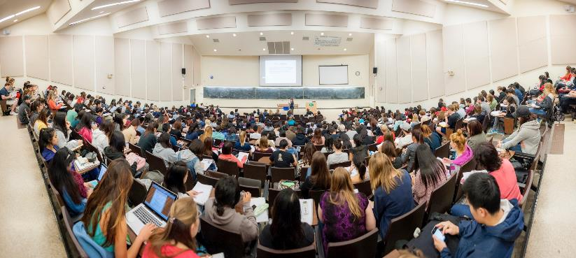
Introductions

Slide 9
What do we assume you know?
Short answer: HW 1.
Longer answer: Rosen Chapters 1, 2, some of 5, some of 9.
Longest answer: You can describe algorithms and their correctness using precise mathematical terminology and techniques. For example:
Sets, relations (equivalence relations, orders)
Logical equivalence, conditionals, hypotheses, conditionals, contrapositives
Universal and existential quantifiers
Proof by contradiction (indirect proof)
Proof by induction
Algorithm invariants

Slide 10

Logistics
Textbook: Rosen 7th Edition
Exams: First Exam: Friday, August 12
Second Exam: Friday, August 26
Final Exam: Friday, September 2

Slide 11
Logistics, part 2
Websites:
Class Website:
Homework assigments, calendar, announcements, study guides, contact info,
lecture slides (avail. Day after lecture.)
Gradescope: gradescope.com
Homework submission and exam return.
Piazza: Announcements and Q&A. Contact instructors here! No HW questions on Piazza.
Office hours: Instructors and tutors. Discuss HW questions here!

Slide 12
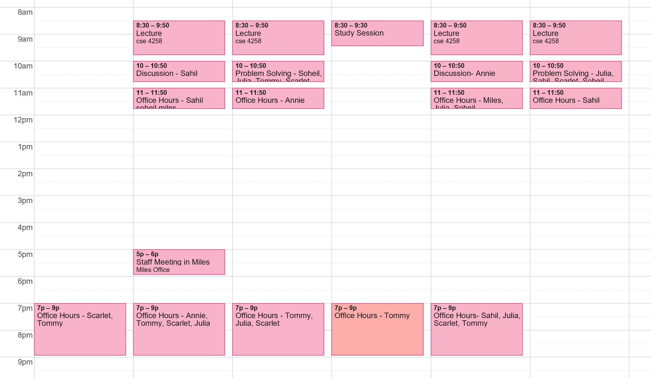
Logistics, part 2

Slide 13
Logistics, part 2
Your grade will be based on a combination of exams (70%) and homework (30%)
Your lowest homework will be dropped and your lowest midterm exam may be dropped if you do better on the final.
Your work will be evaluated not only on the correctness of your answers but on your ability to effectively communicate your ideas.

Slide 14
Academic Integrity Scenarios
You’re working on a homework question and run across a definition you don’t understand. You Google the term and the first hit includes a full solution to the homework question. You avoid reading the solution and close the browser. You keep working on the solution and hand in the assignment, without mentioning the Google search since you didn’t use the result. Is this acceptable?
A. Yes B. No

Slide 15
Academic Integrity Scenarios
You’re not sure if you are interpreting a homework problem correctly. You write a post on Piazza showing what you did to answer it, and asking if this is the correct way of interpreting the question. Is this acceptable?
A. Yes B. No

Slide 16
Academic Integrity Scenarios
You form a study group with two friends and start working on the next homework. Since there are 6 questions you each pick two questions, think about them, and write out your solutions in a shared Google doc. You glance over each other's work before turning in the assignment. Is this acceptable?
A. Yes B. No

Slide 17
Goals
1. Learn concepts which computer science relies upon:
Algorithms
Asymptotic notation
Recurrence relations
Graphs
Enumeration and data representation
Probability

Slide 18
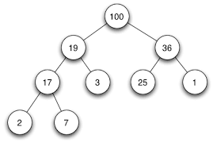
An example of CS vocabulary: Trees
Data structure: Binary search trees
Stay tuned: Chapter 11 in Rosen, Week 6

Slide 19
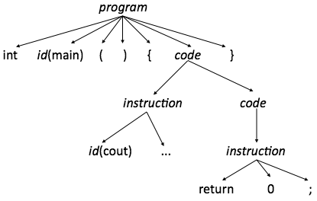
An example of CS vocabulary: Trees
Algorithm: parsing

Slide 20
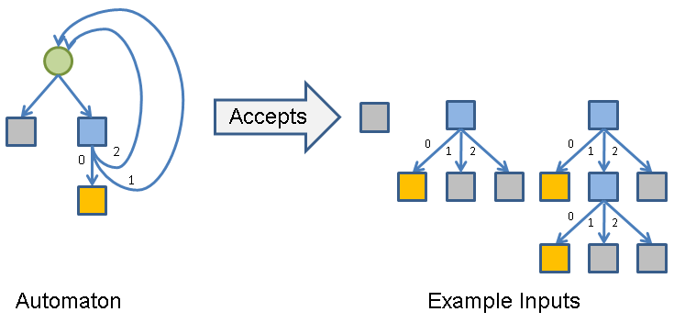
An example of CS vocabulary: Trees
Model: possible paths of computation

Slide 21
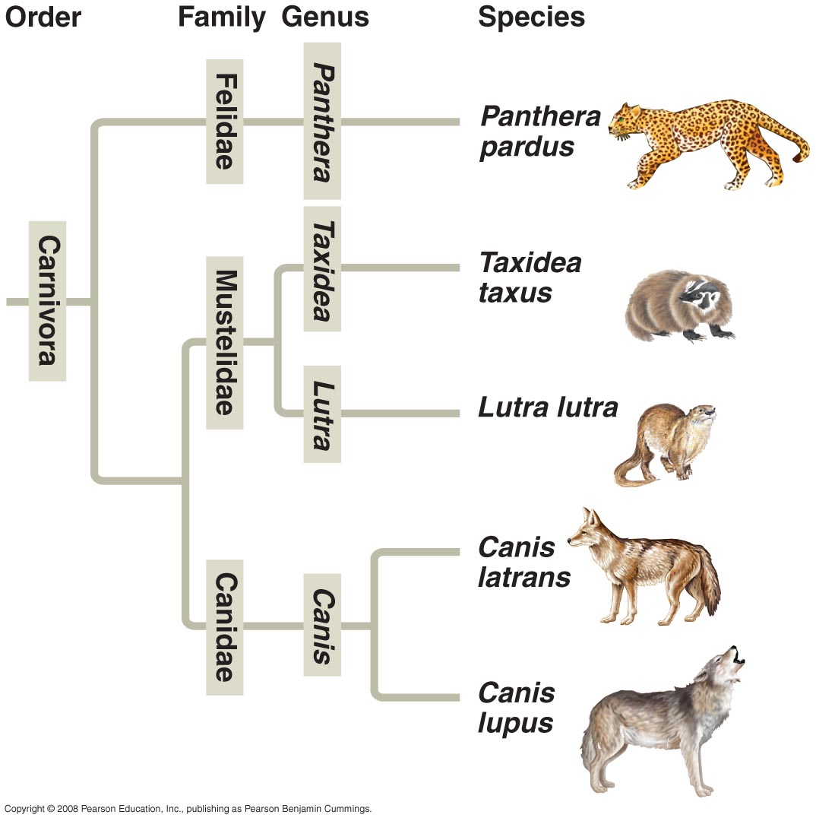
An example of CS vocabulary: Trees
Model: Phylogenetic (evolutionary) tree

Slide 22
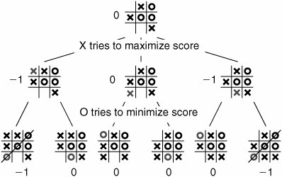
An example of CS vocabulary: Trees
State space: possible configurations of a game
Notes:
Trees can be used to represent all possibilities that may occur in a given situation and to develop algorithms, such as an algorithm for winning tic tac toe.

Slide 23
An example of CS vocabulary: Trees
Conclusion: Many different applications but same underlying idea.
How do we define a tree?
What properties are guaranteed by this definition?
What algorithms can exploit these properties?

Slide 24
Goals
2. Solve problems.
Come up with *new* algorithms
Think of the homework questions as puzzles that you need to unravel: the solution or even the approach won't be clear right away.
You can work on homework in groups of 1-3 students.

Slide 25

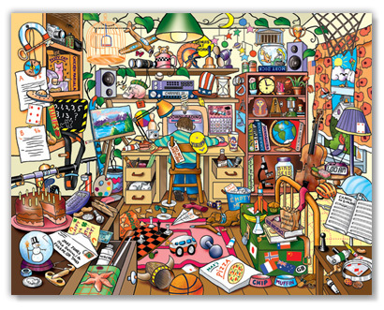
Sorting (or Ordering)
Section 3.1 in Rosen
vs.
* Assume elements of the set to be sorted have some underlying order
Notes:
A surprisingly vast topic studied in computer science is how best to sort a set of objects.
Assume that there is some underlying order among the elements of the set (size order, numerical order, alphabetical order, etc.).

Slide 26
Sorting (or Ordering)
Which of the following collections of elements is listed in sorted order?
42, 10, 30, 25
10, 25, 30, 40
40, 30, 25, 10
All of the above
None of the above
Notes:
All of the above: depending on order! B is usual order on integers, C is reverse order, and A is order that you get from spelling out numbers and alphabetizing ☺

Slide 27
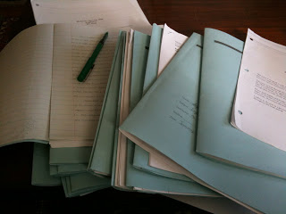
Why sort?
A TA facing a stack of exams needs to input all 400 scores into a spreadsheet where the students are listed in alphabetical order.
OR
You want to find all the duplicate values in a long list.

Slide 28
Why sort?
A TA facing a stack of exams needs to input all 400 scores into a spreadsheet where the students are listed in alphabetical order.
OR
You want to find all the duplicate values in a long list.
It's easier to access data when it is sorted because you know exactly where to find it.

Slide 29
DIY: Sorting Algorithms
1. Find a group we will divide the class in half
2. Sort the names of the people in your group alphabetically by first name.
3. Discuss as a group the strategy you used to sort the papers, and how you might describe it to someone else.
4. Write a clear English description of the strategy your group used (each person should do this.)
5. Select one representative to describe your group's strategy on the board.

Slide 30
Sorting Dance.
https://youtu.be/ywWBy6J5gz8

Slide 31
Discussion of Sorting Algorithms
Is the strategy clear?
Will the strategy always work?
Does the strategy scale well to bigger groups?

Slide 32
General questions to ask about algorithms
1) What problem are we solving?
2) How do we solve the problem?
3) Why do these steps solve the problem?
4) When do we get an answer?

Slide 33
General questions to ask about algorithms
1) What problem are we solving? PROBLEM SPECIFICATION
2) How do we solve the problem? ALGORITHM DESCRIPTION
3) Why do these steps solve the problem? CORRECTNESSS
4) When do we get an answer? RUNNING TIME PERFORMANCE

Slide 34
Sorting: Specification: WHAT
Rosen page 196
Given a list
a₁, a₂, ..., a_{n}
rearrange the values so that
a₁ <= a₂ <= ... <= a_{n}
Values can be any type (with underlying total order). For simplicity, use integers.

Slide 35
Your approaches: HOW
Notes:
Go to next slides depending on what algorithms were suggested

Slide 36

Selection Sort (Min Sort)
"Find the first name alphabetically, move it to the front. Then look for the next one, move it, etc.''

Slide 37
Selection Sort (MinSort) Pseudocode
Rosen page 203, exercises 41-42
procedure selection sort(a₁, a₂, ..., a_{n}: real numbers with n >=2 )
for i := 1 to n-1
m := i
for j:= i+1 to n
if ( a_{j} < a_{m} ) then m := j
interchange a_{i} and a_{m}
{ a₁, ..., a_{n} is in increasing order}

Slide 38

Bubble Sort
"Compare the first two cards, and if the first is bigger,
keep comparing it to the next card in the stack until we
find one larger than it. Repeat until the stack is sorted.''

Slide 39
Bubble Sort Pseudocode
Rosen page 197
procedure bubble sort(a₁, a₂, ..., a_{n}: real numbers with n >=2 )
for i := 1 to n-1
for j:= 1 to n-i
if ( a_{j} > a_{j+1} ) then interchange a_{j} and a_{j+1}
{ a₁, ..., a_{n} is in increasing order}

Slide 40
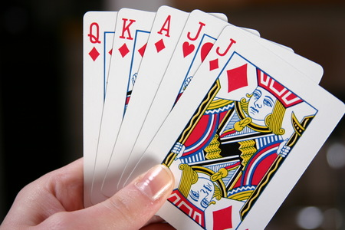
Insertion Sort
"We passed the cards from right to left, each individual
inserting their own card in the correct position as they
relayed the pile."

Slide 41
Insertion Sort Pseudocode
Rosen page 198
procedure insertion sort(a₁, a₂, ..., a_{n}: real numbers with n >=2 )
for j := 2 to n
i := 1
while a_{j} > a_{i}
i := i+1
m := a_{j}
for k := 0 to j-i-1
a_{j-k} := a_{j-k-1}
a_{i} := m
{ a₁, ..., a_{n} is in increasing order}
Notes:
Take an element of A and find where it belongs relative to the elements before it.
Shift everything back to make room and put the element in its proper place.
Now that this element has been inserted where it belongs, do the same for the next element of A.

Slide 42
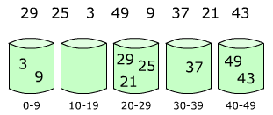
Bucket Sort
"Call out from A to Z, collecting cards by first letter. If there are more than one with the same first letter, repeat with the second letter, and so on.''

Slide 43
Bucket Sort – Pseudo pseudo code
Create empty buckets that have an ordering.
Put each of the elements of the list into the correct bucket.
Sort within each bucket.
Concatenate the buckets in order.
Notes:
How do we determine which buckets to use?
How do our buckets depend on the type of data in A?
How do we sort within each bucket?

Slide 44

Merge Sort
"We split into two groups and organized each of the groups, then got back together and figured out how to interleave the groups in order."

Slide 45
Merge Sort – Pseudo pseudo code
Rosen page 196, 367-370
If the list has just one element, return.
Otherwise,
Divide list into two pieces:
L₁ = a₁ ... a_{n/2} and L₂ = a_{n/2+1} ... a_{n}
M₁ = Merge sort ( L₁ )
M₂ = Merge sort ( L₂ )
Merge the two (sorted) lists M₁ and M₂

Slide 46
Others?
Bogo sort
Quick sort
Binary search tree traversal
https://en.wikipedia.org/wiki/Sorting_algorithm
Notes:
Bogo sort: Randomly shuffle the cards; repeat until ordered
Binary search tree: create and do in-order traversal
We'll come back to these!

Slide 47
Why so many algorithms?

Slide 48
Why so many algorithms?
Practice for homework / exam / job interviews.
Some algorithms are better than others. Wait, better?

Slide 49
Reminders
HW 1 Due Tuesday August 2 at 11:59pm on gradescope.

