Slide 1
Introduction to Graphs
 | Miles Jones | MTThF 8:30-9:50am | CSE 4140
August 11, 2016

Slide 2
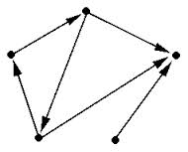
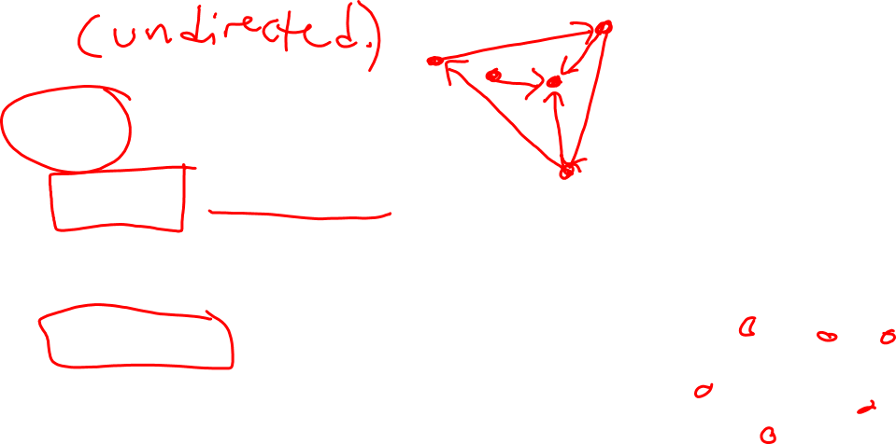
What is a graph?
A (directed) graph G is
A nonempty set of vertices V, also called nodes
and
A set of edges E, each pointing from one vertex to another (denoted with an arrow)

Slide 3
Variants of graphs
Undirected graph: don't need arrows on edges
if there's an edge from v to w then there's an edge from w to v.
Multigraph: undirected graph that may have multiple edges between a pair of nodes. Such edges are called parallel edges.
Simple graph: undirected graph with no self-loops (edge from v to v) and no parallel edges.
Mixed graph: directed graph that may have multiple edges between a pair of nodes and self loops.
Rosen p. 644

Slide 4
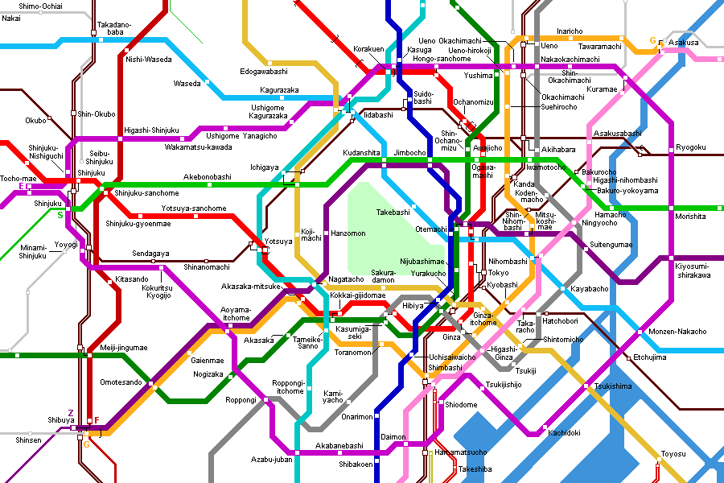

Graphs are everywhere

Slide 5
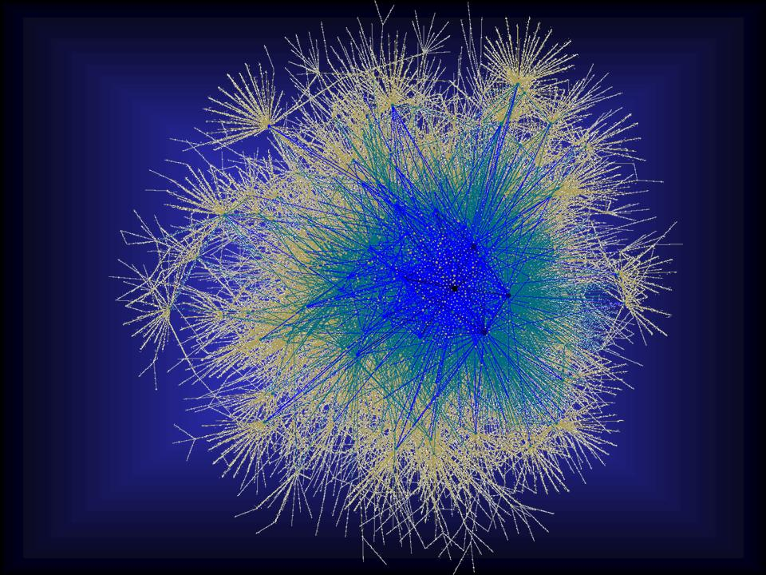
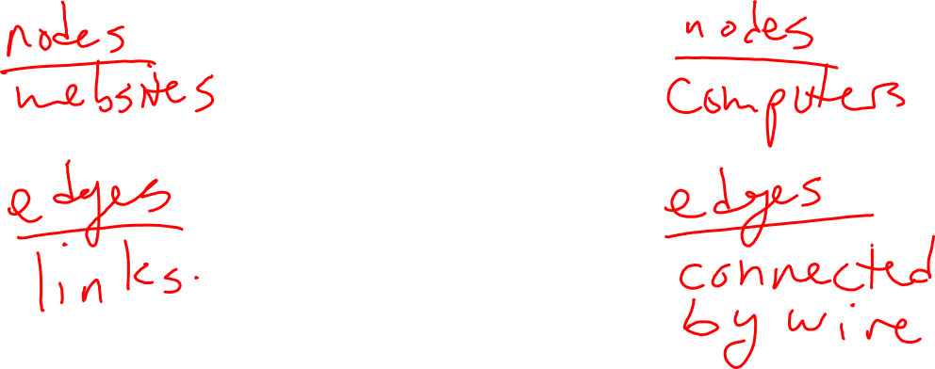
Graphs are everywhere
The internet graph

Slide 6
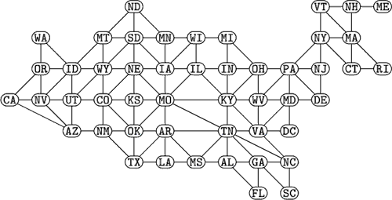
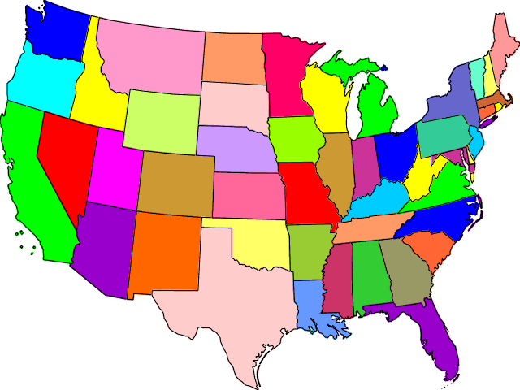
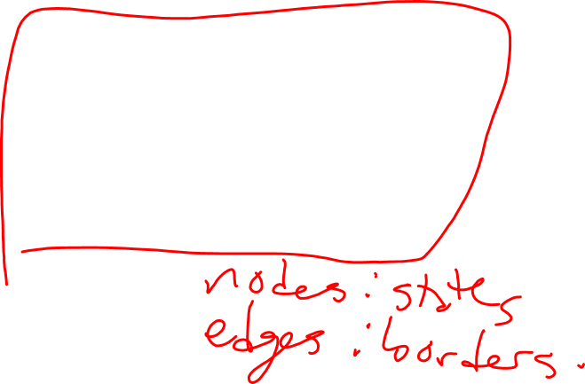
Graphs are everywhere
Map coloring

Slide 7
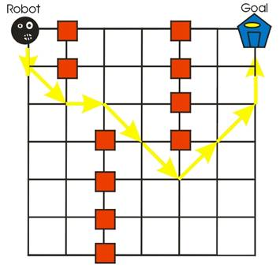
Graphs are everywhere
Path planning for robots

Slide 8

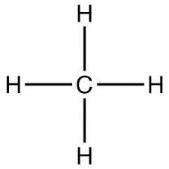
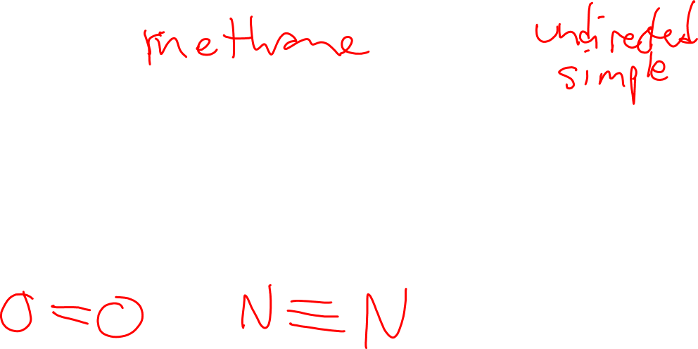
Graphs are everywhere

Slide 9
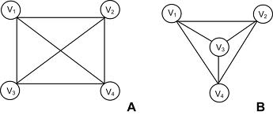
Are these the same graph?
Yes: the set of vertices is the same.
Yes: we can rearrange the vertices so that the pictures look the same.
No: the pictures are different.
No: the left graph has a crossing and the right one doesn't.
None of the above.

Slide 10


Representing directed graphs
☺
Diagrams with vertices and edges
How many vertices?
For each ordered pair of vertices (v,w)
how many edges go from v to w?

Slide 11
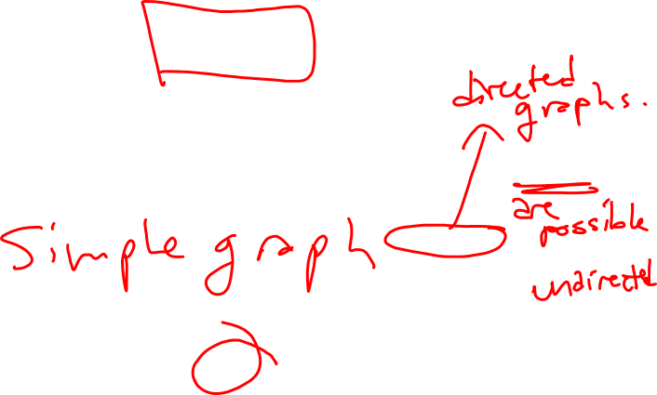
Representing directed graphs
☺
How many ordered pairs
of vertices are there?
n
n(n-1)
n²
n(n-1)/2
2^{n}
Diagrams with vertices and edges
How many vertices? n
For each ordered pair of vertices (v,w)
how many edges go from v to w?

Slide 12

Representing directed graphs
☺
Diagrams with vertices and edges
How many vertices? n
For each ordered pair of vertices (v,w)
how many edges go from v to w?
Need to store n(n-1) ints

Slide 13
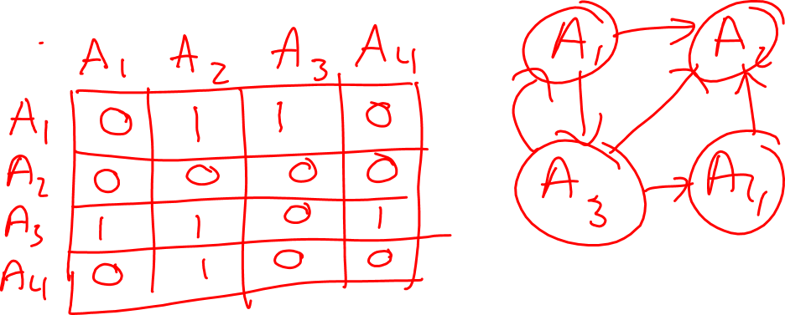
Representing directed graphs
Adjacency matrix n x n matrix:
entry in row i and column j is the number of edges
from vertex i to vertex j
Rosen p. 669

Slide 14
Representing directed graphs
Adjacency matrix n x n matrix:
entry in row i and column j is the number of edges
from vertex i to vertex j
What can you say about the adjacency matrix of a loopless graph?
It has all zeros.
All the elements below the diagonal are 1.
All the elements are even.
All the elements on the diagonal are 0.
None of the above.
Rosen p. 669

Slide 15
Representing directed graphs
Adjacency matrix n x n matrix:
entry in row i and column j is the number of edges
from vertex i to vertex j
What can you say about the adjacency matrix of a graph with no parallel edges?
It has no zeros.
It is symmetric.
All the entries above the diagonal are 0.
All entries are either 0 or 1.
None of the above.
Rosen p. 669

Slide 16
Representing directed graphs
Adjacency matrix n x n matrix:
entry in row i and column j is the number of edges
from vertex i to vertex j
What can you say about the adjacency matrix of an undirected graph?
It has no zeros.
It is symmetric.
All the entries above the diagonal are 0.
All entries are either 0 or 1.
None of the above.
Rosen p. 669

Slide 17
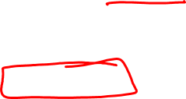
Representing undirected graphs
Simple undirected graph:
* Only need to store the adjacency matrix above diagonal.
What's the maximum number of edges a simple undirected graph with n vertices can have?
n²
n²/2
n(n-1)/2
n(n+1)/2
n

Slide 18
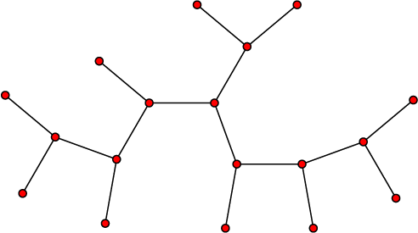
Efficiency?
When is an adjacency matrix an inefficient way to store a graph?
High density of edges compared to number of vertices
Low density of edges compared to number of vertices

Slide 19
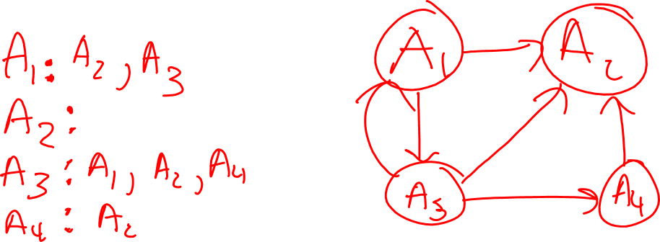
Representing directed graphs
Adjacency list (list of lists):
for each vertex v, associate list of all neighbors of v.
Rosen p. 668

Slide 20
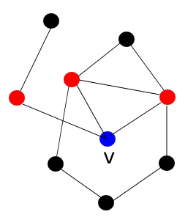
Neighbors
The neighbors of a vertex v are all the vertices w for which there is an edge whose endpoints are v,w.
If two vertices are neighbors then they are called adjacent to one another.
Rosen p. 651

Slide 21
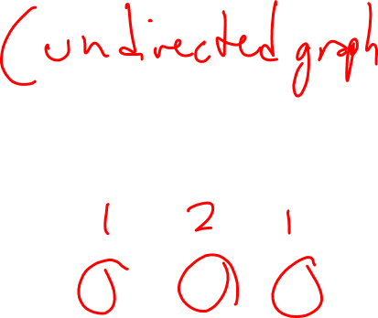
Degree
The degree of a vertex in an undirected graph is the total number of edges incident with it, except that a loop contributes twice.
What's the maximum degree of a vertex in this graph?
0.
1
2
3
None of the above.
Rosen p. 652

Slide 22
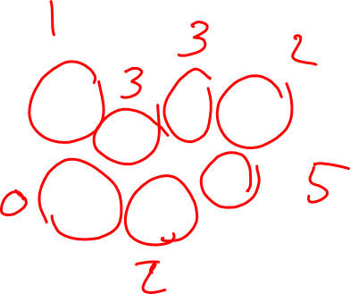
Degree
What's the degree of vertex 0?
A. 5
B. 3
C. 2
D. 1
E. None of the above.

Slide 23

Handshakes
If there are n people in a room, and each shakes hands with d people, how many handshakes take place?
A. n
B. d
C. nd
D. (nd)/2
E. None of the above.

Slide 24
Handshakes
If there are n people in a room, and each shakes hands with d people, how many handshakes take place?
A. n
B. d
C. nd
D. (nd)/2
E. None of the above.
Don't double-count each handshake!

Slide 25
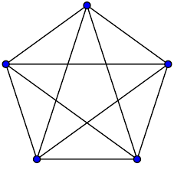
Handshakes "in" graphs
If a simple graph has n vertices and each vertex has degree d, how many edges are there?
2 |E| = n*d

Slide 26
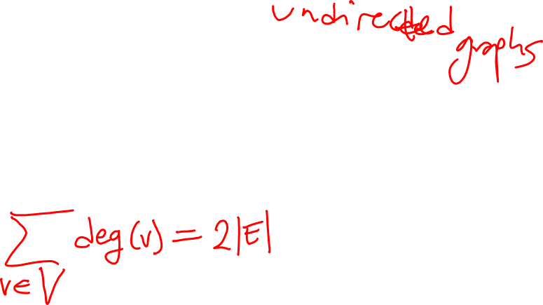
Handshakes "in" graphs
If any graph has n vertices, then
2 |E| = sum of degrees of all vertices

Slide 27
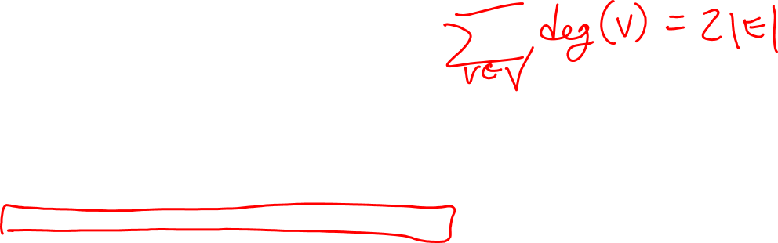
Handshakes "in" graphs
If any graph has n vertices, then
2 |E| = sum of degrees of all vertices
What can we conclude?
Every degree in the graph is even.
The number of edges is even.
The number of vertices with odd degree is even.
The number self loops is even.
None of the above.

Slide 28

Puzzles

Slide 29
Path
Sequence
(v₀, e₁, v₁, e₂, v₂, … , e_{k}, v_{k})
describes a route through the graph from
start vertex v₀
to
end vertex v_{k}

Slide 30
Algorithmic questions related to paths
Reachability:
Is there a path from vertex v to vertex w?
Path:
Find a path from vertex v to vertex w.
Distance:
What's the length of the shortest path from vertex v to vertex w?

Slide 31

Die Hard with a vengeance
https://youtu.be/5_MoNu9Mkm4

Slide 32

Recall: Tartaglia's Pouring Problem
Large cup: contains 8 ounces, can hold more.
Medium cup: is empty, has 5 ounce capacity.
Small cup: is empty, has 3 ounce capacity
You can pour from one cup to another until the first is empty or the second is full.

Slide 33
Tartaglia's Pouring Problem
(l, m, s)
means
l ounces in large cup
m ounces in medium cup
s ounces in small cup
Rephrasing the problem: using configurations
(1) Is there a path from (8,0,0) to (4,4,0) ?
(2) If so, what's the best path?
"Best" means "shortest length"

Slide 34
Tartaglia's Pouring Problem
(l, m, s)
means
l ounces in large cup
m ounces in medium cup
s ounces in small cup
How many configurations are possible?
Infinitely many
4 * 6 * 9 = 216
24
16
None of the above.

Slide 35
Tartaglia's Pouring Problem
(l, m, s) **
means
l ounces in large cup
m ounces in medium cup
s ounces in small cup
**integer values
How many configurations are possible?
Small cup: 0, 1, 2, or 3
Medium cup: 0, 1, 2, 3, 4, or 5
Large cup: 0, 1, 2, 3, 4, 5, 6, 7, or 8

Slide 36
Tartaglia's Pouring Problem
(l, m, s) **
means
l ounces in large cup
m ounces in medium cup
s ounces in small cup
**integer values
How many configurations are possible?
Small cup: 0, 1, 2, or 3
Medium cup: 0, 1, 2, 3, 4, or 5
Large cup: 0, 1, 2, 3, 4, 5, 6, 7, or 8
But can't have 3 in small AND 5 in medium AND 8 in large: Total must be 8.

Slide 37
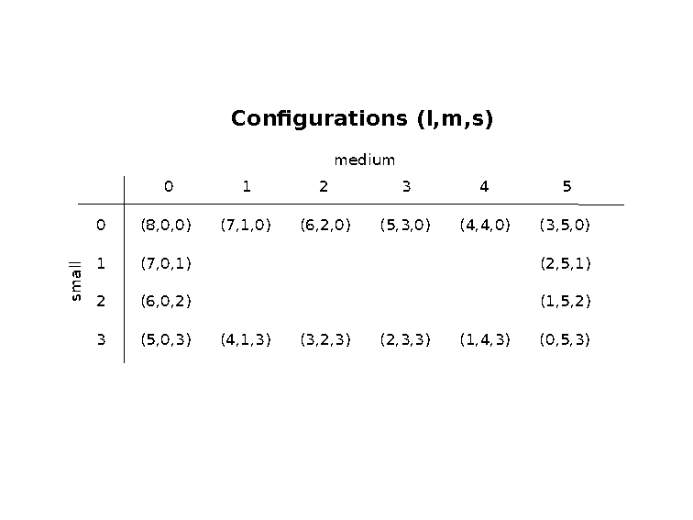

Slide 38
Graph reachability: WHAT
Given a directed graph
G and a start vertex s,
produce a list of all vertices v reachable from s by a directed path in G.

Slide 39
Graph reachability: HOW
Given a directed graph
G and a start vertex s,
produce a list of all vertices v reachable from s by a directed path in G.
At each point in a graph search algorithm, the vertices are partitioned into
X: eXplored
F: frontier (reached but haven't yet explored)
U: unreached

Slide 40
Graph reachability: HOW
procedure GraphSearch (G: directed graph, s: vertex)
Initialize X= empty, F = {s}, U = V – F.
While F is not empty:
Pick v in F.
For each neighbor u of v:
If u is not in X or F, then move u from U to F.
Move v from F to X.
Return X.

Slide 41
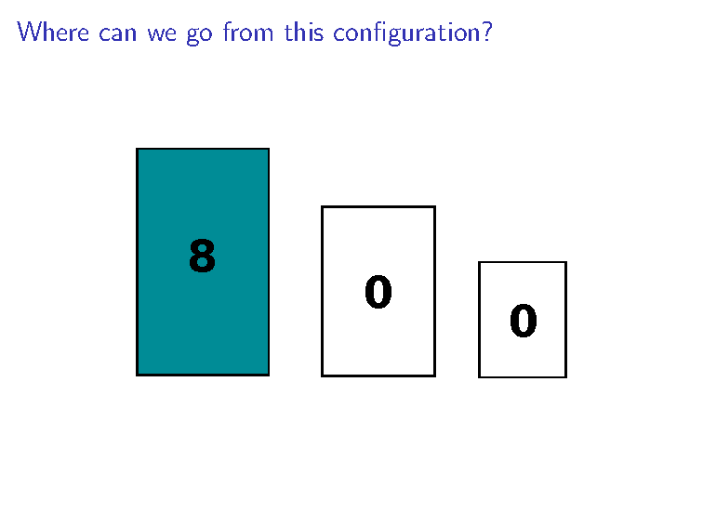

Slide 42
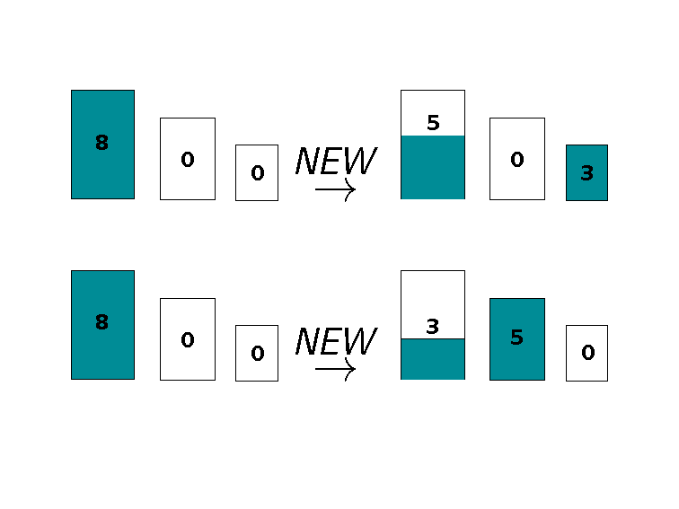

Slide 43
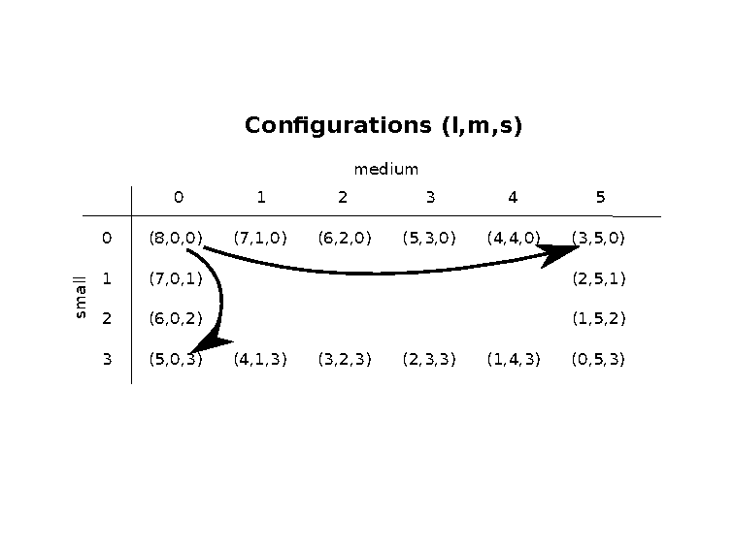

Slide 44
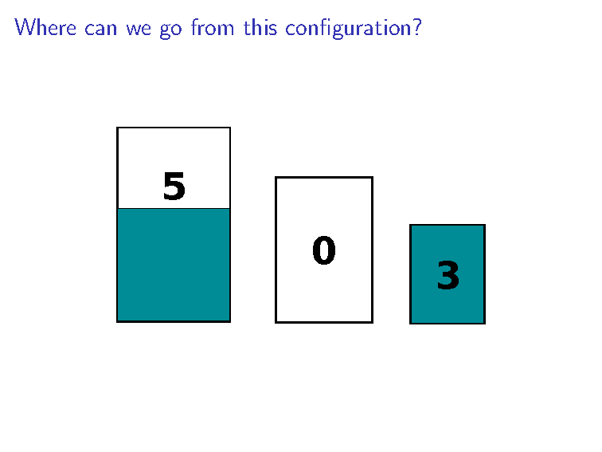

Slide 45
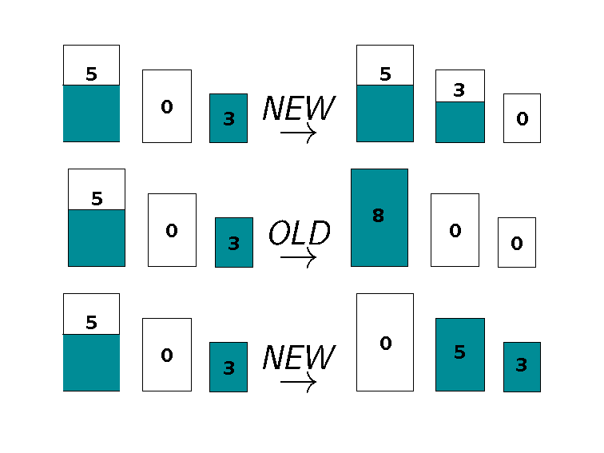

Slide 46
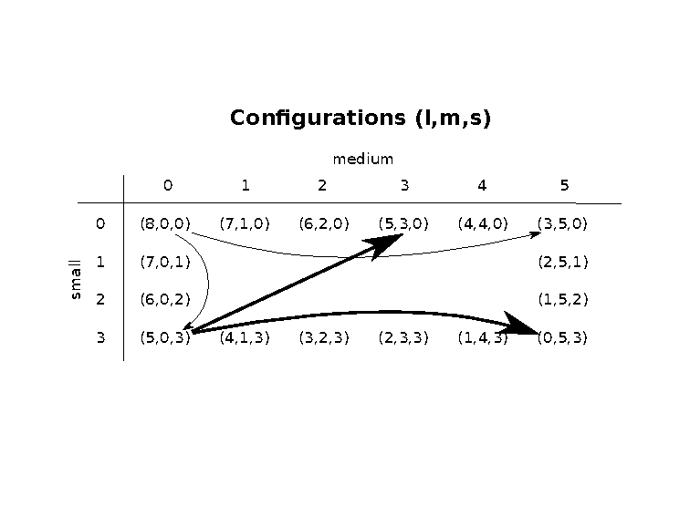

Slide 47
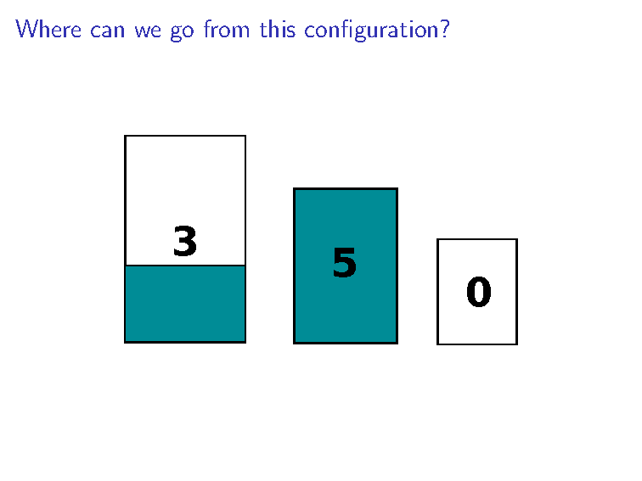

Slide 48
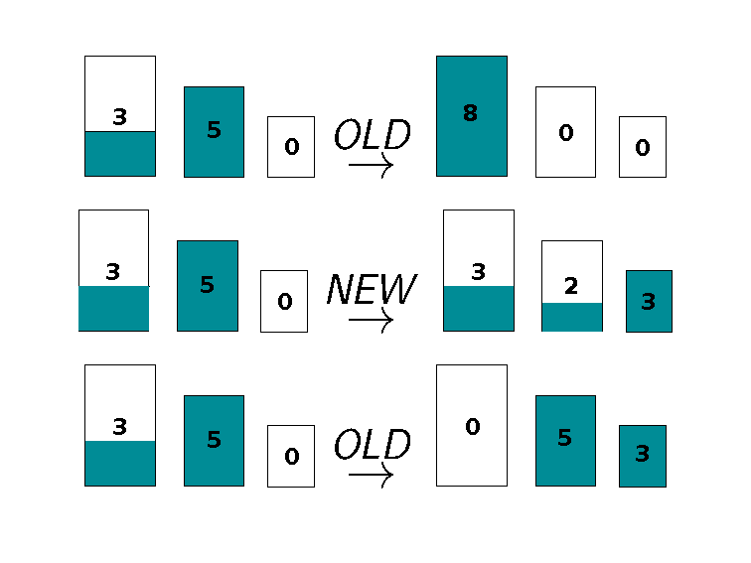

Slide 49
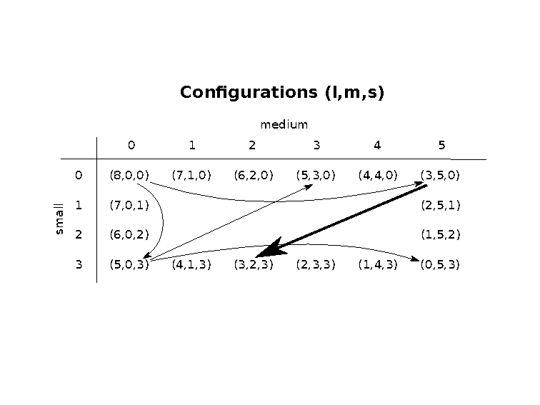

Slide 50
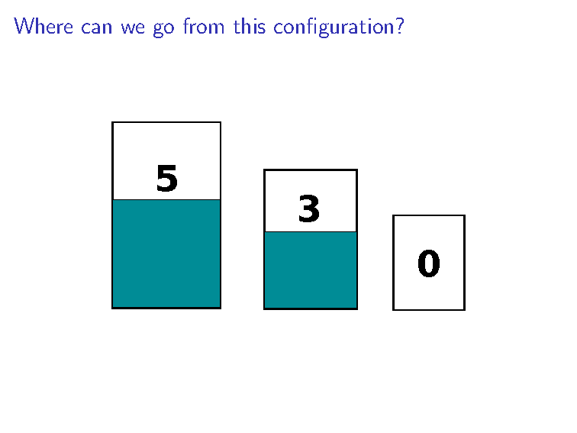

Slide 51
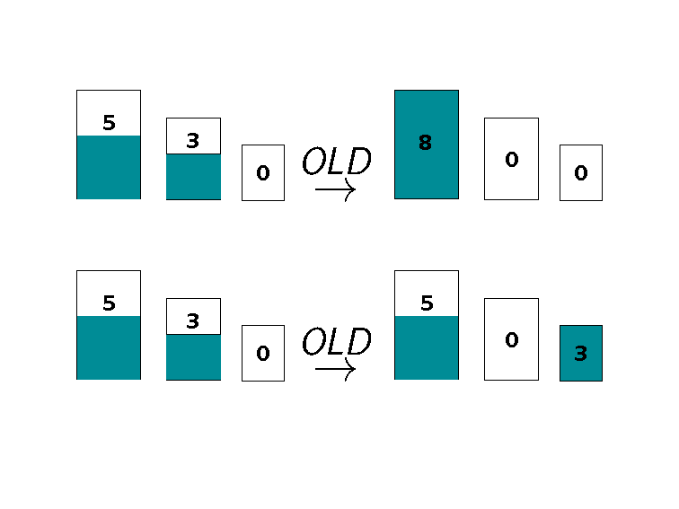

Slide 52
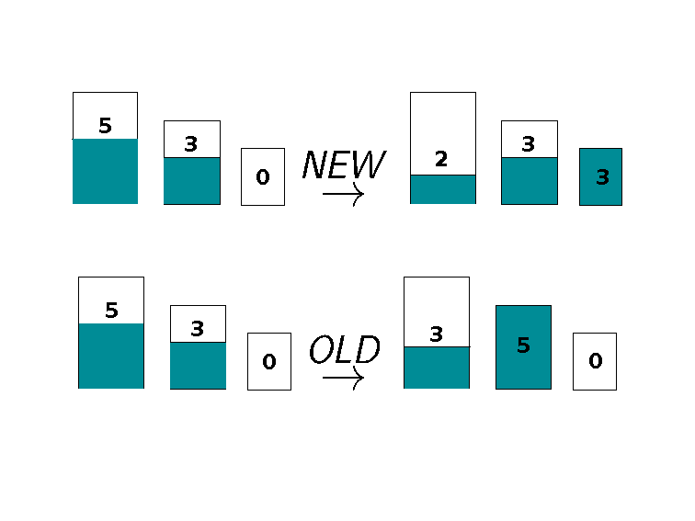

Slide 53
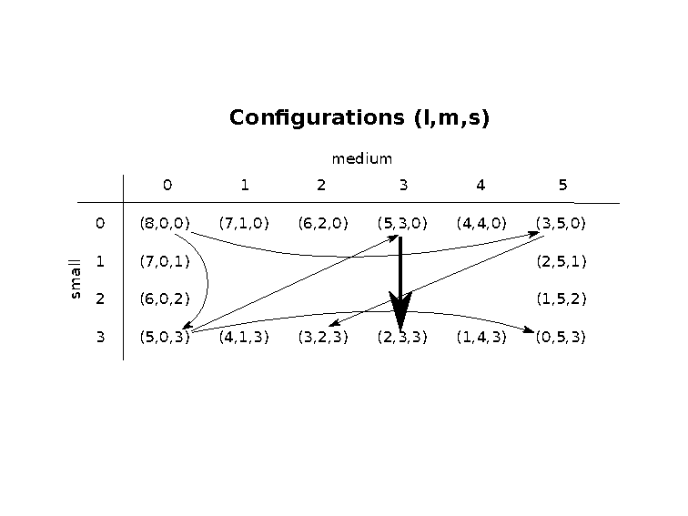

Slide 54
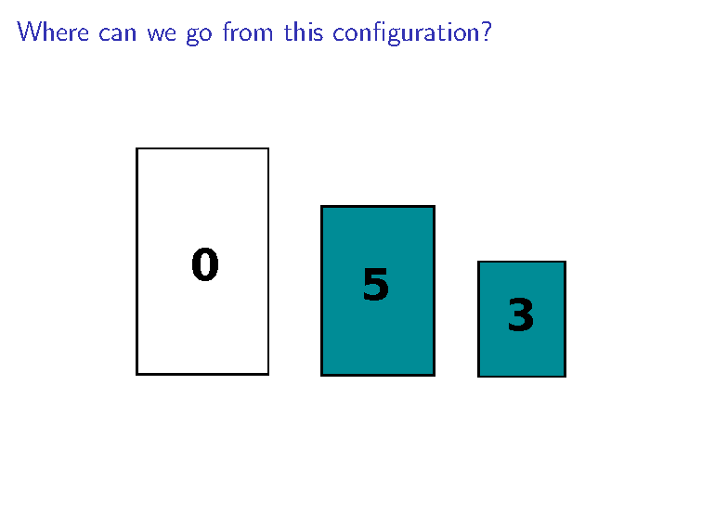

Slide 55
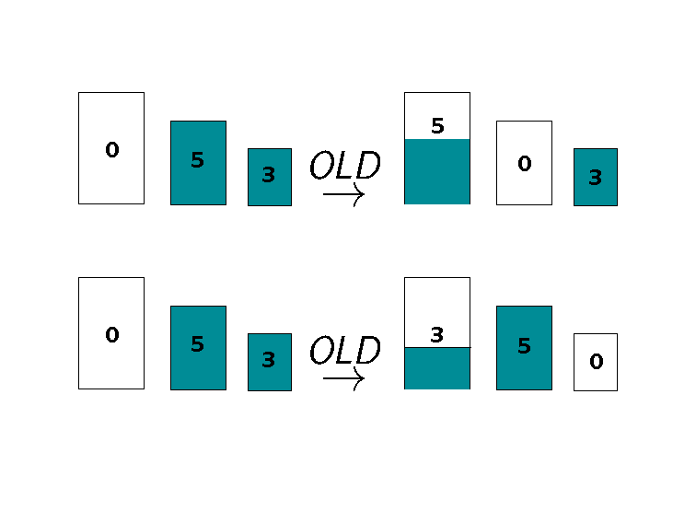

Slide 56
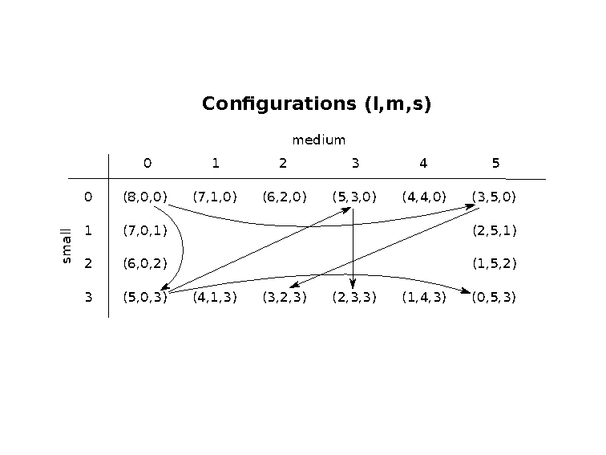

Slide 57
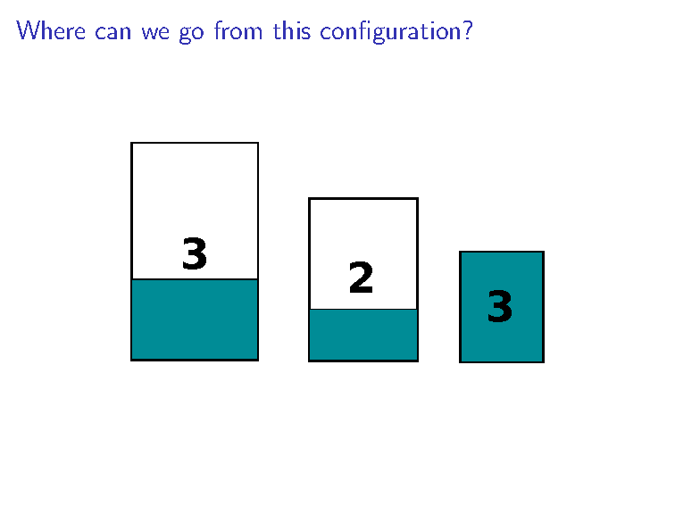

Slide 58
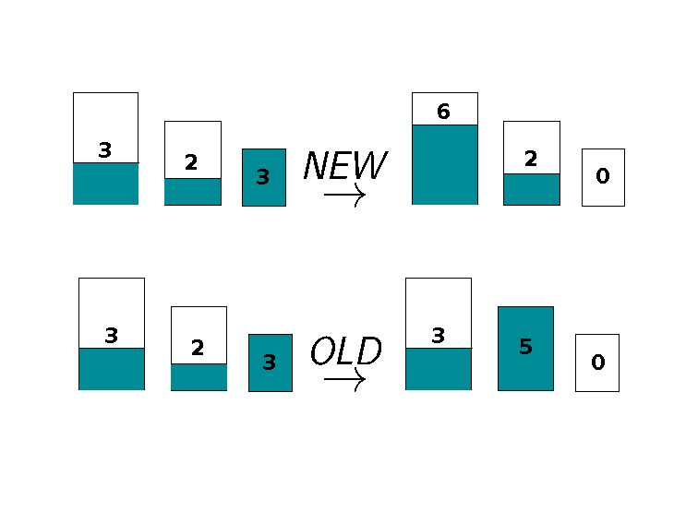

Slide 59
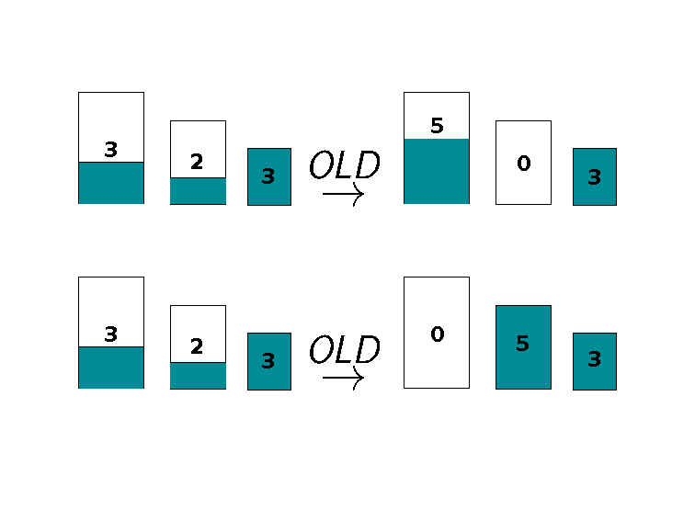

Slide 60
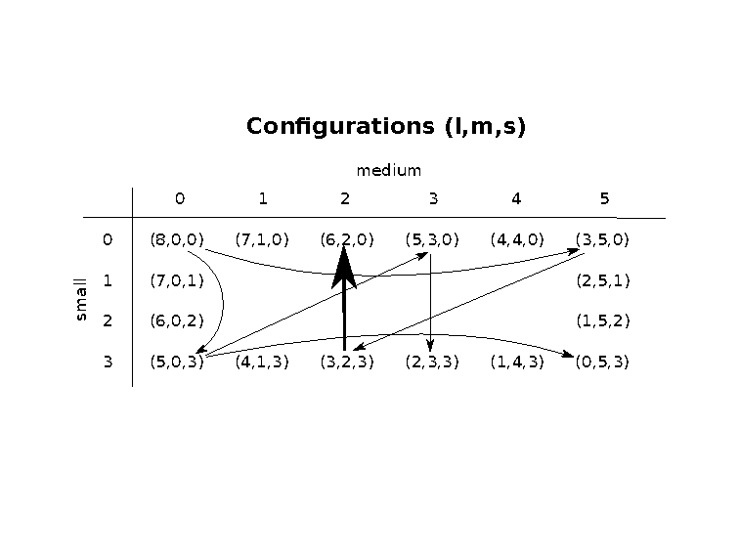

Slide 61
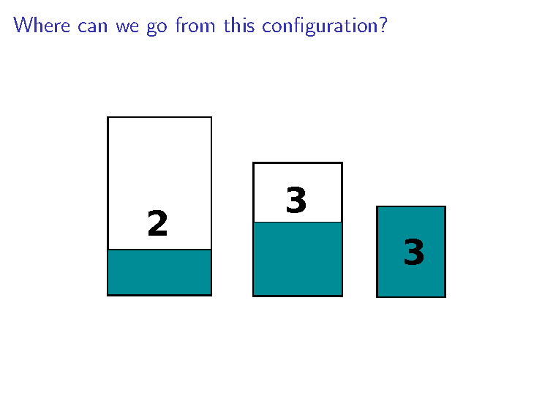

Slide 62
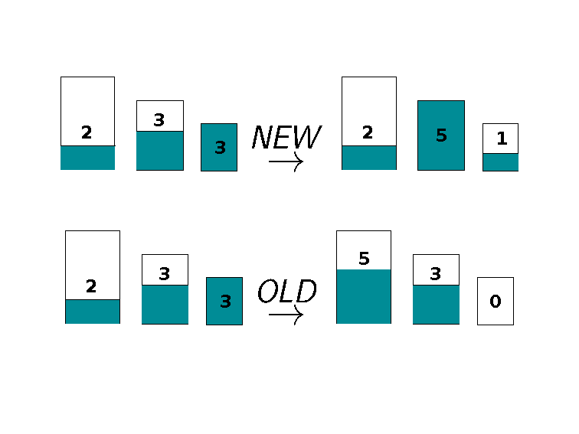

Slide 63
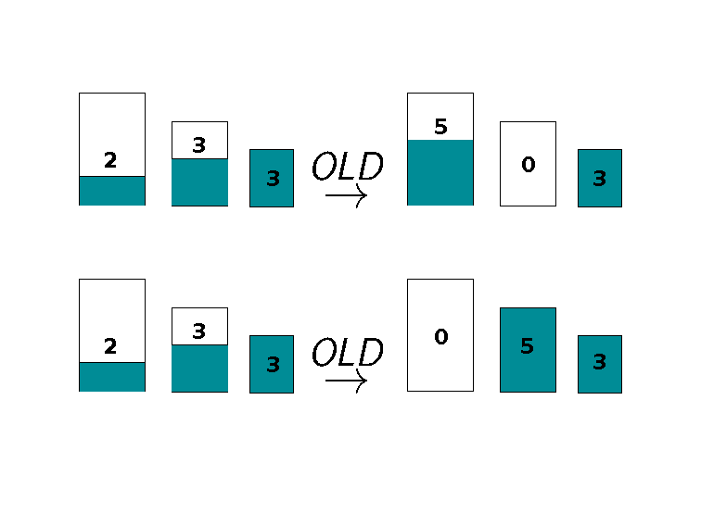

Slide 64
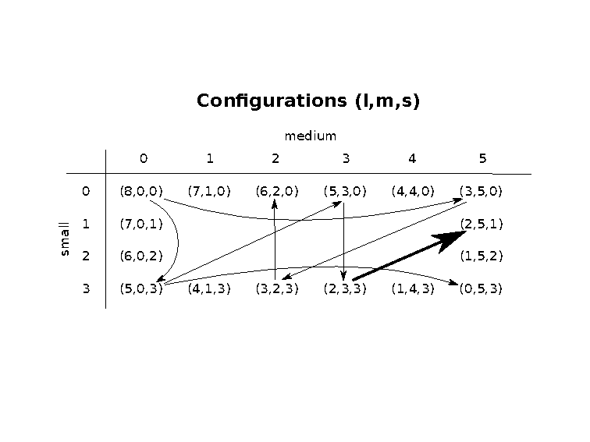

Slide 65
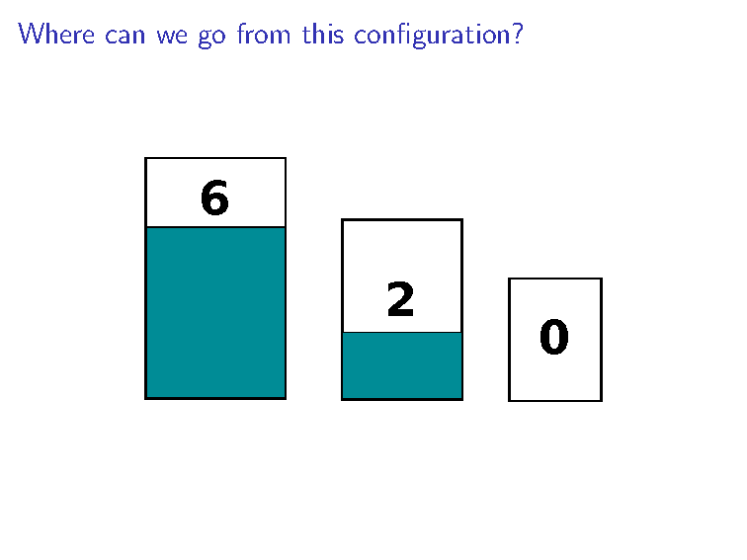

Slide 66
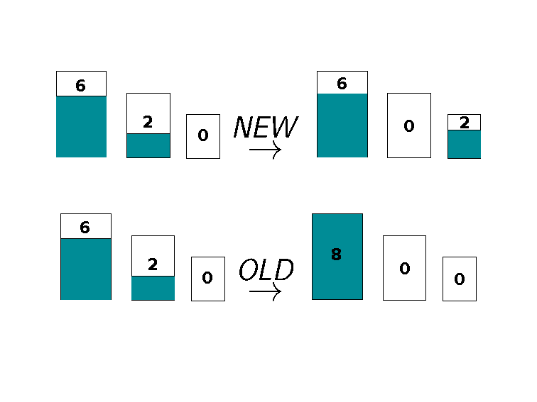

Slide 67


Slide 68


Slide 69


Slide 70


Slide 71


Slide 72


Slide 73


Slide 74


Slide 75


Slide 76


Slide 77


Slide 78


Slide 79


Slide 80


Slide 81


Slide 82


Slide 83


Slide 84


Slide 85


Slide 86


Slide 87


Slide 88


Slide 89


Slide 90


Slide 91


Slide 92


Slide 93


Slide 94


Slide 95
Graph reachability: WHAT
Given a directed graph
G and a start vertex s,
produce a list of all vertices v reachable from s by a directed path in G.

Slide 96
Graph reachability: HOW
Given a directed graph
G and a start vertex s,
produce a list of all vertices v reachable from s by a directed path in G.
At each point in a graph search algorithm, the vertices are partitioned into
X: eXplored
F: frontier (reached but haven't yet explored)
U: unreached

Slide 97
Graph reachability: HOW
procedure GraphSearch (G: directed graph, s: vertex)
Initialize X= empty, F = {s}, U = V – F.
While F is not empty:
Pick v in F.
For each neighbor u of v:
If u is not in X or F, then move u from U to F.
Move v from F to X.
Return X.

Slide 98
Graph reachability: HOW
procedure GraphSearch (G: directed graph, s: vertex)
Initialize X= empty, F = {s}, U = V – F.
While F is not empty:
Pick v in F.
For each neighbor u of v:
If u is not in X or F, then move u from U to F.
Move v from F to X.
Return X.
Before any iterations of while loop…
X = empty F = {(8,0,0)} U = green nodes
(6,2,0)
(6,0,2)
(1,5,2)
(1,4,3)
(3,2,3)
(4,4,0)
(3,5,0)
(8,0,0)
(0,5,3)
(5,0,3)
(2,3,3)
(2,5,1)
(7,0,1)
(7,1,0)
(4,1,3)
(5,3,0)

Slide 99
Graph reachability: HOW
procedure GraphSearch (G: directed graph, s: vertex)
Initialize X= empty, F = {s}, U = V – F.
While F is not empty:
Pick v in F.
For each neighbor u of v:
If u is not in X or F, then move u from U to F.
Move v from F to X.
Return X.
After first iteration of while loop…
v = (8,0,0)
X = {(8,0,0)} F = {(3,5,0), (5,0,3)} U = green nodes
(6,2,0)
(6,0,2)
(1,5,2)
(1,4,3)
(3,2,3)
(4,4,0)
(3,5,0)
(8,0,0)
(0,5,3)
(5,0,3)
(2,3,3)
(2,5,1)
(7,0,1)
(7,1,0)
(4,1,3)
(5,3,0)

Slide 100
Graph reachability: HOW
Different methods of choosing v give breadth-first search vs. depth-first search
procedure GraphSearch (G: directed graph, s: vertex)
Initialize X= empty, F = {s}, U = V – F.
While F is not empty:
Pick v in F.
For each neighbor u of v:
If u is not in X or F, then move u from U to F.
Move v from F to X.
Return X.
After second iteration of while loop…
v = (8,0,0)
X = {(8,0,0), (3,5,0)} F = {(3,2,3), (0,5,3) (5,0,3)}
(6,2,0)
(6,0,2)
(1,5,2)
(1,4,3)
(3,2,3)
(4,4,0)
(3,5,0)
(8,0,0)
(0,5,3)
(5,0,3)
(2,3,3)
(2,5,1)
(7,0,1)
(7,1,0)
(4,1,3)
(5,3,0)

Slide 101
Graph reachability: WHY
procedure GraphSearch (G: directed graph, s: vertex)
Initialize X= empty, F = {s}, U = V – F.
While F is not empty:
Pick v in F.
For each neighbor u of v:
If u is not in X or F, then move u from U to F.
Move v from F to X.
Return X.
Does this algorithm output the collection of vertices v
reachable from s by a directed path in G?

Slide 102
Graph reachability: WHY
procedure GraphSearch (G: directed graph, s: vertex)
Initialize X= empty, F = {s}, U = V – F.
While F is not empty:
Pick v in F.
For each neighbor u of v:
If u is not in X or F, then move u from U to F.
Move v from F to X.
Return X.
Does this algorithm output the collection of vertices v
reachable from s by a directed path in G?
Goal:
Every element of output X is reachable from s in G.
Every reachable vertex is in X (by end of algorithm).

Slide 103
Graph reachability: WHY
procedure GraphSearch (G: directed graph, s: vertex)
Initialize X= empty, F = {s}, U = V – F.
While F is not empty:
Pick v in F.
For each neighbor u of v:
If u is not in X or F, then move u from U to F.
Move v from F to X.
Return X.
Claim: After t^{th} iteration through while loop, every element of
(current version of) X or F is reachable from s in G.
Proof by induction on t.

Slide 104
Graph reachability: WHY
procedure GraphSearch (G: directed graph, s: vertex)
Initialize X= empty, F = {s}, U = V – F.
While F is not empty:
Pick v in F.
For each neighbor u of v:
If u is not in X or F, then move u from U to F.
Move v from F to X.
Return X.
Claim: After t^{th} iteration through while loop, every element of
(current version of) X or F is reachable from s in G.
Base case (t=0):
Before any iterations of loop, X is initialized as empty
and F is initialized as {s}. WTS s is reachable from s in G. ☺

Slide 105
Graph reachability: WHY
procedure GraphSearch (G: directed graph, s: vertex)
Initialize X= empty, F = {s}, U = V – F.
While F is not empty:
Pick v in F.
For each neighbor u of v:
If u is not in X or F, then move u from U to F.
Move v from F to X.
Return X.
Claim: After t^{th} iteration through while loop, every element of
(current version of) X or F is reachable from s in G.
Induction step: Suppose after t^{th} iteration,
every element of X or F is reachable from s in G.
What happens in t+1st iteration?

Slide 106
Graph reachability: WHY
procedure GraphSearch (G: directed graph, s: vertex)
Initialize X= empty, F = {s}, U = V – F.
While F is not empty:
Pick v in F.
For each neighbor u of v:
If u is not in X or F, then move u from U to F.
Move v from F to X.
Return X.
ADD neighbors of v to F
MOVE v from F to X
Claim: After t^{th} iteration through while loop, every element of
(current version of) X or F is reachable from s in G.
Induction step: Suppose that after t^{th} iteration,
every element of X or F is reachable from s in G.
What happens in t+1st iteration? ☺

Slide 107
Graph reachability: WHY
procedure GraphSearch (G: directed graph, s: vertex)
Initialize X= empty, F = {s}, U = V – F.
While F is not empty:
Pick v in F.
For each neighbor u of v:
If u is not in X or F, then move u from U to F.
Move v from F to X.
Return X.
ADD neighbors of v to F
MOVE v from F to X
Claim: After t^{th} iteration through while loop, every element of
(current version of) X or F is reachable from s in G.
Using Claim to prove Goal 1: After the final iteration, output X,
which by claim, only contains vertices that are reachable from s.

Slide 108
Graph reachability: WHY
procedure GraphSearch (G: directed graph, s: vertex)
Initialize X= empty, F = {s}, U = V – F.
While F is not empty:
Pick v in F.
For each neighbor u of v:
If u is not in X or F, then move u from U to F.
Move v from F to X.
Return X.
Does this algorithm output the collection of vertices v
reachable from s by a directed path in G?
Goal:
Every element of output X is reachable from s in G. ☺
Every reachable vertex is in X (by end of algorithm).

Slide 109
Graph reachability: WHY
procedure GraphSearch (G: directed graph, s: vertex)
Initialize X= empty, F = {s}, U = V – F.
While F is not empty:
Pick v in F.
For each neighbor u of v:
If u is not in X or F, then move u from U to F.
Move v from F to X.
Return X.
WTS Goal 2: Every reachable vertex is in X.
Hint: assume, towards a contradiction that some vertex
is reachable from s but not in X.
Look for first vertex on the path between s that is not in X.

Slide 110
Graph reachability: WHEN
procedure GraphSearch (G: directed graph, s: vertex)
Initialize X= empty, F = {s}, U = V – F.
While F is not empty:
Pick v in F.
For each neighbor u of v:
If u is not in X or F, then move u from U to F.
Move v from F to X.
Return X.
How long does it take to pick v in F?
How long does it take to iterate over neighbors of v?
Need to know some implementation decisions.

Slide 111
Graph reachability: WHEN
procedure GraphSearch (G: directed graph, s: vertex)
Initialize X= empty, F = {s}, U = V – F.
While F is not empty:
Pick v in F.
For each neighbor u of v:
If u is not in X or F, then move u from U to F.
Move v from F to X.
Return X.
Assume G stored as adjacency list.
Assume have array Status[]
* length n array
* each entry either F, X, U
What's an upper bound on the time it takes to
do one iteration of the body of the for loop?
O( n² )
O(n)
O( degree (v) )
O( |F| )
None of the above.

Slide 112
Graph reachability: WHEN
procedure GraphSearch (G: directed graph, s: vertex)
Initialize X= empty, F = {s}, U = V – F.
While F is not empty:
Pick v in F.
For each neighbor u of v:
If u is not in X or F, then move u from U to F.
Move v from F to X.
Return X.
Assume G stored as adjacency list.
Assume have array Status[]
* length n array
* each entry either F, X, U
What's an upper bound on the time it takes to
go through the whole for loop for a given v?
O( n² )
O(n)
O( degree (v) )
O( |F| )
None of the above.

Slide 113
Graph reachability: WHEN
procedure GraphSearch (G: directed graph, s: vertex)
Initialize X= empty, F = {s}, U = V – F.
While F is not empty:
Pick v in F.
For each neighbor u of v:
If u is not in X or F, then move u from U to F.
Move v from F to X.
Return X.
Assume G stored as adjacency list.
Assume have array Status[]
* length n array
* each entry either F, X, U
What's an upper bound on the time
spent on the for loop throughout
the whole algorithm?
O( n )
O( |V| )
O( |E| )
O( |F| )
None of the above.

Slide 114
Graph reachability: WHEN
procedure GraphSearch (G: directed graph, s: vertex)
Initialize X= empty, F = {s}, U = V – F.
While F is not empty:
Pick v in F.
For each neighbor u of v:
If u is not in X or F, then move u from U to F.
Move v from F to X.
Return X.
Assume G stored as adjacency list.
Assume have array Status[]
* length n array
* each entry either F, X, U
Total time is asymptotically upper bounded by sum of degrees
of all vertices
i.e. O (2 |E| )
i.e. O( |E| )

