Slide 1

PROJECT -2
Hydrometry: CE-738A
SOIL MOISTURE
2022-2023
DEPARTMENT OF CIVIL ENGINEER
HYDRAULICS AND WATER RESOURCES ENGINEERING
Course Instructor: Presented by:
Dr. Shivam Tripathi Sahil Agrawal and Ranjan Kumar
Monday, November 14, 2022

Slide 2
TABLE OF CONTENTS
INTRODUCTION
VARIOUS SENSOR TO MEASURE SM
LISTS OF COMPONENTS
CIRCUIT DIAGRAM
SEQUENCE OF PROCESSES
UNCERTAINTY ANALYSIS
LIMITATIONS
REFERENCES

Slide 3
1. INTRODUCTION
Soil moisture represents the water content present in the soil
It is a key variable in controlling the exchange of water and heat energy between the land surface and the atmosphere through transpiration and evaporation.
Monitoring soil moisture helps to detect the health of the plant.
Can be measured by direct and indirect methods.
Direct methods includes: gravimetric and volumetric
Indirect methods includes : the applications of electromagnetic or electrical properties calibrated to get soil moisture.
We have used resistive soil moisture sensor which is calibrated with the direct method- volumetric moisture content.

Slide 4
2. VARIOUS SENSORS USED TO MEASURE SM
A) Resistive soil moisture sensor
Measures the conductivity of the soil and describes water content.
B) Capacitive soil moisture sensor
Measures the ions present in the soil.
C) Neutron probe
Detects SM in its Sphere of influence
D) Electromagnetic sensor (
E) Tensiometers
F) GNSS based SM sensor
IN OUR PROJECT WE HAVE USED RESISTIVE SOIL MOISTURE SENSOR.

Slide 5
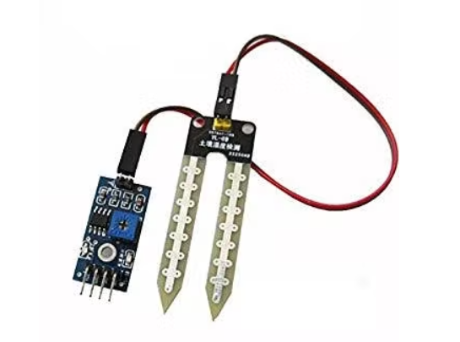
Resistive soil moisture sensor
The sensor consists of two probes which are used to measure the volumetric content of water.
The two probes allow the DC current to pass through the soil and then it gets the resistance value to measure the moisture value.
Soil moisture varies linearly with the resistance value
Corrosion occurs as there is a DC current flowing which causes electrolysis of the sensors decreasing its efficiency.
Resistive soil moisture sensor can give faulty values if some fertilizers were added to the soil which increases its conductivity without much water present in it.

Slide 6
3. LIST OF COMPONENTS
ARDUINO UNO
ESP8266 WIFI MODULE
HW-080 RESITIVE SM SENSOR
DS1307 RTC I2C MODULE
SD CARD MODULE
DHT22 SENSOR

Slide 7
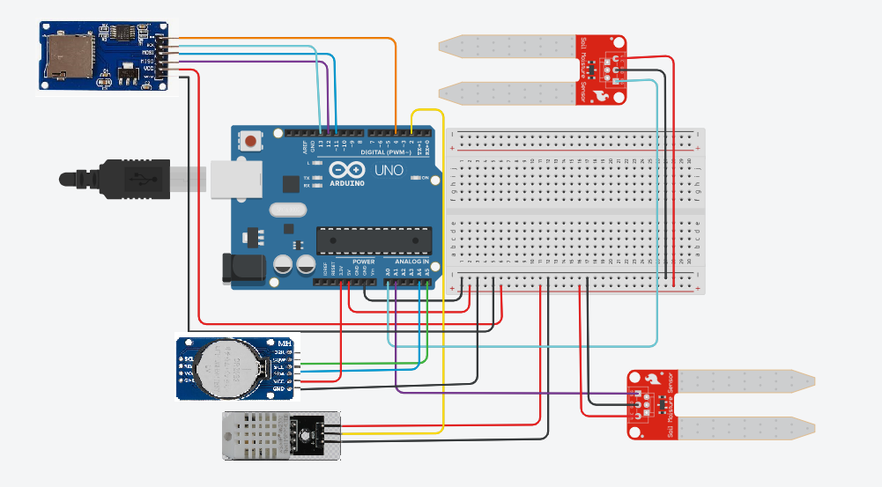
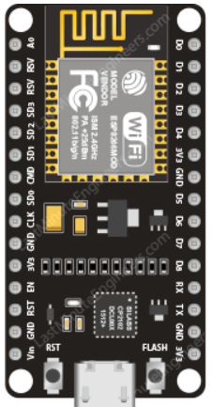
4. CIRCUIT DIAGRAM
Resistive soil moisture sensor
Sd card module
ESP8266 WIFI MODULE
RTC
DHT22
Resistive soil moisture sensor

Slide 8
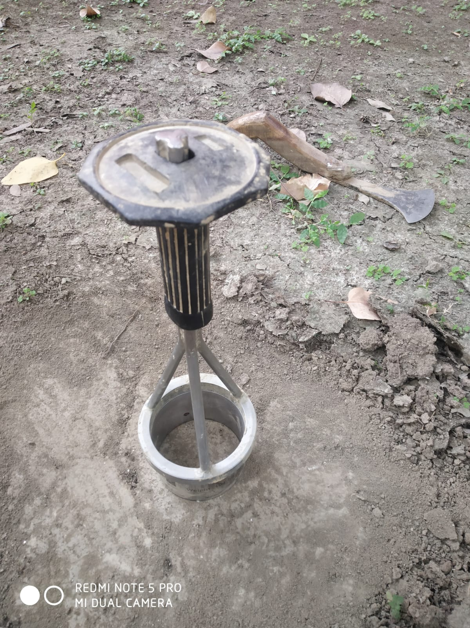
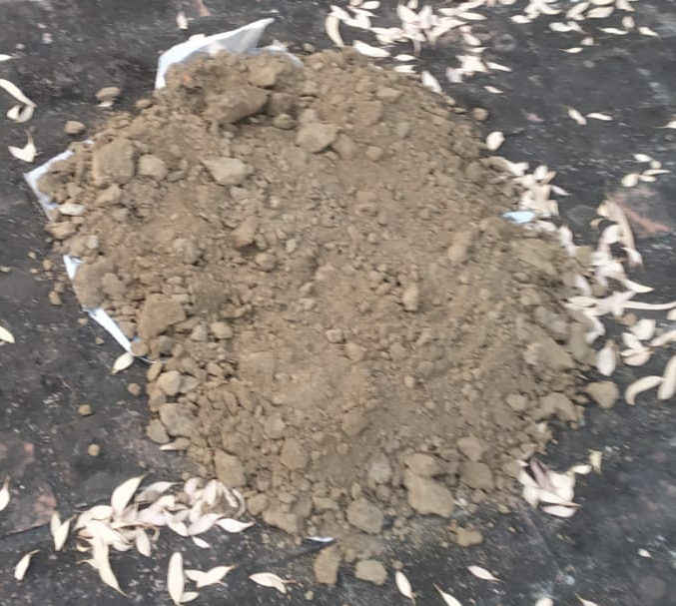
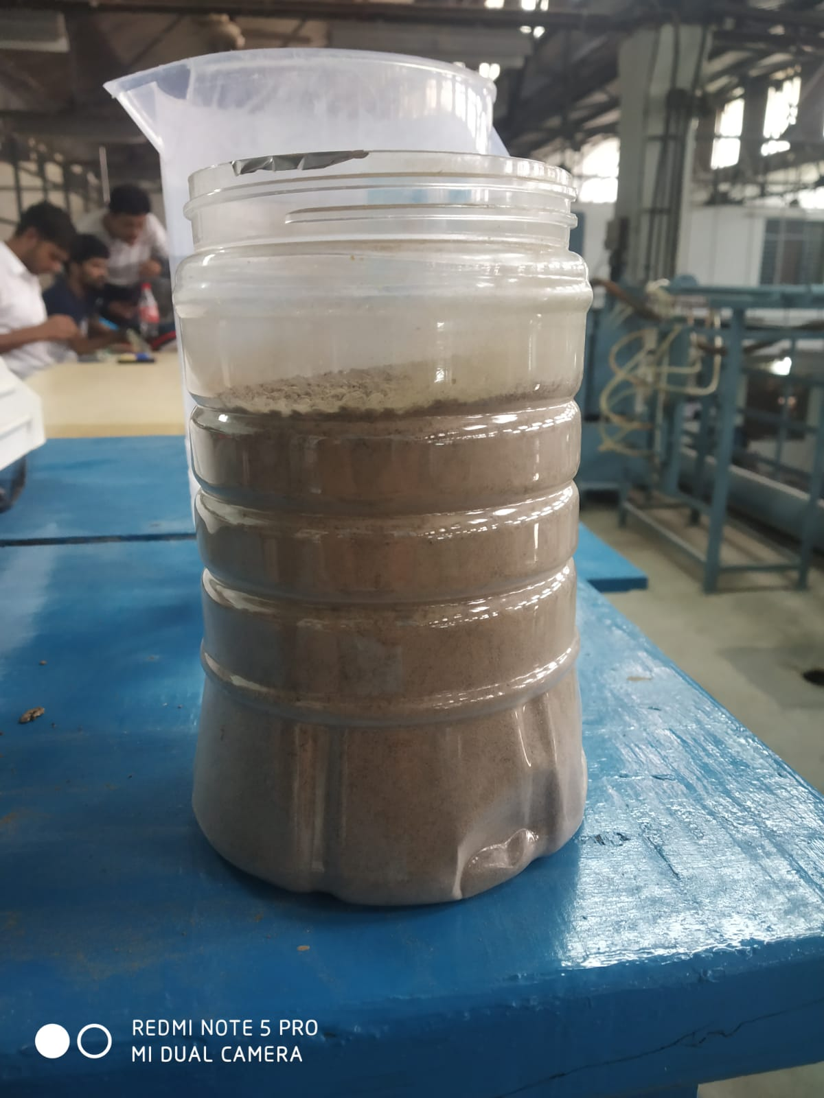
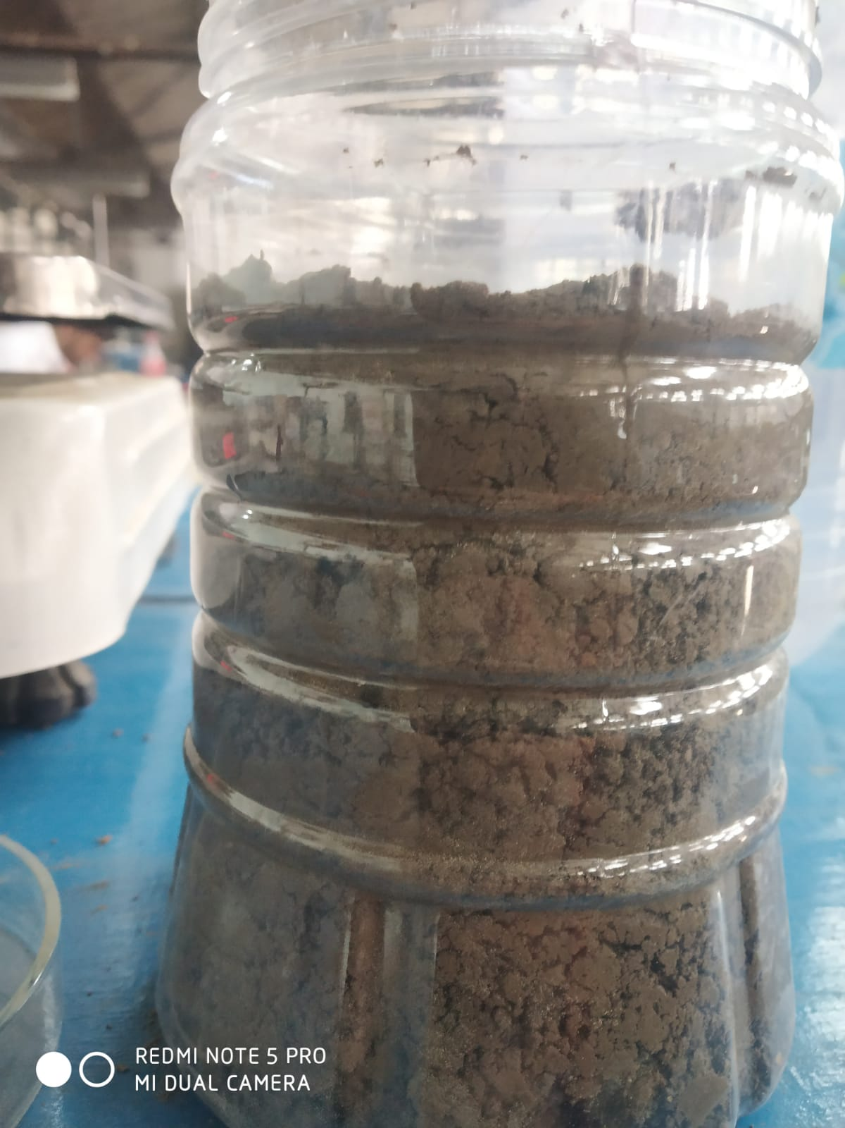
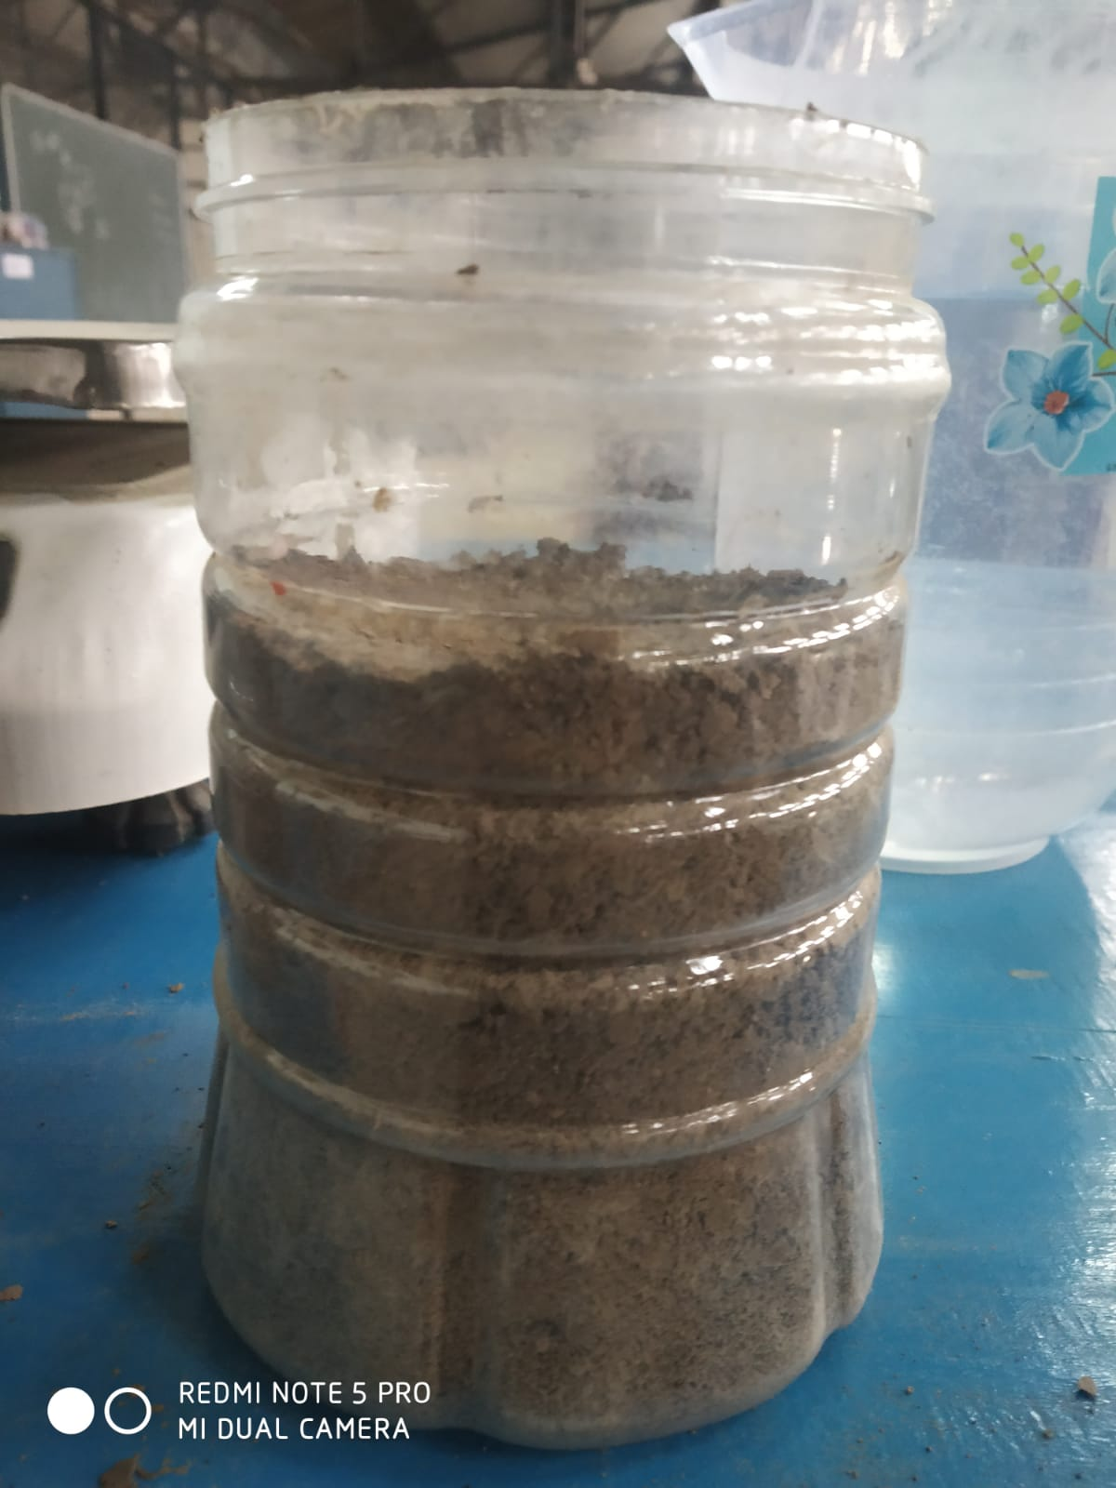
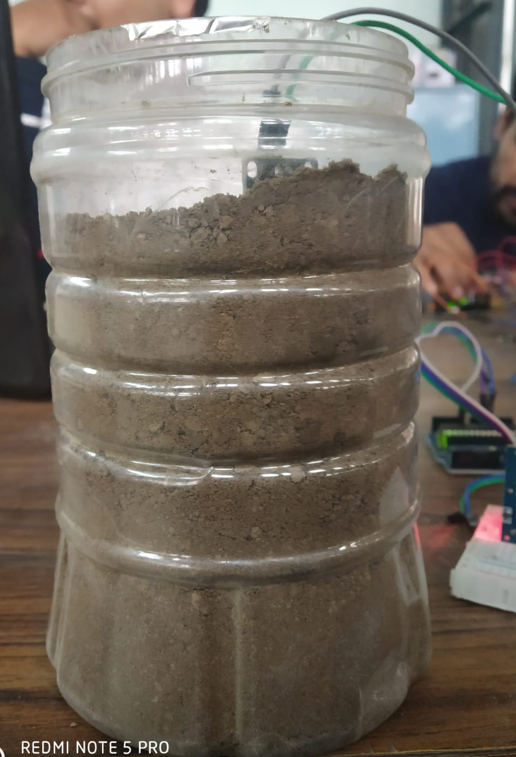
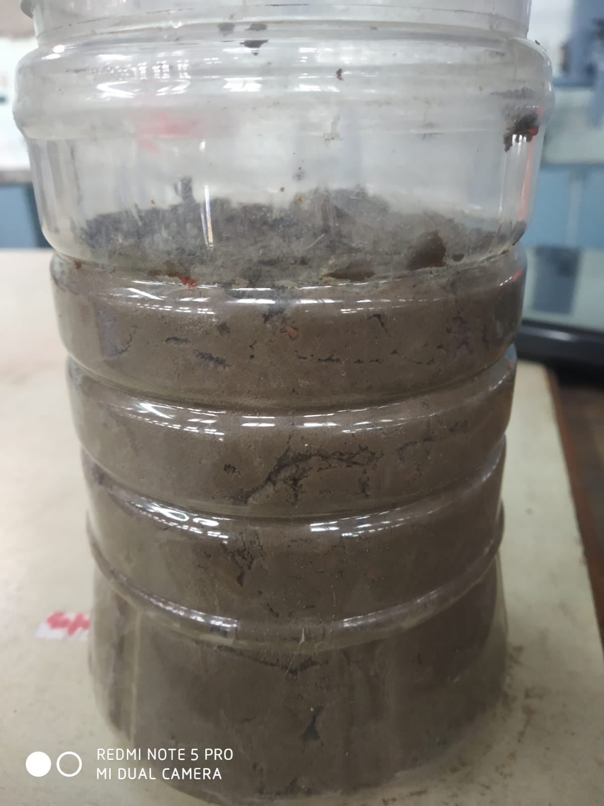
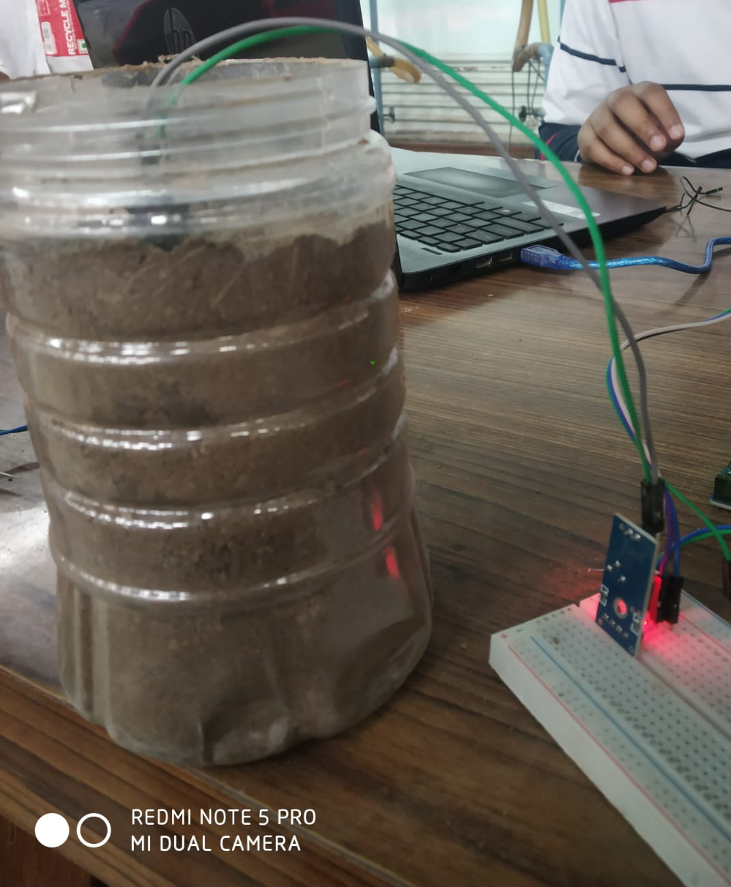
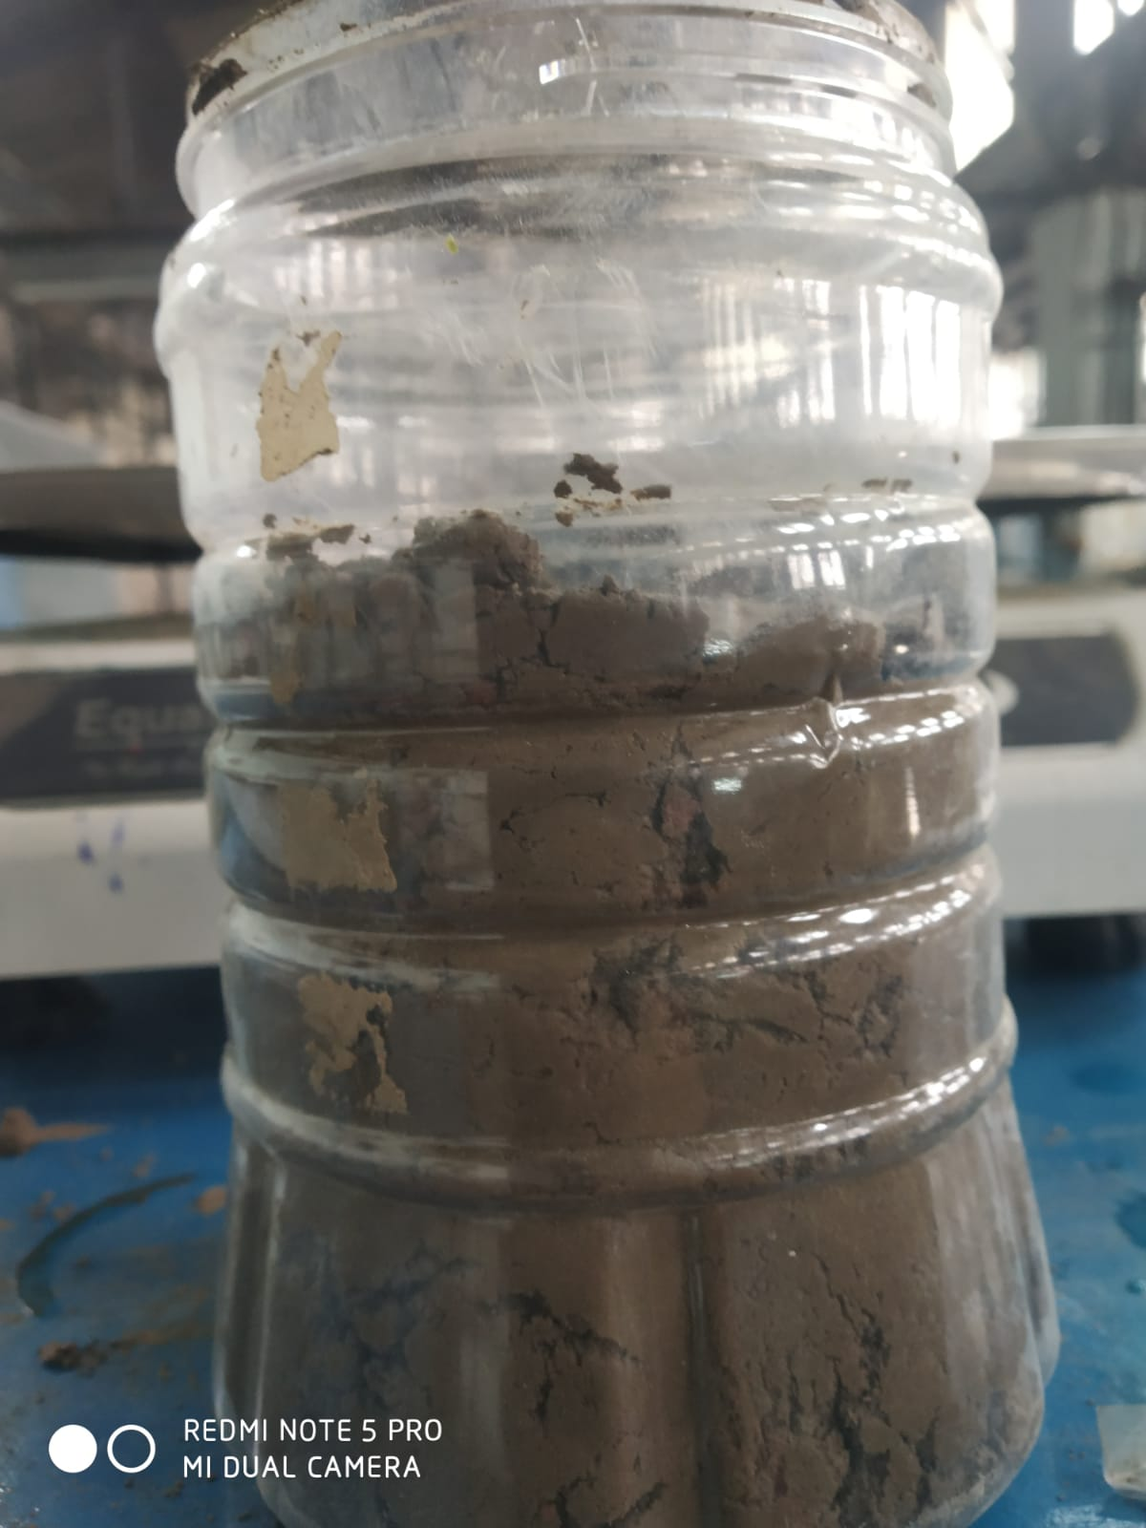
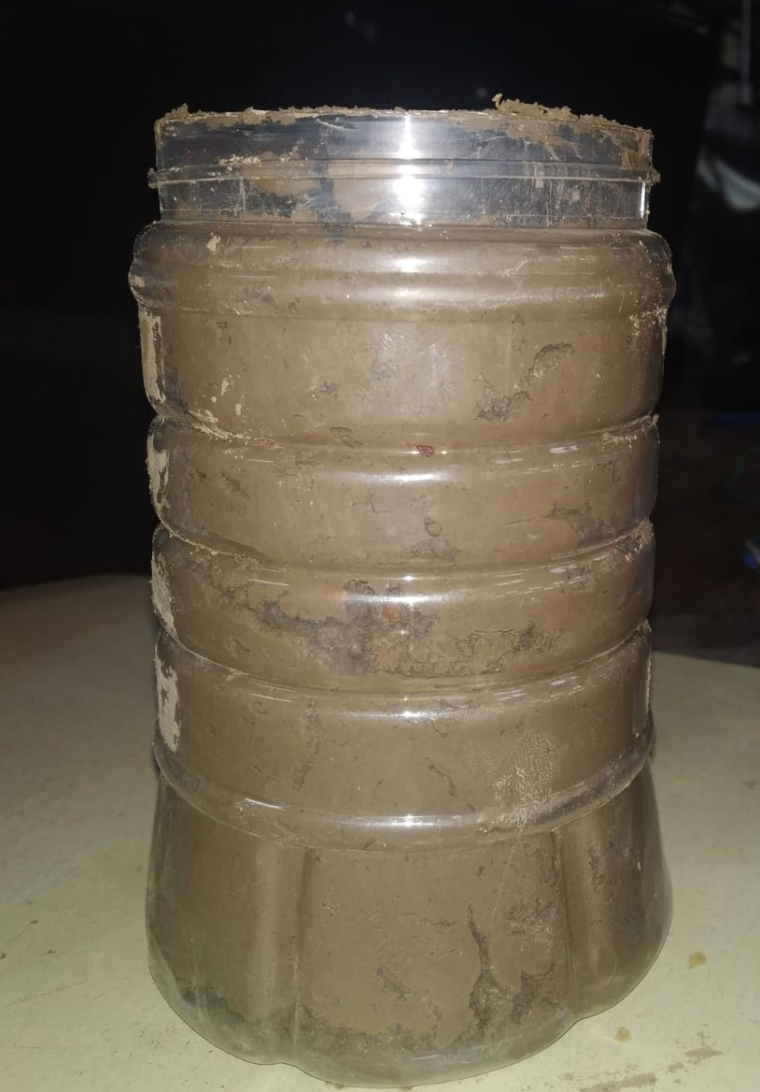
5. SEQUENCE OF PROCECSS
Calibration includes:
Find bulk density of the soil
Take sample of the soil and air dry it
Make different containers with different water content in them.
Use sensor and note the reading and then test a small sample size for gravimetric moisture content by oven drying the sample for 24hours at 105°C.
Then calibrate the sensor with the volumetric moisture content.
Find the uncertainty in calibration constants.

Slide 9
Bulk density
$$\frac{dry weight of soil}{total volume of soil}$$
(𝑑𝑟𝑦 𝑤𝑒𝑖𝑔ℎ𝑡 𝑜𝑓 𝑠𝑜𝑖𝑙)/(𝑡𝑜𝑡𝑎𝑙 𝑣𝑜𝑙𝑢𝑚𝑒 𝑜𝑓 𝑠𝑜𝑖𝑙)
Gravimetric moisture content
$$\frac{weight of water}{total dry weight}$$
(𝑤𝑒𝑖𝑔ℎ𝑡 𝑜𝑓 𝑤𝑎𝑡𝑒𝑟)/(𝑡𝑜𝑡𝑎𝑙 𝑑𝑟𝑦 𝑤𝑒𝑖𝑔ℎ𝑡)
Volumetric moisture content.
Bulk density*gmc
= $\frac{dry weight of soil}{total volume}∗\frac{weight of water }{total dry weight}$
= $\frac{weight of water}{total volume of soil}∗100\%$
Bulk density*gmc
= (𝑑𝑟𝑦 𝑤𝑒𝑖𝑔ℎ𝑡 𝑜𝑓 𝑠𝑜𝑖𝑙)/(𝑡𝑜𝑡𝑎𝑙 𝑣𝑜𝑙𝑢𝑚𝑒)∗(𝑤𝑒𝑖𝑔ℎ𝑡 𝑜𝑓 𝑤𝑎𝑡𝑒𝑟 )/(𝑡𝑜𝑡𝑎𝑙 𝑑𝑟𝑦 𝑤𝑒𝑖𝑔ℎ𝑡)
= (𝑤𝑒𝑖𝑔ℎ𝑡 𝑜𝑓 𝑤𝑎𝑡𝑒𝑟)/(𝑡𝑜𝑡𝑎𝑙 𝑣𝑜𝑙𝑢𝑚𝑒 𝑜𝑓 𝑠𝑜𝑖𝑙)∗100%

Slide 10
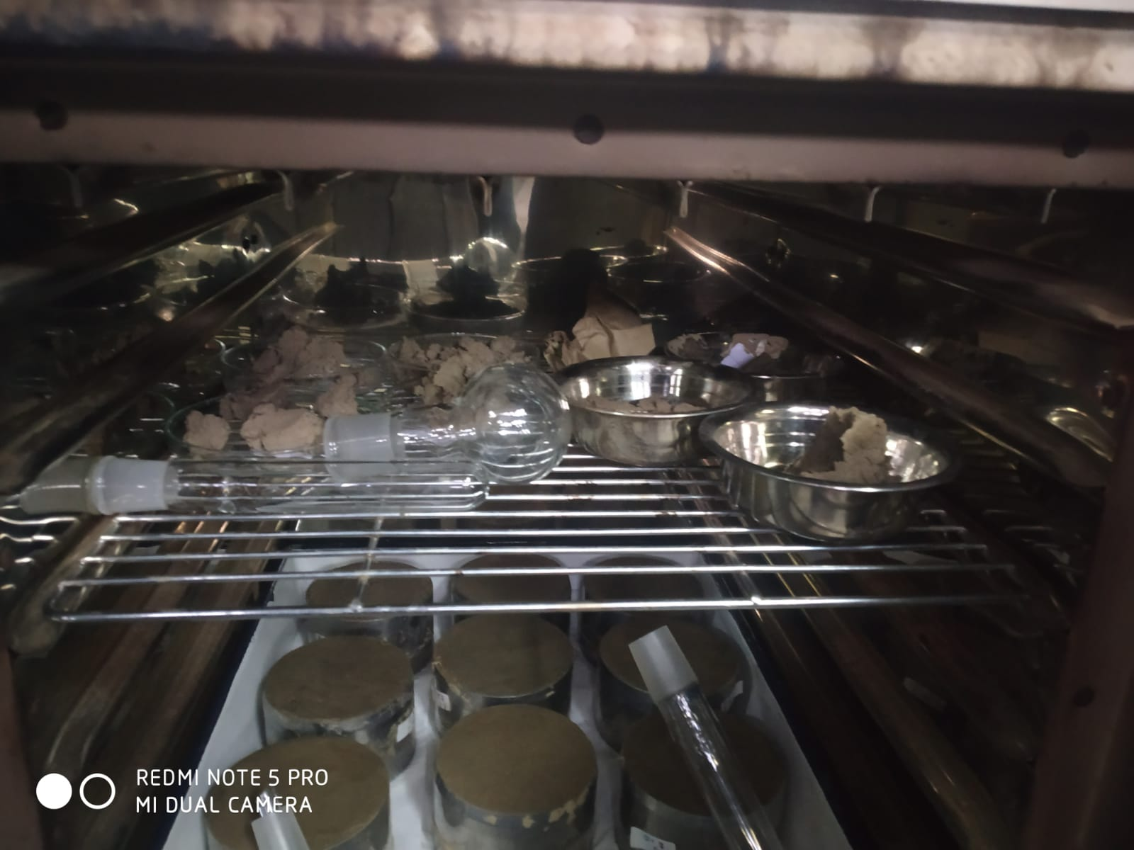
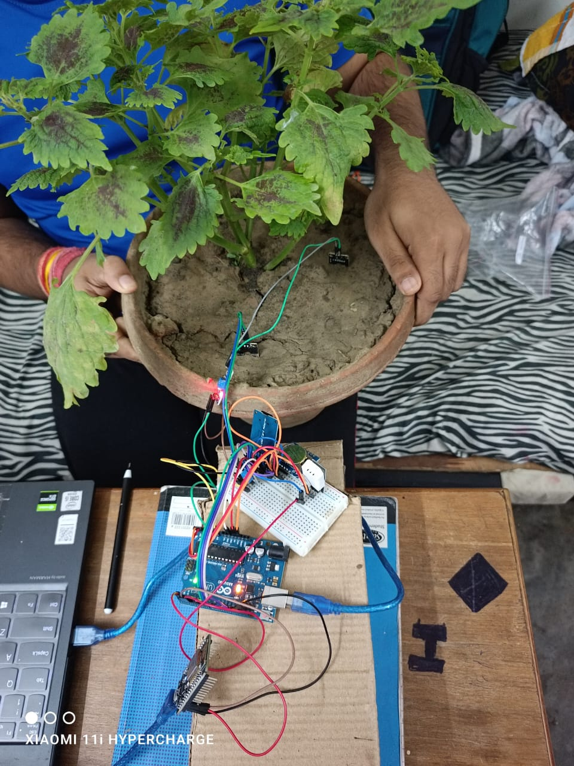
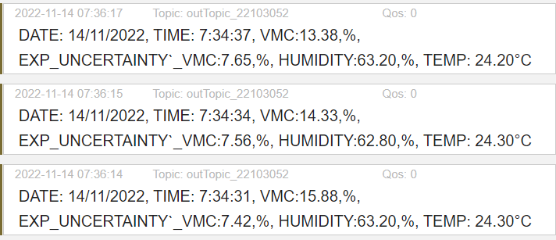
After the calibration
Setup the circuit to measure the soil moisture in a plant
Take sensor reading as the average of 10 continuous reading and consider the uncertainty associated
With all the uncertainty , find uncertainty in the final VMC.
Save the data in SD card, server, display on thingsspeak, using python code store it in postgres.

Slide 11
6. UNCERTAINTY ANALYSIS
Bulk Density
2 samples
Repeatability
Gravimetric soil moisture content
9 samples
Repeatability
Volumetric moisture content
9 samples
= bulk density* gravimetric SMC

Slide 12
Sensor data
Sensor 1
Sensor 2
10 Readings for each sample
9 samples
Corresponding 10 repeatability values
Uncertainty in sensor value
Standard error
Standard deviation/sqrt(n)

Slide 13
Calibration of sensors
Sensor 1 eq.
Sensor 2 eq.
Select the region where R² close to 1
After leaving the value of sample 1 and 9 we get

Slide 14
calibration
Modification of the data showed us the better linear regression model
It also implies that our soil moisture sensor gives better results for soil moisture in the range of sample 2 to sample 9
Why linear regression
If we go for polynomial/power regression line, we get best fit equation for all sample.
but the voltage measure varies linear with the moisture present in the soil.
What we get.
We got equation to calculate the volumetric moisture content with the sensor readings
Therefore from excel we get regression analysis, stating the uncertainty in slope and intercept value.

Slide 15
Calibration equation
Vmc1 = m1*(SR1)+I1
Vmc2 = m2*(SR2)+I2
Uncertainty in m1,m2 and i1,i2 are known
SR1,SR2 are the average value of 10 values and uncertainty for SR will be the standard error.
With the known values we can calculate the uncertainty in the Vmc1 and Vmc2 by applying quadrature method for the known linear measurement model.
Final VMC = (Vmc1+Vmc2)/2
Combined Uncertainty of this model is calculated by quadrature method and a coverage factor is multiplied for the expanded uncertainty.

Slide 16
7. LIMITATION
The soil moisture sensor used gives point based results which has lower influence volume.
The resistive soil moisture sensor reading is related to the volumetric moisture content, therefore it requires bulk density in calibration which binds the sensor to give moisture content of soil with known bulk density.
Sensor is highly prone to electrolysis and corrosion because of the salt present.
No immediate change is observed in reading with change in moisture content, late response.
Sensor is highly inaccurate.
In uncertainty analysis all factors are not considered.

Slide 17
8. REFERENCES
LECTURE SLIDES
CLASS NOTES
TINKERCAD
https://forum.arduino.cc/

Slide 18
THANK YOU

