Slide 1


Introduction to Apache Flink
Stream Processing for Real-Time Applications
Author: Sahil Appayev

Slide 2
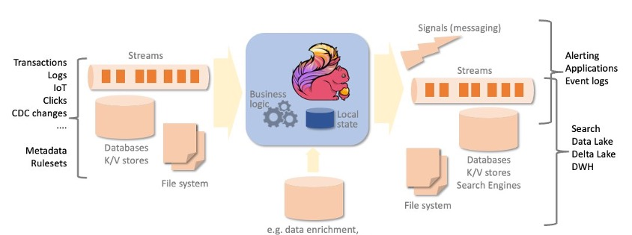
What is Apache Flink?
Open-source stream processing framework
Designed for high-throughput, low-latency data processing
Supports both batch and stream processing (unified API)
Distributed and fault-tolerant
Ideal for real-time analytics and event-driven applications

Slide 3
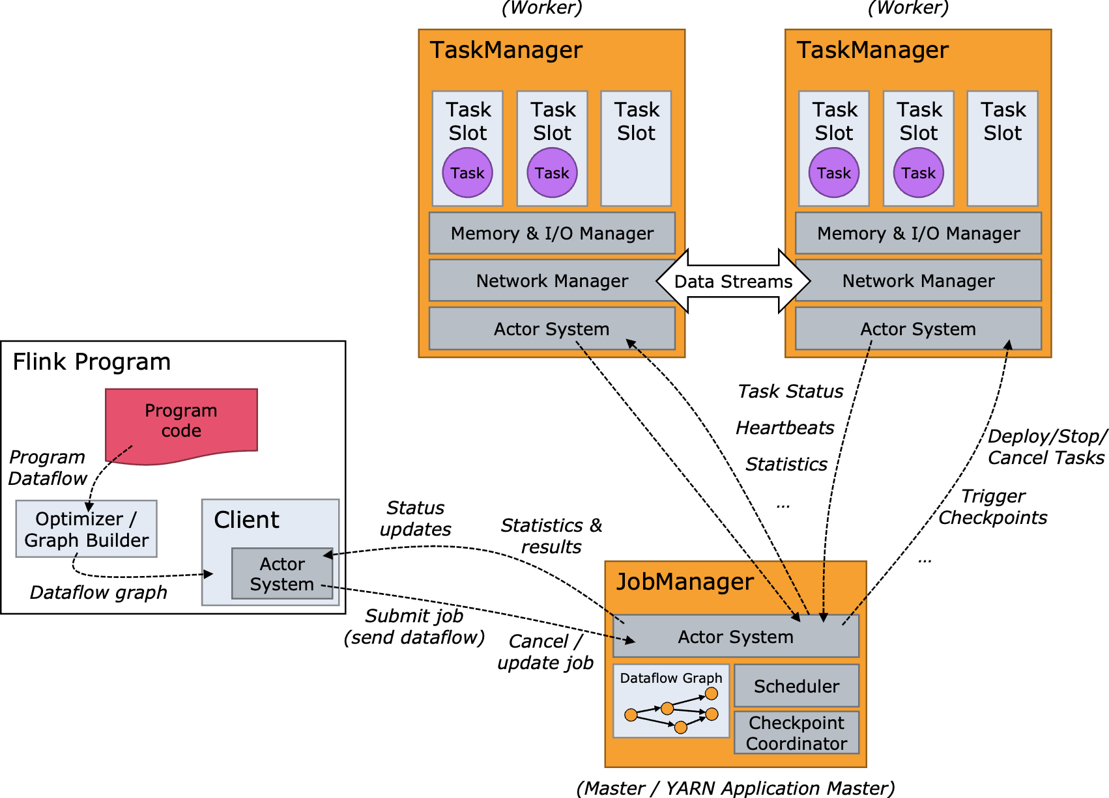
Apache Flink Architecture
JobManager: Coordinates distributed execution
TaskManagers: Execute tasks and manage state
Checkpointing: Ensures fault tolerance
State Backend (RocksDB, memory): Manages application state
Connectors: Kafka, JDBC, Filesystems, etc.

Slide 4
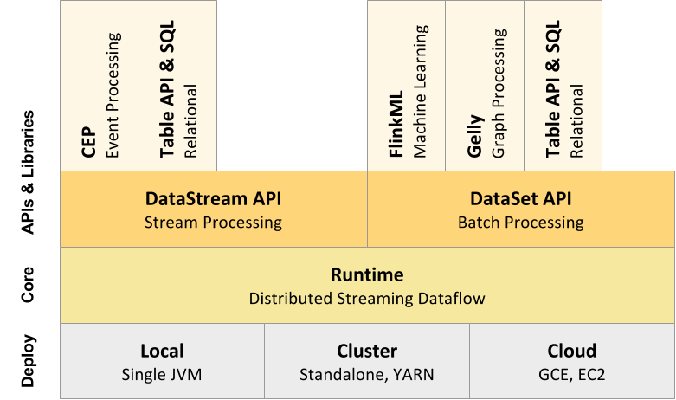
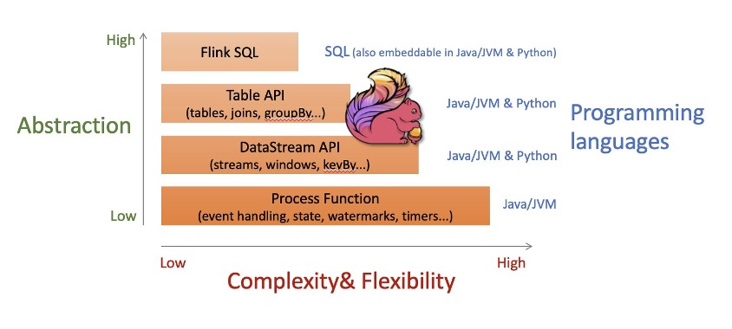
Core Components
DataStream API: For real-time stream processing
DataSet API (legacy): For batch processing
Table & SQL API: Declarative processing
CEP (Complex Event Processing): Pattern detection
Flink ML: Machine learning on streams
Stateful Functions: Event-driven microservices

Slide 5
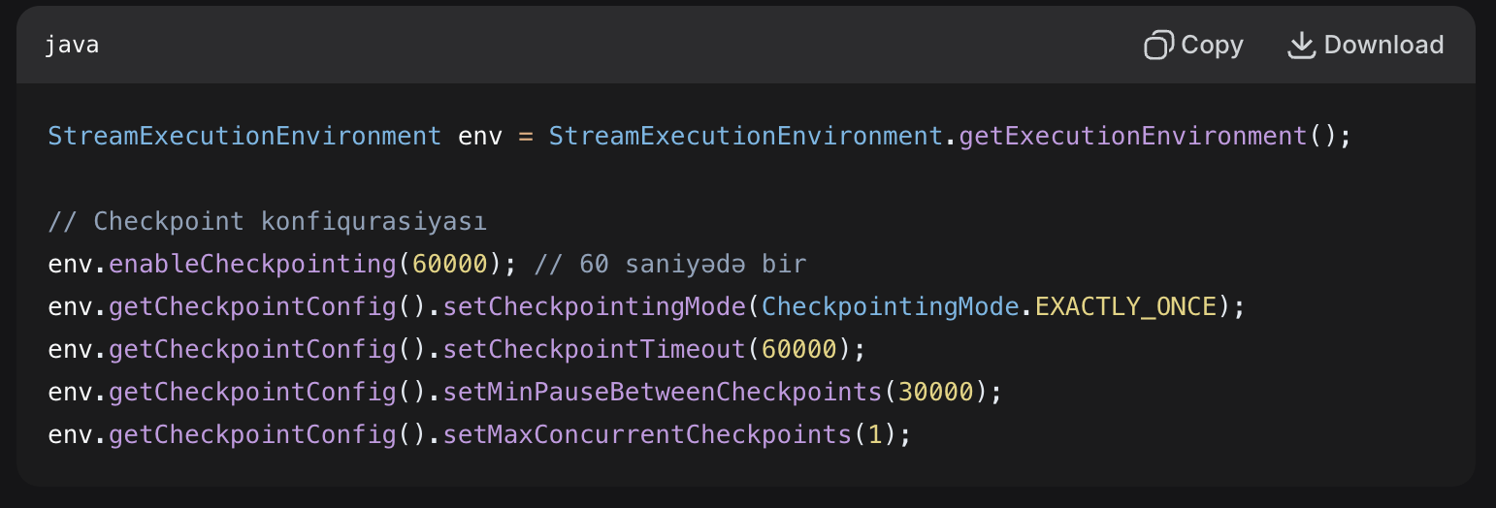
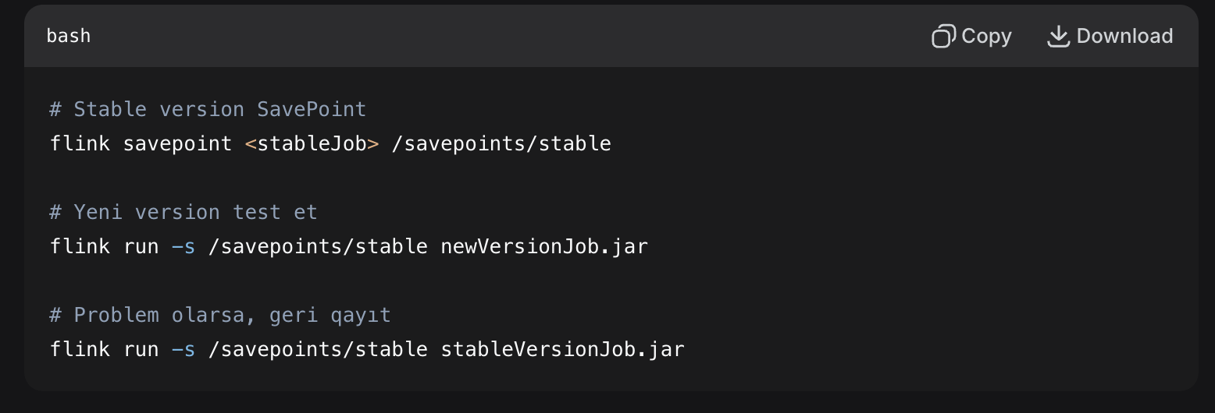
Fault Tolerance
Checkpoints
Automatically created (based on configuration)
Used for fault recovery
Temporarily stored
Design goal: To return the job to the correct state during failover
Savepoints
Manually triggered
Long-term storage
Can be used for Flink version upgrade
Used for job stop/restart

Slide 6
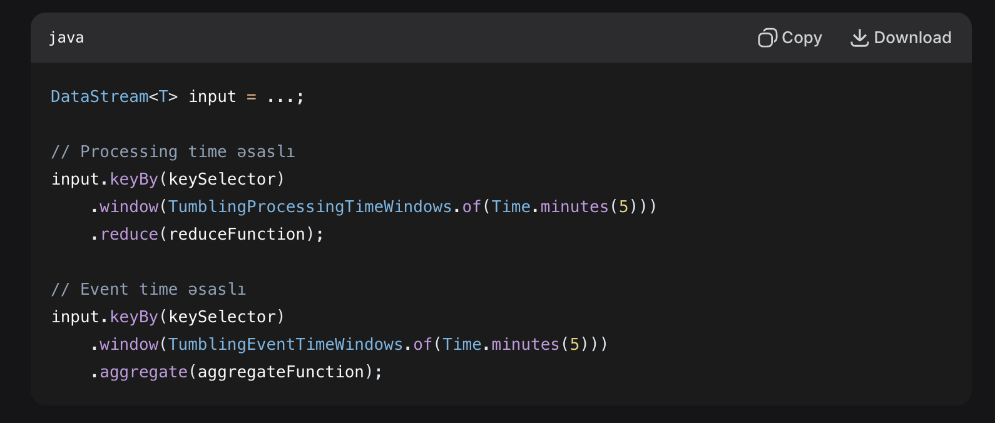
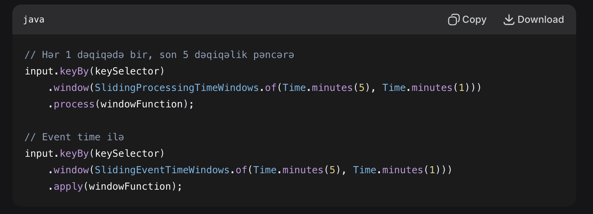
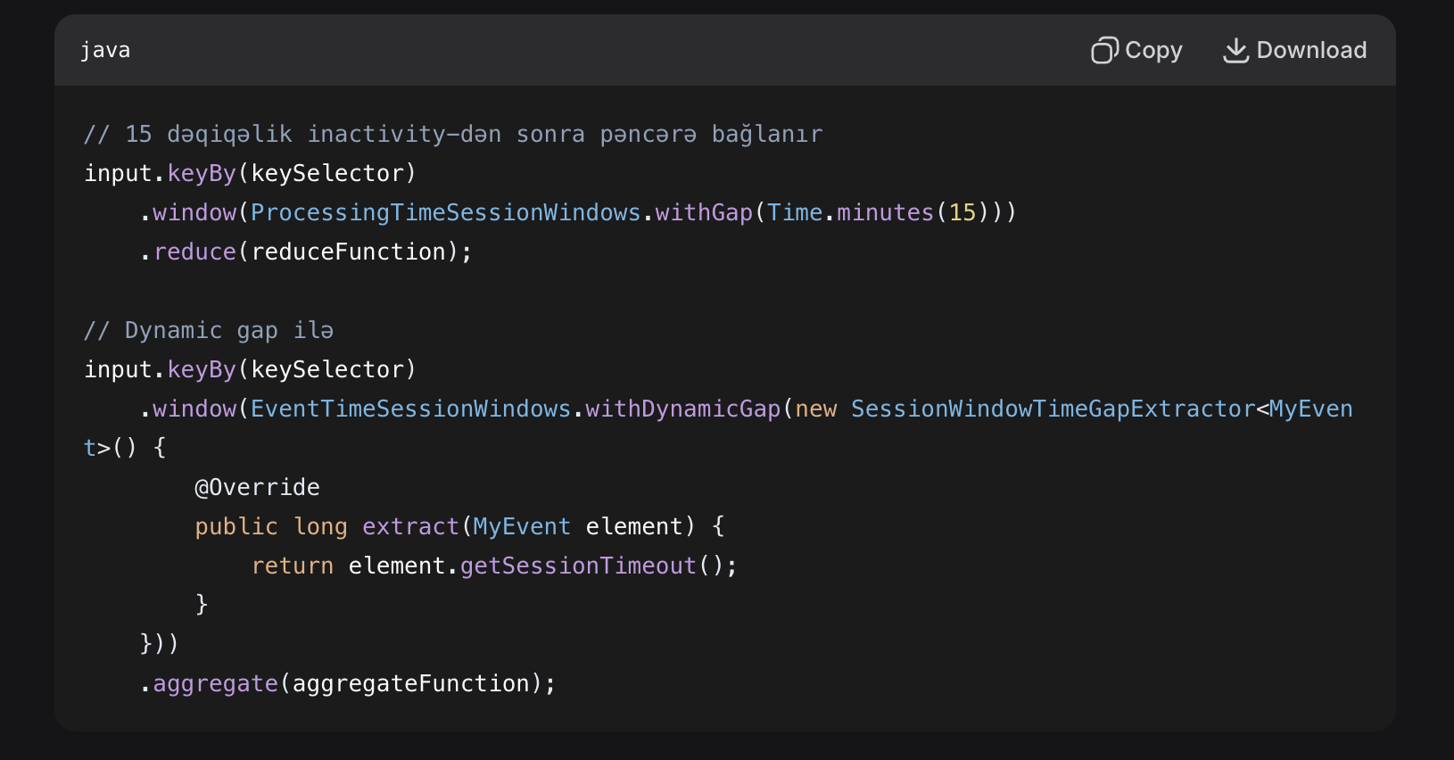
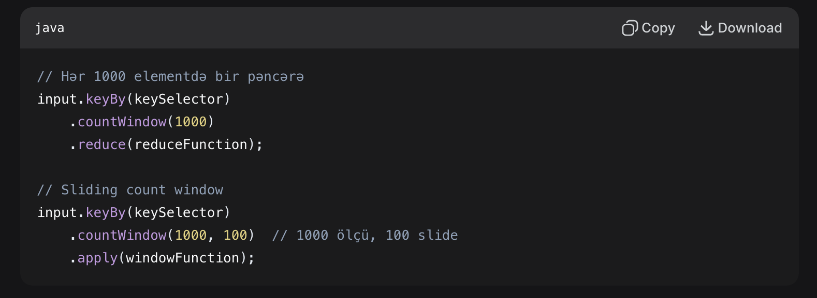
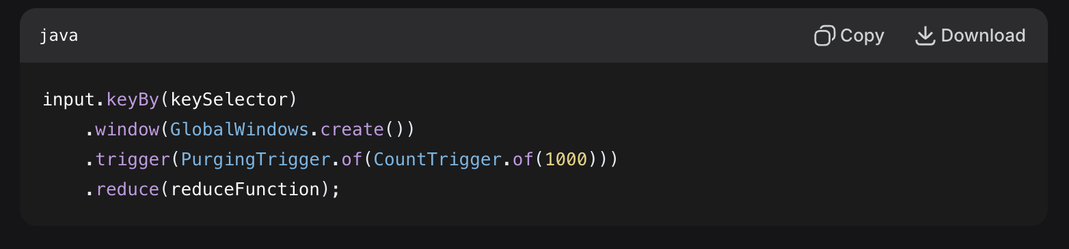
Windowing
Time-based Windows
- Tumbling Windows
- Sliding Windows
- Session Windows
Count-based Windows
Global Windows

Slide 7
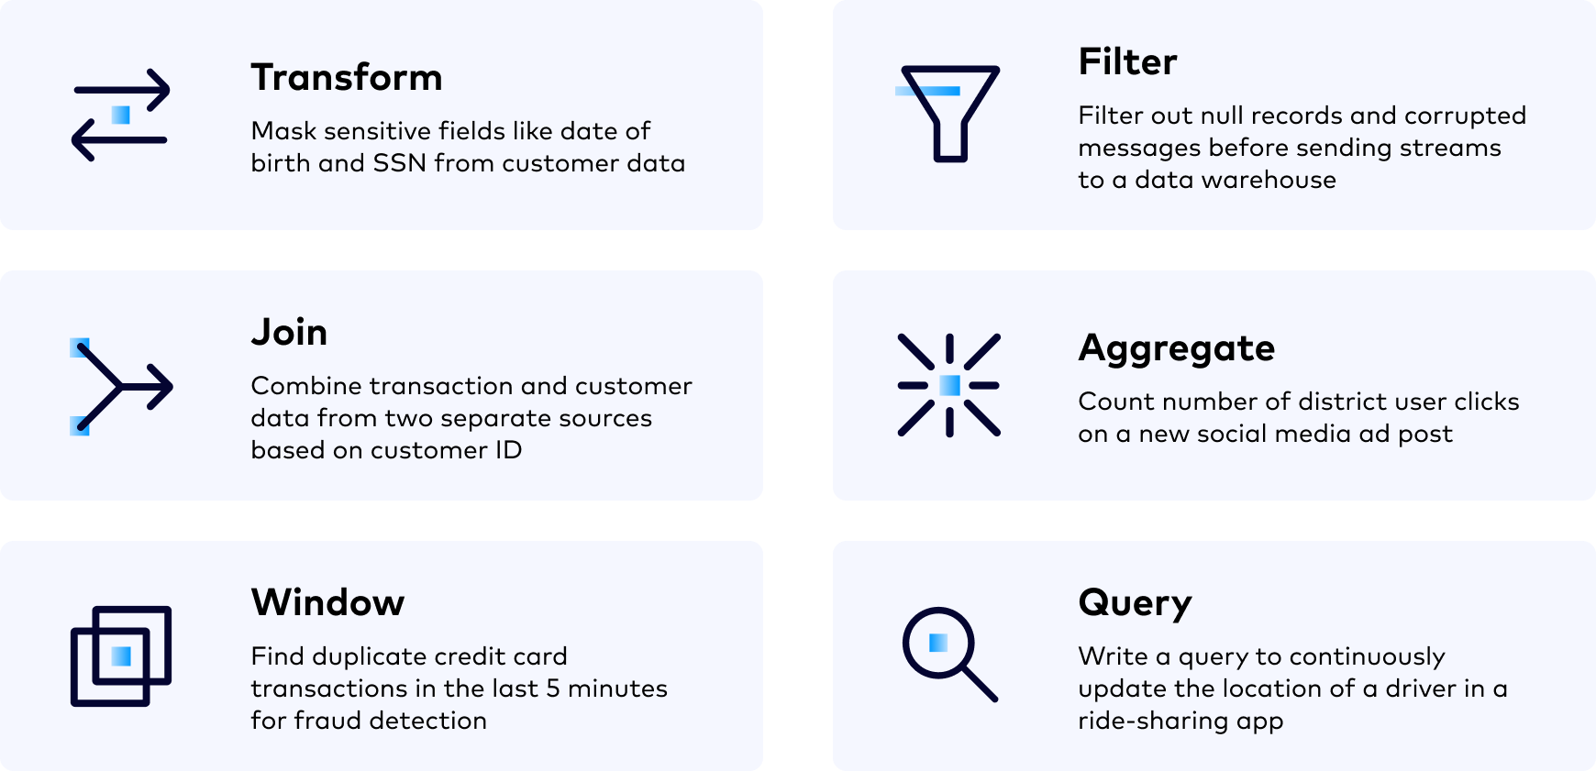
Use Cases of Apache Flink
Real-time monitoring (e.g., fraud detection, anomaly detection)
ETL pipelines and data enrichment
Event-driven applications
Real-time analytics and dashboards
Streaming machine learning
Log processing and alerting

Slide 8
How Flink Works
Define your job using Flink APIs
Submit the job to the cluster (standalone, YARN, Kubernetes)
Flink splits job into parallel tasks
Tasks run on TaskManagers
Checkpoints and savepoints ensure resilience

Slide 9
Thank You For Attention

