Slide 1

Credit Risk Analysis for Lending Club
By: Sahil Avasthi & Saket ingale

Slide 2
Contents
Business Context
Dataset
EDA Objective
EDA Approach
EDA Key Insights
EDA Conclusion
Recommendations

Slide 3
Business Context
Lending Club
Lending Club is a financial technology company that operates a peer-to-peer (P2P) lending platform.
Business Context
Problem Statement
In this case study we’ll be analyzing past loan applicants of a company which is the largest online loan marketplace, facilitating personal loans, business loans, and financing of medical procedures for approving loan applications.
The company wants to understand the driving factors (or driver variables) behind loan default, i.e. the variables which are strong indicators of default.
Founded in 2006, it initially allowed individuals to lend money directly to other individuals seeking personal loans, bypassing traditional financial institutions. Over time, LendingClub expanded its offerings and services.
Borrowers, can easily access lower interest rate loans through a fast online interface exposed by the company
The company can utilize this knowledge for its portfolio and risk assessment.

Slide 4
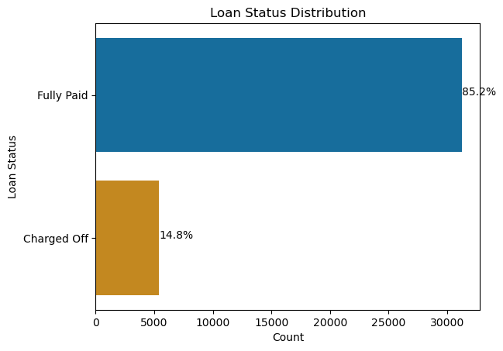
Dataset
The Dataset contains the information for various loan listings for a lending company in USA distributed across various business attributes.
No of records in dataset: 39717 rows
No of attributes in dataset: 111 columns
Target Variable Name: loan_status
Loan Status Values
Fully paid
Applicant has fully paid the loan (the principal and the interest rate)
Charged-off
Applicant has not paid the instalments in due time for a long period of time, i.e. he/she has defaulted on the loan
*Note: We have not considered records with ‘Current’ loan status since it will not be used for charge_off loans driving factors analysis

Slide 5
EDA Objective and Approach
EDA Objective
EDA Approach Followed
Understand the driving factors (or driver variables) behind loan default, i.e. the variables which are strong indicators of default
Understand how consumer attributes and loan attributes influence the tendency of default
Data Cleaning
Fixing Rows and Columns
Univariate Analysis
Univariate Analysis on Important Variables
Segmented Univariate Analysis against Target Column
Bivariate Analysis
Correlation Analysis on Numerical Features
Segmented Bivariate Analysis against Target Column
Missing Values Treatment
Filtering Useful Data

Slide 6
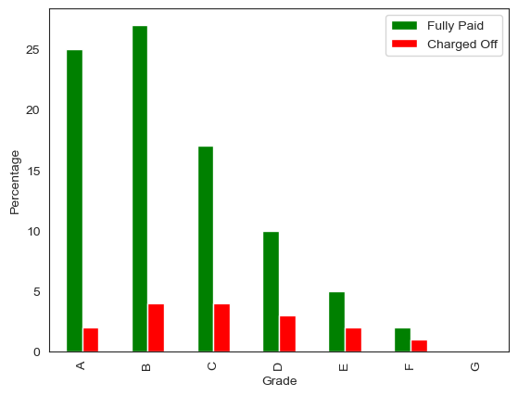
Key Insights about Grades
Grades A to G Indicate various Loan Grades assigned by Lending Club to each loan record
As we can observe in the percentage bar plot, It's clearly visible that Customers with Grades A E or F default less
However, Customers with Grade B or C default more
Customers with Grade B or C loans can be assessed further to avoid loan defaults in future
Thus, Loan Grade Is one of the driving variable behind default loans

Slide 7
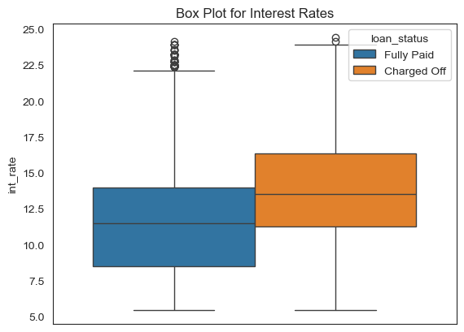
Key Insights about Interest Rate
Int_rate column indicates the interest rate for each loan record in percentage
As we can observe in the plot, It's clearly visible that Customers with higher interest tend to default
However, Customers with interest rate more than 13.75% appear to default more likely
Customers with high interest rate loans can be assessed further to avoid loan defaults in future
Thus, Interest Rate Is one of the driving variable behind default loans

Slide 8
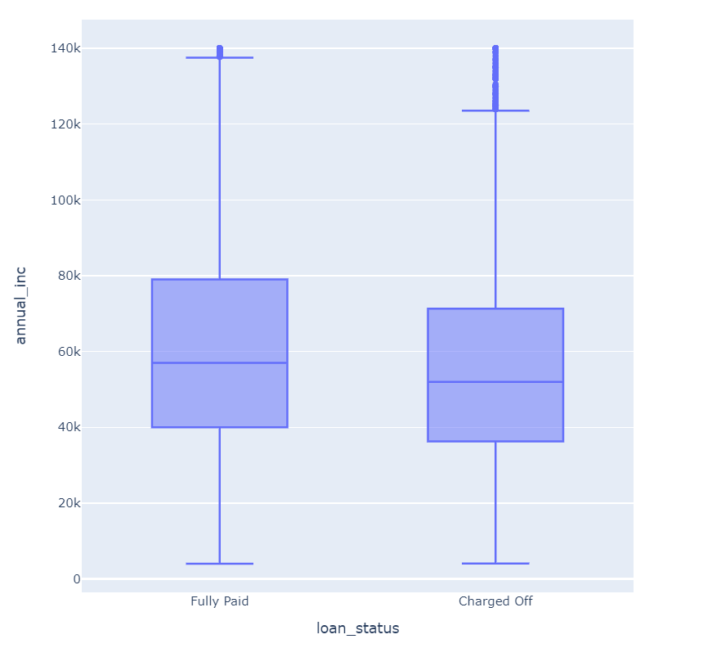
Key Insights about Annual Income
annual_inc column indicates self-reported annual income provided by the borrower during registration.
As we can observe in the plot, It's clearly visible that Income distribution (25 - 75 percentile) for Charged off is 36 - 72 ; Income distribution (25 - 75 percentile) for Fully Paid is 40 - 79.
This means customers income between 36 and 40 has higher chance of default
Customers with this income range can be assessed further to avoid loan defaults in future
Thus, Annual Income Is one of the driving variable behind default loans

Slide 9
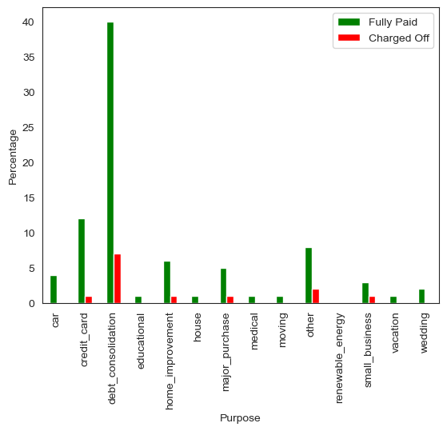
Key Insights about Loan Purpose
Purpose column Indicate A category provided by the borrower for the loan request.
Customers who took loan for debt consolidation are more prone to default as well as they can repay the full loan
Hence loans taken for debt consolidation can be approved with further check only
Thus, Loan Purpose is one of the driving variable behind default loans

Slide 10
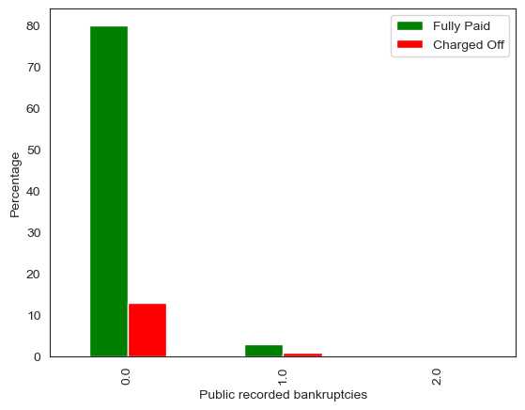
Key Insights about Public Bankruptcies
Column pub_rec_bankruptcies Indicates Number of public record bankruptcies
As we can observe in the plot, customers with both zero and more bankruptcies tend to default
Chances of default is higher (around 50%) for people with more than zero public bankruptcies
Thus, number of public bankruptcies for customers can be analyzed before approving loans

Slide 11
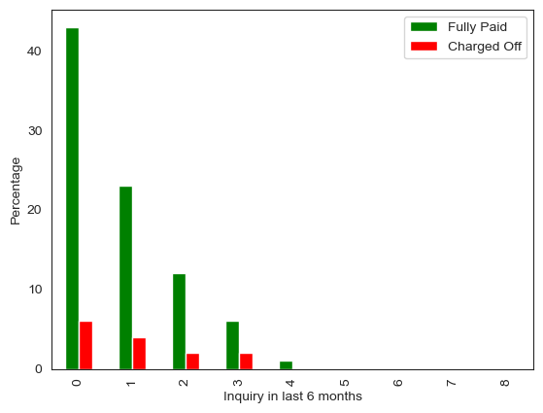
Key Insights about No of Inquiries
Column inq_last_6mths Indicates The number of inquiries in past 6 months
As we can observe in the plot, ratio of heights of percentage appear to be higher for more than 1 inquiry in last 6 months
Thus, number of inquiries in last 6 months can be a good indicator towards default loans

Slide 12
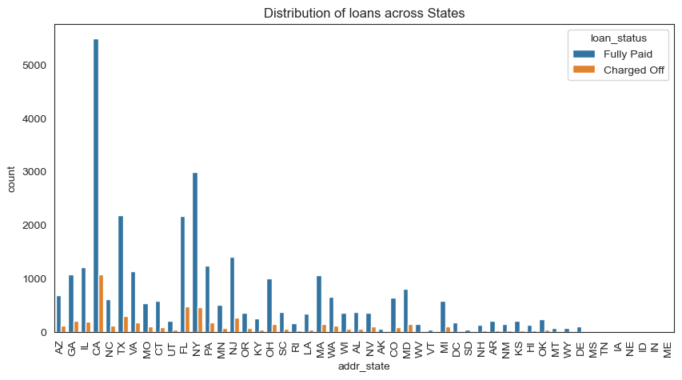
Key Insights about Customer State
Column addr_state Indicates the state provided by the borrower in the loan application
As we can observe in the plot, people in California state tend to take loans more
States CA, FL and NY show comparatively higher chances of default loans

Slide 13
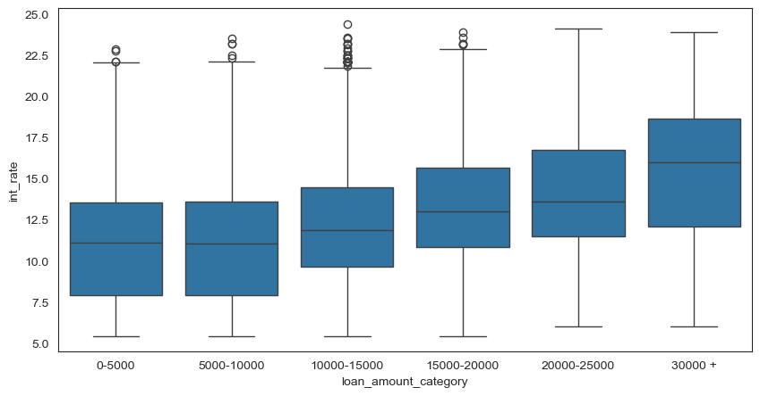
Key Insights Interest rate Vs Loan Amount
As we can observe in the bivariate boxplot, people in there is increasing trend between loan amount and interest rates
Higher interest rates significantly increase the total loan amount
This might motivate customers to charge off during adverse financial conditions

Slide 14
EDA Conclusion
Driving factors behind charging off loans identified using Exploratory Data Analysis are
Grades
Interest Rates
Annual income
Purpose of the loan
Public recorded bankruptcies
No of inquiries in last 6 months
Other key insights that are identified are –
1. Customers with 10+ years & less than 1 year have higher probability to default
2. Customers who own property default less; however, Customers on Rent are slightly more prone to default
3. Customers who took loan in CA are more prone to default as well as they can repay the full loan
4. Customers with 1 inquiries in last 6 months are more likely to default
5. Larger amount of loan contributes to higher chance of defaulting as it increases the interest rate

Slide 15
Recommendations
DTI impacts the repayment of the loans. This we have verified through Grades, interest rates and annual income therefore before approving loans DTI should be verified correctly and thoroughly
Most of the analysis confirm that loans which are approved with higher Grades has high probability of repayment therefore this concludes that banker should approve more loans with higher grades
Customers who are taking loans for debt consolidation or credit card should be thoroughly verified against other factors such as loan Grades and DTI
We have observed that there is negative correlation between Public recorded bankruptcies & Installments therefore customers with more Public recorded bankruptcies should be verified correctly and thoroughly
We have observed that there is negative correlation between Public records & loan amounts therefore customers with more Public records should be verified correctly and thoroughly before approving loans

