Slide 1
SOLIDITY By badal Sahil Pawan

Slide 2
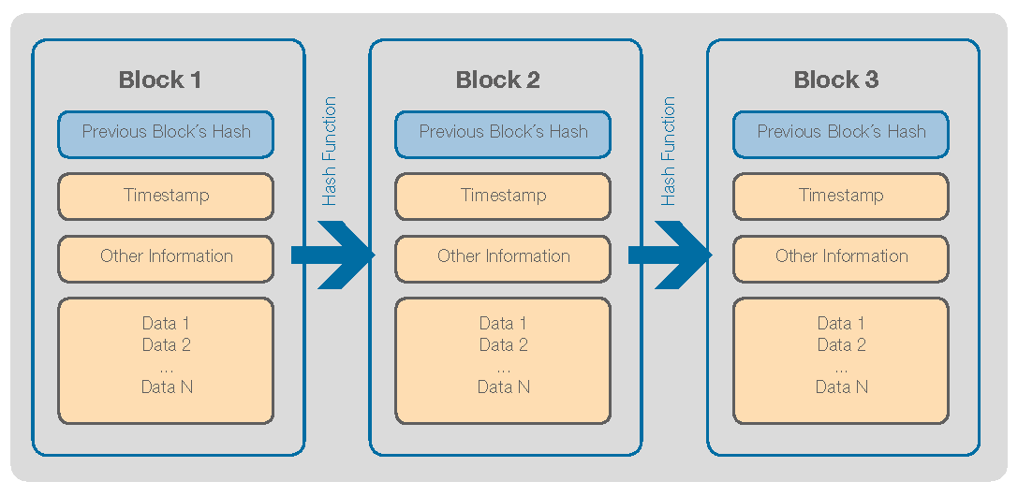
Need of block-chain and History
A Block-chain is a decentralized network on server which transfers data from one user to other user. As block-chain is the further to the all the centralized system as it nearly solves all the issues of the central servers systems.
The major problems are:
Decentralized
Transparent : As block-chain are public the transaction done are transparent between the users.
Secure : As a block-chain is dense network it is almost impossible to hack a network.
Immutable : As the block-chain follows the smart contract to do it’s task other sources can not chance the data within it until it has a owner access.
A block-chain contains n-number of block within It . A block has a timestamp, data , hash , pre-hash in it, the data block is the part where the smart contract is passed and a block will execute it.
It was developed by Christian Reitwiessner, Alex Beregszaszi,
and several former Ethereum core contributors
to enable writing smart contracts on blockchain
platform. Solidity was initially proposed in
August 2014 by Galvin Wood.

Slide 3
About solidity
It is a language used to write a smart contract on a block in block-chain. It is similar to the C++,Python and other Object oriented programming language.
As it shares the features of the object oriented programming language like inheritance, function ,dynamic variable’s , etc.
The syntax of the solidity resembles to the C++ as it shows open and close parenthesis , terminating operator.
It has it’s built in compiler named as “solc” which complies the code from high level language to low level language. It’s compatible with multiple environments such windows(node.js) , macOS , Linux , and all types of terminal. To install in the node.js just simply use “npm install –g solc” .
OR
There is a free online environment to write a smart code on a block-chain which paying any ethers.

