Slide 1
Recruitment & HR Analytics Portal
Sahil Bhiwankar || CS24106

Slide 2
📊 Project Overview
Analyze recruitment data across major tech companies
Visualize quarter-wise hiring trends
Identify highest recruitment growth
Interactive Streamlit dashboard

Slide 3
⚙ Technology Stack
Python – Core programming
Pandas – Data processing
Matplotlib – Grouped Bar Chart
Streamlit – Web dashboard

Slide 4
✨ Portal Features
Company-wise total hiring analysis
Role-wise grouping
Quarter comparison visualization
Growth percentage calculation
Interactive filters

Slide 5
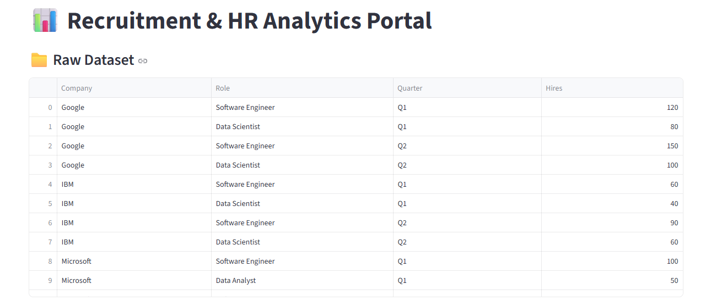
🖥Recruitment Portal Dashboard Preview

Slide 6
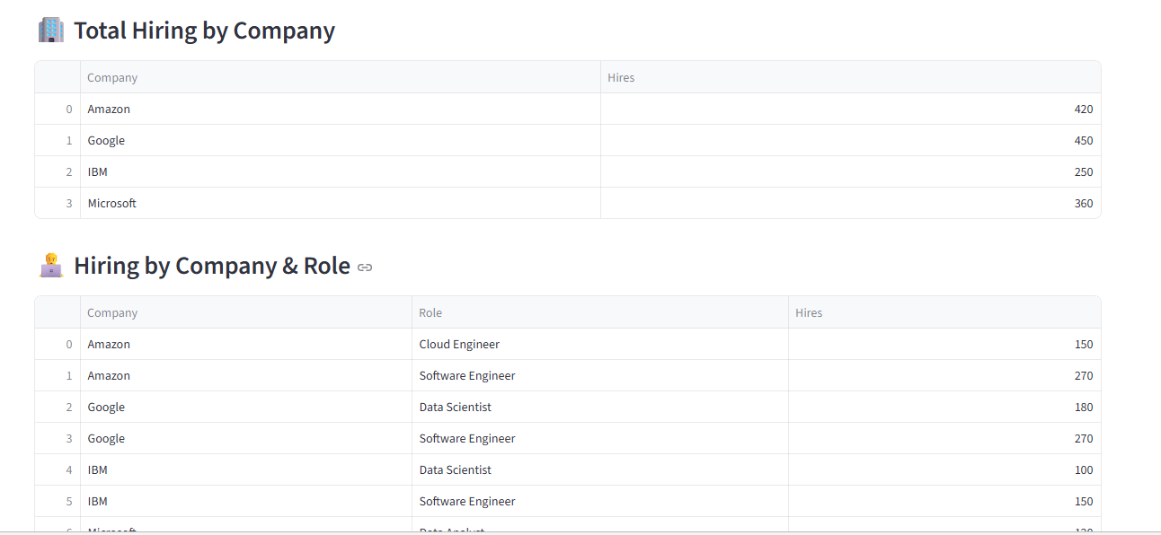
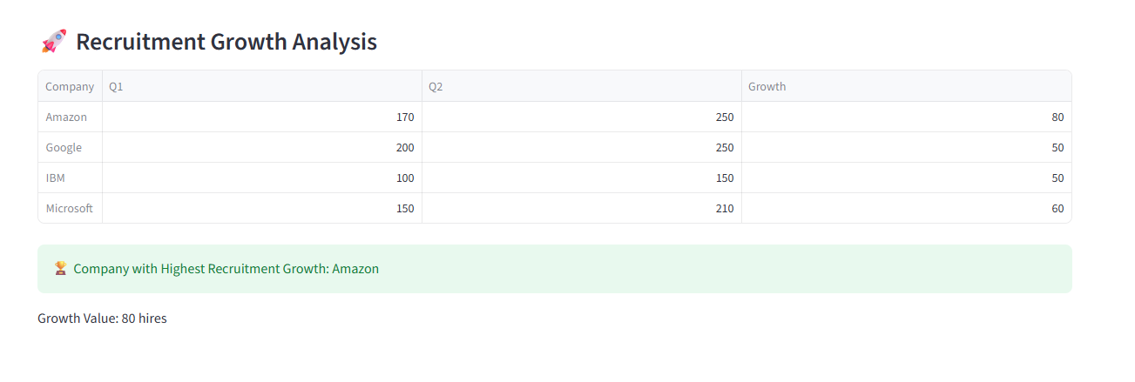

Slide 7
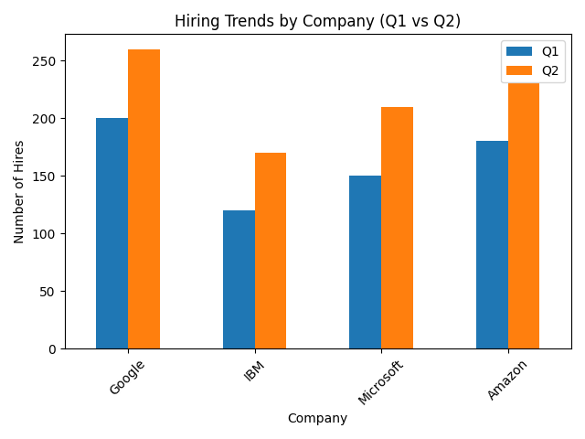
📈 Hiring Trends Visualization

Slide 8
🚀 Future Scope
Integration with real-time HR databases
Machine Learning model for hiring prediction
Cloud deployment for global access
User authentication & multi-user system
Advanced interactive visualizations (Plotly)

Slide 9
🏆 Conclusion
Provides data-driven HR insights
Helps organizations compare hiring performance
Supports strategic recruitment planning
Scalable for real-world implementation

