Slide 1
Protein Function Prediction Using Deep Neural Networks
NLP CS 7650
Sahil Bishnoi​
Baptiste Carbillet​
Yusaku Nitta​
Boyu Zhang​

Slide 2
Project Purpose
Motivation: Address the challenge of protein function annotation.
Objective:
Develop multi-label classification model to enhance biological insights using custom-built neural networks.
Determine optimal embedding and model combination for functional annotation.
Novelty:
Develop our original NN models to explore embedding-annotation relationships.
Integrate additional biological information for enhanced model accuracy.
Notes:
Img credits: https://empireflippers.com/social-media-dtc-ecommerce/
We have been trying to address the challenge of protein function annotation.
In protein research, we have a large knowledge gap between the number of protein sequences we have and what we know about those proteins. , so we are leverging deep learning approach to accurately predict and assign unknown proteins' functions based on their sequences of amino acids, which are building blocks of protein.
So we are going find the best combination of protein sequence embedding and our NN model for this task.
We'll also integrate additional biological information such as proteins types for model training.

Slide 3
Protein Functions and Gene Ontologies (GO)
3 GO categories (Ashburner et al., 2000):
Molecular Function (MF): Protein's physical activities
Ex. Sequence-specific DNA binding
Biological Process (BP): Biological goals led by a protein's MF(s)
Ex. Cell death
Cellular Component (CC): Protein's location
Ex. Nucleus
*Accurate prediction aids research in disease mechanism identification, drug discovery, and evolutionary studies.
Notes:
Img credits: https://empireflippers.com/social-media-dtc-ecommerce/
Our model aims to predict protein functions called gene ontology or GO, and it has 3 major categories.
MF: (Ex. Sequence-specific DNA binding)
BP: (Ex. Cell death)
CC tells where proteins are located
A better understanding of proteins contributes to identification of disease mechanisms, drug discovery, and evolutionary studies.

Slide 4
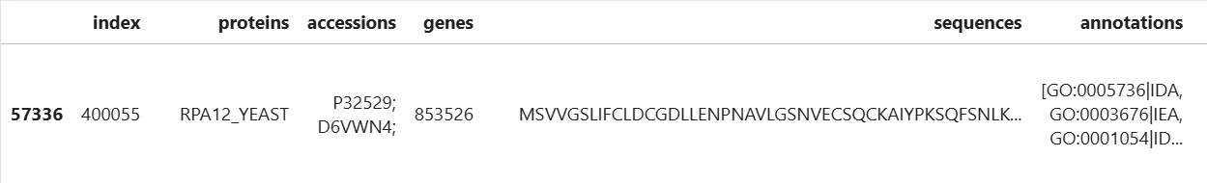
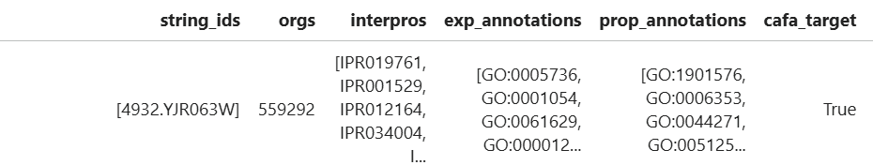
Data Overview
Protein Sequences: Textual representation of amino acid sequences.
InterPro Annotations: Categorize proteins into families, domains, and functional sites. A single protein can belong to multiple InterPro categories.
GO Labels: Multi-label annotations linking proteins to GO terms.
Protein
Protein Sequence
InterPros
Gene Ontology Labels
Notes:
Key points to talk: there are multiple GO labels/InterPro data for individual protein sequence

Slide 5
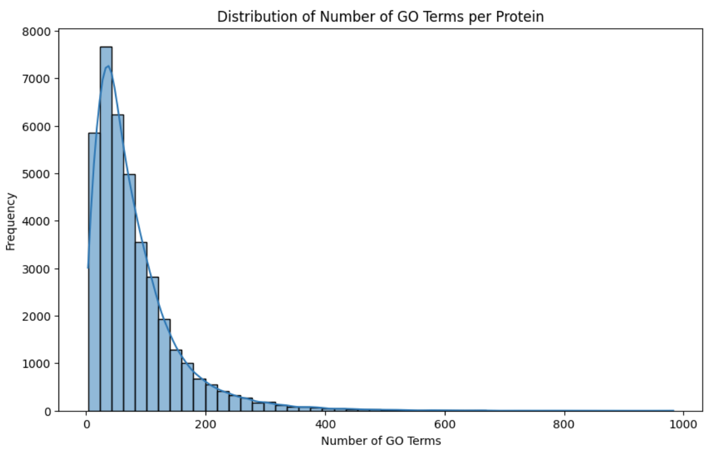
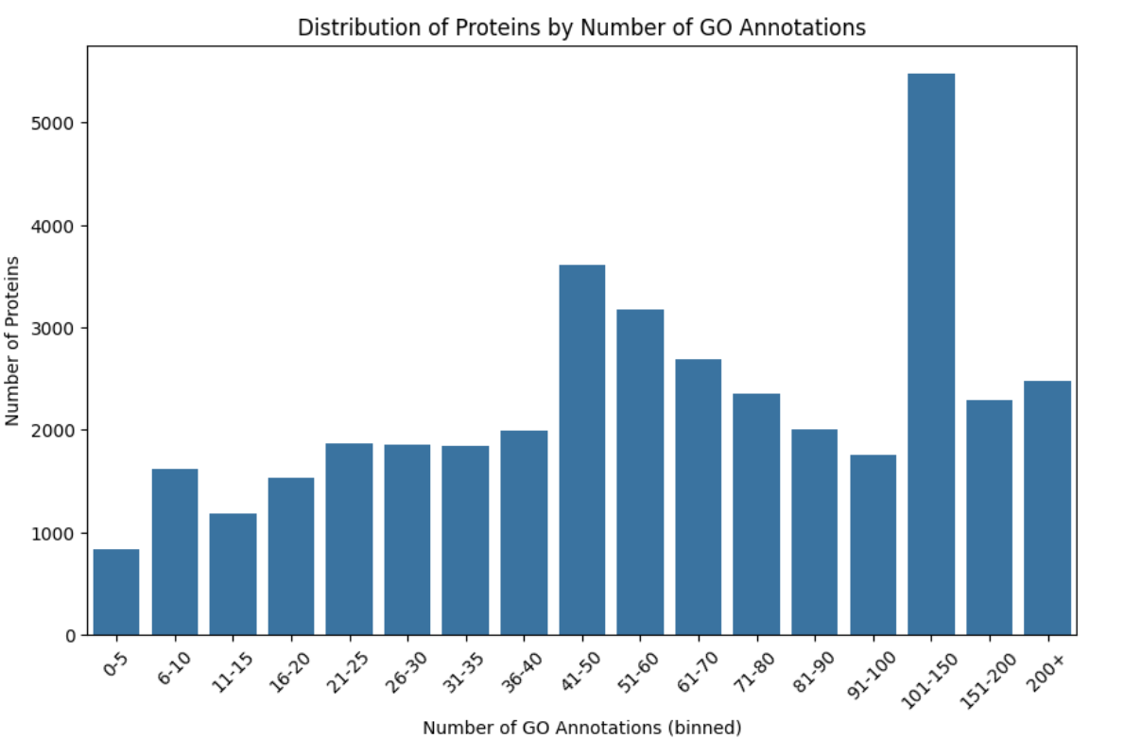
MF
Exploratory Data Analysis
Multi-Label Structure: Proteins associated with several GO terms.
Project Challenge: Handle multi-label structure accurately for reliable predictions.

Slide 6
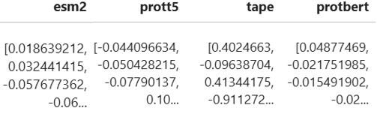
Feature Engineering
Protein Embeddings:
Transformed protein sequences into numerical vectors for model input.
Generated fixed-size embeddings using pretrained models (ESM2, ProtT5, TAPE, and ProtBERT) from Hugging Face.
Preprocessed sequences by replacing rare amino acids with 'X' and adding spaces between residues and tokenized using pre trained model's tokenizer
Mean pooled hidden states from the last layer to create fixed-size vector representations.
InterPro Integration: Multi-hot encoded features capturing protein families, domains, and functional sites.
Generated Embeddings

Slide 7
Model Architecture and Variants
Baseline Neural Network Architecture:​
1. Input Layers: Accepts embeddings (e.g. ESM2, ProtT5, TAPE) or combined embeddings + InterPro.​
2. Hidden Layers:​
Fully connected layers (1024 → 512), ReLU activation.​
Dropout layers (30%) to improve generalization.​
Output Layer: Sigmoid activation for multi-label classification.
Model Variants:​
1. Embedding-Only Models: Input: Protein sequence embeddings.​
Embedding + InterPro (Concatenated):​ Input: Concatenated embeddings and multi-hot encoded InterPro annotations.​
Separate Processing Models:​ Independent processing for embeddings and InterPro annotations.​ Features merged before final layers, allowing specialized processing.​

Slide 8
Custom Logical Loss Function
Binary Cross-Entropy (BCE) Loss: Handles multi-label classification.
Logical Loss Function: Enforces biological consistency in predictions by incorporating GO axioms as constraints.
A Implies B: If term A is predicted, term B must also be predicted. Loss: Penalizes when P(A) > P(B)
Disjointness: Mutually exclusive terms cannot co-occur. Loss: Penalizes if ∑P(disjoint terms) > 1
A and B Imply C: If A and B are predicted, C must also be predicted. Penalizes when min⁡(P(A),P(B)) > P(C)
Benefits
Ensures predictions are biologically valid.
Improves interpretability and performance for complex multi-label tasks.

Slide 9
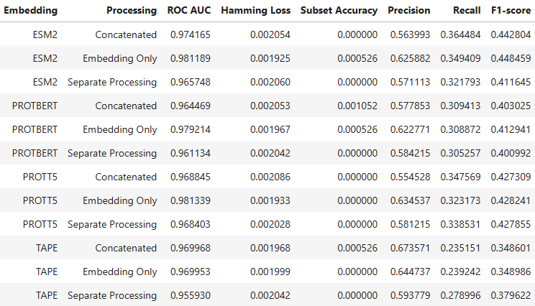
MF
Evaluation Metrics & Results
Metrics Used:
F1-Score, Precision, Recall: Assess balance between true positives and false positives/negatives.
Hamming Loss: Fraction of incorrectly predicted labels.
ROC AUC: How well the model ranks true positives higher than false positives across all possible thresholds.
MF:
Model is conservative in predicting positives. i.e. predicts fewer GO terms to minimize incorrect predictions
Avoids false positives (helping Hamming Loss).
Misses true positives, resulting in lower Recall and Precision.

Slide 10
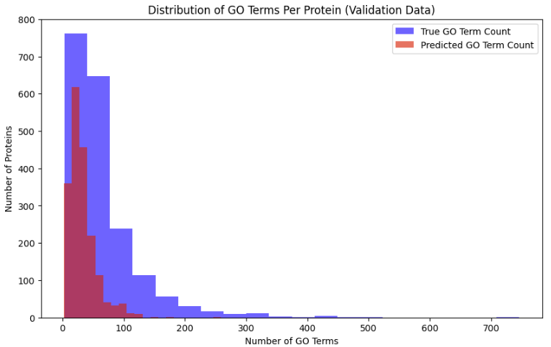
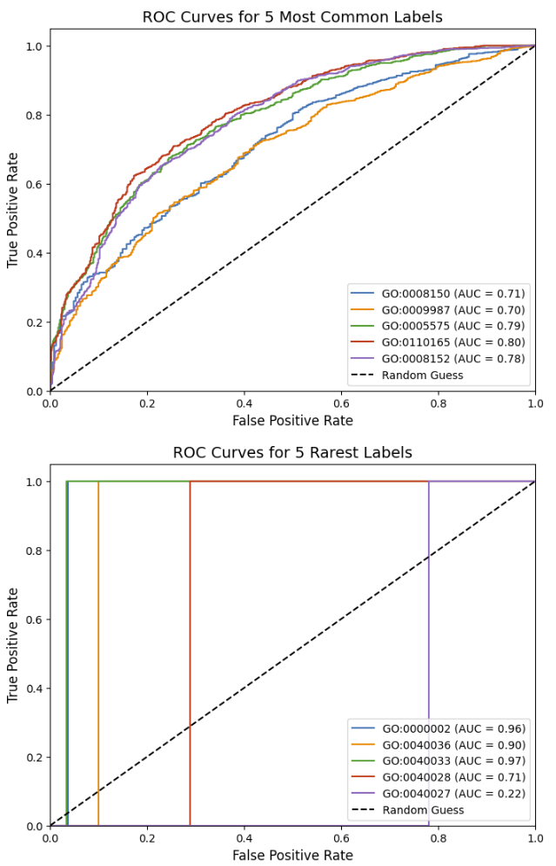
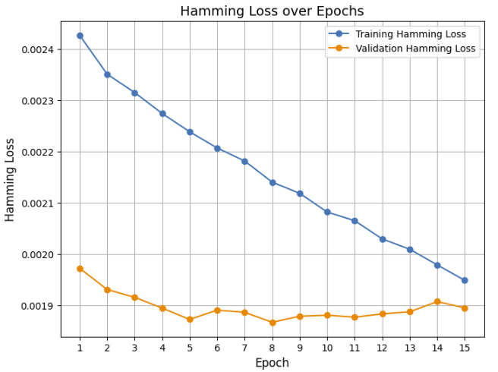
MF
Results on Validation data (Best performing model)
Distribution of True vs Predicted GO terms per protein
ROC Curves for 5 most common and rarest labels
Hamming Loss over Epochs
Model is conservative in predicting positives
Avoids false positives (helping Hamming Loss).
Misses true positives, resulting in lower Recall and Precision.

Slide 11
Conclusion
ESM2 with embedding only model performed the best based on F1 score
Logical loss enforcing biological consistency improved predictions
Achieved high ROC AUC and low Hamming Loss and good F1 score and precision.
Model was conservative, recall remained lower than desired.
Predicting exact GO term combinations is challenging.
Possible Improvements
Use Protein-protein interactions (PPIs) as additional feature
Use Per-Residue Embeddings
Generate embeddings for each amino acid instead of a fixed-size vector.
Sequence-based models (e.g., Transformers, RNN) can be used
Capture both local features and long-range dependencies in protein sequences.

Slide 12
Q&A

Slide 13
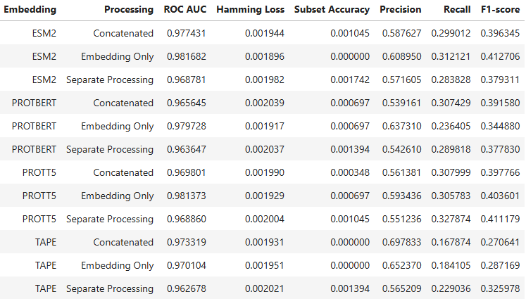
BP
Appendix
Results: Biological Process (BP)

Slide 14
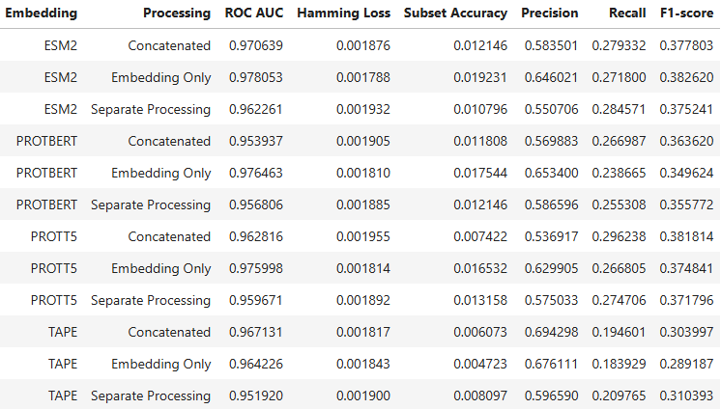
CC
Results: Cellular Component (CC)

