Slide 1
Efficient Method for Data Synchronization in Mobile Database
SASIKUMAR GOUNDAR
1911051
Nidhi Singh
Dept. of Computer Science
Madan Mohan Malaviya, Gorakhpur, India
Mr. Muzammil Hasan
Dept. of Computer Science
Madan Mohan Malaviya, Gorakhpur, India

Slide 2
TABLE OF CONTENTS :
1) ABSTRACT
2) INTRODUCTION
3) BACKGROUND KNOWLEDGE
4) SAMD SYNCHRONIZATION ALGORITHM
5) CONCLUSION

Slide 3
aBSTRACT
(Synchronization Algorithms based on Message Digest algorithm) based on message digest in order to facilitate data synchronization between a server- side database and a mobile database.
The SAMD algorithm makes the images at the server -side database and the mobile database.
If the two images are different, the synchronization progresses according to synchronization policy.
The SAMD uses only the standard SQL functions for the synchronization.
SAMD algorithm can be used in any combinations of server- side database and mobile database because of its independence of database vendor.

Slide 4
INtroduction
In the field of mobile devices, database synchronization is a process that establishes consistency between the data source and master.
Over time, mobile technologies advanced through their equipped devices with a lightweight database, and provide a great role in the exchange of information for the processing of business, organizations and many other fields.
Mobile devices have less processing and insufficient availability of memory and for transmission they always use the network .
It has been demonstrated by this paper that the synchronization algorithm for mobile databases and server databases relies on message digest.

Slide 5
Backgound Knowledge
1) SYNCHRONIZATION FRAMEWORK
2) ROWS INCONSISTENCY
3) MESSAGE DIGEST

Slide 6
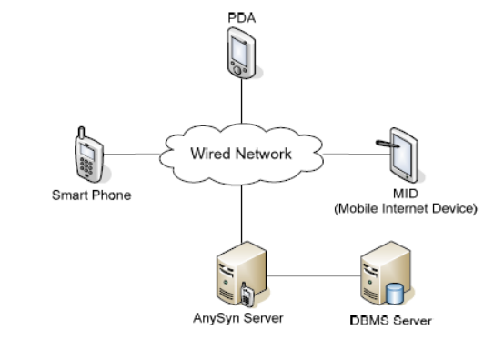
SYNCHRONIZATION FRAMEWORK
The whole framework consists of a server- side database, synchronization server (AnySyn) and multiple mobile devices with internal mobile databases.
The server-side database maintains all of the data required for business, and the mobile database downloads copies of data the user needs from the server-side database
The synchronization server is located between the two databases, to synchronize the data and manage additional information required for synchronization.

Slide 7
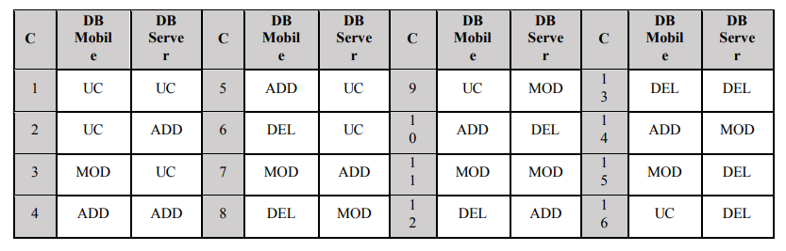
ROWS INCONSISTENCY
An inconsistency refers to a state in which the published data in the server-side database and the subscribed data in the mobile database carry different values due to a change at either side.

Slide 8
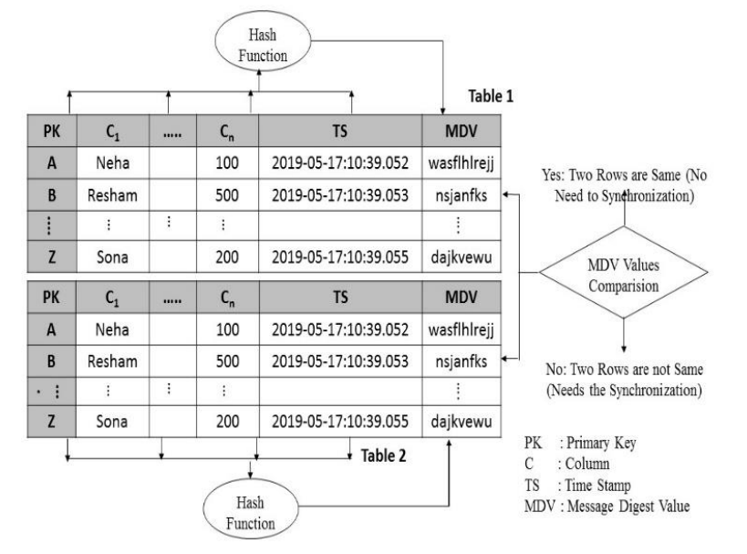
MESSAGE DIGEST
Message digest consists of a unidirectional hash function that maps a message of a random length to a fixed-length hash value. Message digest h is created by the hash function H, which can be expressed as follows
h = H(M)
M is a message of a random length and H(M) is a fixed length message digest.
Data in two rows are identical if two rows in Tables A and B have identical message digest values.

Slide 9
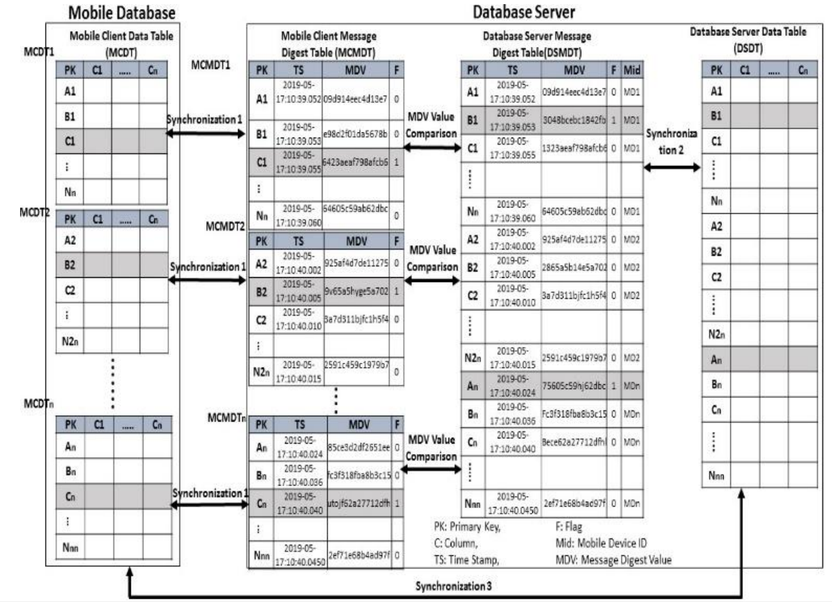
SAMD SYNCHRONIZATION ALGORITHM
Fig displays the table schema of the server-side database and the mobile database where the SAMD synchronization algorithm is applied.

Slide 10
Data Table:
DSDT: Database Server Data Table, MCDT: Mobile Client Data Table
Message digest table
DSMDT: Database Server Message Digest Table, MCMDT: Mobile Client Message Digest Table
Data table contains the business data and the message digest table stores the message digest value from the data table.
The message digest table consists of a PK column of data table, message digest value (MDV) column, flag (F) column and mobile device ID (Mid) column.

Slide 11
The flag column signals an inconsistency that has occurred in the corresponding column, therefore, the flag column is used to identify a row that requires synchronization.
The value of MDV in MCMDT is different from the value of MDV in DSMDT and the MCMDT flag value is 1. Consequently, synchronization is necessary.
Synchronizations 1 and 2 synchronize the data table and message digest table.
Synchronization 3 is performed between two data tables for each inconsistent type.
The mobile device ID value is sent to the server-side database and then the SAMD algorithms select the row from DSMDT whose value of Mid column is the same as the mobile device ID.
Then SAMD Algo analyze the type of inconsistency using flag values, and primary key to identify the row.
Upon completion of synchronization, the flag of the synchronized row is set to 0 in the message digest table.

Slide 12
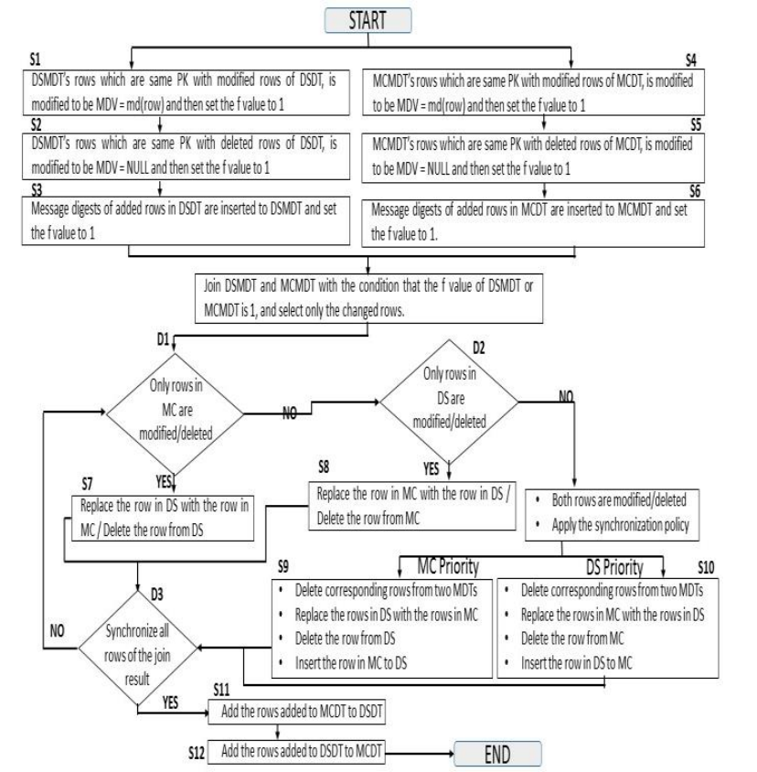
Flow chart for the SAMD
Synchronization Algorithm.

Slide 13
Step S1 is the synchronization process with the DSMDT when a row of the DSDT has been modified. The message digest value is calculated for the DSDT row, which is compared to the MDV column value of the DSMDT.
Step S2 is the synchronization proces for case in which a row is deleted , its MDV column value is set to NULL in the DSMDT.
Steps S3 is the synchronization process for case in which a row is inserted into the DSDT. If a row is inserted, its primary key and message digest values of the new row are added in the DSMDT.
Steps S4~S6 indicate the Synchronization 1 stage. This stage involves synchronizing the MCDT and MCMDT.All the process is same as the DSDT and DSMDT.

Slide 14
Steps S7~S12 display the Synchronization 3 stage. When the DSMDT and MCMDT are FullOuterJoined, the rows that are subject to synchronization and the inconsistent types are identified using the dangling rows and the DSMDT and MDCMDT flags and then the synchronization between the DSDT and MCDT is achieved.
Step S7 involves synchronizing a modified row or one deleted from the MCDT with the DSDT.
Under the D1 condition, Step S7 searches for a row with an MCMDT flag value of 1 and a DSMDT flag value of 0. The flag values indicate that the row was modified or deleted from the MCDT.
Step S8 involves synchronizing the modified or deleted rows from the DSDT with the MCDT. This step is identical to the algorithm of Step S7, but synchronization takes place from the DSDT towards the MCDT.

Slide 15
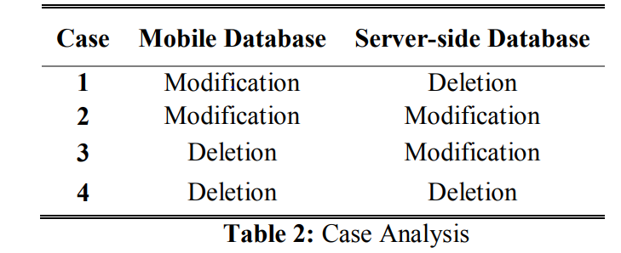
Steps S9 and S10 perform synchronization in the direction from the DSDT towards the MCDT or in the reverse direction, according to the synchronization policy.
The rows subject to synchronization are those with flag values of 1 for both the DSMDT and MCMDT

Slide 16
Step S11 involves reflecting the row inserted into the MCDT to the DSDT.
Step S11 is applied to the row for which the flag value of the MCMDT is 1 and which is a dangling row.
The rows inserted into the MCDT and MCMDT are also inserted into the DSDT and DSMDT completing the process and resolves the inconsistency.
Step S12 reflects the row inserted into the DSDT on the MCDT. The algorithm is identical to that used in Step S11 but with a different synchronization direction.

Slide 17
conclusion
This paper has suggested an (SAMD) synchronization algorithm based on message digest for synchronizing between server-side databases and mobile databases.
The SAMD algorithm is convenient to use in specific venders and to avoid relational databases operating from both server-side and mobile side database SQL results.
This feature is important in order to build efficient mobile business systems because the upcoming mobile business environment has heterogeneous characteristics in which diverse mobile devices, mobile databases and RDBMS exist

Slide 18
bibliography
http://ieeexplore.ieee.org.library.somaiya.edu/document/9066122

Slide 19
THANK YOU

