Slide 1

Vehicle Parking
Management
System
Sahil Changlani
1911046
A3

Slide 2

Contents
Part 1
Abstract
Part 2
Objectives
Part 3
System Architecture
Part 4
Technological Stack
Part 5
Conclusion

Slide 3

Abstract
As the city is developing and with increase in population,
people are finding it difficult to park their vehicles.
In some parking place there is no safety for the vehicle.
There is a chance of theft or vehicles may get damaged.
People waste their time to search vehicle parking place.
To solve these problems , Online Vehicle Parking
Monitoring‟ is used.

Slide 4
Objectives
1)
5)
Faster reservation of a parking slot anytime and from anywhere.
Directing the vehicle owner to the particular parking slot by providing directions in the application.
2)
6)
Providing information about nearby parking slots that are vacant.
QR code for verifying the user who has booked/reserved the parking slot.
3)
7)
Online payment portal integration making it easier for the vehicle owners to complete the transaction.
Payment calculation based on time for which the vehicle was parked.
4)
8)
Graph Analysis depicting the typical peak hours when the parking area is most/least occupied.
Storage of the vehicle and owner details in the backend.

Slide 5
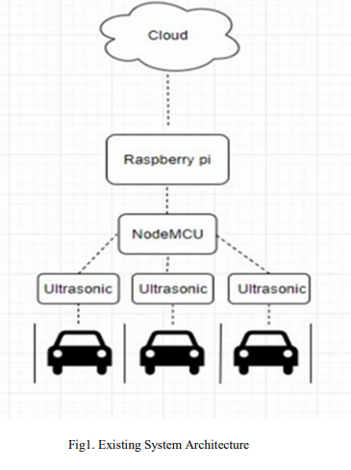
Existing System Architecture
In this system, ultrasonic sensors integrated with Raspberry Pi and Node MCU are used. The information from the Raspberry Pi is passed to the front end GUI and back end database.
The information is fetched from the ultrasonic sensors that detect the presence or absence of a vehicle. This information is forwarded to the Node MCU. A single Node MCU takes care of 4-5 parking slots respectively. There will be many such slot- node MCU pairs will form a network. The Node MCU transmits this information to the Raspberry Pi that has an on- board Wi-Fi module which helps for internet connectivity. Hence the information of whether a parking slot is available or not is forwarded to the Front End (application/website) and the user/ administrator gets to know about the availability of the parking slot.

Slide 6


Existing System Architecture
Additionally, the vehicle entries are stored in the backend database hence keeping a record of the vehicles that have entered in the parking area, so that the details can be quickly and easily accessed. Database helps maintain all the vehicle and
user records for future reference.
It provides GUI so that you can see the available slots.
No solution if parking slots are full. Does not display nearby parking area within the vicinity of the original parking area.

Slide 7
Proposed System Architecture
Working:
Vehicle Owner books/reserves the parking slot using the mobile application. In turn the user will get a QR code which will be used for verification later.
A window of 2 hours will be provided to the user within which he/she has to reach the parking area else, reservation is cancelled.
At the entrance, the user verifies the identity using the QR code and is assigned a particular parking slot based on the type of vehicle (car/bike).

Slide 8
Proposed System Architecture
Thereby, the application will guide the vehicle owner to the particular slot that has been assigned to him/her by giving the directions. Therefore, time won’t be wasted in finding the parking slot.A window of 2 hours will be provided to the user within which he/she has to reach the parking area else, reservation is cancelled.
The details are stored at the backend when the QR code is scanned.
An additional feature our system provides is that it displays the vehicle density patterns in the parking area during different time periods of the day. This therefore will give an idea to the vehicle owner if he/she will get the reservation in that particular or not.

Slide 9
Proposed System Architecture
Suppose if the parking slot is full, our system will provide information for nearby parking areas within the vicinity of the main parking area. The details are stored at the backend when the QR code is scanned.
If the user does not have an application or internet connectivity, then booking for that particular user will be done right at entrance of the parking area by providing a receipt or ticket. Therefore, additional features our system is providing is:
Directions are provided to the parking slot.
Graph analysis of vehicle density in the parking area giving the user an idea of when the parking slot is vacant/full.
Information about nearby vacant parking slots within the vicinity of the main parking slot.

Slide 10
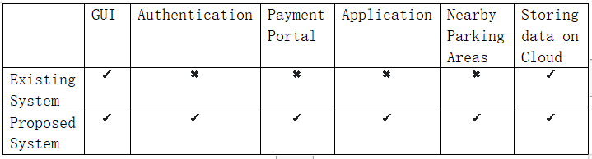
Comparisons & Results

Slide 11
Comparisons & Results
Pricing will be based on the time duration and it will be dynamic as per the number of hours.
Online payment option is available based on time for which the vehicle was parked.
Feedback mechanism for gaining user suggestions.

Slide 12
Technological Stack
03
Software
Android Studio
Arduino IDE
01
04
Firebase
02
Hardware
Firebase Cloud Service
IR sensors
Node MCU

Slide 13
Conclusion
By implementing this system, we are making the work of finding parking slots for private vehicles much easier.
The interface provided by the system would be user friendly and interactive which will attract more customer base.
This thereby will solve the problem of traffic jams causing inconvenience to the people on road.
Finding parking slots will no more be a difficult task for the vehicle owners.
Availability of these parking areas will be known beforehand.
A proper bill and amount calculation based on the time for which the vehicle was parked is provided to the customers using this system.

Slide 14
Implementation
Flutter based app
Login/register system
Database
Book ticket and generate QR code.

Slide 15
Bibliography
http://ieeexplore.ieee.org.library.somaiya.edu/document/9318673
(Original Document)

Slide 16

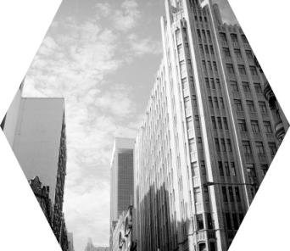

Thank You!

