Slide 1
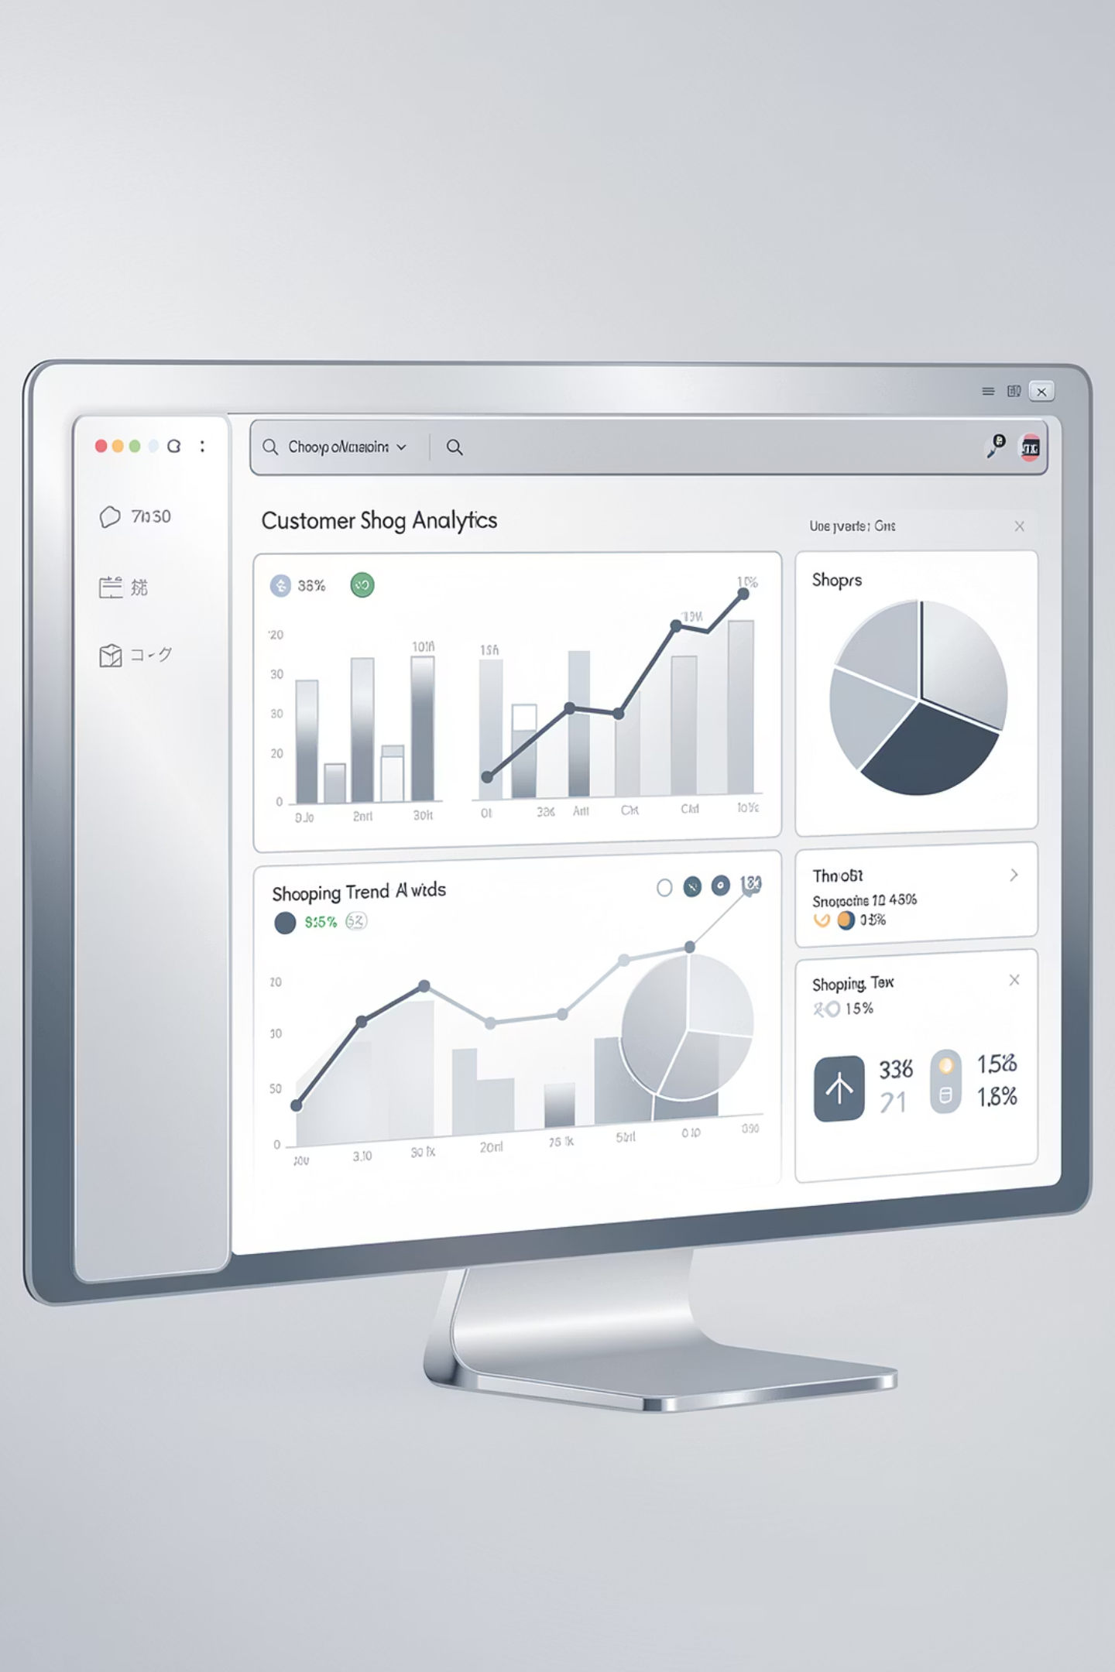
Customer Segmentation & Sales Performance Analysis
Analyzing 3,900+ transactions to identify key revenue drivers and customer segments
TRUPTI BABURAO CHOUGALE
SAHIL NARAYAN DALAVI
SQL · PYTHON · POWER BI

Slide 2
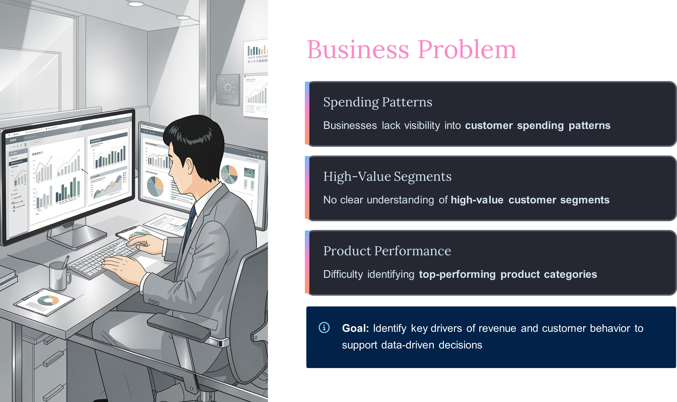

Slide 3
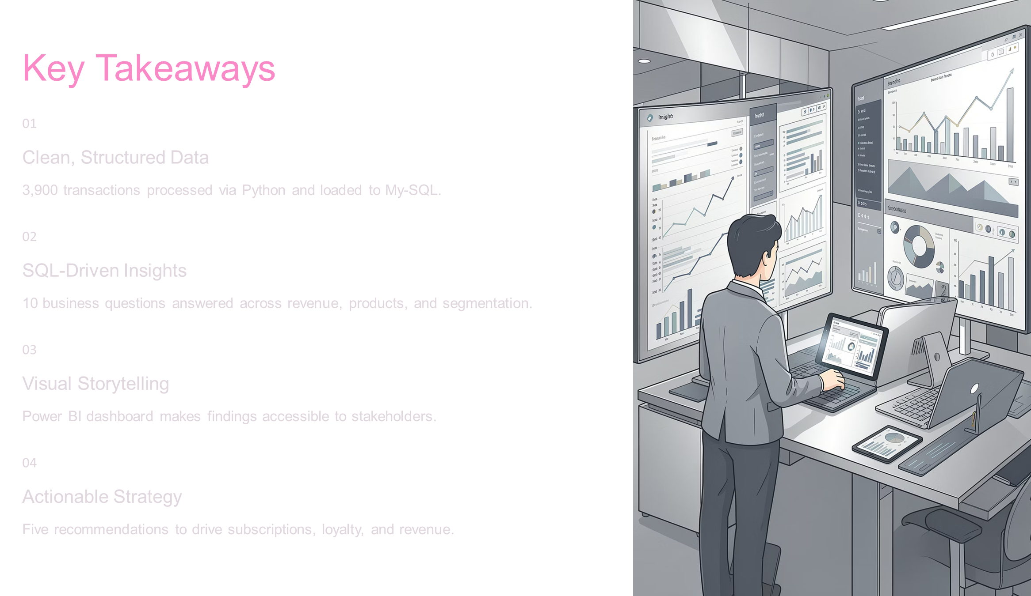

Slide 4
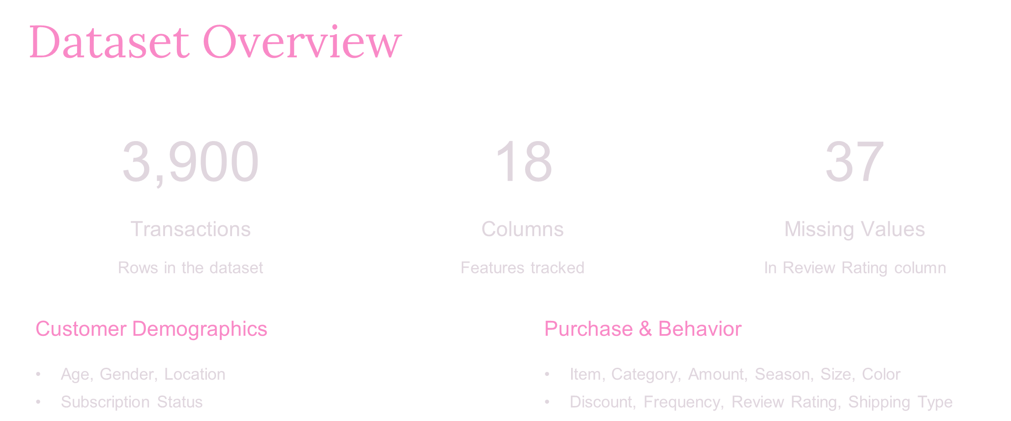

Slide 5
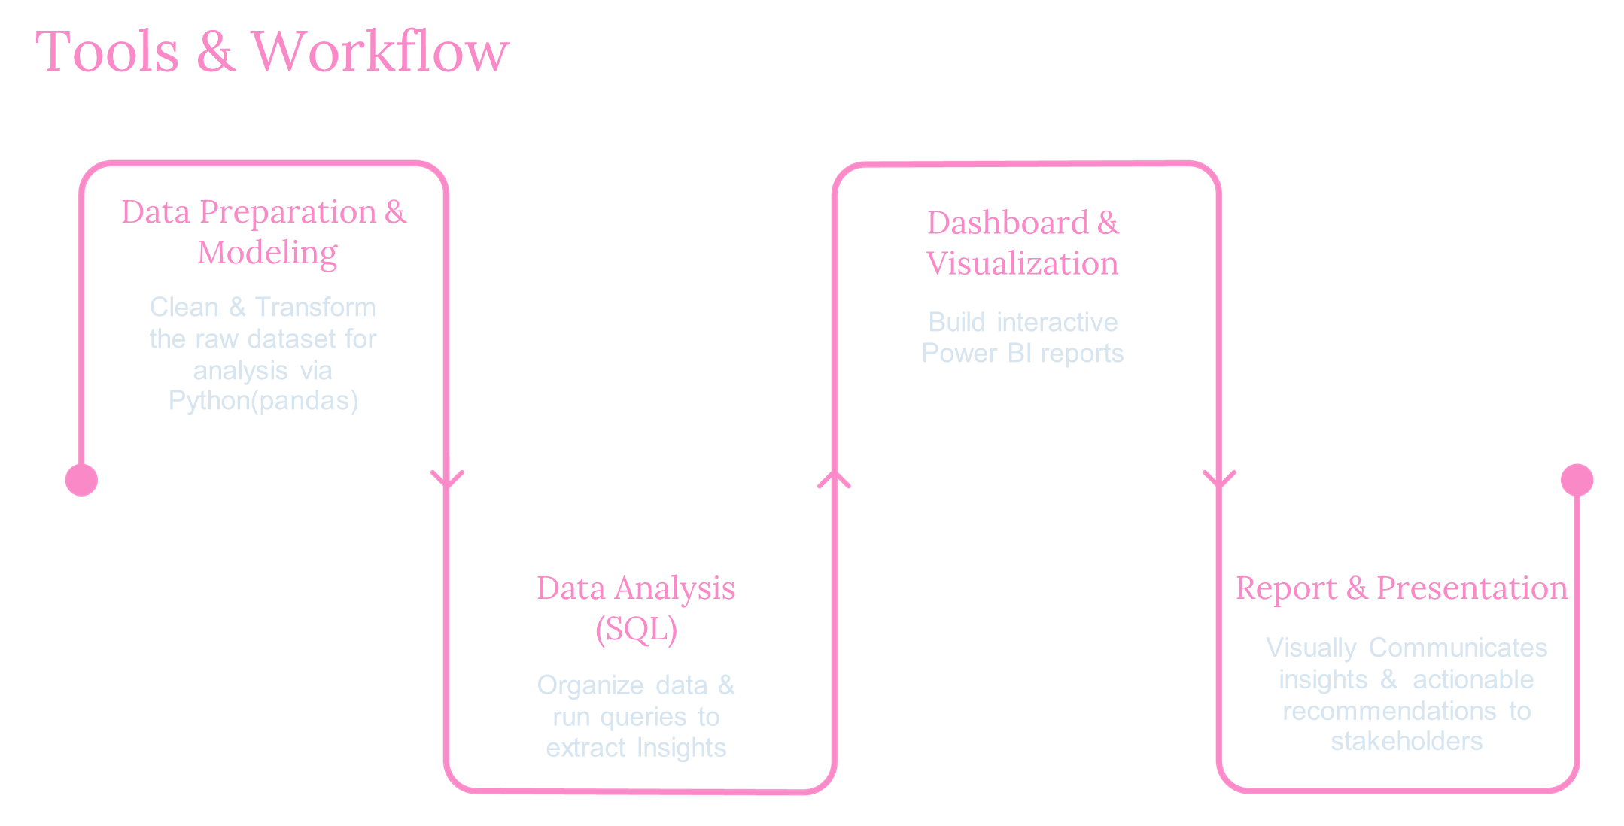

Slide 6
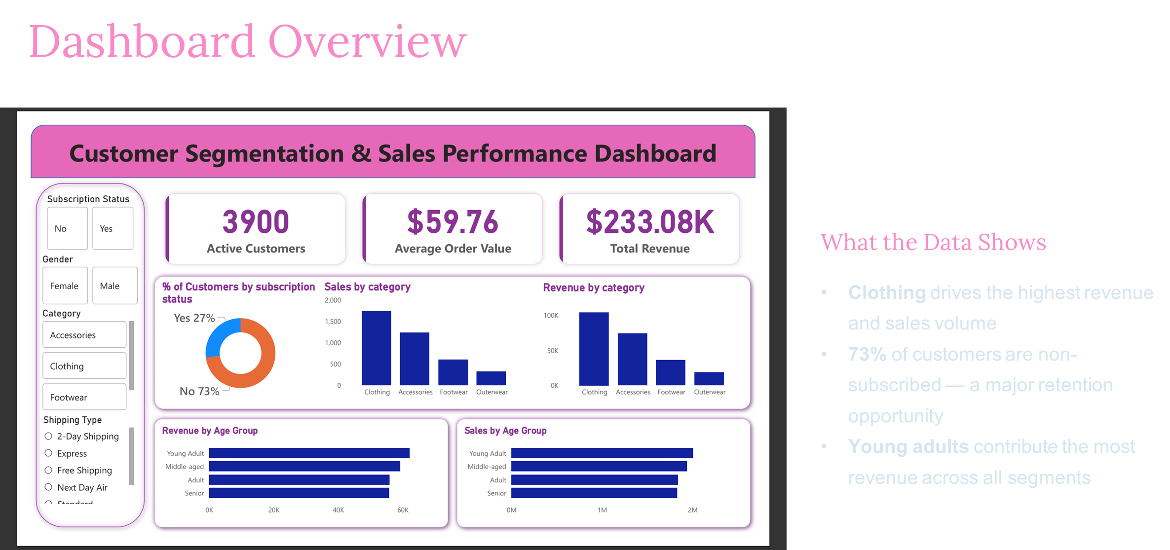

Slide 7
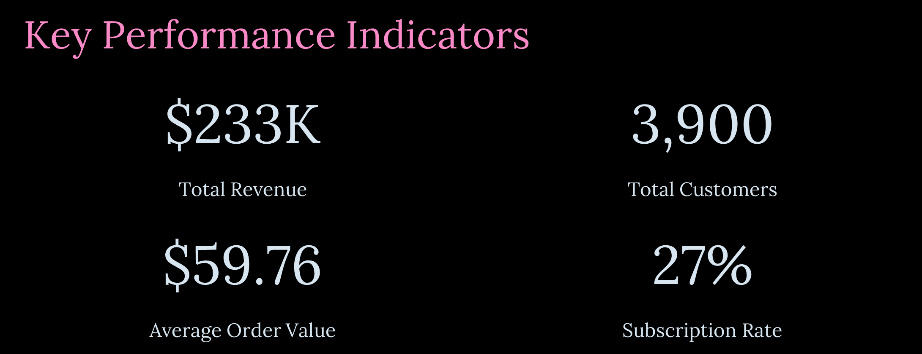

Slide 8
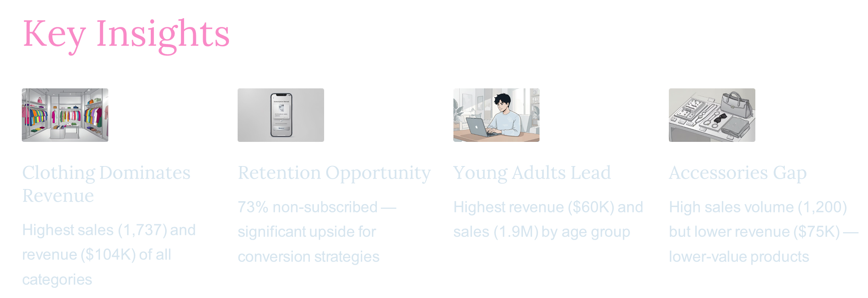

Slide 9
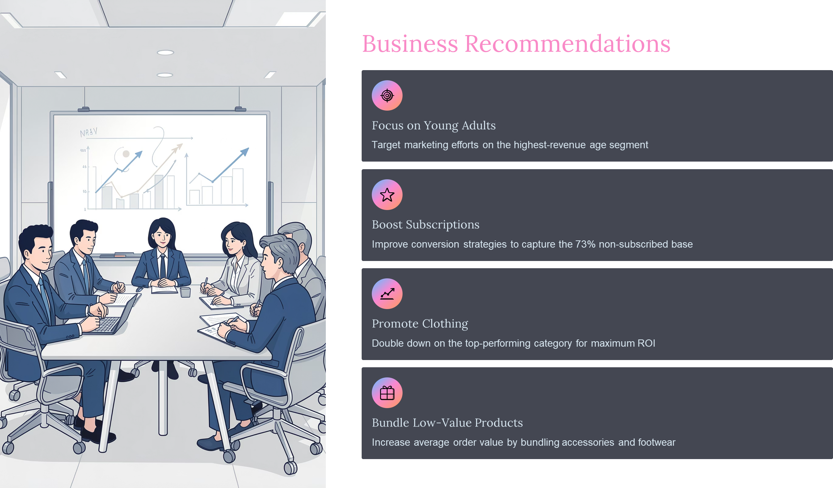

Slide 10


