Slide 1

MCA RESEARCH PROJECT · 2026–27
RELAY
A Multi-Tenant Retrieval-Augmented
Generation Platform for
Document-Grounded Chatbots
P.E.S. Modern College
of Engineering, Pune
Department of MCA
TEAM MEMBERS
Aaditi Choramle
Chitrang Choudhari
Sahil Dhanavade
Pratik Kamble
Guide
Dr. Swati D. Ghule

Slide 2
Introduction
▸ Large language models answer fluently, but can state facts that the source text does not support.
▸ This failure is hallucination: plausible text with no grounding in the organisation’s documents.
▸ Private PDFs, policies, and product notes are not reliably available inside the model.
▸ Keyword search misses paraphrases. Fine-tuning is costly, slow to update, and does not show the source.
▸ Retrieval-Augmented Generation (Lewis et al.) pairs an LLM with a document index.
▸ At question time the system retrieves relevant chunks and asks the LLM to answer only from that evidence.
RAG evolution · Gao et al.
Naive RAG
Advanced RAG
Modular RAG
Relay uses a Naive / Advanced hybrid
Why retrieval is added
LLM
Hallucination /
no private corpus
RAG
Document index
Grounded, cited
answer
Research focus
Build a multi-tenant platform that answers from each organisation’s own documents, with sources.
Relay · MCA Research Project · P.E.S. Modern College of Engineering · 2026–27
02 / 23

Slide 3
Problem Statement & Target Users
Problem
Users
▸ Organisations need website and internal assistants that answer only from their own documents.
▸ Answers should show the source, not only a fluent sentence.
▸ Several organisations must share one hosted platform without seeing each other’s files.
▸ Commercial builders are closed, costly, and hide how retrieval and isolation work.
▸ Open tutorials are usually single-tenant and stop before login, tenancy, and a public embed API.
▸ A shared vector index leaks data if the tenant filter is ever omitted.
Owner
Creates chatbots, uploads documents, tests answers, publishes the widget.
Website visitor
Asks questions from a third-party site through the embeddable widget.
RAG service
Retrieves only that chatbot’s chunks and returns a cited answer.
Research problem
Isolation on a shared index, one shared RAG pipeline, and hosted embeddings decide whether answers stay grounded and tenant-safe.
Relay · MCA Research Project · P.E.S. Modern College of Engineering · 2026–27
03 / 23

Slide 4
Research Objectives
Study the gap
One service
01
Review RAG, dense retrieval, and multi-tenant isolation, and state the gap this work addresses.
02
Design a single Next.js application for authentication, ingestion, search, answering, and the widget API.
Owner security
Document ingestion
03
Use Google OAuth and JWT sessions. Authorise every dashboard call by matching the chatbot owner.
04
Accept PDF, DOCX, and TXT. Extract text, chunk with overlap, embed, and store chatbot_id.
Query-time RAG
Public chat API
05
Embed the question, run filtered top-k search, and generate with OpenRouter and model fallbacks.
06
Expose a CORS endpoint authenticated by a pk_live_ key and an origin allow-list.
Embeddable widget
Test and deploy
07
Publish relay-chat-widget so a customer site can load appearance and ask questions.
08
Verify chunking, models, APIs, and isolation, then deploy the system for demonstration.
Overall objective
Improve the reliability of knowledge-grounded question answering on a shared, isolation-aware platform.
Relay · MCA Research Project · P.E.S. Modern College of Engineering · 2026–27
04 / 23

Slide 5
Working of the Proposed Platform
Offline · Knowledge preparation · writes the index
PDF, DOCX
or TXT
Extract
text
Chunk
800 / 150
Embed
passage
Upsert +
chatbot_id
writes
Shared knowledge base · Pinecone index
Every vector and every query carries chatbot_id. Cosine similarity. Model: multilingual-e5-large.
read at retrieval
Online · Query answering · reads the index
User
query
Authenticate
session or key
Embed
query
Top-k
+ filter
Context
+ LLM
Cited answer
or refusal
Dashboard
Website widget
One function
If no match
Owner tests questions
Visitor on another site
answerChatbotQuery
Refuse, do not call LLM
Ingestion never calls the LLM. A query never writes the index.
A chat message cannot add text to another tenant’s knowledge base. The same answer function serves the dashboard and the widget.
Relay · MCA Research Project · P.E.S. Modern College of Engineering · 2026–27
05 / 23

Slide 6
Research Gap
Problem
Shared assistants must answer only from each organisation’s documents. Demos and closed products do not show how.
Existing research
Identified gaps
This study
▸ RAG conditions a generator on retrieved passages (Lewis et al.).
▸ Gao et al. separate Naive, Advanced, and Modular RAG.
▸ Dense retrieval maps questions and passages into one vector space.
▸ FAISS-style search and hosted vector indexes make nearest-neighbour lookup practical.
▸ Multi-tenant SaaS literature studies isolation of shared data.
▸ Commercial document chatbots show demand, but their internals are closed.
▸ Teaching demos often query one index with no tenant key.
▸ Open prototypes stop at localhost: no login, public key, or widget.
▸ A Next.js UI plus a Python embedder doubles deployment and failure points.
▸ Separate dashboard and widget pipelines drift apart.
▸ One free LLM fails when it is rate-limited or leaks reasoning.
▸ A browser widget key is not a server secret, but is often treated as one.
▸ Logical isolation on a shared Pinecone index.
▸ Mandatory metadata filter: chatbot_id.
▸ One Next.js service and hosted embeddings. No Python sidecar.
▸ One answer function, two facades: JWT session and pk_live_ key.
▸ Model fallbacks, reasoning-leak detection, and a raw-chunk fallback.
▸ Public key permits chat only, and is bound to allowed origins.
Contribution
An inspectable system between a research RAG pipeline and a small multi-tenant product.
Relay · MCA Research Project · P.E.S. Modern College of Engineering · 2026–27
06 / 23

Slide 7
System Architecture
1
Presentation
Landing · Google sign-in · Owner dashboard · Chat workspace · Shadow DOM widget
2
API
Session routes /api/chatbots/* · Public routes /api/public/*
3
Domain
answerChatbotQuery · Chunker · Parser · API-key generator · CORS checks
4
Retrieval
Query embedding · Cosine similarity · Top-k · Mandatory chatbot_id filter
5
Knowledge
MongoDB: users, chatbots, keys, widget config · Pinecone: vectors, text, metadata
6
Generation
OpenRouter · Llama 3.3 70B Instruct · Free-tier fallbacks · Strict grounded prompt
7
Output
Answer · Document name · Chunk score · Refusal if nothing relevant is retrieved
Evaluation layer — functional and qualitative, not a labelled IR benchmark
Unit tests
(Jest)
API and
authorisation
Isolation
checks
Qualitative
RAG scenarios
Live
deployment
Relay · MCA Research Project · P.E.S. Modern College of Engineering · 2026–27
07 / 23

Slide 8
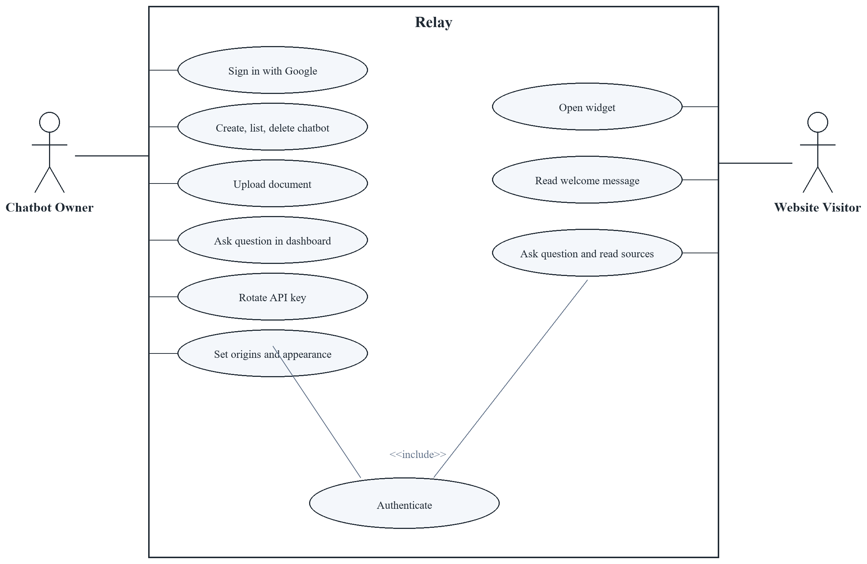
UML Diagram — Use Case
Owner and website visitor
How to read it
▸ The owner signs in, manages chatbots, uploads files, and tests questions.
▸ The visitor only opens the widget and asks a question.
▸ Upload and delete are not visitor actions.
▸ Both paths include Authenticate: a session for the owner, an API key for the visitor.
Relay · MCA Research Project · P.E.S. Modern College of Engineering · 2026–27
08 / 23

Slide 9
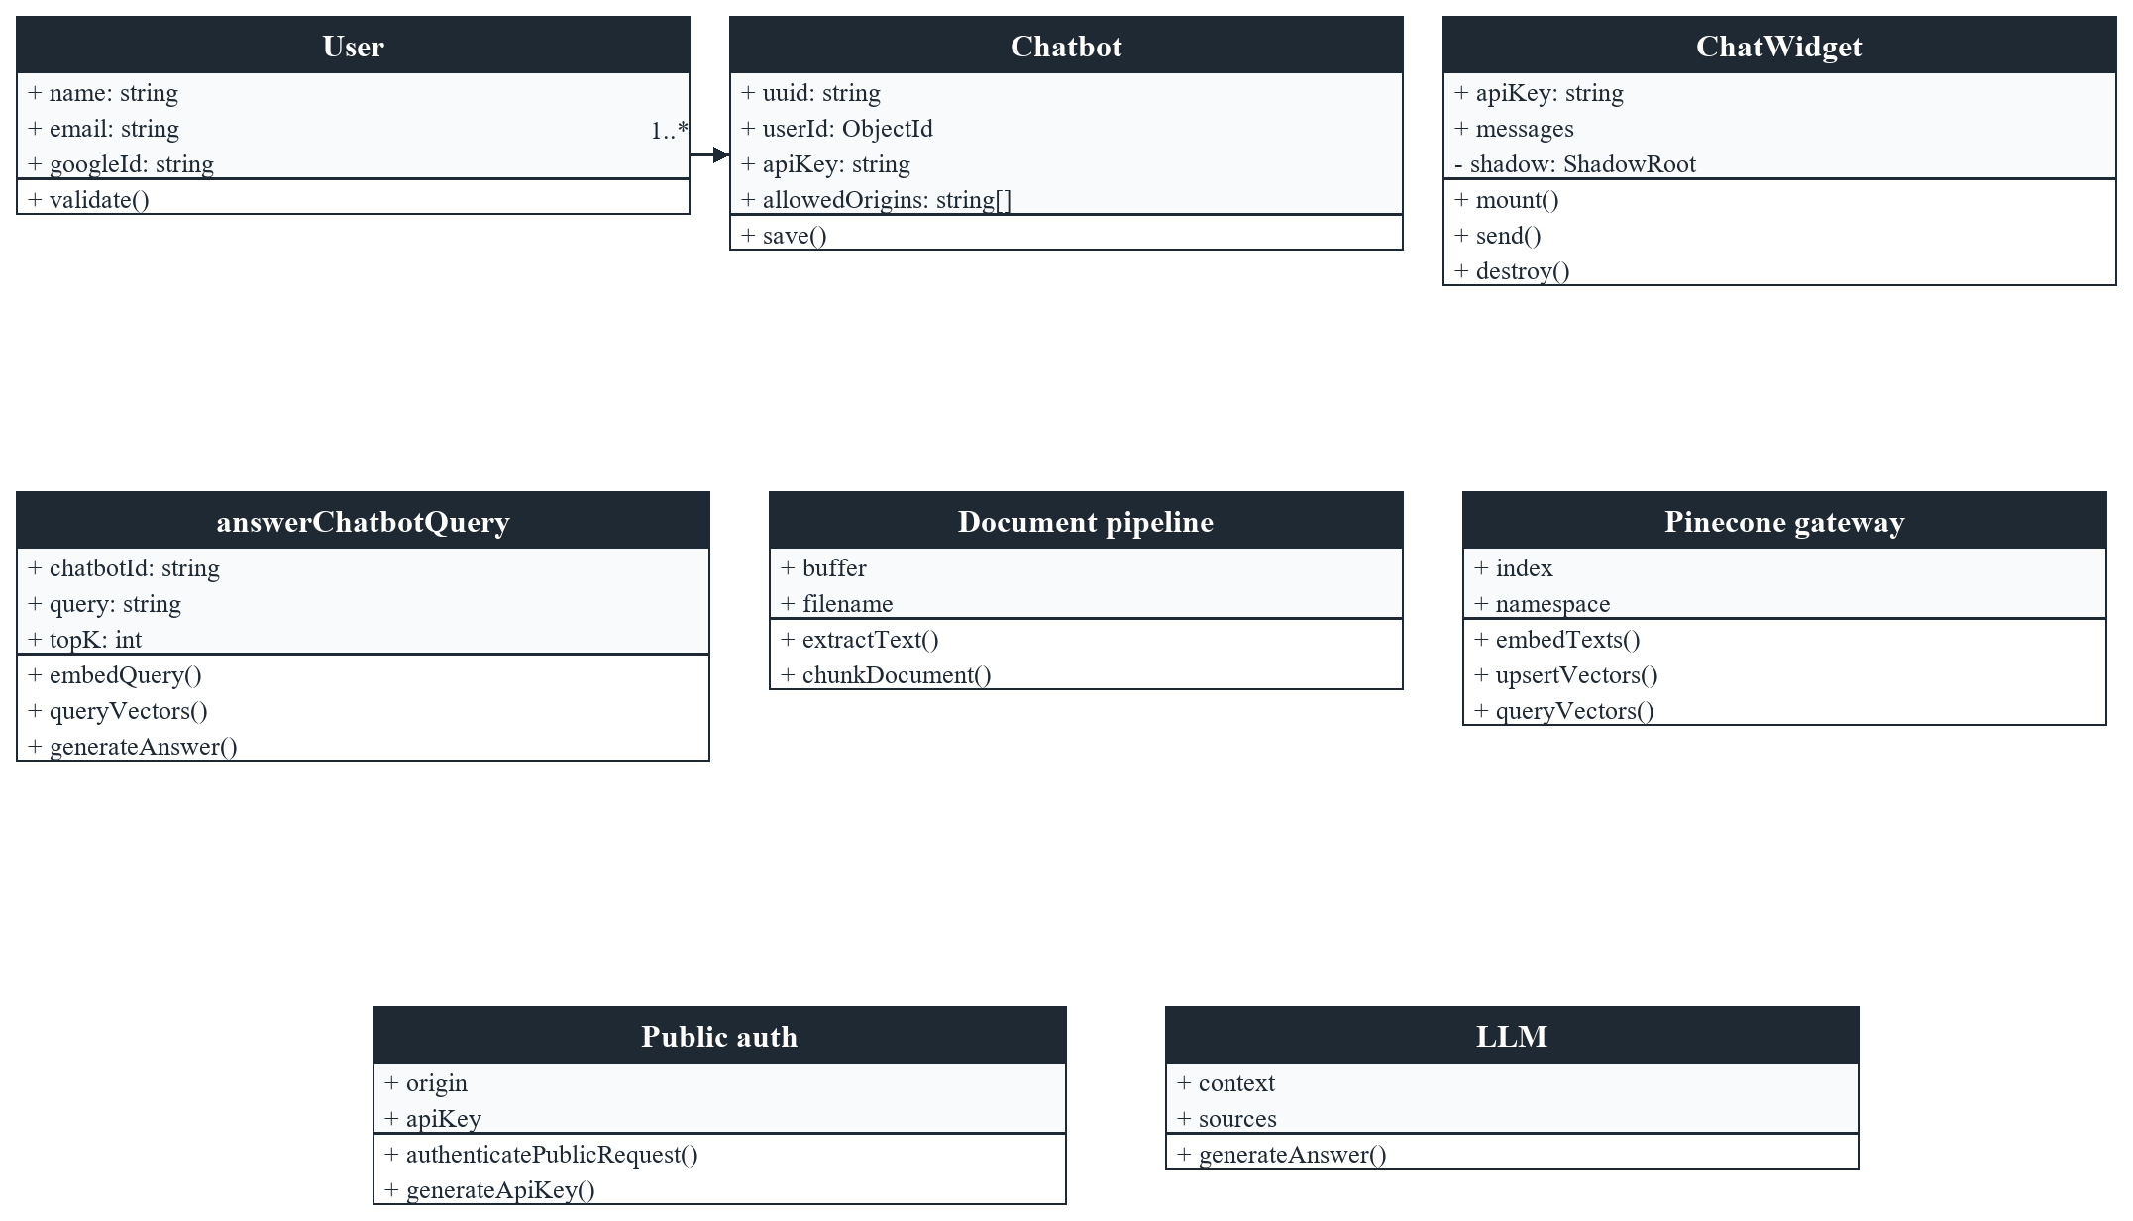
UML Diagram — Class
Core domain classes
One user owns many chatbots. Answering runs through answerChatbotQuery, the document pipeline, Pinecone, public auth, and the LLM.
Relay · MCA Research Project · P.E.S. Modern College of Engineering · 2026–27
09 / 23

Slide 10
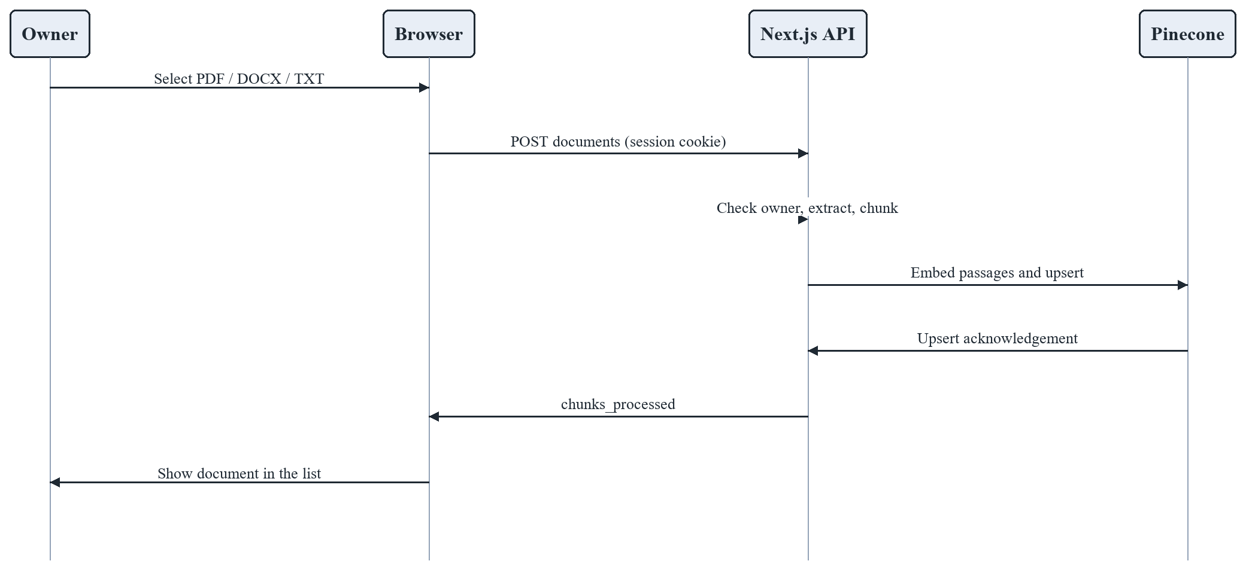
UML Sequence — Document Upload
Document Upload
The owner uploads a file. The API checks ownership, chunks the text, and upserts vectors.
Relay · MCA Research Project · P.E.S. Modern College of Engineering · 2026–27
10 / 23

Slide 11
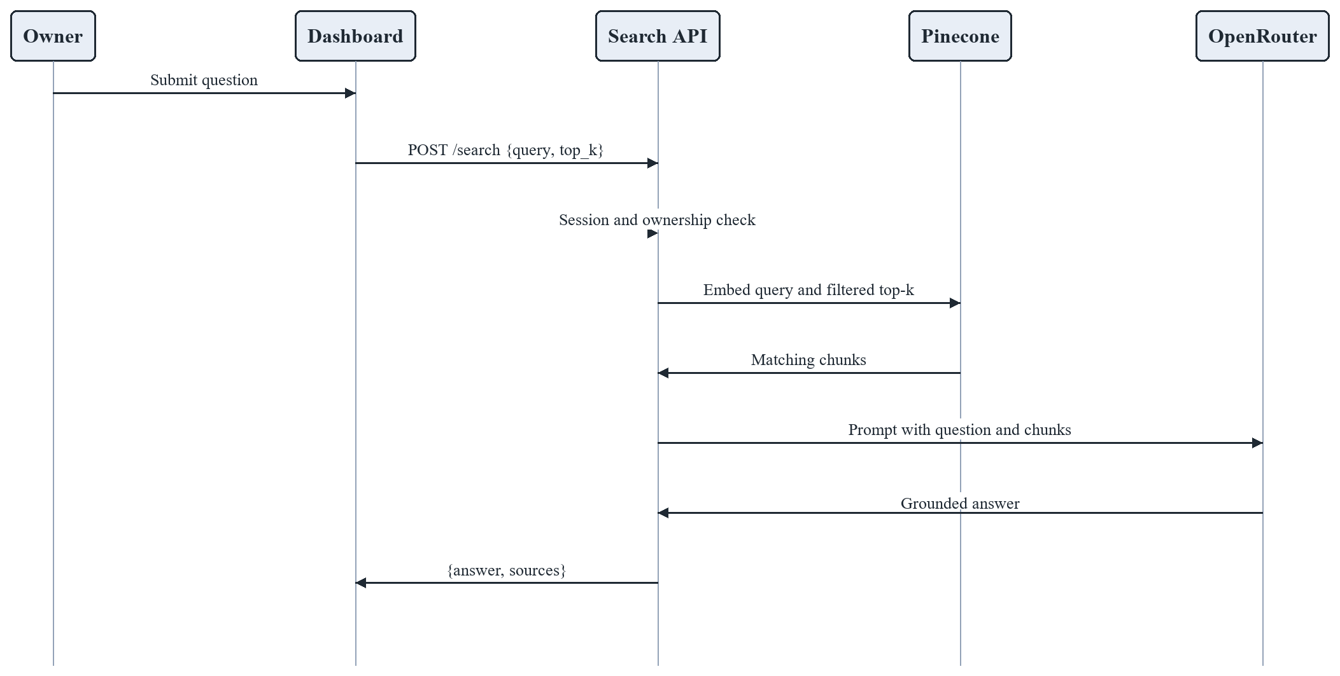
UML Sequence — Dashboard Question and Answer
Dashboard Question and Answer
A signed-in owner asks a question. Retrieval is filtered, then the LLM answers from those chunks.
Relay · MCA Research Project · P.E.S. Modern College of Engineering · 2026–27
11 / 23

Slide 12
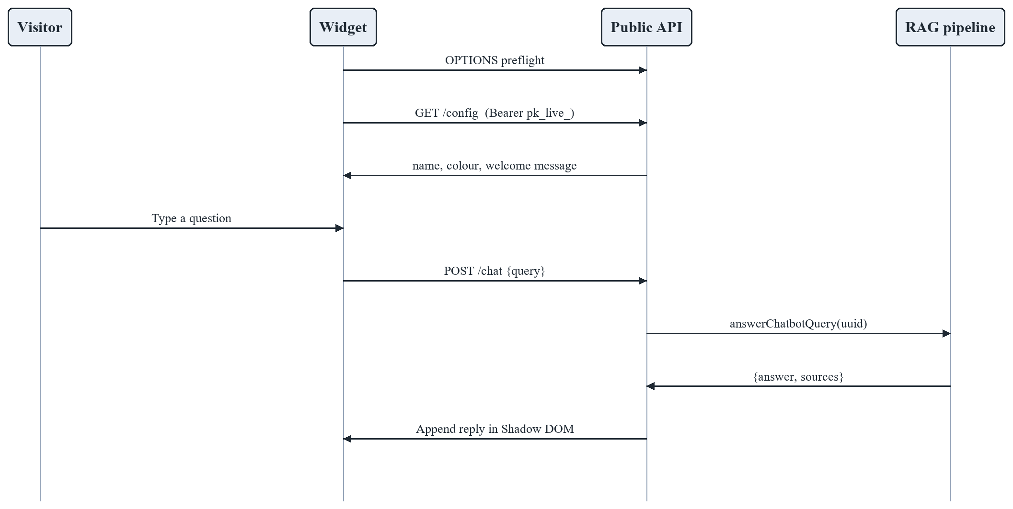
UML Sequence — Public Widget Chat
Public Widget Chat
The visitor never receives the owner session. The widget uses the public key and the same answer function.
Relay · MCA Research Project · P.E.S. Modern College of Engineering · 2026–27
12 / 23

Slide 13
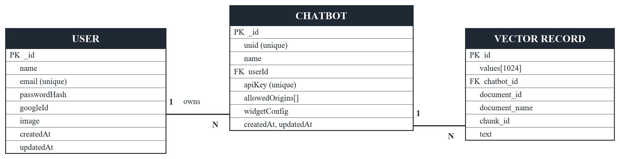
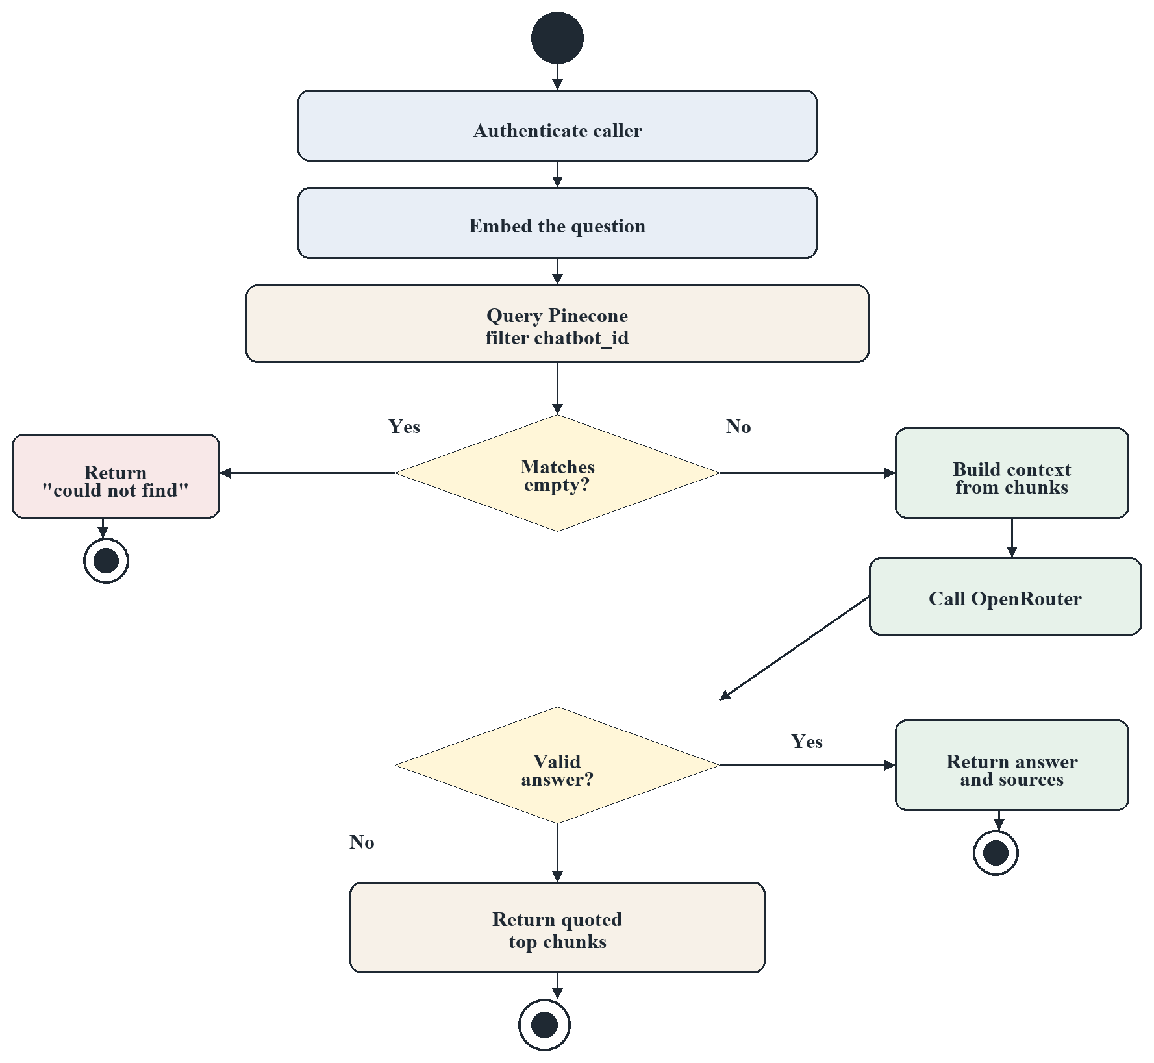
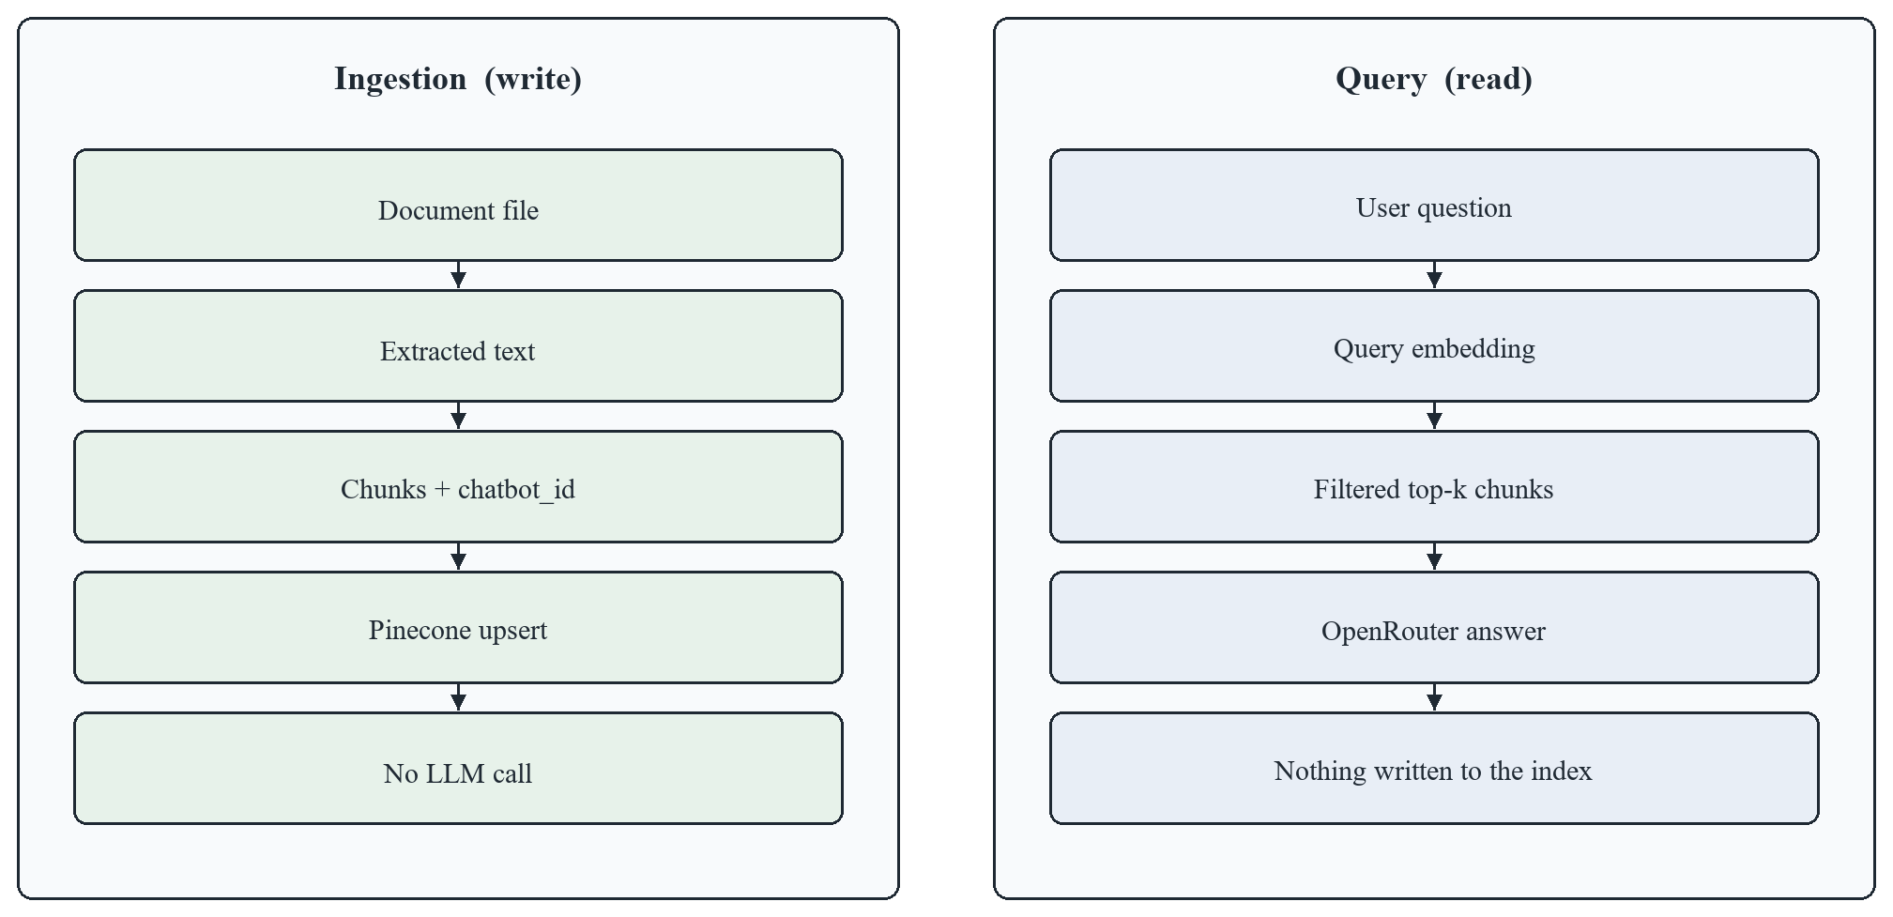
UML Diagrams — Activity, Data and Structure
Activity · RAG answering
ERD · user owns chatbots; vectors are in Pinecone
Data flow · ingestion writes, query only reads
Relay · MCA Research Project · P.E.S. Modern College of Engineering · 2026–27
13 / 23

Slide 14
Working of Retrieval-Augmented Generation
1 Query
Dashboard or widget
2 Embed
inputType: query
3 Retrieve
Cosine + filter
4 Top-k
5, or 10 public
5 Context
DOCUMENT i : text
6 LLM
Context only, 0.1
7 Guard
Empty or failure
8 Answer
Cite or refuse
Left to right. Dense retrieval on this chatbot’s chunks. BM25 is discussed only as a weak baseline for paraphrases.
Traditional LLM
RAG in Relay
Question
LLM
Answer
Question
Retrieve
LLM + context
Cited answer
May answer from parametric memory alone. The source of a private fact is not shown.
The prompt forbids facts outside the retrieved chunks. Sources and scores are returned.
What this changes
The model depends less on its original training data. The knowledge base is updated by uploading a file, not by retraining.
If no chunk matches, the system says it could not find the answer and does not call the LLM.
Relay · MCA Research Project · P.E.S. Modern College of Engineering · 2026–27
14 / 23

Slide 15
System Workflows, Diagrams & Test Cases
A Query flow
B Activity
C Ingestion
D Evaluation
User query
Ask question
Upload file
Set a scenario
Authenticate
Check access
Extract text
State expected
Top-k retrieve
Search index
Recursive chunk
Run on the system
Build context
Match found?
Embed passage
Record observed
LLM
Generate or refuse
Upsert vectors
No labelled scores
Cited answer
Show sources
Return count
Review questions
E Answer states
Idle
Query
Retrieve
Generate
Delivered
No match → Refusal, no LLM call
LLM failure or leaked reasoning → Raw excerpt
Test case | Input / scenario | Expected result | Status
Short chunk | Text under 800 characters | One chunk | Pass
Long chunk | Paragraphs split by a blank line | Each chunk ≤ 800; metadata kept | Pass
In-corpus question | Wording close to an uploaded chunk | Grounded answer and source name | Observed
Paraphrase | Same meaning, different words | Dense retrieval still returns the chunk | Observed
Unknown question | Answer is not in any document | Refusal; no invented policy | Observed
Cross-tenant | Ask chatbot A about chatbot B’s file | B’s text excluded by chatbot_id | Observed
LLM failure | Rate limit or leaked reasoning | Quoted excerpt of the top chunks | Observed
Access control | No session, non-owner, or bad origin | HTTP 401 or 403 | Pass
Relay · MCA Research Project · P.E.S. Modern College of Engineering · 2026–27
15 / 23

Slide 16
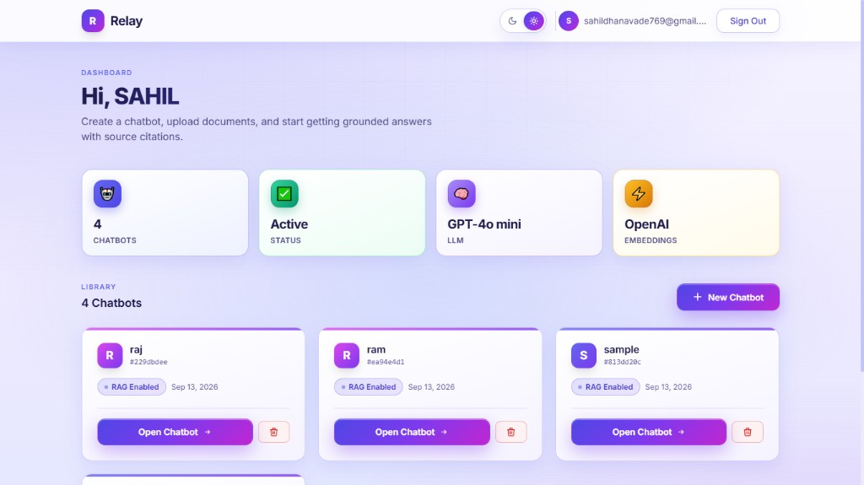
Product Screenshot — Owner Dashboard
Four chatbots on one account
▸ After Google sign-in the owner sees a library of independent chatbots.
▸ Each bot shows RAG Enabled. Opening or deleting one does not change the others.
▸ This is the account-level view of multi-tenancy.
Relay · MCA Research Project · P.E.S. Modern College of Engineering · 2026–27
16 / 23

Slide 17
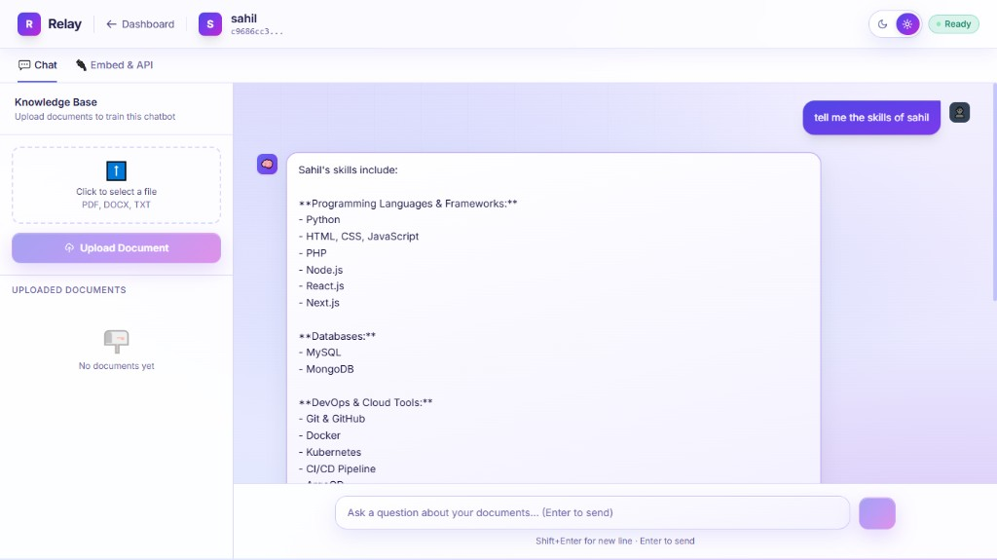
Product Screenshot — Chat Workspace
Grounded answer on chatbot sahil
▸ The question was “tell me the skills of sahil”.
▸ The answer is a structured list taken from the uploaded document, not a raw vector dump.
▸ The same screen accepts PDF, DOCX, and TXT, and opens Embed & API.
Relay · MCA Research Project · P.E.S. Modern College of Engineering · 2026–27
17 / 23

Slide 18
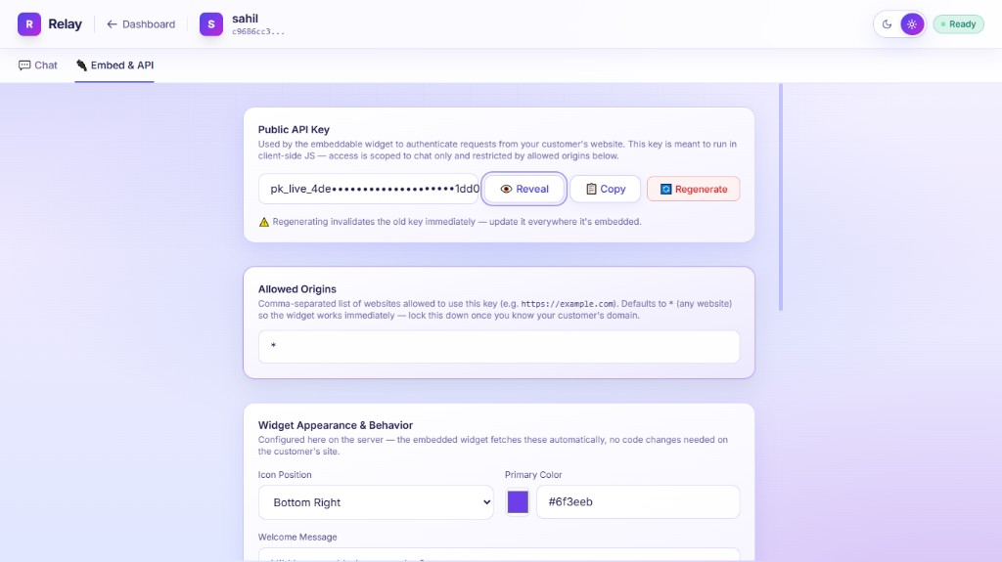
Product Screenshot — Embed Settings
Public key, origins, and appearance
▸ Each chatbot has a pk_live_ key. Regenerating it invalidates the previous key.
▸ The key allows chat only. Allowed origins restrict which sites may call it.
▸ Colour, position, and welcome text are stored on the server.
Relay · MCA Research Project · P.E.S. Modern College of Engineering · 2026–27
18 / 23

Slide 19
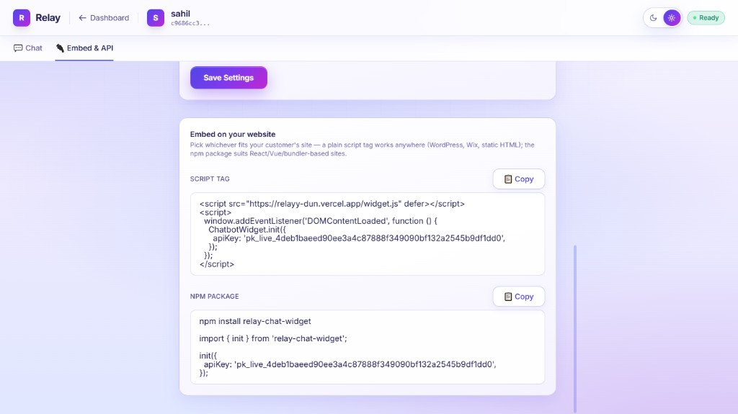
Product Screenshot — Embed Snippets
Script tag and npm package
▸ A customer site can load widget.js or install relay-chat-widget.
▸ The page sends only the public API key. It does not receive the owner session.
▸ Changing appearance in the dashboard updates the widget without rebuilding the site.
Relay · MCA Research Project · P.E.S. Modern College of Engineering · 2026–27
19 / 23

Slide 20
Future Scope
01
02
03
Near term
Next
Later
▸ Golden questions per document, with RAGAS and nDCG.
▸ Hybrid retrieval: dense vectors plus BM25 for codes and names.
▸ Cross-encoder reranking of the top 20 down to the top 5.
▸ Delete Pinecone vectors when a file or chatbot is removed.
▸ Conversation memory for follow-up questions.
▸ Analytics: question volume, unanswered rate, top sources.
▸ Rate limits and per-key quotas on the public chat API.
▸ Durable multipart upload to object storage.
▸ More inputs: HTML, Markdown, CSV, and captioned images.
▸ On-premises embeddings when text cannot leave the institution.
▸ Organisation accounts with more than one owner.
▸ Self-RAG: skip retrieval for chitchat, retrieve for knowledge questions.
These directions extend the deployed system. They were not implemented in the current study.
Relay · MCA Research Project · P.E.S. Modern College of Engineering · 2026–27
20 / 23

Slide 21
Limitations
Research limitations
System limitations
▸ Retrieval quality is not scored on a labelled set. RAGAS, BLEU, and nDCG were not computed.
▸ The reported evaluation is functional and qualitative. It is not a large information-retrieval benchmark.
▸ Answer quality still depends on chunk quality. A bad split can make the model under-answer.
▸ The study does not estimate accuracy on a public question-answering dataset.
▸ Each question is independent. Follow-ups are not resolved with dialogue history.
▸ PDF extraction is text only. Scanned pages, tables, and figures are not parsed.
▸ Large-file reassembly is in memory and can fail across serverless instances.
▸ The default origin list is “*”. A copied public key can still query an allowed origin.
▸ Deleting a chatbot removes the database record, not the Pinecone vectors.
▸ Embeddings and generation depend on Pinecone and OpenRouter. Production sign-in is Google only.
Relay · MCA Research Project · P.E.S. Modern College of Engineering · 2026–27
21 / 23

Slide 22
Conclusion
01
RAG fits closed-domain question answering: upload a file to update knowledge, and return the source with the answer.
02
A shared index is sufficient when every vector is tagged with chatbot_id and every query filters on that field.
03
Hosted embeddings and a remote LLM let one Next.js service run the full pipeline, without a Python sidecar.
04
Dashboard chat and the public widget stay consistent because both call the same answer function.
05
A widget key should allow chat only, bound to allowed origins. It is not a secret with write access.
06
Free-tier models need a defined failure path: another model, leak detection, then a raw chunk excerpt.
Takeaway
Better retrieval leads to better context — and better context leads to more reliable generation.
Demonstrated at relayy-dun.vercel.app · npm package relay-chat-widget
Relay · MCA Research Project · P.E.S. Modern College of Engineering · 2026–27
22 / 23

Slide 23
THANK YOU
Questions & Discussion
Aaditi Choramle
Chitrang Choudhari
Sahil Dhanavade
Pratik Kamble
P.E.S. Modern College of Engineering, Pune
Master of Computer Application · 2026–27

