Slide 1
Course Title:- Large Scale Data Analytics
Project Name:- Human Resources Analysis
Student Name:- Sahil Dhankhad

Slide 2
Introduction
Description : Why are the best and most experienced employees of company leaving prematurely? We will try to predict which valuable employees will leave next. Fields in the dataset include
Employee satisfaction level
Last evaluation
Number of projects
Average monthly hours
Time spent at the company
Whether they have had a work accident
Whether they have had a promotion in the last 5 years
Sales
Salary
Whether the employee has left

Slide 3
Description of Solution
Find out the which employee is going to leave.
Develop a model to predict who is going to leave or stay in the company.
You have to select number of employees information you want . This solution doesn’t provide you any kind of probability number.

Slide 4
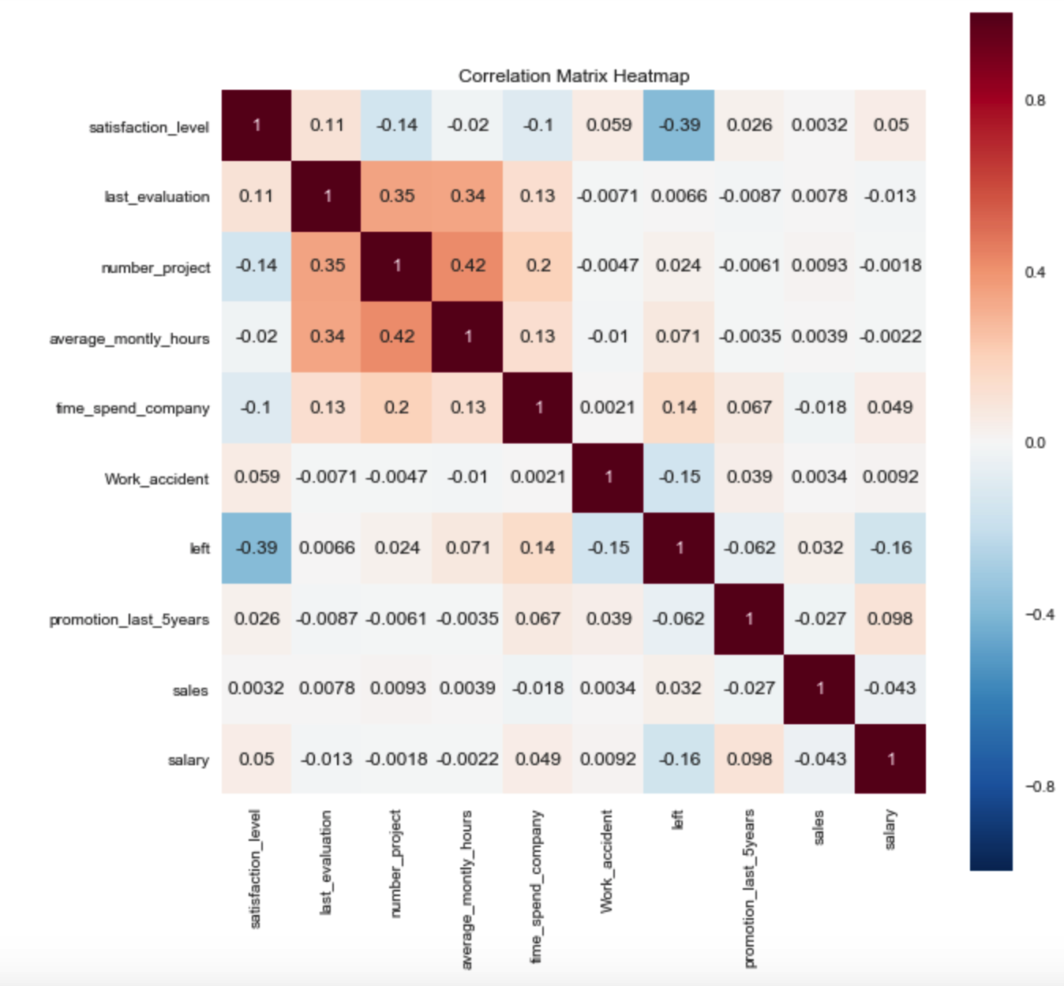
Confusion Matrix
Evaluation and satisfaction level scores are high which shows that less number of employees left the company because of this reason.
Getting promotions makes people happy and they are less likely to leave the job.
The higher the number of projects in hand the more will be the average monthly hours spend in office and it results in good evaluation but on the other hand it makes employees unhappy as they are spending more time at work place and have less time for themselves.

Slide 5
Solution work
Before developing prediction model we need to understand the data.
Before making a decision about the future we should analyze the past.
All factors are analyzed and compared with each other.
How one factor effects the other factor .
Using two factors to predict about how many employee will stay or leave the company.
Ranking all features to know which one is more important analyze the data.
The model is selected based on their accuracy score.
Prediction model gives the information about the employee who is going to leave the company.

Slide 6
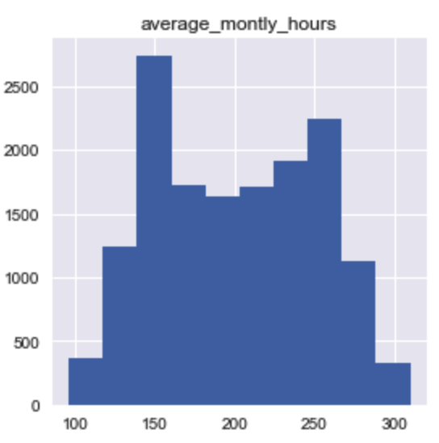
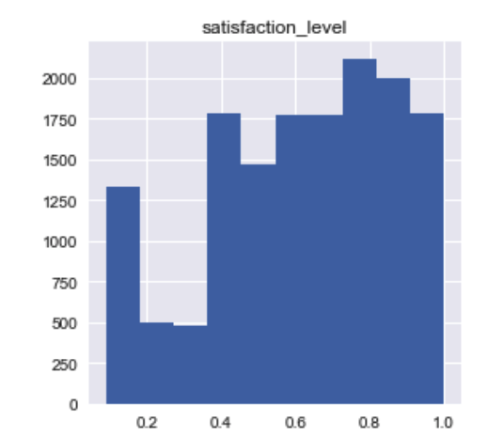
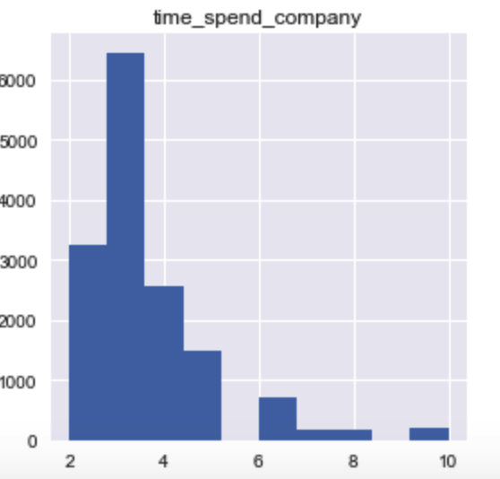
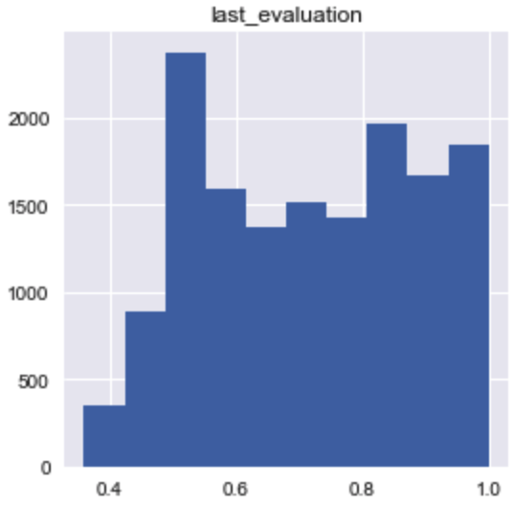
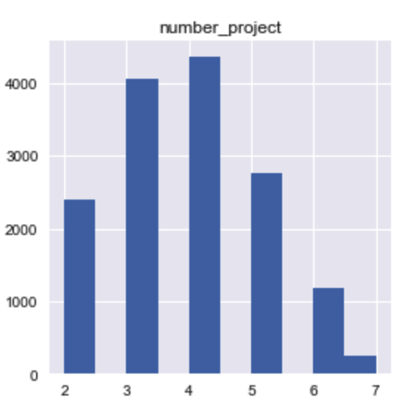
Analysis of data.
large number of employees have spent at least 3 years at the company.
Large number of employees are working 150 hours monthly.
Employee satisfaction level is 0.6-1.
More employees are working on 3-4 projects.

Slide 7
How far I have reached in my solution.
In my solution I have described the information of different departments.
To understand our data properly, analysis of all variables was done.
five models were used to find out the best working model.
Most important feature was found amongst all the features, it helps to build a better predicating model.
Predicating model tells weather the employee is going to stay or leave.

Slide 8
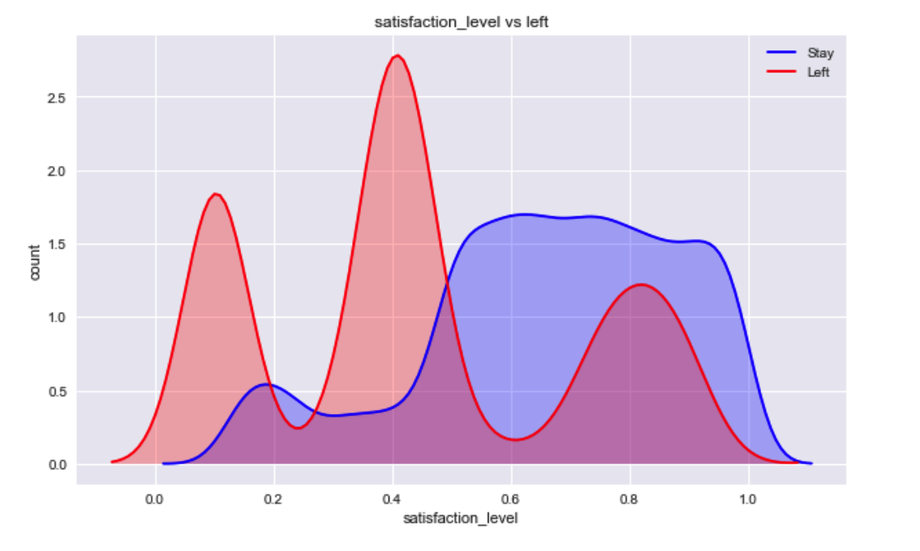
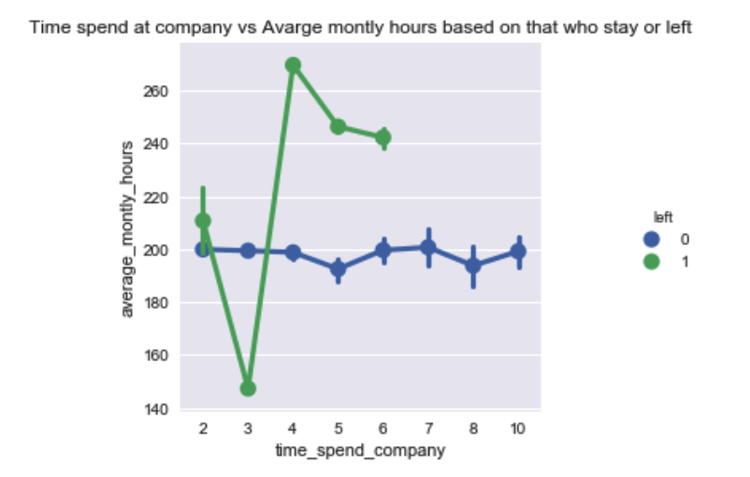
Relationship between Variables

Slide 9
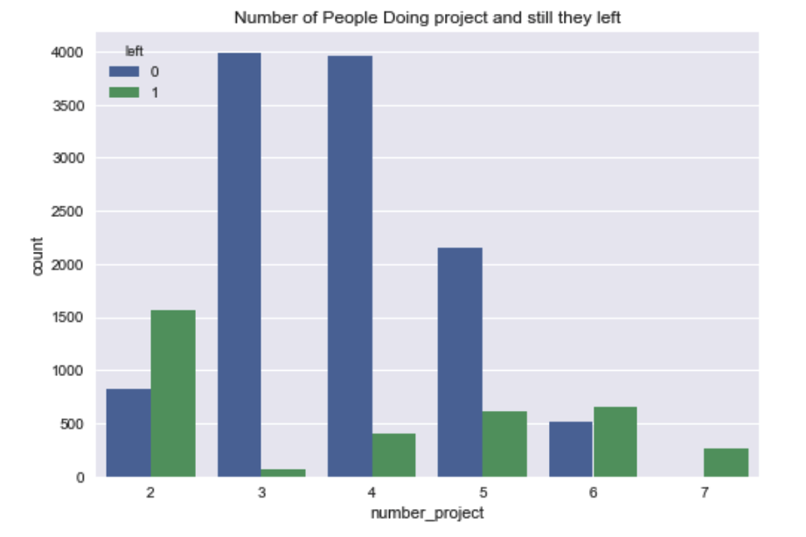
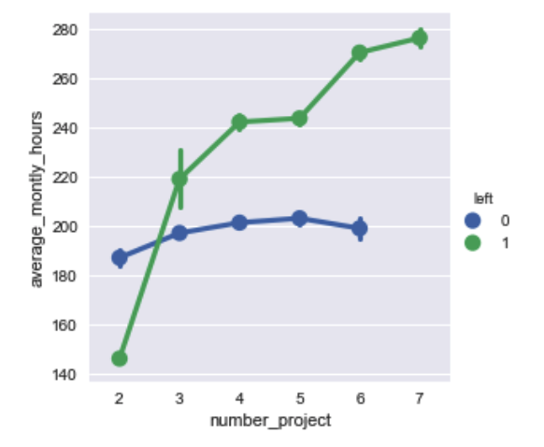
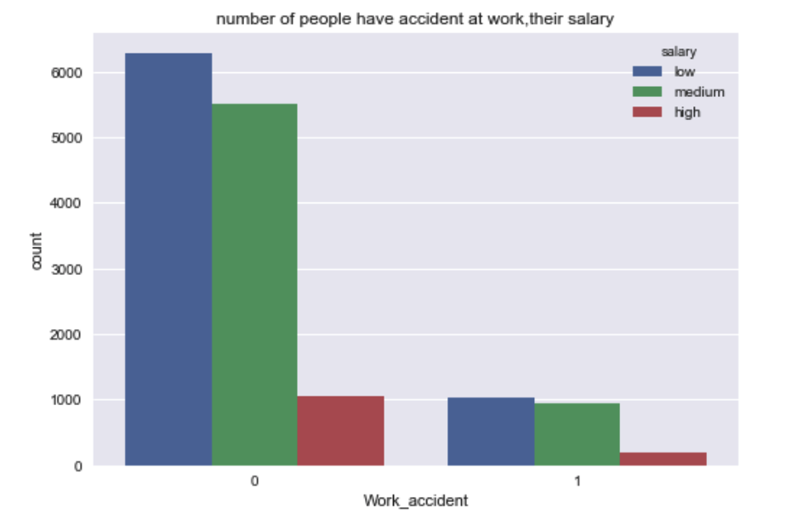
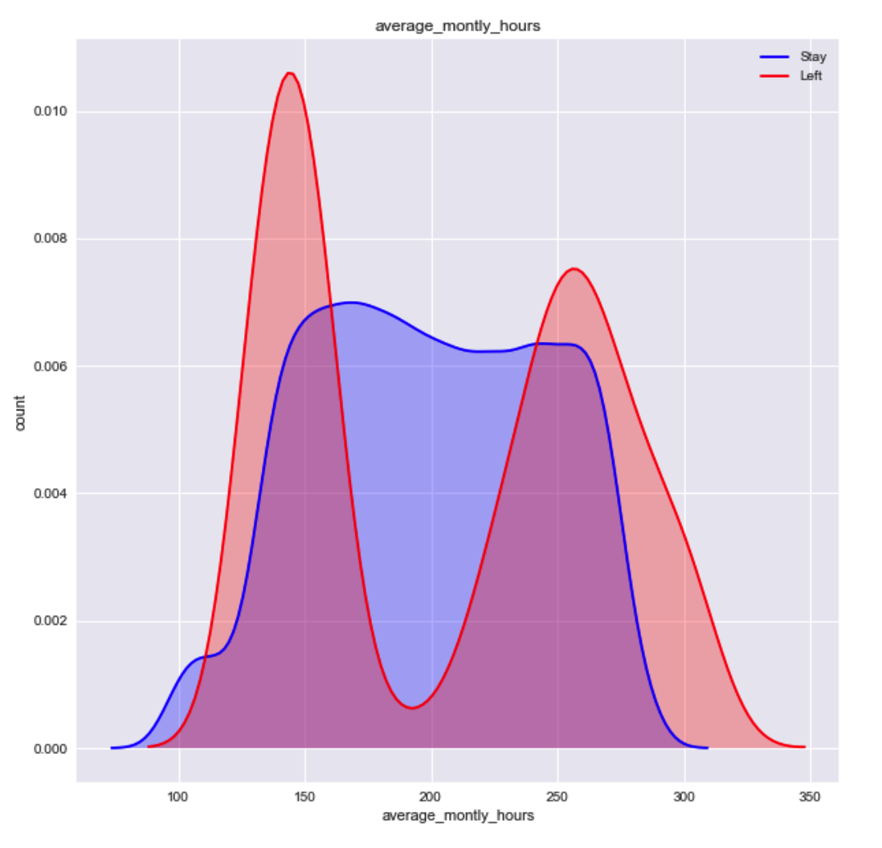
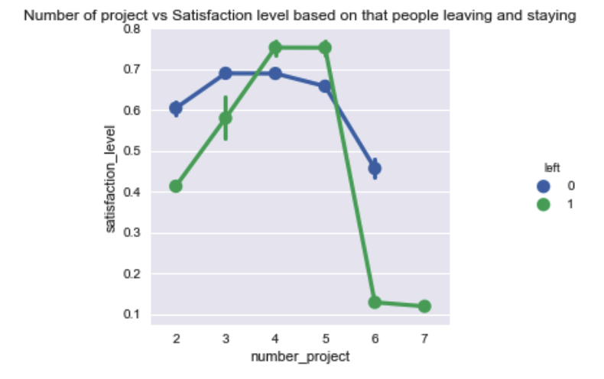

Slide 10
How did I find my Result
I verified all of my variable result with predication probability model.
I find out the variables which are important for prediction model and variables that change the model accuracy score a lot.
I plot the ranking of all important variables using Random forest and Decision tree. Both solution changes the ranking but satisfaction level always got the first ranking.
Satisfaction level is more important among the other variable. If an employee is satisfied with their job then they will stay in the company.
Predicting probability give me the exact probability of which employee is going to leave the company and at the same time it show us the give probability of all related features to leaving employee.

Slide 11
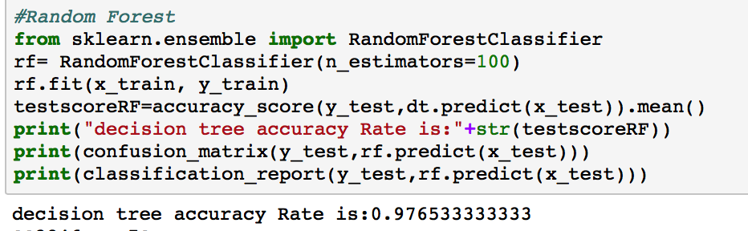
Enhancement
We need more improvement in Variable data.
We need to add more variable so we can calculate more better resulted model
If I had more information about whether the employee are married, have children, single, age group, distance of office from house and other important factor then this model can be improved and more accurate result would have been achieved.

Slide 12
How can you generalize the result of your solution
You can use the same method to find out the solution of any kind.
You can find out the relationship between the different variable and then analyze which variables effect each other.
Using this Important variable you can find out the important features in data.
Using the precision and recall they can find out which model is better than the other.
Using the probability model we can predict the probability of other projects also if we understand the features.

Slide 13
Why I use specific procedure
I need to find out the important variables amongst all the others.
I need to analysis the relationship between all variable. It gives us an idea about which variable affects which feature.
I used five different models to find out the best accuracy score amongst all the chosen models.
I’m using classification report to find out precision and call to find out better model.

Slide 14
How to validate your work Final Model Parameter used
promotion_last_5years Satisfaction_level
Number_project
Average_monthly_hours
Time_spend_company
Work_accident
Salary
I used Random Forest because it gives us best accuracy , better precision and better recall.
 | Accuracy | Precision | Recall
Final Model | 0.94 | 0.99 | 0.99

Slide 15
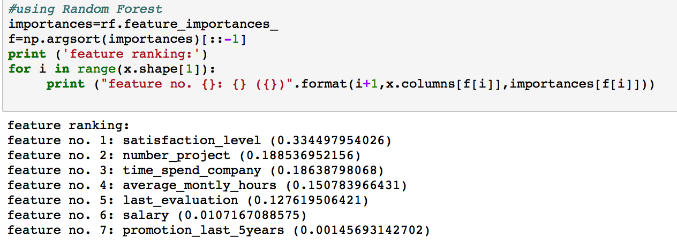
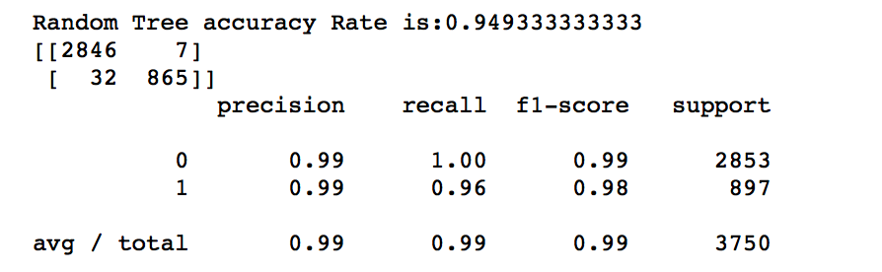
.
Variable Removed :
Work_accident
Sales Variable Used in final Model :
Satisfaction_level
Last_evaluation
Number_project
Average_monthly_hours
time_spend_company
Salary
Promotion_last_5Years

Slide 16
Conclusion
This paper analysis the different method done on employee dataset and usage of many different model to make prediction model to calculate the employee is going to stay or left the company.
This model can be applied throughout many department of the company and used the company HR department to make better decision to make a decision about the employees before they left the company.
You can make this model more perfect by adding more features by at any time.

Slide 17
Conclusion
Employee satisfaction , years at company, number of project , average monthly hours and evaluation are top important features to determining employee left the company.
Employees that have 2,5 and 7 projects was at risk of they are about to leave the company.
Employees with low, medium salaries are the large number who left the company.
Employee satisfaction is the main features or factor responsible for employee left the company.
Employee Who generally left the company when they are worked more than 220-250 hours/month. They feel that they are doing overworked.
Employee generally left the company when they are work 150 hours/month. They feel underworked.

