Slide 1

Experiential Learning
Project Assessment-I on
“ Word Counter” under the course
Python Programming Language (N-PCCCM304P)
Presented By :
Sahil Dhapke
[CM25048]
Under the Guidance
of
Mrs. Suchita Meshkar
Session:2026-27 (ODD )
Department of CSE(AI&ML)
S. B. JAIN INSTITUTE OF TECHNOLOGY MANAGEMENT AND RESEARCH,NAGPUR
An Autonomous Institute, Affiliated to RTMNU, Nagpur

Slide 2
Problem statement
Counting words and letters by hand takes too much time.
People make mistakes when counting long paragraphs manually.
It is hard to see which words are repeated again and again.
Common words like is, the, and and make the count confusing.
We need a fast Python program to count everything automatically.

Slide 3
Objectives
To build a simple tool that counts words and letters instantly.
To count paragraphs and sentences in any text.
To count unique (different) words.
To find and show the most repeated words.
To let users type text or load a .txt file easily.

Slide 4
Algorithm
Start the program.
Ask the user to type text or choose a text file.
Read and save the text.
Break the text into lines, sentences, and words.
Remove common words like is or the if requested.
Count all letters, words, and repeated words.
Show the final numbers on the screen.
Stop the program.

Slide 5
Flowchart/pseudocode
Start
1. User Enters Text or Chooses File
2. Break Text into Words and Sentences
3. Remove Common Stop Words (Optional)
4. Count Words, Letters, and Repeated Words
5. Show Results on Screen
End

Slide 6
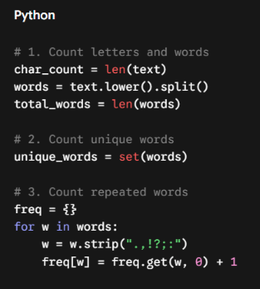
Understanding of Python logic

Slide 7
How it works & benefits
Simple Flow:
User Text → Clean Text → Count Everything → Show Results
How it Works:
  Splits Text: Divides sentences using full stops and words using spaces.
  Counts Words: Uses Python lists and dictionaries to count numbers fast.
  Cleans Up: Removes common words so you see only important words.
Benefits:
  Very fast and saves time.
  100% accurate results with no manual errors.

Slide 8
GitHub Details & My Contribution
Repository Name : python-word-counter
My Contribution:
  Understood the problem and planned the project steps.
  Wrote the simple Python code using split and dict.
  Tested the code with different texts.
  Created the GitHub repo and made this presentation.

Slide 9
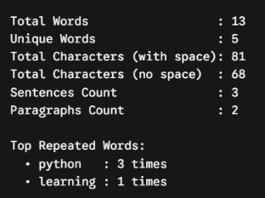
Result / Expected Output

Slide 10
Phase 2
S. B. Jain Institute of Technology Management and research

Slide 11
Improvements
Added character counting
Added sentence counting
Added paragraph counting
Added unique word counting
Added word frequency
Added most frequent word
Added empty input checking
Improved the output design

Slide 12
My Contribution
Created the Word Counter program
Added word counting logic
Added character and sentence counting
Added paragraph counting
Added word frequency
Tested the program with different texts
Improved the final output

Slide 13
Flowchart/pseudocode
Start
Enter Text
Count Words
Count Characters
Count Sentences
Find Word Frequency
Show Result
End

Slide 14
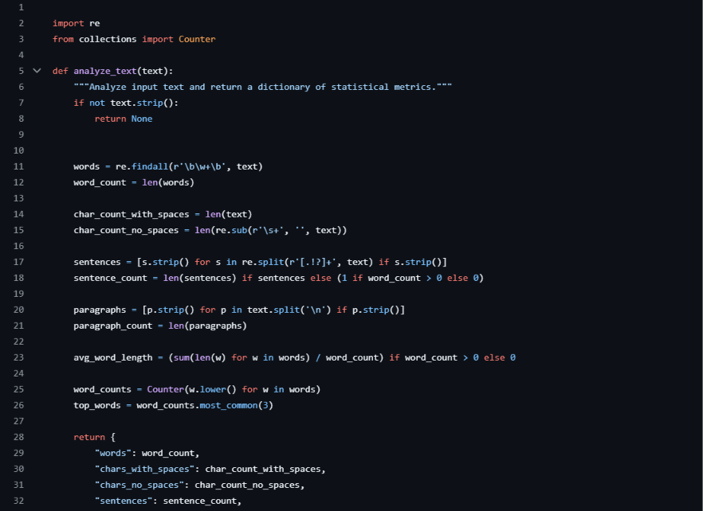
Code

Slide 15
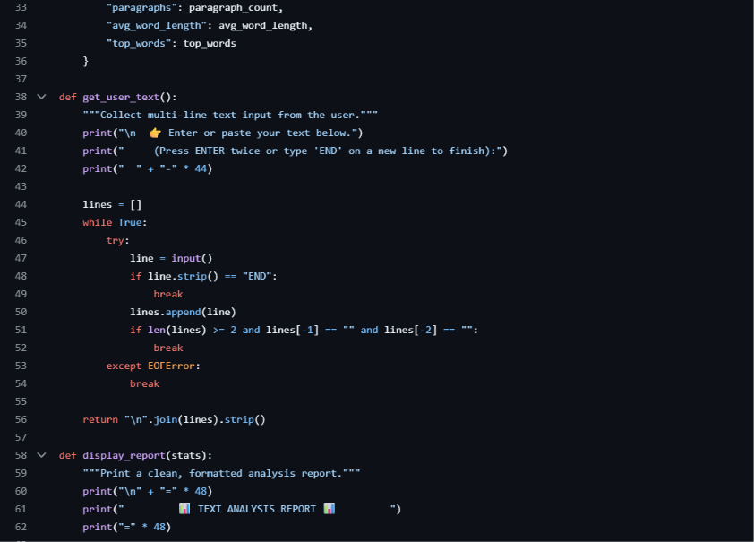

Slide 16
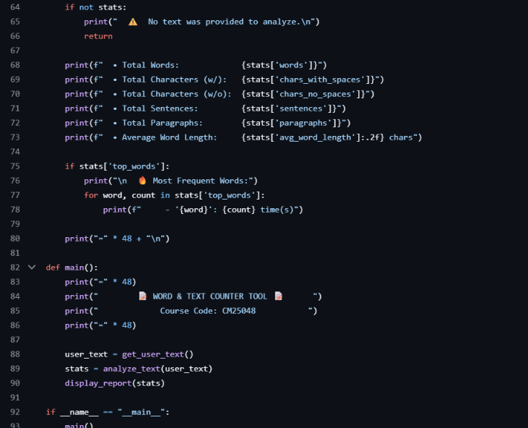

Slide 17
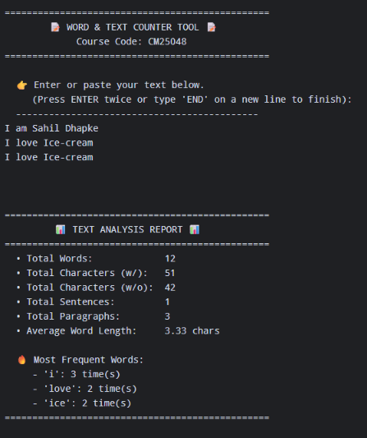
Output

Slide 18
Conclusion
The Word Counter is a simple and useful Python project.
It helps us count words, characters and sentences easily.
It also helps us find repeated words.
This project helped us learn Python basics and text processing.

Slide 19
Phase 3
S. B. Jain Institute of Technology Management and research

Slide 20
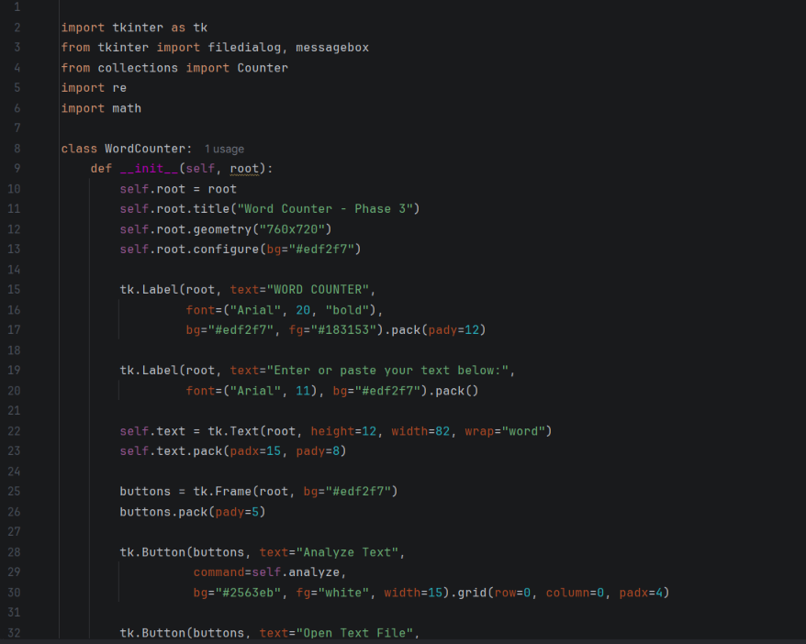
Code

Slide 21
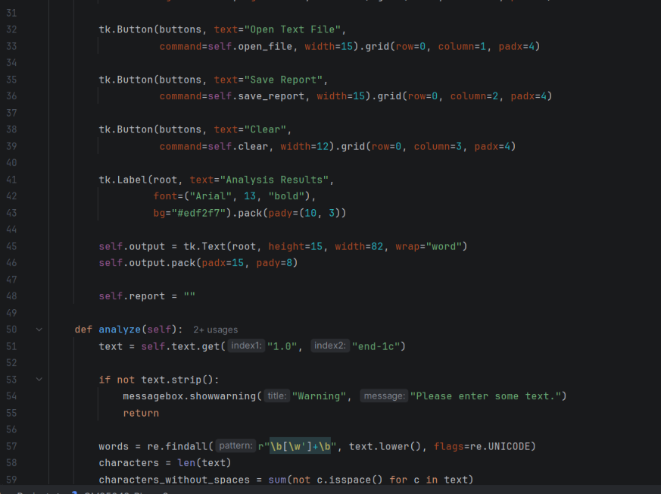

Slide 22
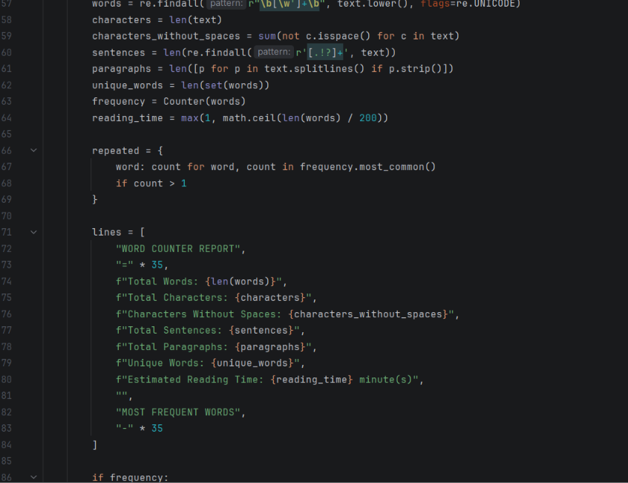

Slide 23
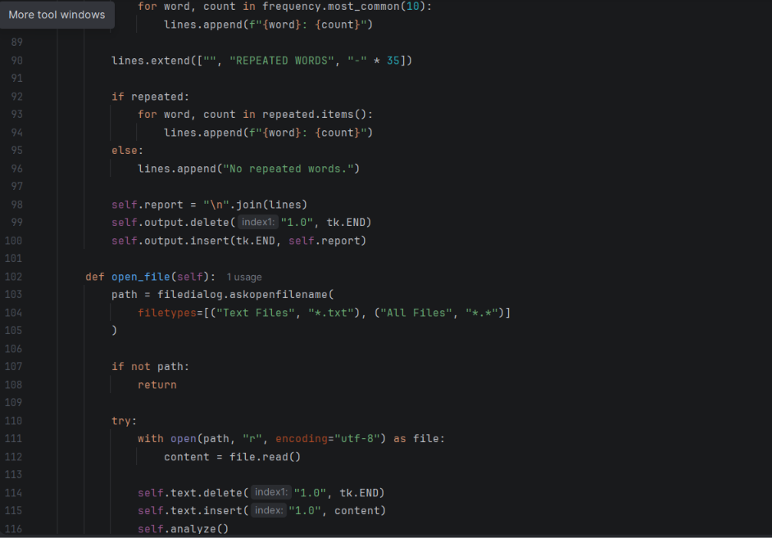

Slide 24
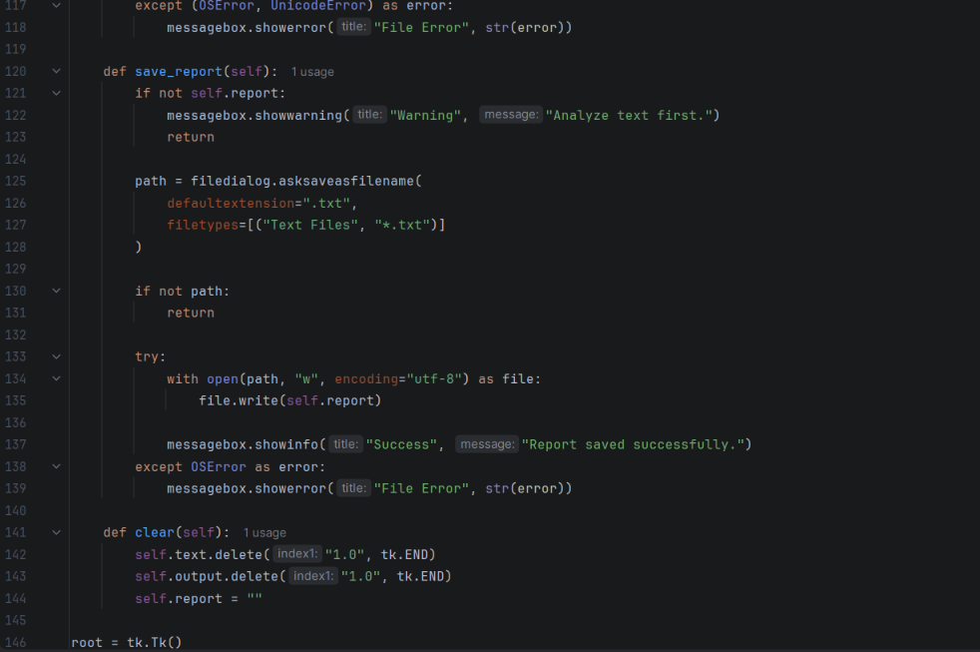

Slide 25
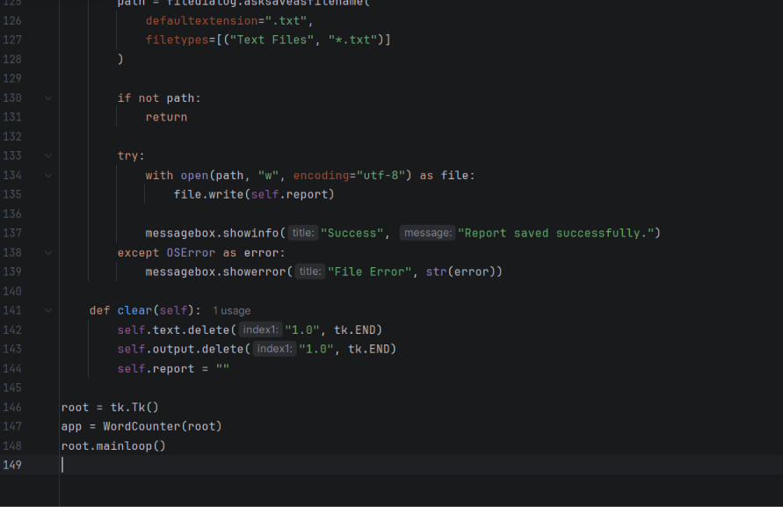

Slide 26
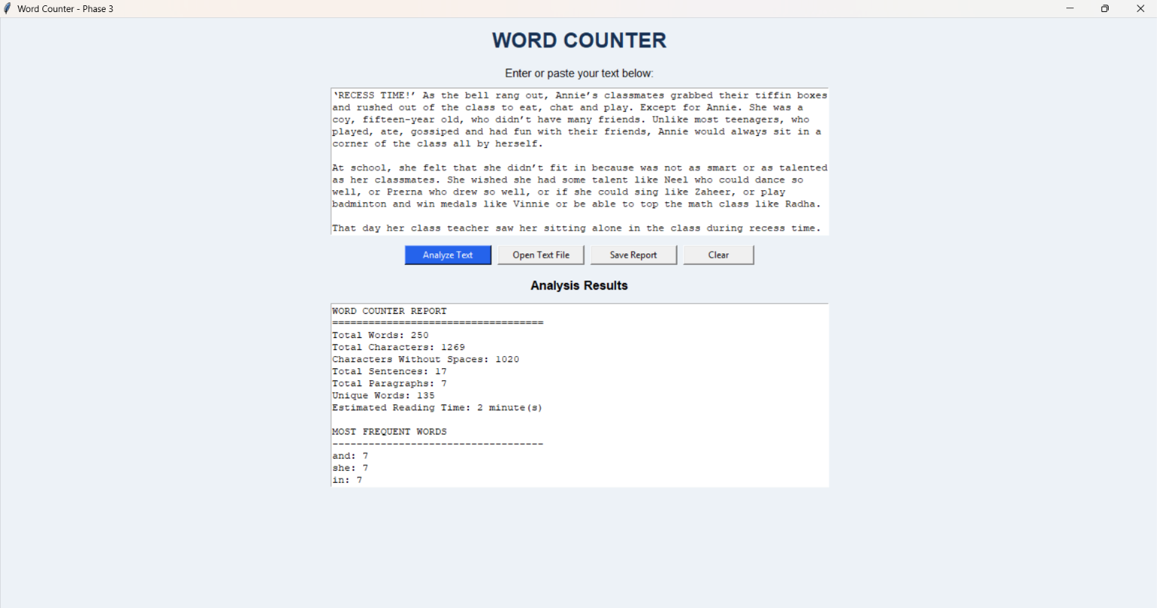
OUTPUT :

Slide 27
Phase 3 – Improvements Made
Improved the Word Counter using Python.
Added a user-friendly interface using Tkinter.
Added an option to enter and analyze text.
Added word and character counting.
Added sentence and paragraph counting.
Added unique word and repeated word detection.
Added a list of the ten most frequently used words.
Added estimated reading time.
Added an option to open text files.
Added an option to save the analysis report.
Added a clear button to reset the input and results.
Improved input validation and error handling.
Tested the program with different text inputs.

Slide 28
Technologies Used
Python
Tkinter
re module
collections.Counter
math module
Functions and loops
Conditional statements
File handling

Slide 29
Thank you
S. B. Jain Institute of Technology Management and research

