Slide 1
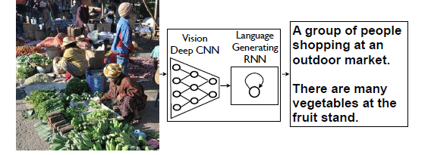
Orthogonality Enforced Encoder-Decoder Approach for Hindi Image Captioning
Working under supervision of
Dr. Rajib Jha
and
Dr. Sriparna Saha
Presented By-
Sahil Aggarwal
1701EE56

Slide 2
PROBLEM DEFINITION
Image captioning refers to the process of generating a textual description for an image which defines the object and activity within the image.
Why Hindi ?
Because it can be useful for people who are not able to read English text.
It is one of the most ancient languages in the world and is spoken in South Asia and India. Hindi, which has evolved from the Sanskrit language, is the fourth most spoken language in the world.
The captions can be read out loud to give visually impaired people a better understanding of their surroundings

Slide 3
Introduction
It is a complex task to generate a well-formed caption of an image because it requires object recognition and object relationships in a natural language.
Deep learning-based image captioning models came into existence with recent advances in machine translation. The goal of machine translation is to translate the source language S into the target language T by optimizing p(T|S).
The topic of image captioning is very similar to machine translation, where the source is an image, and the target is a caption. Here, instead of RNN, a convolutional neural network (CNN) is used as an encoder.

Slide 4
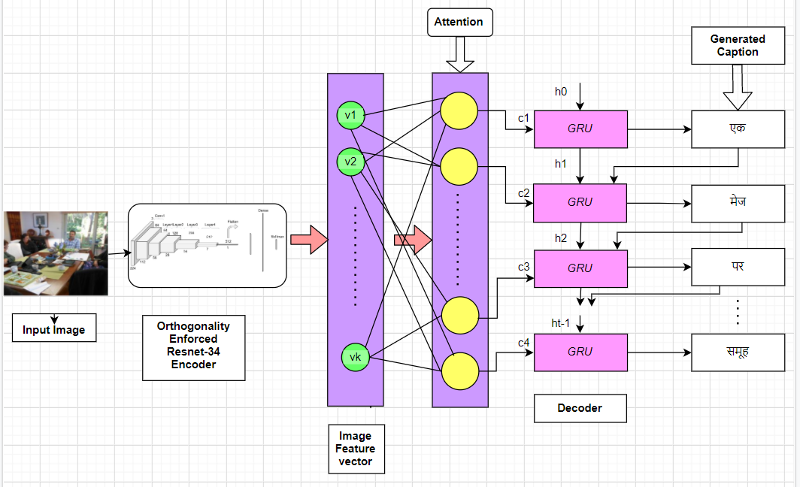
Process Flow Diagram of Proposed Method

Slide 5
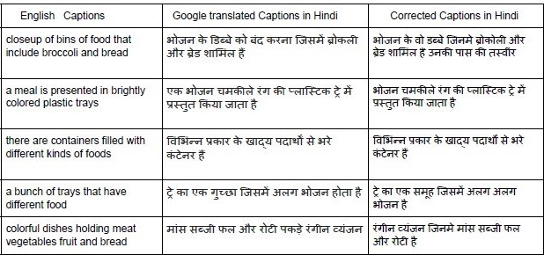

Dataset Description
I have chosen MS-COCO (82783 images with 5 captions for each image) dataset for our experiment which is a commonly used dataset for caption generation in English language.
As no Hindi image captioning dataset is available in the literature,
I was handed manually annotated the captions of this MS COCO dataset to generate a gold standard image captioning data set for Hindi language.

Slide 6
ResNet As Encoder
But Why Resnet (Residual Networks)?
More layers is better but because of the vanishing gradient problem, model weights of the first layers can not be updated correctly through the backpropagation of the error gradient (the chain rule multiplies error gradient values lower than one and then, when the gradient error comes to the first layers, its value goes to zero).
That is the objective of ResNet : preserve the gradient. How?
This residual connection doesn’t go through activation functions that “squashes” the derivatives, resulting in a higher overall derivative of the block.
Because of these skip connections, we can propagate larger gradients to initial layers and these layers also could learn as fast as the final layers, giving us the ability to train deeper networks.

Slide 7
Can we gain more from Orthogonality Regularization in Training Deep CNNs? (2018)
Nitin Bansal Xiaohan Chen Zhangyang Wang
Texas A&M University
Neural Information Processing Systems (NIPS’18)
The basic idea behind orthogonalization is we want different weight matrices to learn uncorrelated features.
For that making Gram Matrix that basically tells correlation between weight elements || W^{T}W - I || close to zero during training helps achieve orthogonality.

Slide 8
Importing trained Resnet model and extracting feature vectors
For importing trained model which is in form of checkpoint.pth.tar., I had to define class of ResNet Model which consists of convolution layer , BatchNormalization layer and Relu activation and maxpooling.
Batch normalization reduces the amount by what the hidden unit values shift around
I had to learn Pytorch framework along this project to extract feature vectors.
I loaded annotations which were in form of pickle file.
Then with 100 batch size I applied trained model on processed dataset converting RGB images to torch stack that are easy to process as they are in numerical forms and extracted feature vectors before avg. pooling layer.

Slide 9
ATTENTION MECHANISM
1. Using representations (such as those from the top layer of a convnet) that extract most imp. information in image has one potential drawback of losing information which could be useful for richer, more descriptive captions. 2. Using more low-level representation can help preserve this information.
Reference- Show, Attend and Tell: Neural Image Caption Generation with Visual Attention ICML (2015)

Slide 10


Attention mechanism contd.
The model takes a single raw image and generates a caption y encoded as a sequence of length c.
where k is the size of the vocabulary and c is the length of the caption.
I used a convolutional neural network in order to extract a set of feature vectors which we refer to as annotation vectors.
The extractor produces l vectors, each of which is a d-dimensional representation corresponding to a part of the image in our case (49x512).

Slide 11
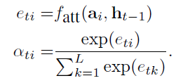
I define the context vector z^t i.e. a dynamic representation of the relevant part of the image input at time t.
I define a mechanism that computes z^t from the annotation vectors ai;
i = 1; : : : ;l corresponding to the features extracted at different image locations.
For each location i, the mechanism generates a positive weight αi which can be interpreted either as the probability that location i is the right place to focus for producing the next word.
The weight i of each annotation vector ai is computed by an attention model fatt for which we use a multilayer perceptron conditioned on the previous hidden state h(t-1)

Slide 12

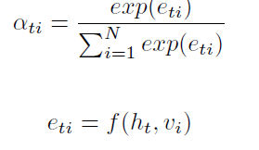
BAHDANAU ATTENTION
It is a commonly used model of attention for encoder-decoder architecture. It is additive attention; here, the context vector is calculated as:
Here f represents proposed feed-forward neural network jointly trained on all parameters, ht is denoting hidden state of RNN at time step t and vi is the image feature vector, N is the length of the generated caption.

Slide 13
IMPLEMENTATION DETAILS (BA)
I feed feature vectors to encoder RNN that produces hidden states and that are passed through decoder RNN.
The hidden states from both encoder and decoder are multiplied with respective weight matrices.
Then I applied tanh activation function to Wcombined.
I calculated alignment scores as follows:
Alignment scores = W _{combined}*tanh(W_{decoder}* H_{decoder} + W_{encoder}*H_{encoder})
Softmax*alignment scores = attention weights

Slide 14
Gated Recurrent Unit as decoder
GRUs are improved version of standard recurrent neural network.
GRU uses, so-called, update gate and reset gate. Basically, these are two vectors which decide what information should be passed to the output.
Update gate
The update gate helps the model to determine how much of the past information (from previous time steps) needs to be passed along to the future.
Reset gate
This gate is used from the model to decide how much of the past information to forget.

Slide 15
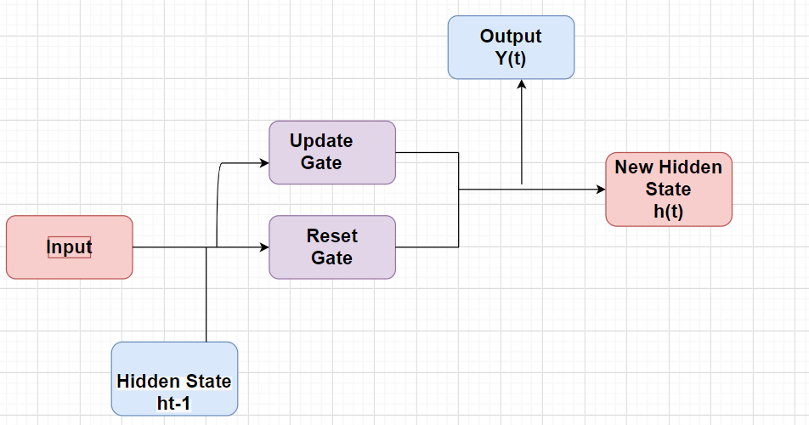




GRU INTERNAL STRUCTURE
zt
rt
z_{t}$=sigmoid(W\left(z\right)∗xt+U\left(z\right)∗ht−1)$
r_{t}$=sigmoid(W\left(r\right)∗xt+U\left(r\right)∗ht−1)$
h’_{t}$=tanh(W∗xt+rt ⨀\left(U∗ht−1\right))$
h_{t}$=zt⨀ht−1+ht′ ⨀\left(1−zt\right))$
I imported gru unit cell using tensorflow rather than implementing to save time and code getting more complex.

Slide 16
My Model Details
I have two main modules that are caption generator and captioning Solver.
Orthogonality enforced RESNET34 is used to extract features of input images of dimension 224∗224 and convert them into feature vectors of dimension 49∗512.
To feed the input caption, the embedding layer with 512 neurons is used, 0.4 Dropout is used to prevent over-fitting.
Softmax cross-entropy loss function is used here with Adam optimizer.
Adam optimizer’s learning rate is 4e−4. There’s a batch size of 128.
It takes approximately 14 hours and 15 epochs to train our model cluster of 8 GPU Nvidia GTX 1080.
It takes roughly 20 to 30 seconds to generate a caption for an image.

Slide 17
BRIEF REVIEW
I extracted the features from image using pre-trained CNN (ResNet-34 good image classification accuracy on ImageNet with orthogonality enforced as proposed in the paper (Novelity).
I have used unidirectional RNN like GRU(Gated Recurrent unit) on the decoder side.
I have used Bahdanau attention as attention mechanism here.

Slide 18
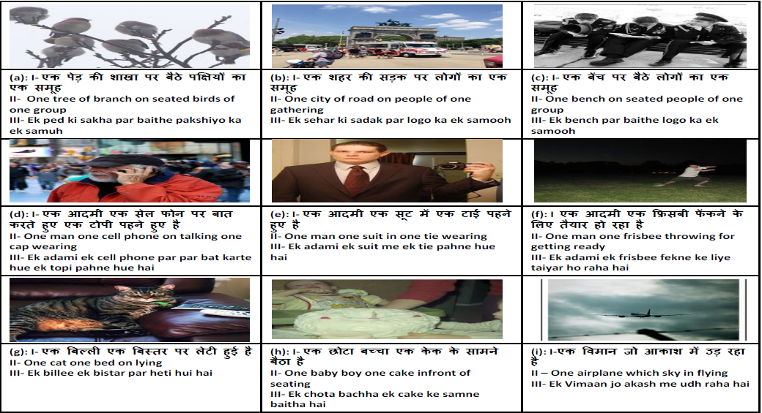
Output
Generated captions by the proposed method on test images, here I, II and III represent: (I)- Generated caption in Hindi, (II)-Gloss annotation, (III)-
Transliteration

Slide 19
Previous work
To the best of our knowledge, the following previous works have
been done for image captioning in the Hindi language:
Dhir et al. [1] had used encoder-decoder based architecture for Hindi image captioning, where they had used RESNET 101 and GRU as encoder and decoder, respectively.
Mishra et al. [2] had proposed a transformer-based architecture where they had used transformer-based decoder for language modeling.
Mishra et al. [3] had explored different encoder decoder architectures with different attention mechanisms for Hindi image captioning.
Therefore, we have compared our approach with these methods.

Slide 20
My Results Comparison
These are the results for image captioning in the Hindi Language using orthogonality regularization based CNN. The Bilingual Evaluation Understudy Score, or BLEU for short, is a metric for evaluating a generated sentence.
Model | BLEU-1 | BLEU-2 | BLEU-3 | BLEU-4
OERN34 + Bahdanau attention with GRU | 66.1387 | 47.9718 | 33.4135 | 22.7287
OERN34 + Adaptive attention with GRU | 66.9081 | 47.9280 | 32.2677 | 21.2099
Mishra et al. [3] TALLIP | 67.0 | 47.8 | 31.9 | 21.2
Mishra et al. [2] Transformer Approach | 62.9 | 43.3 | 29.1 | 19.0
Dhir et al.[1] CICling | 57.0 | 39.1 | 26.4 | 17.3

Slide 21
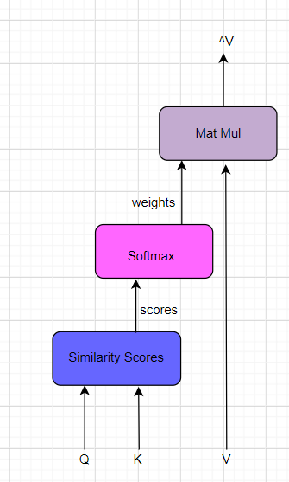
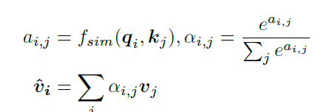
Attention (Future Work)
School of Electronic and Computer Engineering, Peking University
Peng Cheng Laboratory
Macau University of Science and Technology
An attention module fatt(Q;K; V ) operates on some queries, keys and values and generates some weighted average vectors (denoted by Q, K, V and ^ V respectively).
It first measures the similarities between Q and K and then uses the similarity scores to compute weighted average vectors over V.

Slide 22
Attention on ATTENTION
Thus we propose the AoA module to measure the relevance between the attention result and the query. The AoA module generates an “information vector” i and an “attention gate” g via two separate linear transformations, which are both conditioned on the attention result and the current context (i.e. the query) .
The attention module outputs a weighted average for
each query, no matter whether or how Q and K/V
are related. Even when there is no
relevant vectors, the attention module
still generates a weighted average vector,
which can be irrelevant or even misleading
information.

Slide 23
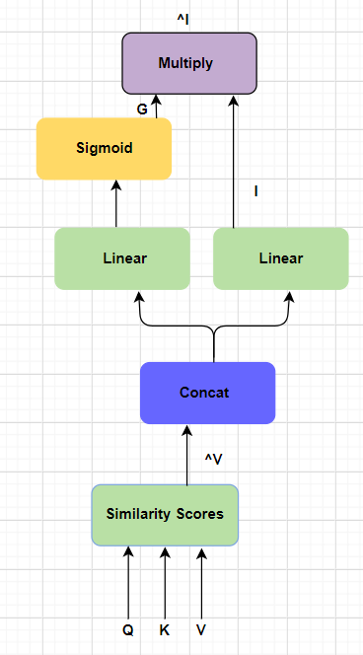
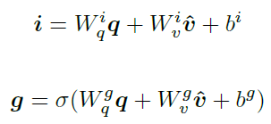

Attention on Attention (AoA) Contd.
Thus we propose the AoA module to measure the relevance between the attention result and the query. The AoA module generates an “information vector” i and an “attention gate” g via two separate linear transformations, which are both conditioned on the attention result and the current context (i.e. the query) q.

Slide 24
Reference taken for feature extraction code
https://github.com/VITA-Group/Orthogonality-in-CNNs/blob/master/Imagenet/resnet/resnet.py
https://github.com/yunjey/show-attend-and-tell/blob/master/prepro.py
Actual Code
https://drive.google.com/file/d/16GRN3AwKF6akl7eUx2zZ32MTx-5klFmP/view?usp=sharing

Slide 25
Links:
https://www.overleaf.com/project/5feb768fa42b0014dbe1abf6
https://github.com/VITA-Group/Orthogonality-in-CNNs
https://github.com/yunjey/show-attend-and-tell
References:
Orthogonality in CNNs
https://arxiv.org/pdf/1810.09102.pdf
Show Attend and tell - Neural Image Caption Generator with Visual Attention
https://arxiv.org/pdf/1502.03044.pdf

