Slide 1

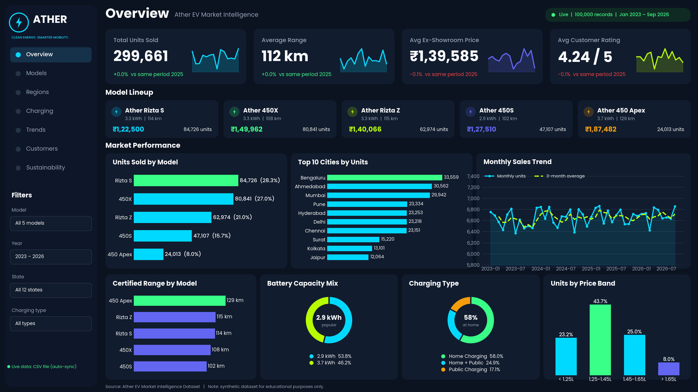
ATHER
EV MARKET ANALYTICS PROJECT
Ather EV Market Intelligence
Sales, model, regional and sustainability insights from 100,000 records
The interactive Streamlit dashboard (full 4K image on slide 4)
100K
records
5
models
18
cities
Notes:
Introduce the project: a 100,000-record Ather EV market dataset turned into an interactive Streamlit dashboard. Note the dataset is synthetic and for educational use.

Slide 2

Introduction & Dataset
Ather Energy builds electric scooters for Indian cities. This project turns a 100,000-record market dataset into one dashboard for sales, pricing, range, charging and ratings.
Each record holds 15 fields: model, year, battery, range, price, city, state, charging type, month, units, rating and warranty.
299,661
₹4,183 Cr
scooters sold
ex-showroom value
18 cities
45 months
across 12 states
Jan 2023 – Sep 2026
5 models: Rizta S, Rizta Z, 450S, 450X and 450 Apex
Synthetic dataset, built for learning
Notes:
Revenue is ex-showroom price multiplied by units sold, about Rs 4,183 crore across 299,661 units.

Slide 3





Objective & Approach
Model insights
Regional insights
Customer view
Sustainability
Compare units, revenue and range by model
Find the cities and states that lead sales
Track ratings, price bands and charging habits
Estimate CO2 and petrol savings
Approach
Load CSV
Clean & enrich
Aggregate
Visualise
Recommend
Notes:
Four objectives drive the dashboard. The pipeline: load the CSV, enrich it (date, revenue, CO2 estimates, price bands), aggregate, visualise, then turn insights into recommendations.

Slide 4



The Interactive Dashboard
7 pages
Overview to Sustainability
Live data
CSV auto-sync, simulator or API
Filters
Model, year, state and charging
Notes:
Full-resolution (3840 x 2160) dashboard image. Open it zoomed to read every chart. KPI strip, model lineup, units by model, top cities, trend, range, battery, charging and price band.

Slide 5
Model Performance
49.3%
of units come from the Rizta family
₹1,212 Cr
450X earns the most revenue (29.0%)
8.0% → 10.8%
450 Apex: share of units vs revenue
Notes:
Rizta S leads units (84,726) but the 450X earns the most revenue because of its higher price. The premium 450 Apex punches above its unit share.

Slide 6
Regional Performance
31.4%
of units from Bengaluru, Ahmedabad and Mumbai
53.9%
from Maharashtra, Gujarat and Karnataka
4.23 – 4.25
average rating in all 18 cities
Notes:
Bengaluru leads with 33,559 units (11.2%). Smaller cities such as Nagpur, Mysuru and Lucknow each hold under 3% of units. Customer ratings are almost identical everywhere.

Slide 7
Sales Trend & Customer Satisfaction
~20K
units every quarter (19.4K – 20.4K)
+0.0%
Jan – Sep 2026 units vs 2025
4.24 / 5
average rating; 31.7% of records score 4.5+
y-axis starts at 18,000 to show small movements
Notes:
Sales have plateaued: Jan-Sep units were 59,423 (2023), 59,897 (2024), 60,291 (2025) and 60,299 (2026). Ratings are stable at 4.24 across years, models and cities.

Slide 8
Charging & Sustainability
72,203 t
CO2 avoided per year (estimate)
53.3 M litres
petrol saved per year (estimate)
3.4 M trees
equivalent yearly CO2 absorption
Assumes 8,000 km/year per scooter, petrol scooter 0.051 kg CO2/km, grid 0.71 kg CO2/kWh.
Notes:
58% of units charge at home only, and 42% rely on public charging at least part of the time. Sustainability numbers are estimates using the assumptions printed on the slide, as in the dashboard code.

Slide 9


Key Findings & Recommendations
What the data shows
What to do next
1
Sales are flat at about 20K units a quarter
1
Push tier-2 cities like Nagpur and Lucknow (under 3% each)
2
Rizta S and 450X make 55% of units
2
Grow the 450 Apex: highest price, ₹1.87L
3
Three states give 54% of all units
3
Add fast-charging partners in the top 3 states
4
42% of buyers use public charging
4
Promote the 5-year warranty (49% of units today)
Notes:
Findings come straight from the dashboard data. Recommendations are suggested next steps based on those findings.

Slide 10


Skills Demonstrated & Conclusion
Conclusion
Python & Pandas
Plotly & Streamlit
This project turns 100,000 raw sales records into a live dashboard that shows where Ather sells, which models earn the most and how customers charge. With sales flat at about 20K units a quarter, the next gains lie in tier-2 cities, premium models and charging access.
Clean, enrich and aggregate 100K rows
Build an interactive, filterable dashboard
Business analytics
Storytelling
KPIs, same-period growth and price bands
Turn numbers into clear recommendations
Notes:
Close by linking the technical work (Python, Pandas, Streamlit) to the business story and the recommendations.

