Slide 1
ML for Data Science
Model Selection
Dr. Vinny Davies
(original slides by Dr Simon Rogers)
vinny.davies@glasgow.ac.uk

Slide 2
Model selection
Our definition
Any optimisation done outside the training process.

Slide 3
Example: SVMs
Finding alpha is training
Choosing the kernel is model selection
Choosing SVMs in the first place is also model selection!
Why do you choose a particular method? - We will come to this in a minute

Slide 4
Other Examples
Choosing a particular family of models (SVM versus KNN etc)
KNN: choosing K
Kmeans: choosing K
Gaussian Process: choosing covariance function (and its hyper-parameters)
Linear regression: choosing polynomial order
Regularised linear regression: choosing regularisation parameter
Random forest: choosing the number of trees
Can you think of any other examples?

Slide 5
Choosing a family of models

Slide 6
Choosing a method
Choosing a method is not normally a straightforward procedure
How would we go about choosing a method to use?

Slide 7
Problem and Data
What are the aims of the project? E.g. Explainability or Prediction
What data do we have available? E.g. Regression or Clustering
What type of data do we have?
How much data do we have?
Do we expect to see non-linear relationships?
Are there any regulatory constraints?
What end results do we want?
What performance measure(s) are we trying to satisfy?
What prior knowledge do we have?

Slide 8
Practical Constraints
Computational time
Computational power
Ease of implementation
Explainability
Allocated modelling time (e.g. how many hours can you spend on the project?)

Slide 9
Compare against a baseline
There is a tendency to just fit Neural Networks etc, but how do we know whether the performance is good?
Comparing against a simple baseline where possible, e.g. linear regression, helps us see whether these more complex methods are worthwhile
Complex methods usually come at some form of cost in terms of interpretability
What happens if there is minimal performance improvement?
Should we consider using the simple method instead?
Think about our other constraints beyond best performance

Slide 10
Reduce your options down to a few
It’s impossible to fit every model to a dataset
Reduce your possible models down to a few
What I am calling a ‘family of models’
There models will hopefully meet most or all of your criteria
For each model we will still need to do training and model selection
This is just the first step of model selection

Slide 11
Choosing from a group of models

Slide 12
Choosing from a group of models
We can be either
Choosing between variations of one model, e.g. choosing a kernel
Choosing between different models, e.g. Neural Net or SVM
Or choosing both of the above
On what criteria do we choose?
Predictive performance? MSE or MAE?
Classification performance?
Interpretability?

Slide 13
Predictions
Assume we are building an ML system for a predictive task
The best model is the model that gives the best predictions
Define best:
Highest accuracy (is this always good?)
Lowest number of false negatives (diagnostics)
...best will be application dependent
Model selection scheme:
Train each of the models in question
Test their predictions against ground truth
Pick the best one

Slide 14
Predictions on training data
Can we use predictions on the training data?
NO!

Slide 15
Predictions on training data
Can we use predictions on the training data?
NO!
Often our model selection choice will be between models of varying complexity in the same family (polynomial order, SVM kernel hyper-parameter)
As a model becomes more complex, it can memorise more of the training data
Being able to memorise more does not necessarily mean we can predict better (generalisation)
….memorising answers to past exam questions doesn’t help you much

Slide 16
Out of sample data
Techniques you’ve already seen (holding out a validation set, Cross-Validation) should be used instead of training predictions
We can see this in a similar linear regression example
Keep an eye out for what happens if we look at the training data and the held out data

Slide 17
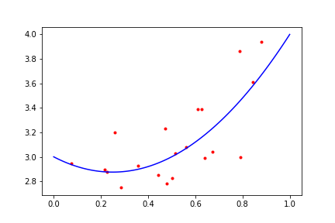
Data and true function
Quadratic
w0 = 3, w1=-1, w2=2
Noise variance = 0.05

Slide 18
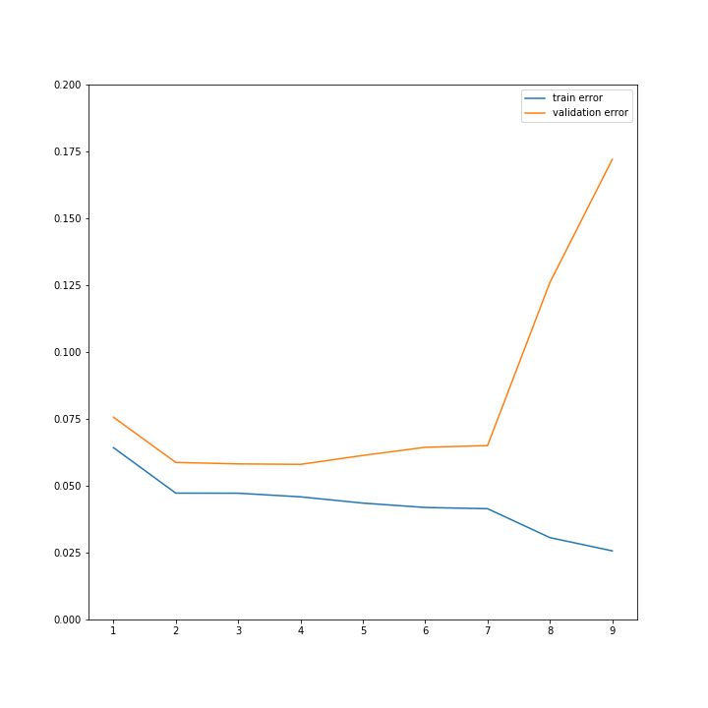
Training error v validation error (validation N = 100)
Mean squared error as polynomial order increases
Training error will *always* decrease as complexity increases
Memorising v generalising
Over-fitting
Validation error is minimised between ~2 and 4
Which one should we pick?

Slide 19
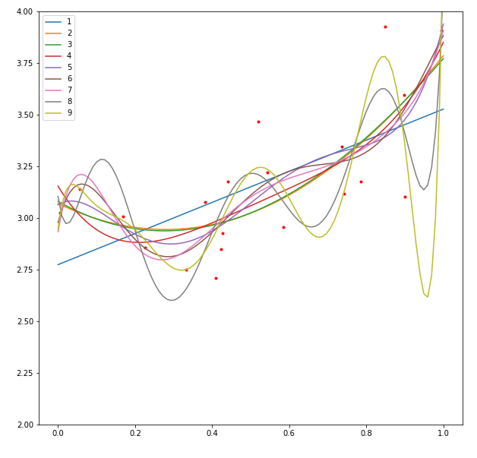
What do the functions look like?

Slide 20
Choosing validation set
Most of the time, random selection is best as it avoids bias
To do this we need to
Choose how much to keep as training data
And how much to use as validation data
Once we have choose this we can randomly assign data to either be training or validation

Slide 21
Choosing validation set
When might bias be important?
Time series: normally predicting the future is more important than predicting the past
When data we’re predicting might come from a slightly different distribution than training
E.g. clinical data collected from hospitals A, B, C, and D that will be train a model to be used at a new hospital, E.
Validate by holding out a hospital (batch)

Slide 22
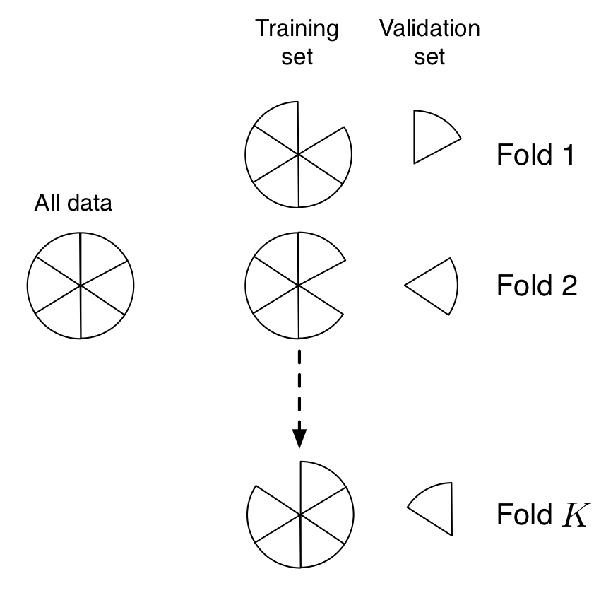
What if we don’t have a nice validation set?
Data is almost always a limiting factor
How much to train? How much to validate?
More train = better model, harder to validate
More validate = worse model, but easy to measure how bad it is!
Cross-validation:
Repeatedly hold out a chunk of data
Limit -- with N observations, train N different models, each with one point held-out for testing

Slide 23
In-sample data
Can’t use the quantity we’re optimising
Likelihood, loss
Increasing complexity will generally increase this value: overfitting
But: there exist quantities that we can use
They combine the likelihood with a term than penalises complexity
Akaike Information Criteria (AIC)
Bayesian Information Criteria (BIC)

Slide 24

AIC
k = number of parameters
L = value of likelihood at maxima
Chose the model with lowest AIC
We can plot it for our polynomial example…
Likelihood is product over training points of normal pdf function (because we assumed normal noise)

Slide 25
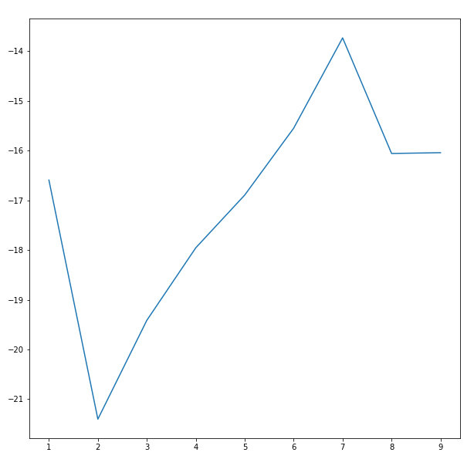
AIC
AIC correctly suggests a quadratic (order 2) model
But: it will only work when maximising likelihood (and not, say, minimising some loss)
In this example I assumed we knew the noise variance.
If we didn’t know that, it probably wouldn’t be so clear...

Slide 26
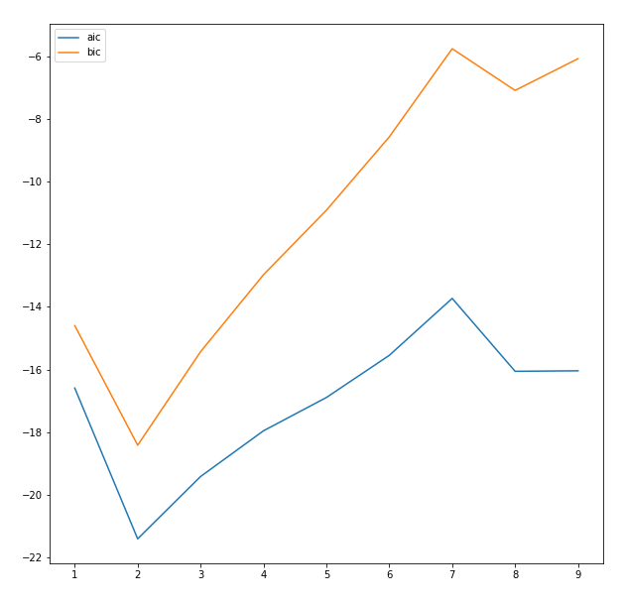

BIC
Very similar but penalty has ln(n) instead of 2
n = number of training points
Low BIC is good
Increases more rapidly as complexity increases
Needs more data to be confident that extra complexity is warranted

Slide 27
AIC v BIC
When should you use {A,B}IC?
In theory BIC is better if the true model is in the set being compared
What is the true model?
In our example there is a true model. Quadratic, known noise variance
In practice, the true model doesn’t really exist
If you can compute one, you can compute the other…
Try them both!

Slide 28
Let’s get philosophical
Is BIC really Bayesian?
BIC is computed for a particular set of parameter values
Those that maximise the likelihood
Bayesians don’t like parameter values
They average over them
For model comparisons, the Bayesian holy grail is the marginal likelihood
But..in practice, it’s often impossible to calculate...

Slide 29
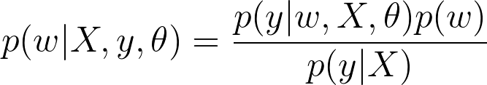
Bayesian inference
Assume linear regression (although it’s general)
w = regression parameters
X = train data, y = train labels, theta = anything else (e.g. noise variance)
Equation above links the posterior (LHS) with the likelihood and prior (RHS), and marginal likelihood (RHS, denominator)

Slide 30
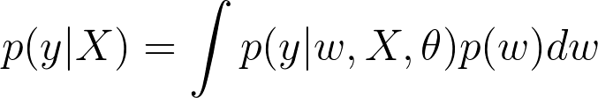
Marginal likelihood
Marginal likelihood (RHS; denominator) is computed by averaging out the parameters from the numerator of the RHS.
This is almost always analytically intractable.
An exception is when the likelihood and prior form a conjugate pair, e.g. Gaussian and Gaussian
Numerically approximating it is very challenging...
...it’s a high-dimensional integral

Slide 31
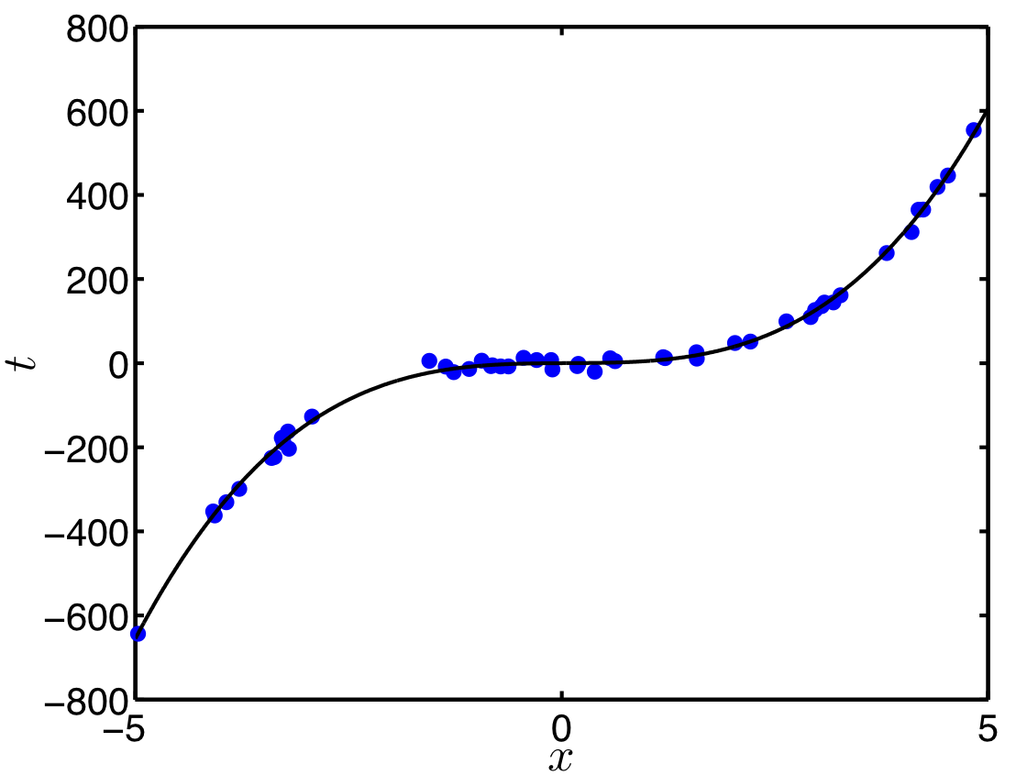
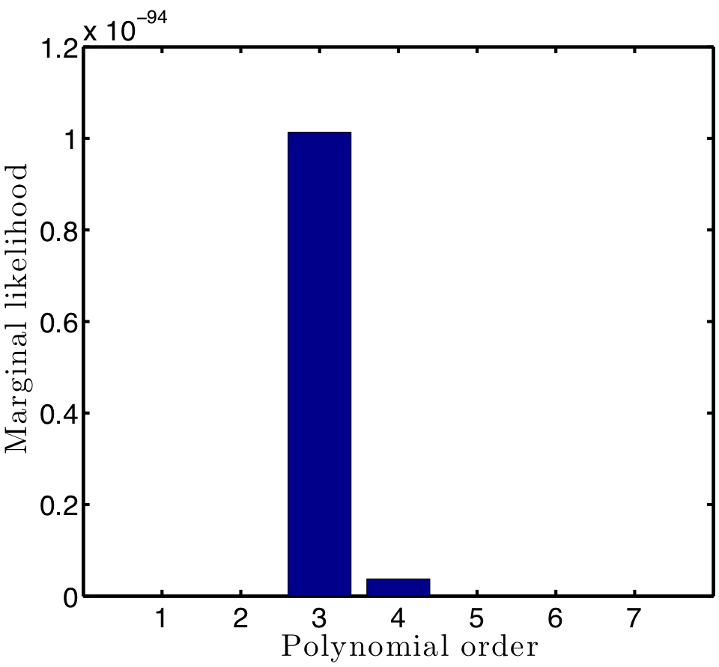
Marginal likelihood when conjugate
Assume prior and likelihood are both Gaussian.
Marginal likelihood is another Gaussian
Evaluate for different orders
Example of cubic (third order) taken from http://bit.ly/firstcourseml

Slide 32
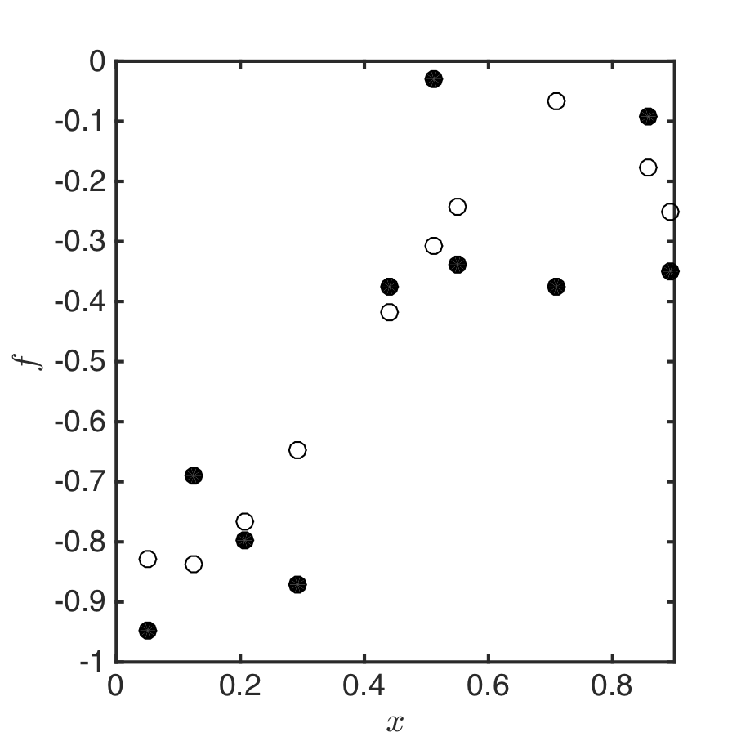
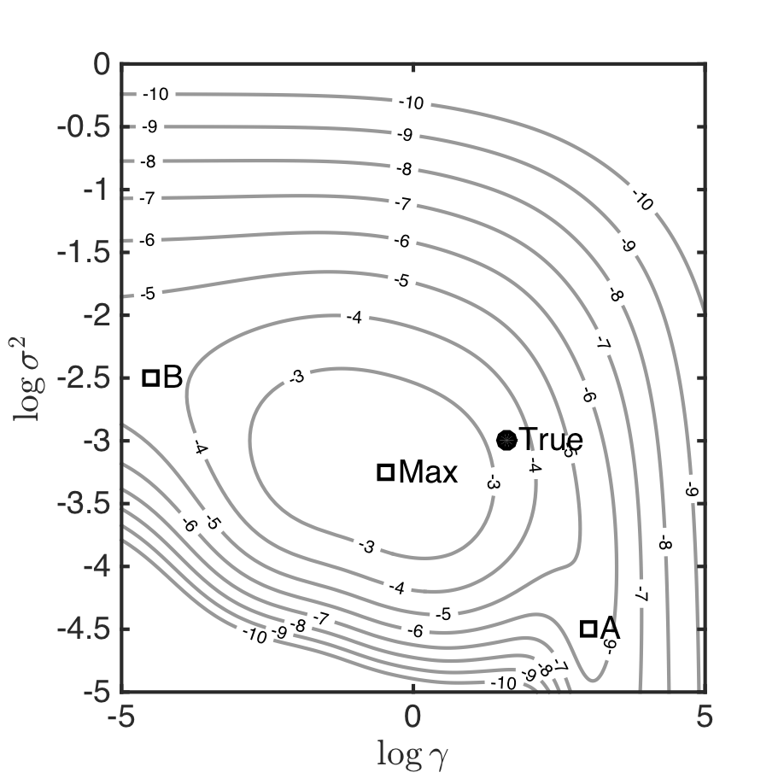
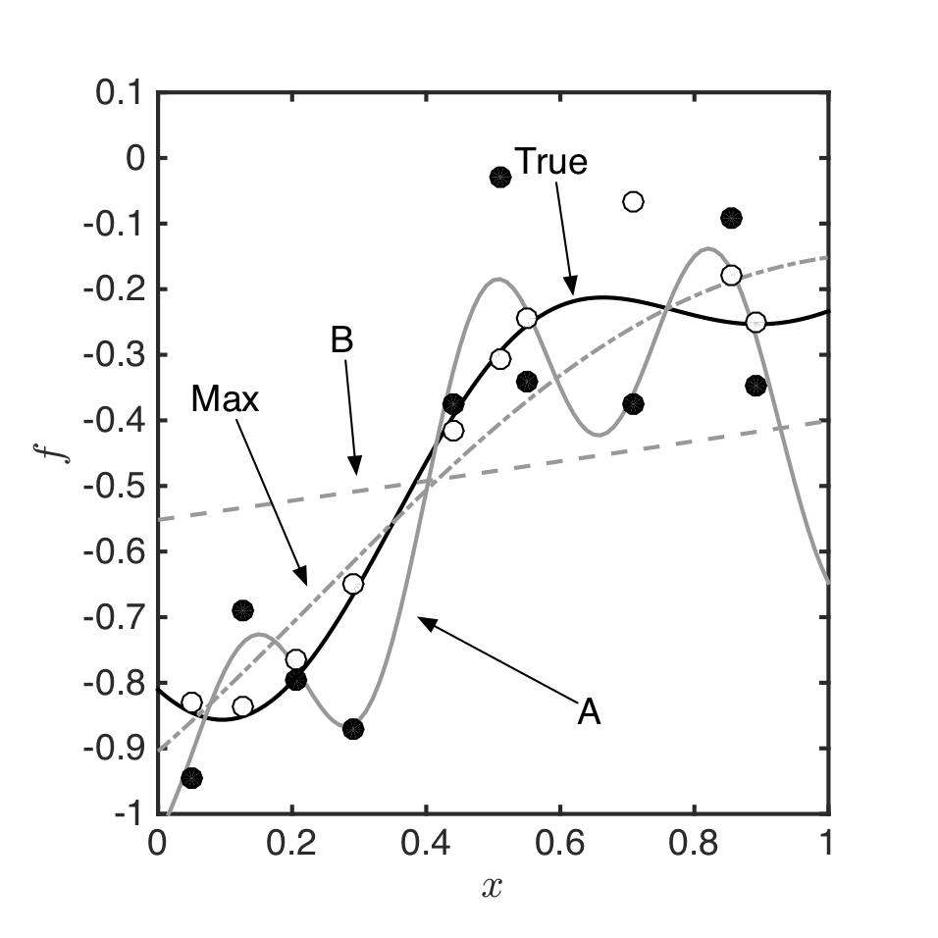
Aside - Gaussian Processes
You saw GPs earlier in the semester
Under certain conditions (regression, gaussian noise), GP marginal likelihood is analytically tractable and can be used to optimise parameters
Example of optimising noise variance and covariance parameter
Noise variance
White = true function
black = noisy observations
Covariance parameter

Slide 33
Finally: ensemble methods
Why do we want to choose a single model anyway?
Ensemble methods fit multiple methods, then combine them to get to get predictions

Slide 34
Summary
Model selection:
Any optimisation that is not training
Strategies (in rough order of popularity):
Out of sample performance: e.g. validation, CV, LOO
In sample performance: e.g. AIC, BIC
Being Bayesian: compute marginal likelihood
Generally an ill-posed problem:
What does *best* mean?

