Slide 1
IILM UNIVERSITY, GREATER NOIDA
School of Computer Science and Engineering
Potential Client Analysis
and Automation
Six-week remote internship | Data Science Intern, Artificial Intelligence Department, Colourbar Communications
STUDENT NAME | ROLL NUMBER | PROGRAMME | SECTION
Sahil Gautam | CS-23411430 | B.Tech CSE (2023 to 2027) | 4CSE11
SEMESTER | ORGANISATION | DURATION | PERIOD
7th Semester | Colourbar Communications | Six weeks, remote mode | 1 June 2026 to 13 July 2026

Slide 2
CHAPTER 4.1
Internship Overview
ORGANISATION
ROLE
DEPARTMENT
DURATION
Colourbar Communications
Data Science Intern
Artificial Intelligence
Six weeks, remote
New Delhi 110028
Individual contributor
Data-driven business initiatives
1 June to 13 July 2026
PROJECT UNDERTAKEN
Potential Client Analysis and Automation
A six-week remote project focused on client-data analysis, lead scoring and workflow automation for internal stakeholders.
Source: Internship report and completion certificate issued by Colourbar Communications, dated 25 July 2026.
Sahil Gautam | CS-23411430 | IILM University
3

Slide 3
CHAPTER 4.3
Problem Statement
THE EXISTING SITUATION
THE PROBLEM ADDRESSED
Prospective clients were evaluated manually, one record at a time.
Manual evaluation is slow and consumes analyst time that could be spent on client engagement.
The approach does not scale as the volume of prospective client data grows.
Judgement varies between reviewers, so lead quality is difficult to compare.
How can an organisation identify high-value potential clients reliably, and streamline the decision-making around them, without adding manual effort as the data grows?
The project answers this with a repeatable, data-driven scoring pipeline.
The intended value was more efficient identification of high-value clients, less manual processing and better-informed decisions; the report states no quantitative performance metrics.
Sahil Gautam | CS-23411430 | IILM University
5

Slide 4
CHAPTER 4.4
Project Objectives
1
Build client profiles
Extract, clean and pre-process client-related data from diverse internal repositories to form comprehensive client profiles.
2
Analyse the data
Conduct exploratory data analysis to uncover market trends, behavioural patterns and the key drivers of client acquisition.
3
Score and segment leads
Develop and apply machine-learning methods to score, rank and segment potential client leads.
4
Automate the workflow
Automate the client scoring workflow through Python scripting and data pipelines so manual processing effort is reduced.
5
Communicate the insight
Design interactive dashboards that communicate analytical findings to cross-functional stakeholders.
Sahil Gautam | CS-23411430 | IILM University
6

Slide 5
CHAPTER 4.6
Technologies and Tools Used
PROGRAMMING LANGUAGE
DATA HANDLING
STATISTICS
Python 3
Data preparation
Exploratory analysis
Scripting, data handling and workflow automation across the project.
Cleaning, transformation and preparation of client data for analysis.
EDA to examine trends, behavioural patterns and drivers of client acquisition.
PRE-PROCESSING
MODELLING
VISUALISATION
Machine learning
Machine learning
Automation and dashboards
Algorithms for lead scoring, ranking and segmentation.
Model-based methods used to support client scoring, ranking and segmentation.
Python scripts, automated data pipelines and interactive dashboards for internal stakeholders.
Technologies documented in the report: Python, EDA, machine-learning algorithms, automated data pipelines and interactive dashboards.
Sahil Gautam | CS-23411430 | IILM University
8

Slide 6

CHAPTER 4.7
System Architecture
The workflow moves client data from internal repositories through preparation, analysis, machine-learning scoring and automation into dashboard-based stakeholder consumption.
01
02
03
04
Internal repositories
Cleaning and pre-processing
Exploratory analysis
ML scoring and segmentation
Client data collected from diverse internal sources
Prepare data for reliable analysis
Surface trends, behaviours and acquisition drivers
Score, rank and segment potential leads
05
06
07
08
Automated pipeline
Dashboard output
Stakeholder review
Internal outputs
Run scoring through Python and data pipelines
Present outputs for stakeholder consumption
Use ranked and segmented leads in internal decisions
Data-driven view of potential client segments
Architecture adapted from the report: repositories → preparation → analysis → ML scoring → automation → dashboards.
Sahil Gautam | CS-23411430 | IILM University
9

Slide 7
CHAPTER 4.8
Methodology
1
Data Management
End-to-end extraction, cleaning and pre-processing of client data drawn from diverse internal repositories, producing comprehensive client profiles.
2
Exploratory Analysis
Detailed exploratory data analysis to surface market trends, behavioural patterns and the key drivers behind client acquisition.
3
Predictive Analytics
Application of machine-learning methods to score, rank and segment potential leads for internal review.
4
Workflow Automation
Python scripts and automated data pipelines that automate the client-scoring workflow and reduce manual processing effort.
5
Data Visualisation
Interactive dashboards that carry analytical insight through to cross-functional stakeholders in a readable form.
The documented workflow connects preparation, analysis, modelling, automation and visualisation for internal stakeholders.
Sahil Gautam | CS-23411430 | IILM University
10

Slide 8
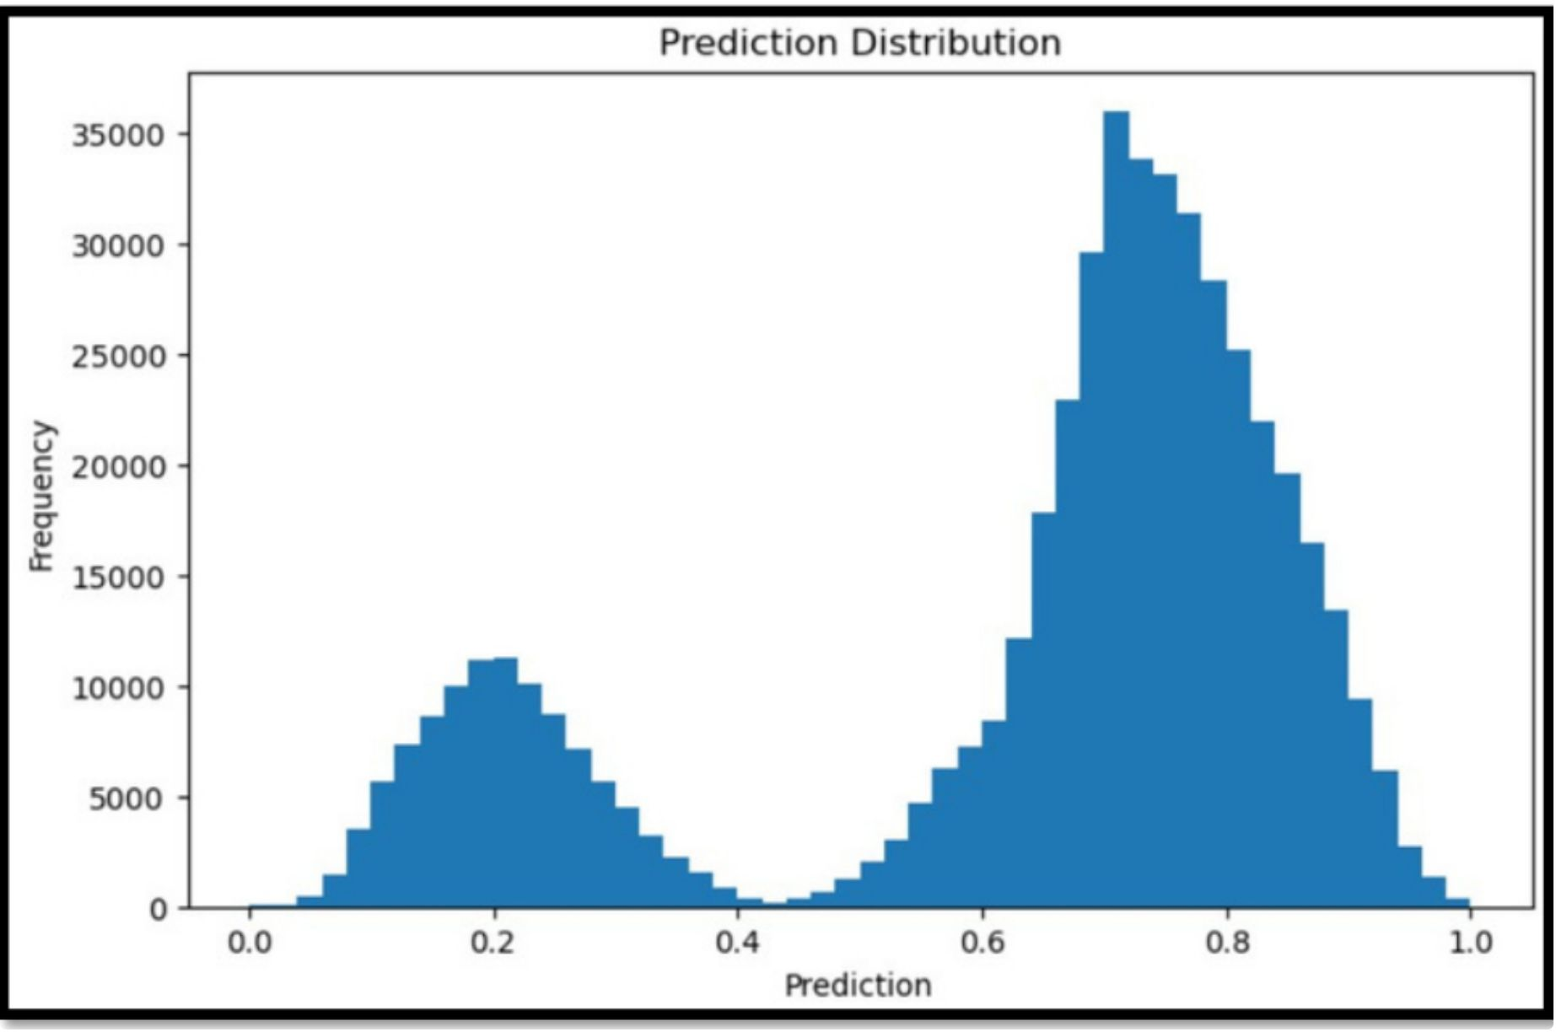
ANALYSIS
Scoring Output and Segmentation
The output supports practical segmentation
The scoring output can be used to distinguish higher-priority leads from leads for later review; the report does not state quantitative performance metrics.
LOWER-PRIORITY SEGMENT
Leads for later review
Segmented for follow-up planning
HIGHER-PRIORITY SEGMENT
Leads prioritised for outreach
Segmented for focused outreach
DECISION USE
Relative score bands
Use score and segment outputs to guide review
Sahil Gautam | CS-23411430 | IILM University
13

Slide 9
TABLE 4.1
Summary of Key Contributions
CONTRIBUTION AREA | DESCRIPTION | OUTPUT
Data Management | Extraction, cleaning and pre-processing of client data | Complete client profiles
Exploratory Analysis | Identification of market trends and client acquisition drivers | Documented patterns
Predictive Analytics | Machine learning based scoring, ranking and segmentation of leads | Ranked lead list
Workflow Automation | Python scripts and automated data pipelines | Reduced manual effort
Data Visualisation | Interactive dashboards for stakeholder reporting | Shared analytical view
Project workstreams documented in the internship report; no quantitative performance metrics were reported.
Sahil Gautam | CS-23411430 | IILM University
14

Slide 10
REFLECTION
Skills and Learning Outcomes
TECHNICAL
PROFESSIONAL
Data extraction, cleaning and pre-processing
Exploratory data analysis and distribution diagnostics
Applying machine-learning methods to lead scoring, ranking and segmentation
Interpreting analytical outputs for lead prioritisation
Workflow automation with Python scripts and pipelines
Designing interactive dashboards for internal stakeholders
Structured problem-solving on an open-ended business problem
Translating a business need into data, scoring and segmentation workflows
Communicating findings to cross-functional stakeholders
Working independently during a six-week remote internship
Documenting analysis and workflow decisions clearly
The internship strengthened practical data-science capability across preparation, analysis, modelling, automation and visualisation; the report does not quantify these outcomes.
Sahil Gautam | CS-23411430 | IILM University
16

Slide 11
LOOKING AHEAD
Future Scope and Boundaries
1
Scale the pipeline
Potential next step: extend the documented workflow to additional internal data sources and more regular pipeline runs.
2
Refine the scoring model
Potential next step: validate and refine scoring as more client-outcome data becomes available.
3
Extend the dashboards
Potential next step: extend dashboards with stakeholder-friendly views of score and segment outputs.
Integrate with business systems
4
Potential next step: explore integration with relevant internal systems if the workflow is taken beyond the internship scope.
These are proposed extensions only; the internship scope covered internal analysis, modelling, automation and visualisation, not organisation-wide deployment or long-term maintenance.
Sahil Gautam | CS-23411430 | IILM University
17

Slide 12
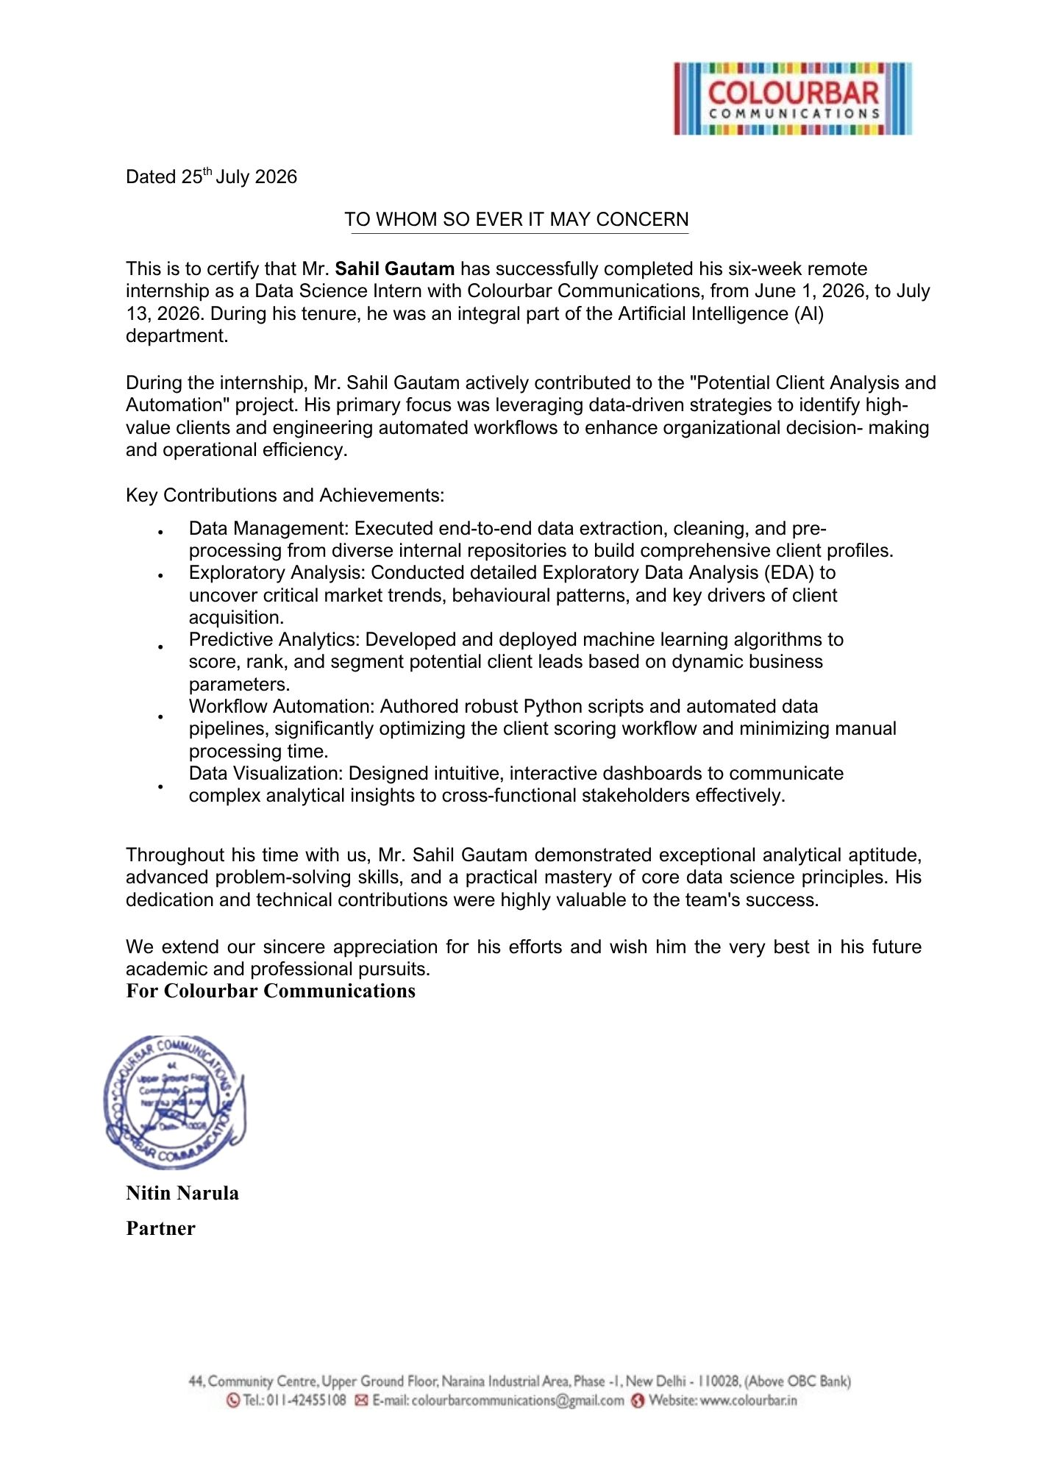
CHAPTER 4.10
Internship Completion Certificate
Issued by Colourbar Communications
ISSUED TO
Mr. Sahil Gautam
ROLE
Data Science Intern
DEPARTMENT
Artificial Intelligence
SIGNED BY
Nitin Narula, Partner
DATED
25 July 2026
The certificate confirms Sahil Gautam's Data Science Intern role, the Artificial Intelligence department, the project context and the six-week remote internship. Its date is 25 July 2026.
Sahil Gautam | CS-23411430 | IILM University
18

