Slide 1

MarginMind
AI-Powered Merchant Revenue Growth Assistant
Turning business data into better decisions.
MarginMind
00

Slide 2




THE CHALLENGE
The Problem
Running an online store is not only about selling products. A merchant may have hundreds of products, many orders, different prices and a large amount of stock. The difficult part is knowing what to do next.
A merchant should not have to manually check every number to know what to do next.
Which product needs attention?
Which price should be changed?
Where is stock sitting without enough sales?
How can the merchant decide without checking everything manually?
MarginMind
01

Slide 3



THE APPROACH
Our Solution
MarginMind helps merchants understand what is happening in their business and decide what to do next. It looks across the core signals of the business:
Product Sales
Revenue
Orders
Stock
Product Prices
It then gives the merchant clear, product-level recommendations based on the available business data.
The merchant always has the final say before a recommendation is applied.
MarginMind
02

Slide 4






THE WORKFLOW
How MarginMind Works
Merchant Data
Business Analysis
Product-Level Insights
Recommendation
Merchant Approval
Action
Audit Record
This keeps the decision process simple and gives the merchant control at every important step.
MarginMind
03

Slide 5

NATURAL CONVERSATION
What Can the Merchant Ask?
How is my business performing?
Which product sells the most?
Which product has excess stock?
Which product should I change the price for?
What can I do to increase sales?
Show me my product performance.
No need to manually search through different numbers to understand the business.
MarginMind
04

Slide 6
EXAMPLE IN ACTION
Pricing Recommendations
MarginMind identifies products that deserve attention based on sales and stock information.
USB C Charger
Recommendation
Flagged for review
Current Price
₹3,000
MarginMind flags this product for a price change and explains why it was selected — high stock paired with low sales volume.
Units Sold
5
The recommendation is shown to the merchant before anything is changed.
Stock on Hand
55
MarginMind
05

Slide 7




STAYING IN CONTROL
Merchant Approval
MarginMind does not directly change the merchant’s price. Every recommendation passes through a clear approval step.
Recommendation
Merchant Reviews It
Approves or Rejects
Action Applied
MarginMind proposes a change
Full context is shown
Merchant makes the call
Only approved changes go live
This gives the merchant control over important business decisions.
MarginMind
06

Slide 8


LIVE COMMERCE
Payments and Orders
Customers can purchase products through Razorpay Test Mode. A successful payment flows straight into the merchant’s business data.
Payment Verified
Order Recorded
Stock Updated
Business Data Updated
This connects the shopping experience directly with the merchant’s business dashboard.
MarginMind
07

Slide 9




UNDER THE HOOD
Technology Used
Frontend
Backend
Database
HTML · CSS · JavaScript
Python · FastAPI · SQLAlchemy
PostgreSQL
Language Model
Payment System
Agent Framework
Mistral
Razorpay
LangChain
MarginMind
08

Slide 10
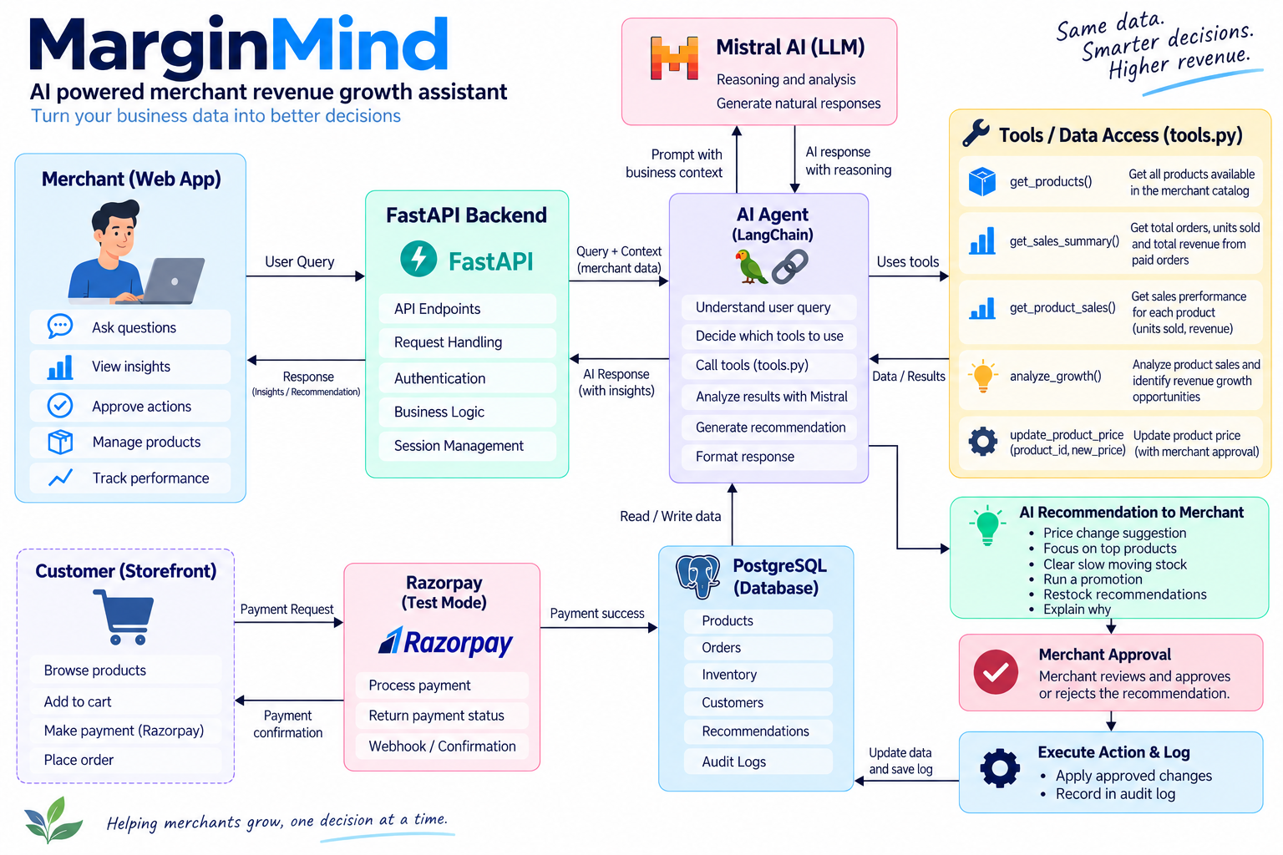
SYSTEM DESIGN
Architecture
MarginMind
09

Slide 11

BEYOND DASHBOARDS
What Makes MarginMind Different
Most store dashboards show merchants what already happened. MarginMind focuses on the next decision.
A TYPICAL DASHBOARD SHOWS
MARGINMIND HELPS ANSWER
Sales
5
What should I do about it?
Stock
55
The merchant gets information, a recommendation and control over the final action — all in one place.
Revenue
₹7,995
MarginMind
10

Slide 12


TRUST BY DESIGN
Safety and Control
Business decisions should not happen without the merchant knowing. MarginMind follows a simple approach.
The System Recommends
The Merchant Decides
The System Records
Every approved action can be tracked through the audit log.
MarginMind
11

Slide 13




WHAT’S NEXT
Future Scope
Product Bundle Suggestions
Marketing Recommendations
Sales Forecasting
Identify complementary products and suggest bundles based on sales, stock and product relationships.
Suggest suitable promotions and offers for products that need more attention.
Estimate future sales trends to help merchants plan inventory.
The goal is to make MarginMind useful for more parts of everyday merchant operations.
Customer Insights
Multi-Action Automation
Understand purchasing patterns and identify opportunities for better product targeting.
Expand MarginMind from recommendations to more merchant-approved business actions.
MarginMind
12

Slide 14
MarginMind
From business data to better decisions.
A merchant should not have to spend hours looking through numbers just to figure out what to do next. MarginMind brings the numbers, reasoning and decision process together — while keeping the merchant in control.
MarginMind
13

