Slide 1

APPLICATION OF MATRIX MULTIPLICATION IN
COMPUTER GRAPHICS
SUBMITTED BY: VISHAL DAHIRE BL.EN.U4 MEE 22034

Slide 2
COMPUTER GRAPHICS: Disciple of Generating Images with the aid of Computers. Today, Computer Graphics is a Core Technology in Digital Photography, Film, Video Games, Cell Phone and many Specialized Applications. Computer Graphics can be a series of Image or a Single Image. It is often abbreviated as CG or typically in the context of film as CGI.

Slide 3

VECTOR GRAPHICS: Vector Graphics are computer graphics images that are defined in terms of 2D points, which are connected by lines and curves to form polygons and other shapes. Each of these points has a definite position on the X-Axis and Y-Axis of the work plane and determines the Direction of the Path. Vector graphics are commonly found today in the SVG, EPS, PDF or AI graphic file formats and intrinsically different from the more common raster graphics file formats such JPEG, PNG, APNG, and GIF.

Slide 4
TRANSFORMATIONS IN COMPUTER GRAPHICS
SCALING
TRANSLATION
ROTATION
REFLECTION
SHEARING

Slide 5
SCALING:It is used to alter or change the size of objects. The change is done using scaling factors. There are two scaling factors, i.e. S_{x} in x direction S_{y} in y-direction. If the original position is x and y. Scaling factors are S_{x} and S_{y} then the value of coordinates after scaling will be x¹ and y₁. Enlargement: If T₁ = If (x₁ y₁)is original position and T₁is translation vector then (x₂ y₂) are coordinated after scaling [X2,Y2] = [X1,Y1] =[2X1,2X2] Reduction: If T₁= If (x₁ y₁) is original position and T₁ is translation vector, then (x₂ y₂) are coordinates after scaling [X2,Y2] = [X1,Y1] =[0.5X1,0.5Y1]
2
0
0
2
2
0
0
2
0.5
0
0
0.5
0.5
0
0
0.5

Slide 6
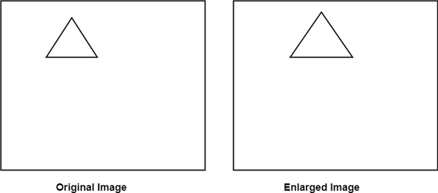
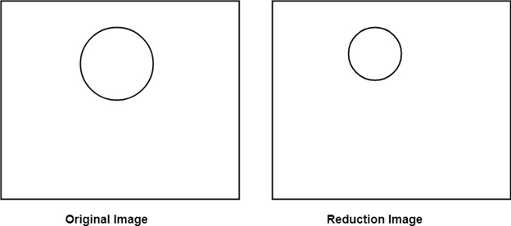
The image will be enlarged two times The Image will be reduced

Slide 7
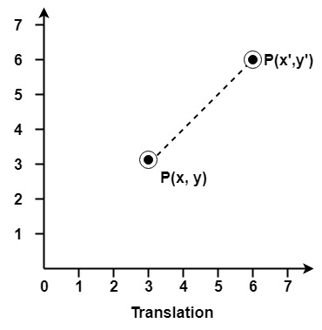
Translation It is the straight line movement of an object from one position to another is called Translation. Here the object is positioned from one coordinate location to another.
For translating polygon, each vertex of the polygon is converted to a new position. Similarly, curved objects are translated. To change the position of the circle or ellipse its center coordinates are transformed, then the object is drawn using new coordinates.
Let P is a point with coordinates (x, y). It will be translated as (x¹ y¹).

Slide 8
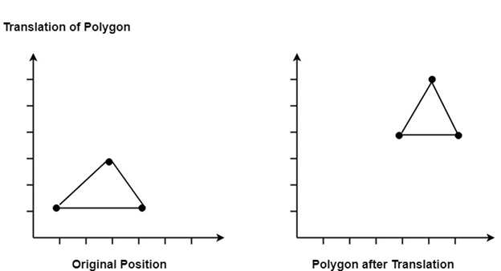
1 | 0 | 1
0 | 1 | 0
t_{x} | t_{y} | 1
1 | 0 | t_{x}
0 | 1 | t_{y}
0 | 0 | 1

Slide 9
Rotation: It is a process of changing the angle of the object. Rotation can be clockwise or anticlockwise. For rotation, we have to specify the angle of rotation and rotation point. Rotation point is also called a pivot point. It is print about which object is rotated. TYPES OF ROTATION: 1. Anticlockwise Rotation 2. Clockwise Rotation The positive value of the pivot point (rotation angle) rotates an object in a counter-clockwise (anti-clockwise) direction. The negative value of the pivot point (rotation angle) rotates an object in a clockwise direction.

Slide 10
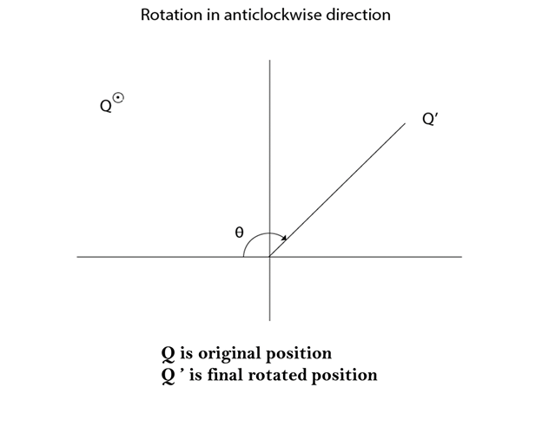
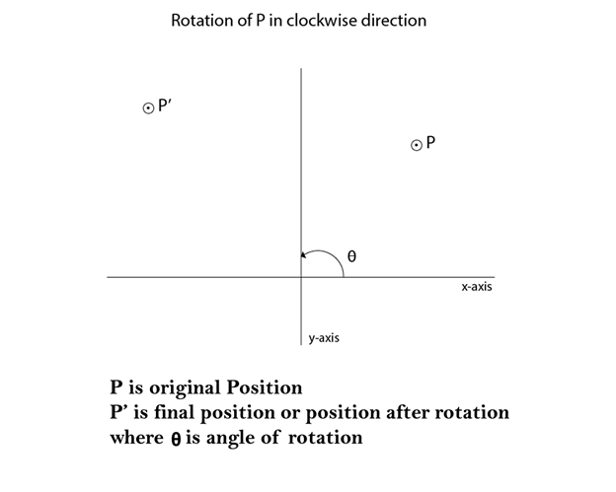
Cos θ
Sin θ
Sin θ
Cos θ
Cos θ
Sin θ
-Sin θ
Cos θ

Slide 11
Reflection: It is a transformation which produces a mirror image of an object. The mirror image can be either about x-axis or y-axis. The object is rotated by180°. Types of Reflection: Reflection about the x-axis Reflection about the y-axis Reflection about an axis perpendicular to xy plane Reflection about line y=x

Slide 12
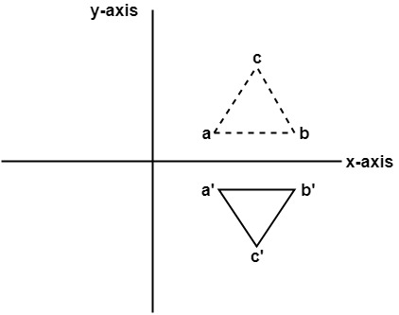
1. Reflection about x-axis: The object can be reflected about x-axis with the help of the following matrix In this transformation value of x will remain same whereas the value of y will become negative. Following figures shows the reflection of the object axis. The object will lie another side of the x-axis.
1 | 0 | 0
0 | -1 | 0
0 | 0 | 1

Slide 13
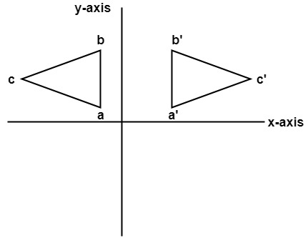
2. Reflection about y-axis: The object can be reflected about y-axis with the help of following transformation matrix Here the values of x will be reversed, whereas the value of y will remain the same. The object will lie another side of the y-axis. The following figure shows the reflection about the y-axis
-1 | 0 | 0
0 | 1 | 0
0 | 0 | 1

Slide 14
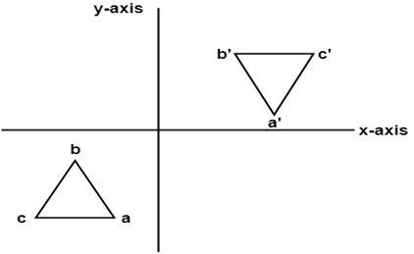
3. Reflection about an axis perpendicular to xy plane and passing through origin: In this value of x and y both will be reversed. This is also called as half revolution about the origin.
-1 | 0 | 0
0 | -1 | 0
0 | 0 | 1

Slide 15
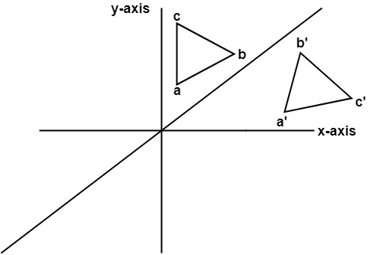
4. Reflection about line y=x: The object may be reflected about line y = x with the help of following transformation matrix First of all, the object is rotated at 45°. The direction of rotation is clockwise. After it reflection is done concerning x-axis. The last step is the rotation of y=x back to its original position that is counterclockwise at 45°.
0 | 1 | 0
1 | 0 | 0
0 | 0 | 1

Slide 16
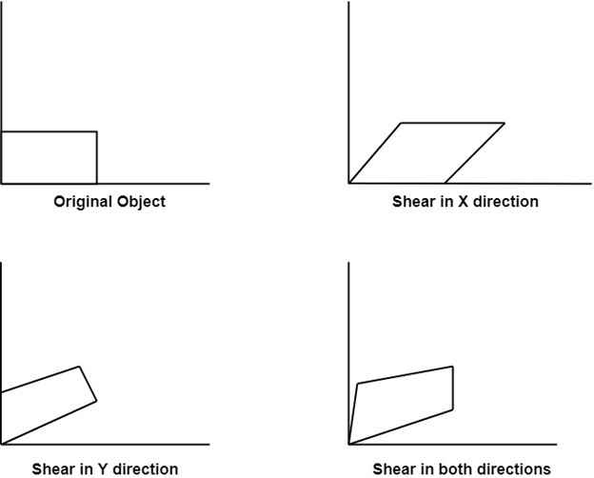
Shearing: It is transformation which changes the shape of object. The sliding of layers of object occur. The shear can be in one direction or in two directions. Shearing in the X-direction: Shearing in the Y-direction:
1 | 0 | 0
sh_{x} | 1 | 0
0 | 0 | 1
1 | sh_{y} | 0
0 | 1 | 0
0 | 0 | 1

Slide 17
The End
Bibliography https://www.javatpoint.com/computer-graphics

