Slide 1

2
Building a Weather App with React
By Sahil Gupta
2110991222
G-19

Slide 2

Technologies Utilized
HTML
Used to structure and organize the content of the weather app.
CSS
Enabled us to design and style the app, making it visually appealing.
JavaScript
Provided the necessary functionality to make the app interactive and dynamic.

Slide 3

Integration with Weather API
Expandable API
The weather app utilizes an API to retrieve weather data for different cities worldwide.
Real-Time Updates
Stay up to date with the latest weather information as the API continuously feeds the app with current data.
Global City Selection
You have the freedom to choose cities from all over the world and obtain their weather data.

Slide 4
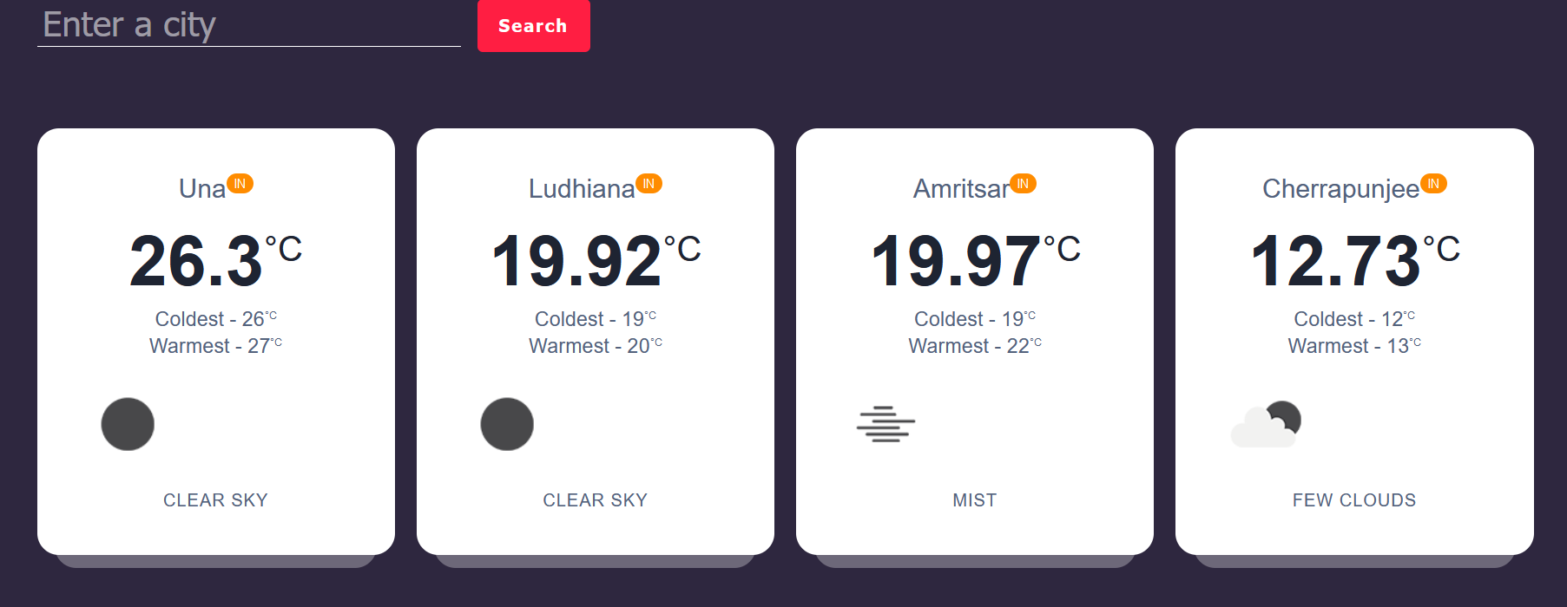
Displaying Multiple Cities
At a Glance
Worldwide View
Convenient Overview
Easily compare the weather of multiple cities simultaneously on one screen.
Explore the weather conditions of cities across the globe with just a few clicks.
Effortlessly manage and monitor the weather in various locations all in one place.

Slide 5



Error Handling and Validation
1
No Duplicate Cities
2
Valid City Check
3
Friendly Feedback
If you enter the same city multiple times, the app will detect it and provide an error message.
If you enter the name of a non-existing city, the app will prompt you to enter a valid city name.
Receive clear and helpful messages to ensure correct inputs and a smooth user experience.

Slide 6
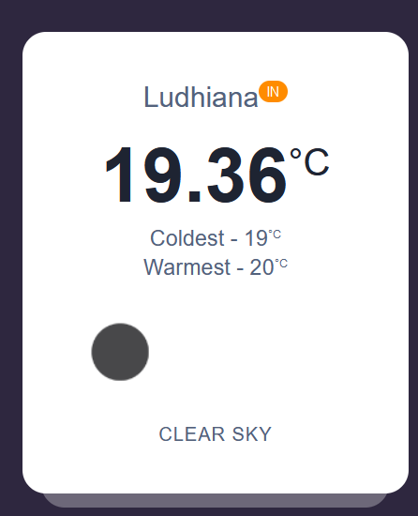
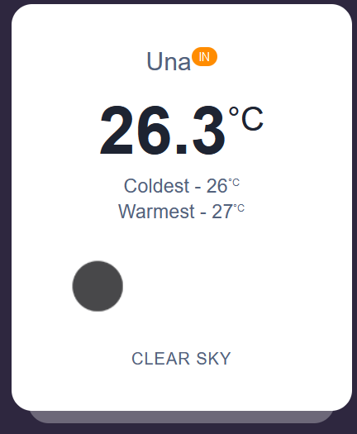
Highest and Lowest Temperatures
1
Highest Temperature
Stay informed about the peak temperature for each selected city on a specific day.
Lowest Temperature
2
Keep track of the lowest temperature recorded in each city on a given day.
3
Prepare Accordingly
Plan your activities based on temperature fluctuations, ensuring a comfortable experience.

Slide 7



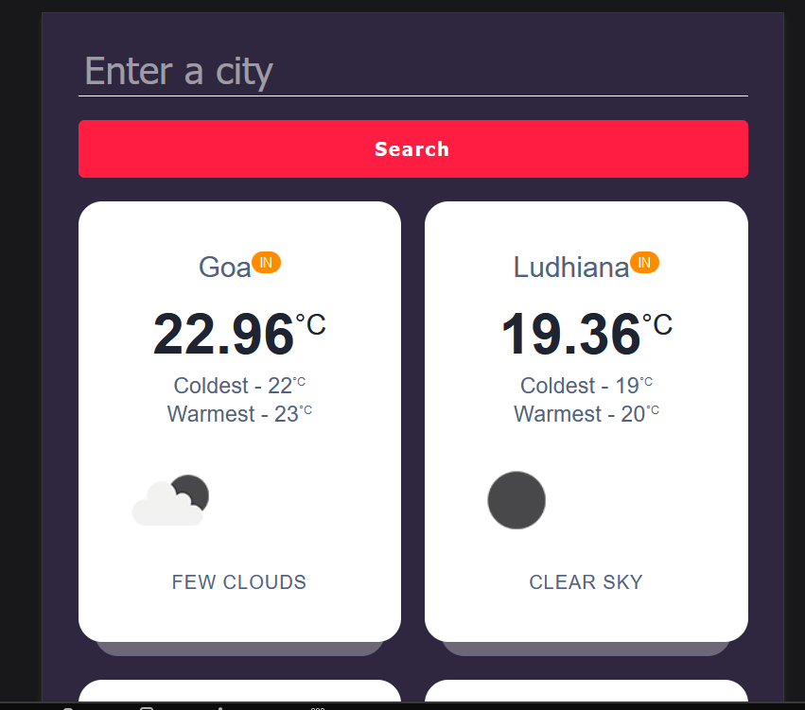
Responsive Design
Cross-Device Compatibility
Mobile-Friendly Interface
Effortless Navigation
Enjoy seamless usability and access the weather app from various devices, including desktops, tablets, and mobile phones.
Experience an optimized interface that adapts to different screen sizes, enhancing your interactions with the app.
Benefit from a user-friendly design, ensuring smooth navigation and intuitive interactions across devices.

Slide 8

Benefits of the Weather App
1
Stay Prepared
2
Efficient Planning
3
Enhanced Travel Experience
Always be informed and ready for any weather conditions, whether at home or during your travels.
Plan your activities effectively, considering the forecasted weather for any desired city.
Optimize your travel experiences by basing your itinerary on accurate and up-to-date weather data.

Slide 9
Unlock the World's Weather
Summary
Try It Now!
Experience the power of React and witness the convenience of our weather app. Check the weather in multiple cities, stay informed about the highest and lowest temperatures, all within a responsive and user-friendly interface.
Join millions of users already enjoying the benefits of our weather app. Discover the world's weather and make every day a breeze.

Slide 10
Thank You

