Slide 1

CS299 Innovation Lab
Stock Portfolio Optimization using LSTM and MPT
Project by :
Sahil Gupta
1901CS49
Shivanshu Sanjeev
1901CS56
Under the mentorship of :
Dr. Somanath Tripathy
Associate Professor
IIT Patna
Notes:
Good afternoon sirs. This presentation is for predicting the scour depth of a bridge using various regressor models. The project has been prepared by me(Anish) and Yash.

Slide 2

Objective
In the current financial era, high frequency trading (HFT) is becoming very common among people and it's very obvious that inexperienced investors are risk-averse.
So, the goal of this project is to build an optimized portfolio for investment in the stock market where the investor will provide the names of certain number stocks and the model will return the best possible combination of shares amongst the top-performing stocks which will be first predicted by the LSTM model and then the selected stocks will be optimized using Markowitz Portfolio Theory.
Notes:
So as we know bridge failure is a very common problem all around the world. We made an effort in this project to actually study the variation of this depth wrt various parameters by using a different combination in 2 different models which we will see in detail in the upcoming slides.

Slide 3
Introduction
We will be considering the Yahoo finance stocks data and will create a LSTM network for prediction. Here we have two file train and test, having its Stocks share prices open, high, low, close values for a particular day. Using this data in our LSTM model we will predict the closing prices for next 6 months.
The Predicted stocks would then be filtered on the basis of better moving average price in future as compared to their current price, and top performing stocks would be selected.
The selected stocks would then be processed in MPT model to finally generate an optimized portfolio of investment at a very higher accuracy and lesser unwanted risk.
Notes:
So as we know bridge failure is a very common problem all around the world. We made an effort in this project to actually study the variation of this depth wrt various parameters by using a different combination in 2 different models which we will see in detail in the upcoming slides.

Slide 4
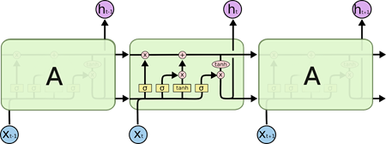

LSTM
The Long short-term memory (LSTM) is a special type of Recurrent Neural Networks (RNN) architecture that is mainly used in deep learning. LSTM uses a set of feedback connections to process sequences of data.
This architecture is known for its efficiency in making predictions, processing, and classifying large-scale time-series data despite the presence of some lags between events.
It was named long short-term memory because its cell unit has the ability to forget a part of previously stored data and can, at the same time, memorize additional new pieces of information.
Notes:
So what is pier scour? 1st lets try to understand whats pier. Pier is an intermediate support for the adjacent ends of two bridge spans. Now when heavy consistent flow of water eventually erodes the soil creating a vacant space, this vacant space is called the scour depth and this process is named as the Scouring of pier

Slide 5
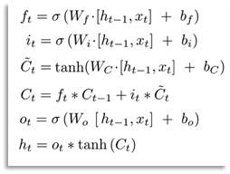
LSTM
An LSTM unit encapsulates the following elements:
• Cell: represents the memory part of the LSTM that monitors the dependencies between different elements constituting the input sequence.
• Input gate: regulates the information flowing into the cell.
• Output gate: regulates the information flowing out of the cell.
• Forget gate: remembers the different values over a
time interval.
Notes:
So what is pier scour? 1st lets try to understand whats pier. Pier is an intermediate support for the adjacent ends of two bridge spans. Now when heavy consistent flow of water eventually erodes the soil creating a vacant space, this vacant space is called the scour depth and this process is named as the Scouring of pier

Slide 6
What is Modern Portfolio Theory?
Modern portfolio theory (MPT) is a theory on how risk-averse investors can construct portfolios to maximize expected return based on a given level of market risk. Harry Markowitz pioneered this theory in his paper “Portfolio Selection”.
Modern portfolio theory argues that an investment's risk and return characteristics should not be viewed alone, but should be evaluated by how the investment affects the overall portfolio's risk and return. MPT shows that an investor can construct a portfolio of multiple assets that will maximize returns for a given level of risk.
Notes:
So what is pier scour? 1st lets try to understand whats pier. Pier is an intermediate support for the adjacent ends of two bridge spans. Now when heavy consistent flow of water eventually erodes the soil creating a vacant space, this vacant space is called the scour depth and this process is named as the Scouring of pier

Slide 7
What is Modern Portfolio Theory?
Likewise, given a desired level of expected return, an investor can construct a portfolio with the lowest possible risk. Based on statistical measures such as variance and correlation, an individual investment's performance is less important than how it impacts the entire portfolio.
MPT assumes that investors are risk-averse, meaning they prefer a less risky portfolio to a riskier one for a given level of return.
Notes:
So what is pier scour? 1st lets try to understand whats pier. Pier is an intermediate support for the adjacent ends of two bridge spans. Now when heavy consistent flow of water eventually erodes the soil creating a vacant space, this vacant space is called the scour depth and this process is named as the Scouring of pier

Slide 8
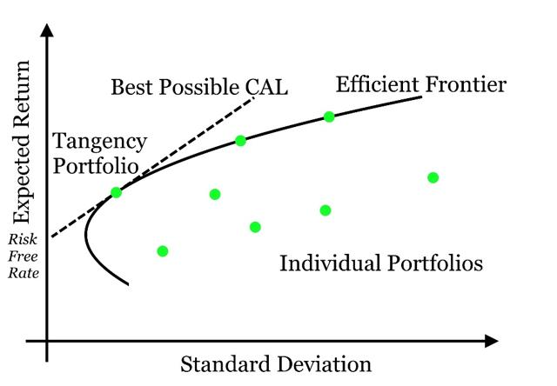

Efficient Frontier Curve & Max Sharpe Ratio
The Efficient Frontier is a common phrase in Modern Finance since the inception of Modern Portfolio Theory in 1952 by Harry Markowitz.
The efficient frontier, a cornerstone of modern portfolio theory, shows the set of portfolios that provide the highest level of return for the lowest level of risk. When a portfolio falls to the right of the efficient frontier, they possess greater risk relative to their return. Conversely, when a portfolio falls beneath the slope of the efficient frontier, they offer a lower level of return relative to risk.
Notes:
So now the question was how do we compare and evaluate the results our models produce. We compared the Pearson Correlation Coefficient, RMSE Value and the R2 score. RMSE value is simply the root of squared difference between our results and the results that were expected. PCC value is the covariance of predicted output and the output we get. R2 score is the variance in dependent variable that the independent variables explain together. Here on, I now handover the presentation to Yash

Slide 9
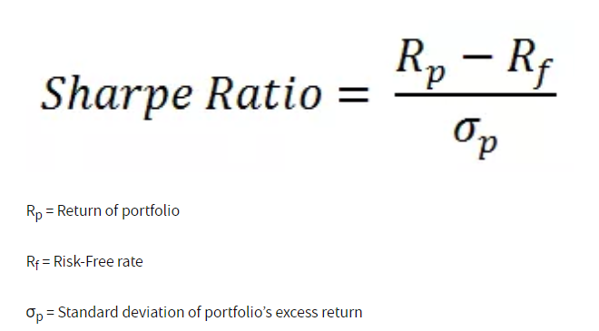
Efficient Frontier Curve & Max Sharpe Ratio
Owning a portfolio with the Maximum Sharpe Ratio is the dream of every investor ("or more likely should be")!!!
Sharpe Ratio - It is the average return earned in excess of the risk-free rate per unit of volatility or total risk. Volatility is a measure of the price fluctuations of an asset or portfolio.
So what is the dream portfolio and how can you make one?
According to Markowitz's theory, there is an optimal portfolio that could be designed with a perfect balance between risk and return.
Notes:
So now the question was how do we compare and evaluate the results our models produce. We compared the Pearson Correlation Coefficient, RMSE Value and the R2 score. RMSE value is simply the root of squared difference between our results and the results that were expected. PCC value is the covariance of predicted output and the output we get. R2 score is the variance in dependent variable that the independent variables explain together. Here on, I now handover the presentation to Yash

Slide 10
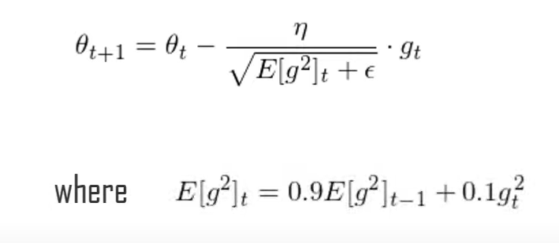
Adam Optimizer
The type of optimizer used can greatly affect how fast the algorithm converges to the minimum value. Here we have chosen to use Adam optimizer. The Adam optimizer combines the perks of two other optimizers: ADAgrad and RMSprop.
The stochastic gradient descent update for RMS prop is given by:
Adam(Adaptive Movement Estimation) is another method that computes the adaptive learning rates for each parameter based on its past gradients.
Notes:
So now the question was how do we compare and evaluate the results our models produce. We compared the Pearson Correlation Coefficient, RMSE Value and the R2 score. RMSE value is simply the root of squared difference between our results and the results that were expected. PCC value is the covariance of predicted output and the output we get. R2 score is the variance in dependent variable that the independent variables explain together. Here on, I now handover the presentation to Yash

Slide 11
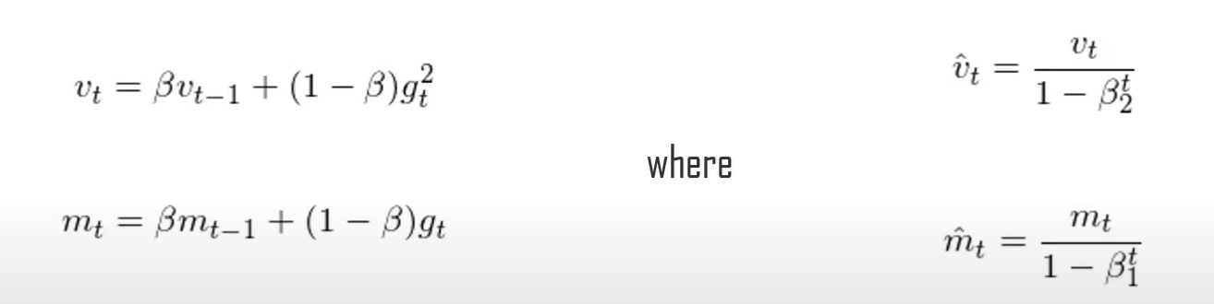
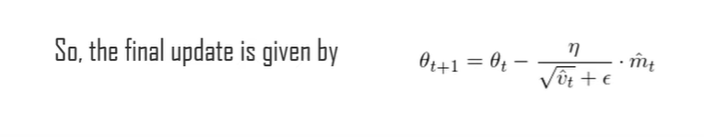
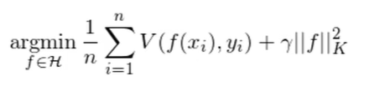
Adam Optimizer
The minimization problem is given by:
Another important aspect of training the model is making sure the weights do not get too large, hence, overfit. For this purpose, we chose to do regularization.
Notes:
So now the question was how do we compare and evaluate the results our models produce. We compared the Pearson Correlation Coefficient, RMSE Value and the R2 score. RMSE value is simply the root of squared difference between our results and the results that were expected. PCC value is the covariance of predicted output and the output we get. R2 score is the variance in dependent variable that the independent variables explain together. Here on, I now handover the presentation to Yash

Slide 12
Roadmap of Project
Dataset was taken from yahoo finance and were visualized using table and plots.
Each stocks future prices
were predicted using the LSTM model of which Top 5 stocks were selected.
Efficient frontier curve was drawn to get the idea of possible portfolios and mark the point of least risk.
1
3
5
2
4
6
The closing values of each stock were processed and normalized to be able to use the different stock values in a single LSTM model.
Calculations related to optimized portfolio were made like the annual covariances and correlation matrix.
Finally, a portfolio was made based on the predictions made by the LSTM.

Slide 13

Models Used
Linear Regression : Multi-factor models of asset pricing indicate a linear relationship between the expected return of assets while exposing to one or more risks. Linear regression analysis is used to predict the value of a variable based on the value of another variable. The variable you want to predict is called the dependent variable. The variable you are using to predict the other variable's value is called the independent variable.
LSTM (Long Short Term Memory) : Already described earlier.
Notes:
As I said earlier 2 different models have been taken into consideration as stated in the paper. A remarkable difference b/w both models is that instead of froude number, froude number minus critical froude number has been taken in model 2 unlike model 1.

Slide 14
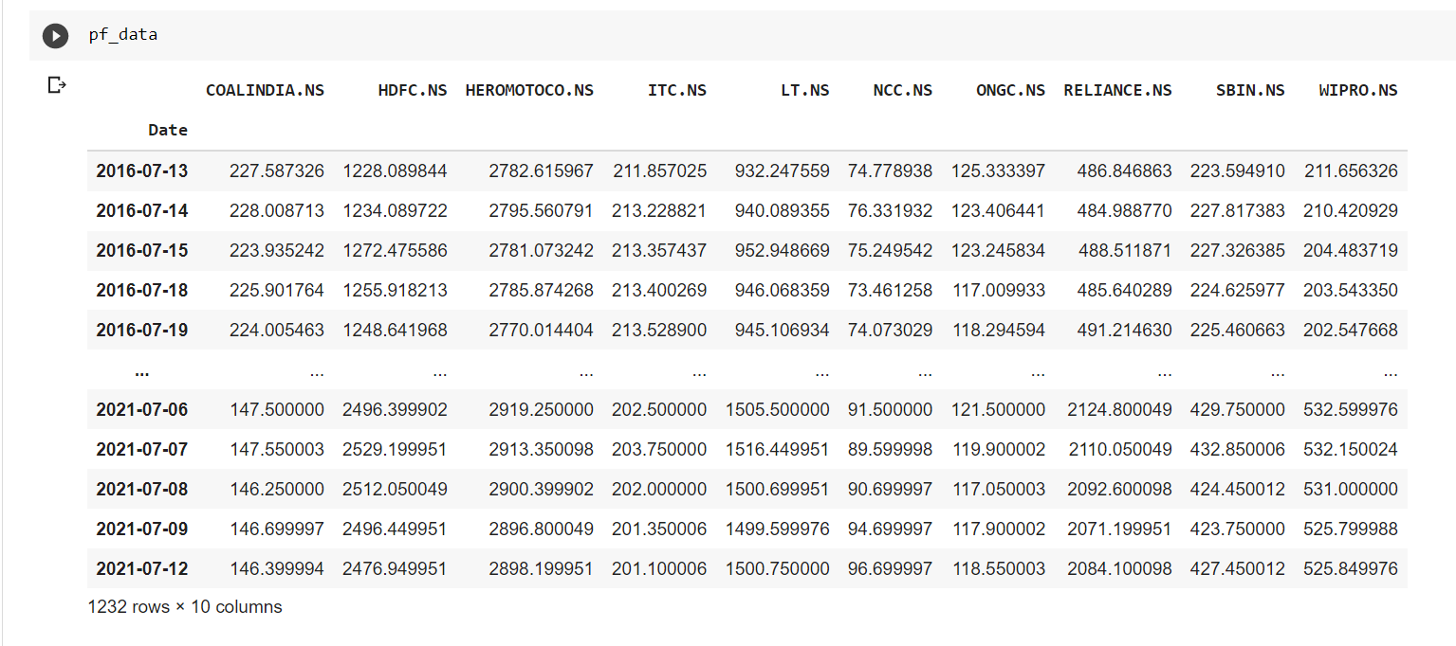
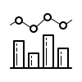
Dataset: Overview
Notes:
Hello sirs, I am Yash and I’ll be taking it on from here. As we see, this is basically the dataset overview, entire data is of the float type evidently. A statistical presentation of the mean, 25%, 50%, 75% percentiles, min and max values has been shown.

Slide 15
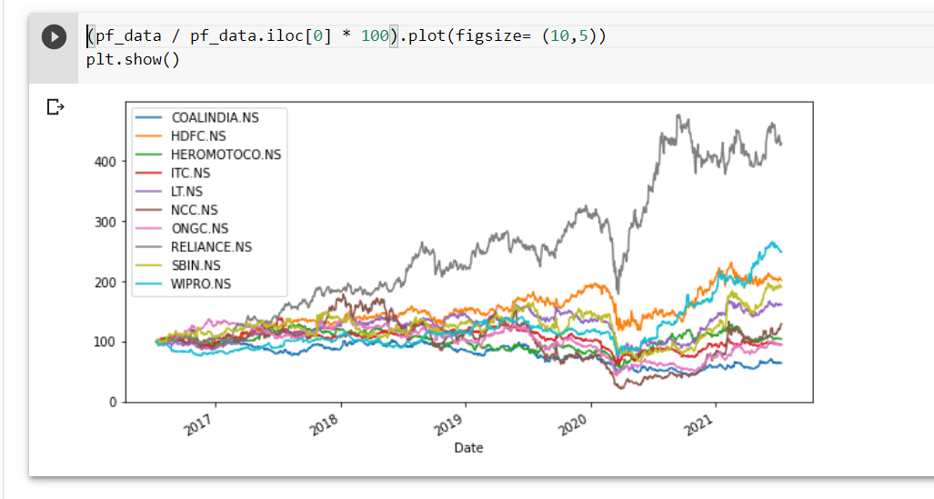

Dataset (Graphical)

Slide 16
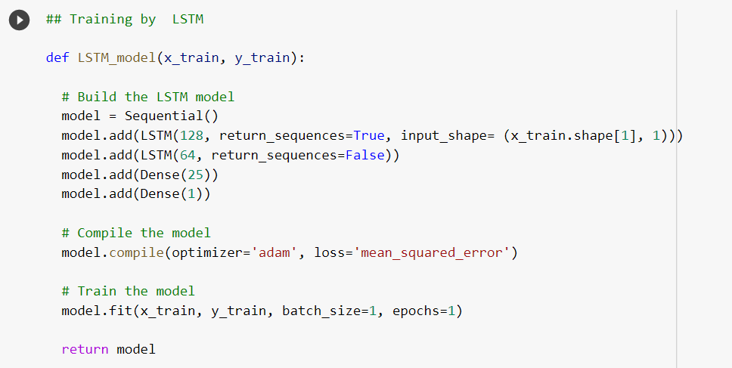
Training the LSTM
Notes:
So what is pier scour? 1st lets try to understand whats pier. Pier is an intermediate support for the adjacent ends of two bridge spans. Now when heavy consistent flow of water eventually erodes the soil creating a vacant space, this vacant space is called the scour depth and this process is named as the Scouring of pier

Slide 17
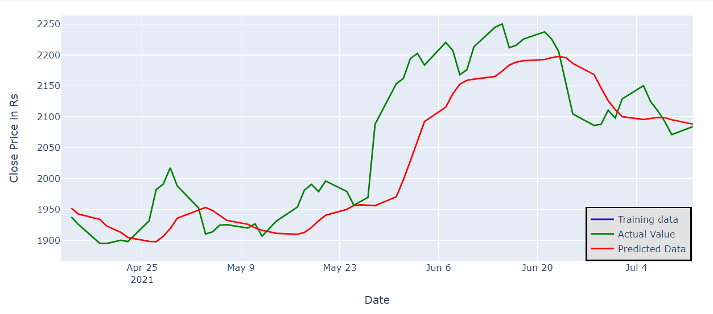
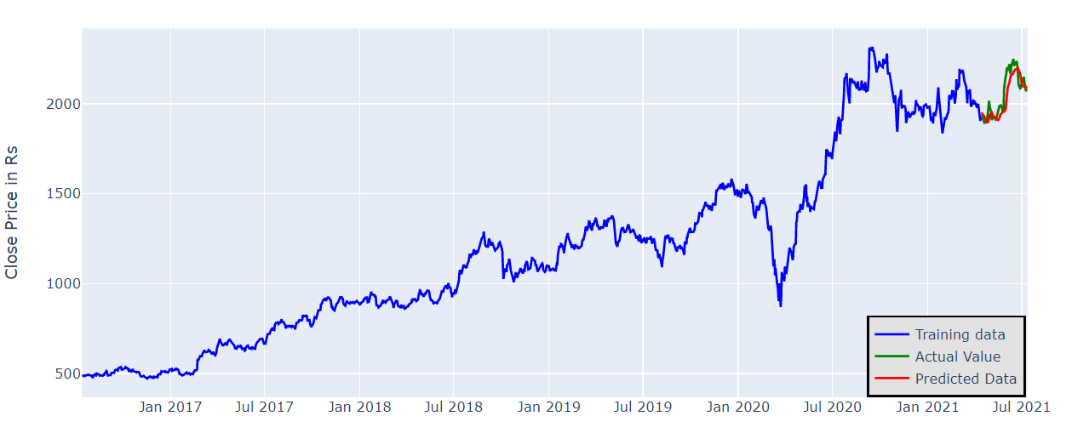
Predictions by LSTM

Slide 18
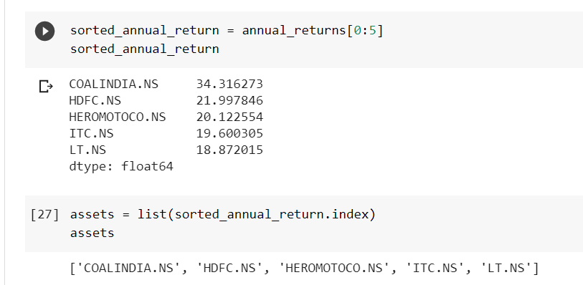
Selecting best stocks for making portfolio
Selecting the top 5 stocks out of all predicted stocks, on the basis of their moving average returns over the coming six months.

Slide 19
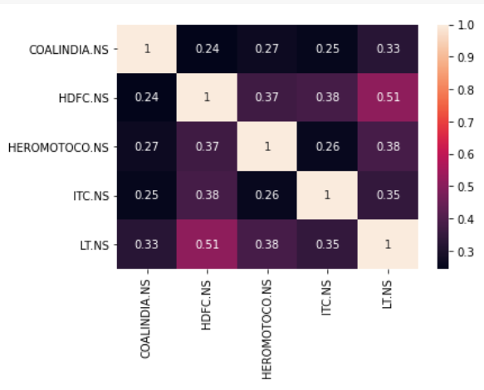
Heatmap
A heatmap is a graphical representation where individual values of a matrix are represented as colors.
It is very useful in visualizing the correlation between different parameters of dataset.
The heatmap for our dataset has been shown alongside.
A positive value indicates direct correlation and a negative value indicates inverse correlation.
Higher the magnitude, higher is the correlation.
Notes:
Heres the heatmap of the correlation coefficients between each parameter with every other parameter. The magnitude of correlation coefficient ranges from 0 to 1. Higher the magnitude, higher is the correlation. A negative coefficient implies inverse dependence.

Slide 20
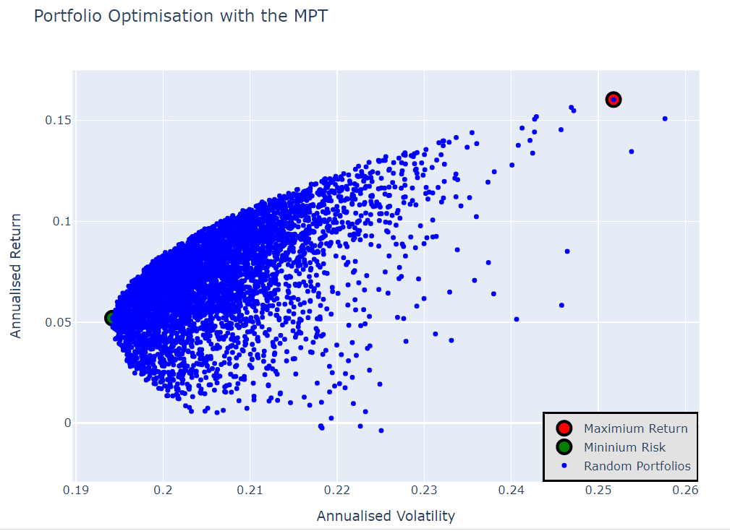
Efficient Frontier Curve

Slide 21
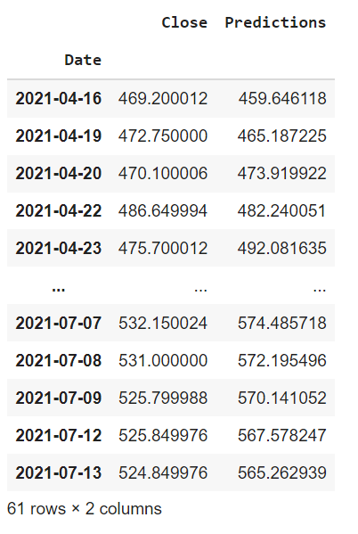

Observations
The testing RMSE values we found were as low as 2.646, 3.524 and 3.895 for ONGC, NCC and ITC stocks respectively which is pretty accurate to predict future values of stock.
Given aside are the closing actual and predicted values of Wipro Stock given by the LSTM model.
However, future values for any time period can be predicted using this model.

Slide 22
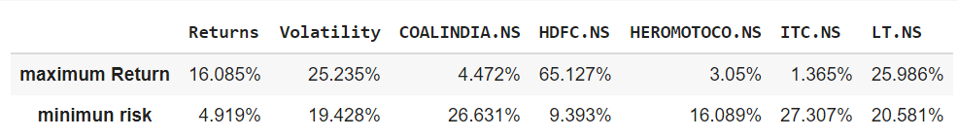
Observations
Given below is the portfolio finally given to us.
By the table below, we can get the max return of 16.085% with a volatility of 25.235% by investing the highest 65.127% in HDFC.
It also shows that we can get the return of 4.919% at the min risk possible by investing the highest 26.631% in Coal India.

Slide 23
Existing Work and Our Innovation
There are numerous classical method to build a portfolio like Dow Jones theory, Random Walk theory, Formula theory and then the most accurate one is Markowitz Portfolio theory.
But since Markowitz portfolio theory consider covariance and correlation between two stocks as a measure of risk so it overlooks the possibility of unwanted and unexpected changes in stock prices such as downside risks.
So to back up the decision of what stocks we should invest in, we first predict the behaviour of stocks with the help of LSTM, by doing this we have decreased the risk of choosing the risky stocks even further as MPT alone, only decides on the basis previous performance but LSTM will feed in the the predicted future data to the MPT model which makes it more accurate and less risky for investors.
Notes:
So as we know bridge failure is a very common problem all around the world. We made an effort in this project to actually study the variation of this depth wrt various parameters by using a different combination in 2 different models which we will see in detail in the upcoming slides.

Slide 24

Applications
The objective typically maximizes factors such as expected return, and minimizes costs like financial risk.
Plays a significant role in constructing an investment portfolio in terms of two important aspects stock selection and allocation.
Not only does this allow investors to make a safe long term investment but also maximize return in a relatively shorter time period.
In modern days, we are using powerful computer programs to transact a large number of orders in fractions of a second and to analyze markets and execute orders based on market conditions.
Finally, this work can greatly help the quantitative traders to take decisions.
Notes:
Speaking of applications, this entire project is an interdisciplinary area of study. Quite clearly it focuses on stopping the unfortunate breakage of so many bridges due to scouring. Selection of the foundational material can be better done according to the swelling potential.

Slide 25

Conclusion
Through this project, we learnt how to apply deep learning techniques such as LSTM and Linear Regression Models, how to use keras-tensorflow library, how to collect and preprocess given data, how to analyze model's performance and optimise LSTM Network and to ensure increase in positive results. We built a model to accurately predict the future closing price of a given stock, using Long Short Term Memory Neural Net algorithm.
And also using the predicted stock prices from the LSTM, we were able to make an optimized portfolio which can help investors in making risk-averse decisions.
Notes:
Aisa ka aisa padh dena word to word

Slide 26
Thank You
Notes:
Thank You so much.

