Slide 1
Drupal Knowledge Sharing Session By Sahil Gupta
8 OCT 2015

Slide 2
What is Drupal?
Open Source software written in php.
A CMS (content-management system )
A sophisticated web application building tool.
Drupal was created in 2000 by Dries Buytaert and publicly released in 2002

Slide 3
Why use a CMS?
It helps manage complexity.
It provides a user interface (UI) for adding, editing and publishing content.
It provides a means for collaboration among many to perform the above tasks.
It removes the role of webmaster.

Slide 4
What can Drupal be?
blog
Forum
Online newspaper, Portal / Directory
Brochure site, portfolio, Flickr like photo drop
Social community site, job post board
Video site like YouTube
Project management site
CRM, ERP, SCM, Wiki
Shopping cart system

Slide 5
What can Drupal be?
E-learning, training site
Dating site
Anything you can think of…

Slide 6
Drupal Layers
User Browser
User Browser
User Browser
Layer 1
Apache Web Server
Layer 2
Web Server / PHP Engine
Drupal
Layer 3
Data Storage i.e. database engine (MySQL, SQL-Server)

Slide 7
Why Drupal?
Market Presence | 1,500,000+ sites
Global Adoption | 228 countries
Extensive Capabilities | 22,000+ modules
Broad Community | 80,000+ active members on Drupal.org
Active Development | 20,000+ developers
Expert Drupal Services | 1000s of companies

Slide 8
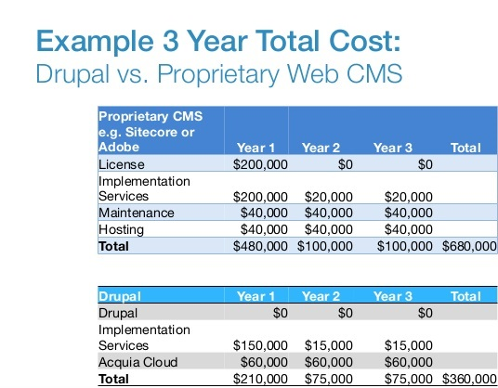
Why Drupal?

Slide 9
Why Drupal?
It has superior session handling for a CMS.
It has superior security.
It is a more consistent, reliable and flexible framework for development.
It is considered better for SEO from our research.
Risk mitigation
Focus on your core business.

Slide 10
Websites build using Drupal
whitehouse.gov The white house
forbes.com Business & Financial Information
economist.com Newspaper
Folio.jhu.edu Johns Hopkins University
soundsnap.com Free online sound Library
warchild.org.uk Charity Website
dnaindia.com Entertainment & News
kotak.com Bank Website
fox.com Broadcasting
packtpub.com Online Tutorials & Publication ...

Slide 11
Downsides of Drupal
Learning Drupal is hard and Drupal has a steeper learning curve than other CMS’s available in market.
Drupal and it’s developers make no excuse for this fact- it is a robust, flexible tool
That said, the Drupal community is constantly addressing usability and user-experience issues because they want the industry market share.

Slide 12
Drupal in AIA
Currently used for supporting Intranet websites :
RiskyBiz
AAMP
Finance Exchange
Beehive
Actuaries (Currently In Development)
Fraud Case Management ( Coming Soon )

